Slide 1

Bureau of Air and Waste
Quality Management System
QA Team Refresher Training
Rev. 02/2026

Slide 2
Why Do We Have a Quality Management System?
As a science-based agency, our goal is to make good decisions based on sound scientific data.
MassDEP has a stated goal of maintaining and improving the quality of environmental data used for decision-making.
When federal grant money funds an environmental data collection activity or system, EPA requires states to document how they ensure the quality of that data.
These procedures must meet federal requirements for a Quality Management System (QMS).

Slide 3
What is a Quality Management System (QMS)
The procedures we follow to ensure that the environmental data we use to make decisions or to describe environmental conditions are accurate
The documentation of those procedures
EPA QMS policy is based on the national consensus standard, ANSI/ASQC E4-1994, Specifications and Guidelines for Environmental Data Collection and Environmental Technology Programs.

Slide 4
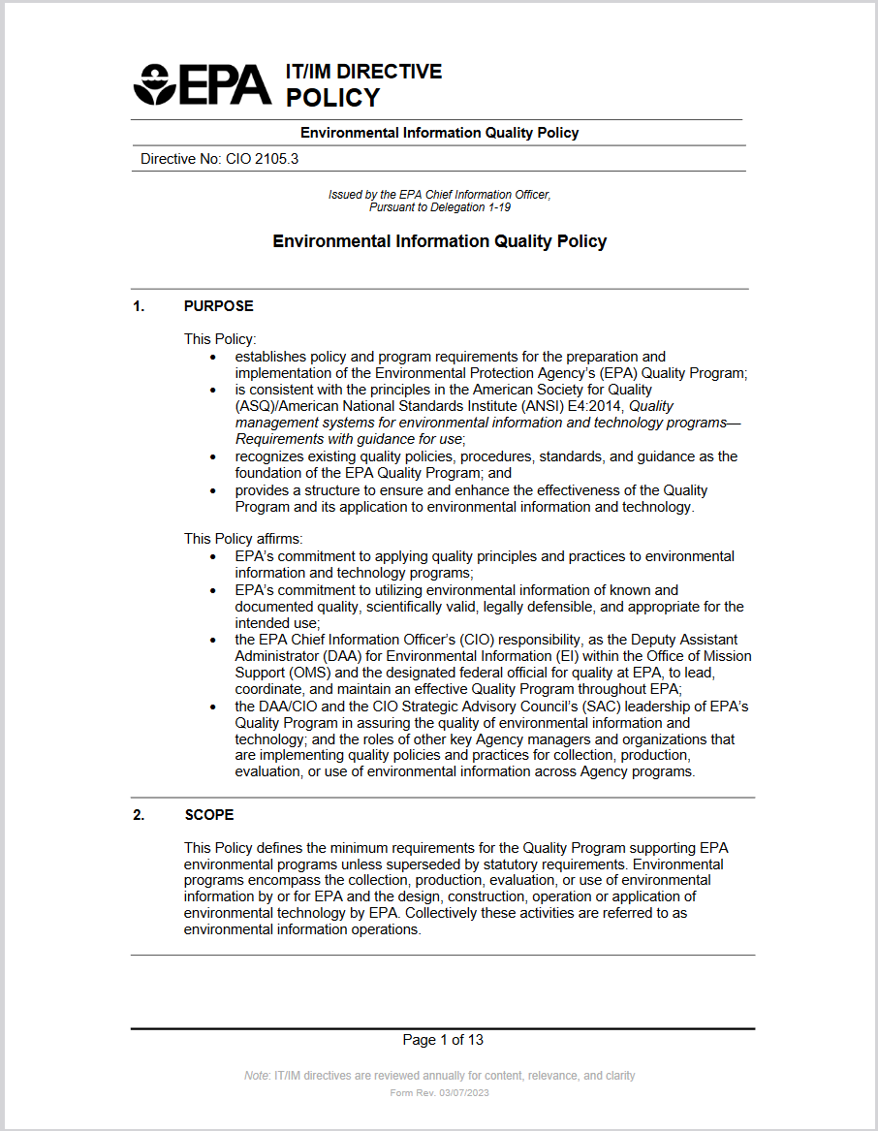
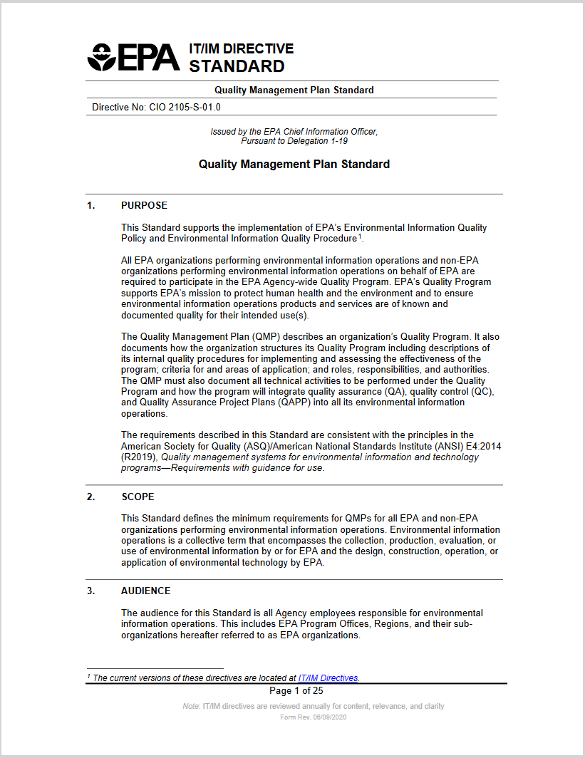
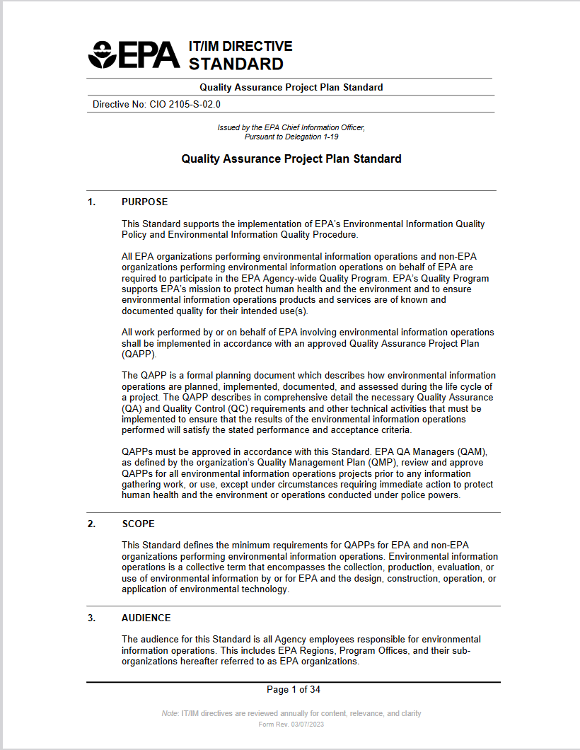
QMS Requirements*
CIO 2105.3 Environmental Information Quality Policy contains policy and program requirements for EPA’s Quality Program (including recipients of federal funding)(rev Apr 10, 2023
CIO 2105-S-01.0 Quality Management Plan Standard Quality Management Plan (QMP) Requirements (rev Jan 17, 2023)
CIO 2105-S-02.0 Quality Assurance Project Plan Standard QAPP Requirements (rev Jul 18, 2023)
Guidance Documents: lots and lots of guidance documents
*https://www.epa.gov/quality/agency-wide-quality-program-documents
Notes:
*https://www.epa.gov/quality/agency-wide-quality-program-documents

Slide 5
EPA Revisions
EPA updated requirements for QMPs and QAPPs in 2023 (replacing QA/R-2 and QA/R-5).
NO changes to the rule ( 2CRF 1500.1) or to the scope of which projects require a QAPP
Made the format consistent with ISO standards
Minor updates to overall document organization
Some updates to substance
Phase in new requirements as QAPPs and QMPs need to be updated
Notes:
EPA updated the long-standing requirement documents for QMPs and QAPPs (EPA QA/R-2 and EPA QA/R-5). The updates were triggered by an Office of the Inspector General audit. This update is NOT making changes to the rule (2 CRF 1500.12) or scope of which projects are required to have a QAPP. The updates include making the format consistent with ISO standards, minor updates to overall document organization, and some updates to substance. Since the ISO standard format is more streamlined than the original formats – with just the requirement stated - EPA intends to update the accompanying Guidance documents and add more explanation and examples there.

Slide 6
EPA – Other changes coming
Over the years, EPA has made incremental steps in improving their method of tracking the whole “universe” of federally-funded projects that require QAPPs
EPA wants states to submit each QAPP labeled with grant number & program (such as CAA 105)
EPA is asking states to cc their EPA PPG Project Officer when submiting annual QAPP status lists
EPA will include a new PPG P&C List commitment (beginning FY26-27) regarding QAPPS
QAPP tracking on R1 QA Roundtable SharePoint

Slide 7
What is Environmental Data?
AMBIENT DATA: air quality, water quality, discharges, and waste quantities
PROGRAM DATA: reports on agency actions and decisions

Slide 8
What are Data Activities?
  Sampling
  Analysis
Data management, data mining
Reporting
Databases
Modeling
  Performance measurement projects
Data Transfer to EPA

Slide 9
What is Data Quality?
MassDEP QMS goal: Match data quality to the specific situation
Strike the right balance:
  Our aim is not 100% perfection, 100% of the time
  Our goal is to ensure that the data is as accurate as needed for the intended purpose.

Slide 10
QMS is the method
The QMS ensures the information system is institutionally supported (financially, administratively, and technically) to meet needs for information management, training, assessment and continuous improvement of information systems.
The QMS applies to all Federally-funded projects that involve environmental data operations.

Slide 11
What is our QMS?
MassDEP’s Quality Management Plan (QMP)
BAW Quality Assurance Project Plans (QAPPs)
BAW Quality Management Team
BAW Annual QA Self-Assessment
EPA Quality System Audit
For MassDEP, the QMS (above) reflects our existing procedures, policies, organizational structure, training, guidance, and management structure that makes sure our work gets done and documented properly.
Notes:
QUALITY MANAGEMENT PLAN: The QMP is the MassDEP description of the general ways we ensure quality. With contributions from each Bureau, MassDEP submitted a new QMP in 2020that is valid for 5 years, through June 2025.
QUALITY ASSURANCE PROJECT PLANS: QAPPs are required for federally funded environmental data operations, such as data collection, modeling, or generation.
QA TEAMS- MassDEP team reports to Bureau of Policy and Evaluation(BPE), with members from each bureau. Our BAW QA team is headed by the BAW Assistant Commissioner and team members represent every BWR program or division that has QAPPs.
ANNUAL QA SELF-ASSESSMENT: Our internal audit to confirm that QAPPs are being followed, staff and management understand their roles and responsibilities, and identify problems and corrective actions.
EPA QUALITY SYSTEM AUDIT: when MassDEP is audited by EPA , the Bureau must provide a complete record of all QA-related communications, training, assessments and activities.
Each of these QMS components is described in the sections that follow, starting with the Quality Management Plan (QMP).

Slide 12
MassDEP’s Quality Management Plan (QMP)
A QMP must be approved by EPA every 5 years.
Our QMP describes how DEP meets EPA’s QA requirements including:
  Organization and approval processes
  Training, procurement and documentation
  Contents, approvals, and resources for QA project plans (QAPPs) for specific projects that are subject to EPA’s QA requirements
  List of such projects (updated annually)
The Bureau of Planning and Evaluation (BPE) is responsible for the QMP along with bureau QA teams. It is signed by the Assistant Commissioners for each bureau.
Notes:
The MassDEP QMP spells out:
Quality system assessment and improvement procedures.
How we ensure proper documentation and records AND
Even how we ensure goods and services are procured properly
The QMP also address Quality Assurance Project Plan (QAPP) development, contents and implementation procedures, which we will get to in a moment.

Slide 13
When is a QAPP needed?
We must produce a QAPP when BAW is collecting data, analyzing data, or building a data system for a federally-funded activity OR when a model is being applied to data collection for which MassDEP is receiving federal funds.
All of our currently active QAPPS are for air monitoring (Air Assessment Branch in Lawrence), except for one (IRA QAPP – Air and Climate Division in Boston). In the past they have been for federally-funded data systems or special studies like mercury in fish.
If you have (or are thinking about getting) a new federal grant that funds collecting or analyzing environmental data or building a data system, you need to plan for a QAPP.

Slide 14
What is a QAPP?
A Quality Assurance Project Plan (QAPP) sets out the data quality objectives for each individual “data operation” in a federally-funded project and how we will meet them.
A QAPP must cover . . .
  specific procedures such as sampling methods, analytical methods, instrument testing/maintenance/calibration, QC, data management, review, and validation
  QA roles and responsibilities for staff and managers, including independence of assessors
  training, documentation, and SOPs
  assessment of the plan, oversight, and how problems are handled
Notes:
The QAPP describes the specific procedures, roles, responsibilities, training requirements and procurement procedures used to ensure that these data quality objectives are met.

Slide 15
Who approves a QAPP?
Each QAPP has to be signed by the Project Manager and approved by a BAW Quality Assurance Scientist, the DD, and AC and any others indicated in the QAPP.
The QAPP must be approved by EPA before work can begin on new federally-funded projects.
Substantial QAPP revisions also require EPA approval.
Notes:
EPA expects the level of detail in the QAPP to be in line with the extent and complexity of the project. A simple basic QAPP is sufficient for a simple, straightforward project, as long as all required QAPP components are included. A complex project would require an appropriately detailed QAPP. Depending on the QAPP, the required internal approval may range from the project manager all the way up to the Assistant Commissioner.

Slide 16
What is the BAW QA Team?
Each bureau has a QA Team that reports to the BPA AC (Ann Lowery) and DEP QA Coordinator (Jesse Grant).
BAW’s team includes the AC, DDs, a QA Manager, QA Scientists, and the DDD for the Air Assessment Branch who is the Project Manager for the AAB QAPPs.
Responsibility for following QA requirements must be written in the EPRS (or MassPerform for managers) for the QA Team and any staff working under a QAPP or with specific QA responsibilities under the QMP.
Notes:
EPA expects the level of detail in the QAPP to be in line with the extent and complexity of the project. A simple basic QAPP is sufficient for a simple, straightforward project, as long as all required QAPP components are included. A complex project would require an appropriately detailed QAPP. Depending on the QAPP, the required internal approval may range from the project manager all the way up to the Assistant Commissioner.

Slide 17
What does the QA Team do?
Identify projects that require QAPPS
Review/approve QAPPS
Help update the QMP
Conduct Annual QA Assessment
Ensure QA problems are identified and addressed
Assign qualified staff to QA work
Ensure adequate QA training

Slide 18
QA Role of Assistant Commissioner
Ultimate responsibility for QA activities in the bureau
Approve/sign the MassDEP QMP and confirm that BAW QA priorities are addressed
Review QAPPs for:
  feasibility of implementation
  consistency with bureau goals, priorities & objectives
  consistency with federal grant objectives and EPA requirements for QAPP development
Resolve differences between QA Team and other staff/managers and make final decisions on whether QAPPs are needed
Allocate BAW resources in accordance with QAPP requirements
Ensure appropriate bureau/regional participation in assessments of the QMS

Slide 19
QA Role of Division Directors
Assign a qualified Project Managers
Ensure that Project Managers develop QAPPs in a timely manner and update QAPPs as needed
Approve data quality objectives consistent with BAW, MassDEP and federal grant goals and objectives
Evaluate QAPPs for feasibility of implementation
Approve QAPPs and notify the AC
Ensure QAPPs, including all assessments, are implemented as planned or revised
Ensure that qualified staff are assigned to projects and that the necessary training is provided to project staff

Slide 20
Role of QA Manager
Ensure that all QA requirements under the QMP are met and that the quality system as described in the MassDEP QMP is implemented
Convene/oversee the BAW QA Team
Conduct BAW’s annual QA refresher training
Conduct interviews of BAW QA team and managers for annual self-assessment (in person or via questionnaires)
Complete BAW’s annual QA self-assessment
Recommend updates to the QMP
Coordinate development of recommendations for improving BAW’s QA efforts
Confirm that corrective actions are implemented

Slide 21
Role of BAW QA Team
Assist in developing, implementing, and updating the Bureau Quality Assurance System and the MassDEP QMP
Identify needed QAPPs
Develop a schedule for producing and updating QAPPs
Develop BAW’s annual QA self-assessment tool
Compile list of nonconformances for annual QA assessment
Increase quality awareness and quality consciousness in the bureau
Perform staff training

Slide 22
Role of QA Project Manager
Define data quality objectives for the project
Review QAPPs for consistency with MassDEP goals, policies and procedures, and with EPA requirements
Ensure QAPPs are technically sound
Ensure QAPPs are distributed to the appropriate staff and management
Ensure that project staff are competent and follow procedures, training and SOPs in the QAPP
Identify training needs of project staff
Ensure that assessments in the QAPP are performed on schedule
Implement quality improvements in response to QAPP assessment results or problems identified through routine project implementation
Identify when new SOPs are required and ensure their completion

Slide 23
Role of QA Scientists
Understand scientific and technical QA requirements and communicate these to the QA Project Manager, QA Team, and staff
Work with the QA Team to identify training needs and assist with training
Assist staff reviewing federal grants and recommend when QAPPs are required
Work with QA Team and staff to develop and update QAPPs
Verify that the QAPPS are consistent with EPA requirements and guidance
Initiate corrective actions in response to nonconformances
Communicate that work can begin on a project because the QAPP has been approved.

Slide 24
EPA QAPP mailbox
As of January 2020, the EPA Region 1 QA Branch has begun using a new mailbox for QAPP submittals. All QAPPs submitted to the EPA R1 QA Branch for initial review must be sent to R1QAPPs@epa.gov. From there, they will be distributed to EPA QA staff for review.
This mailbox is for initial QAPP submittals only. Follow-up responses and revisions should be sent directly to the QA reviewer.
Note that this mailbox is for the QA branch only. You must continue to send QAPPs to the EPA project officer and EPA technical contact (if applicable) as well.

Slide 25
Annual QA Self-Assessment
Confirms that QAPPs are being followed, staff and management understand their roles and responsibilities, and identifies problems/solutions
Refresher Training for BAW managers and supervisors
Update QAPP list
Questionnaires for staff working under QAPPs
BAW QA Team interviews
Evaluate need for training, procedure changes, and QMP modifications
Submit MassDEP QA lead in BPE

Slide 26
Periodic QA Audit by EPA
EPA Region 1 audits MassDEP’s QA program every 5 years
Our most recent audit was 2024 – no significant issues were found
Our next audit is scheduled for 2029

Slide 27
Where are QA docs kept ?
BPE maintains all DEP QA files.
Copies of files relevant to BAW (below) are available to staff on SharePoint here: QA Files
  Current MassDEP QMP
  QAPP List
  BAW QAPPS
  QSA Report & Docs (for annual assessments)
  MassDEP Audit Findings are available from BPE on request.

Slide 28
More training
More QA training is available at the the EPA Quality training website:
https://www.epa.gov/quality/training-courses-quality-assurance-and-quality-control-activities

Slide 29
Thank you and questionnaire
Please go to this link to complete the QA questionnaire and confirm that you have completed the training.
https://massgov.formstack.com/forms/annual_baw_quality_assurance_assessment_for_the_qa_team
Thank you for supporting the BAW QA efforts.
– BAW QA Team

