Slide 1

How to Use
MOSES AppStream
Replacement for Amazon WorkSpaces (AWS) for non-state staff
August 12, 2022
  MassHire Programs & Services are funded in full by US Department of Labor (USDOL) Employment and Training Administration grants. (Additional details furnished upon request.)

Slide 2





Housekeeping
Please keep your line muted unless asking a question
You can use the chat or unmute your line to ask a question
The session will be recorded.
Both this training deck and the recording will be shared early next week
Please introduce yourself in the chat

Slide 3
Training Outline
Here’s what’s coming, who is affected, & why this is happening
How AppStream is different from AWS
How to use AppStream to get to MOSES
AppStream interface
  Resizing the view
  Switching applications
  Printing
  Ending the session
Understanding your DETMA account
Tips for easing the transition
Setting up MFA
How to get help

Slide 4
Here’s what’s coming:
Amazon AppStream to replace Amazon WorkSpaces for non-state employees
AppStream deployment is starting soon with pilot locations in this order:
    Bristol
    Metro North
    Franklin Hampshire
    Central
Pilot location deployment starts early to mid September
Everywhere else happens after all pilot locations are done

Slide 5
Who is affected
    Approx. 800 total MOSES users
    560 users (70%) are non-state and will move to AppStream
    240 users are state and will not be affected
    Only non-state users will move to AppStream; this includes partner agencies
    If you don’t have a DETMA.org email address, you will be moving to AppStream

Slide 6
Why this is happening
    AppStream has fewer technical issues than Amazon WorkSpaces
    No program installed on local computer to update
    AppStream runs faster than Amazon WorkSpaces
    Lower burden on the helpdesk
    Lower cost because it’s not always running & waiting for you to connect

Slide 7
  Differences from AWS
Just need a web browser, no program installed
No more AWS updates, no administrative permission needed
Easier to switch computers, no program to download/install/update
Much faster than AWS
Less confusing, less likely to lose files, not a separate computer

Slide 8
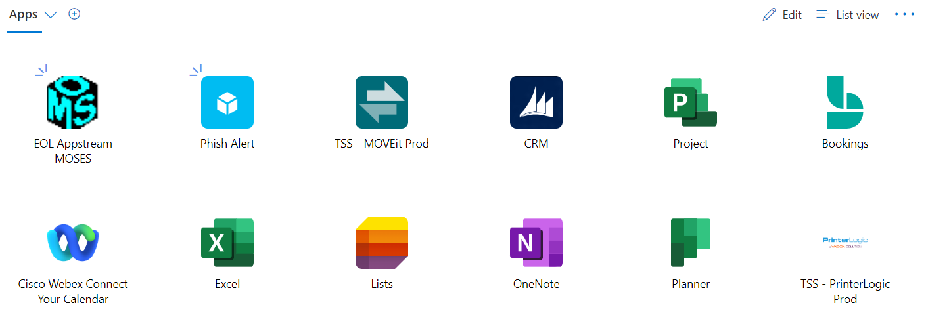
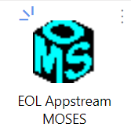
Getting to MOSES
Go to https://myapplications.microsoft.com (Applications Portal)s
  Bookmark this page! Create shortcuts!
Log in with your full DETMA account (looks like an email address) & DETMA password (same as AWS, not MOSES)
  firstname.lastname@detma.org
Click the Appstream icon in the Applications Portal

Slide 9
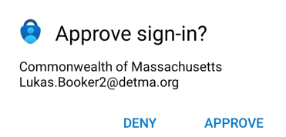
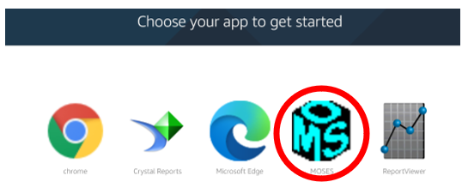
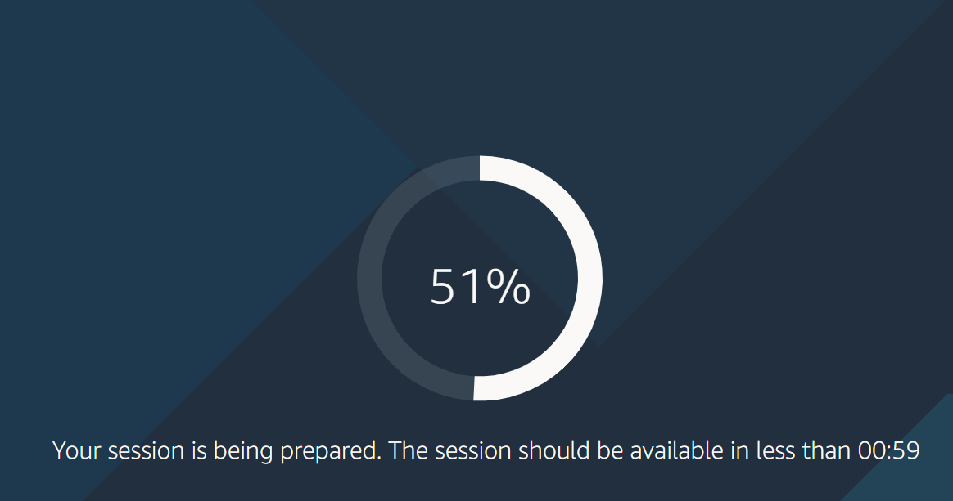
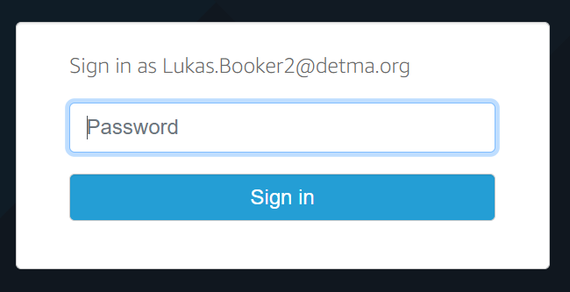
Getting to MOSES – cont.
Click AppStream icon in Applications Portal
Approve MFA sign-in (cellphone)
Click MOSES
Wait approximately 2 minutes for session to be prepared
Enter DETMA account password again (no MFA required)

Slide 10
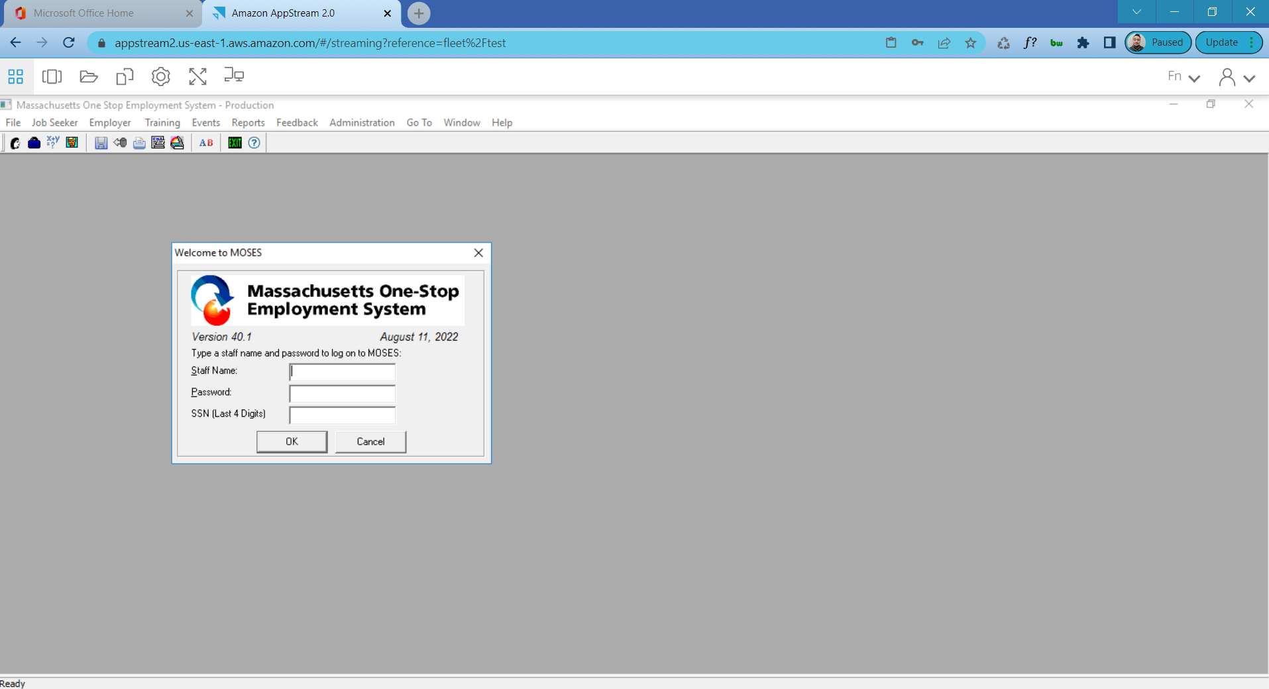
AppStream Interface

Slide 11
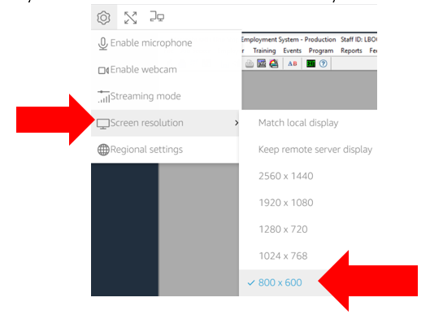
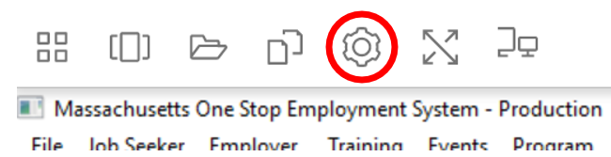
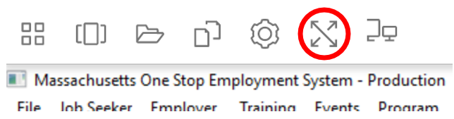
Resizing the View
Resize/change screen resolution
Toggle full screen

Slide 12
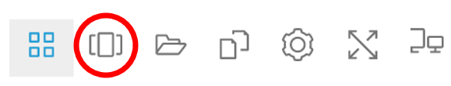
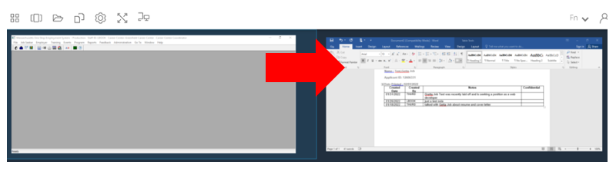
Switching Applications

Slide 13
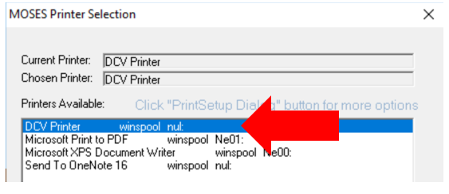
Printing
One extra step from normal –
Choose DCV Printer (should be the default any time you print)
Print job opens in a NEW browser tab (outside AppStream)

Slide 14
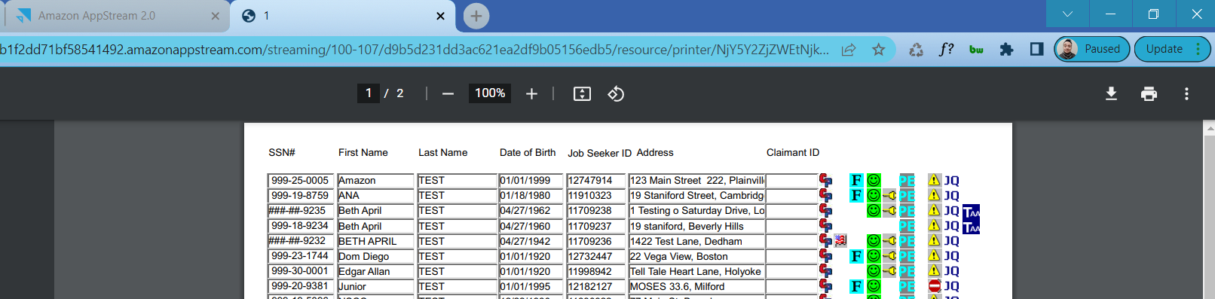
Printing – cont.
1. Print job opens in NEW TAB
2. Click Print again here
3. Click this X when done

Slide 15
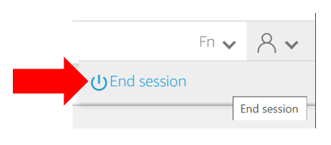
Ending the Session
Inactivity timeout: 30 minutes
Screen times out after 15 but you can sign back in to retrieve your session
Please end your session by clicking the person icon > End session

Slide 16
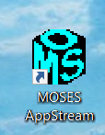
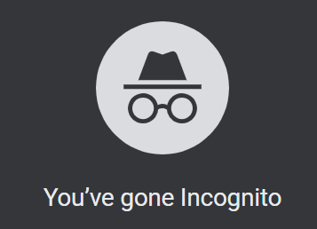
Easing the transition
Create a shortcut icon directly to the Office 365 apps portal
(See “How to Create a Shortcut to AppStream for MOSES” guide)
Use a different browser or Incognito/Private Mode if you already use another account for Office 365 apps
Remember that your state DETMA account has a SEPARATE password from MOSES, and can be changed, locked, and reset separately from your MOSES password
Look for a browser window called “Amazon AppStream 2” on your taskbar, NOT the AWS logo

Slide 17
Your not-so-new DETMA account
You already have a DETMA account that you use to sign into Amazon WorkSpaces
You will log in to Applications Portal with the full username (looks like an email address) – you probably haven’t used this name before
  Short name for AWS: LBooker2
  Full name for AppStream: Lukas.Booker2@detma.org
Don’t worry, this doesn’t give you another mailbox to check
Don’t give this out, you can’t be reached at this email address

Slide 18
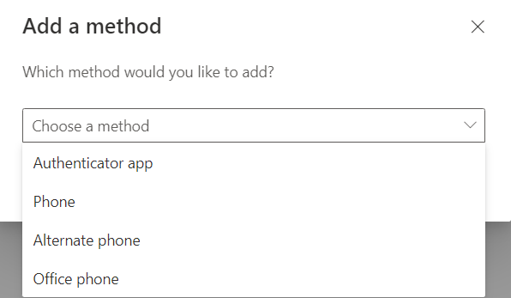
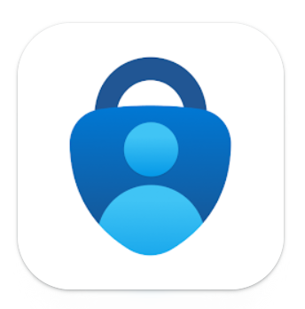
Setting up MFA
When your AppStream access is ready, you will receive an email with instructions & a link to set up multi-factor authentication (MFA)
MFA can be performed via:
  Prompt from Microsoft Authenticator (easiest!)
  Text message to your cellphone
  Phone call to your cellphone
  Phone call to a desk phone/landline
  Code from another authentication app
Get a head start by downloading the Microsoft Authenticator app on your smartphone:
  Play Store (Android)
  App Store (Apple/iPhone)

Slide 19
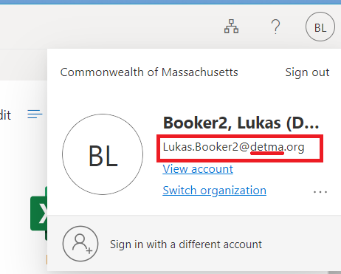
Setting up MFA- cont.
Many Career Centers and agencies are already using Microsoft accounts for services such as Office 365
You will NOT see AppStream if you’re not logged in to your DETMA account
Check by clicking the initials
circle in the top-right corner
Make sure the email is
@detma.org

Slide 20
How to get help
Locked out of either AppStream or MOSES?
Contact EOTSS:
(844) 435-7629 or MassGov@service-now.com

Slide 21

Questions?

