Slide 1
Massachusetts Federal Funds Partnership
-This meeting will be recorded. ​
-Please mute yourself after arrival.
-Please submit your questions via the chat function.
-Questions will be answered during Q&A.
April 2026 Meeting

Slide 2
Agenda
FFIO Updates
Q&A
Open Funding Opportunities
Building Resilient Infrastructure and Communities Program - MEMA
Safe Streets and Roads for All Update - MassDOT

Slide 3
FFIO Updates

Slide 4
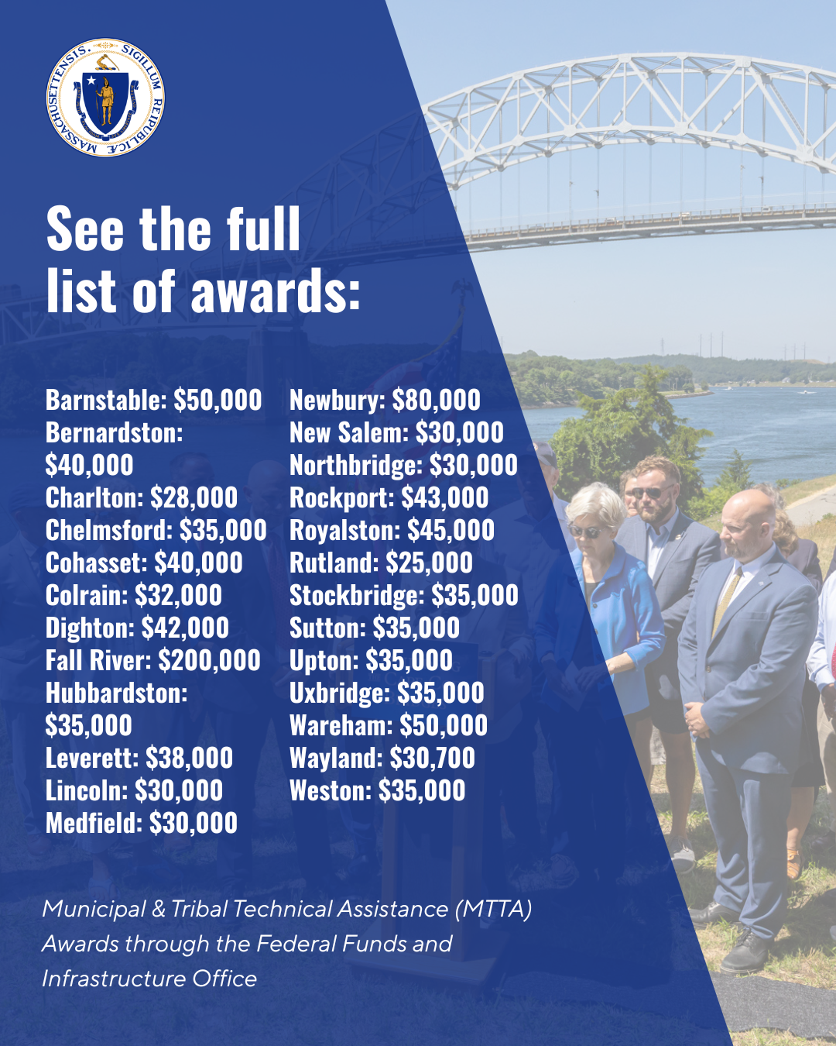
The Municipal and Tribal Technical Assistance (MTTA) Program
Round 2 Awards:
  FFIO’s Municipal & Tribal Technical Assistance Grant Program is accepting applications on a rolling basis. Projects must either be pursuing federal funding or have received federal funding.
  Grant funds support the following activities:
  Planning
  Feasibility studies
  Grant-writing
  Post-award implementation support
  Hiring personnel
  & more!
  FFIO announced our second round of awards earlier this month – see the full list here!

Slide 5
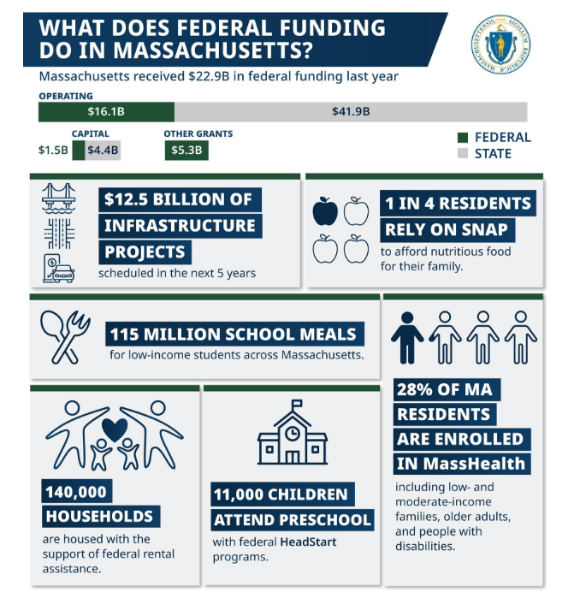
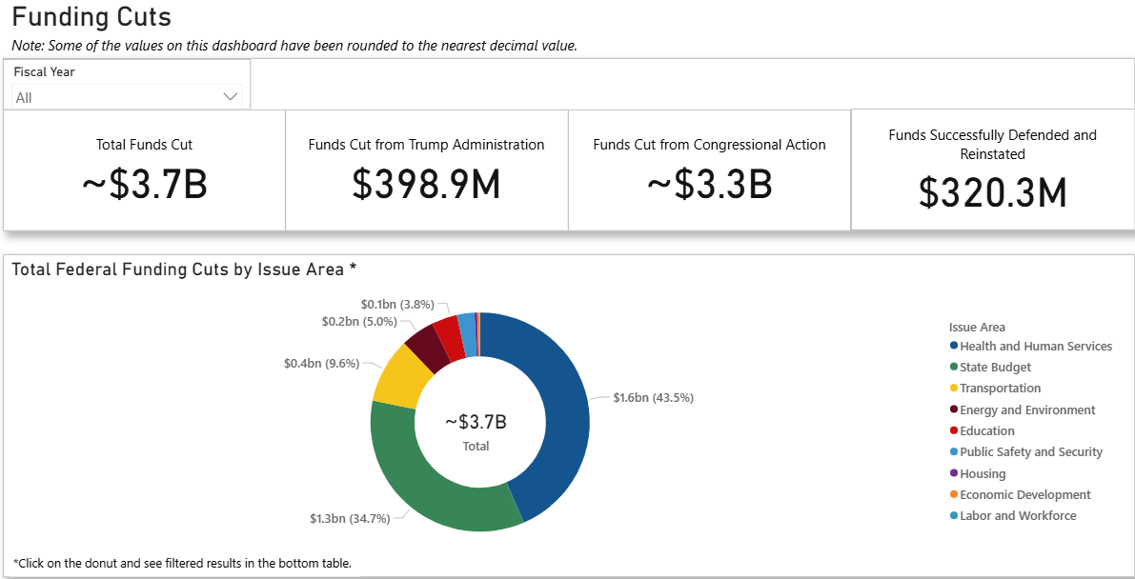
Mass.gov/FedImpact
Massachusetts is Tracking and Communicating the Impact of Federal Funding Cuts
Website updated weekly on federal funding impacts

Slide 6
Get in touch with FFIO
Find more information on Federal Funds Partnership meetings, video recordings, grant lists, and other resources on the FFIO website.
Follow FFIO on LinkedIn to see the latest updates from our office.
Contact the FFIO email inbox (FedFundsInfra@mass.gov) for questions about federal grant opportunities!

Slide 7
Open Funding Opportunities

Slide 8
Recently Opened Federal Grants
Grant Name | Eligibility | Max Award | Deadline
Safe Streets and Roads for All Funding Opportunity | City or township governments, public and state-controlled institutions of higher ed, federally recognized Native American tribal governments, metropolitan planning organizations (MPOs), and many others. (See NOFO for more.) | $25 M | 5/26/2026
Fiscal Year 2024 & 2025 Building Resilient Infrastructure and Communities (BRIC) | States, District of Columbia, U.S. Territories, and Federally recognized Tribal Nations. (See NOFO for more + list of sub applicants .) | $150 M | 6/8/26 – Final Sub-applications due in FEMAGO
Electric or Low-Emitting Ferry Pilot Program | State and local governments, federally recognized tribes and others. | None listed | 5/11/2026
Passenger Ferry Grant Program | State, local governments, federally recognized tribes, and more. | Not listed | 5/11/2026
*See FFIO’s monthly newsletter for the more open grants relevant to municipalities and tribes. To sign up, email fedfundsinfra@mass.gov

Slide 9
Recently Opened Federal Grants
Grant Name | Eligibility | Max Award | Deadline
Partners for Fish and Wildlife | Local governments, private higher education institutions, tribes, and more. | $750k | 9/30/2026
Rural Law Enforcement Violent Crime Reduction Initiative | Units of local government | $400k | 5/27/2026
De-escalation and Crisis Response Training Program | State and local governments, tribes, higher education and others. | $700k | 5/27/2026
Innovative Approaches to Literacy | Nonprofits, tribal governments and organizations, and independent school districts. | None listed | 6/09/2026
*See FFIO’s monthly newsletter for the more open grants relevant to municipalities and tribes. To sign up, email fedfundsinfra@mass.gov. See grants.gov for full list of open federal grant opportunities.

Slide 10

FY25 Safe Streets and Roads for All (SS4A) Funding Opportunity: Information for Massachusetts Municipalities
Derek Krevat, MassDOT Office of Transportation Planning
April 28, 2026

Slide 11

What is SS4A?
The Infrastructure Investment and Jobs Act (IIJA) established the Safe Streets and Roads for All (SS4A) competitive grant program with $5 billion in appropriated funds over 5 years, 2022-2026. The SS4A program funds regional, local, and Tribal initiatives through grants to prevent roadway fatalities and serious injuries.
The SS4A program aims to prevent fatalities and serious injuries on roads and streets involving all roadway users.
SS4A supports planning, infrastructure, and behavioral and operational initiatives.

Slide 12
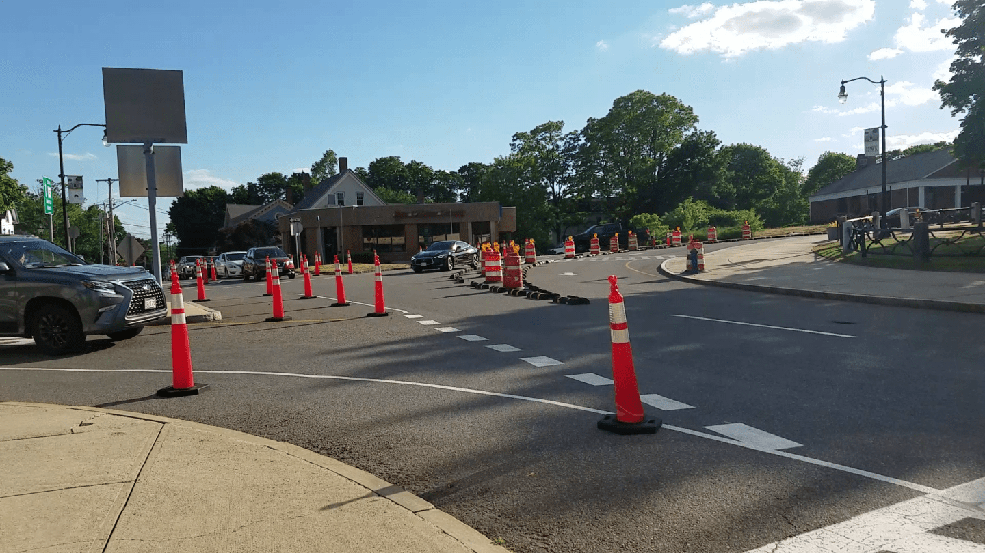
What Types of Grants are Available?
Planning and Demonstration Grants:
Develop a comprehensive safety action plan (Action Plan)
Conduct supplemental safety planning to enhance an Action Plan.
Carry out demonstration activities to inform the development or update of an Action Plan.
Implementation Grants:
Perform planning, design, and development activities for projects and strategies identified in an Action Plan.
Implement projects and strategies identified in an Action Plan that address roadway safety problems.
May also include supplemental planning and demonstration activities.

Slide 13
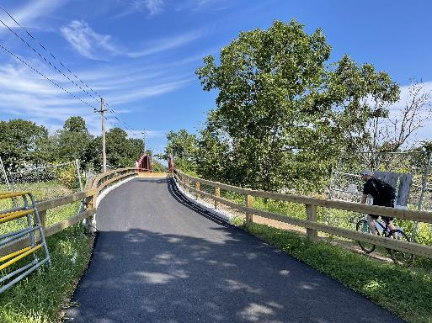
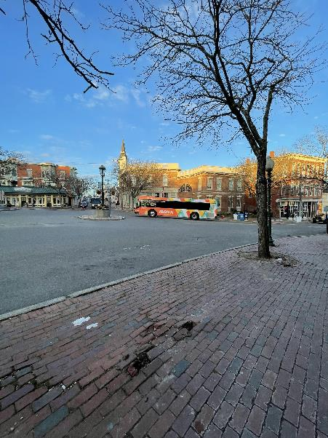
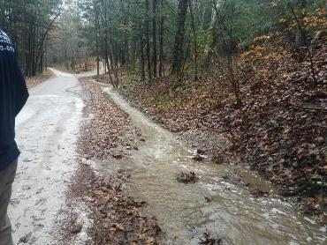
Who is Eligible to Apply?
Town, City, and County governments in Massachusetts.
Metropolitan planning organizations (MPOs) in Massachusetts are also eligible.
Multijurisdictional groups of eligible entities can apply.
States are not eligible applicants.

Slide 14
FY 2026 Funding Round
Application Deadline: May 26th, 2026
Amounts Available
$687,809,874 is available for Implementation Grants
o Expected number of awards: 40 to 70
o Expected funding range: $2,500,000 to $25,000,000
$305,678,320 is available for Planning and Demonstration Grants
o Expected number of awards: 400 to 700
o Expected funding range: $100,000 to $5,000,000

Slide 15

How to Apply and Where to Find More Information
Applications likely to be submitted electronically via Valid Eval
How to Apply: https://www.transportation.gov/grants/ss4a/how-to-apply
Agency Contact Information: SS4A@dot.gov

Slide 16
Contact Info
Although MassDOT and the Barr Foundation are currently at capacity for full technical assistance support, please contact MassDOT (see information below) for general assistance with application review, letters of support and match funding.
Contact Information:
Derek Krevat (Manager of Municipal Planning & Support): Derek.Krevat@dot.state.ma.us
MassDOT Municipal Planning and Support: MuniSupport@dot.state.ma.us

Slide 17
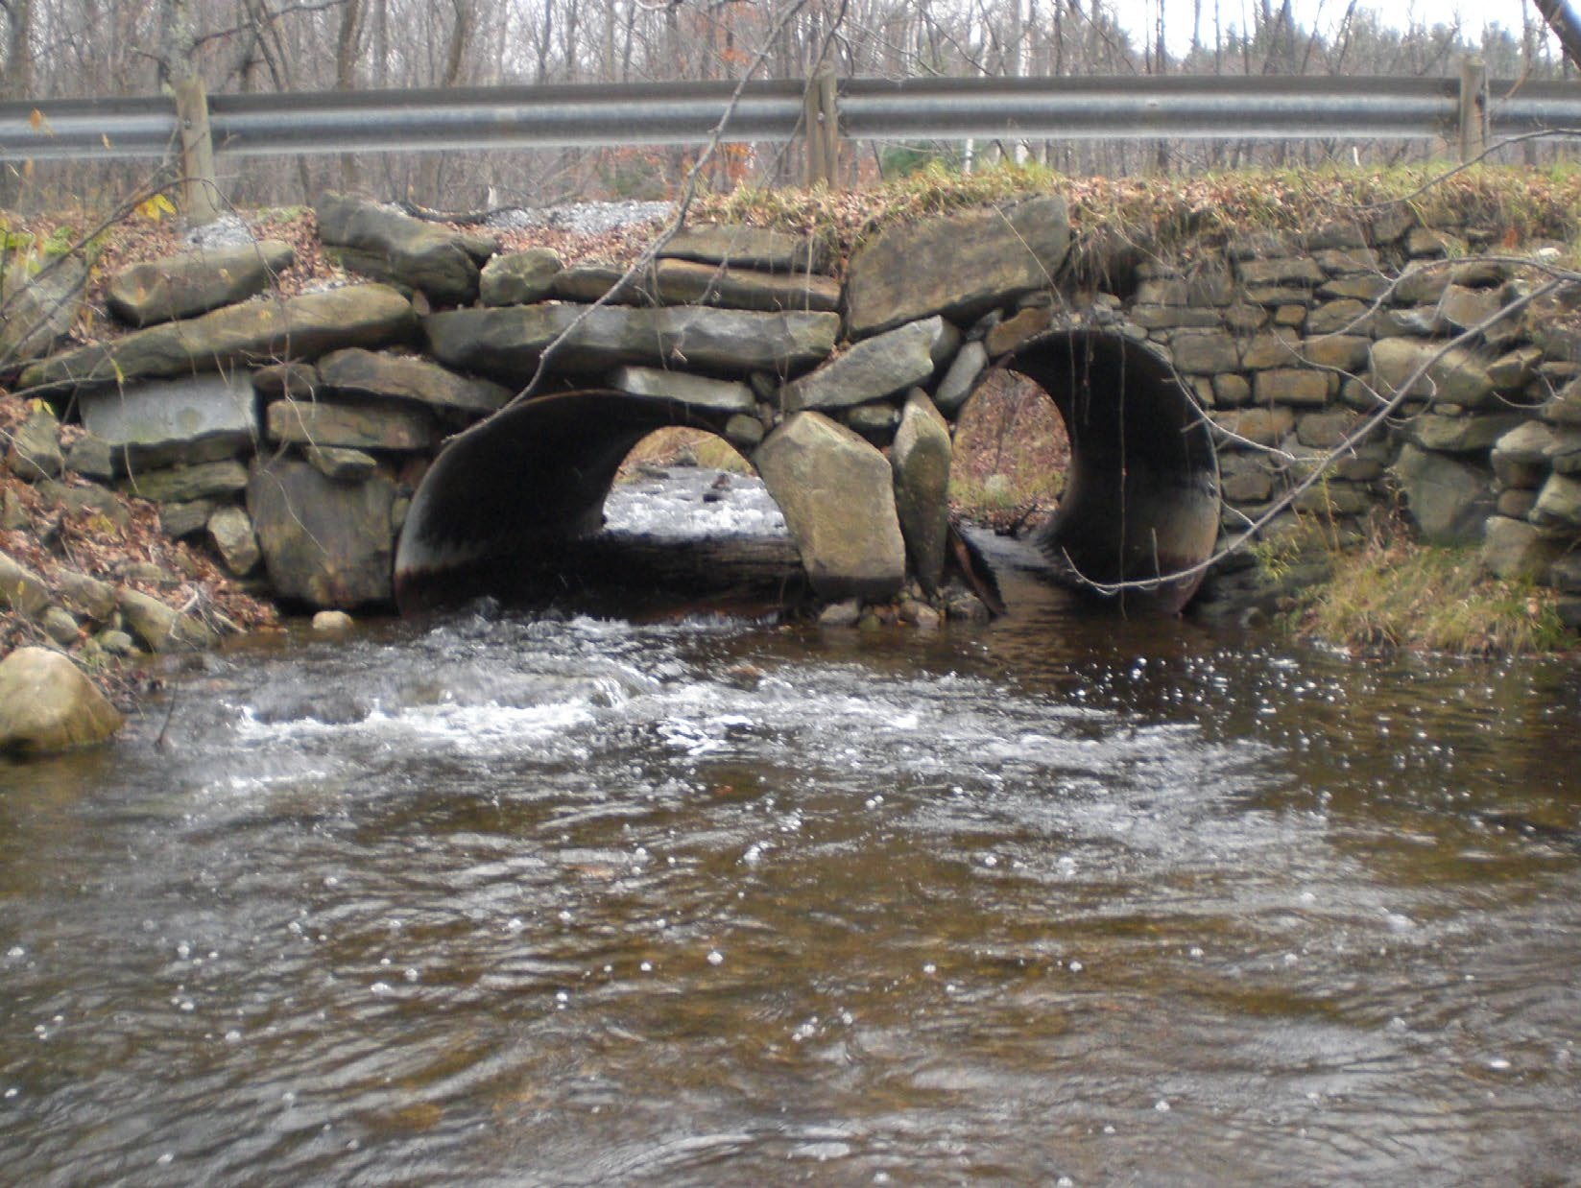
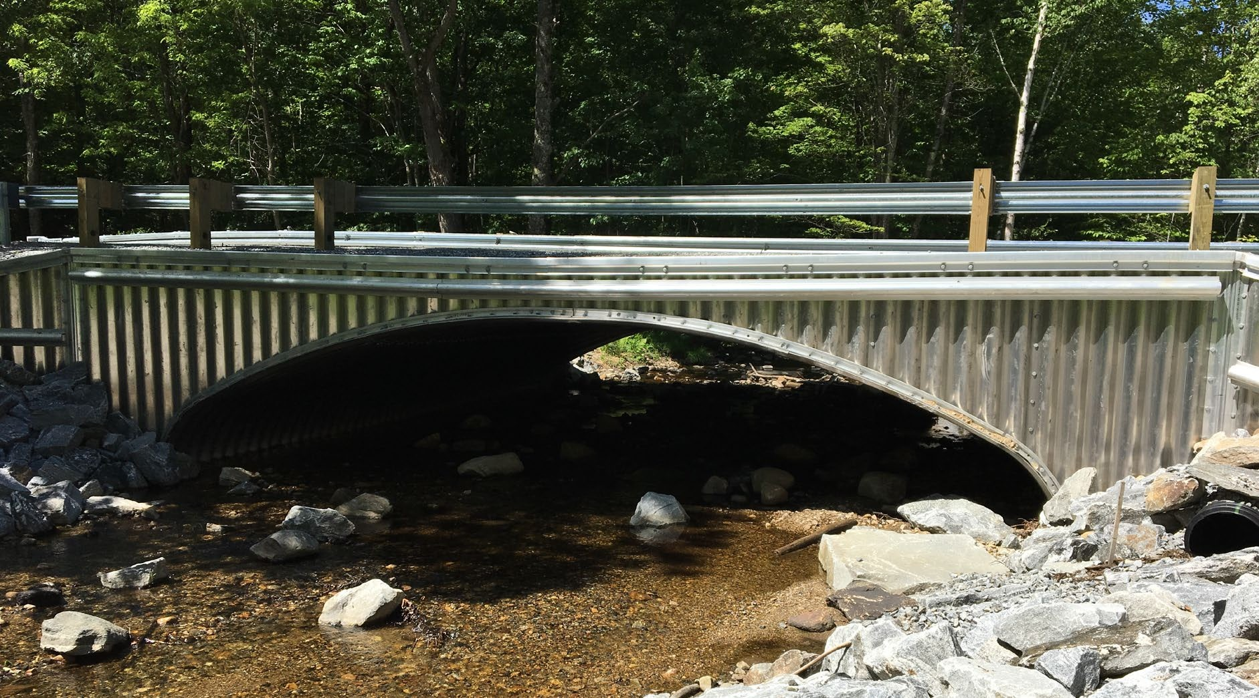
FEMA Hazard Mitigation Assistance
FY24-FY25 BRIC
Massachusetts Emergency Management Agency
April 2026

Slide 18
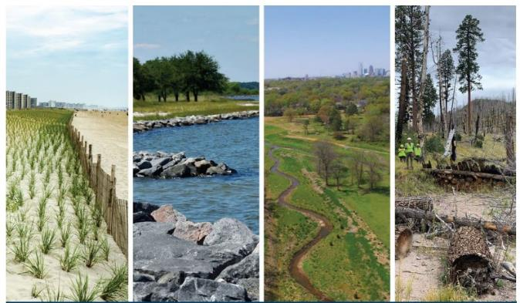
What is Hazard Mitigation?
Providing
Providing increased level of protection that will reduce or eliminate risk
Adapting
Adapting to natural hazards
Protecting
Protecting people, structures and infrastructure from future hazards
Maintaining
Maintaining consistency with resiliency and sustainability principles
Minimizing
Minimizing the costs of disaster response and recovery
Saving
Saving lives and money!

Slide 19
Building Resilient Infrastructure and Communities (BRIC)
Hazard mitigation funding for states, tribal governments, and local communities/special district governments
Establishes an annual national competitive award
  Between $500 Million - $2 Billion in grant funding awarded annually
  Funds projects up to $20 Million (Federal Share)
  Projects can be up to 36 months
  State allocation per FEMA NOFO
    $2MIL Construction Projects and / or C&CB Activities
    $1MIL Building Code
  Tribal allocation also available
Announced by an Annual Notice of Funding Opportunity (NOFO)
  Statement of Interest due on Tuesday, April 21, 2026
  Subapplications due to MEMA Monday, June 8, 2026

Slide 20

Eligible Activities (Project Types)
(See 2025 HMA Program and Policy Guide for full list)
Mitigation Projects
Property Acquisition
Structure Elevation
Mitigation Reconstruction
Flood Risk Reduction Measures
Stabilization
Floodproofing
Safe Rooms
Wildfire Mitigation
Retrofitting
Secondary Power Source
Early Warning Systems
Aquifer Recharge, Storage and Recovery
Capability & Capacity Building
Project Scoping for Infrastructure
Partnerships
Codes & Standards

Slide 21
HMA Project Requirements
Mitigate a Natural Hazard
Demonstrates an increase in Level of Protection (LOP)
Feasible to Implement
- Regulatory - Design - Construction
Cost-Effective (BCA)
Must comply with Environmental & Historic Preservation (EHP)

Slide 22
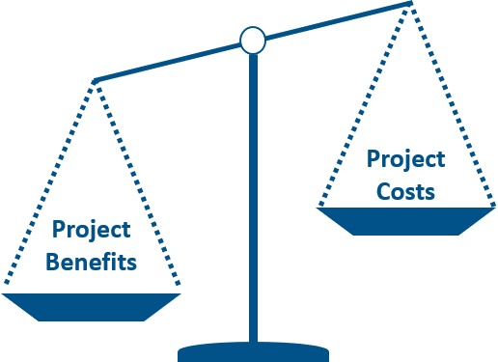
What is a Benefit Cost Analysis (BCA) ?
Benefit-Cost Analysis (BCA) is a method that quantifies the benefits (avoided losses) of a mitigation project compared to its costs.
Establishes the project's Cost Effectiveness (requirement is a BCR > 1)
BCAs involve technical studies that require heavy data collection, supporting documentation development, and in many cases, engineering expertise.
BCAs are required for project subapplications.

Slide 23

What you need to know about FEMA Hazard Mitigation Grants:
MEMA is the conduit for applications and funding to and from FEMA. MEMA manages the State Contracts/Grant Awards.
The process from grant application to grant award can take several months to a year (or longer) - please be prepared.
It is the sub-applicant’s responsibility to maintain, and keep current, their local hazard mitigation plan for eligibility.
It is the subrecipient’s responsibility to ensure that proper procurement is undertaken for projects which use federal funds.
MEMA is the conduit for applications and funding to and from FEMA. MEMA manages the State Contract / Grant Awards.

Slide 24
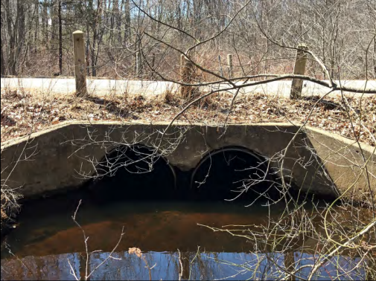
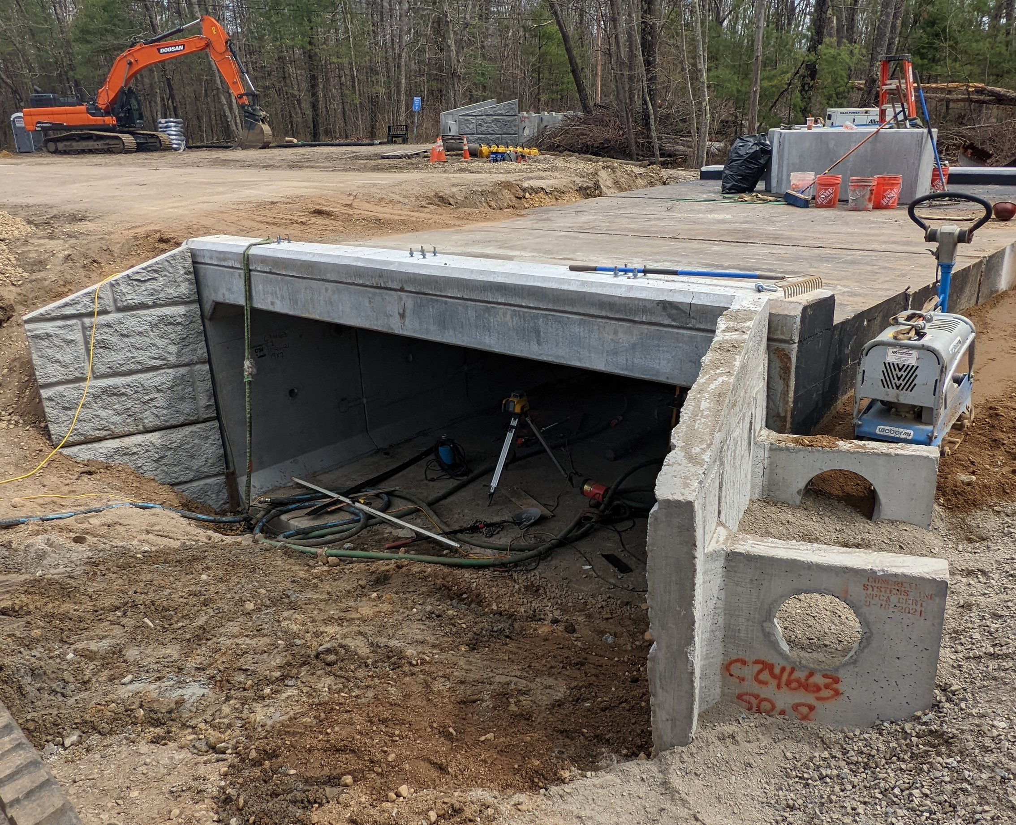
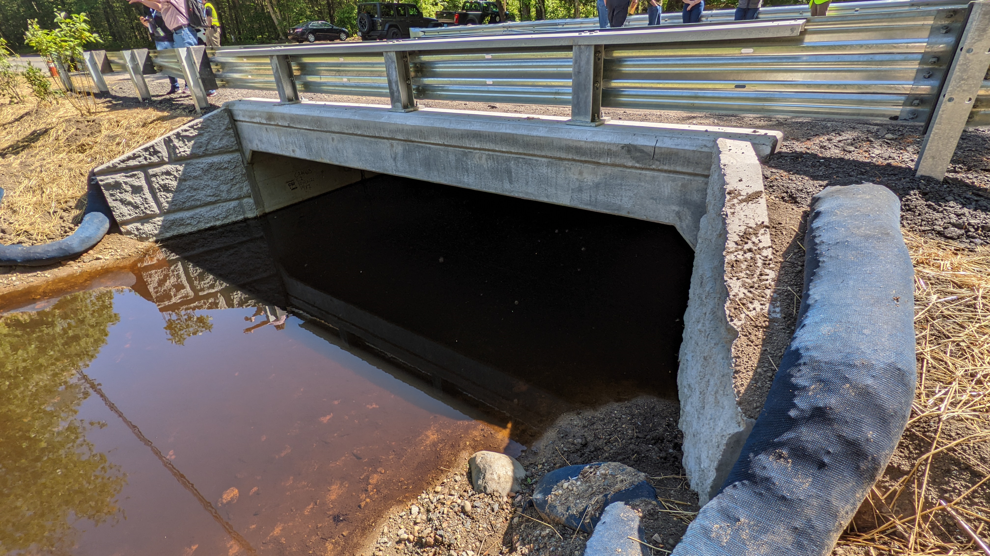
Culvert Upgrade: Merrimac
Before
This project included the upgrade of an undersized culvert with a precast box culvert which meets the Massachusetts Stream Crossing Standards.
Project was funded through the HMGP program.
Completed Summer 2022.
During
During
After

Slide 25
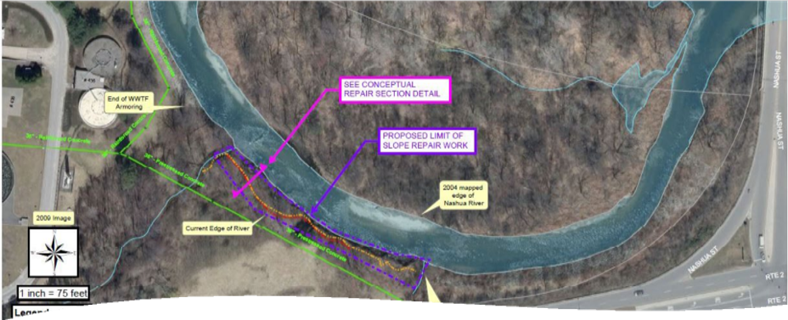
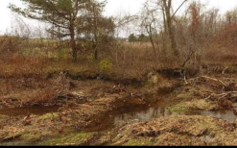
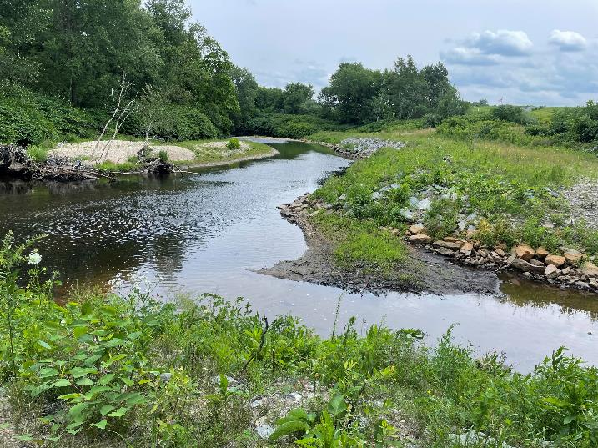
Bank Stabilization: Leominster
The Nashua River Bank Stabilization project focuses on the protection of a critical sewer line and wastewater treatment facility.
This project was recently completed using HMGP funding.

Slide 26
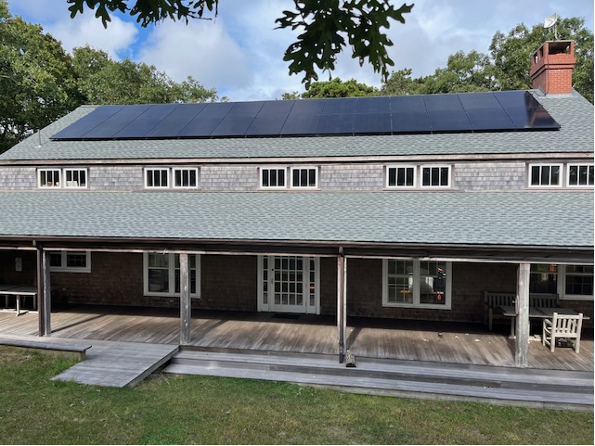
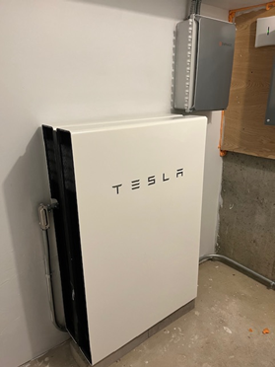
Shelter Microgrid: Chappaquiddick
The Chappaquiddick Community Center Shelter Microgrid project provides emergency power for residents on Chappaquiddick Island in the event of severe weather.
This project is the first of its type to be funded by FEMA in Region 1 and was recently completed using HMGP funding.

Slide 27
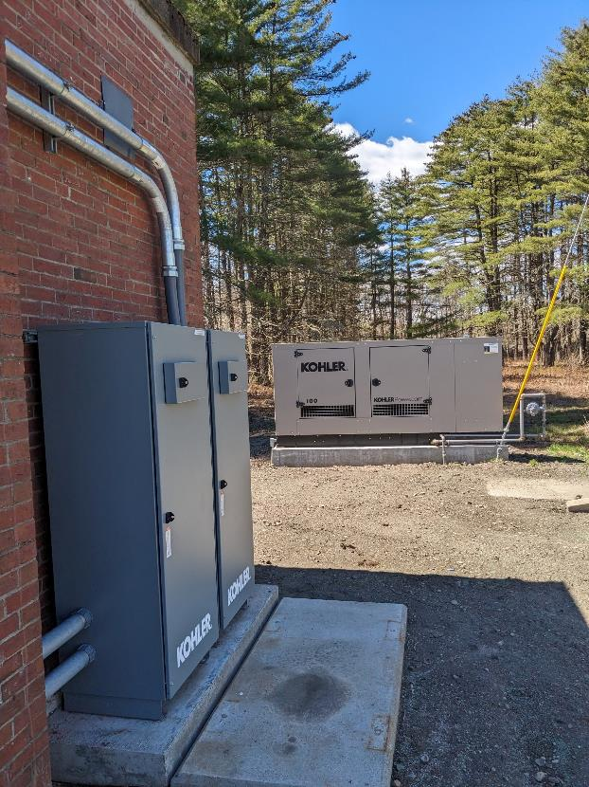
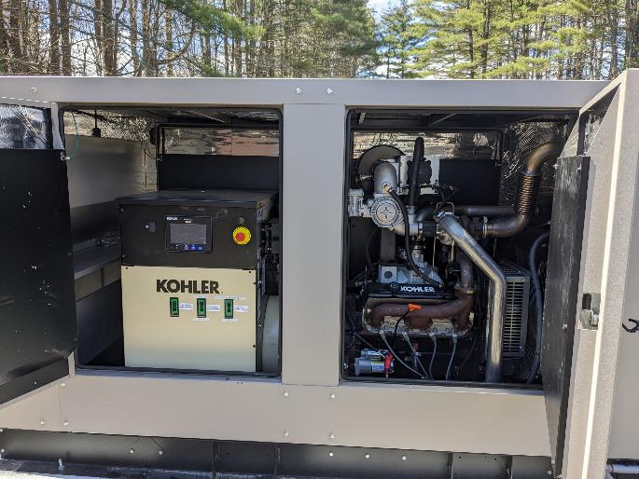
Generators: Greenfield
Well pump station generators purchased and installed to ensure potable water access during power outages.
Project was funded through the HMGP program.
Project completed in Spring 2024.

Slide 28
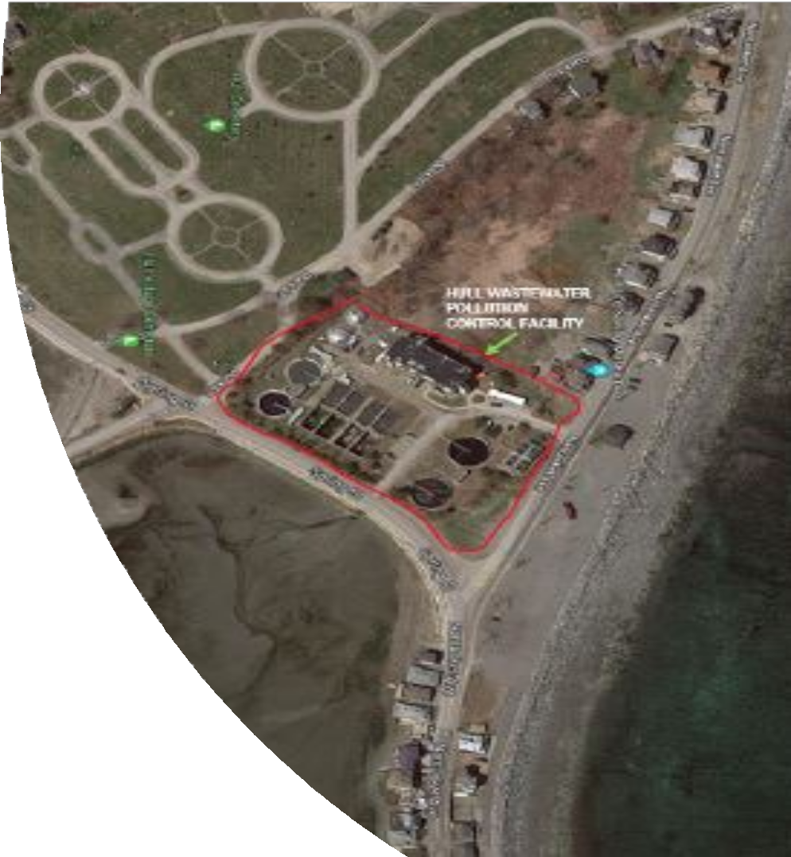
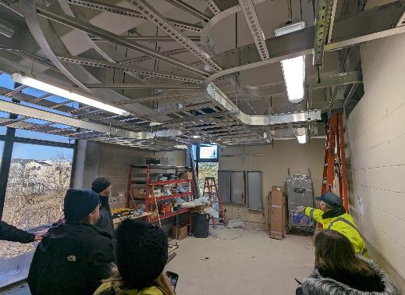
Flood Resiliency Retrofit:
Hull
This project elevated critical electrical assets above predicted future flood elevations.
Project is underway and being funded through the HMGP program.
Project was completed in Fall 2025.

Slide 29

Non-Federal Cost Share
Cost share is typically 25% of the total project for cost.
Non-Federal cost share may include:
  Local, state, or private cash payments (MVP Funding, Culvert Replacement Municipal Assistance Funding, FFIO, etc.)
  In-Kind Contributions (labor, equipment, materials, etc.)
  Other Federal Funding typically not allowed as match

Slide 30
BRIC FY24 / FY25 Application Timeline
Statement of Interest (SOI) Deadline | April 21, 2026
Sub-applicant Register with FEMA GO Deadline | April 21, 2026
Federal Grant Application Period Opens | March 25, 2026
Sub-application State Deadline | June 8, 2026
State Review Committee | June – July 2026
Submittal to FEMA for National Competitive Review | July 20, 2026
Award Notification for FY24-FY25 Cycle | TBD
Project Initiation | TBD

Slide 31
Technical Assistance Available
Technical Assistance
Submit a Statement of Interest (SOI)
on MEMA's Website

Slide 32

Helpful Links:
MEMA Hazard Mitigation Website
Statement of Interest
BRIC State Notice of Funding Opportunity
Benefit-Cost Analysis (BCA) Download
2025 HMA Program & Policy Guide
FEMA GO Portal
Sam.gov Registration / Information
Federal Procurement Information

Slide 33

MEMA Hazard Mitigation Website
Contact MEMA
Shelly O'Toole
MEMA State Hazard Mitigation Officer
michelle.otoole@mass.gov
508-820-1443
Elena Kilduff
MEMA Regions 1 & 3
elena.kilduff@mass.gov
508-820-1436
David Woodbury
MEMA Regions 2 & 4
david.woodbury@mass.gov
508-820-2034
Michael Enko, CFM
MEMA Civil Engineer
michael.enko@mass.gov
508-820-1440
Patrick Limerick
Mitigation and Recovery Grants Support Coordinator
patrick.limerick@mass.gov
508-404-4369
Jeff Zukowski
State Hazard Mitigation Planner
jeffrey.zukowski@mass.gov
508-820-1422
Marybeth Groff, CFM
Hazard Mitigation & Climate Adaptation Coordinator
marybeth.groff@mass.gov
508-820-1435

Slide 34
Q&A
Place your questions in the chat!

Slide 35
Federal Funds Partnership Meeting Schedule
Future meeting dates:
  Tuesday, May 26th 2-3 pm
  Tuesday, June 23rd 2-3 pm

