Slide 1
Implementing Clinical-Community Linkages for Fall Prevention Lessons from the Massachusetts Prevention and Wellness Trust Fund
Santhi Hariprasad, MPH
Massachusetts Commission on Falls Prevention
Wednesday, April 26, 2017

Slide 2
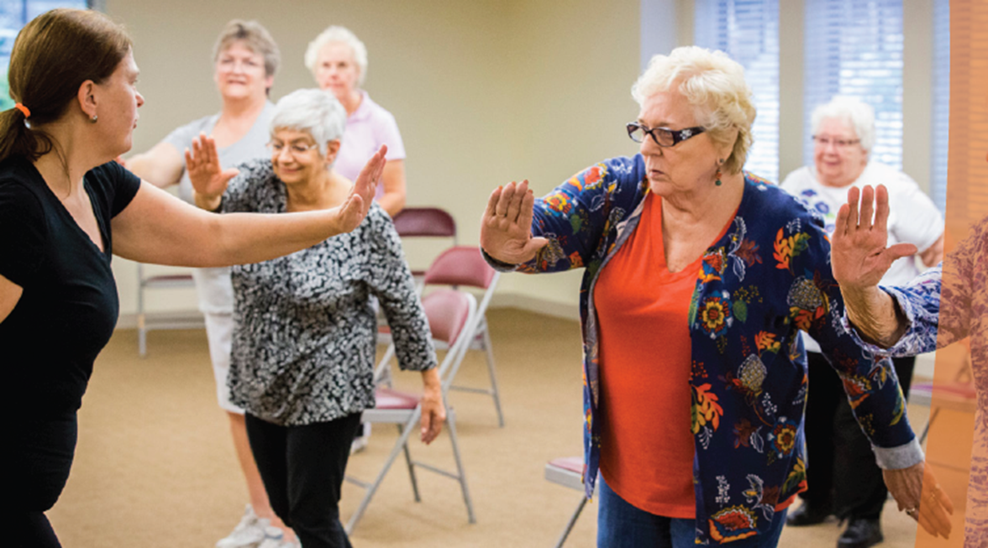
Overview
Prevention and Wellness Trust Fund (PWTF) Overview
Results
Lessons Learned
Future Directions

Slide 3
Massachusetts Prevention and Wellness Trust Fund Overview

Slide 4
The Prevention and Wellness Trust Fund
$60 million in trust for 4 years (2013-17) as part of cost-containment legislation Chapter 224, enacted in 2012
Focus on 4 priority health conditions
Evidence-based interventions with return on investment in 3 to 5 years
Goals:
to reduce rates of the most prevalent and preventable health conditions, and substance use;
to increase healthy behaviors;
to address health disparities;
to strengthen the evidence-base for prevention programming.

Slide 5
PWTF Partnerships: Nine Diverse Communities

Slide 6
The Burden of Falls in the United States
Annual Medicare costs $31 billion (CDC)
2.8 million ED visits, 27K deaths each year (CDC)
Contribute to disability, dependence, depression
Yet…
Only 37% of older patients were asked about falls by their providers (Chou et al., 2006)
Only 8% of providers used clinical guidelines to direct their care (Jones et al., 2011)

Slide 7
PWTF’s Fall Prevention Interventions
Clinical:
CDC’s Stopping Elderly Accidents, Death, & Injury (STEADI) Tool Kit (23 organizations)
Community:
A Matter of Balance (18 organizations)
Tai Chi (8 organizations)
Assisted Home Safety Assessments (16 organizations)

Slide 8
CDC’s STEADI Toolkit

Slide 9
PWTF Model
Primary Care Clinical
Guidelines
Clinical-Community Linkages
Community Interventions
Screening
Treatment
Referral
Community Health Workers
MA SIM e-Referral
Fax
Feedback report
Engagement
Enrollment
Completion

Slide 10
Technical Assistance Strategy
Learning sessions 2x per year
On-site STEADI CME / CEU trainings
Calls and webinars with experts and DPH staff
Online resources
Quarterly data reports
Ongoing program monitoring: implementation plans, workflows, PDSAs, and progress reports

Slide 11
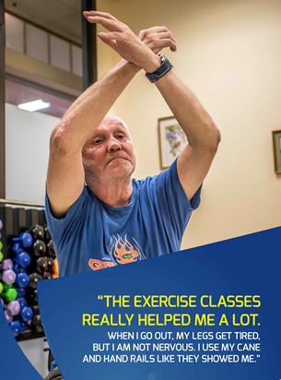
PWTF in Action
Jim now uses his cane regularly and “nails the chair-squat move in Tai Chi class,” according to his instructor.
Jim Price, Age 70, Lynn MA

Slide 12
STEADI Data Snapshot: April-June 2016*
Patients 65+ in PWTF Clinical Sites | % | n
Patients screened for falls and fall risk | 41.3% | 7675/18,595
Patients who screened positive and received Gait, Strength, Balance Assessment (i.e. TUG test) | 17.0% | 365/2,141
Patients who screened positive and received a multifactorial risk assessment and documented plan of care | 29.2% | 626/2,141
Patients screened who were referred to a community-based intervention | 6.4% | 493/7,675
*Based on 23 PWTF clinical sites’ submissions of EMR data or data reporting sheets to DPH on a quarterly basis

Slide 13
Latino Health Insurance Program: Fall Risk Level of Patients Pre and 6 months Post Intervention (n=60)
*Shared with permission from Dr. Milagros Abreu, CEO, LHIP

Slide 14
STEADI Implementation
Challenges:
Competing priorities
Unclear reimbursement strategy
Few examples of successful implementation
No standard EMR template

Slide 15
STEADI Implementation
Successes:
Many sites added falls EMR template
Over 200 providers and clinic staff trained in STEADI
Several successful models:
Falls Clinic
Medicare Annual Wellness Visit
Thousands of older adults screened, assessed and referred
Partnerships with community-based organizations

Slide 16
STEADI Implementation
Lessons Learned:
Identify a committed clinical champion
Develop EMR template and billing strategy before fully implementing
Train all staff in STEADI toolkit
Divide tasks among team
Start small and be flexible

Slide 17
Clinical Referrals and Community Intervention Participation (December 2014 – December 2016)
*Based on PWTF CBOs submissions of data reporting sheets to DPH on a quarterly basis

Slide 18
Successful Linkages to Community Interventions
Lessons Learned:
Community referrals a part of pre-visit planning/huddles
Clinical-CBO partnership
CBO does info sessions about programs for clinical staff
Referral to CBO includes detailed information (alternate phone #s, language spoken, patient’s level of interest, etc.)
Clinical site follows up with patients who do not enroll
Warm Handoffs
Care team discusses referral with patient
Give patients info sheets describing programs
Mail patient a joint letter from clinical site and CBO

Slide 19
Lessons Learned: Scaling Fall Prevention Initiatives
Disseminate lessons learned through STEADI implementation projects
Collect and disseminate EMR templates used for screening, assessment and referral in clinical settings
Organize CME/CEU trainings on STEADI and community fall prevention
Create guidance on existing financial incentives and reimbursement for clinical providers to engage in fall prevention work
Convincing payors of the business case for funding fall prevention work
Integrate screening and referral into state and community functions (e.g. Home Healthcare workers, EMS, senior centers)
Educate and encourage CBOs to provide evidence-based fall prevention classes
Bolster use of HLCE statewide calendar

Slide 20
Questions?
Laura Coe, MPH
PWTF Technical Assistance Team Manager
laura.coe@state.ma.us
Santhi Hariprasad, MPH
PWTF Quality Advisor for Falls
santhi.hariprasad@state.ma.us

