Slide 1
Executive Office of Elder Affairs
RESPECT INDEPENDENCE INCLUSION
Overview: Statewide Needs Assessment Project – 4.27.2021

Slide 2
Statewide Needs Assessment Project - Agenda
Foundation and Purpose
Creating a Direction Forward
Project Timeline
AAA Project Details and Requirements
Community Sessions
Elder Affairs Data Resources
Other Methodologies and Strategies
Data – What Do We Know
Next Steps and Opportunities
Questions

Slide 3
Foundation and Purpose
State Plan - State Unit on Aging
Section 305 (a)(1)(E)
the State shall…[Determine] the incidence of the need for supportive services, nutrition services, multipurpose senior centers, and legal assistance,…
Section 305 (a)(2)(E)
the State agency shall – provide assurance that preference will be given to providing services to older individuals with greatest economic need and older individuals with greatest social need (with particular attention to low-income older individuals, including low-income minority older individuals, older individuals with limited English proficiency, and older individuals residing in rural areas),…

Slide 4
Foundation and Purpose (continued)
Older Americans Act/Title III Funding
What are the Needs/What is Revealed?
Older Adults
Caregivers
Identify Gaps in Services/Programs
Questions to identify next steps
How will identified needs set the course?
How will data inform goals, objectives and plans?
What is working well?
Are conventional/routine needs being addressed?
Are systemic changes needed?
What changes are required?

Slide 5
Creating a Direction Forward
Administration for Community Living – Pillars to Focus
Supporting Families and Caregivers;
Expanding Employment Opportunities;
Increasing the Business Acumen of Aging Network Partners;
Working Towards the Integration of Health, Health Care, and Social Services Systems, Including Efforts through Contractual Arrangements;
Connecting People to Resources; and
Protecting Rights and Preventing Abuse.

Slide 6
Creating a Direction Forward (continued)
Executive Office of Elder Affairs - Values
We Value Growing Older.
We Value Choice, including the Choice to Live in the Community.
We Value the Contributions that Older Adults and Individuals with Disabilities make to Society.
We Value a Person-Centered Approach that Promotes Dignity and Takes into Account Cultural Identities.
We Value Collaboration with our Partners, Advocates, and Other Stakeholders.

Slide 7
Creating a Direction Forward (continued)
Area Agency on Aging - Considerations
Goals, Objectives, and Strategies?
Plans for 2022-2025?
Measurable Outcomes?
Coordination Across ACL/EOEA/AAA?
Engaging Older Adults and Caregivers?
Supporting Consumer Control (Person-Centered Planning)?
Reaching Vulnerable Adults?
Collaborations with Partners?
Optimizing LTSS?
Leveraging Funding and Resources?

Slide 8
Project Timeline
Initial Planning with AAAs 7.30.2020
AAA Project Administration 9.1.2020 - 12.18.2020
Older Adults and Caregivers
Partners and Providers
Advocates
AAA Data Submission 12.31.2020
EOEA Data Resource Release 1.31.2021
Summary Report Release 7.1.2021

Slide 9
AAA Project Details and Requirements
Methods Used in Conducting Needs Assessment:
1. Community Sessions - Engaging Older Adults and their Caregivers (50%)
5 (five) Methods that Target OAA Identified Populations
Greatest Economic and Social Need; Low Income; Low Income Minority; Rural; At Risk
3 (three) Methods that Target Older Adults in Social Isolation
Living Alone; Limited English Proficiency; LGBTQ+; Rural; Indigenous Population
Areas of Concern
Methodologies
Reporting Form
Web Based Submission

Slide 10
AAA Project Details and Requirements (continued)
2. Elder Affairs Data Resources
Family Caregiver Survey Results – FFY19
Family Caregiver Survey Results – FFY20
Information & Referral Call Trends Report – SFY20
Information & Referral Call Trends Report – SFY21
Information & Referral Consumer Satisfaction Survey – CY19
Information & Referral Consumer Satisfaction Survey – CY20
Options Counseling Consumer Satisfaction Survey Results – SFY19
Options Counseling Consumer Satisfaction Survey Results – SFY20
Elder Nutrition Program Satisfaction Survey – FFY20
Home Delivered Meals
Congregate Meals

Slide 11
AAA Project Details and Requirements (continued)
2. Elder Affairs Data Resources (continued)
Home Care Falls Assessment Data
Data on consumers active in home care (Basic, ECOP, Choices, or Over- Income) in Calendar Year 2020, and is based on each consumer’s most recent CDS assessment.
Number of times the consumer fell in the last 90 days or since last assessment.
Was the consumer injured as a result of the fall(s)?
Does the consumer feel unsteady when standing or walking?
Does the consumer worry about falling?
Was the consumer referred for falls interventions, notifications, and/or follow-up since the last assessment?
What falls interventions have been recommended by the ASAP since the last assessment (check off response)?.
Identify the reason for not referring the consumer for falls interventions, notification and/or follow-up.

Slide 12
AAA Project Details and Requirements (continued)
3. Other Methodologies and Strategies
Census/American Community Survey Data
External Resources, Data, Surveys
Professional/White Paper
Other Resources, Etc.

Slide 13
Data – What Do We Know
2017 Statewide Needs Assessment
Transportation
Housing
Health Care
Of 22 Areas of Concern, Staying Active & Wellness Promotion ranked 13th
2021 Statewide Needs Assessment (preliminary)
Isolation
Transportation
Housing
Of 22 Areas of Concern, Staying Active & Wellness Promotion ranked 14th

Slide 14
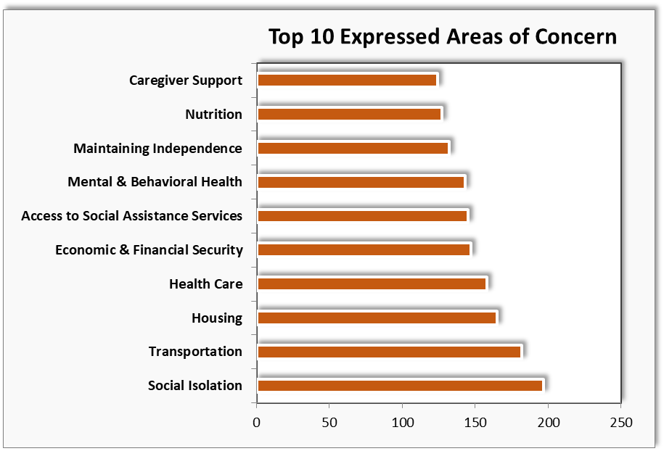
Data – What Do We Know
2021 Needs Assessment Project Data (Preliminary)

Slide 15
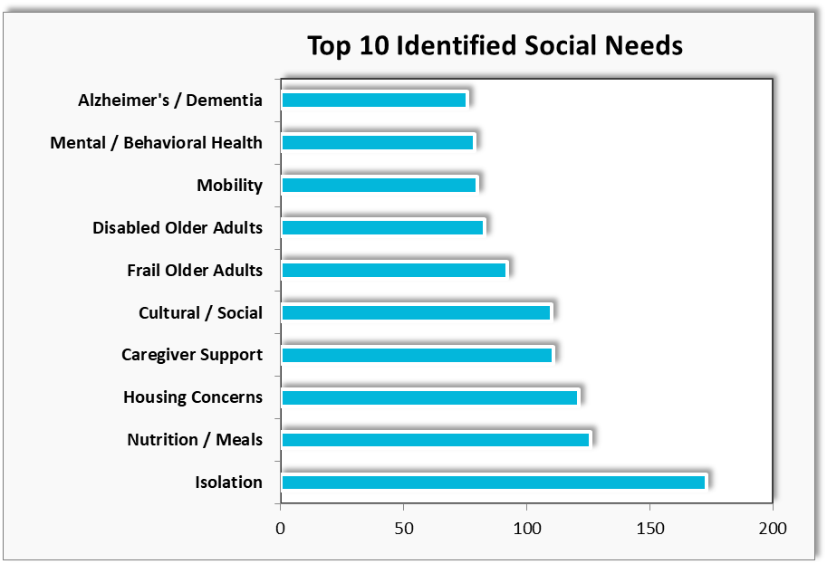
Data – What Do We Know
2021 Needs Assessment Project Data (Preliminary)

Slide 16
Next Steps and Opportunities
Issue MA 2021 Statewide Needs Assessment Report
Submit MA State Plan on Aging, 2022-2025 – 7.1.2021
Submission of 21 Area Agency on Aging Plans, 2022-2025
Distinct Falls Prevention Survey (2022/23?)
Opportunities
Area Agencies on Aging/Elder Affairs Collaboration
Outreach
Title III Standard Funding
American Rescue Plan Funding – Title III-D Target (?)

Slide 17
Questions?
Contact
Ted Zimmerman
State Planner
Legal Assistance Developer
Executive Office of Elder Affairs
Commonwealth of Massachusetts
One Ashburton Place, 5th flr
Boston, MA 02108
Ted.Zimmerman@mass.gov
WP: 617-222-7403
HP: 508-336-3893

Slide 18
Thank you!

