Slide 1
ARPA in the Commonwealth:
Coming up on Three Years
Executive Office for Administration and Finance
March 2024

Slide 2
ARPA Three Years Later
Overview and Eligible Uses

Slide 3
The Third Anniversary Of The “ARPA Money” in Massachusetts
Overview and Eligible Uses – Spending Progress Report – Compliance and Reporting
Overview
The Commonwealth received its allocation of $5.3 B from the Coronavirus State Fiscal Recovery Fund (CSFRF) on May 19, 2021. The federal government provided this grant to respond to and recover from the public health emergency caused by COVID-19.
This presentation summarizes the rules and procedures implemented by the Commonwealth to spend these funds, provides a spending progress report on the programs and projects supported by the funds, and describes the ongoing work required complete this work over the next several years.
Figures in the presentation are in $ millions unless otherwise noted as of January 31, 2024. Data is subject to frequent changes.
Table of Contents
Overview and Eligible Uses
Spending Progress Report
Compliance and Reporting Obligations

Slide 4

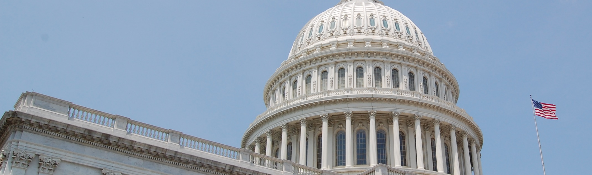
ARPA Money Supports COVID-19 Response and Recovery
Overview and Eligible Uses – Spending Progress Report – Compliance and Reporting
The American Rescue Plan Act of 2021, Pub. L. 117-2 (March 11, 2021) (ARPA) provided $350 B in direct aid to state and local governments through the Coronavirus State and Local Fiscal Recovery Funds (CSLFRF).
CSLFRF is administered by the US Department of the Treasury. Federal oversight is provided by the US Treasury Office of the Inspector General (“Treasury OIG”).
The Commonwealth’s allocation comes from the Coronavirus State Fiscal Recovery Fund (CSFRF).
  Note that the Commonwealth received dozens of federal grants that were created or expanded by ARPA. CSFRF is the single largest, most flexible, and least like other federal grants.

Slide 5

The ARPA Money Is The Single Largest COVID-Related Federal Grant
$5.3 B in revenue from ARPA CSFRF compared to tax revenue for scale only; also note a further $7.2 B in budget surpluses in FY21 and FY22
$5.3 B in Flexible Federal Aid
The American Rescue Plan Act of 2021, Pub. L. 117-2
(March 11, 2021) (ARPA) provided $195 B in direct aid to states through the Coronavirus State Fiscal Recovery Fund (CSFRF).
The Commonwealth received its allocation of $5.3 B as a single lump sum payment on March 19, 2021.
  This grant has become known simply as “the ARPA money”.
Total Tax Revenue FY1974-FY2023 per FY SBFR; all figures in nominal $ millions.

Slide 6
CSFRF Offers More Flexibility But Poses More Risk Than Other Grants
Characteristic | CSFRF (“the ARPA Money”) | Most Federal Grants
Payment Structure | Provided as an advance lump sum payment | Provided as a reimbursement
Eligible Uses | Specified in federal regulation (31 CFR Part 35); State must justify eligibility to federal government after spending occurs | Specified in contracts and/or work plans agreed to with the federal administering agency in advance
Flexibility | Broad; federal government provides criteria but states responsible for assigning uses | Limited to None; federal government proscribes uses
Allocation Method | Legislative appropriations process, primarily | Spent by executive branch agency per grant award terms; little to no role for Legislature in most cases (though there are notable exceptions, like Medicaid or Child Care Development Block Grants)

Slide 7
Eligible Uses Are Broad But Have Significant Rules Attached
The ARPA money is flexible, but recipients must follow federal rules and regulations for the four eligible categories articulated in statute and defined by U.S. Treasury.
Public Health Emergency
Premium Pay
Reduction in Revenue
Infrastructure
Respond to public health emergency with respect to COVID-19 or its negative economic impacts
Provide premium pay to employees providing essential work during the COVID-19 public health emergency
Provide government services to the extent of reduction in revenue due to COVID-19
Invest in water, sewer, or broadband infrastructure
Also called “revenue replacement” or “revenue loss”
Natural Disasters
Provide emergency relief for the negative economic impacts of natural disasters, including temporary emergency housing, food assistance, financial assistance, and other needs
Surface Transportation Projects
Includes projects eligible under Title I of the Housing and Community Development Act of 1974
Total amount of funds capped at the greater of $10 M or 30% of recipient’s total award
1
2
3
4
5
6

Slide 8

The Flexible Revenue Loss Provision Simplifies Our Approach
Overview and Eligible Uses – Spending Progress Report – Compliance and Reporting
Revenue Loss: Provide government services to the extent of the reduction in revenue calculated due to COVID-19 (also known as “revenue loss”);
  The Commonwealth calculated $3.9 B in revenue loss.
All Other Eligible Uses: Direct COVID-19 costs and responding to economic impacts, premium pay, and water, sewer, and broadband infrastructure.
Prohibited Uses: Debt service payments, tax cuts, and contributions to a pension fund.
CSFRF-supported expenses need to be obligated (i.e. under contract and encumbered in MMARS) by December 31, 2024, and spent fully by December 31, 2026.

Slide 9
CSFRF Responsibilities Will Stretch Over About Ten Years
The American Rescue Plan Act (ARPA) passed by U.S. Congress on March 11, 2021
Massachusetts received ARPA CSFRF funds in May 2021
ARPA CSFRF funds must be obligated by December 31, 2024
ARPA CSFRF funds must be spent by December 31, 2026
Final Recovery Performance Plan Report due on April 30, 2027
The federal audit period continues for five years after the final reported expenditure; as late as December 31, 2031

Slide 10
ARPA Uses Were Allocated Over 2021 and 2022
1
Figures do not sum to the total due to rounding.
$5.3 B from the Coronavirus State Fiscal Recovery Fund
U.S. Treasury transferred the grant into a Commonwealth Federal Grant Account
2
3
4
$117 M allocated to immediate-needs programming
$200 M set aside for the Governor to allocate
$4.9 B subject to legislative appropriations process
Administration allocated funds to VaxMillions and Aid to Disproportionately Impacted Communities.
The MA Legislature set aside $200 million for the Administration to program as they deemed necessary for COVID-19 relief.
The MA Legislature moved unspent CSFRF funds into a state fund that requires legislative appropriation.
5
6
7
8
$159 M appropriated for Emergency Paid Sick Leave
$2.6 B appropriated in ARPA 1.0 in
December 2021
$1.9 B appropriated in ARPA 2.0 in
November 2022
$89 M appropriated in
July 2023 Supp and $90 M appropriated in FY23 Closeout Supp
In May 2021, the MA General Court passed Chapter 16 of the Acts of 2021, establishing the COVID-19 Emergency Paid Sick Leave program.
In December 2021, the MA General Court passed Chapter 102 of the Acts of 2021.
In November 2022, the MA General Court passed Chapter 268 of the Acts of 2022. The amount allocated from CSFRF shifts as programming design continues.
In July 2023, $89 M was allocated for grants to fiscally strained hospitals in Ch. 26 of the Acts of 2023. In December 2023, an additional $90 M was allocated in Ch. 77 of the Acts of 2023.

Slide 11
ARPA Money Has Been Allocated in Conjunction With State Surpluses
Overview and Eligible Uses – Spending Progress Report – Compliance and Reporting
ARPA Flexibility
ARPA 1.0 charged ANF with assigning expenditures to either ARPA or the Transitional Escrow Trust.
ARPA 2.0 charged ANF with assigning expenditures to either ARPA or the General Fund.
Funding source flexibility means that ANF can adjust sources based on eligibility, timing concerns, or other factors.
Chapter 77 of the Acts of 2023 removed legislative caps on ARPA 1.0 to allow for more flexible spending.
Assignment Adjustments for ARPA 2.0 (Chapter 268 of Acts of 2022)
ANF initially assigned $2.2 B to federal funds, but re-assignments worth about $300 M were made due to timing concerns (2024/2026 deadlines), availability of other federal funds, and other factors.

Slide 12
ARPA Three Years Later:
Spending Progress Report

Slide 13
$89 M left to Allocate, $1.6 B left to Encumber, $1.9 B left to Expend

Slide 14
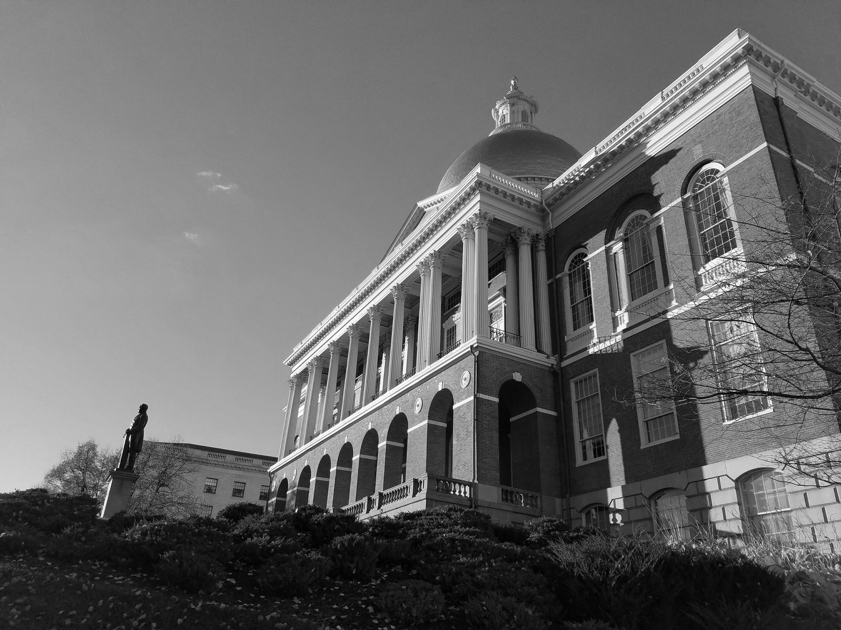
$5.197 B Is Allocated to 9 Policy Areas, 170 Programs, and 621 Earmarks
Figures are in $ millions unless otherwise noted as of January 31, 2024. Data is subject to frequent changes.

Slide 15
31 CSFRF Funded Programs Have Been Completed to Date
Completed ARPA Program Highlights
$599 M has been awarded to fiscally strained hospitals throughout Massachusetts.
Nearly $460 M in premium payments has been distributed to essential workers.
Businesses have been reimbursed a total of $159 M for employee paid leave for vaccinations and paid sick leave for COVID-19.
Chapter 766 schools received $79 M for workforce retention and recruitment initiatives.
Figures are in $ millions unless otherwise noted as of January 31, 2024. Data is subject to frequent changes.

Slide 16

Federal Rules Must Be Completed Before Spending Can Begin
Overview and Eligible Uses – Spending Progress Report – Compliance and Reporting
Federal Compliance Requirements
Compliance Checklist: The federal government requires states to follow extensive rules related to the funds. ANF developed a “compliance checklist” to adhere to these requirements.
Key milestones in the compliance checklist include:
  Program Design: An agency drafts a detailed program design document that describes business processes and personnel supported by the funds.
  Key Performance Indicators (KPIs): An agency identifies Key Performance Indicators for federal reporting purposes.
  Interdepartmental Service Agreement (ISA): ANF transfers funds to an agency when the compliance checklist is complete. An agency can then launch the program.
Progress toward these milestones is reflected on the subsequent slides with “Harvey balls” that depict the status of each element. A filled-in ball has completed the milestone, while an empty ball (white) has not started progress on the step.

Slide 17
The Compliance Checklist Ensures Federal Rules Are Followed
1
6
7
CSFRF funds are allocated by the Legislature and funding designations are made by ANF
Agencies designate a Compliance Officer for each CSFRF program
Agency Compliance Plan is completed and approved by ANF
Agency Compliance Officer completes a program design
Agency Compliance Officer completes the KPI Key Questions Reporting Template
Draft ISAs are completed and approved by ANF
CSFRF Funds are transferred to the agency from ANF
ANF works with the agency to determine U.S. Treasury eligibility for the program
Agency begins administering the program and spending begins
2
5
8
3
4
9
Note: All activities are required to comply with 31 CFR Part 35 and 2 CFR Part 200 of the US Code of Federal Regulations and are subject to annual review by external auditors.

Slide 18
$1.6 B for Health and Human Services Programs
Overview and Eligible Uses – Spending Progress Report – Compliance and Reporting
COVID Relief and Recovery
Fiscally Strained Hospitals received $689 M in grants in four tranches.
MA Repay Program ($110 M+) applications are in review and awards are anticipated to be announced in June 2023. Supported by multiple sources.
$55 M towards 12-month rate enhancement providing flexible financial support for eligible workforce members for recruiting and retention.
Note: The Behavioral Health Trust Fund required further appropriation to expend funds ($192.65 M). These funds were appropriated in the FY24 Budget, and the FY23 Closeout Supp. authorized the necessary transfer from the Transitional Escrow Fund to the Behavioral Health Trust Fund.

Slide 19
$830 M for Housing Initiatives
Overview and Eligible Uses – Spending Progress Report – Compliance and Reporting
Housing Highlights:
Commonwealth Builder Grants will produce affordable homeownership units for households earning between 70% and 120% of area median income (AMI) in 29 designated municipalities.
MassDREAMS expands down payment assistance to support sustainable and durable homeownership and long-term housing security.
Public Housing Maintenance modernizes public housing developments through infrastructure improvements in 153 projects.
Housing Programs Ensure Affordability and Safety:
Affordable Housing Trust Fund created and preserved affordable housing units with a particular focus on low-income households.
Rental Housing Production funds construction and rehabilitation of rental housing projects, which will receive federal or state low-income housing tax credits (LIHTC), state tax-exempt bond financing and other state financial assistance.
LIHEAP funding pays a portion of eligible households (150% FPL) primary heating source bills during the 2023-2024 heating season.

Slide 20
$764 M for Premium Pay, Paid Sick Leave, and Aid to Hard Hit Munis
Overview and Eligible Uses – Spending Progress Report – Compliance and Reporting – About
Direct Relief to Residents
$460 M Essential Worker $500 checks delivered to 540,000 eligible residents and $250 checks to 229,000 eligible residents.
$159 M for Paid Sick Leave enabled 16,840 employers to provide paid leave for COVID-related issues.
$109 M provided to help Chelsea, Everett, Methuen, and Randolph recover from COVID-19.
$15 M in grants provided to municipalities in response to summer 2023 flood-related disasters.

Slide 21
$738 M for Energy and Environmental Affairs Projects
Overview and Eligible Uses – Spending Progress Report – Compliance and Reporting
Energy and Environmental Affairs Programs
Most EEA spending in ARPA 1.0 was assigned to state sources; most of the programs shown above were enacted in ARPA 2.0 (Chapter 268).
Most federal funding is supporting existing state programs.
Major Investments at EEA
State Parks and Trails initiatives fully programmed for the following:
  $68 M for land acquisition | $60 M for targeted DCR projects including dam removal | $27 M for public trail maintenance and acquisition grants | $20 M for various stewardship opportunities
$50 M transferred to MassCEC for expansion of decarbonization and energy efficiency programs.
Electric Vehicle-related spending required technical fixes to legislation. Program design is now underway.
Food Security Infrastructure Grants (FSIG) expected to quickly spend to fill gaps in food network.

Slide 22
$644 M for Labor and Workforce Development Programs
Overview and Eligible Uses – Spending Progress Report – Compliance and Reporting
LWD Programs
Unemployment Insurance Trust Fund transfer made to repay federal loans associated with COVID-related UI.
1,940 employers and 11,159 new hires supported by the HireNow program.
Workforce Development program study to be procured.
Workforce Development Initiatives
High-demand industry workforce program to train 1,500 residents in collaboration with 15 community colleges; 313 completed trainees, 383 enrollees. ~14% of trainees have been placed in an opportunity related to the training.
Green New Deal Job Training programs; $2.5 M in grants awarded to education institutions with further rounds to be evaluated. Administered by EOE.
Workforce Development: $7.4 M to compensate low-income individuals enrolled in regional career center training programs

Slide 23
$343 M for Economic Development Initiatives
Overview and Eligible Uses – Spending Progress Report – Compliance and Reporting
Business Assistance
$75 M contracted for hotels and motels impacted by COVID-19, $75 M for women-owned, veteran-owned, and minority-owned businesses, and $3 M program for movie theaters.
Most of these grants have been awarded to date.
Broadband Summary
$70 M for digital equity partnerships with non-profit organizations via MassTech Collaborative ($45 M from Ch 102, $25 M from Ch 268). These funds are to be deployed in conjunction with other broadband funding, including at least $100 M through the federal Broadband Equity, Access, and Deployment (BEAD) funds through IIJA/BIL and $175 M from the ARPA Capital Projects Fund (CPF).
$5 M to support growth in MA robotics sector through workforce commercialization and marketing
$25 M for Boston community building renovation.

Slide 24
$250 M for Education Initiatives
Overview and Eligible Uses – Spending Progress Report – Compliance and Reporting
Education Initiatives Lead to Student and Teacher Success:
$100M has been allocated for DESE HVAC to improve ventilation and air-quality to support healthy learning environments in public school districts, especially those disproportionately impacted by COVID-19.
Chapter 766 Schools addressed workforce impacts of COVID-19 and aimed to reduce staff vacancies; 8,867 FTEs were maintained and a further 207 FTEs were recruited.
Pathways in Technology Early College expands upon similar state funded programs to boost student success and provide a pathway to college for high school students.

Slide 25
$30 M for Public Safety Programs
Overview and Eligible Uses – Spending Progress Report – Compliance and Reporting
Public Safety Efforts Protect Vulnerable Populations:
School Safety Infrastructure grants, administered in consultation with the department of elementary and secondary education, support school safety infrastructure improvements aimed to protect against acts of gun violence.
Nonprofit Security grants support and protect non-profit organizations at high risk of terrorist attacks or hate crimes through security equipment and enhancements.

Slide 26
$26 M for Veterans’ Service Programs
Overview and Eligible Uses – Spending Progress Report – Compliance and Reporting
Veterans’ Service Efforts
$5M for Executive Office of Veterans’ Services establishment.
Veteran's Service Programs and Local Projects is 3 earmarks to support housing.
Note: The Executive Office of Veterans’ Services was established on March 1, 2023. EOVS continues to work with state agency partners to assume responsibility for these programs and projects.
Veterans Accessibility to Long Term Care
$20M dedicated to identifying homeless veterans and connecting individual veterans and their families to services including housing supports. This will connect veterans not currently served by the Holyoke and Chelsea veterans' homes.

Slide 27
$14 M for Transportation Earmarks
Overview and Eligible Uses – Spending Progress Report – Compliance and Reporting
Local Transportation Projects
MassDOT to deploy local project earmarks to 34 recipients with an average value of $413 K.

Slide 28
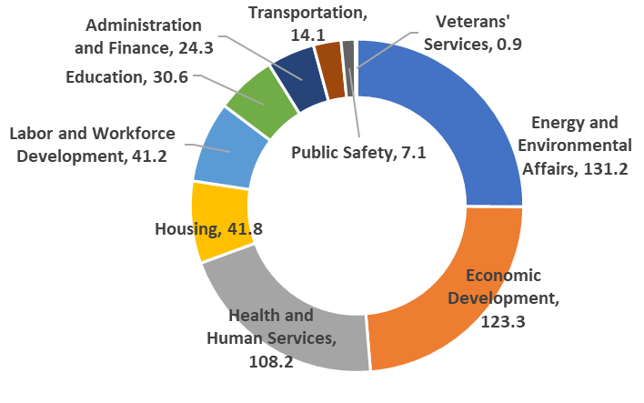
Progress Is Being Made on Local Project Earmarks
Overview and Eligible Uses – Spending Progress Report – Compliance and Reporting

Slide 29
Nearly 1,500 Earmarks Support Communities
Overview and Eligible Uses – Spending Progress Report – Compliance and Reporting
Local Project vs Programmatic Earmarks
Programmatic Earmarks: Require a state agency or entity to deliver a good or service.
Local Project Earmarks: Requires a state agency to contract with a specified entity for a specific purpose.
There are 1,484 Local Project Earmarks worth $522.7 M supported by ARPA or state surplus funds.
  863 ARPA 1.0 earmarks worth $297.3 M are funded with state resources.
  618 ARPA 2.0 earmarks worth $222.2 M are funded with federal resources.
  3 earmarks allocated via Executive Action worth $3.25 M are funded with federal recourses.
Earmark Highlights
$204.2 M of ARPA state and federally funded earmarks has been expended as of December 31, 2023.
  $15 M towards Massachusetts Alliance for Supportive Housing
  $10 M for psychiatric beds for youth in crisis
  $10 M for Jewish Vocational Services for Rapid Reemployment services
  $7 M for East Boston Neighborhood Health Center Behavioral Health Services
  $6 M for Melrose Wakefield Healthcare, Inc Behavioral Health Facility
  $5 M for Western MA Food Bank HQ and Distribution Center Construction
Notes:
This does not include Chapter 77 or Executive Action

Slide 30
Recipients Must Document Eligible Uses for Reimbursement
Secretariat Compliance Checklist for Earmarks
Agency initiates earmark process by collecting pre-award requirements from recipient
Agency collects invoices and reports from recipient
ANF and the agencies work to complete the compliance checklist (see slide 36 for more information). Once ANF signs off, agencies communicate with recipients directly.
These requirements include a completed earmark contact collection form, completed spending plan, and a signed contract with the terms applicable to the CSFRF grant.
In conjunction with other CSFRF programs, earmark funds are distributed on a reimbursement basis.
Agency transfers earmark funds to recipient
Agency completes ANF monthly reporting exercise and provides KPI Reporting Template
Agency stores all documents related to earmark in centralized manner
As recipients submit invoices, agencies will disburse funds on a cadence that they determine.
ANF created and provided a Key Performance Indicator Template for agencies to provide to recipients. Agencies will collect this information to provide to ANF when spending is completed.
Agencies will retain all documents to be provided as necessary to FFO for audit and reporting for 5 years following the close of the federal grant.

Slide 31
Context: ARPA, CARES Act, Bipartisan Infrastructure Law, IRA, CHIPS
Overview and Eligible Uses – Spending Progress Report – Compliance and Reporting
ARPA Efforts Occur Amid Historic Federal Investments in Housing, Climate, and Recovery
ANF continues to track more than $100 B in federal spending related to COVID relief and recovery in Massachusetts in addition to CSFRF spending.
  Local governments (counties, cities, and towns) have $3.4 B in ARPA money to spend with the same parameters and timeline.
Massachusetts is competing for up to $17.5 B in transportation, water and sewer, broadband, and climate infrastructure investments from the Bipartisan Infrastructure Law, CHIPS+Science, and Inflation Reduction Act.
State Tax Revenue and Spending Growth (FY20-FY22)
Commonwealth tax revenues grew $11 B, or 39 percent since fiscal 2020, producing more than $7.2 B in state budget surpluses to spend.
Operating budget increases totaled approximately $15 B since fiscal 2020, or 34 percent.
  Note that non-tax revenue also grew during this period to support spending.
Agency staff are managing expanded programs and projects associated with all these sources.
…and Decline (FY23-FY24)
Commonwealth tax revenues fell $2 B, or 4.7 percent from FY22 to FY23.
CSFRF revenue has also allowed programs to continue in FY24 when other revenue pressures have required budgetary reductions

Slide 32
ARPA Three Years Later:
Compliance and Reporting Obligations

Slide 33
ARPA Money Comes With Federal Strings Attached
Overview and Eligible Uses – Spending Progress Report – Compliance and Reporting – About
Compliance Obligations
Ensure that uses comply with all applicable federal rules and regulations.
Agencies complete a program design providing a high-level overview of goals and objectives, relevant parties’ roles and responsibilities, the flow of funds, and any compliance concerns.
Program staff complete a key reporting template to define how the agency plans on collecting the data required by U.S. Treasury prior to receiving the funding.
Desk Reviews
ANF conducts monthly desk reviews to ensure that agencies are following the complex and extensive federal compliance and reporting requirements.
  The Federal Funds Office Compliance Team began CSFRF Desk Reviews in January 2023.
  To date, 205 transactions across 19 State Agencies are in review.
  Review of transactions will continue through the end of the federal grant (December 31, 2026) and beyond to ensure compliance.

Slide 34
The Commonwealth Must Complete Regular Financial Reports
Overview and Eligible Uses – Spending Progress Report – Compliance and Reporting
Reporting Obligations
  Quarterly project and expenditure report: Quarterly spending reports until at least April 2027.
  Recovery plan performance report: Annual report that summarizes efforts to deploy funds in an equitable manner, community engagement efforts, labor practices for infrastructure projects, and use of evidence-based interventions.
Expenditures are reported to U.S. Treasury on the project level, which is determined by the legislation defining the programs, agency program staff, and ANF.
Reporting Updates
9 quarterly spending reports submitted on time; next report due 4/30/2024.
3 annual Recovery Plan Performance Reports submitted on time; next report due 7/31/2024.

Slide 35



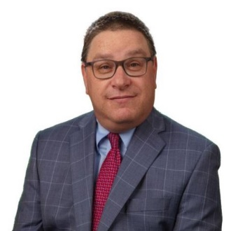
Pandemic-Era Programs Are Already Being Reviewed
Overview and Eligible Uses – Spending Progress Report – Compliance and Reporting
Federal Pandemic Response and Accountability Committee
Case Study of COVID-related spending in the City of Springfield
FY22 Single Audit
Required FY2023 Single Audit is in progress; no issues identified in the FY20, FY21, and FY22 Audits
Office of the State Auditor
Audit of ANF Coronavirus Relief Fund Municipal Program Desk Reviews Process
Office of the Inspector General
Pandemic Oversight unit collecting data from agencies

Slide 36
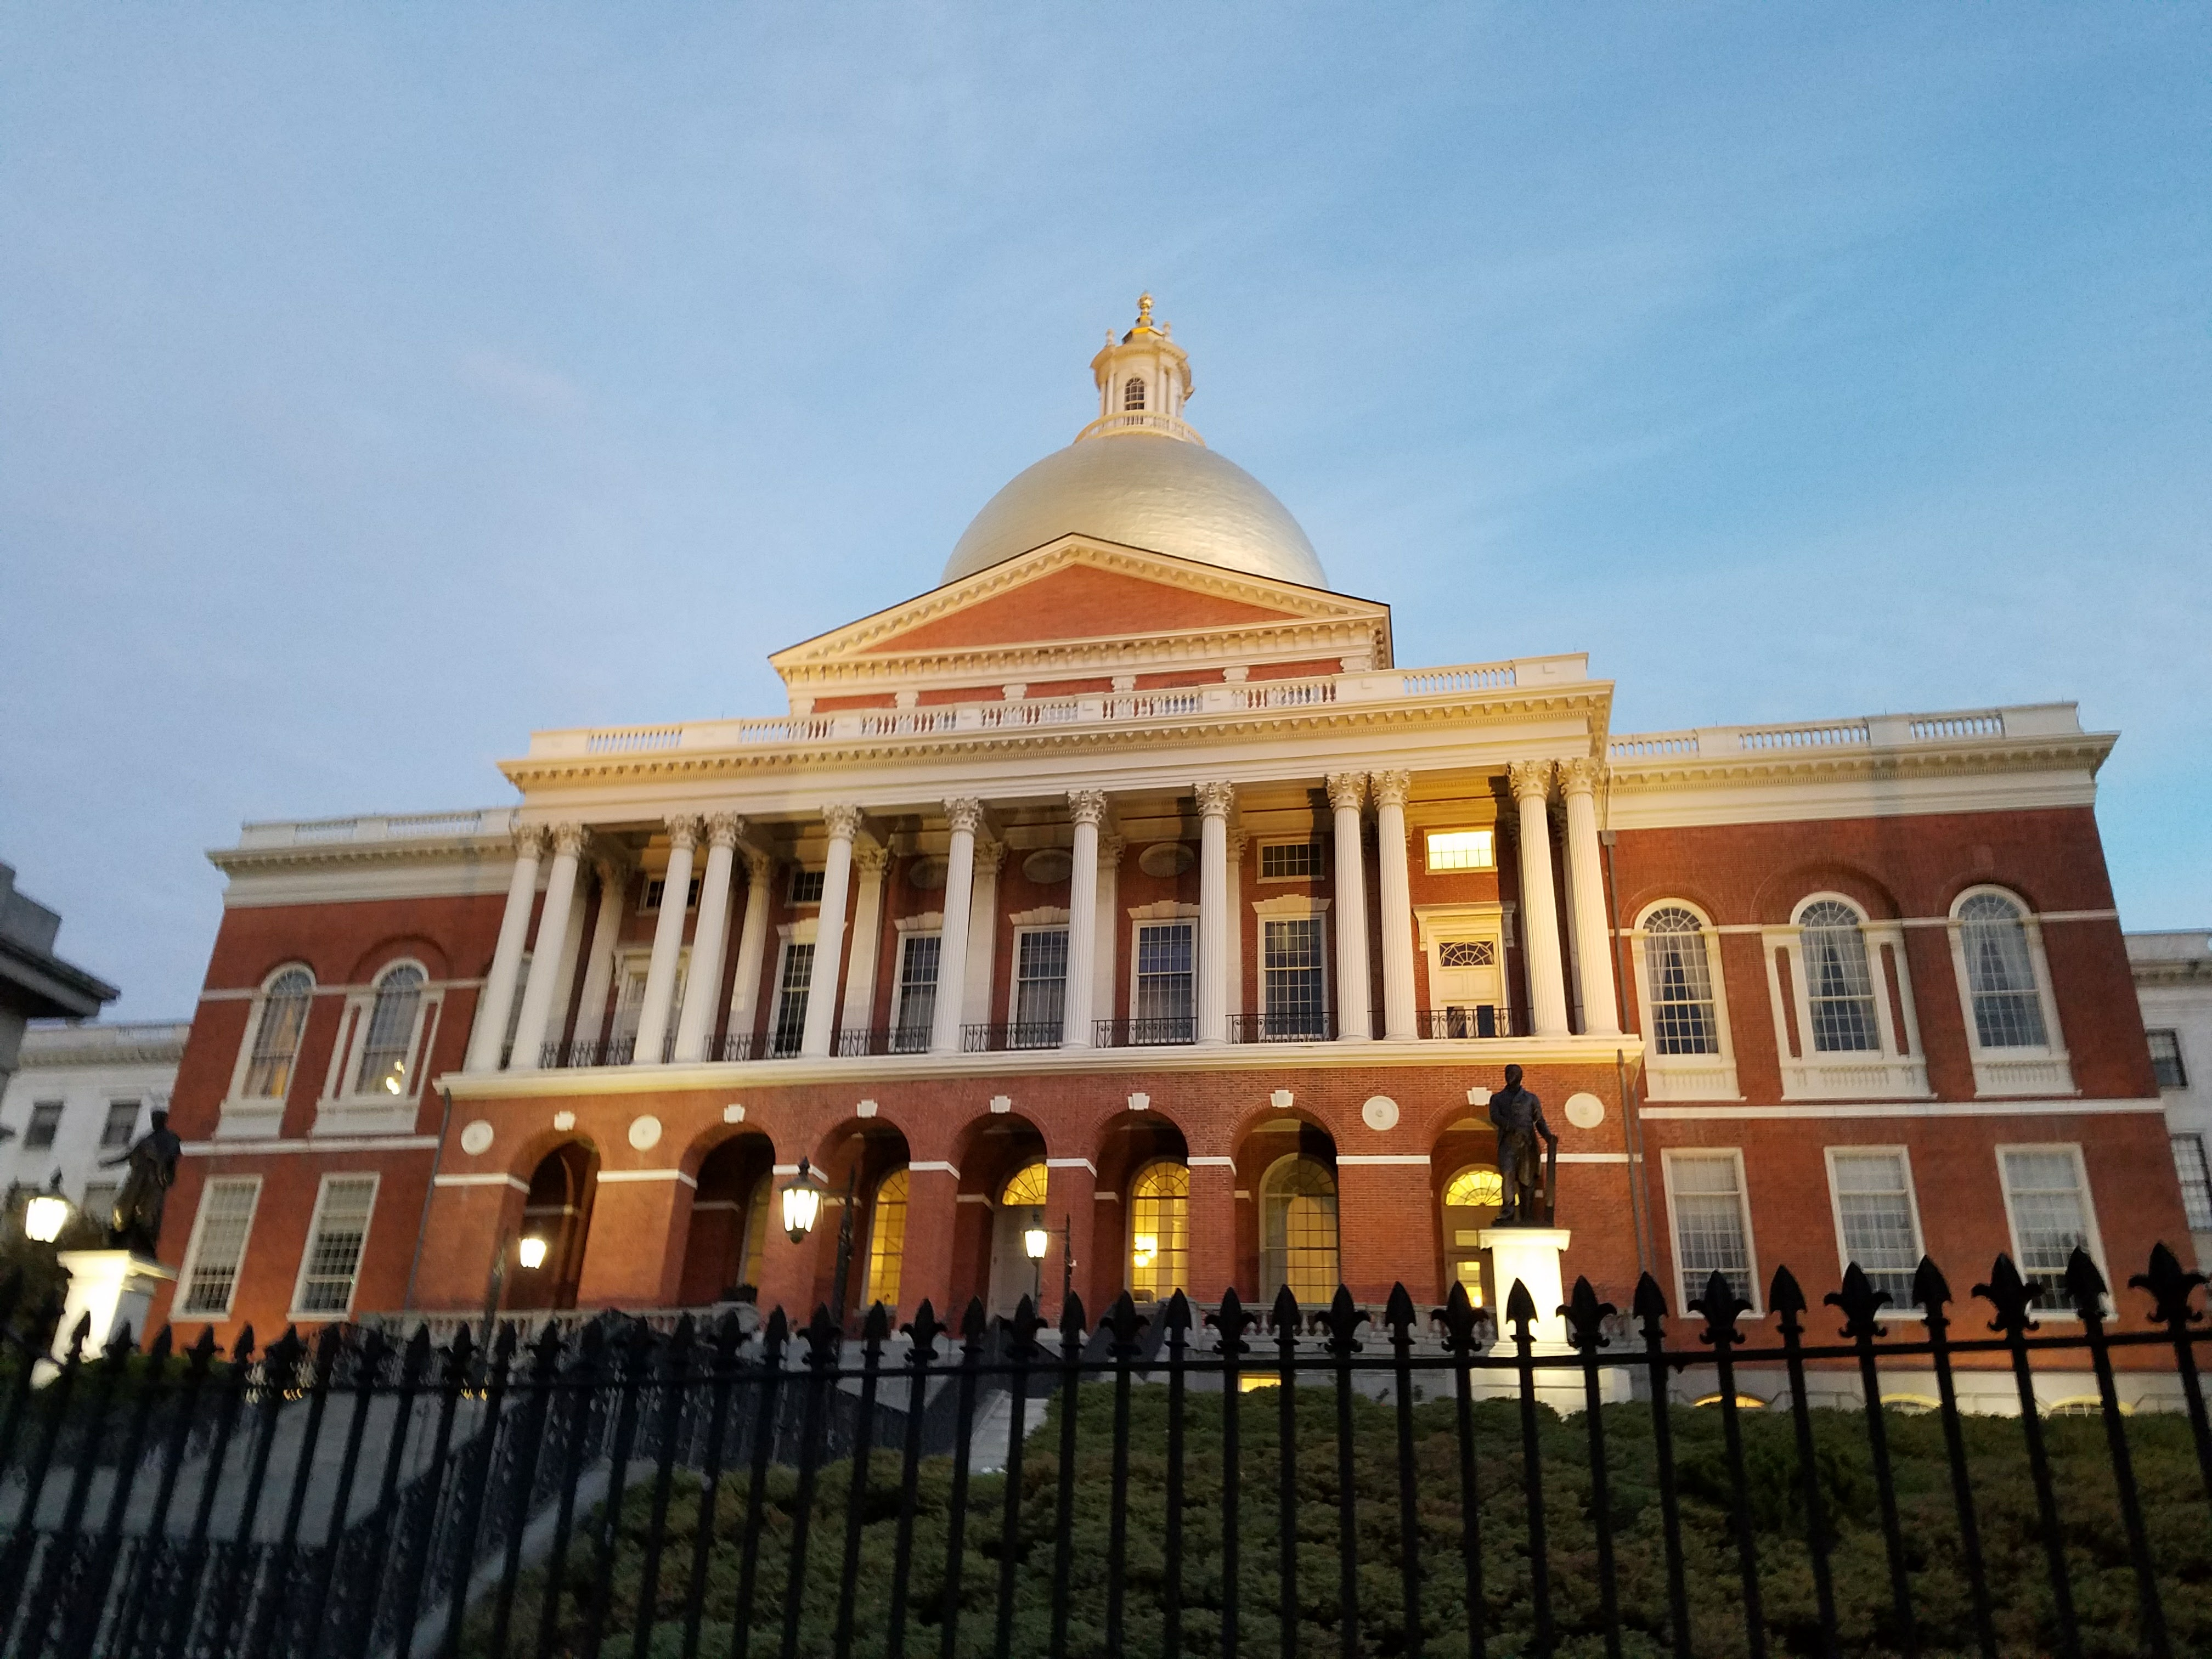
The Equity and Accountability Review Panel Will Set Equity Goals
Overview and Eligible Uses – Spending and Progress Report – Compliance and Reporting
Federal Funds Equity and Accountability Review Panel
Created in ARPA 1.0, the Equity Panel is charged with setting goals for uses of ARPA money in terms of geographic and demographic distribution.
25-member panel has met since February 2022 to establish allocation goals for ARPA funds.
Panel chairs are Marcony Almeida-Barros, Deputy Chief of Staff for Access and Opportunity at the Office of the Governor and Tracye Whitfield, Executive Director at the Coalition for an Equitable Economy.
The Panel evaluates if ARPA funds are prioritized in Massachusetts towns or cities that suffered the greatest hardship and were disproportionately affected due to the COVID-19 pandemic.

Slide 37
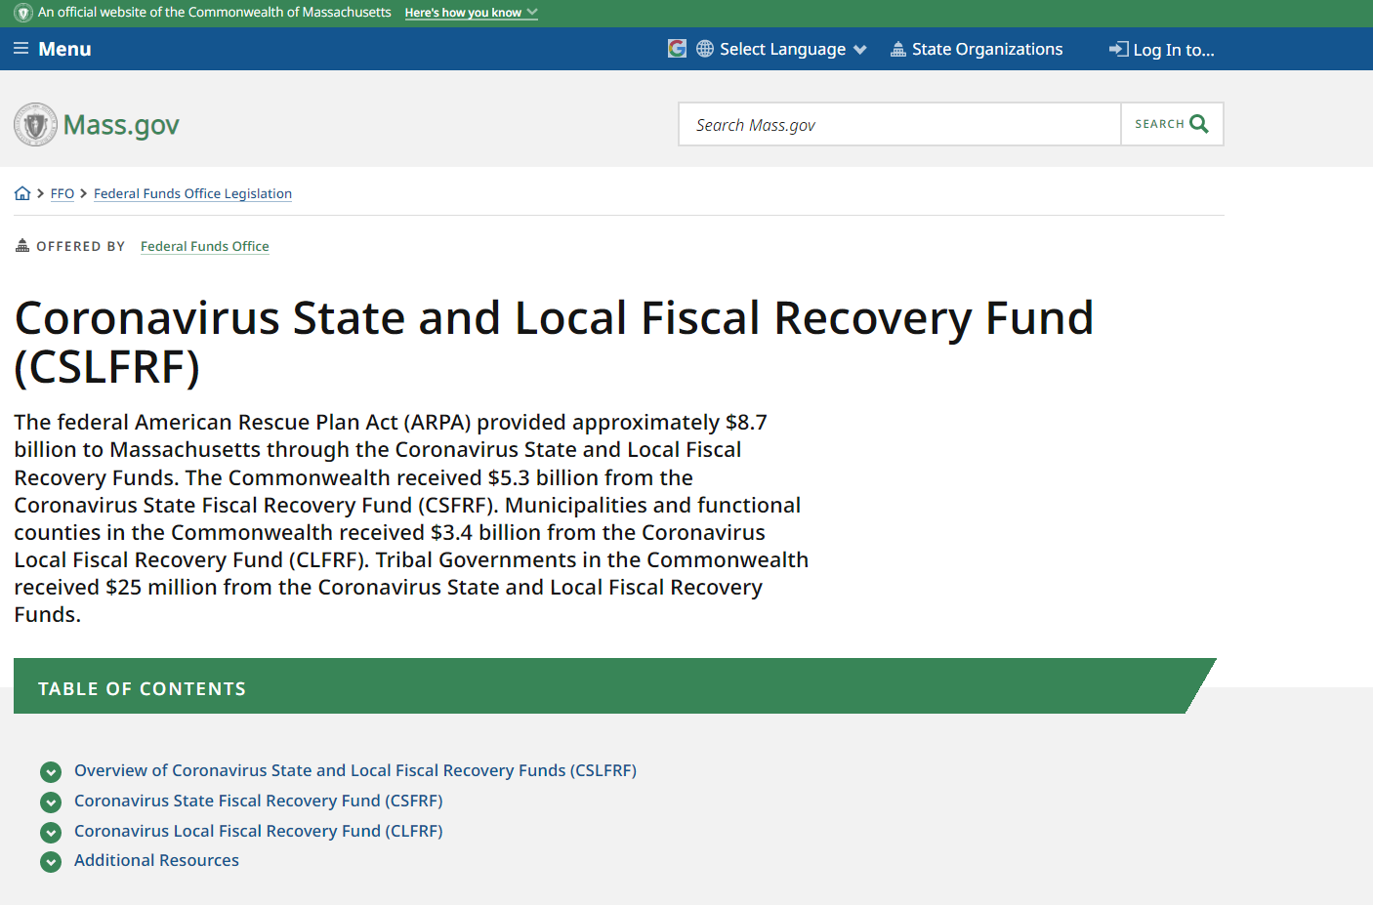
The Commonwealth Is Recognized Nationally For Transparency
Key Resources
Coronavirus State Fiscal Recovery Fund Spending Table
Premium Pay Geographic Distribution Dashboard
Legislatively Required Fund Allocation Reports on Chapter 102 of the Acts of 2021 and Chapter 268 of the Acts of 2022
Coronavirus State Fiscal Recovery Fund Recovery Plan Performance Reports
Coronavirus Local Fiscal Recovery Fund Allocation Dashboard

Slide 38
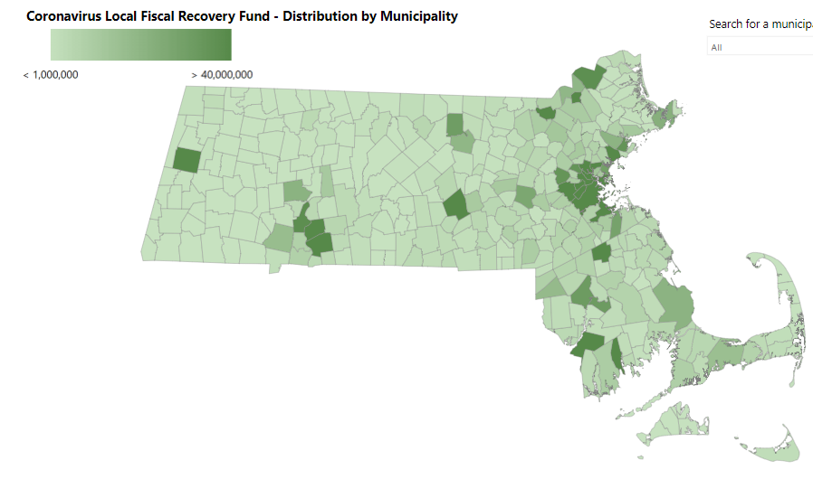
Local Governments Received ARPA Money, Too
Overview and Eligible Uses – Spending Progress Report – Compliance and Reporting
Local governments (counties, cities, towns) in Massachusetts received $3.4 B directly from the federal government.
  CLFRF recipients are prime recipients of the federal grant and are responsible for reporting directly to U.S. Treasury.
  ANF assisted smaller municipalities (generally, those under 50k population) in accessing both tranches of CLFRF money.
  A full summary of CLFRF payments is available on the ANF COVID-19 Federal Funds website.
  Counties, cities, and towns report expenditures directly to the federal government; the state has no role.
    The federal data tools have not been updated in months, obscuring the perspective on local uses.
______________________________a

Slide 39
ANF’s Approach: Maximize Revenue, Minimize Risk
Goal | Task | Results
Maximize revenue | Revenue optimization | Assign appropriations to federal or state surplus based on eligibility. $1 B in FEMA revenue coming to the state.
Maximize revenue | Opportunity Tracking | $116 B tracked in COVID inventory. Competing for up to $17.5 B in IIJA/BIL, IRA, CHIPS inventory.
Maximize revenue | Coordination/Technical Assistance | Regular presentations to the agency CFOs monthly meeting. Collaborations with MMA, MAPC, Comptroller, FEMA/MEMA.
Minimize risk | Compliance Checklist | 6 step compliance checklist to establish eligibility and implement business processes to comply with federal rules.
Minimize risk | Desk Reviews | 19 desk reviews of federal-supported spending in progress.
Minimize risk | Audit Management | No findings on FY21 and FY22 Single Audits; FY23 Single Audit in progress. Coordinate external audits (SAO audit of ANF, federal Pandemic Response Accountability Committee work in Springfield).
Minimize risk | Financial Reporting | 9 quarterly financial and 3 annual performance reports filed.
Minimize risk | Transparency website | Nationally-recognized transparency website.

