Slide 1
Ask Away
April 17, 2025
Deeptha Ramalingam, Scott Geer, Manuela Batista, Andrew Pursley

Slide 2
Agenda
Early Intervention Updates
Authorized Service Types/Procedure Codes
Ongoing Business

Slide 3
Early Intervention Updates
ICC Fiscal Subcommittee’s next meeting is Thursday, June 12, 2025, 2:00pm – 4:00pm
  Topic: FY25 Review and FY26 Scheduling
  Link: Interagency Coordinating Council (ICC) | Mass.gov
The FY26 House Joint Ways and Means Budget was released on April 16th
  There were no changes from the Governor’s budget
The FFY25 Part C Grant Application is available to review and comment at https://www.mass.gov/info-details/ffy25-part-c-grant-application-draft
The MA Accounting Office recently changed the minimum required information to deposit checks. Because of the uniqueness of EI it has caused a considerable backlog in our ability to deposit checks. This issue has been resolved and are beginning to process the checks on hand. We apologize for this inconvenience, and we appreciate your patience and help as we resolve the backlog.
The current version for the Reimbursement Policy Manual v9
Notes:
Details on the new process will be covered by Manuela and the end of this Ask Away.

Slide 4
Authorized Service Types
Procedure Codes
April 17, 2025

Slide 5
Early Intervention
Massachusetts Early Intervention (EI) is a program for infants and toddlers (birth to 3 years old) who have developmental delays or are at risk of a developmental delay.
Notes:
We are the Massachusetts Early Intervention Massachusetts Early Intervention is a program for infants and toddlers (birth to 3 years old) who have developmental delays or are at risk of a developmental delay.

Slide 6
Service Types/Service Codes and Rates
The DPH Service Type must be provided in the claim file submitted to DPH for both charge claims and encounter claims.
DPH will only accept service codes that are listed in the reimbursement manual in accordance with 101 CRM 349.00 or 101 CRM 358.00.
DPH will reimburse Early Intervention and Autism Services at rates listed in the Reimbursement Policy Manual.
Each insurance will provide specific guidance regarding their requirements as defined under these codes. This may vary from DPH policy.
Notes:
Service Types and Service Codes and Rates This may vary from DPH policy.
All insurance companies have different procedures- We have no control over their standards rules and regulations.

Slide 7
EI- EIBI Service Codes and Rates Definitions
Client - A client is the recipient of services provided by an Early Intervention program. This term is interchangeable with patient.
Patient - A patient is the recipients of services provided by an Eligible Provider. This term is interchangeable with client.
Co-treatment - A child visit or center-based individual visit that involves two professional staff members and the client, the client’s caregiver, or both. Co treatment sessions are billed on the basis of working hours and are limited to four working hours per session.
Unit - A Unit is fifteen minutes of service provided to a client. In the case of a community child group, EI-only child group, and/or a parent-focused group, one unit is 15 minutes of service provided to an individual client. In the case of a child visit and/or a center based individual visit, one unit is 15 minutes of service provided to an individual client, except for situations defined under co treatment. In the case of a screening and/or assessment, one unit is 15 minutes of service provided by one professional staff member.
Notes:
Early Intervention and Early Intensive Behavioral Intervention Service Codes and Rates Definitions
Client, Patient, Co-treatment, and Unit

Slide 8
General Early Intervention (EI)
An Early Intervention (EI) Program is a program that shows evidence of having met the Early Intervention Operational Standards of the Department of Public Health and that provides services such as medical, therapeutic, educational, developmental, and social services for children and their families. Services are provided to children from birth through three years old, who are also at biological, environmental, or established risk.
DPH contracts with groups of Early Intervention providers based on catchment areas.
The rates of reimbursement have been certified by the Commonwealth and filed with the Secretary of the Commonwealth are to be used for services governed by 101 CMR 349.00.
The table can be found on the Reimbursement Policy Manual for Early Intervention and Autism Services “Service Codes and Rates”. Only service codes listed are eligible for reimbursement through MA PART C.
Notes:
The Service Codes and Rates of Early Intervention

Slide 9
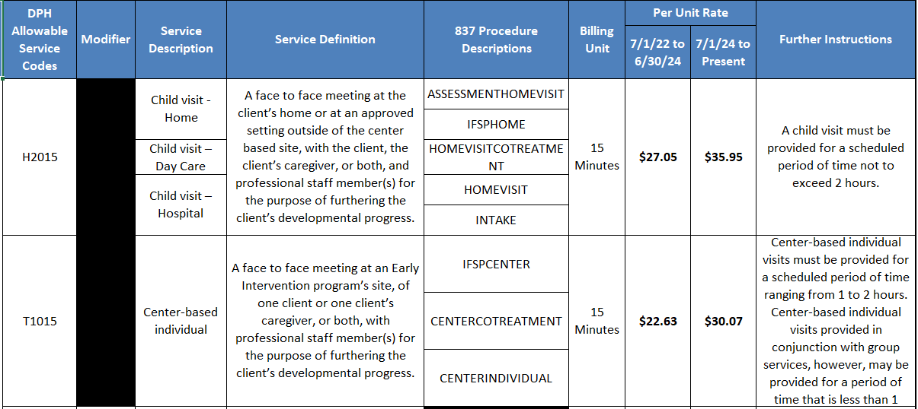
Early Intervention Service Codes and Rates (1 of 4)
Notes:
Early Intervention Service Codes and Rates Table

Slide 10
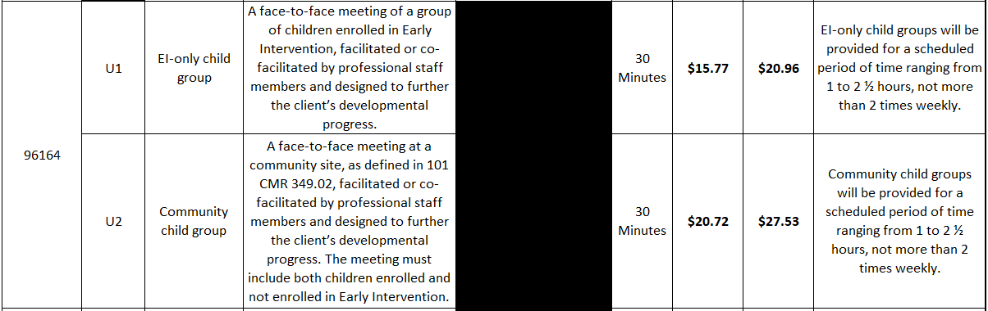
Early Intervention Service Codes and Rates (2 of 4)
Notes:
Service Codes #96164- has two modifiers

Slide 11
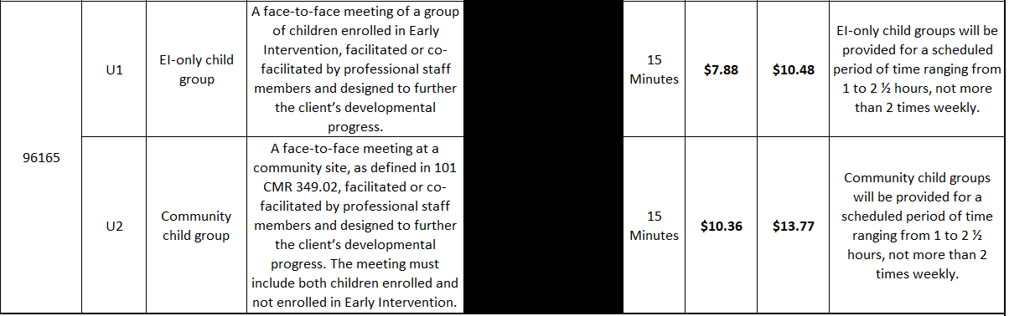
Early Intervention Service Codes and Rates (3 of 4)
Notes:
Service Codes #96165 has two modifiers

Slide 12
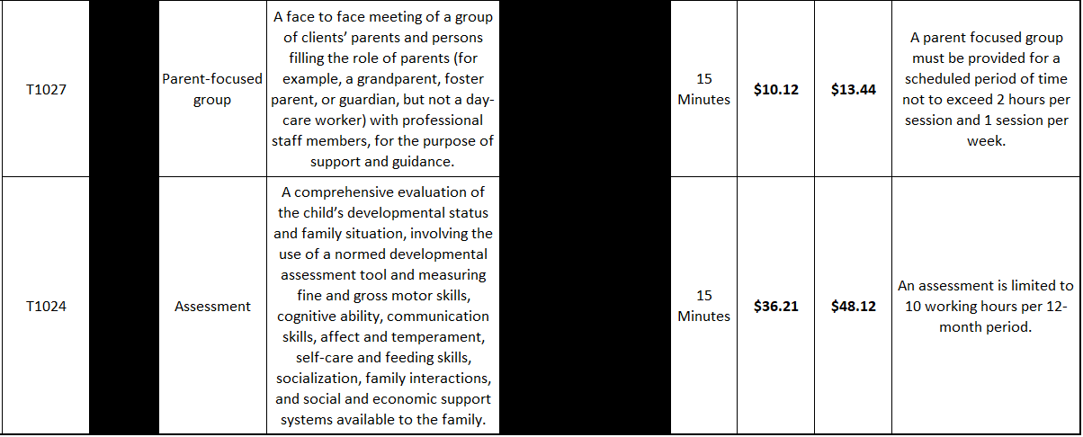
EIBI Service Codes and Rates (4 of 4)
Notes:
Early Intensive Behavioral Intervention Service Codes and Rates table

Slide 13
Early Intensive Behavioral Intervention (EIBI)- Autism
Eligible Provider is any person, partnership, corporation, or other entity that is authorized to provide Applied Behavior Analysis services in the Commonwealth of Massachusetts and who meets such conditions of participation as have been adopted by a governmental unit.
DPH contracts with groups of Early Intensive Behavioral Intervention providers based on catchment areas.
The rates per service unit approved by EOHHS. The rates of payment that have been certified by the Commonwealth and filed with the Secretary of the Commonwealth are to be used for services governed by 101 CMR 358.00.
The table can be found on the Reimbursement Policy Manual for Early Intervention and Autism Services “Service Codes and Rates”. Only service codes listed are eligible for reimbursement through MA PART C.
Notes:
The Service Codes and Rates Early Intensive Behavioral Intervention

Slide 14
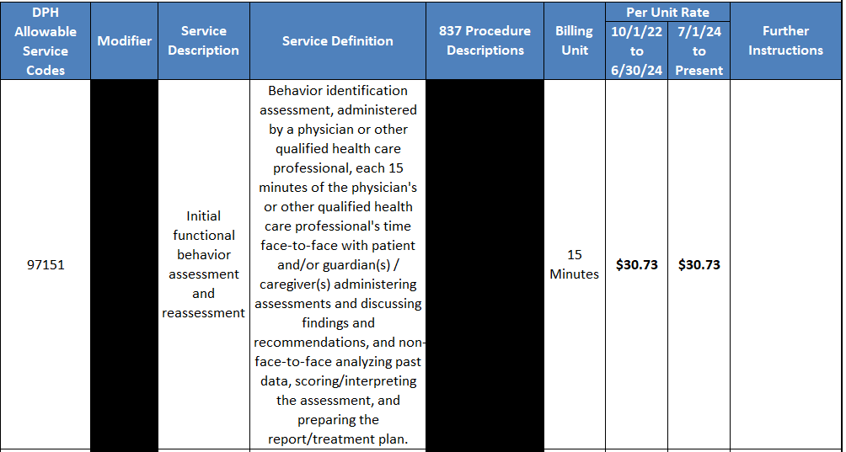
Early Intervention Service Codes and Rates (1 of 3)
Notes:
Early Intervention Service Codes and Rates Table

Slide 15
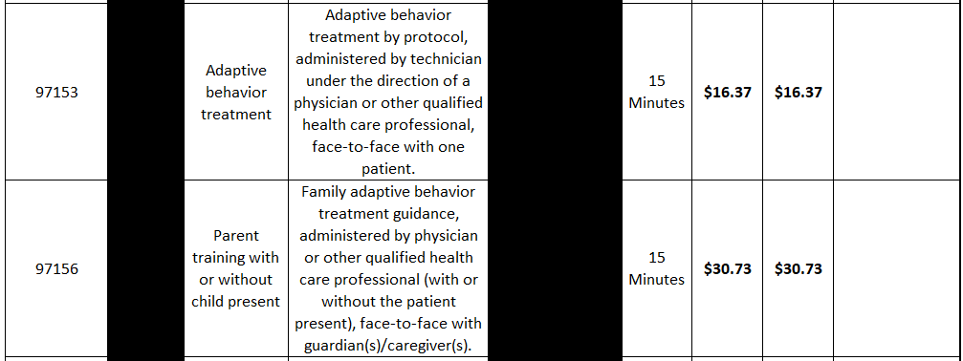
Early Intervention Service Codes and Rates (2 of 3)

Slide 16
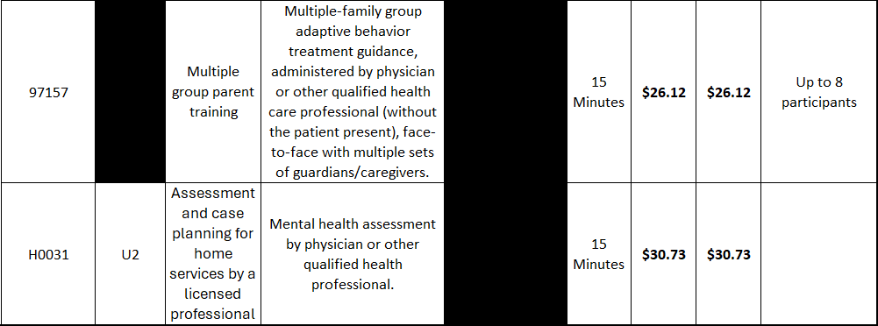
Early Intervention Service Codes and Rates (3 of 3)
Notes:
H0031 has a modifier U2

Slide 17
Ongoing Business

Slide 18
Negative Payment Voucher
Mail Check: MA Department of Public Health (DPH)
Attention BFHN Early Intervention Finance Manager
250 Washington St, (5th floor)
Boston, Massachusetts 02108

Slide 19
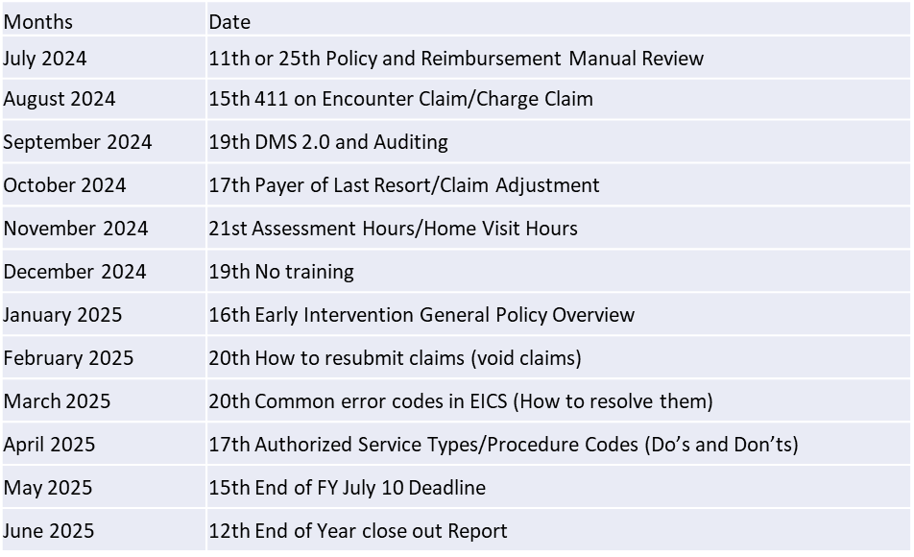
Ask Away – Next trainings
Next meeting May 15th 2025 at 10am-10:45am
End of FY July 10 Deadline
Ask Away trainings are available online in the Early Intervention website under the billing and reimbursement tab.
  Link: https://www.mass.gov/info-details/early-intervention-billing-reimbursement

