Slide 1
Ask Away
March 20, 2025
Deeptha Ramalingam, Scott Geer, Manuela Batista

Slide 2
AGENDA
Early Intervention Updates
Common Error Codes in EICS (How to resolve them)
Ongoing Business

Slide 3
Early Intervention Updates
Ask Away trainings are available online in the Early Intervention website under the billing and reimbursement tab.
  Link: https://www.mass.gov/info-details/early-intervention-billing-reimbursement
ICC Fiscal Subcommittee’s next meeting is Thursday, April 10, 2025, 2:00pm – 4:00pm
  Topic: Part C application review
  Link: Interagency Coordinating Council (ICC) | Mass.gov
The FY26 Governor’s budget was submitted and pending Joint Ways and Means Budget
  Early Intervention funding was in line with expectations
Find information on the Early Intervention Division’s Part C draft grant application and budget for federal fiscal year 2025
  https://www.mass.gov/info-details/ffy25-part-c-grant-application-draft

Slide 4
Common Error Codes in EICS
(How to resolve them)
March 20, 2025

Slide 5
Early Intervention
Massachusetts Early Intervention (EI) is a program for infants and toddlers (birth to 3 years old) who have developmental delays or are at risk of a developmental delay
Notes:
We are the Massachusetts Early Intervention Massachusetts Early Intervention is a program for infants and toddlers (birth to 3 years old) who have developmental delays or are at risk of a developmental delay.

Slide 6
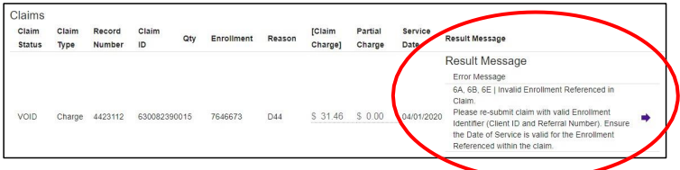
Error Codes
Assigning Error Codes
When service delivery data has been uploaded into the EI Client System via the Claim Submission Process, a series of validations and adjudications (business rules) occur in the System
If the claim passes all validations and adjudications, there will be no errors in the Error Message entity associated to the claim
If the claim does not pass a validation or adjudication, then an error code is assigned to the claim, as shown below
Notes:
Assigning Error Codes
When service delivery data has been uploaded into the EI Client System via the Claim Submission Process, a series of validations and adjudications (business rules) occur in the System
If the claim passes all validations and adjudications, there will be no errors in the Error Message entity associated to the claim
If the claim does not pass a validation or adjudication, then an error code is assigned to the claim, as shown below

Slide 7
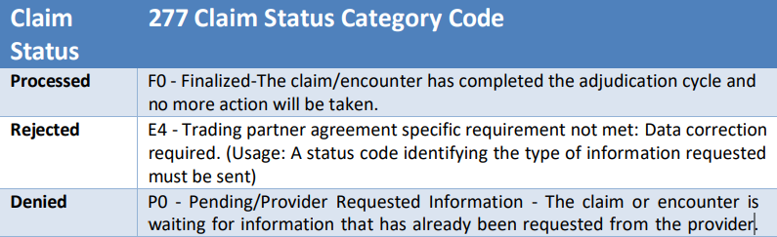
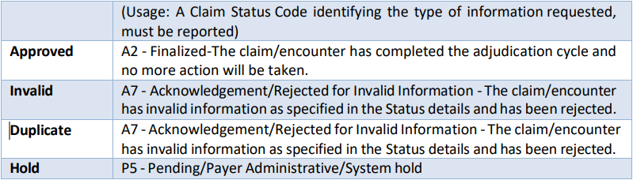
Claims Status
When you receive a rejected claim status, it means the claim contains an error. The rejection will include an error code that explains the issue. You must fix the error before the claim can be processed.
Notes:
When you receive a rejected claim status, it means the claim contains an error. The rejection will include an error code that explains the issue. You must fix the error before the claim can be processed.
Claim status, 1. Processed, 2. Rejected, 3. Approved.

Slide 8
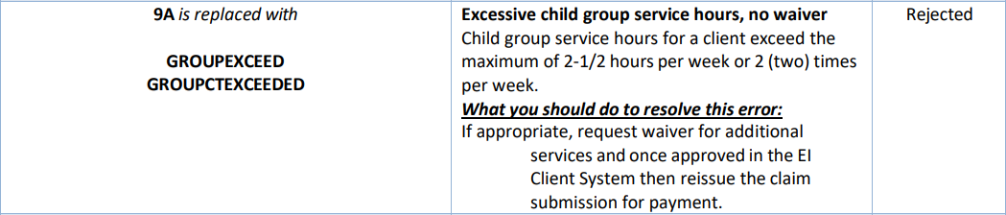
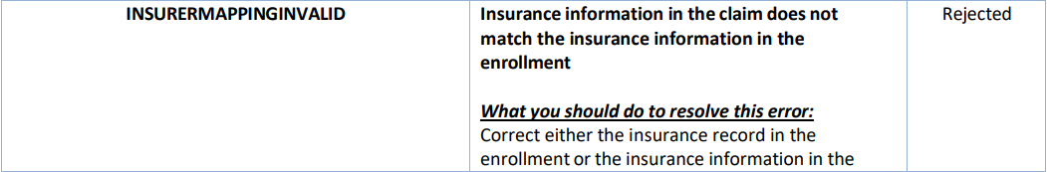
Common Errors
Notes:
Common Errors GroupExceed and InsurerMappingInvalid

Slide 9
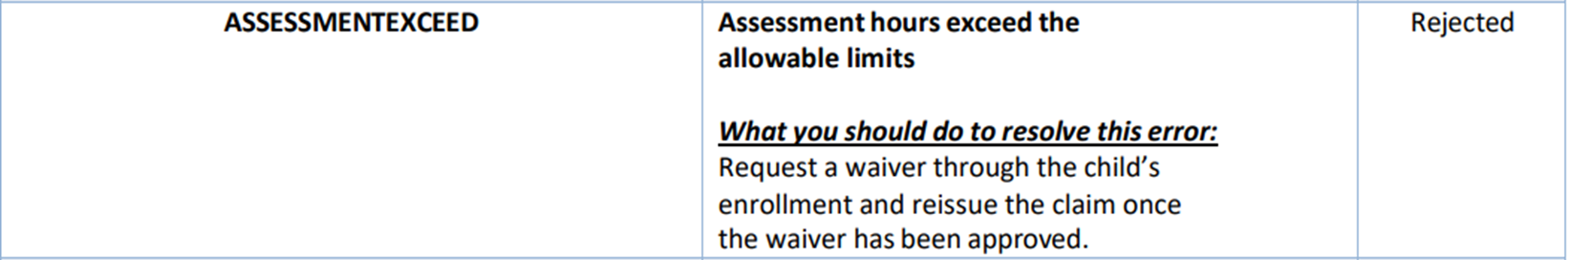
Common Error reported to Help Desk
Notes:
Common Errors AssessmentExceed

Slide 10
Ongoing Business

Slide 11
Negative Payment Voucher
Mail Check: MA Department of Public Health (DPH)
Attention BFHN Early Intervention Finance Manager
250 Washington St, (5th floor)
Boston, Massachusetts 02108

Slide 12
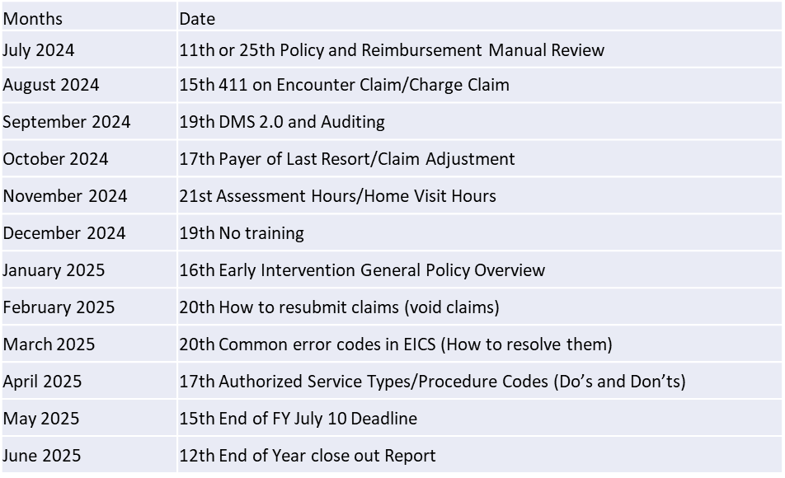
Ask Away – Next meeting
Next meeting April 17th 2025 at 10am-10:45am
Authorized Service Types/Procedure Codes (Do’s and Don’ts

