Slide 1
Encounter and Charge
Claims
August 15, 2024

Slide 2
Why is this important 1 of 2
As the Lead Agency (LA) for the Part C program (Early Intervention) for the Commonwealth, we are the "single line of responsibility" and among other things, we are required to:
Provide general administration and supervision;
And oversee the Identification and coordination of all available resources (Money).
It is ALL our responsibility to ensure that Part C dollars are used only as the "Payor of Last Resort (POLR):
MA is a Fee Free state – which means families never pay for EI or EIBI services.
Order of reimbursement must be: Private/Public source (i.e. Third-Party Insurance or Public Health Insurances), State Funding set aside for EI and finally Federal services when all other options have been exhausted.
Audit requirements:
Federal: The State must provide the assurance in Section II.B.13 of the annual grant application that it has a statewide system that meets the single line of responsibility for the program.
State: The department is required to submit routine reports on expenditures.
Creates a sustainable Early Intervention system:
Accurate Encounter and Charge Claims allows for us to ensure our State remains financially viable and is in accordance with both State and Federal regulations and requirements.
Notes:
As the Lead Agency for the Part C program (Early Intervention) for the Commonwealth, we are the "single line of responsibility" and among other things, we are required to:​
Provide general administration and supervision;​
And oversee the Identification and coordination of all available resources.
It is ALL our responsibility to ensure that Part C dollars are used only as the "Payor of Last Resort
As you all may know MA is a Fee Free state – which means families never pay for EI or EIBI services.​
Order of reimbursement must be: Private/Public source (i.e. Third-Party Insurance or Public Health Insurances), State Funding set aside for EI and Federal services when all other options have been exhausted.​
We’re also responsible for audit requirements
For Federal: The State must provide the annual grant application that it has a statewide system that meets the single line of responsibility for the program.​
For the State: it’s a Quarterly reports that are submitted to the house and senate committees on ways and means on the total number of units of service purchased and the total expenditures for the units of service paid by the department​
In order to ensure our state remains financially viable and is in accordance with both state and federal regulations and requirements we need the encounter and charge claims to be submitted accurately

Slide 3
Claim Types
All service billing activity is to be reported to the Department of Public Health.
This billing activity is categorized into two different types of claims
Encounter Charge
Early Intervention Client System (EICS) categorizes these claims into the following categories:
Early Intervention Services
General
Supplemental
Uninsured
Early Intensive Behavior Intervention
General
Supplemental
Uninsured
Notes:
All service billing activity is to be reported to the Department of Public Health.
This billing activity is categorized into two different types of claims
Encounter and Charge
The Early Intervention Client System also known as the (EICS) categorizes these claims into the following categories:
Early Intervention Services (EI) and Early Intensive Behavior Intervention (EIBI) and then it’s split between the following
General
Supplemental
Uninsured
General and Supplemental are paid from our State funds
And the Uninsured claims are paid from our Federal funds.

Slide 4
Encounter Claim
Claim details on Early Intervention Services paid in full by insurance
EICS PORTAL
Encounter Claim Submission: Utilizes 837 or XML File Layout
Notes:
Claim details on Early Intervention Services paid in full by insurance is the definition for an encounter claim.
They are uploaded in our EICS PORTAL
Utilizing an 837 or XML File Layout

Slide 5
Charge Claim
Claim submission requesting full or partial payment by DPH
EICS PORTAL
Charge Claim Submission: Utilizes 837
Notes:
In difference of a Charge claim which is a
Claim submission requesting full or partial payment by DPH
It’s also uploaded in our EICS PORTAL
And it only Utilizes an 837 to be uploaded

Slide 6
Encounter & Charge Validation
Documented formatting requirements
Hours and Date of service is within the enrollment start and discharge data
Enrollment number and information and insurance information on each claim must match the DPH Early Intervention Client System
Service type and procedure code
Proper adherence to service level requirements (waivers taken into consideration) and rates (only applies to charge)
Notes:
Our EICS system validates both Encounter and Charge claims as follows:
Documented formatting requirements
Hours and Date of service is within the enrollment start and discharge data
Enrollment number and information and insurance information on each claim must match
Service type and procedure code
Proper adherence to service level requirements (waivers taken into consideration) and rates (only applies to charge)

Slide 7
Encounter Claim View
1
2
3
4
6
7
5
Total Claim [ Transaction] Charge Amount
Submitted Monetary Amount
Paid By Insurers Monetary Amount
Approved for Payment By DPH Monetary Amount
Total Service Quantity Count Minutes
Quantity of Service (Minutes)
Paid By Insurers Service Unit Count
Notes:
Now I will show a few claim samples but first I would like to show you what we see in the EICS system on our end and how is interpret
Total Claim [ Transaction] Charge Amount​ – Is the the total amount you are billing for
The Submitted Monetary Amount​- is the amount expected to be paid by DPH.
Paid By Insurers Monetary Amount​- This is the amount that was paid by the insurance company.
Approved for Payment By DPH Monetary Amount​- This is the amount that DPH has approved to pay
Total Service Quantity Count Minutes​- This is the # of minutes that the service was provided for.
Quantity of Service (Minutes) ​- “Same”
Paid By Insurers Service Unit Count- This is the # of minutes that the insurance paid for.
This is a sample of a Encounter claim
The provider submitted the claim to the insurance company for payment and received the full payment. The provider is reporting the claim to DPH for data/reporting purposes.
1. The total claim charge amount was $126.40
2. Claim being submitted to dph for $0
3. The insurance paid $126.40
4. DPH Paid $0
5. This was a claim for 75minutes

Slide 8
Charge Claim View w/ Insurance Payment
1
2
3
4
5
6
7
Total Claim [ Transaction] Charge Amount
Submitted Monetary Amount
Paid By Insurers Monetary Amount
Approved for Payment By DPH Monetary Amount
Total Service Quantity Count Minutes
Quantity of Service (Minutes)
Paid By Insurers Service Unit Count
Notes:
This is a sample of a charge claim,
The provider submitted the claim to the insurance company for payment, and the remaining balance was submitted to DPH for payment.
1. The total claim charge amount was $251.76
2. Claim being submitted to dph for $232.80
3. The insurance paid $18.96
4. DPH approved the remaining balance of $232.80
5. This was a claim for 120 minutes

Slide 9
Charge Claim View w/o Insurance Payment
1
2
3
4
5
6
7
Total Claim [ Transaction] Charge Amount
Submitted Monetary Amount
Paid By Insurers Monetary Amount
Approved for Payment By DPH Monetary Amount
Total Service Quantity Count Minutes
Quantity of Service (Minutes)
Paid By Insurers Service Unit Count
Notes:
This is a sample of a charge claim,
The provider does not have insurance, the claim has been submitted to DPH for payment.
1. The total claim charge amount was $101.12
2. Claim being submitted to dph for $101.12
3. The insurance paid $0
4. DPH approved the remaining balance of $101.12
5. This was a claim for 60 minutes

Slide 10
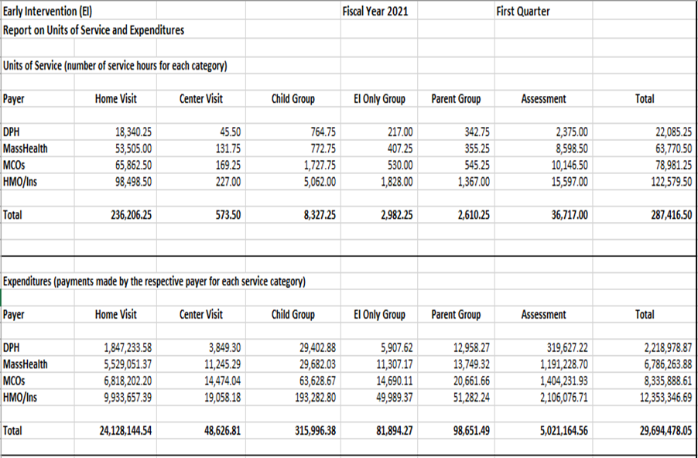
Why is this important 2 of 2
Federal Reporting
Fiscal Indicators
Legislative reporting requirements
Quarterly reports are submitted to the State house and senate committees on ways and means on the total number of units of service purchased and the total expenditures for the units of service paid by the department
Forecasting budgets (MOE)
• The term maintenance of effort (MOE) cannot be found as such in the Part C regulations, it is the common term used to refer to the "supplement not supplant" requirement for IDEA Part C Funds. (34 CFR §303.225)
Notes:
This is a view of what the quarterly federal report looks like
As you can see in the graph
•The total number of units of service purchased is shown on the top
•versus
• the total expenditures for the units of service paid by the department
This is what is reported.

Slide 11
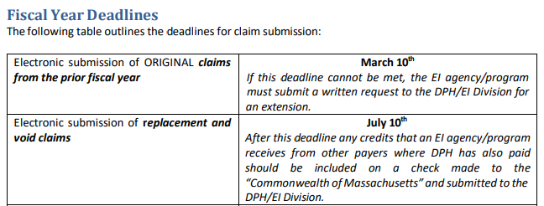
Claim Submission Deadline
Monthly PV Cycle10th of the month if not the next business day.
Notes:
Encounter and Charge claims must be submitted by the 10th of each month. If the 10th falls on a weekend or holiday then the deadline is extended through the first business day following the weekend or holiday.

