Slide 1
Ask Away
May 15, 2025
Deeptha Ramalingam, Scott Geer, Manuela Batista, Andrew Pursley

Slide 2
Agenda
Early Intervention Updates
End of Fiscal Year July 10 Deadline
Ongoing Business

Slide 3
Early Intervention Updates
ICC Fiscal Subcommittee’s next meeting is Thursday, June 12, 2025, 2:00pm – 4:00pm
  Topic: FY25 Review and FY26 Scheduling
  Link: Interagency Coordinating Council (ICC) | Mass.gov
The FY26 Senate Ways & Means Budget was released on May 6th
  There was a slight increase from the Governor’s budget
We have received FFY25 OSEP Part C Allocation Table. Massachusetts allocation is $9,423,457.
The MA Accounting Office recently changed the minimum required information to deposit checks. Because of the uniqueness of EI it has caused a considerable backlog in our ability to deposit checks. This system issue has been resolved, and we are working to process the checks on hand. We apologize for this inconvenience, and we appreciate your patience and help as we resolve the backlog.
The current version for the Reimbursement Policy Manual v10 (pending publication)
Notes:
Details on the new process will be covered by Manuela and the end of this Ask Away.

Slide 4
Reimbursement Policy Manual Changes
Notes:
Details on the new process will be covered by Manuela and the end of this Ask Away.

Slide 5
End of Fiscal Year
July 10 Deadline
May 15, 2025

Slide 6
Early Intervention
Massachusetts Early Intervention (EI) is a program for infants and toddlers (birth to 3 years old) who have developmental delays or are at risk of a developmental delay.
Notes:
We are the Massachusetts Early Intervention Massachusetts Early Intervention is a program for infants and toddlers (birth to 3 years old) who have developmental delays or are at risk of a developmental delay.

Slide 7
End of Fiscal Year Deadline
Claim submission Deadline
Electronic submission of replacement and void claims must be submitted by July 10th
After this deadline any credits that a contracted program receives from other payers where DPH has also paid should be included on a check made to the “Commonwealth of Massachusetts” and submitted to the DPH/EI Division, in addition to supporting documentation through our secure portal.
Per State statue Early intervention is only allowed to pay out claims from the current and prior fiscal year. It states “that funds in this item may be used to pay for current and prior year claims”. Please be aware after the July 10th deadline, all contracted programs will not be allowed to be reimbursed for any claims older than June 30, 2024.
Notes:
End of Fiscal Year Deadline, the electronic claim submission of replacement and void claims must be submitted by July 10th
Per State statue Early intervention is only allowed to pay out claims from the current and prior fiscal year. It states “that funds in this item may be used to pay for current and prior year claims”
Please be aware after the July 10th deadline, all contracted programs will not be allowed to be paid for any claims older than June 30, 2024.

Slide 8
Replacement Claim and Void Claim
Replacement Claims and Void Claims are different procedures within the EICS system
The replacement claim should be submitted with a claim frequency of 7. The Claim Frequency Code should be 7 to indicate that what was previously submitted should be ignored and the submitted claim taken in its place
Void Claim should be submitted with a claim frequency of 8. The Claim Frequency Code 8 should be used to indicate a complete void of the original claim referenced. The Original Claim ID should be populated with the claim
Notes:
Replacement Claims and Void Claims are distinct procedures in the EICS system.
A Replacement Claim is submitted with a claim frequency of 7, indicating that the previously submitted claim should be ignored and replaced with the new one.
A Void Claim is submitted with a claim frequency of 8, indicating that the original claim is being completely voided. The Original Claim ID should be included to reference the claim being voided.

Slide 9
Replacement Claim
If a correction to a previously submitted claim is needed, you can submit a replacement claim to:
Correct the rate billed, location, procedure, or modifiers
Add/Correct some patient data such as diagnosis or prior authorization information specific to prior payer information
Make changes to your original claim such as modify units/minutes or charges for services originally submitted in error
Ensure a new claim id number is used for the replacement claim and that the Original Claim ID is populated with the Claim Number that needs replacement (need a new replacement claim, you will need a new claim identifier, original claim 123, the replacement claim will be 1234, and you will need to reference the original claim in the replacement claim submission)
***A replacement claim should contain a claim frequency code of [7] in Loop 2300 CLM05-3 segment and reference the original claim identifier
Notes:
To correct a previously submitted claim, you can submit a replacement claim to:
Correct the rate billed, location, procedure, or modifiers.
Add or correct patient data, such as diagnosis or prior authorization information.
Modify units, minutes, or charges for services originally submitted in error.
Make sure to use a new claim ID for the replacement claim, and reference the original claim number in the "Original Claim ID" field. The replacement claim should include a claim frequency code of [7] in Loop 2300 CLM05-3 and reference the original claim identifier.

Slide 10
Void Claim
Changes have occurred and is needed to void the claim
Previous list of reasons to submit a replacement claim
Charge claim has re-adjudicated and an Encounter claim needs to be submitted
Encounter claim has re-adjudicated and a Charge claim needs to be submitted
Void existing claim: In order to “void” an already submitted claim, a new claim should be created with a claim frequency of 8 and it should reference the original claim that is to be voided. The void claim should be sent to Early Intervention Client System (EICS) when the previously submitted claim should be removed/not considered for payment. A void claim must match the original claim with the exception of the claim frequency type code and the payer assigned claim number. A void claim should not contain “negative” values within the claim. It should contain a claim frequency code of [8] in Loop 2300 CLM05-3 segment. The replacement or void claim is required to be submitted with the “Original Reference Number” (Payer Claim Control Number) in Loop 2300 REF segment. REF01 must be [F8] and REF 02 must be the “Original Reference Number”. If the required information in Loop 2300 REF01 and REF02 is not submitted, the claim will reject back to the submitter
Notes:
To void an already submitted claim, create a new claim with a claim frequency of 8, referencing the original claim to be voided. This void claim should be submitted to the Early Intervention Client System (EICS) when the previously submitted claim needs to be removed or not considered for payment. The void claim must match the original claim, except for the claim frequency code and payer-assigned claim number, and should not contain “negative” values.
The void claim must include a claim frequency code of [8] in Loop 2300 CLM05-3 and reference the Original Reference Number (Payer Claim Control Number) in Loop 2300 REF, with REF01 = [F8] and REF02 = Original Reference Number. Failure to submit this required information will result in the claim being rejected.

Slide 11
Ongoing Business

Slide 12
Negative Payment Voucher
Mail Check: MA Department of Public Health (DPH)
Attention BFHN Early Intervention Finance Manager
250 Washington St, (5th floor)
Boston, Massachusetts 02108

Slide 13

Looking Ahead: Fiscal Year 2026 Schedule
Next month we will be sharing our upcoming schedule for the next fiscal year.
If there are any topics, themes, or initiatives you’d like us to consider, please let us know!
Your input is valuable and helps us tailor our sessions to what matters most to you.

Slide 14
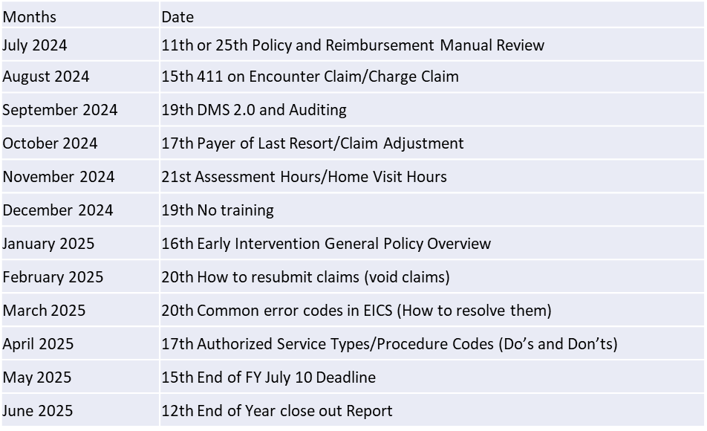
Ask Away – Next trainings
Next meeting June 12, 2025 at 10am-10:45am
End of Year close out Report
Ask Away trainings are available online in the Early Intervention website under the billing and reimbursement tab.
  Link: https://www.mass.gov/info-details/early-intervention-billing-reimbursement

