Slide 1
Ask Away
June 12, 2025
Deeptha Ramalingam, Scott Geer, Manuela Batista, Andrew Pursley

Slide 2
Agenda
Early Intervention Updates
End of Fiscal Year July 10 Deadline
Ongoing Business

Slide 3
Early Intervention Updates
ICC Fiscal Subcommittee’s next meeting is TBD, 2:00pm – 4:00pm
  Topic: TBD
  Link: Interagency Coordinating Council (ICC) | Mass.gov
The FY26 Senate Ways & Means Budget was released on May 6th
  There was a slight increase from the Governor’s budget
We have received FFY25 OSEP Part C Allocation Table. Massachusetts allocation is $9,423,457.
The MA Accounting Office recently changed the minimum required information to deposit checks. Because of the uniqueness of EI it has caused a considerable backlog in our ability to deposit checks. This system issue has been resolved, and we are working to process the checks on hand. We apologize for this inconvenience, and we appreciate your patience and help as we resolve the backlog.
The current version for the Reimbursement Policy Manual v10
Notes:
Details on the new process will be covered by Manuela and the end of this Ask Away.

Slide 4
End of Fiscal Year
July 10 Deadline
June 12, 2025

Slide 5
Early Intervention
Massachusetts Early Intervention (EI) is a program for infants and toddlers (birth to 3 years old) who have developmental delays or are at risk of a developmental delay.
Notes:
We are the Massachusetts Early Intervention Massachusetts Early Intervention is a program for infants and toddlers (birth to 3 years old) who have developmental delays or are at risk of a developmental delay.

Slide 6
End of Fiscal Year Deadline
Claim submission Deadline
Electronic submission of replacement and void claims must be submitted by July 10th
After this deadline any credits that a contracted program receives from other payers where DPH has also paid should be included on a check made to the “Commonwealth of Massachusetts” and submitted to the DPH/EI Division, in addition to supporting documentation through our secure portal.
Per State statue Early intervention is only allowed to pay out claims from the current and prior fiscal year. It states “that funds in this item may be used to pay for current and prior year claims”. Please be aware after the July 10th deadline, all contracted programs will not be allowed to be reimbursed for any claims older than June 30, 2024.
Notes:
Per State statue Early intervention is only allowed to pay out claims from the current and prior fiscal year. It states “that funds in this item may be used to pay for current and prior year claims”
Please be aware after the July 10th deadline, all contracted programs will not be allowed to be paid for any claims older than June 30, 2024.

Slide 7
Monthly Payment Vouchers
Previously
Currently
Regular EI/EIBI Payment Voucher
2025 MAN250707R25
Supplemental EI/EIBI Payment Voucher
2025 MAN250707S25
Uninsured EI/EIBI Payment Voucher
  2025 MAN250707D25
Account Analyst manually making changes to reflect autism payments being separated
Remittance file only reflected 3 different type of Vouchers
Regular EI Payment Voucher
  2025 MAN250707R25
Regular EIBI Payment Voucher
2025 MAN250707A25
Supplemental EI Payment voucher
2025 MAN250707S25
Supplemental EIBI Payment Voucher
2025 MAN250707B25
Uninsured EI Payment Voucher
2025 MAN250707D25
Uninsured EIBI Payment Voucher
  2025 MAN250707C25
Remittance File will reflect 6 different type of Vouchers
Notes:
This is a big news!!! PREVIOULSY OUR MONTHLY PAYMENT VOUCHERS WERE NOT BEING REFLECTED CORRECTLY IN THE REMITTANCE FILE.
Moving forward the Remittance File will reflect six different type of Vouchers.
Regular EI Payment Voucher
2025 MAN250707R25
Regular EIBI Payment Voucher
2025 MAN250707A25
Supplemental EI Payment voucher
2025 MAN250707S25
Supplemental EIBI Payment Voucher
2025 MAN250707B25
Uninsured EI Payment Voucher
2025 MAN250707D25
Uninsured EIBI Payment Voucher
2025 MAN250707C25

Slide 8
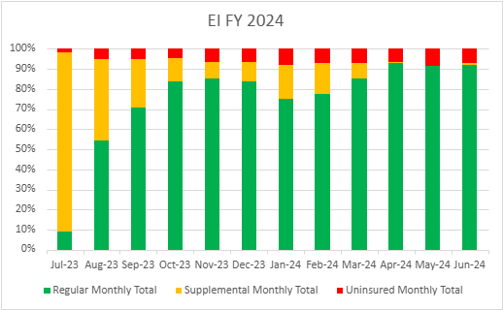
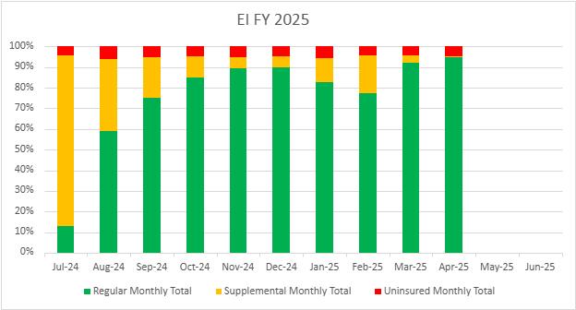
Early Intervention Monthly Trends
Fiscal Year 2024 - 2025
Early Intervention/ Early Intensive Behavioral Intervention Monthly Payments for FY 24 - 25
Notes:
These graphs reflect a pattern of how claims are being submitted throughout the year for Fiscal Year 2024 and Fiscal Year 2025.
All claims are reflected for both EI and EIBI claims.

Slide 9
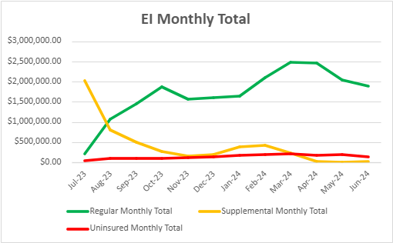
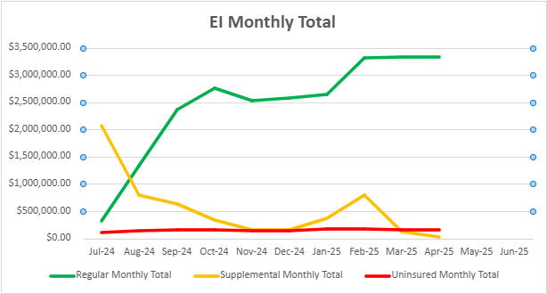
EI/EIBI Monthly Payments for FY24-FY25
Notes:
A different look at our data- Uninsured claims tend to stay low throughout the year. The graphs due show an increase due to the rate change.
This does not include any Earmark payments.

Slide 10
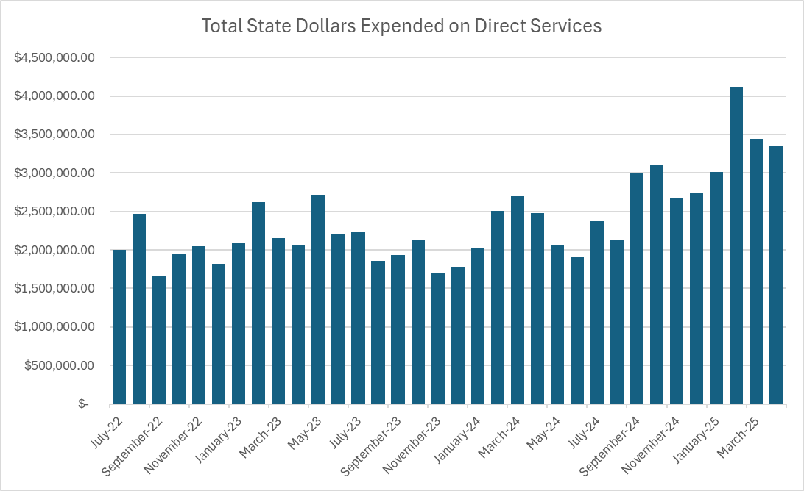
Early Intervention State Monthly Trends
Fiscal Year 2024 - 2025
Notes:
This shows all Regular and Supplemental Claims submitted for both FY24 and FY25. These claims we paid out from our State dollars.

Slide 11
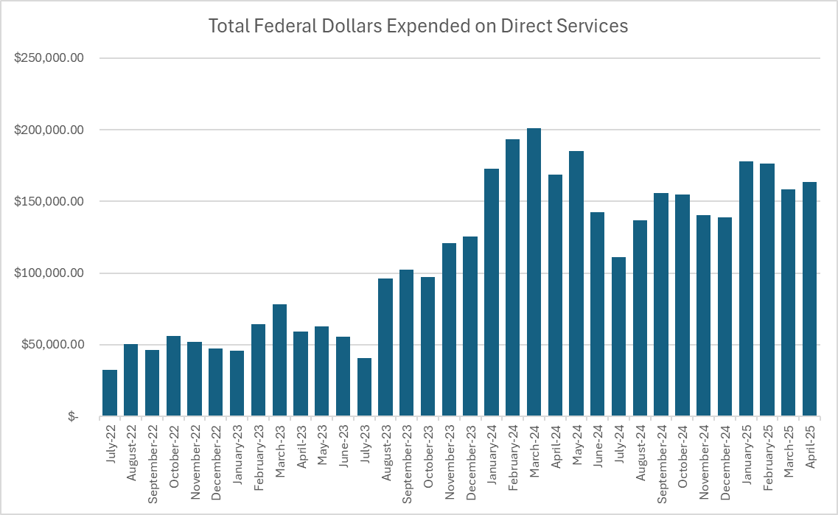
Early Intervention Federal Monthly Trends
Fiscal Year 2024 - 2025
Notes:
This graph shows all the Uninsured Claims paid in FY24 and FY25 from our Federal dollars.

Slide 12
New Ask Away Schedule/Topics for FY26
Date | Topics
July 17, 2025 | Negative PVs – Why/How Are They Created? What’s the Process?
August 14, 2025 | (TBD)
September 18, 2025 | (TBD)
October 16, 2025 | (TBD)
November 13, 2025 | No Training
December 18, 2025 | (TBD)
January 15, 2026 | (TBD)
February 12, 2026 | (TBD)
March 12, 2026 | (TBD)
April 9, 2026 | (TBD)
May 14, 2026 | (TBD)
June 11, 2026 | (TBD)
Join us on the for a focused session on different key topics, billing, reimbursement, etc.

Slide 13

Ask Away – Next meeting
Next meeting July 17th , 2025 at 10am-10:45am
All about Negative Payment Vouchers
Ask Away trainings are available online in the Early Intervention website under the billing and reimbursement tab.
  Link: https://www.mass.gov/info-details/early-intervention-billing-reimbursement
Notes:
Summer starts June 20th

