Slide 1
Ask Away
February 20, 2024
Deeptha Ramalingam, Scott Geer, Manuela Batista

Slide 2
Parental Consent to Access Insurance Requirement Reminder
February 20, 2024

Slide 3
Consent to Access Insurance
The Early Intervention Division is committed to providing high-quality Part C/early intervention services to enhance the development and learning of infants and toddlers through individualized, developmentally appropriate interventions embedded in everyday activities at no cost to families.
Part C of the Individuals with Disabilities Education Act (IDEA) requires that parental consent is obtained before public benefits insurance or private insurance is used.
The Department of Public Health Consent to Access Insurance
Under the Individuals with Disabilities Education Act (IDEA), Part C/early intervention services are provided to infants and toddlers with disabilities or developmental delays. Use of public benefits or insurance or private insurance is allowable under 34 CFR 303.520; it is not required.
Families who choose to use Medicaid, Children’s Health Insurance Program (CHIP), or private insurance, must do so voluntarily. The same applies to private insurance; parents may choose to use it but are not obligated to do so. In either case, written parental consent is required before insurance is accessed. This consent can be changed at any time.
Families who do not provide consent to use public benefits or insurance or private insurance must not be penalized in any way. These families must not lose access to services or experience a reduction in the quality of services provided. If a parent chooses not to use insurance, it must not result in any extra charges.
Notes:
The Early Intervention Division provides high-quality, individualized Part C/early intervention services for infants and toddlers at no cost to families. Parental consent is required before using public or private insurance to access services. Families can choose to use Medicaid, CHIP, or private insurance voluntarily, and their decision will not impact the quality or availability of services. If parents opt not to use insurance, they will not face any penalties or extra charges.

Slide 4
How to capture consent in EICS
This is the initial appointment prompt
You are also required to respond to the 'consent to access' insurance when each IFSP is completed
TRAINING – NOT AN ACTUAL CLIENT
Notes:
Where to find the consent selection in EICS

Slide 5
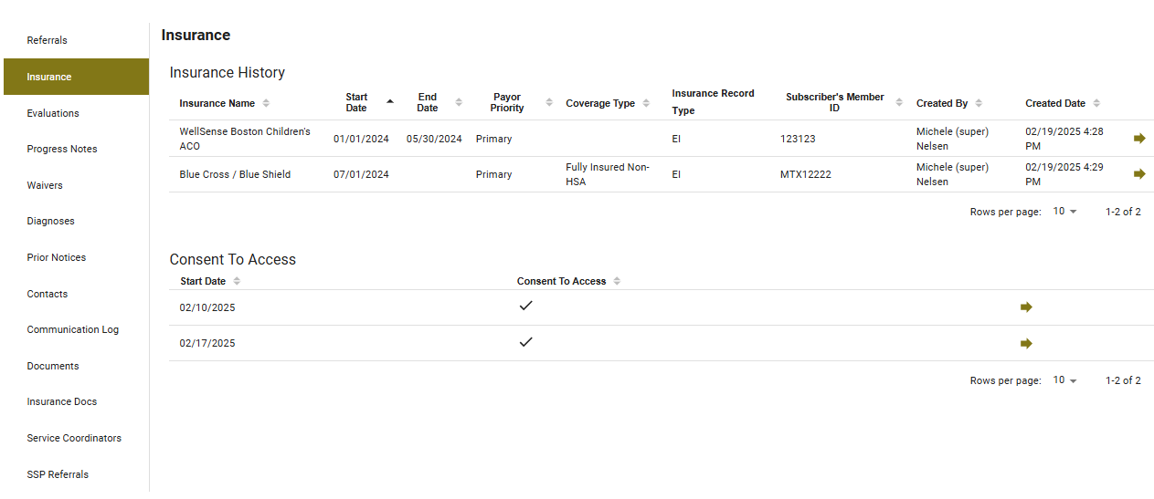
How to capture consent in EICS
TRAINING – NOT AN ACTUAL CLIENT
TRAINING – NOT AN ACTUAL CLIENT
Notes:
EICS Consent To Access visual on the client profile.

Slide 6
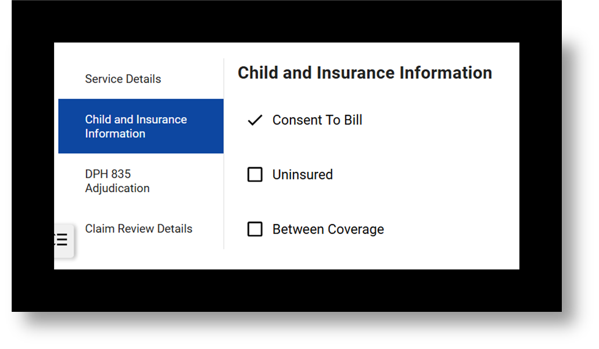
EICS
Ensure to obtain written consent to use public benefits or private insurance initially, each time there is a change in service provision, and when private insurance is a prerequisite for public benefit.
EMR users – ensure “consent to access” insurance segment with the date and yes/no is sent in.
This must be attested in EICS prior to each claim submission. Ensure that “Consent to Bill” under Service Details is selected. If not, you will need to go back to the Insurance/PCP Information task or create an Update Insurance Ad Hoc task and complete that section before submitting your claim. Depending on your roles, the Insurance Confirmation task must also be completed.
Notes:
Obtain written consent to use public benefits or private insurance at the start, whenever service provisions change, and when private insurance is required for public benefits. For EMR users, ensure the “consent to access” insurance section with the date and yes/no response is submitted. This consent must be attested in EICS before claim submission. Also, ensure that “Consent to Bill” is selected under Service Details. If not, update the Insurance/PCP Information or create an Update Insurance Ad Hoc task before submitting the claim. Complete the Insurance Confirmation task if required by your role.

Slide 7
Remember: There are many different consents in EICS
Ensure to obtain written consent to use public benefits or private insurance initially, each time there is a change in service provision, and when private insurance is a prerequisite for public benefit. This should be maintained at your location and presented upon request.
Ensure Insurance information in the EICS is current and up to date.
Ensure consent to access insurance is verified before services are provided and before claims (for both encounter and charge) are submitted to DPH.
Notes:
Obtain written consent to use public benefits or private insurance at the start, whenever service provision changes, and when private insurance is required for public benefits. Keep this consent on file and available upon request. Ensure insurance information in EICS is up-to-date, and verify consent to access insurance before providing services and submitting claims (both encounter and charge) to DPH.

Slide 8
How to resubmit claims
(void claims)
February 20, 2024

Slide 9
Early Intervention
Massachusetts Early Intervention (EI) is a program for infants and toddlers (birth to 3 years old) who have developmental delays or are at risk of a developmental delay
Notes:
We are the Massachusetts Early Intervention Massachusetts Early Intervention is a program for infants and toddlers (birth to 3 years old) who have developmental delays or are at risk of a developmental delay.

Slide 10
Replacement Claim and Void Claim
Replacement Claims and Void Claims are different procedures within the EICS system
The replacement claim should be submitted with a claim frequency of 7. The Claim Frequency Code should be 7 to indicate that what was previously submitted should be ignored and the submitted claim taken in its place
Void Claim should be submitted with a claim frequency of 8. The Claim Frequency Code 8 should be used to indicate a complete void of the original claim referenced. The Original Claim ID should be populated with the claim
Notes:
Replacement Claims and Void Claims are distinct procedures in the EICS system.
A Replacement Claim is submitted with a claim frequency of 7, indicating that the previously submitted claim should be ignored and replaced with the new one.
A Void Claim is submitted with a claim frequency of 8, indicating that the original claim is being completely voided. The Original Claim ID should be included to reference the claim being voided.

Slide 11
Replacement Claim
If a correction to a previously submitted claim is needed, you can submit a replacement claim to:
➢ Correct the rate billed, location, procedure, or modifiers
➢ Add/Correct some patient data such as diagnosis or prior authorization information specific to prior payer information
➢ Make changes to your original claim such as modify units/minutes or charges for services originally submitted in error
➢ Ensure a new claim id number is used for the replacement claim and that the Original Claim ID is populated with the Claim Number that needs replacement (need a new replacement claim, you will need a new claim identifier, original claim 123, the replacement claim will be 1234, and you will need to reference the original claim in the replacement claim submission)
***A replacement claim should contain a claim frequency code of [7] in Loop 2300 CLM05-3 segment and reference the original claim identifier
Notes:
To correct a previously submitted claim, you can submit a replacement claim to:
Correct the rate billed, location, procedure, or modifiers.
Add or correct patient data, such as diagnosis or prior authorization information.
Modify units, minutes, or charges for services originally submitted in error.
Make sure to use a new claim ID for the replacement claim, and reference the original claim number in the "Original Claim ID" field. The replacement claim should include a claim frequency code of [7] in Loop 2300 CLM05-3 and reference the original claim identifier.

Slide 12
Void Claim
Changes have occurred and is needed to void the claim
Previous list of reasons to submit a replacement claim
Charge claim has re-adjudicated and an Encounter claim needs to be submitted
Encounter claim has re-adjudicated and a Charge claim needs to be submitted
Void existing claim: In order to “void” an already submitted claim, a new claim should be created with a claim frequency of 8 and it should reference the original claim that is to be voided. The void claim should be sent to Early Intervention Client System (EICS) when the previously submitted claim should be removed/not considered for payment. A void claim must match the original claim with the exception of the claim frequency type code and the payer assigned claim number. A void claim should not contain “negative” values within the claim. It should contain a claim frequency code of [8] in Loop 2300 CLM05-3 segment. The replacement or void claim is required to be submitted with the “Original Reference Number” (Payer Claim Control Number) in Loop 2300 REF segment. REF01 must be [F8] and REF 02 must be the “Original Reference Number”. If the required information in Loop 2300 REF01 and REF02 is not submitted, the claim will reject back to the submitter
Notes:
To void an already submitted claim, create a new claim with a claim frequency of 8, referencing the original claim to be voided. This void claim should be submitted to the Early Intervention Client System (EICS) when the previously submitted claim needs to be removed or not considered for payment. The void claim must match the original claim, except for the claim frequency code and payer-assigned claim number, and should not contain “negative” values.
The void claim must include a claim frequency code of [8] in Loop 2300 CLM05-3 and reference the Original Reference Number (Payer Claim Control Number) in Loop 2300 REF, with REF01 = [F8] and REF02 = Original Reference Number. Failure to submit this required information will result in the claim being rejected.

Slide 13
CONNECT WITH DPH

