Slide 1
Policy and Reimbursement
Manual Review
July 25, 2024

Slide 2
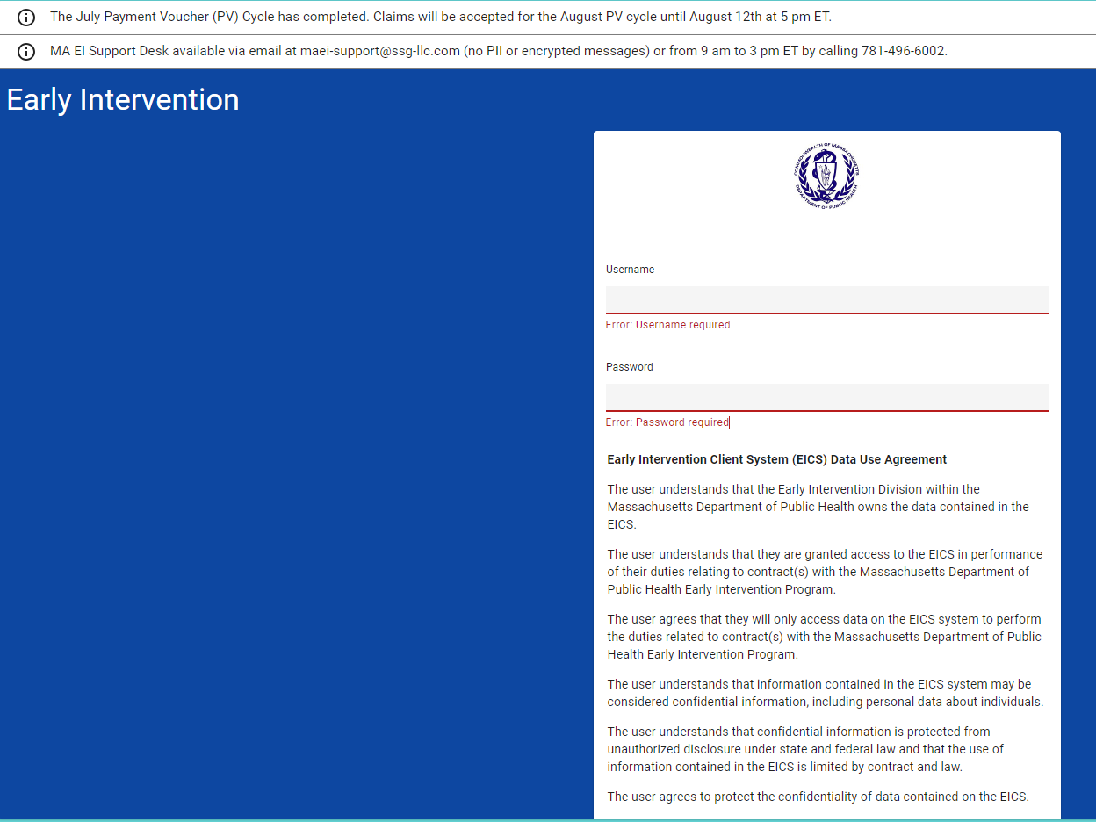
MAEI – Early Intervention Client System (EICS)
Link Early Intervention (casetivity.com)
Banners contain important reminders and are updated monthly
Login access required (username/password)
Coordinate with your Clinical Oversight Support Specialist to request access
Notes:
Welcome to the Massachusetts Early Intervention website best known as the Early Intervention Client System (EICS).
When you first log in to the website it will look like this image on the left hand side. I have included the link for reference – Access is needed in order to have a username. You may request access to your Clinical Oversight support specialist or best know “COSS”, they will pass along your information in order to get access.
As you may see on the top of the web page, you will see some important banners which contain important reminders and are updated monthly.
As you can see the banner shown notifies us that the July PV cycle has been completed and that we will be accepting claims for the August PV until August 12th at 5pm eastern time.
The other banner shown provides instructions on how to submit a help desk ticket by email or by calling.
If you call the help desk ticket a case will be opened and one of our team members will reach out to you. The phone number does not mean someone live will be responding to your question or concern.
When you receive access, you will be able to enter your username and password and log in to our site.

Slide 3
MAEI – EICS
3
1
2
Welcome Back Name!
Dashboard: role (Claim Biller)
Right hand corner (HELP)
Notes:
This is the welcome page for our EICS when you login.
As you can see the banners are still showing. They will not disappear while you’re on the Early Intervention page.
You will be greeted with a “Welcome back, and your name and role. Some people will have a Welcome back “Mary program” or Welcome back “Sue vendor” to help you distinguish in which account you’re logged in. This will depend on how they have created your account.
Under your greeted message you will see the role you have been assigned- in this case we’re viewing a “Dashboard – assigned to a Claim biller”. Not all role dashboards will look the same.
On your right top corner, you will see the “Help” tab, you can click on in order to access the documents such as the reimbursement manual.

Slide 4
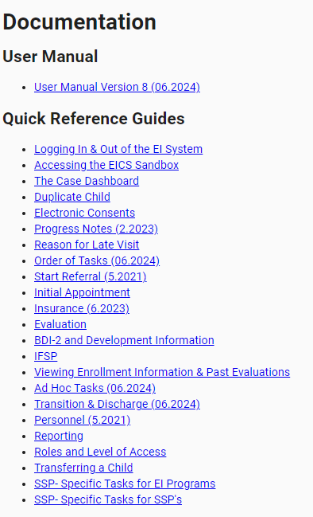
Help tab
1
Notes:
Once you click on the “Help” tab you will be directed to this new page in which you will have access to the following.
The picture on the left hand side it’s an overview of what the page will look like.
The numbers correspond w the following tables, enlarged for review. You may also notice some of the links have a date (month and year) next to it, it means this is when it was last updated.
#1 is the User manual and quick reference guide- in this section you can find some cheat sheets of the common needs such as logging in and out of the Early Intervention system, and transferring a child.

Slide 5
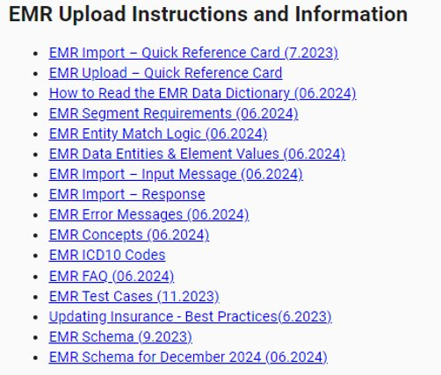
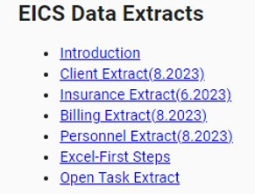
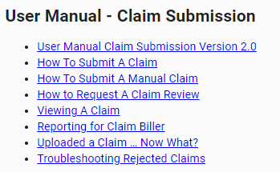
Help tab (continued)
2
5
6
3
Notes:
On this page we have the following:
#2: It’s a section for the Dashboard Specific Information- This section has documents on how to access various dashboards, depending on your assigned role.
#3: Is the User Manual and Claim Submission- This section has some very useful links such as troubleshooting rejected claims, how to view or submit a claim.
**** I have not forgotten about #4, it’s on my next slide and will discuss later.
#5: Is the EMR- Upload Instructions and information- this section is loaded with recently updated information. In case you have any EMR questions take a look at this section first before submitting a new help desk ticket.
#6: EICS Data Extracts- This section relates to various options for data extract.

Slide 6
Help tab — Billing Guides
4
Notes:
Last but not least,
#4: Billing guides – This section has important documents- such as the Fiscal Year 2025 calendar, 837 health care claim companion guide, and most important, our reimbursement manual labeled as the 837 – reimbursement policy manual for early intervention and autism services.
At this point you would click on the title in order to access a copy of the document.
Once you click on the link you will get a new tab.

Slide 7
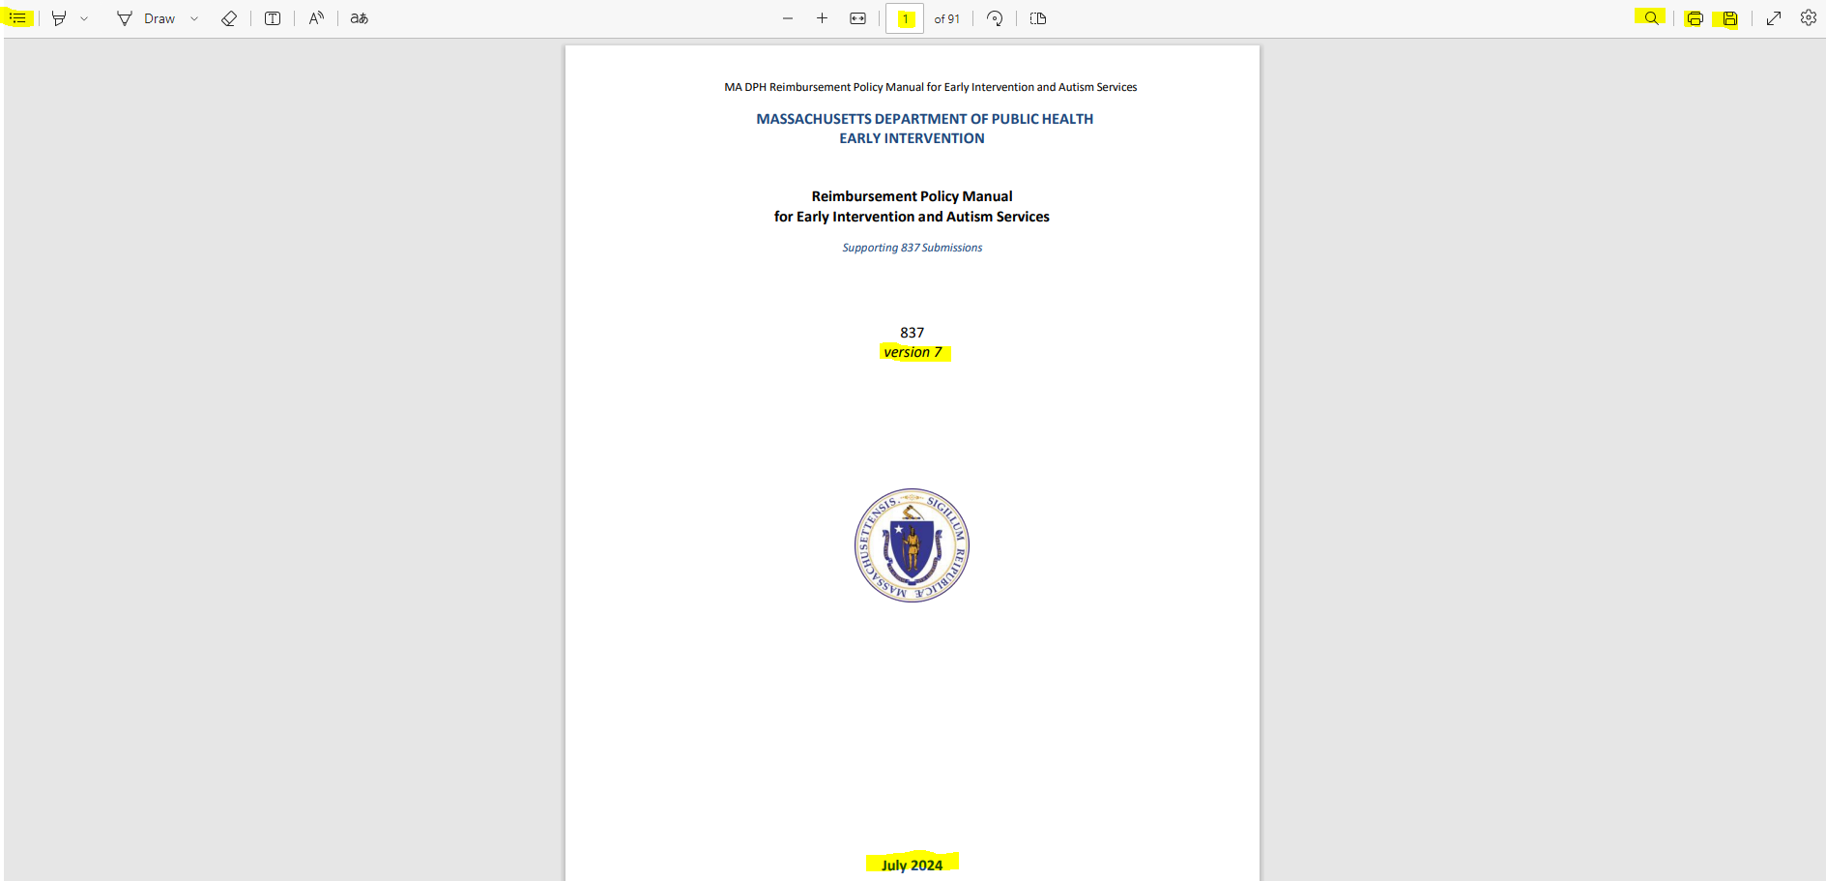
Reimbursement Policy Manual
1
Link: DPH+EI+Reimbursement+837+Manual+v7.pdf (casetivity.com)
4
5
6
7
8
Direct link (requires login)
Reflects which version is being viewed
Reflects date that manual was last updated
Table of Contents
Reflects current page #, can changed to go to particular page
Search option
Print option
Save/Download option
2
3
Notes:
This will be your view once you click on the title. I have highlighted and numbered some key features.
#1: Is a Direct link it does (requires login)​, you may also favorite this link for easy access if you choose to no save it in your desktop.
#2: Reflects which version we’re viewing Version 7
#3: Reflects date that manual was last updated​ which was July 2024 on the left hand corner we have a box w lines which the image belongs to the
#4: Is the table of Content which is helpful to view the sections available and click on the title of preference and the document will navigate you to your selection.
#5: In the top mid of the document, you will see a 1 out of 91. Our current reimbursement manual is 91 pages long, this feature will help you navigate the file with ease since you’re able to edit the # to the page of your preference. This is one of the reasons why we want to make our reimbursement a little more precise, because 91 pages can be a little overwhelming.
#6: Is the magnifying glass and your search option. It’s my favorite feature because whenever you have a question or would like to confirm information you can click on the magnifying glass, and you can enter key words… For example, I have forgotten how many hours are allowed for assessment hours. I’ll come to my desktop look for my saved copy, I will click on my magnifying glass, and I’ll search “Assessment hours”, automatically the file will tell me how many times these words are found in the file… in which I will find that 10 hours are the allowed for assessment hours. We use this technique to answer some of your help desk ticket. That’s one of the reasons why we emphasize for you to have a copy. You may have the answer in your fingertips instead of having to create a helpdesk ticket and wait to get a response from one of our team members.
Right next to our favorite feature we have a print option labeled as
#7: in case you prefer a hardcopy.
And finally for sure our recommendation
#8: which is the option to save/download the file. You may save a copy to your desktop and whenever you have a question or would like to confirm information you will have easy access to it instead of having to FIND your password in order to login and look for the file.

Slide 8
Reimbursement Recent Updates
Notes:
This is the second page of the reimbursement manual which provides you with a list of the changes between versions.
In this case we can see our current version 7 had an update on July 2024 in pages 77-79, in which we include the new tables reflecting service codes and rates for Early Intervention and EIBI… Early Intensive behavioral Intervention.

