Slide 1
Assistive Technology & Low Vision Devices
Alexander Pooler, MPA
Supervisor, Vocational Rehabilitation & Children’s Services
March 28, 2025

Slide 2
Objective
Overview of how MCB determines the best-fit technology and training for students
Enhancing student success through technology-based tools and training
Common assistive technology solutions:
Hardware
Software
Available training options for consumers
Review of effective and ineffective solutions
A look at the future of assistive technology

Slide 3
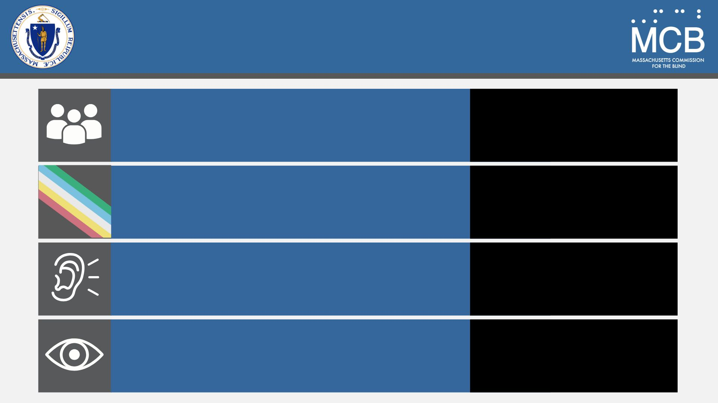
Disability in Massachusetts Source: U.S. Census Bureau, 2023 American Community Survey 1-Year Estimates
Total Population
7,029,917
People with Disabilities
12.8%
Hearing Difficulty
3.1%
2.0%
Vision Difficulty
~30,000 Massachusetts residents are legally blind

Slide 4
Assistive Technology Unit
Alexander Pooler, Director of Assistive Technology
Email: alexander.pooler@mass.gov
Mobile: 857-248-2607
Richard Flint, Vocational Rehabilitation (VR) Trainer
Evan Silver, Assistant Director of Assistive Technology
Region 1: William Hersh
Region 2: Brendan Finn
Region 3: James Verrill
Region 4: Jeffery Tillinghast
Region 5: Frank Ventura
Region 6: Hope Paulos

Slide 5
Assistive Technology Unit Support Staff
Lauren Nardini, ADA Specialist & Social Work Technician
Alvin Calderon, ADA Specialist & Social Work Technician
Joseph Trudeau, ADA Specialist & Social Work Technician
External Contractors
Low Vision Specialist at The Carroll Center for the Blind
JAWS Scripting with occupational rehabilitation
Other services at:
Community non-profit organizations, such as Perkins School for the Blind
Private entities, such as New England Low Vision and Blindness

Slide 6
Vocational Rehabilitation (VR) Services
Must be registered with MCB
Accept services and receive a regionally assigned case manager
Develop and agree upon a vocational rehabilitation plan
Identify the need for assistive/adaptive technology
Case manager refers to the Assistive Technology (AT) Unit
Case assigned to an AT Specialist in the region

Slide 7
Assistive Technology (AT) Assessment
Review the student’s current skillset and visual impairment
Identify tasks and goals to be addressed
Deploy appropriate hardware/software solutions
Provide training and ongoing support
Coordinate with disability services at the institution
Collaborate with the MCB team and relevant stakeholders:
Institution
Professors & Instructors
Family
Any internship, volunteer, or academic opportunities

Slide 8
Assessing the Student’s Current Needs
Assistive Technology needs evolve from secondary to post-secondary education or vocation training
Computer literacy on Chrome differs from literacy in a PC environment
Windows
Office
Clarify the difference between “want” vs. “need” in technology
Considerations for Apple products
If school has a computer or equipment requirements, MCB will work to meet them

Slide 9
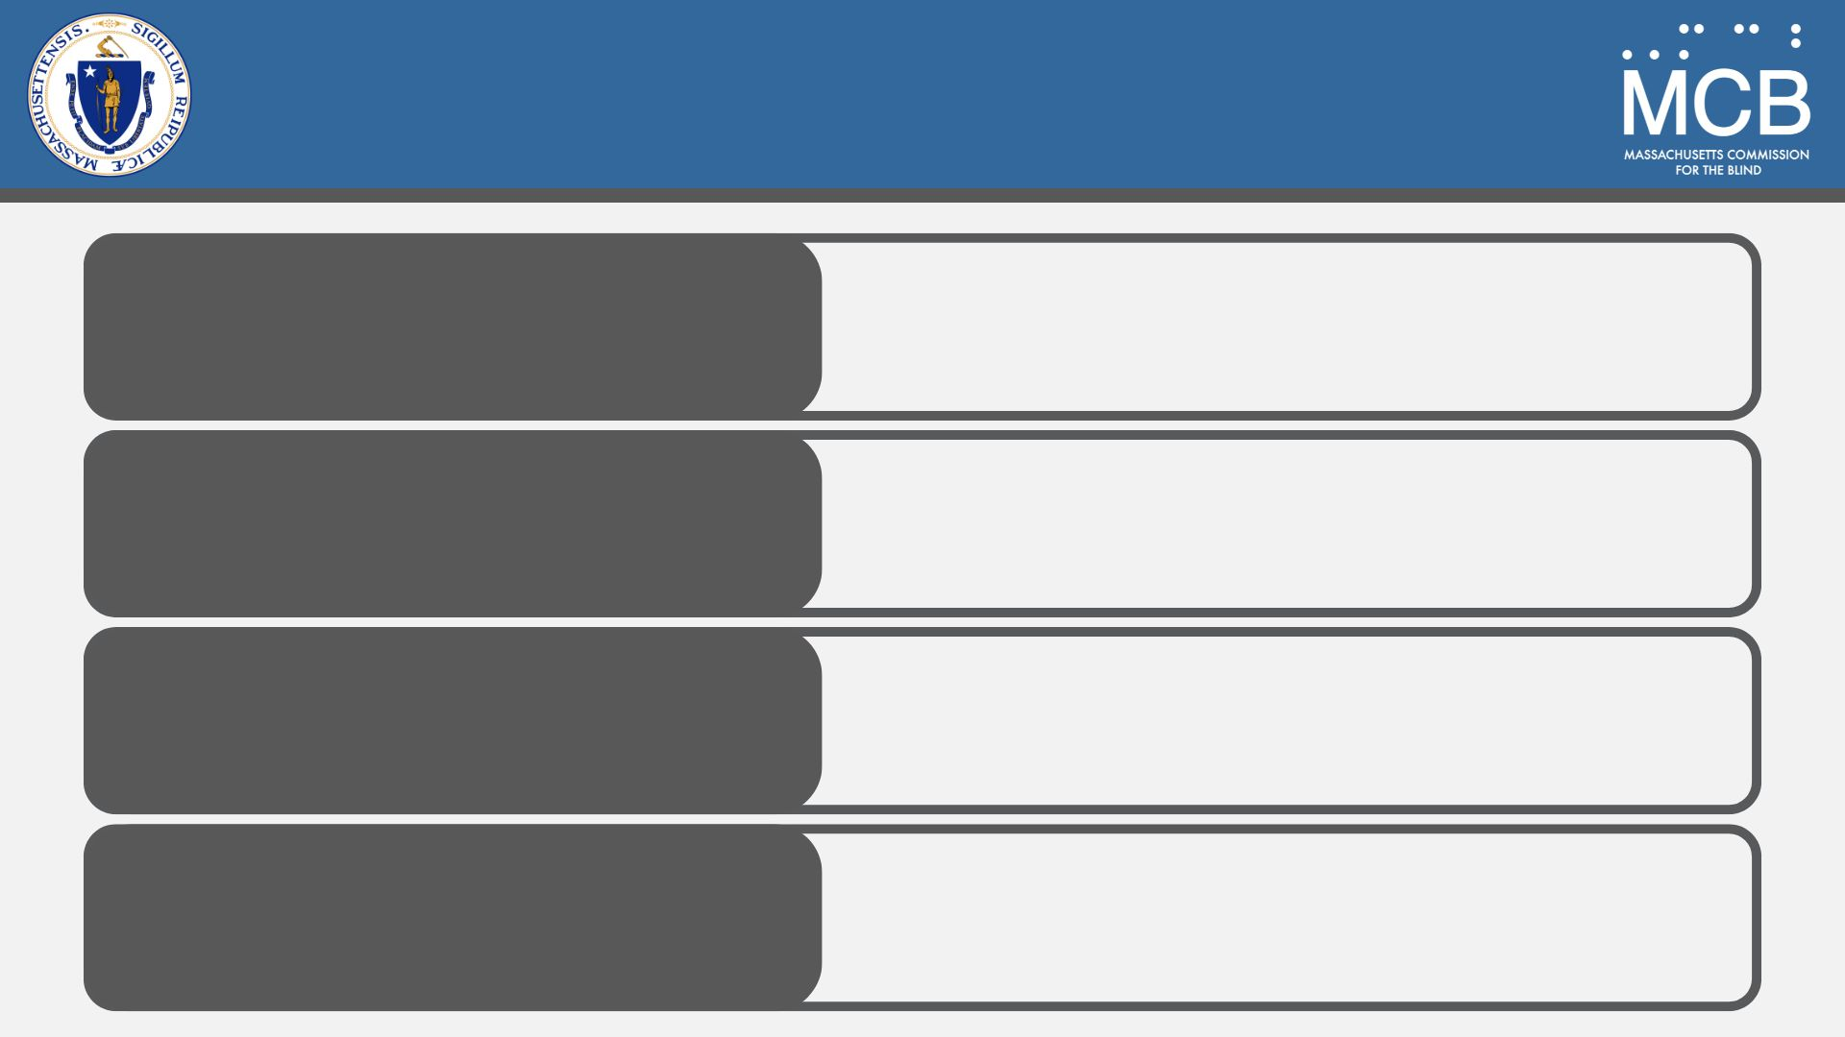
Technology Solutions MCB Deploys
Dedicated Low-Vision
Technology
Desktop and portable video magnification
Blindness Technology
Optical Character Recognition (OCR) devices
Mainstream Technology (Adapted for Accessibility Technology)
iPad
Software That Renders
a Computer Accessible
JAWS
ZoomText
Fusion

Slide 10
Responsibility of Students
Ensure proper care of technology
Be mindful of trips to the beach or family vacations
Must maintain communication with case manager, AT unit, disability services, school, teachers, and professors
Inform us of access issues with digital materials with as much advance notice as possible
Be mindful of deadlines and set reasonable expectations
Study aboard considerations
Leaving Massachusetts for school
MCB cannot provide services outside of Massachusetts; coordination with a local vocational rehabilitation (VR) agency may be required

Slide 11
Managing Expectations
MCB provides the tools to succeed
Not always the “cool” tools, but the ones that work best
Some items can be upgraded, others cannot:
Computer operating systems
Adaptive software
When issues arise, they may take time to resolve:
Timely communication is key
Repairs may take time
Loaner equipment may or may not be available
Students are responsible for keeping teachers, professors and instructors updated on status of any issues

Slide 12
Benefits of Introducing Assistive Technology Early
Remember the issue of Chrome vs. PC?
Early introduction allows the student to become comfortable with the technology while receiving maximum support
Helps stretch the student’s comfort zone
Encourages greater individual independence

Slide 13
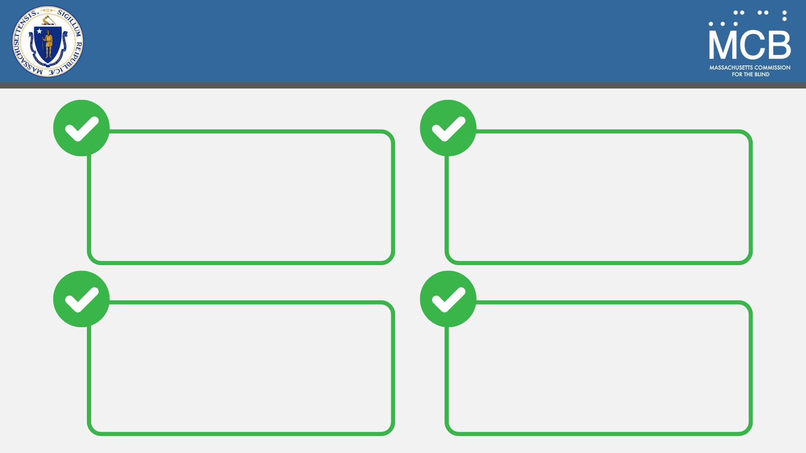
Best Approach
Have a clear goal
in mind
Understand the student’s limits & abilities
The best technology is only as useful as the student's ability to use it
Allow student to continue using familiar technology while exploring new options

Slide 14
Determining Success
Example
Desktop Video Magnifier
Portable Magnifier

Slide 15
Example Continued
Standalone OCR
Smart Phone Application

Slide 16
Training & Ongoing Support
Everything is changing
Technology
Tasks
Classroom expectations
Integrating technology with the curriculum
As the student progresses with assistive technology
Their understanding, comfort, and expectations grow
We can now do more!

Slide 17
What Success Looks Like
Achieving
vocational goals
Increased
self-confidence
Expanded access to
a wider range of technology that enhances outcomes
Greater personal & community independence

Slide 18
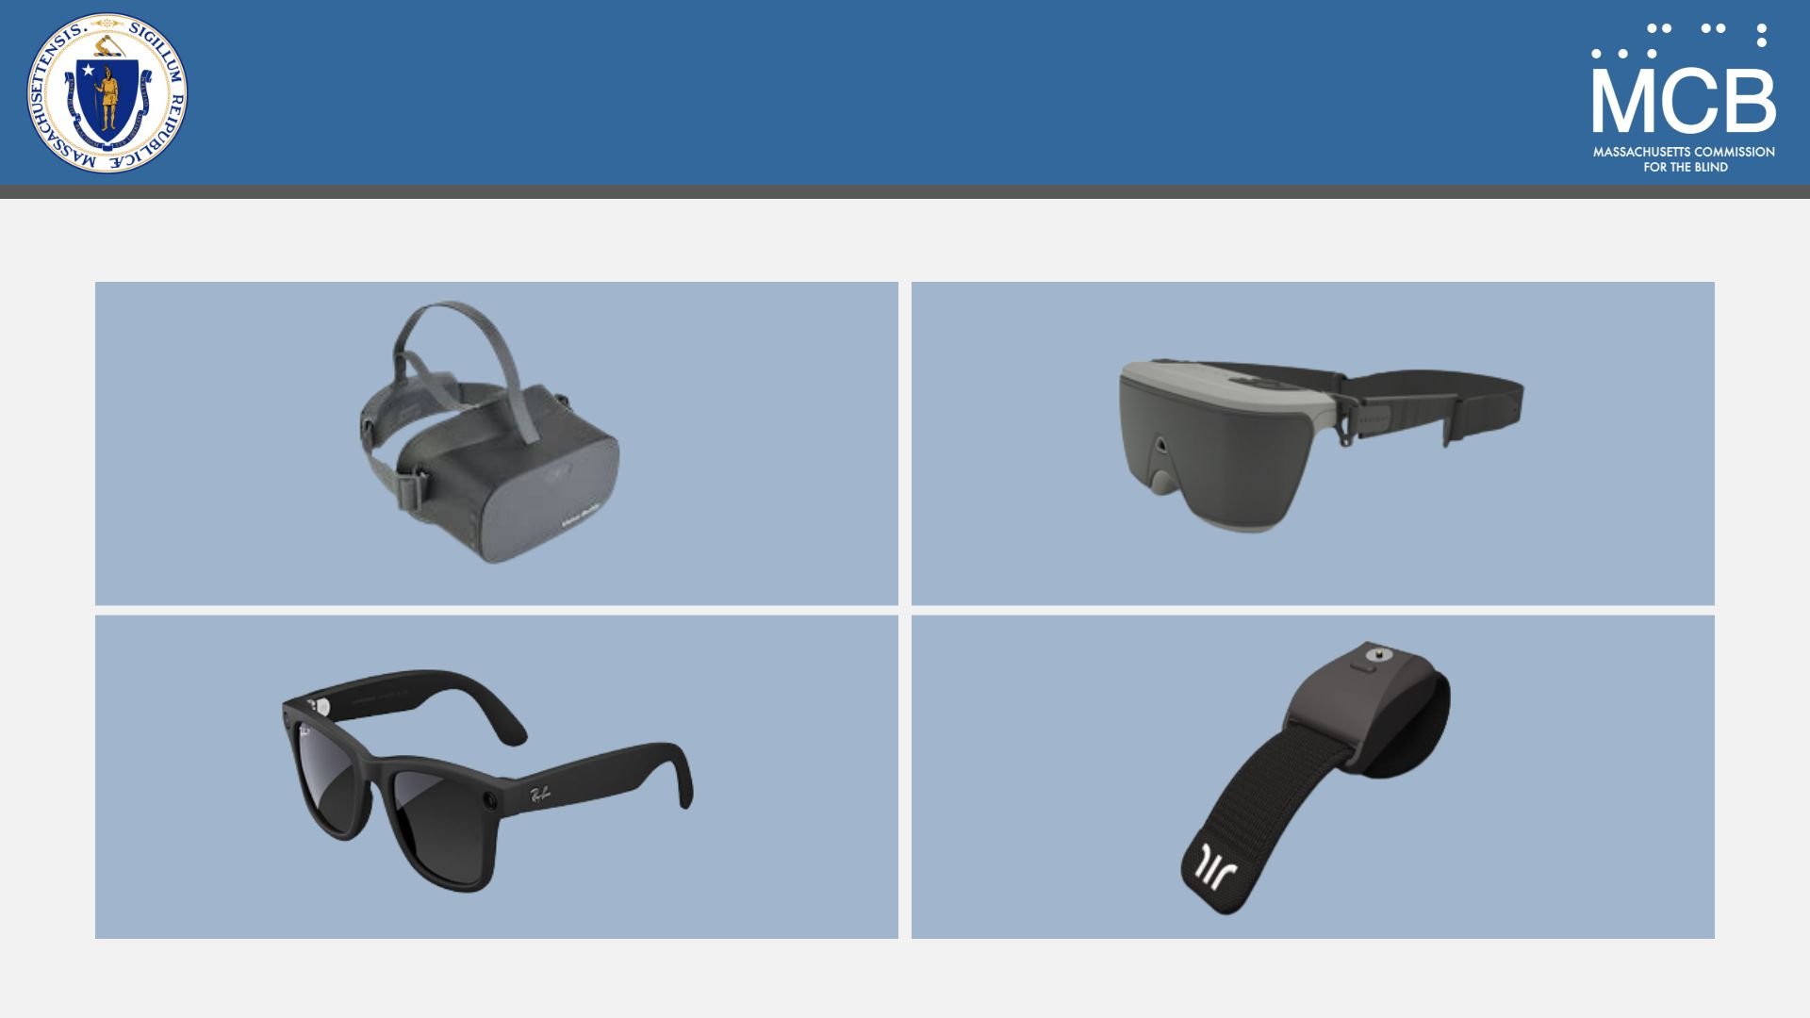
The Future…

Slide 19
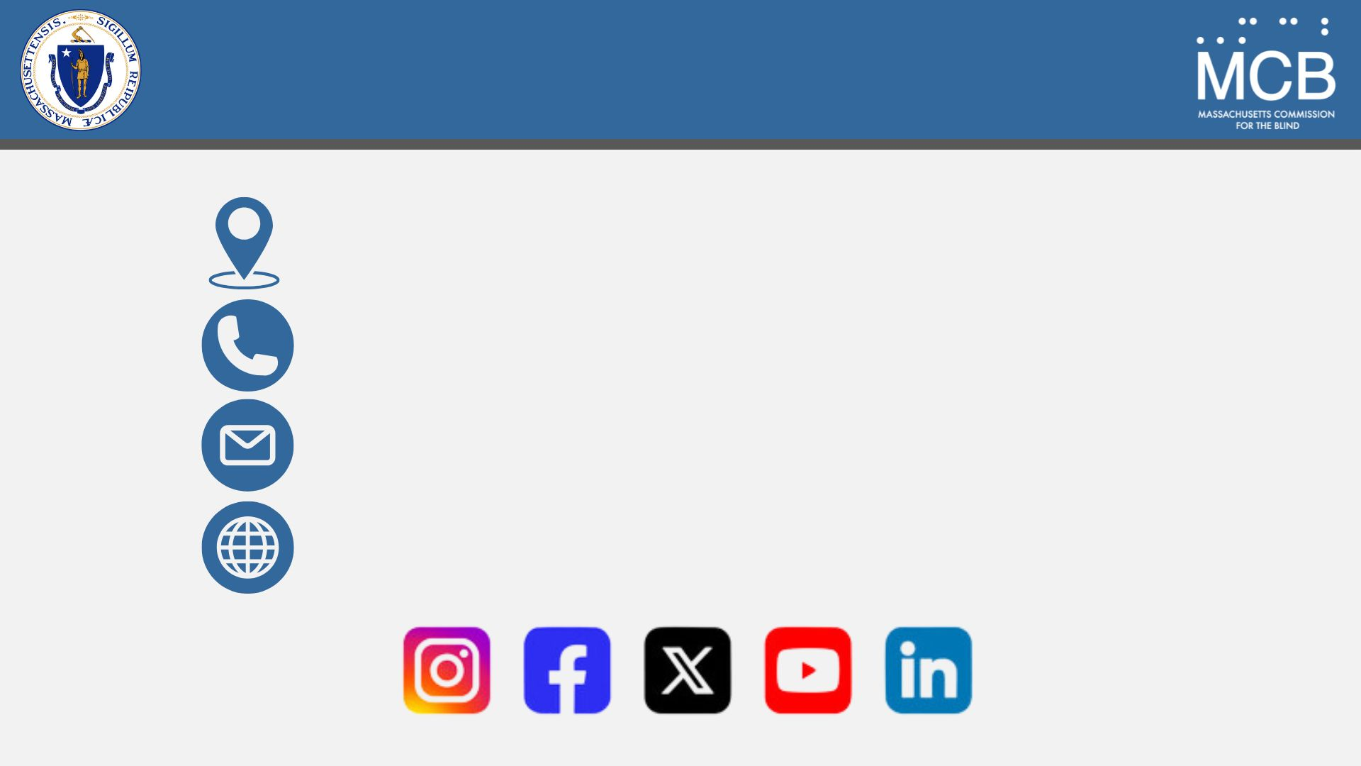
Connect With Us
600 Washington Street, Boston, MA 02111
1-800-392-6450
mcbinfo@mass.gov
mass.gov/mcb

