Slide 1
CCFA Attendance: entering attendance, codes, and placement schedules
Updated: April 2017

Slide 2
Agenda
Overview
How to Enter Attendance
Attendance Codes
Month Totals
Placement Schedules
How to Locate Absence History
FAQs

Slide 3
Overview
Family
Placement
Attendance
Authorization
The above graphic shows where attendance falls in the CCFA workflow.
Providers should enter their own attendance.
Final submission for review reflects accuracy and completeness
Admin Orgs and CCRR admins can enter attendance for any providers under their umbrella.
FCCs, Center Based Care for contract admins
IFCs/ICCs for CCRRs
Not optimal or recommended
Submission for review reflects Admin reviewed and approved of the paper record and implies accuracy and completeness
Attendance is complete when the attendance status on the Submit Monthly Billing page says “Ready to Submit.”

Slide 4
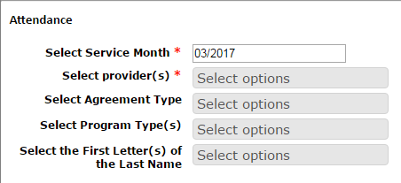
How to Enter Attendance
Go to Provider + Attendance
Enter criteria
Service Month and Provider(s) are required fields.
You can enter attendance for more than one provider.
Additional option to select agreement type, program type, and first letter(s) of the last name.
These filters are useful for LOCs with many children in attendance.
Click “Next.” You will be brought to the attendance page for the Service Month selected.

Slide 5
How to Enter Attendance
Enter attendance by week and select “Save” until attendance for that month is complete.
CCFA automatically saves attendance records when you navigate between weeks.
You cannot enter attendance for future days.
When the month is complete, select “Save and Review” to check for completeness.
There is no option to “Save and Review” until the month is complete.
CCFA runs a check to make sure a code is entered for all children in the month.
If attendance is confirmed as complete, you will be asked if you would like to do more attendance
“Yes”—you will be brought back to the Provider + Attendance page
“No”—you will be brought to the Provider + Submit Monthly Billing page
Attendance is complete. See the CCFA Billing slide deck for next steps.

Slide 6
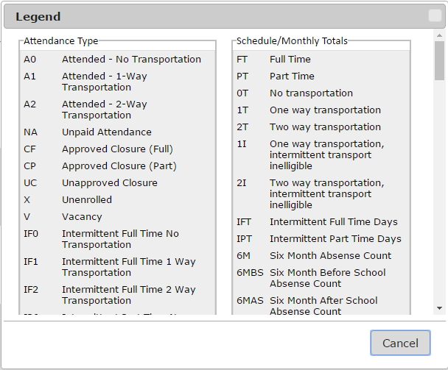
Attendance Codes
CCFA limits the attendance codes based on program and the child’s schedule.
There’s a link at the top of the screen that will display the legend for the attendance codes.
Note: the legend shows attendance codes for all placement types, not just those in the selected program.
It is important to use the correct code
A0 denotes attendance with no transportation.
The attendance code pays to the placement schedule.
Transportation codes populate based on maximum allowed for the placement.
Transportation may be less than the maximum allowed.
Notes:
HAVE WE UPDATED THIS SHEET YET?

Slide 7
Attendance Codes
All non attended days must be marked.
Absences are marked as either explained or unexplained.
Explained—the program was informed by the parent
Unexplained—no show, no call
CCFA makes the determination regarding payment.
Non attended days pay to the placement’s schedule.
Consecutive unexplained absences—after an initial warning has been issued—beyond 3 are not paid.
EEC pays all attended days.
See Chapter 10 of the Financial Assistance Policy Guide for complete guidance on attendance.
See attendance code cheat sheets for more details regarding attendance codes, placement programs, and billing patterns.
Regular, Intermittent and School Closure Attendance Codes Cheat Sheet
Flex and Intermittent Flex Attendance Codes Cheat Sheet

Slide 8
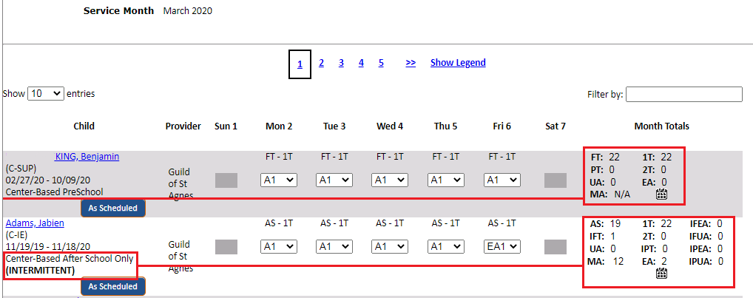
Month Totals
The attendance screen displays Month Totals for each placement.
The categories depend on the placement type and schedule.
Contains counts for days attended, absences, and master auth. totals
Other totals may include transportation, intermittent days, etc.
A month icon will link to the monthly view for that placement.
See Placement Schedules slides below for more details.
The MA category displays the total number of absences for the child and all placements within the master authorization.
Exceptions include DCF and DTA referrals where the MA count displays as N/A.

Slide 9
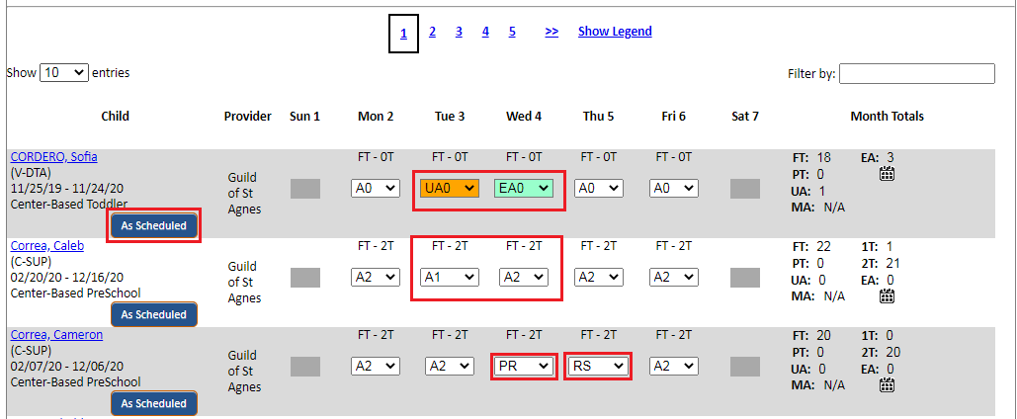
Placement Schedules—Regular
For weeks where the child attends all scheduled days, use the ‘As Scheduled’ button to prepopulate the attended (A) code and transportation maximum, if applicable.
Modify transportation as needed.
Mark explained absences using the EA code.
Mark unexplained absences using the UA code.
Use the “X” code if the placement start date is before the child begins attending the program.
Use “PR” for days when the provider refused service.
Use “RS” for days when the parent refused service.

Slide 10
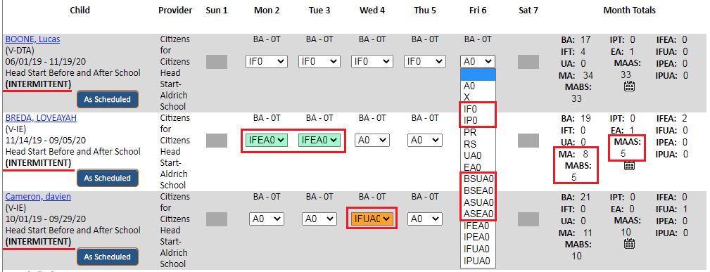
Placement Schedules—Intermittent
Placement details on the left say if the child is intermittent.
Attendance and absence codes remain the same for intermittent placements on school days (A, EA, UA).
If the child is a Before and After school placement, and is only absent from one program, mark with the appropriate code.
BSEA/BSUA—absent from before school, attended after school
ASEA/ASUA—absent from after school, attended before school
IF, and IP codes denote attendance on an intermittent day, when school is closed but the provider is open.
IF—attended the full day (up to 10 hours)
IP—attended partial day (up to 6 hours)
Absences on intermittent days are marked as either IFEA/IPEA (explained) or IFUA/IPUA (unexplained)
Recall that the total number of allowable service hours per week depends on the authorization.
Full-time authorizations allow for up to 50 hours of care each week (i.e. 5-IF days during a school vacation week).
Part-time authorizations allow for up to 30 hours of care each week (i.e. 3-IF or 5-IP days during a school vacation week).
The Month Totals on the right include master auth. before school (MABS) and master auth. after school (MAAS) counts in addition to the MA total.

Slide 11
Placement Schedules—Flexible
Placement details will say if the child is Flex
There is no option for “as scheduled”.
Must enter an attended or absence code for the number of days the child is expected to attend
FF denotes full day attendance. FP denotes partial day attendance.
Absence codes remain the same—EA or UA
Flexible placements have an additional NA code to be used on the day(s) the child was not expected to attend that week.
Cannot use NA to denote an absence.
The monthly totals will contain an FH category displaying the total number of hours allotted for the child for that week.
The count will go down as attendance is entered.

Slide 12
Placement Schedules—Intermittent Flexible
Placement details will say if the child is Intermittent Flex
As with Flexible placements, there is no option for “as scheduled”.
Must enter an attendance or absence code for the number of days the child is expected to attend.
The FA code denotes attendance on a school day
The IFF and IFP codes denote attendance on an intermittent day.
Absence codes remain the same—EA or UA.
NA is a date not attended by Flexible Placement if the service days number is reached.
The monthly totals will contain an FH category displaying the total number of hours allotted for that child for that week.
The count will go down as attendance is entered.

Slide 13
Placement Schedules—School Closure Only
OCCASIONAL is listed under the placement details on the left.
NA is the default code and is prepopulated. Enter attendance only when child attends the program.
IF denotes full day attendance
IP denotes partial day attendance
The remainder of the codes denote an absence.
IFEA/IFUA: full-day explained/ unexplained
IPEA/IPUA: part-day explained/ unexplained

Slide 14
How to Locate Absence History
Attendance Page
See above screen shots, able to see MA, MAAS, MABS totals
Person Details Page
The Absence Counts section shows absences over a 12-month period, looking back from the current month.
Absences in this view could span more than one master authorization
For scenarios where the child has more than one absence type, like Before and/or After School absences, the total number of absences is displayed.
Days Absent Report
Select Reports + General Reports + Days Absent Report or
Reports + General Reports + Days Absent Report post 3/1/2019
Set parameters: Service Month, Min. Days Absent, Provider List

Slide 15
FAQs
How do I tell if my attendance is complete?
Go to Provider + Submit Monthly Invoices
Look at the status of the month in question
If the status is Incomplete, you have missing attendance
Note: the attendance status will say incomplete until you click “Save and Review”.
My attendance status is incomplete. How do I find the incomplete record?
Go to Provider + Attendance
Click on “Save and Review”
CCFA will display the list of placements with incomplete attendance
How do I enter attendance when a family is on vacation?
Please refer to the Policy Guide for vacation and approved break in care guidelines. If you have additional questions, please email eecsubsidymanagement@mass.gov.
What are some best practices for entering attendance?
Each organization should determine how they will handle entering attendance across their provider locations. For example, each center enters their own attendance. The attendance is then approved at a secondary level by a billing manager
Ideally, providers are entering attendance on a weekly basis.

Slide 16
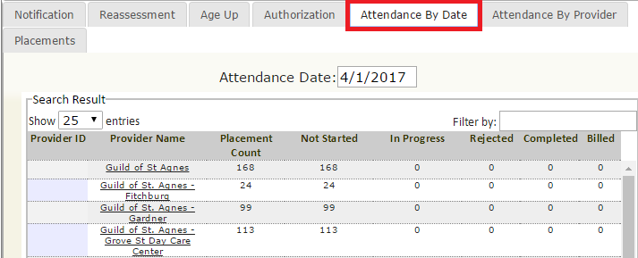
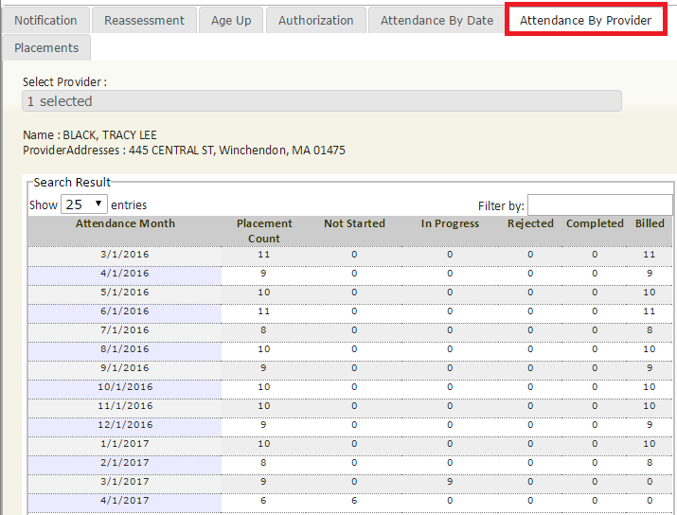
FAQs
How can I see which of my providers have complete attendance in a single view?
Go to Home and select the Attendance by Date tab to see the attendance status of all providers under your organization.
Select the Attendance by Provider tab to see current and historical views of attendance by service month.

