Slide 1
Public Health Council Meeting
August 12, 2026
Robert Goldstein, Commissioner
Today’s presentation is available on mass.gov/dph under “Upcoming Events” by clicking on the August Public Health Council listing.​

Slide 2
Updates
Commissioner Robbie Goldstein

Slide 3
Welcome, Taylor Rich and Kahoney Anderson!

Slide 4

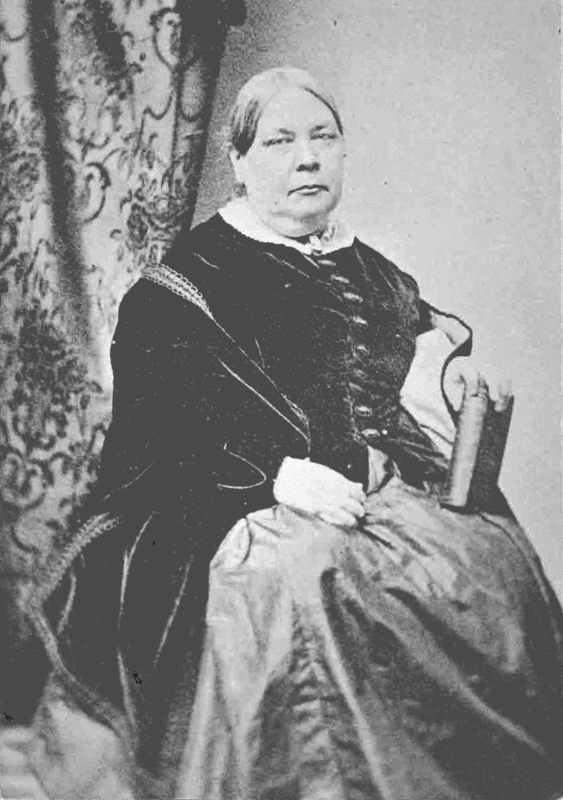
The Boston Hunters
Image courtesy Women's Pro Baseball League
Harriot Hunt

Slide 5

National Immunization Awareness Month

Slide 6
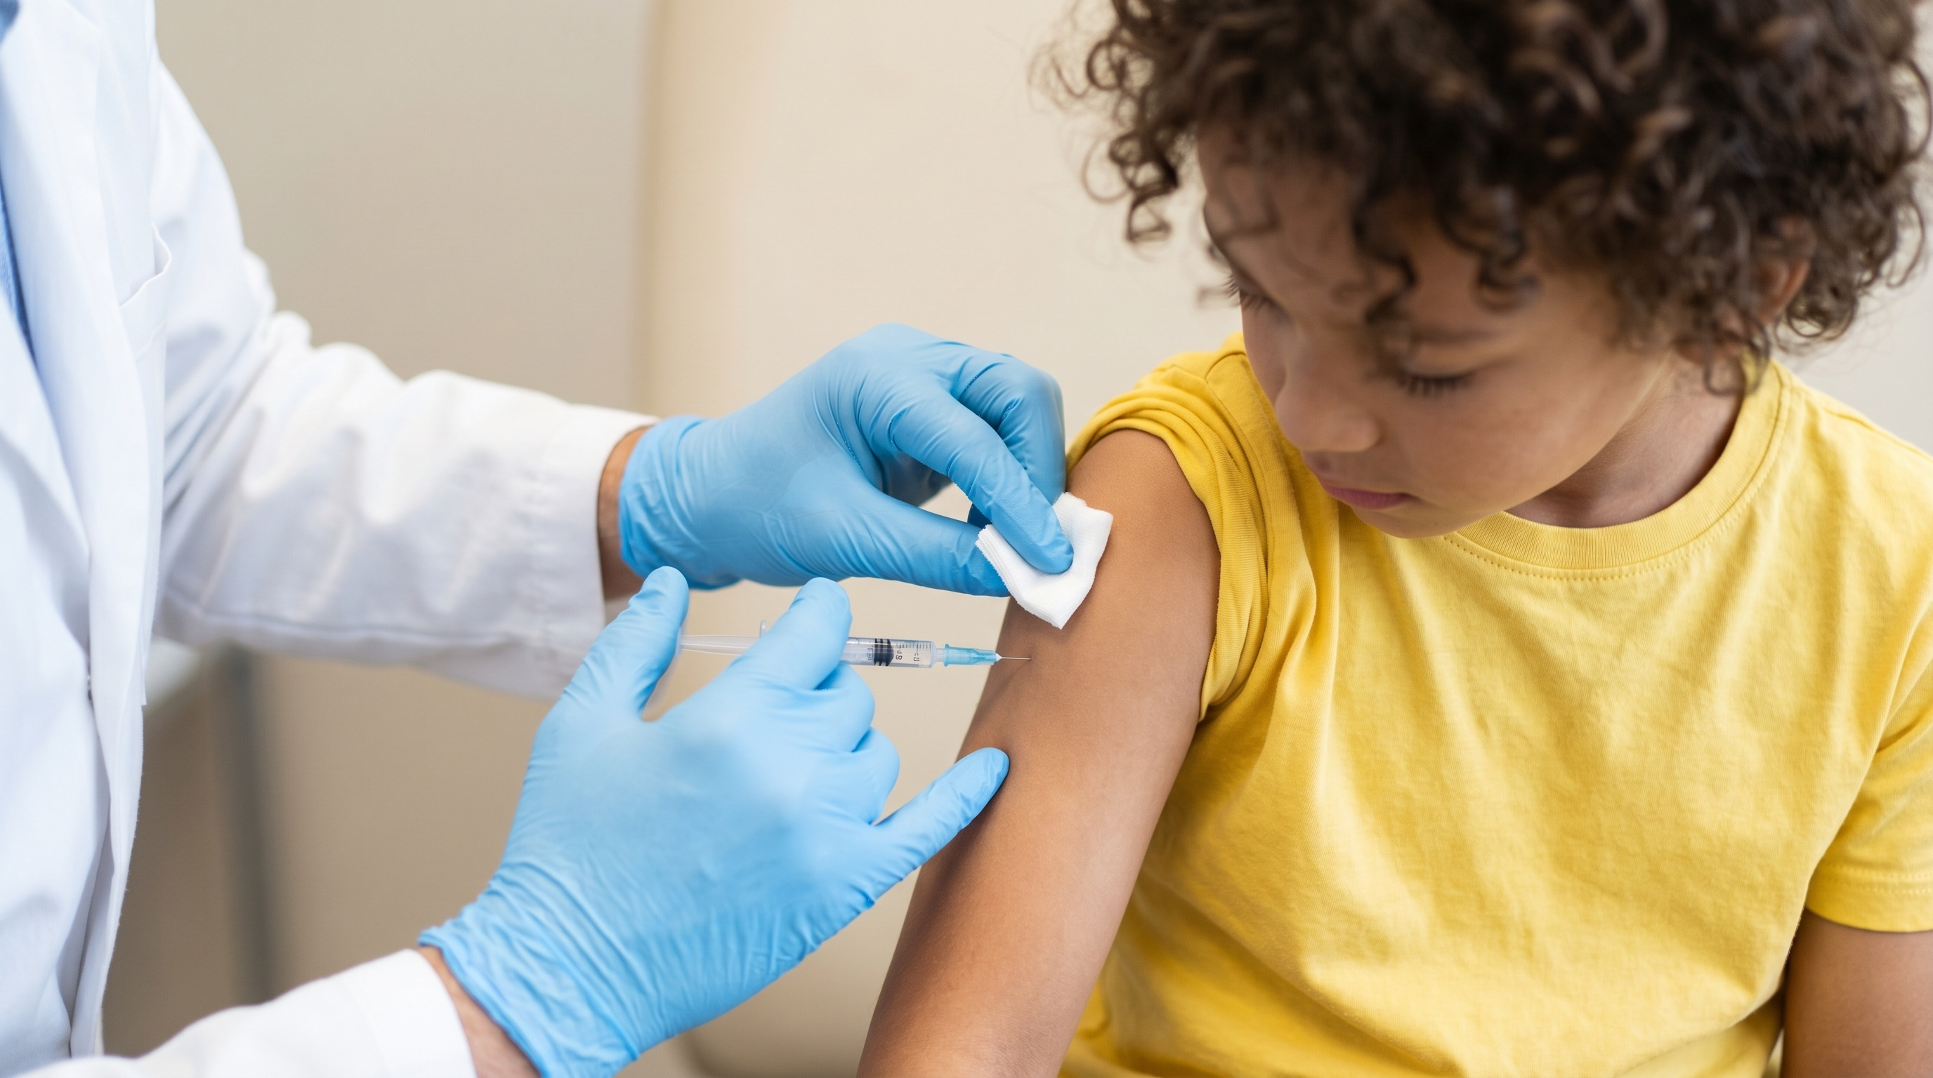
Back-to-School Readiness

Slide 7
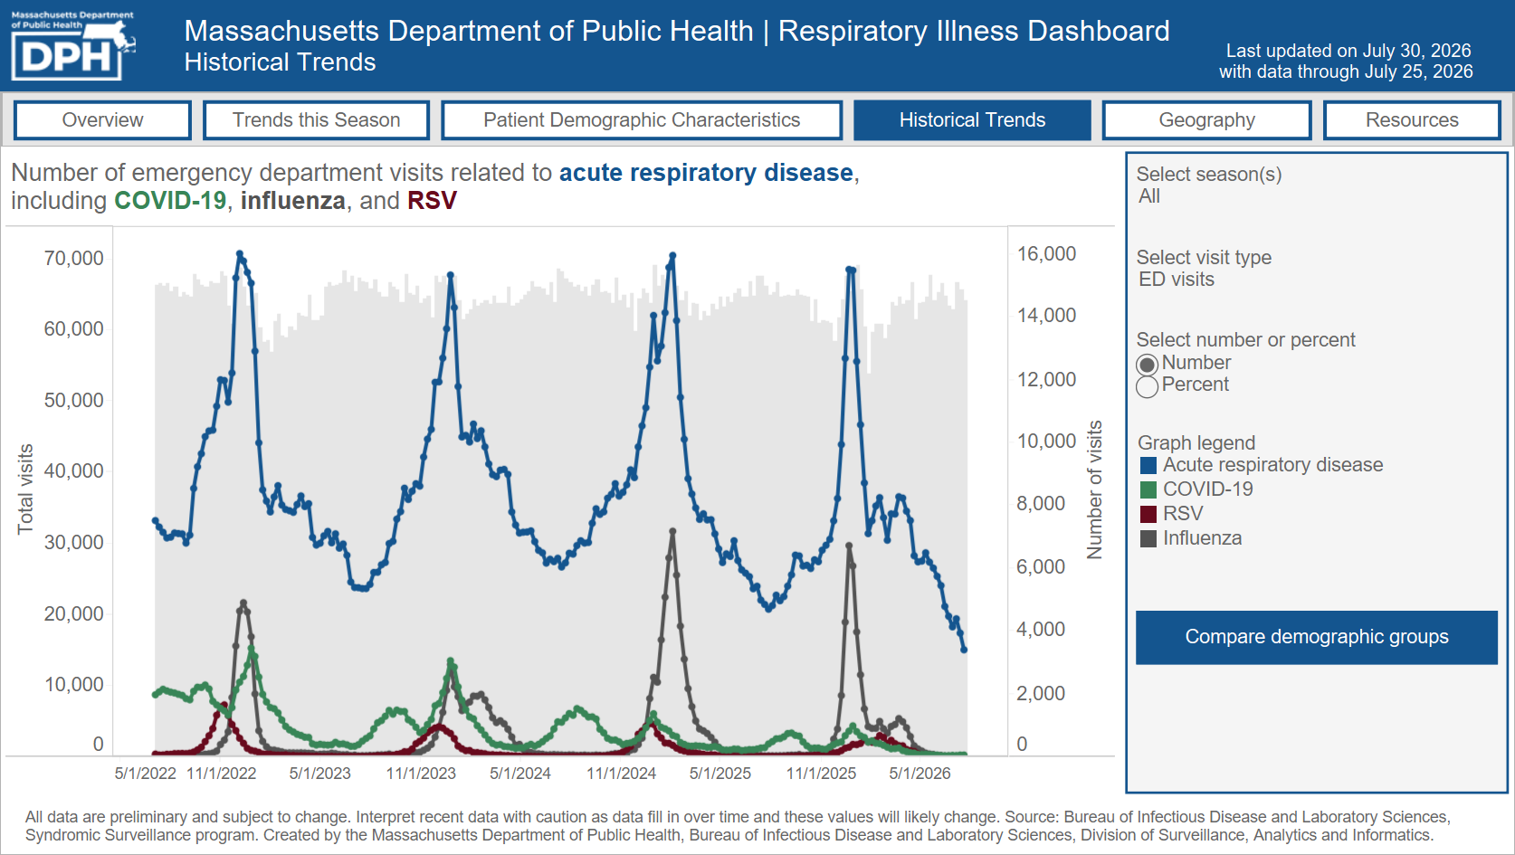
Fall and Winter Respiratory Readiness
Respiratory Illness Dashboard historical trends

Slide 8

Mosquitoes, Ticks, and Foodborne Illness
View foodborne and waterborne illness data online.

Slide 9
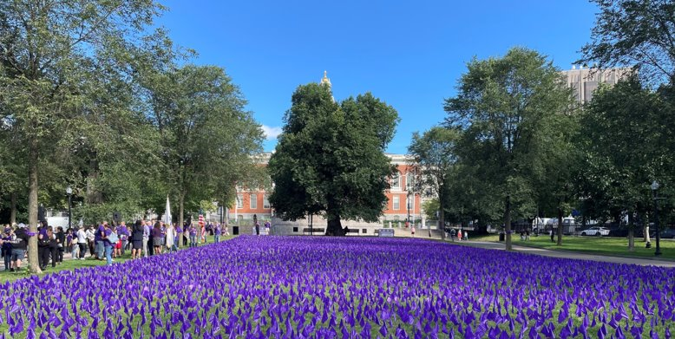
International Overdose Awareness Day, August 31

Slide 10

Community Health Equity Survey launch

Slide 11
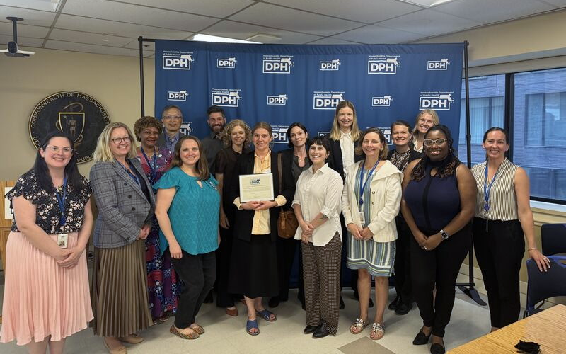
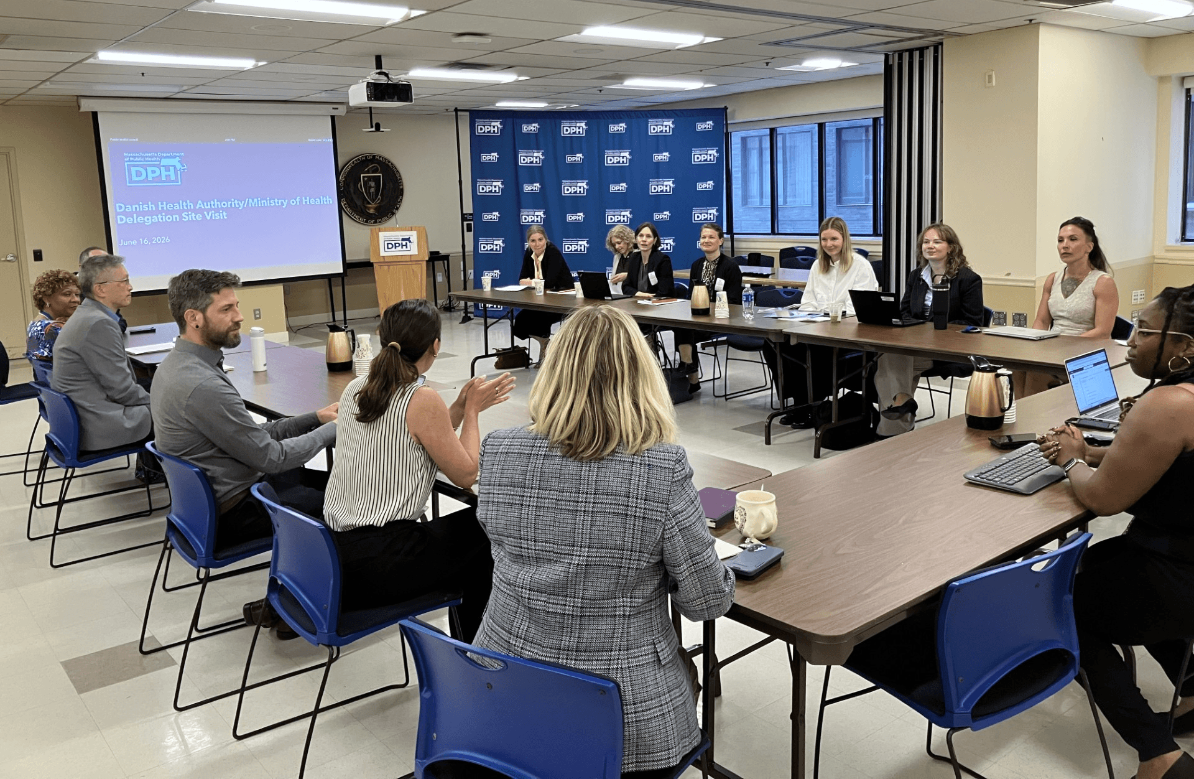
Danish Delegation Visit

Slide 12
End of the legislative session
Passed and signed:
  PROTECT Act for immigration reform
Governor’s desk:
  Essential expansions for abortion access
  Key home care licensure reform
Pending in conference committees:
  Economic development bill
  Primary care access

Slide 13
Federal Updates

Slide 14
DPH FIFA World Cup™ Response
A Cross-Bureau Activation
Kerin Milesky
Director, Office of Preparedness and Emergency Management

Slide 15
Recap and Reflections

Slide 16

Seven matches at Boston Stadium

Slide 17
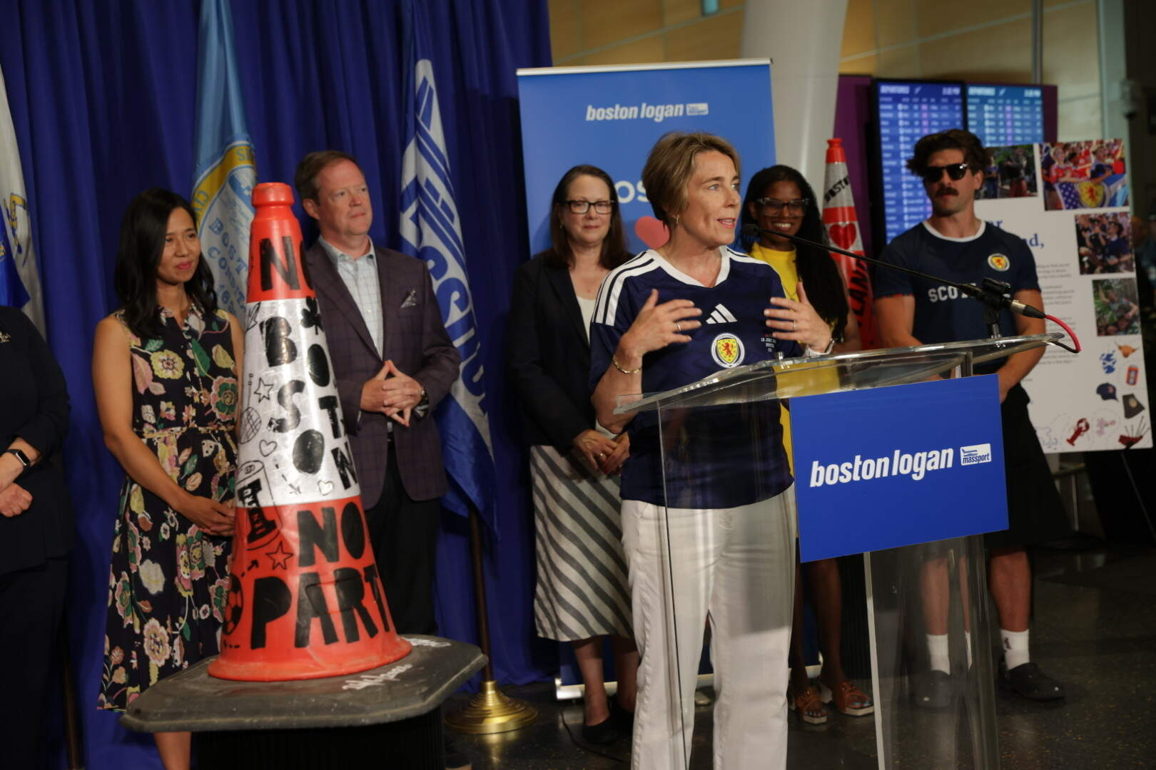
Fan Fest and Watch Parties
Boston Fan Fest
  15 days of operation
  More than 155,000 fans from more than 108+ countries*
  43 live matches*
49 tracked, large watch parties (each with 1000+ participants)
All while there were several co-occurring events
  4th of July, 250th celebration, Sail Boston, Brigham nurses strike
Boston Mayor Michelle Wu and a host of Massachusetts and Scottish officials look on as Massachusetts Gov. Maura Healey lauds a traffic cone at Logan Airport (Robin Lubbock/WBUR)
*Source: Boston26, https://bostonfwc26.com/fifa-fan-festival/

Slide 18
DPH Activities: Planning
DPH coordinated departmental and external planning efforts.
Engaged key stakeholders including many acute care hospital systems, BPHC, COBTH, 4 licensed ambulance services, 4 CMED centers, 3 regional HMCCs, RIDOH, Boston 26, and other external agencies
DPH posted World Cup specific web content and public health guidance was distributed in 5 languages.
Focused support to local boards of health.

Slide 19
DPH Activities: Activations
Emergency Operations Plan (EOP) to Level 1 – Enhanced Monitoring started 6/1
Approximately 100 individuals rostered to support preparedness and response activities for the entirety of the tournament and its associated celebrations.
Escalated to Level 3 – Full Activation of the Department Operations Center (DOC) on each of the seven matches held at Boston Stadium
Approximately 40 individuals rostered to support each match in either an in-person, virtual, or on-call capacity
Promoted situational awareness, provided heat mitigation supplies, monitored and mitigated health and medical impacts, and closely collaborated with other agencies to provide executive level decision making, strategic public safety and security guidance, and alignment of Federal, State, and local operational resources.
Held pre-event calls ahead of each match and was in touch with impacted hospitals during each match.

Slide 20
Data Tracking and Analysis

Slide 21
Data Tracking & Analysis
Goal: Track a wide variety of data sources and metrics to get early notification of strain or impacts on the health of everyone within Massachusetts.
Developed two primary data products
  Daily Dashboard was more expansive and served multiple purposes.
  Match Day Dashboard tracked emergency department volume during matches as a potential early warning system.
Elizabeth Mello, MS; OPEM - Preparedness Data Systems Epidemiologist

Slide 22
Data Expertise Across DPH
OHSP: Define Capacity Measures
OPEM: Develop Visualizations and Communication
BIDLS: Syndromic Surveillance
BHCSQ: Massachusetts Ambulance Trip Registry Information System
BCEH: Unhealthy heat alerts, weather forecasts, air quality
Elizabeth Mello, MS; OPEM - Preparedness Data Systems Epidemiologist

Slide 23
Results

Slide 24
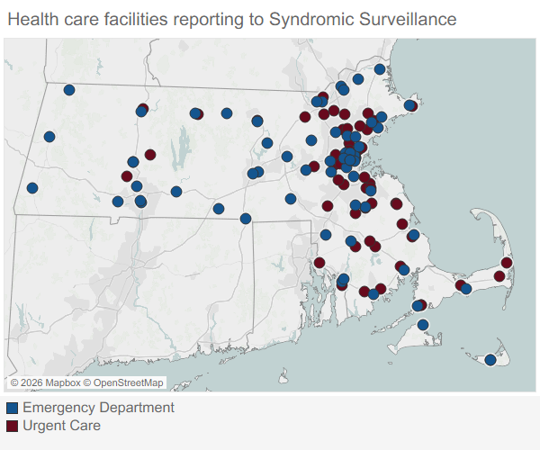
Utilization: Urgent Care
Activities Messaging on appropriate care utilization, web content translated into 5 languages.
Data Onboarded new urgent care centers to Syndromic Surveillance. Urgent care visits within normal volume for summer.
Next Steps Continue onboarding urgent care centers to reporting database in collaboration North East Regional Urgent Care Association (NERUCA).
Chiara Moore, MPH; OHSP – Assistant Director of Healthcare Strategy and Planning
Source: Syndromic Surveillance Program. Data are preliminary (as of 7/22/2026) and subject to change. For more information: https://www.cdc.gov/nssp/index.html

Slide 25
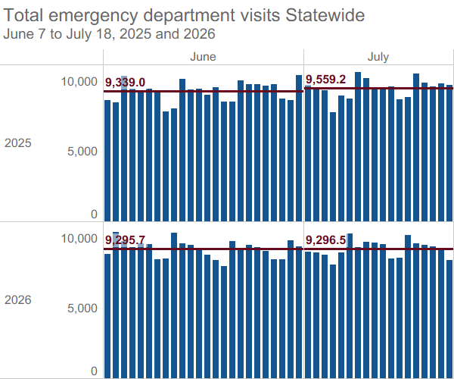
Utilization: Emergency Departments
Activities Coordination with MA and RI hospitals including preparedness meetings. Direct coordination with Sturdy Memorial Hospital during matches.
Data ED visit volume was within normal ranges for summer. People presenting with primary care and urgent care needs did not increase.
Next Steps Deeper analysis to understand visitor utilization and healthcare costs.
Chiara Moore, MPH; OHSP – Assistant Director of Healthcare Strategy and Planning
Source: Syndromic Surveillance Program. Data are preliminary (as of 7/22/2026) and subject to change. For more information: https://www.cdc.gov/nssp/index.html

Slide 26
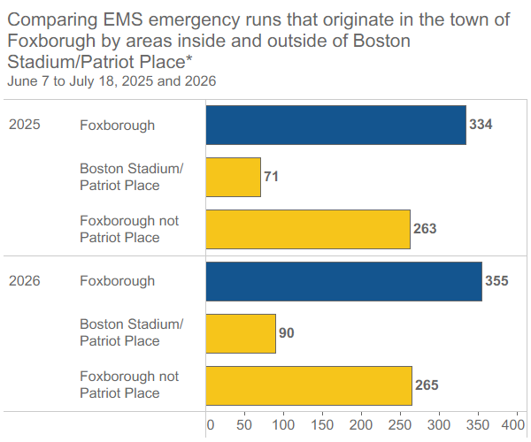
Utilization: Emergency Medical Services
Activities Strike teams staged at Foxborough to support EMS response. Strong collaboration with Coastal EMS.
Data Boston Stadium transports went to 14 hospitals, Sturdy Memorial Hospital received 50% of them. There were 32 transports from Boston Fan Fest to Boston hospitals. There was a 20% year over year increase in runs from the stadium area but nearly the same number from the rest of Foxborough.
Next Steps Improve timely reporting of EMS data, incorporate best practices for event support into routine practice.
Kerin Milesky; OPEM – Director
Source: Massachusetts Ambulance Trip Record Information System (MATRIS). Data are preliminary (as of 7/22/2026) and subject to change. For more information: https://www.mass.gov/info-details/massachusetts-ambulance-trip-record-information-system-matris

Slide 27
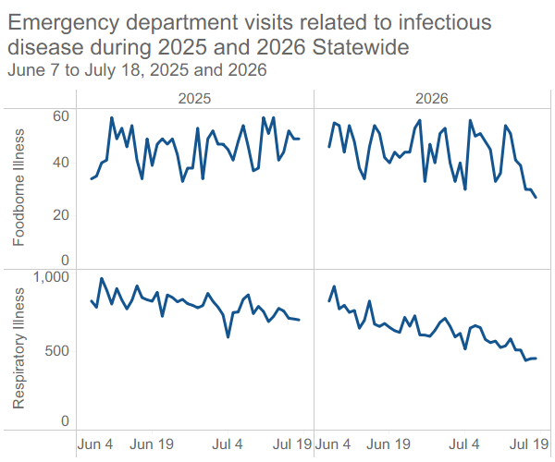
Infectious Disease Surveillance
Activities DPH tracked broad infectious disease syndromes for foodborne and respiratory illnesses from Syndromic Surveillance. Additional cluster detection analyses (TreeScan), SPHL readiness, and Report My Meal reporting. Deployed processes for communications with international visitors.
Data Foodborne illness and respiratory illness were within normal ranges. No outbreaks related to FIFA were identified.
Next Steps Integrate TreeScan into routine surveillance
Kathleen Roosevelt, MPH; BIDLS – Deputy Director
Source: Syndromic Surveillance Program. Data are preliminary (as of 7/22/2026) and subject to change. For more information: https://www.cdc.gov/nssp/index.html

Slide 28
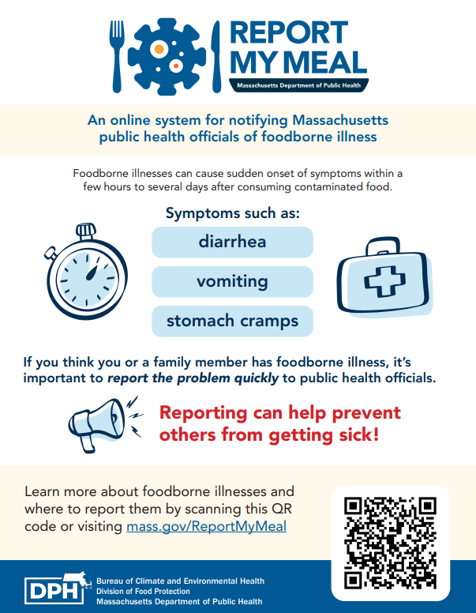
Foodborne Illness: Report My Meal
New online platform for the public to report suspected foodborne illness directly to local and state public health officials
Promoted during the FIFA World Cup games to encourage reporting and aid outbreak detection
Informational flyer translated into 10 languages
Johanna Vostok, MPH; BIDLS – Epidemiologist, Foodborne & Waterborne Illness Coordinator

Slide 29
Promotion of Report My Meal during the World Cup
Included on mass.gov’s World Cup guidance for keeping the public healthy
Shared with clinicians across the state
Communication to LBOHs encouraging promotion of Report My Meal via social media, posting flyers in communities, and further sharing with clinical settings
Timely launch of new reporting capacity to enable more rapid detection of clusters
Johanna Vostok, MPH; BIDLS – Epidemiologist, Foodborne & Waterborne Illness Coordinator

Slide 30
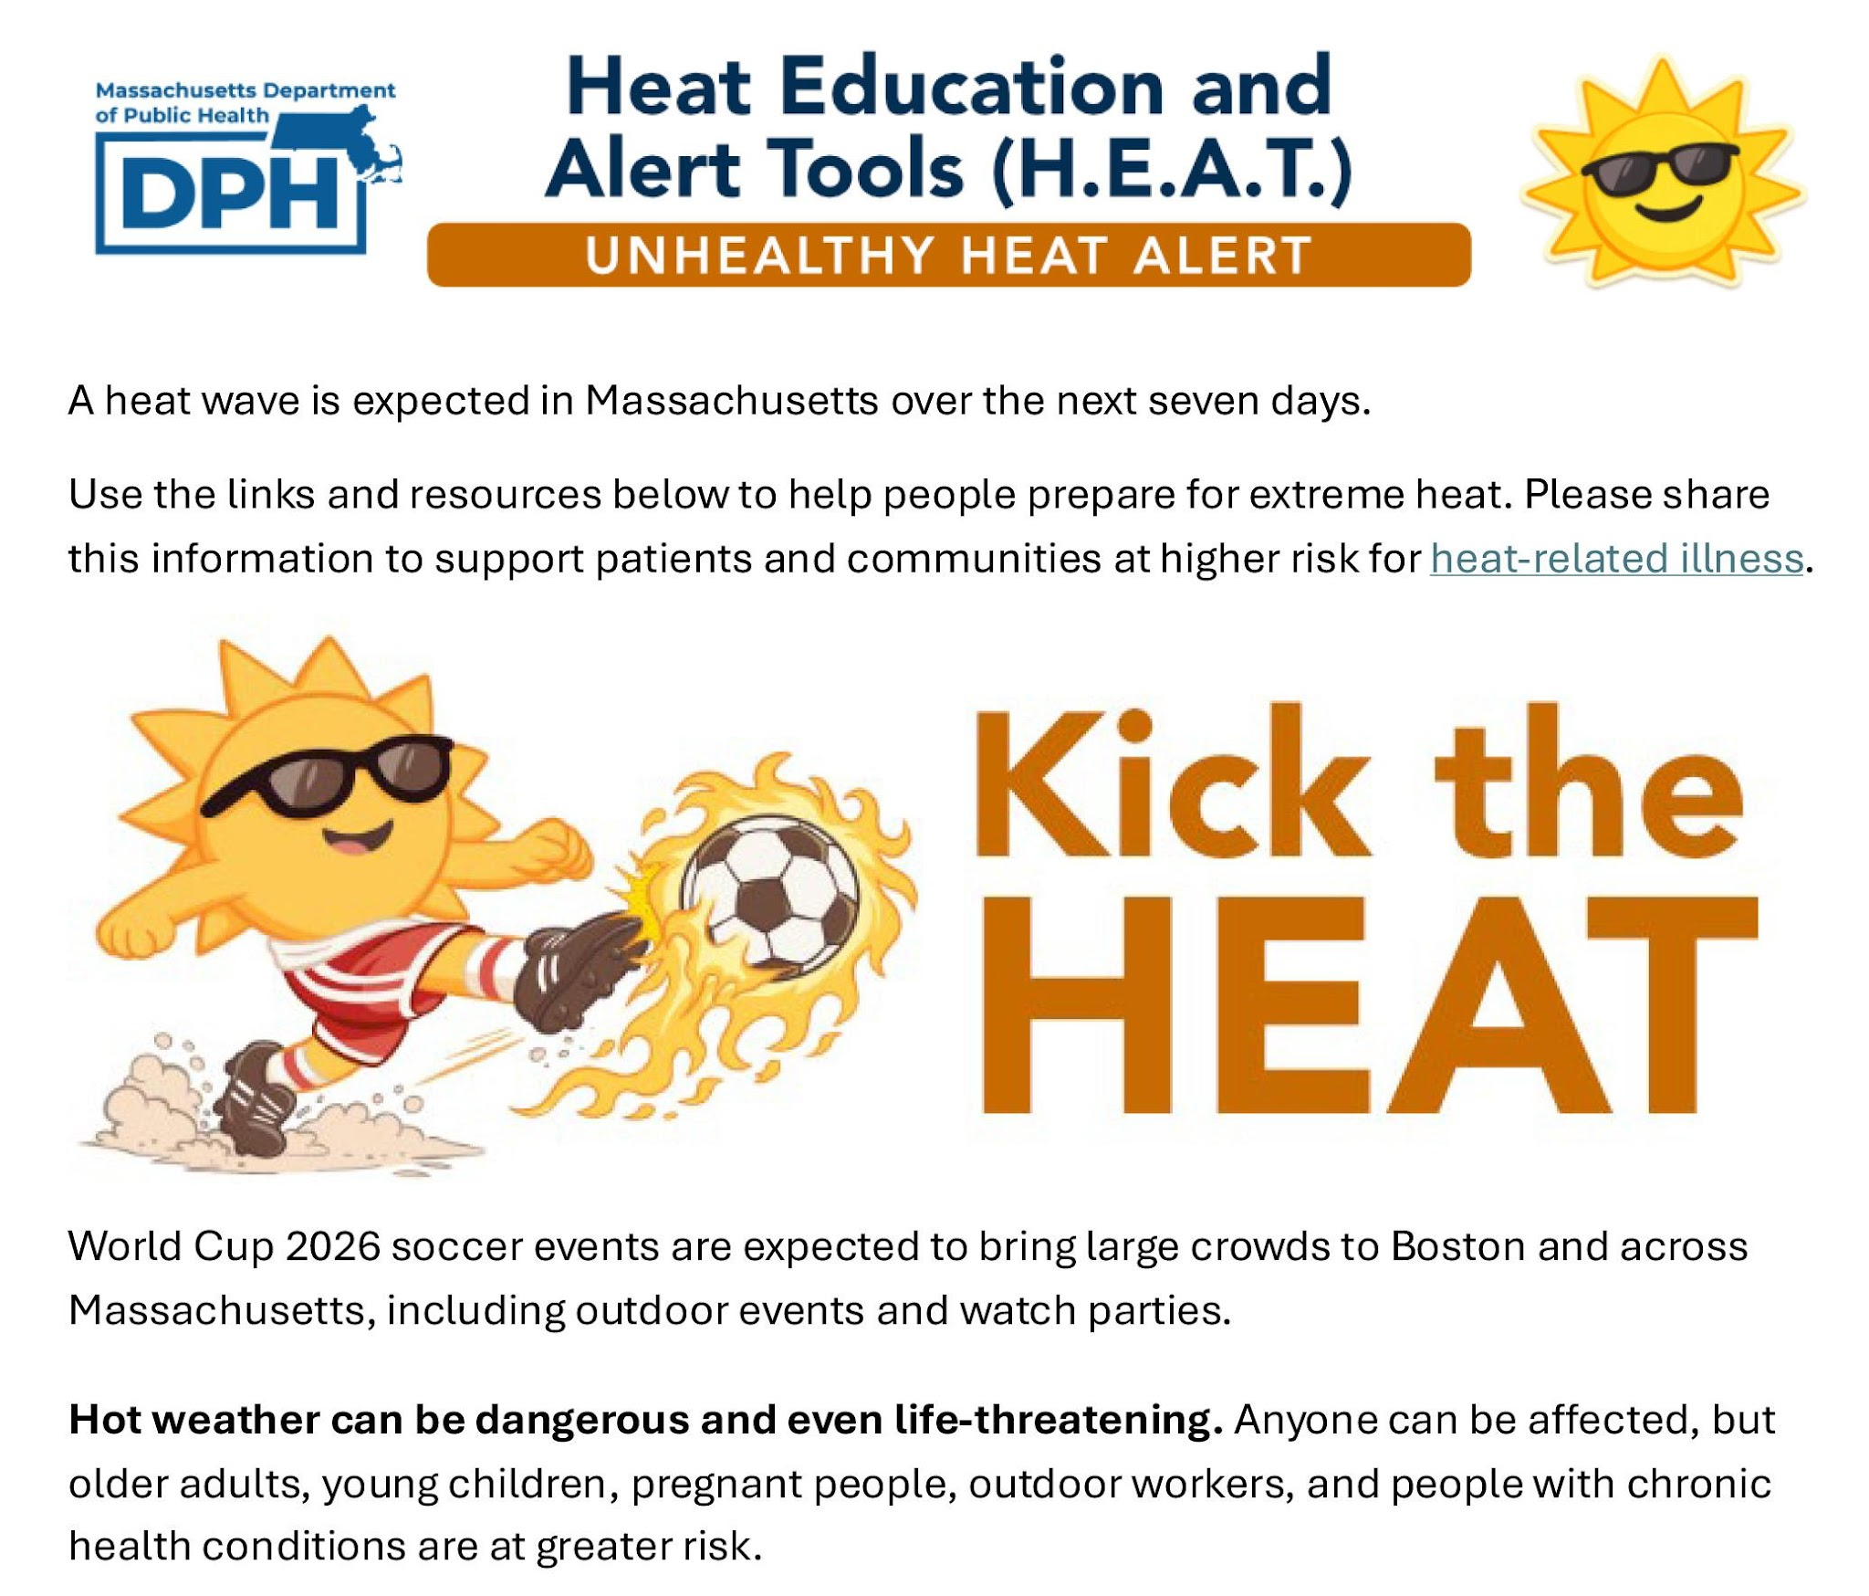
HHAN Heat Outreach: Targeted Alerts for Audience-Specific Action
Uses the Unhealthy Heat Forecast to guide timely alerts and outreach
Provides audience-specific guidance, links, and ready-to-share resources
Connects heat safety to timely topics, including FIFA, Fourth of July, boating, and outdoor events
Helps partners quickly amplify consistent, actionable heat safety messages
Terry Howard; BCEH – Deputy Director
Healthcare Sector
Long-term Care Facilities
Local Boards of Health
Health Equity Partners
Correctional Facilities
Recreational Camps for Children
Farm Labor Camps
DCR Partners for Pool Operators
Regional Planning Agencies
https://www.mass.gov/extreme-heat

Slide 31
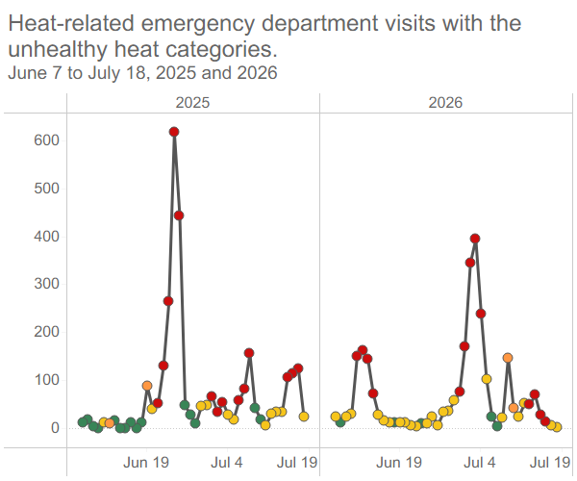
Heat Alerts
Activities Issued alerts for four periods of unhealthy heat across 16 days with three of those days coinciding with Boston Stadium match days. Distributed 56,000 cans of water, 60,000 sunscreen packets, 81,000 hand sanitizer wipes, 28,000 insect repellant wipes.
Data DPH's Unhealthy Heat forecast identifies periods of heat with higher than usual Heat Related Illness rates.
Next Steps Formal data analysis for the season for HRI data and review of our new community alert platform data analytics.
Terry Howard; BCEH – Deputy Director
Source: Syndromic Surveillance Program. For more information: https://www.cdc.gov/nssp/index.html
DPH Unhealthy Heat Forecast. For more information: https://www.mass.gov/info-details/massachusetts-unhealthy-heat-forecast Data are preliminary (as of 7/22/2026) and subject to change.

Slide 32
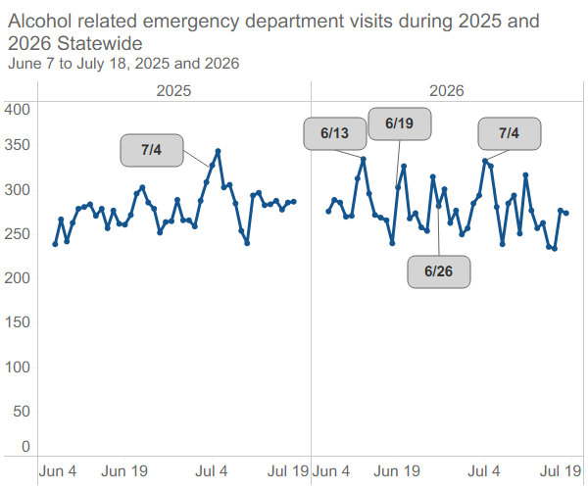
Alcohol and Other Substance Use Surveillance
Activities Monitored uptake of extended hours for alcohol consumption.
Data Observed increased alcohol-related visits for days around weekend matches (6/13 Haiti vs. Scotland, 6/19 Scotland vs. Morocco, 6/26 Norway vs. France). Typical increase 7/4th holiday.
Next Steps Improve messaging & education regarding the impact of alcohol in MA, including the release of data briefs and fact sheets.
Deirdre Calvert; BSAS – Director
Source: Syndromic Surveillance Program. Data are preliminary (as of 7/22/2026) and subject to change. For more information: https://www.cdc.gov/nssp/index.html

Slide 33
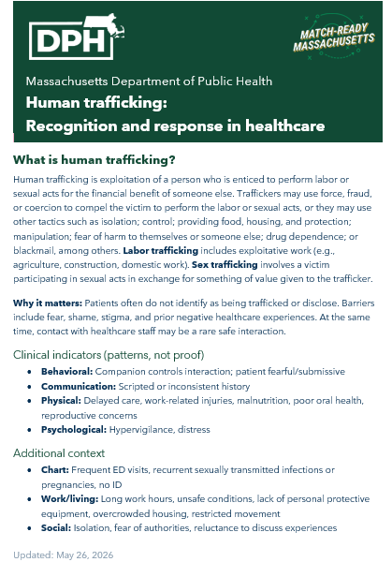
Human Trafficking and Sexual Assaults
Activities BCHAP’s SANE and SDV programs created a flyer distributed to clinicians statewide on HT indicators, screening, and response. The SANE program also took steps to ensure thorough coverage at all SANE sites during the relevant time period.
Data While the daily number of suspected sexual assault ED visits fluctuated over the course of the tournament, the weekly volume was consistent week to week and compared with last year.
Next Steps Continue work to integrate human trafficking stakeholders into emergency preparedness event planning.
Keesha LaTulippe; BCHAP - Deputy Director

Slide 34
Conclusions

Slide 35
Primary Data Conclusions
While emergency department and urgent care volume changed over time, there was not a large increase over the World Cup period compared with last year.
Increases in alcohol-related and heat-related emergency department visits were observed on specific days.
While increases alcohol-related visits aligned with some matches, it's less clear if other types of ED visits increased directly related to hosting the World Cup.
Volumes did not overwhelm EMS, urgent care, or hospital settings.
Katherine T. Fillo, Ph.D., MPH, RN-BC ; Chief Clinical Officer-Director of Healthcare Strategy & Planning

Slide 36
Looking Ahead
It will take time to understand how much of an impact can be ascribed directly to hosting the World Cup in Massachusetts.
  For example, healthcare claims data will not be considered complete and be made available until early 2027.
We plan to conduct fuller analyses on if there were healthcare costs and visits above what we would expect to see.
Katherine T. Fillo, Ph.D., MPH, RN-BC ; Chief Clinical Officer-Director of Healthcare Strategy & Planning

Slide 37
Event Summary
At this point, there are no concerning or unexpected trends in our data.
A smooth and uneventful tournament did a lot to ensure this.
Planning efforts around heat mitigation also may have helped keep healthcare impacts low.
Overall, while the planning and execution took a tremendous amount of work, we had the best possible outcome, a safe and smooth event period.
Katherine T. Fillo, Ph.D., MPH, RN-BC ; Chief Clinical Officer-Director of Healthcare Strategy & Planning

Slide 38
Thank you
Thank you for the opportunity to share about DPH’s FIFA health monitoring today.
Please direct any questions to:
Kerin Milesky
Director
Office of Preparedness and Emergency Management
kerin.milesky@mass.gov

Slide 39
Thanks to our slide contributors!
Analysts
Leadership
Matthew Blackburn
Rosa Ergas
Gerard Gonzales
Fareesa Hasan
Megan Hatch
Lizzy Mello
Amber Mullen
Jaclyn Skidmore
Claire Wilkinson
Deirdre Calvert
Katherine Fillo
Terry Howard
Keesha LaTulippe
Kerin Milesky
Chiara Moore
Kathleen Roosevelt
Johanna Vostok

Slide 40
Next meeting:
September 9, 2026

