Slide 1
EPIA - August 2022 All Ages
Number of referrals in period: 572

Slide 2
Expedited Psychiatric Inpatient Admission Dashboard | Aug-22 |  |  |  |  | Jul-22 |  |  | Aug-21 |  |  |  | Variance (Jul 20 vs. Jul 21) |  | Percent Change (Jul 20 vs. Jul 21)
 | Referrals |  | Time to Placement (Days) |  |  | Referrals |  | ATP³ | Referrals |  | Time to Placement |  | Referrals | ATP³ | Referrals | ATP³
 |  |  | Average | Median | Max |  |  |  |  |  | Average | Max
SUMMARY | 572 |  | 2.76 | 1.00 | 26 | 494 |  | 2.79 | 679 |  | 2.89 | 28 | -107 | -0.13 | -16% | -4%
Age (Note 2 referrals in August had unknown age and are not included in age groupings)
0-12 | 19 | 3% | 2.53 | 1.00 | 11 | 18 | 4% | 7.11 | 43 | 6% | 4.02 | 18 | -24 | -1.49 | -56% | -37%
13-17 | 46 | 8% | 2.91 | 2.00 | 11 | 68 | 14% | 3.38 | 106 | 16% | 4.14 | 28 | -60 | -1.23 | -57% | -30%
Subtotal: 0-17 | 65 | 11% | 2.80 | 2.00 | 11 | 86 | 17% | 4.16 | 149 | 22% | 4.11 | 28 | -84 | -1.31 | -56% | -32%
18-22 | 35 | 6% | 2.66 | 2.00 | 18 | 47 | 10% | 2.26 | 50 | 7% | 2.46 | 15 | -15 | 0.20 | -30% | 8%
23-64 | 421 | 74% | 2.71 | 1.00 | 26 | 325 | 66% | 2.42 | 430 | 63% | 2.58 | 21 | -9 | 0.13 | -2% | 5%
65+ | 49 | 9% | 3.16 | 2.00 | 16 | 35 | 7% | 3.57 | 50 | 7% | 2.34 | 13 | -1 | 0.82 | -2% | 35%
Insurance Coverage
Commercial | 40 | 7% | 2.45 | 1.00 | 9 | 34 | 7% | 4.35 | 78 | 11% | 3.49 | 17 | -38.00 | -1.04 | -49% | -30%
Health Safety Net | 2 | 0% | 0.50 | 0.50 | 1 | 1 | 0% | 1.00 | 6 | 1% | 4.83 | 16 | -4.00 | -4.33 | -67% | -90%
MassHealth ACO/MCO⁴ | 359 | 63% | 2.55 | 1.00 | 26 | 366 | 74% | 2.40 | 386 | 57% | 2.57 | 28 | -27.00 | -0.02 | -7% | -1%
MassHealth Fee-for-Service | 2 | 0% | 1.00 | 1.00 | 1 | 8 | 2% | 3.88 | 9 | 1% | 3.56 | 14 | -7.00 | -2.56 | -78% | -72%
MassHealth (Unspecified) | 6 | 1% | 3.00 | 2.50 | 6 | 5 | 1% | 3.40 | 5 | 1% | 1.60 | 4 | 1.00 | 1.40 | 20% | 88%
Medicare Only | 21 | 4% | 3.71 | 2.00 | 13 | 14 | 3% | 3.21 | 26 | 4% | 3.73 | 15 | -5.00 | -0.02 | -19% | 0%
Medicaid only - Out of State | 7 | 1% | 4.14 | 1.00 | 15 | 4 | 1% | 2.75 | 5 | 1% | 5.20 | 17 | 2.00 | -1.06 | 40% | -20%
Medicaid-Medicare | 107 | 19% | 3.14 | 2.00 | 19 | 47 | 10% | 3.53 | 145 | 21% | 2.85 | 18 | -38.00 | 0.29 | -26% | 10%
Uninsured | 28 | 5% | 3.50 | 2.00 | 28 | 15 | 3% | 5.13 | 19 | 3% | 4.74 | 21 | 9.00 | -1.24 | 47% | -26%
State Agency Engagement
DCF | 30 |  | 2.87 | 1.50 | 11 | 40 |  | 4.75 | 54 |  | 4.11 | 18 | -24 | -1.24 | -44% | -30%
DDS | 8 |  | 4.50 | 4.50 | 9 | 15 |  | 3.47 | 10 |  | 4.50 | 11 | -2 | 0.00 | -20% | 0%
DMH | 78 |  | 1.91 | 1.00 | 13 | 59 |  | 3.98 | 97 |  | 3.13 | 16 | -19 | -1.22 | -20% | -39%
DYS | 1 |  | 8.00 | 8.00 | 8 | 0 |  |  | 2 |  | 2.00 | 3 | -1 | 6.00 | -50% | 300%

Slide 3
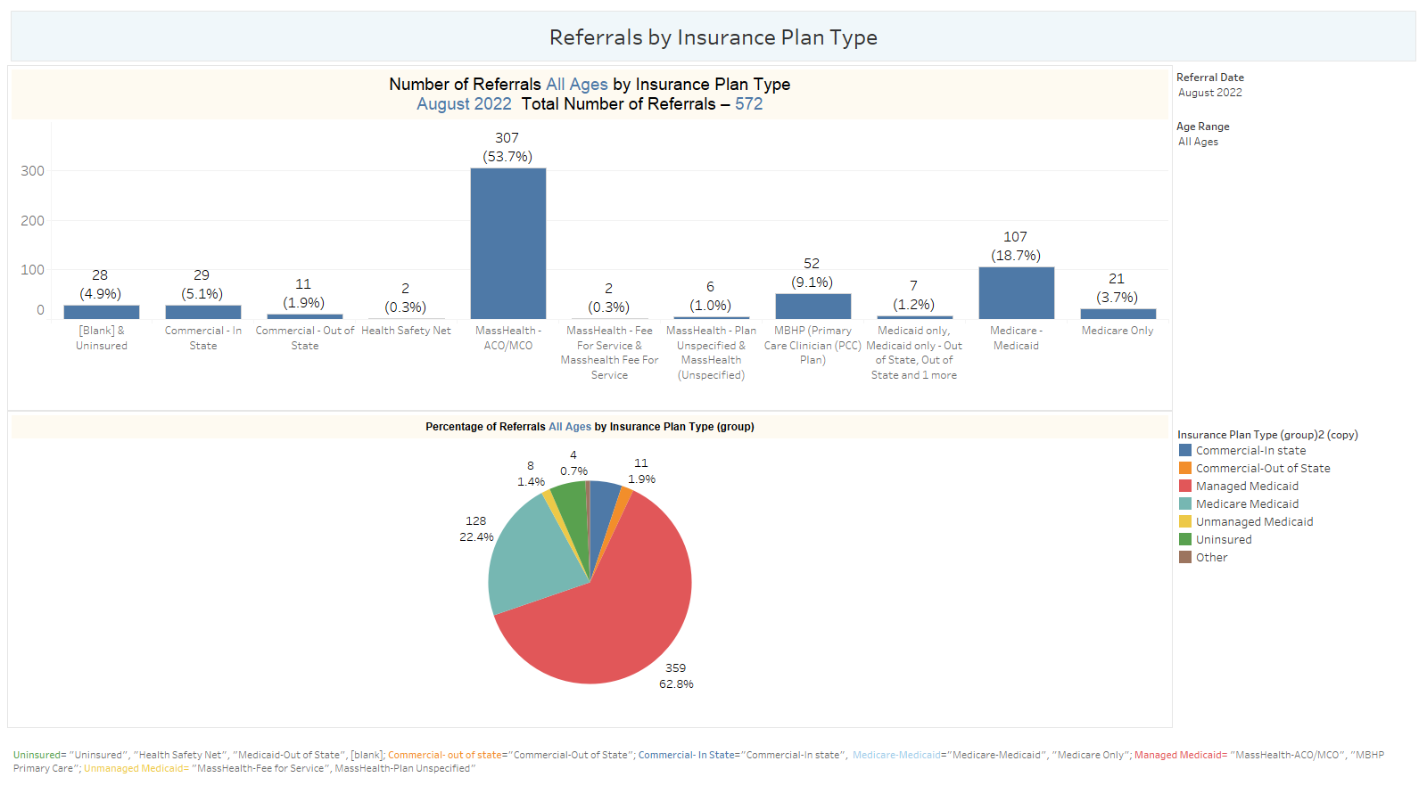

Slide 4
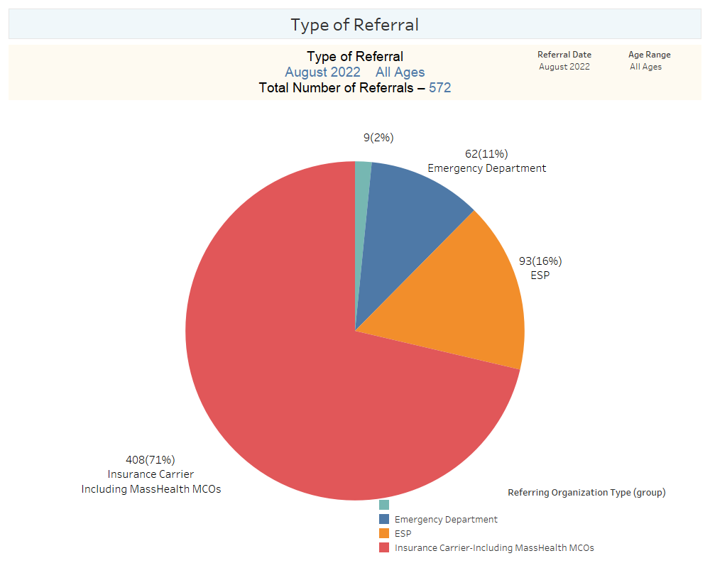

Slide 5
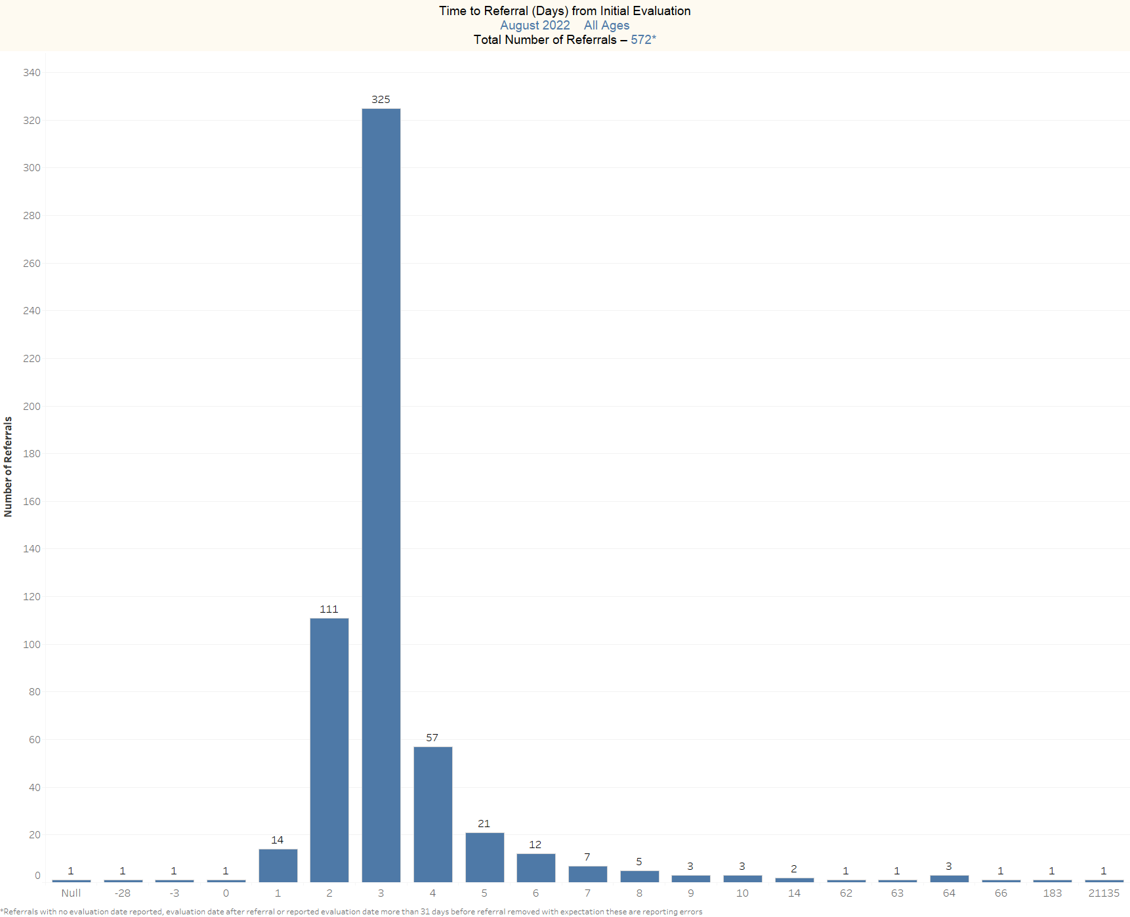

Slide 6
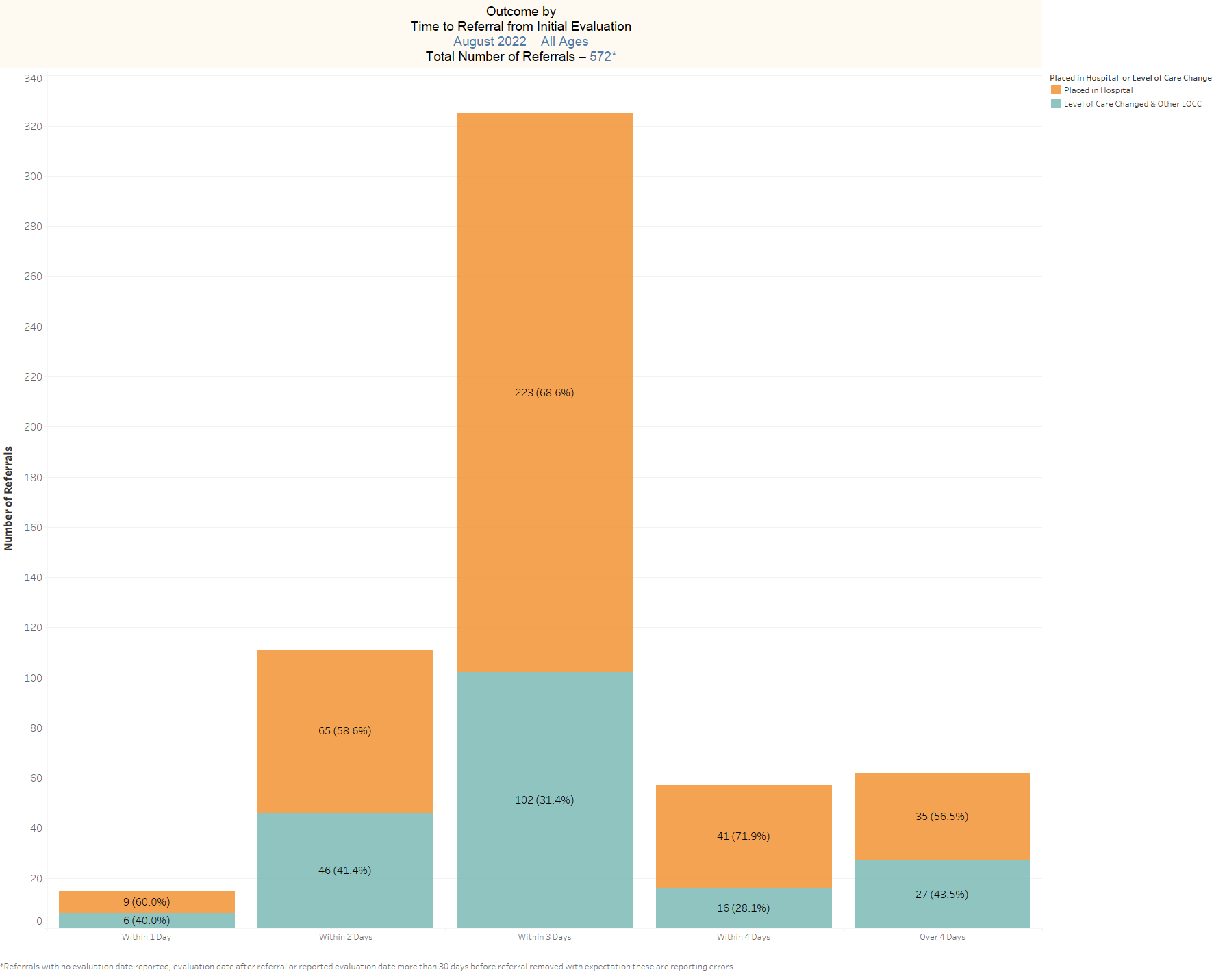

Slide 7
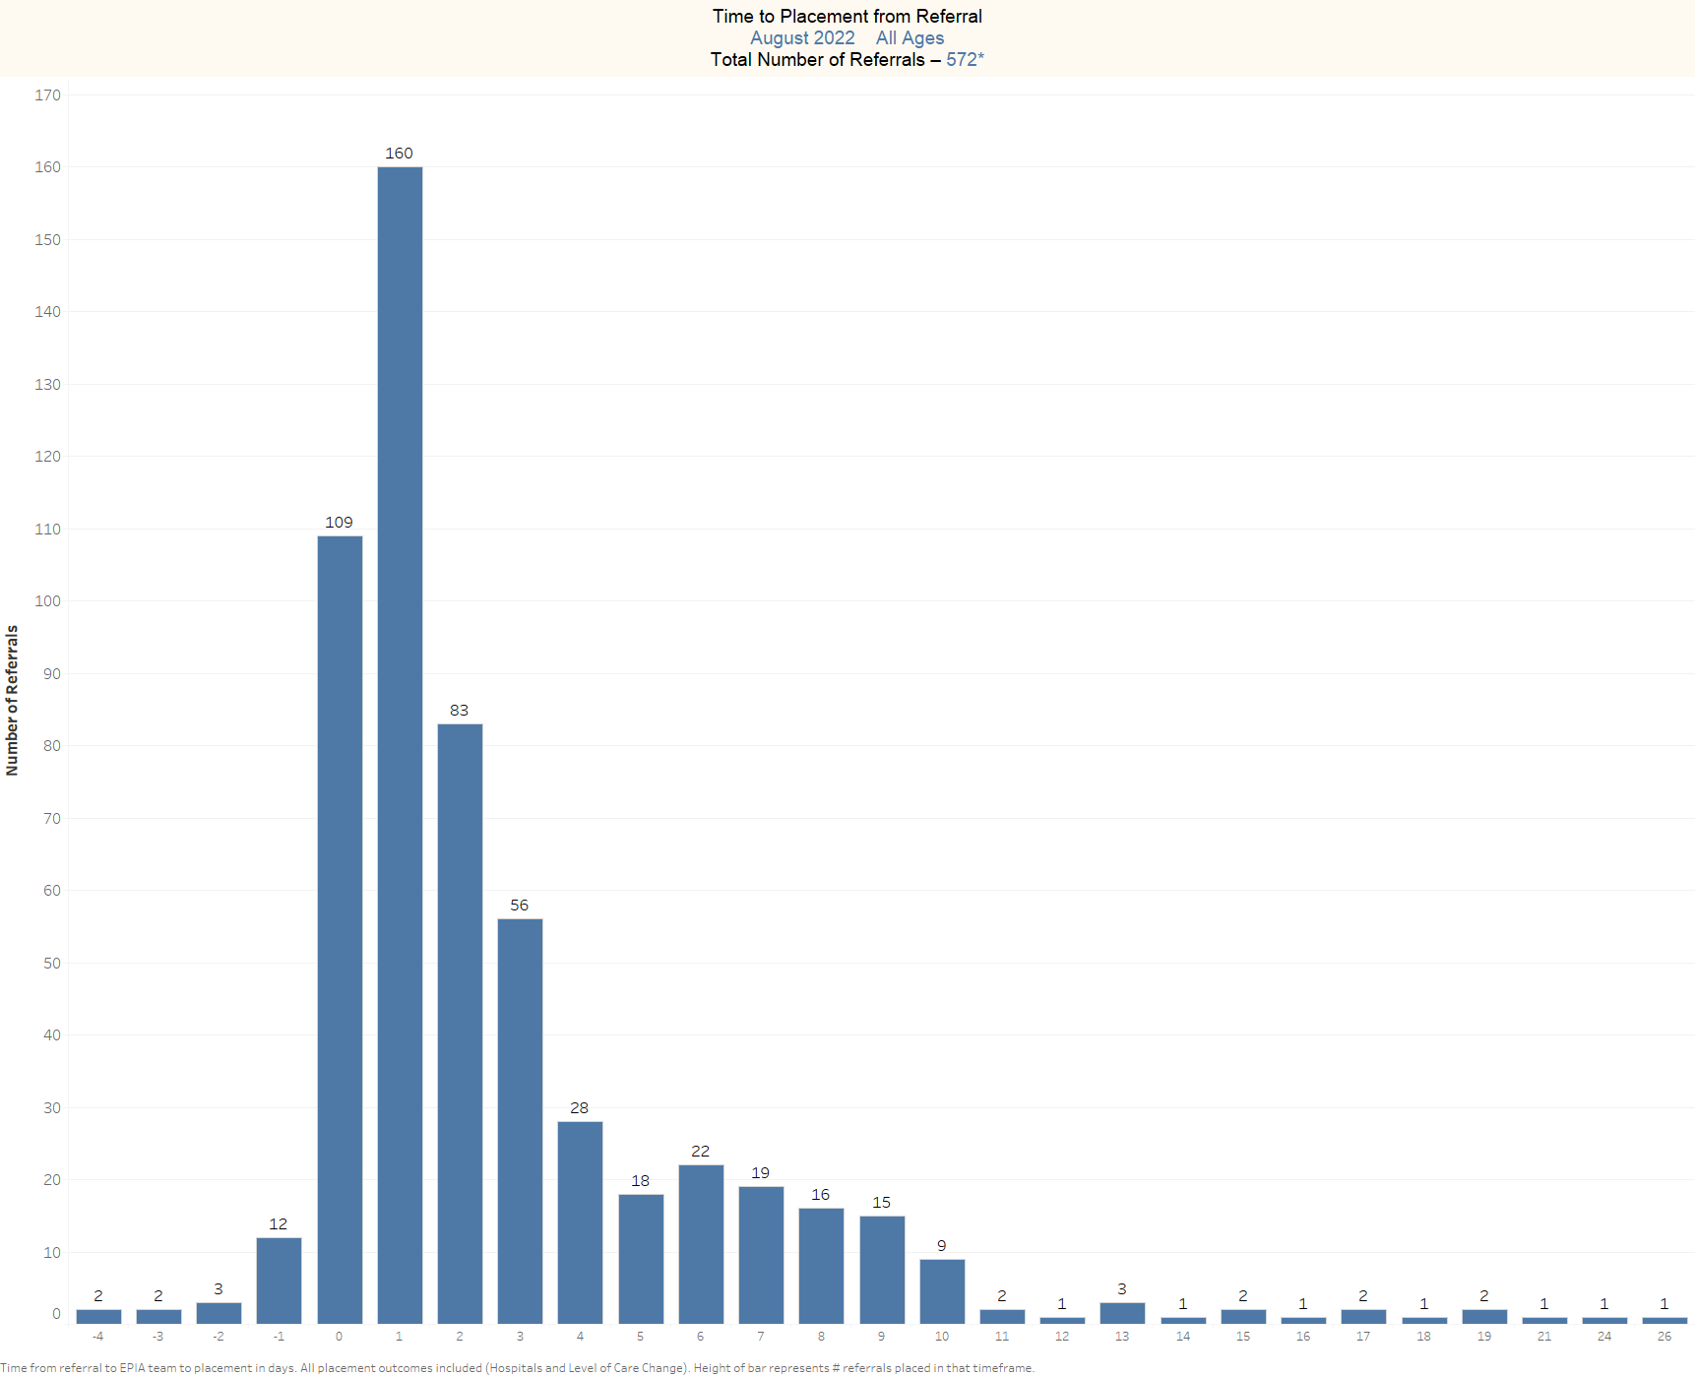

Slide 8
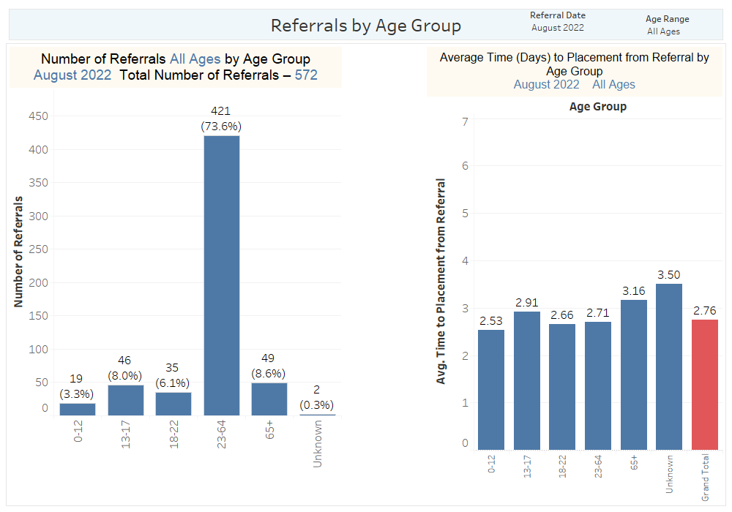

Slide 9
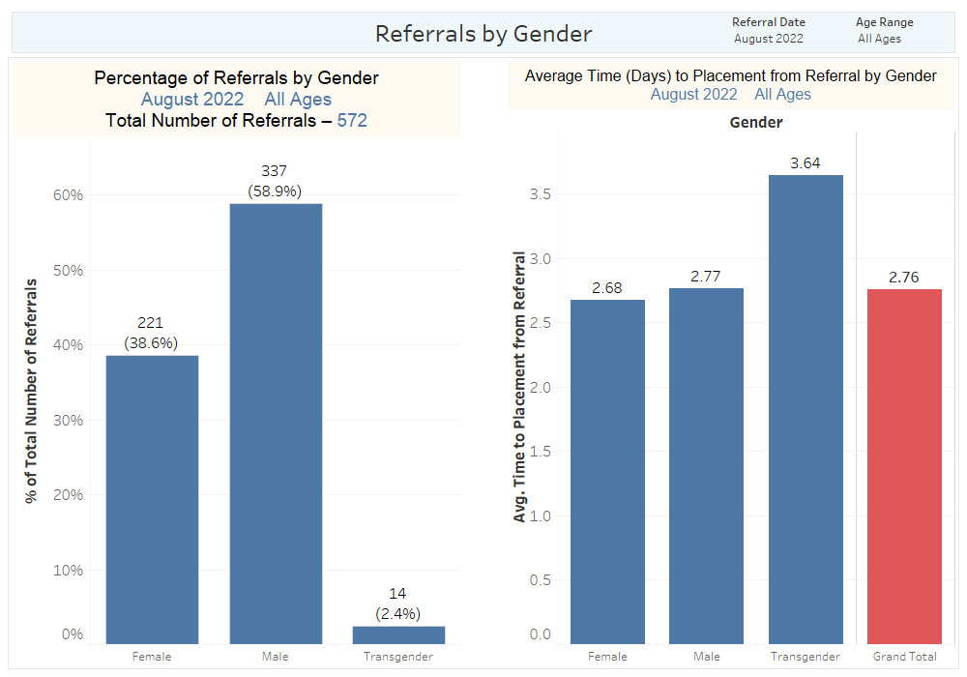

Slide 10
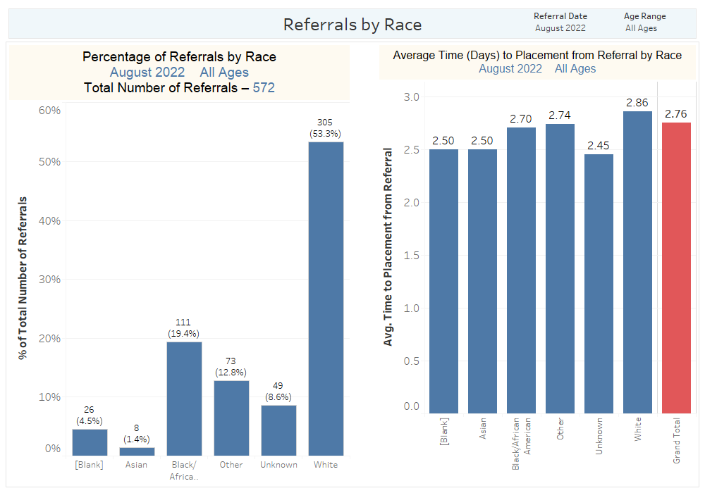

Slide 11
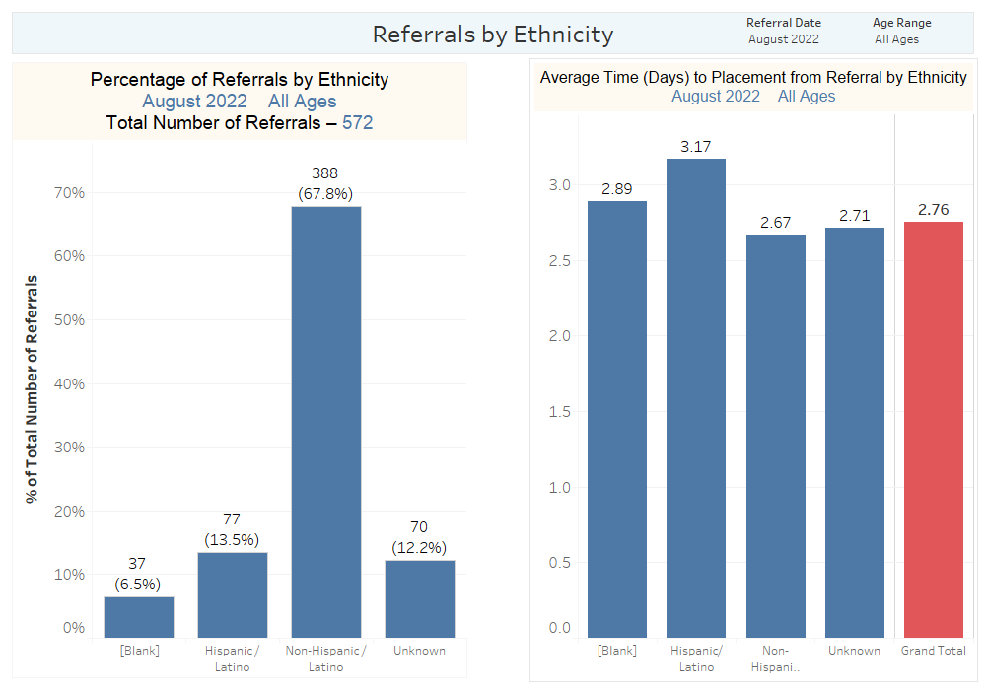

Slide 12
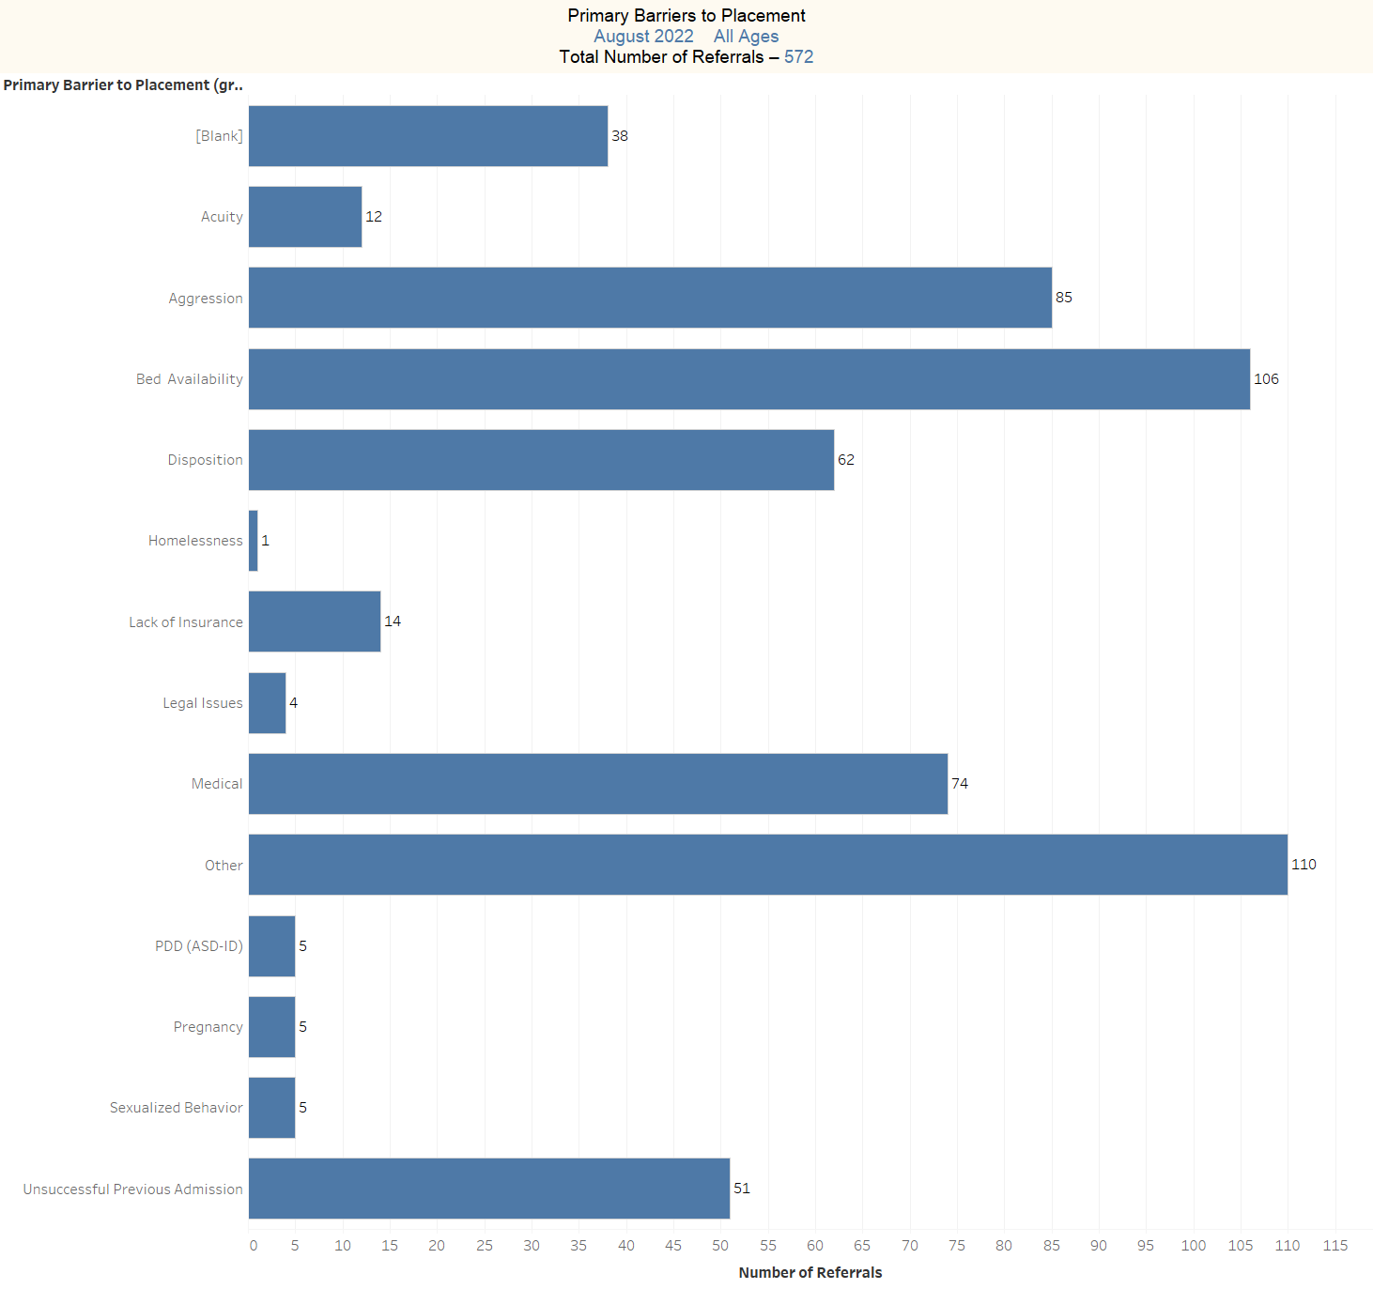

Slide 13
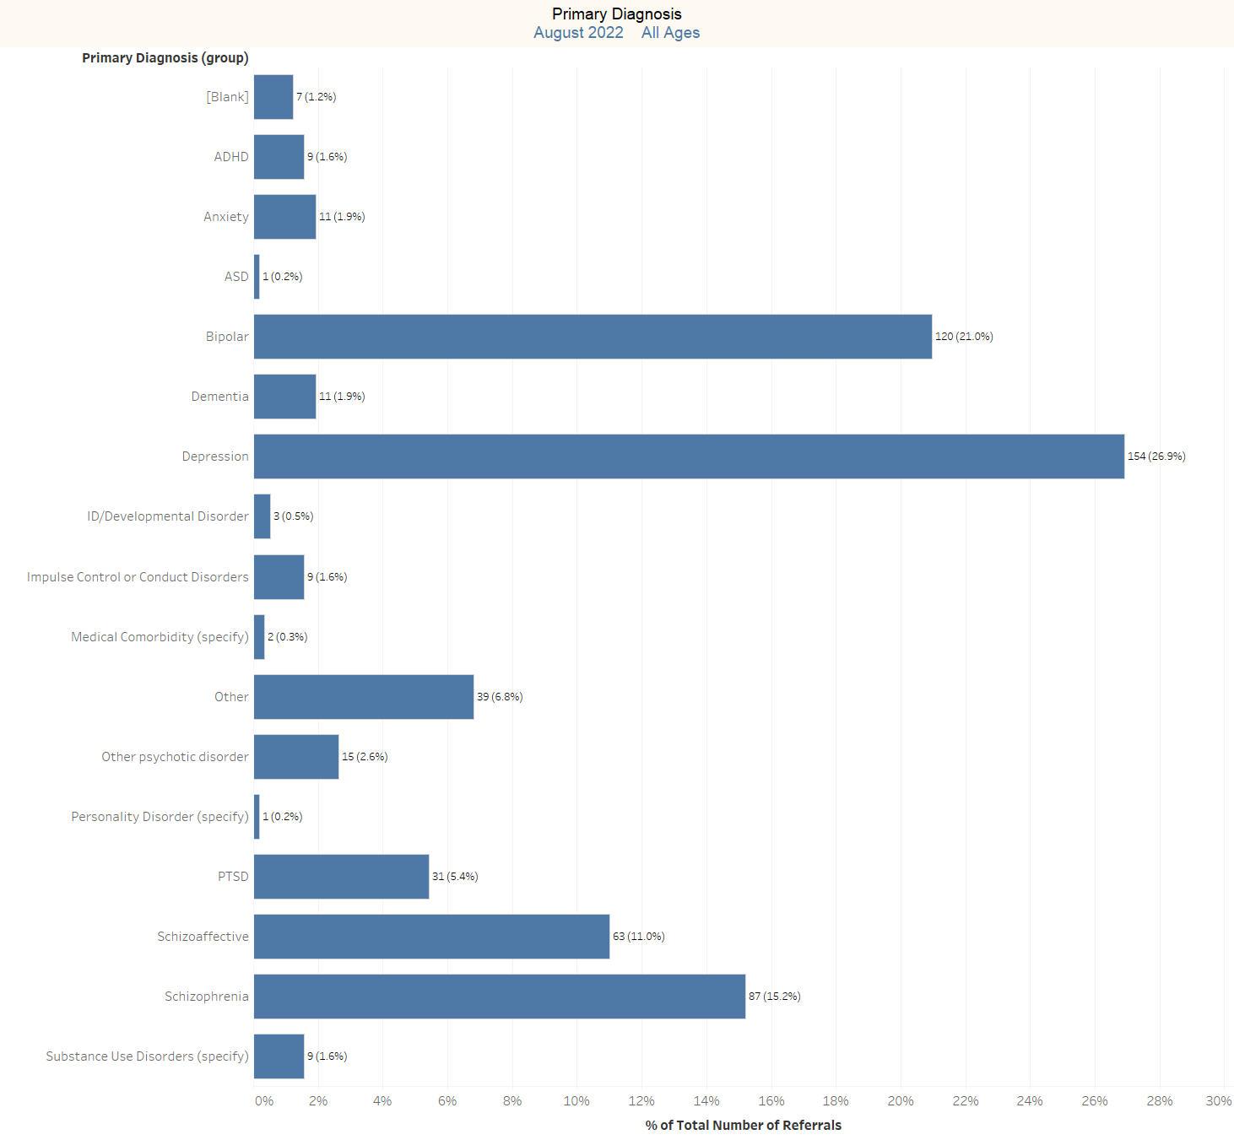

Slide 14
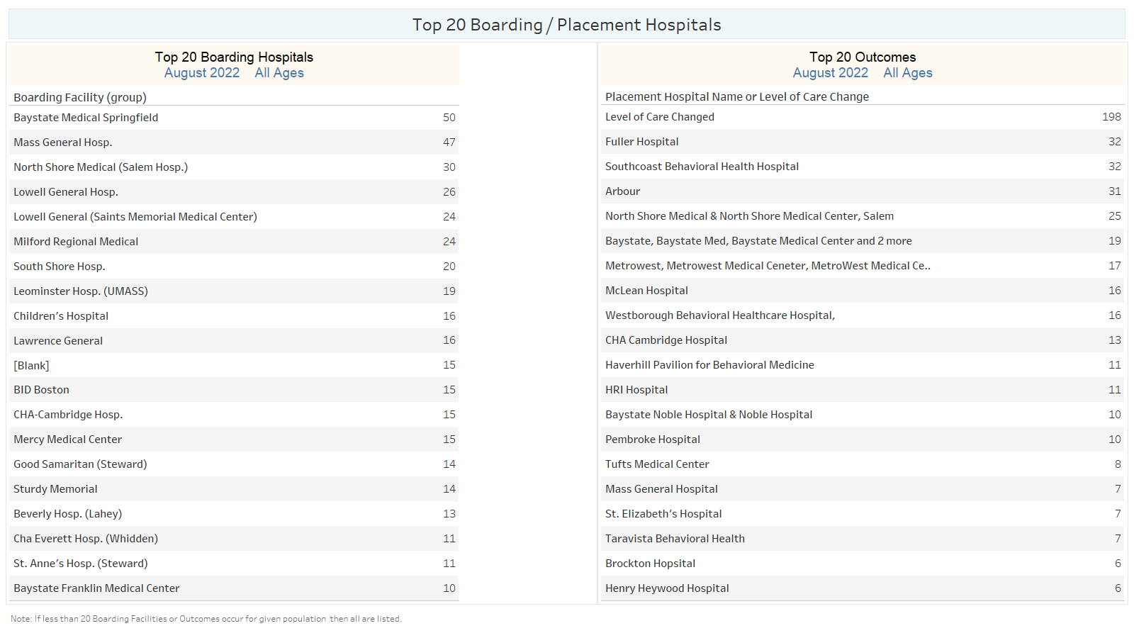

Slide 15
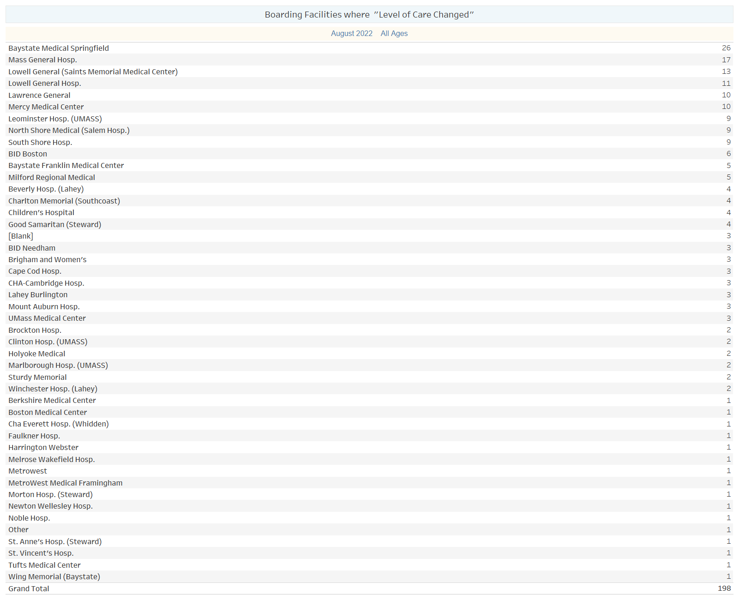

Slide 16
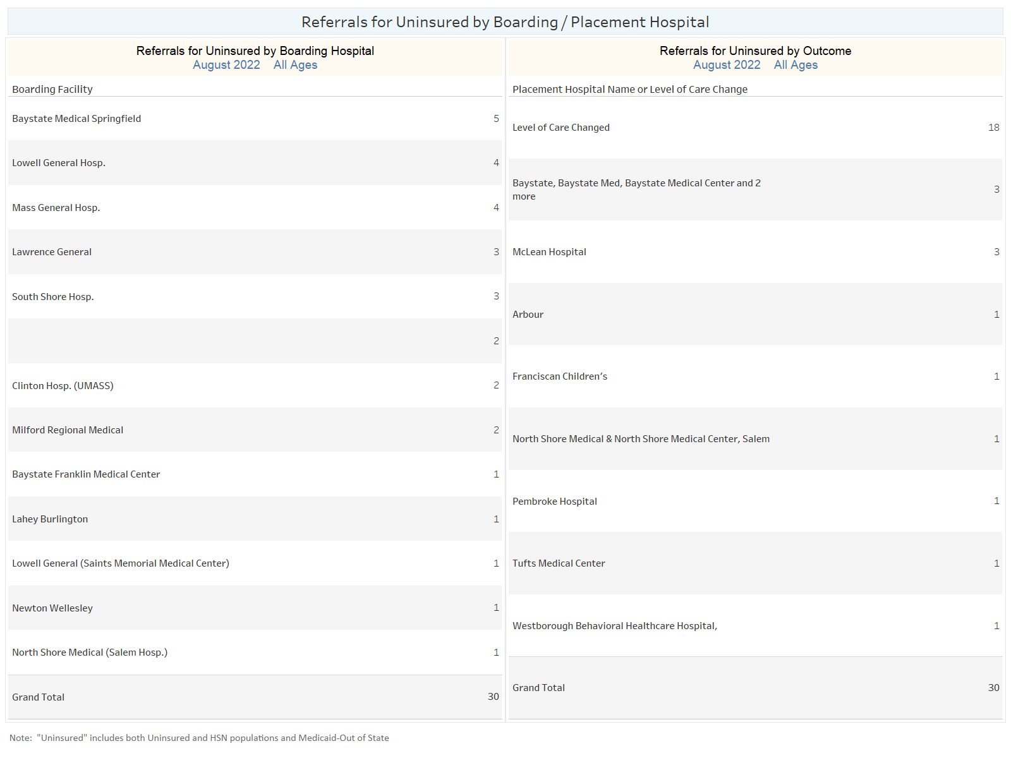

Slide 17
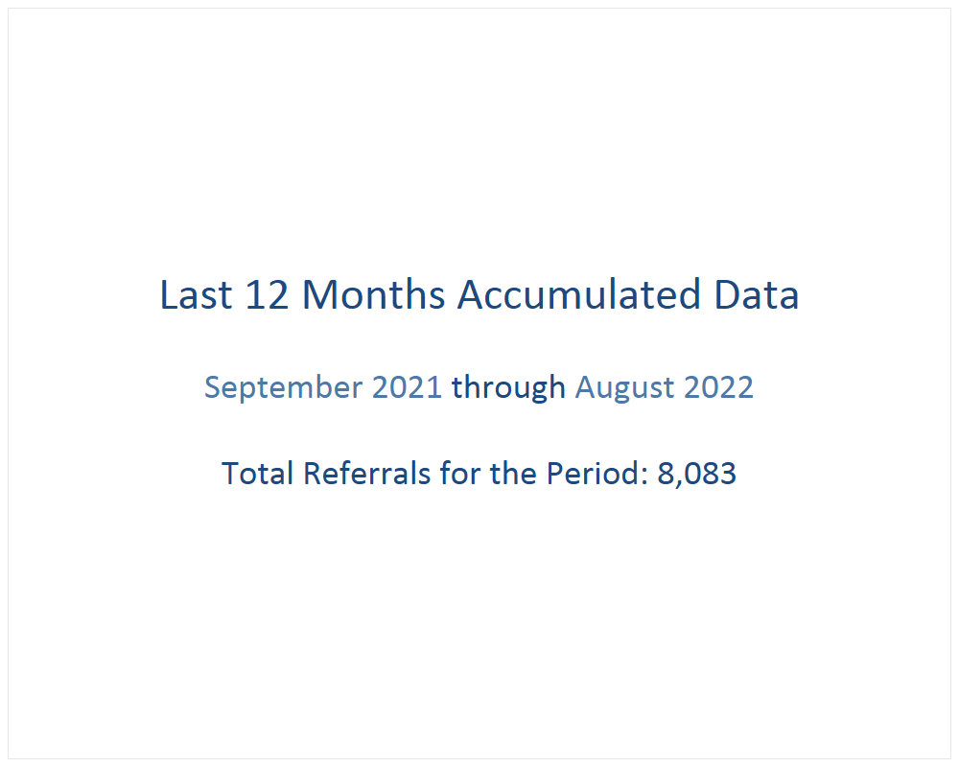

Slide 18
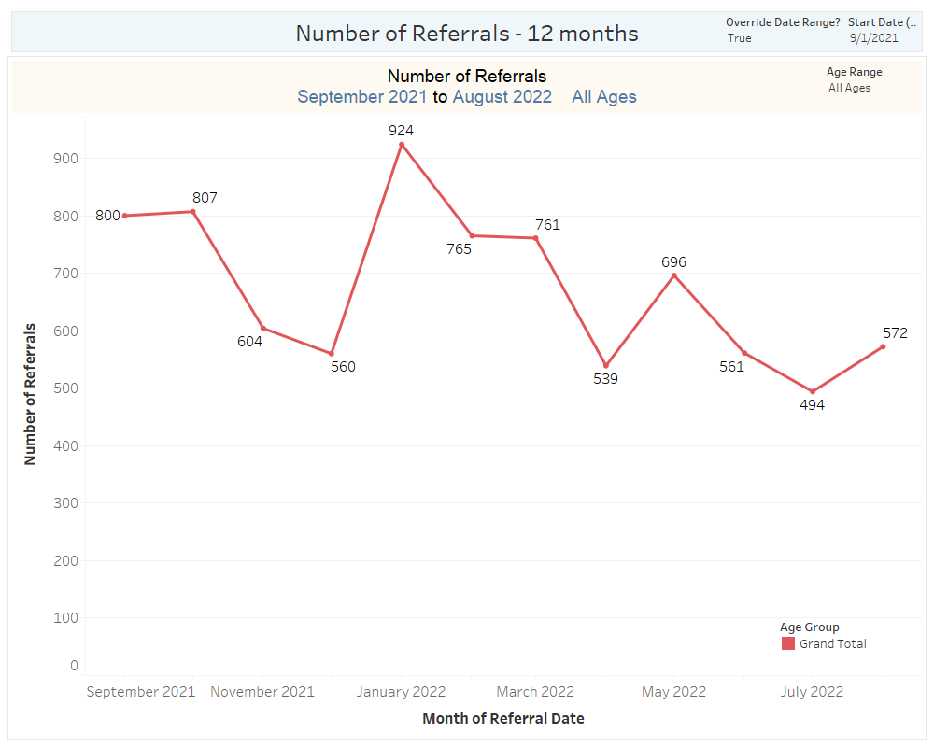

Slide 19
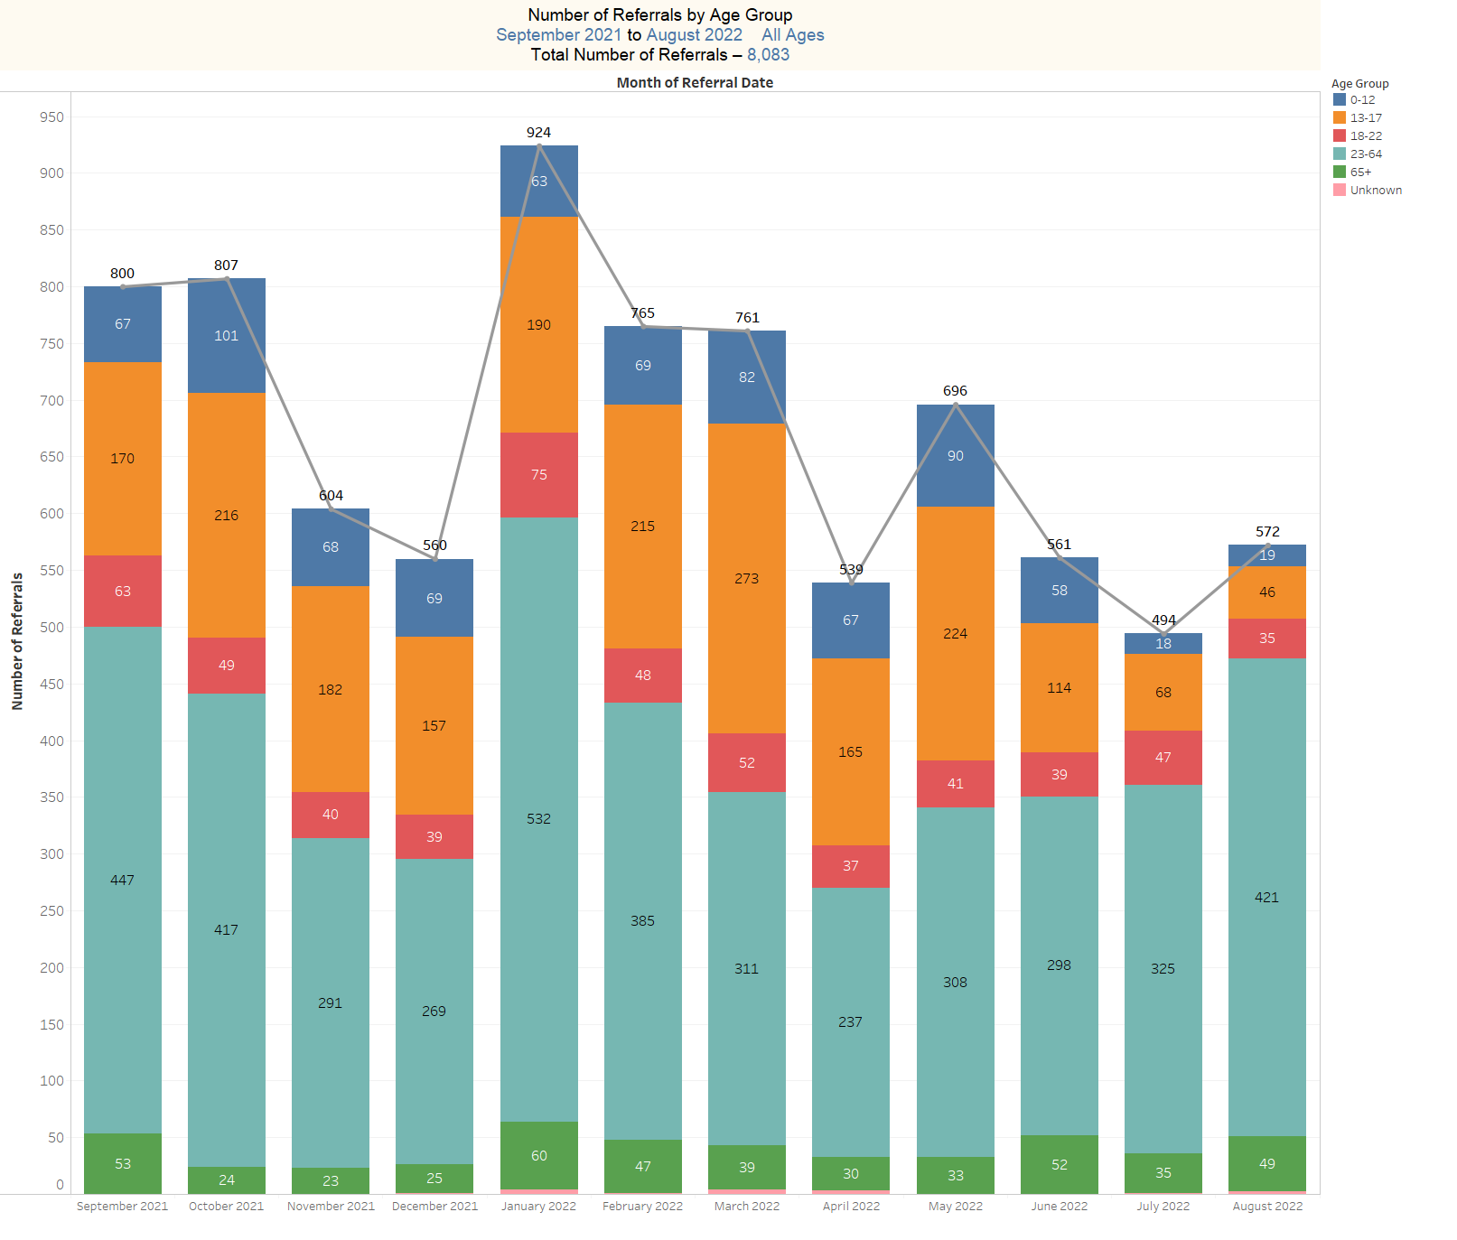

Slide 20
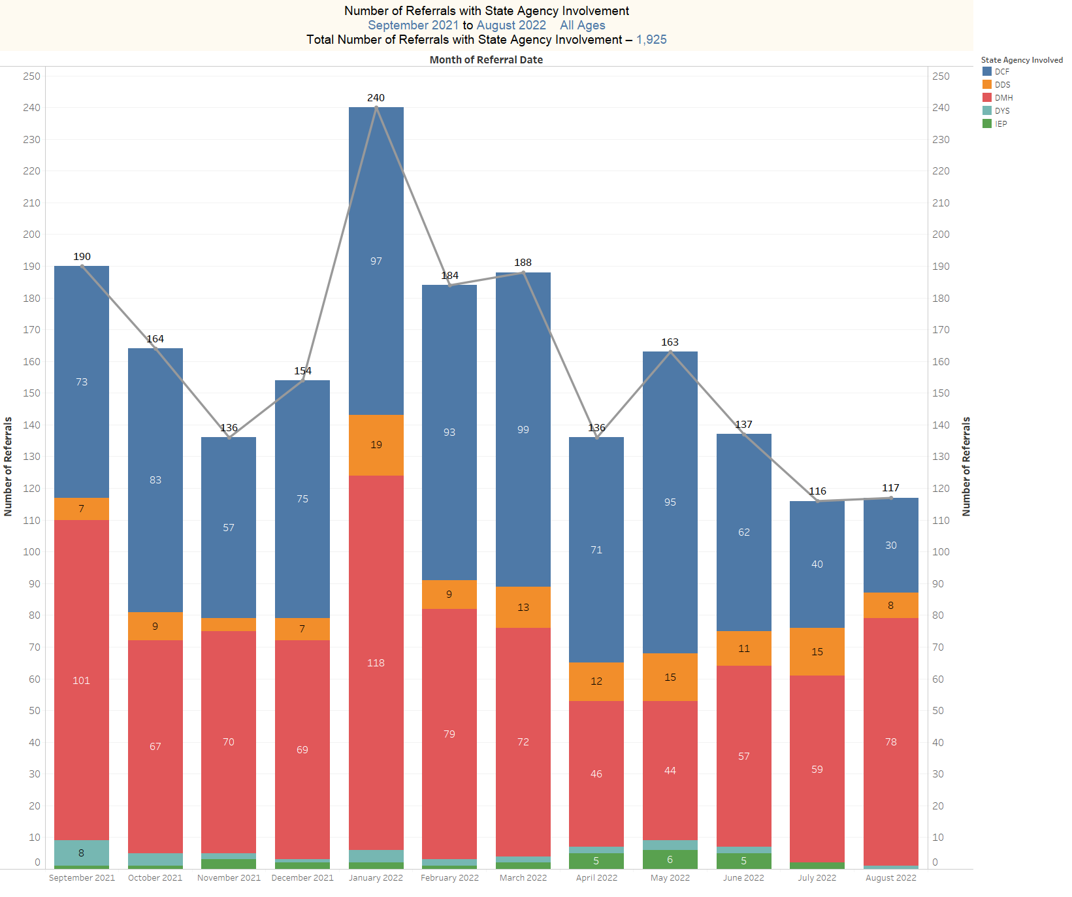

Slide 21
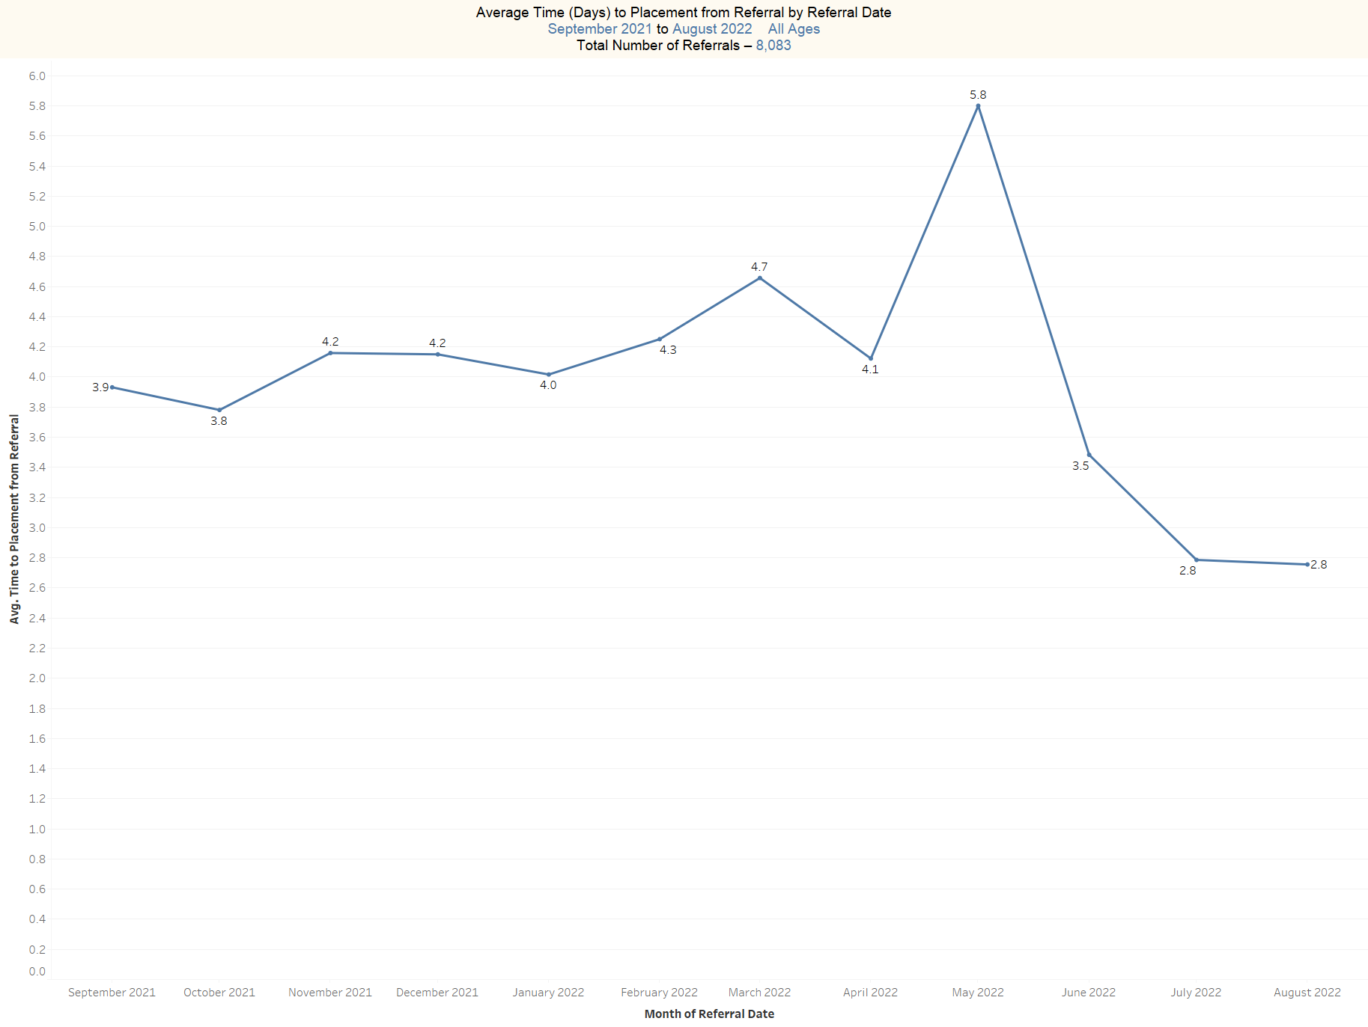

Slide 22
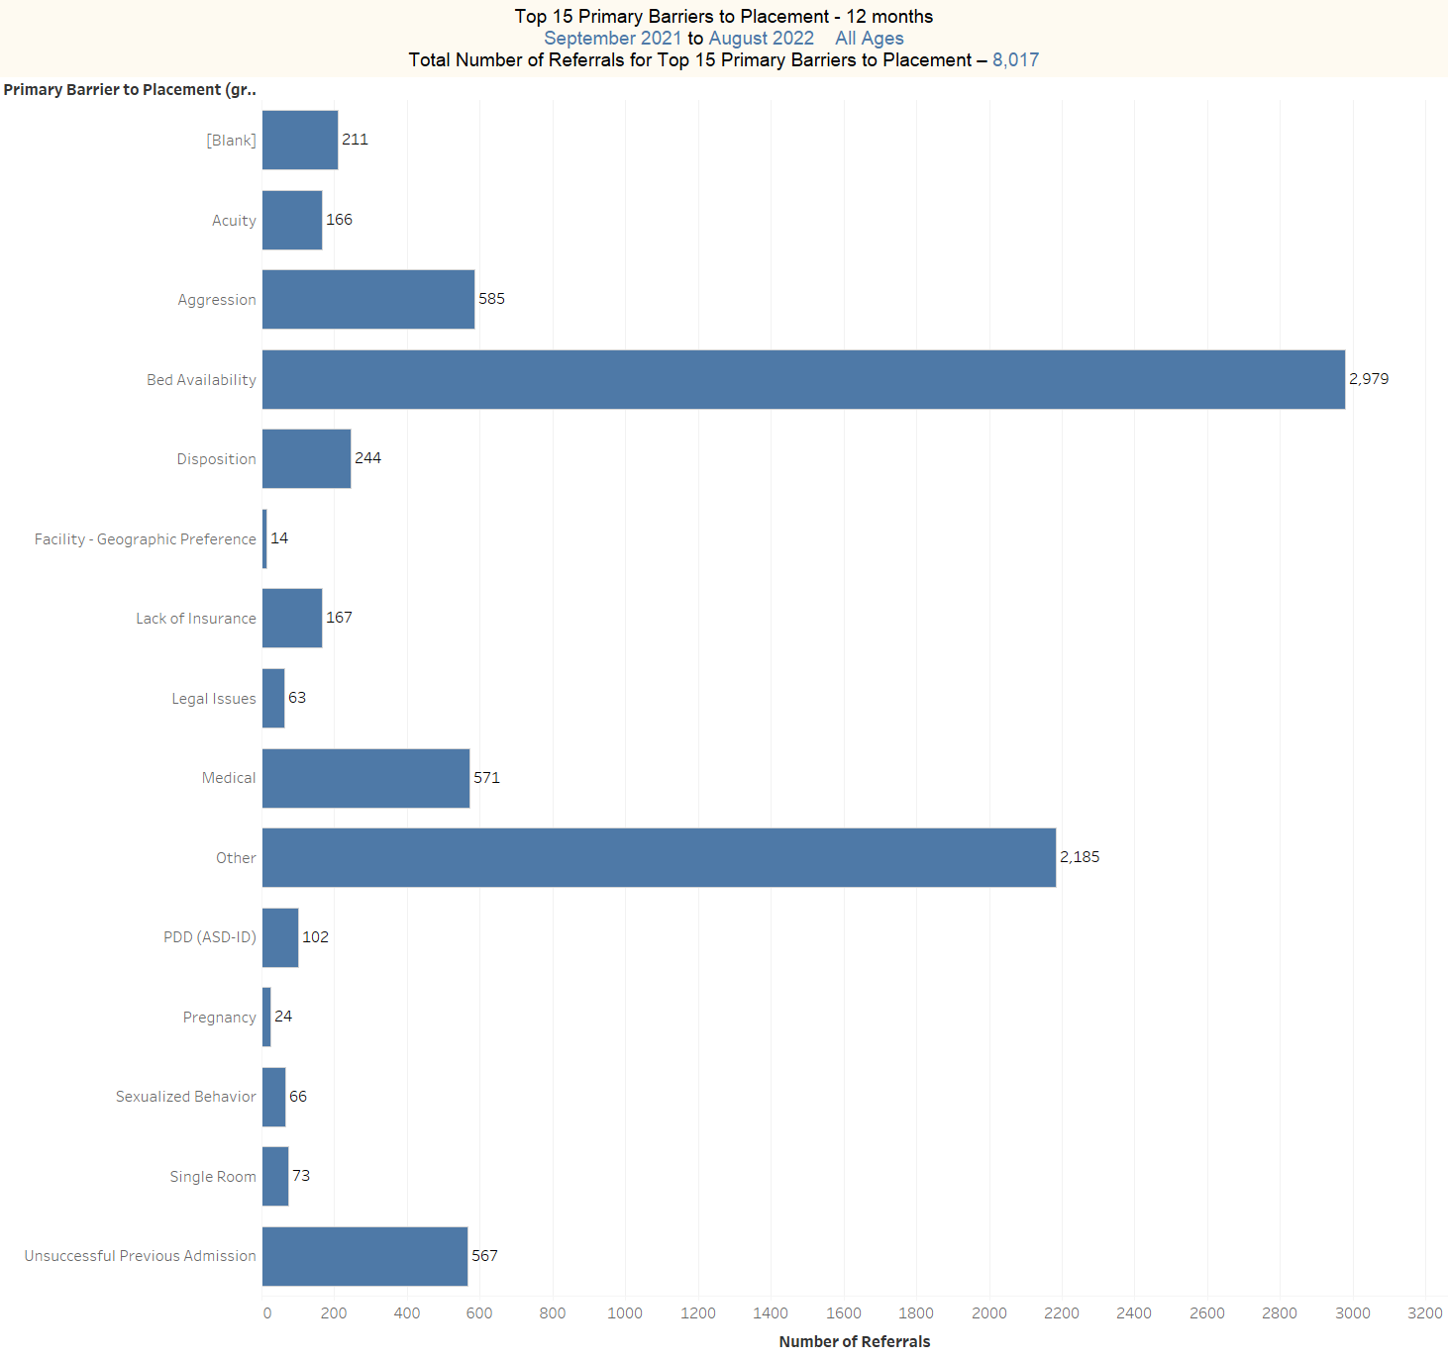

Slide 23
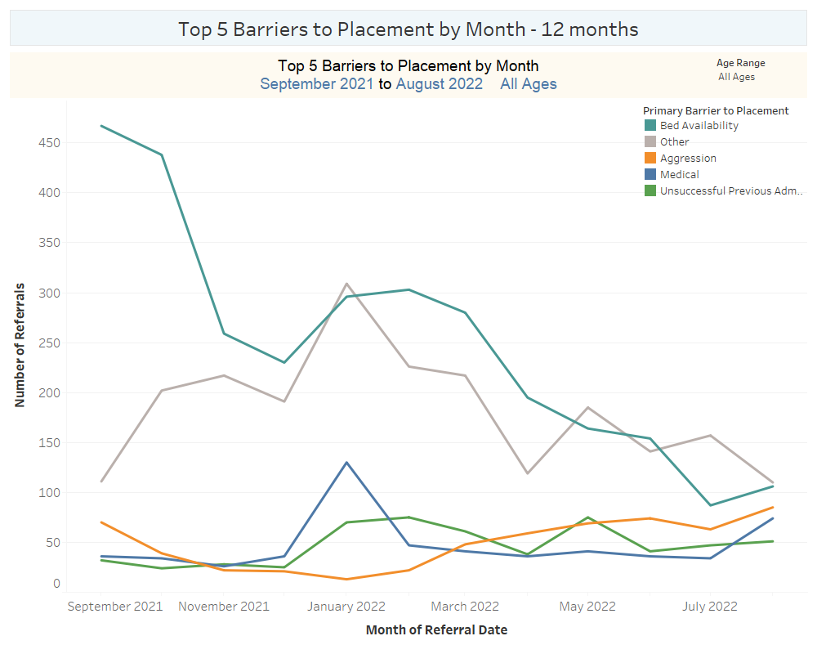

Slide 24
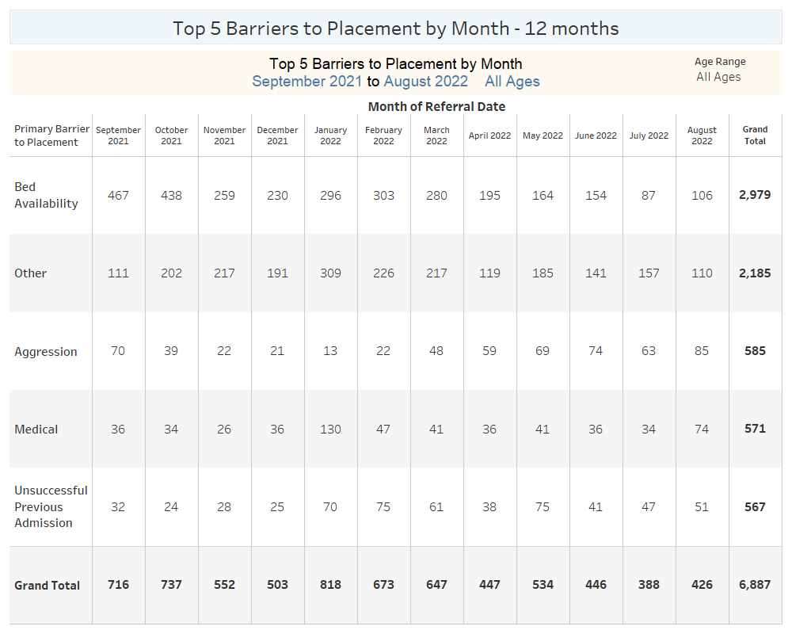

Slide 25
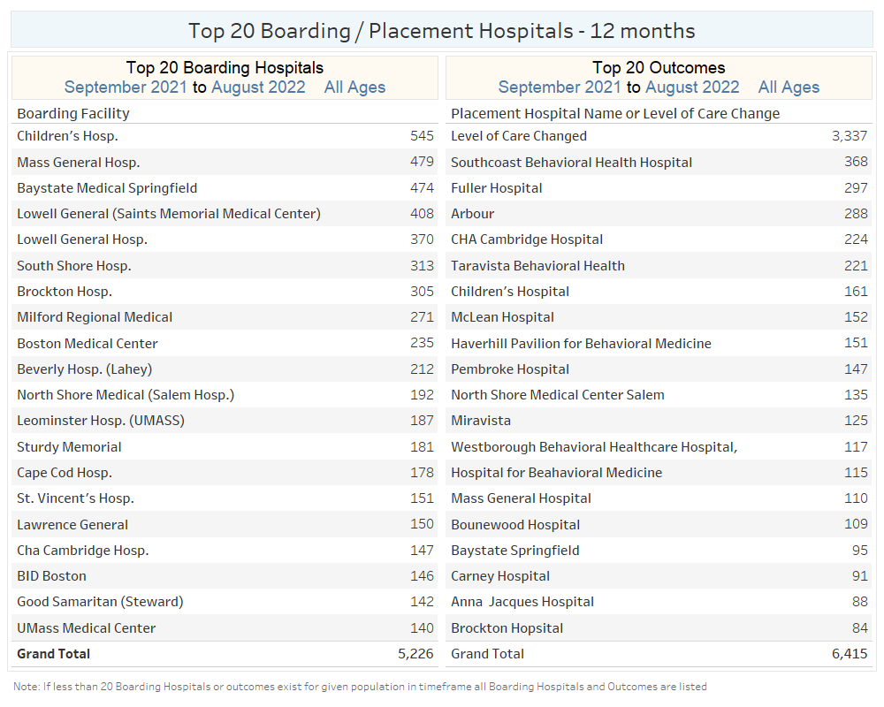

Slide 26
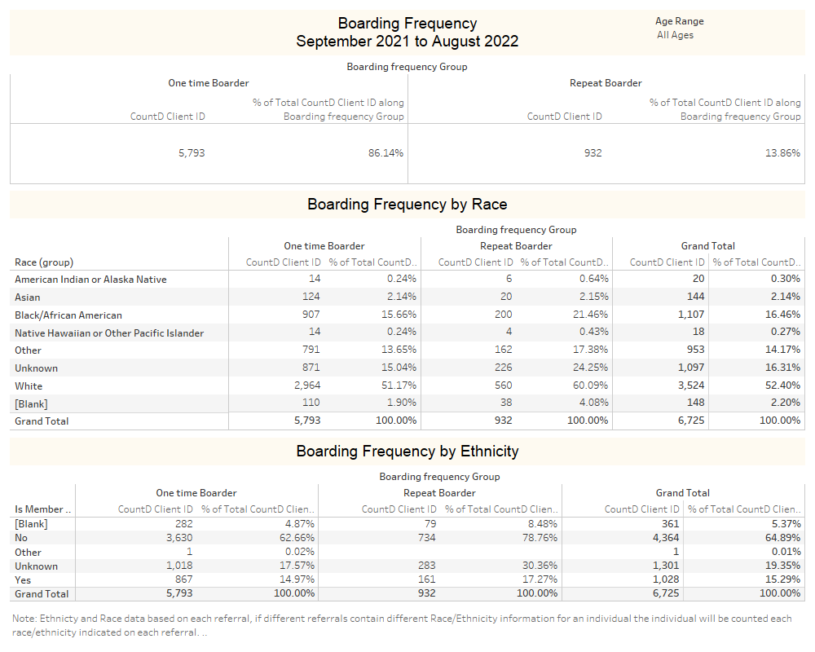

Slide 27
