Slide 1
Facilitator Info Slide: Please Remove before Presenting
This is a self-led presentation developed by the Office of the Child Advocate that can be given to audiences of caregivers, educators, and anyone who might benefit from knowledge on how to support children with wandering tendencies around water safety.
This presentation takes approximately (30 - 60 minutes) to complete, and can be done in virtual, hybrid, or in-person formats.
Please review the accompanying facilitator guide before presenting.
Notes:
REMOVE BEFORE PRESENTING

Slide 2
Autism, Wandering and Water Safety
What You Need To Know
Facilitator Name, Title, Organization
Date
Notes:
Estimated Time: 45 Seconds
Speaker Notes:
Thank you for joining us. My name is [insert name] and I am the [insert title] at the [insert organization name, if applicable].
Today we are talking about a difficult but important topic.
Wandering is a common challenge for families of children with autism. Our goal today is to provide water safety information and resources.
Interactive/Chat Options
As we begin, think about one experience you’ve had supporting a child or family where safety concerns felt especially urgent or complex.
Feel free to share with us what brought you here today and what you hope to gain.

Slide 3
About this Training
Disclaimer:
This training material entitled “Autism, Wandering, and Water Safety- What You Need To Know” (June 2026) and the companion “Autism, Wandering, and Water Safety- Training Facilitator Guide” (June 2026) were developed by the Massachusetts Office of the Child Advocate (OCA) in consultation with agencies and organizations supporting a public awareness campaign relating to Autism, Wandering, and Water Safety. It is intended only for educational purposes, specifically to increase public awareness of strategies that promote drowning prevention among children with autism.
The OCA has made this material publicly available and expects that individuals, agencies, and organizations will use, adapt, and present this information in service of the public interest. However, anyone external to the OCA who delivers or facilitates presentation of this training material shall not represent themselves as an employee, agent, or other representative of the OCA. The individual or entity that delivers the training material is responsible exclusively for any errors, inaccuracies, or liabilities that arise from their communication of the material to others. Moreover, an individual’s or entity’s use of the training material does not establish an affiliation with, or endorsement by, the OCA or the Commonwealth of Massachusetts.
Notes:
Estimated Time: 90 seconds
Speaker Notes:
Before we get started, please note that this training material, entitled “Autism, Wandering, and Water Safety- What You Need To Know” (June 2026) and the companion “Autism, Wandering, and Water Safety- Training Facilitator Guide” (June 2026) were developed by the Massachusetts Office of the Child Advocate (OCA) in consultation with agencies and organizations supporting a public awareness campaign relating to Autism, Wandering, and Water Safety. It is intended only for educational purposes, specifically to increase public awareness of strategies that promote drowning prevention among children with autism.
The OCA has made this material publicly available and expects that individuals, agencies, and organizations will use, adapt, and present this information in service of the public interest. However, anyone external to the OCA who delivers (facilitates presentation of) this training material shall not represent themselves as an employee, agent, or other representative of the OCA. The individual or entity that delivers the training material is responsible exclusively for any errors, inaccuracies, or liabilities that arise from their communication of the material to others. Moreover, an individual’s or entity’s use of the training material does not establish an affiliation with, or endorsement by, the OCA or the Commonwealth of Massachusetts.
https://www.mass.gov/orgs/office-of-the-child-advocate
https://www.mass.gov/news/massachusetts-launches-campaign-to-prevent-drowning-deaths-among-children-with-autism

Slide 4
Learning Objectives
Understand and identify key risk factors contributing to drowning deaths among children with Autism Spectrum Disorder (ASD), with a focus on wandering and elopement behaviors.
01
Describe evidence-based methods for preventing wandering and drowning in children with ASD, including therapeutic strategies, home safety modifications, and caregiver education.
02
Demonstrate how to navigate and connect families to relevant resources, and services in Massachusetts that support drowning and wandering prevention for children with ASD.
03
Notes:
Estimated Time: 30 seconds
Speaker Notes:
Our objectives today are focused on:
Understand and identify key risk factors contributing to drowning deaths among children with Autism Spectrum Disorder (ASD), with a focus on wandering and elopement behaviors.
Describe evidence-based methods for preventing wandering and drowning in children with ASD, including therapeutic strategies, home safety modifications, and caregiver education.
Demonstrate how to navigate and connect families to relevant resources, and services in Massachusetts that support drowning and wandering prevention for children with ASD.

Slide 5
Fast Facts
1 in 31 8-year-olds have autism
Drowning is the leading cause of death for children with ASD
Children with autism face a 160-fold increased risk of drowning
(Thomas et al., 2024)
Notes:
Estimated Time: ~90 Seconds
Speaker Notes:
To start, let’s consider what we are seeing in the literature as well as in Massachusetts around the prevalence of autism and this risk of drowning. So many of you might have heard about this risk through news articles or from families who are concerned about how this risk impacts their lives.
The CDC finds that 1 in 31 eight-year-olds has an autism spectrum disorder diagnosis in the United States.
This is not because there is a rise in the amount of autism that we're seeing in children but due to an increase of awareness and access to services.
Children are now more likely to get the proper diagnosis that can help them learn, grow and interact with the rest of their community.
For the specific population of children with autism, drowning is the leading cause of death. Children with autism face a 160-fold increased risk of drowning compared to children without autism.
It is important we talk about why this is occurring and what's available to help prevent drownings in the future for children specifically in the case of children with autism spectrum disorder.
Interactive/Chat Option
What stands out to you about these statistics?

Slide 6
High Risk Behaviors
Wandering
Affinity for Water
Drowning Risk
Wandering is more common in children with Autism
When children wander, they may end up in unsafe places, like near water or in traffic
Researchers note that children with autism may be especially interested in water
(Thomas et al., 2024)
Notes:
Estimated Time: Two Minutes
Speaker Notes:
One study found a nearly five-times greater occurrence of wandering in four- to five-year-olds with compared to their neurotypical peers. A research study found that between one-quarter and one-half of caregivers reported wandering in the preceding six months. When we look at the connection between the diagnosis and drowning, we want to identify the high-risk behaviors leading to these adverse outcomes.
Wandering, also called elopement or bolting, is the idea that a child will leave a supervised area. This could happen at home, or while at a park or grocery store. In most children, we see this in the early toddler stage. Parents know the risk of taking their eyes off a two-year-old for a moment. However, in the autism population, this behavior can persist much longer, sometimes all the way through adulthood.
Children with ASD often have an increased affinity for water. Some think this is due to the sensory pressure of water.
Deep pressure can be very comforting, like a weighted blanket. Water is also sparkly and has movement, which is attractive to many children.
When you combine wandering with an affinity for water, the risk is clear.
A child who wanders may be dysregulated or overwhelmed by an unfamiliar environment and seek out a body of water for comfort. They might also associate it with fun, like a local pond they visit on walks.
These factors lead to the increased drowning risk we see in the news.

Slide 7
Counseling Parents
Only 1 in 3
of parents of children with autism receive counseling about wandering.
(Thomas et al., 2024)
Notes:
Estimated Time: ~90 Seconds (30 seconds of speaking and one minute to leave the poll open)
Speaker Notes:
For [insert audience] like you, it is vital to be knowledgeable enough to provide safety information while acknowledging the stress and fear caregivers face.
Interactive/Chat Option (utilize a poll or Mentimeter):
On a scale from 1-5, how confident are you in counseling a parent of a child with autism about wandering and water safety?

Slide 8
Layers of Prevention
Provide tools and guidance to support parents and providers develop a layered approach to prevention of wandering and drowning
(Wikipedia, 2023)
Notes:
Estimated Time: ~45 seconds
Speaker Notes:
One study found that only one-third of parents of children with autism reported receiving any formal counseling about wandering.
This is a significant gap.
While it can be hard to talk about “taboo” topics like child death, acknowledging these concerns is important for injury prevention.
If a child repeatedly wanders, the parent is under incredible stress and often feels isolated. Making sure we can talk about it and point them toward support is an essential tool.
Caregivers need a layered approach to prevent wandering and subsequent drowning. It’s a complicated process that needs to be highly tailored to the family's needs.

Slide 9
Prevention and Harm Reduction
Home modifications
Therapies
Tracking & Monitoring Devices
Educating First Responders
Safe Water Habits
Notes:
Estimated Time: One Minute
Speaker Notes:
Earlier, we showed a graphic of the “Swiss Cheese Model” of prevention. Families often use several strategies at once.
Here are the most common “slices” used:
Home Modifications: Parents can use padlocks or decals to prevent wandering.
Therapies: Depending on age, different therapies can help curb the behavior.
Tracking and Monitoring Devices: We have a list of considerations to help you coach families on selecting a device.
Educating First Responders: When elopement happens, first responders must be knowledgeable, as these calls differ from traditional 911 calls.
Safe Water Habits: Knowing how to swim can buy time in an emergency, but a child in the water alone is a dangerous situation. Just because someone can swim doesn't mean they can swim in cold water or a pond.
Now let's get into those home modifications and resources.

Slide 10

Home Modifications
Physical Barriers
Out of reach door locks
Window locks
Alarms
Door alarms
Window alarms
Visual Cues
Stop sign stickers
Yard fencing
Enclosing beds
Pool fencing
Pool alarms
Big Red Safety Box
Free-of-charge toolkit given to autism families
Keep fire safety and emergency evacuation planning in mind
Notes:
Estimated Time: 90 Seconds
Speaker Notes:
Home modifications can be a quick fix. We focused on this because our review found that while it can happen at school or residential programs, 52% of children who fatally wandered started out at home.
Physical barriers include:
Ensuring door and window locks are out of reach.
Putting up yard and pool fencing.
Enclosing beds, such as using netting to help the child stay in bed so the caregiver can rest, and
"Stop" decals or "No-Go" signs if that works for the child
Alarms on doors, windows, and pools.
If an alarm goes off too often, people tune it out. Alarms are good practice, but they are not foolproof.
You must also balance the risk of wandering with the risk of being stuck during a fire.
If you put high deadbolts on doors, make sure you have an emergency evacuation plan that you practice so you can get the bolts undone quickly. Fire spreads very fast. Balancing these risks is a necessary part of the conversation.

Slide 11
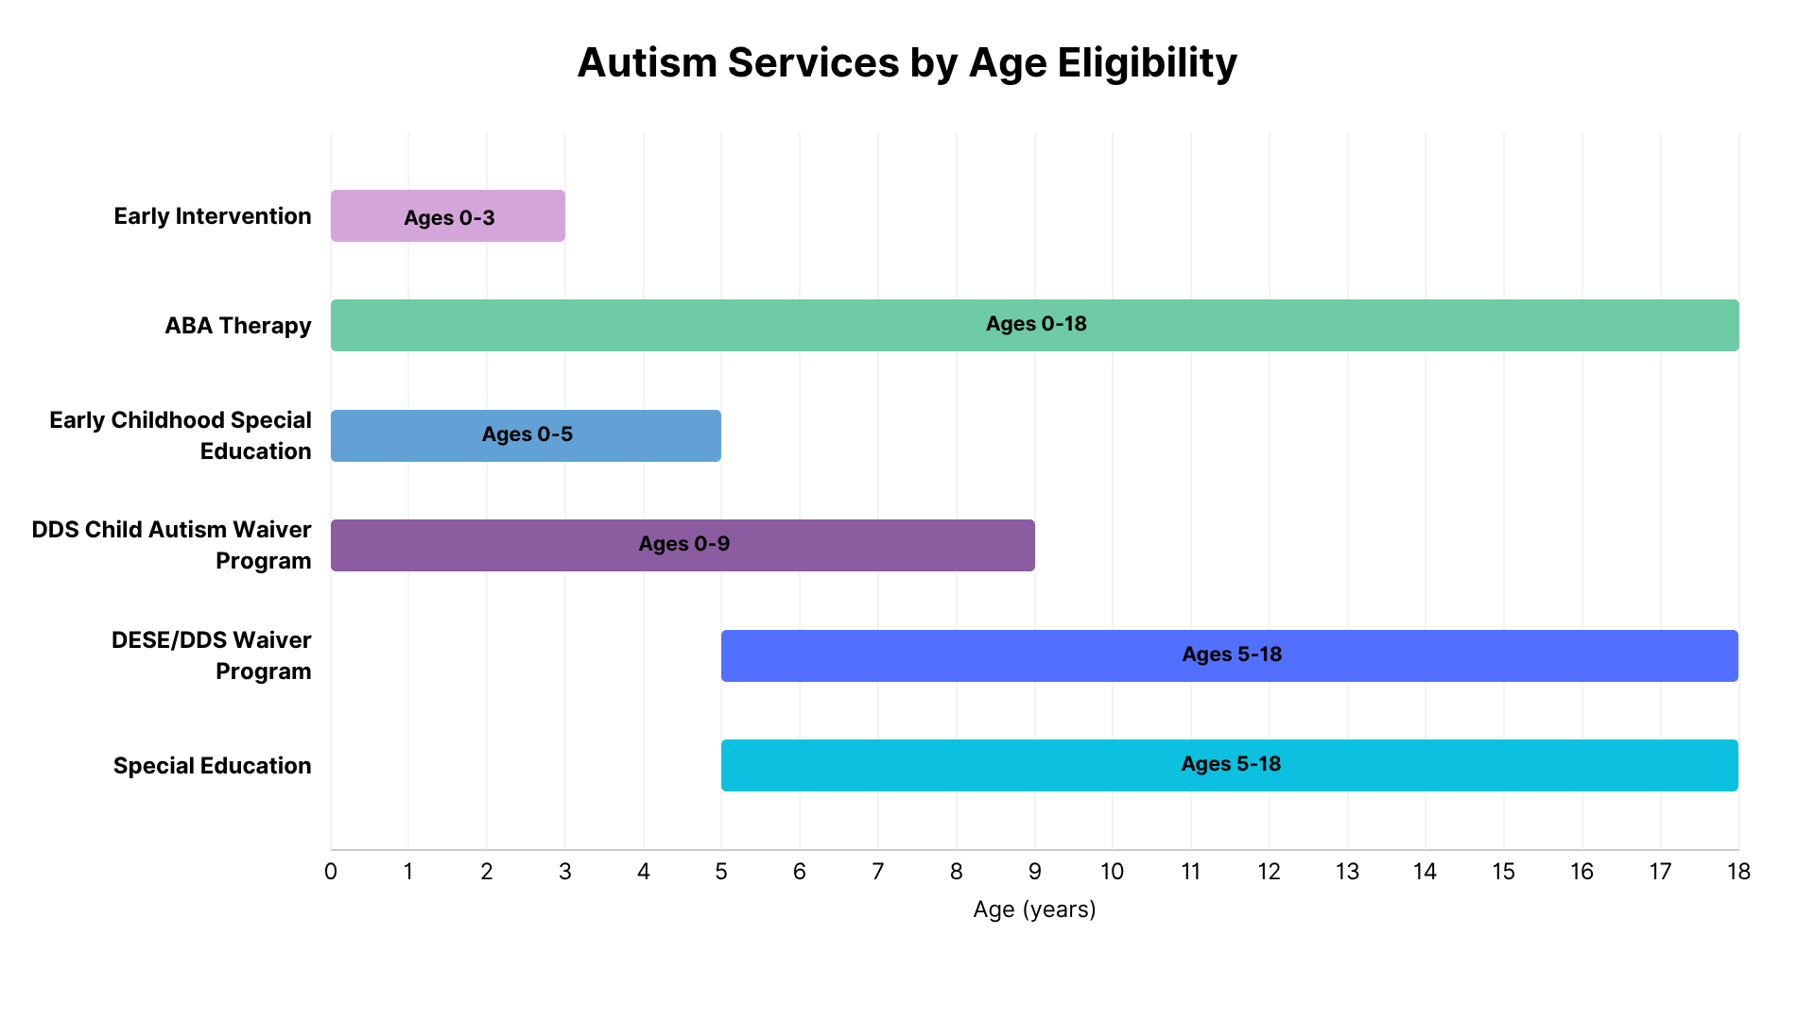
Autism Services By Age Eligibility
Notes:
Estimated Time: Two Minutes
Speaker Notes:
This chart shows behavioral interventions across the lifespan up to age 18. These systems are complex. It can be stressful for a parent and/or caregiver to manage all of the stressors of life and navigate these systems.
Wandering behavior can be addressed by Applied Behavior Analysis (ABA) and other therapeutic treatments.
What we have here first and foremost is early intervention: Early Intervention providers are wonderful at figuring out assessing and making plans to get children the skills they need, and it starts so early.
Next is ABA therapy, that is Applied Behavioral Analysis: This can include things like floor time or other therapeutic interventions that help children get to the root of the behavior address that behavior and redirect to healthier behaviors. There's lots of ABA centers across the Commonwealth. But it can be difficult to navigate them. DDS programs offer financial supports for ABA and other therapies.
Then in the preschool ages we also have early childhood special education and then we move into special education in the school-age years starting at five.
There's a DESE and DDS waiver program for children with autism spectrum disorder as well as the standard DDS Department of Developmental Services Child Autism Waiver program that runs from zero to nine. There are many resources and therapies that could help depending on the age and need of the child.
Next, we have our tracking and monitoring devices. We have a handout that we'll be able to provide with many of these resources.

Slide 12
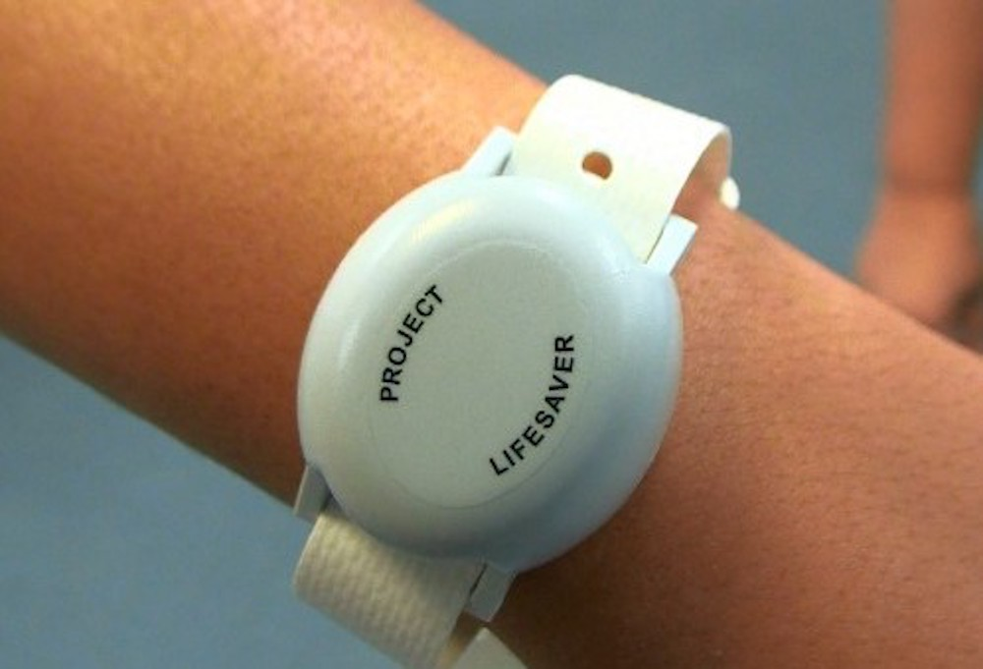

Tracking & Monitoring Devices
Tracking and monitoring devices can alert a caregiver as soon as a child has wandered, or help in locating a missing child
Consider:
  Price
  Wearability
  Type of technology
  Battery life
  Water resistance
  Monitoring alerts
https://www.mass.gov/info-details/autism-wandering-and-water-safety-financial-resources#monitoringtracking-devices
Notes:
Estimated Time: ~90 Seconds
Speaker Notes:
Tracking devices can bring up complicated feelings, but they are helpful during an elopement. You don't have much time to reach a child, so real-time tracking is vital.
Considerations for families include:
Price: Not all of these devices are affordable. Some of them are paid for by service providers so you can get them for free.
Wearability: Autism often involves sensory challenges, making bracelets or anklets difficult. Some are “non-removable” while others are easily taken off.
Technology: Some devices have radio frequency-based technology that can pick up signal easily. Other GPS devices need satellite access and may not work if wet or underground.
Alerts: There are devices that also notify you the moment a child leaves a specific parameter.
Interactive/Chat Option:
Here is a list of products to consider. These products are not endorsed by us or the Office of the Child Advocate, but we do want to offer some of this research for caregivers who would otherwise have to do this on their own.
SafetyNet Tracking Systems
Project Lifesaver
Apple Air Tag
Angel Sense
Verizon Gizmo Watch
JioBit
Amber Alert GPS
GPS Smart Sole

Slide 13
Educating Emergency Responders
Proactively provide or prepare information for first responders
  Supports help seeking behavior in the child
  Grounds the caregiver in a moment of crisis
  Expedites and informs the response
File of Life
9-1-1 Disability Indicator Form
Meet and Greets
Notes:
Estimated Time: 90 Seconds
Speaker Notes:
One way we can prevent a situation from getting worse once wandering has occurred is by proactively preparing emergency responders. Families can visit police or fire stations to introduce their child. This helps the child feel comfortable and allows parents to explain how to search for their specific child.
We also acknowledge that some families may have reasons that they do not want to have this proactive kind of contact with a police officer specifically. An alternative is to connect with their local fire department.
Caregivers can keep a file of life including information about allergies, medications, contact information, and health problems that you'll want to have on hand for if they are calling 911. In that moment it can be incredibly hectic and stressful. People can panic and forget information that they want to provide. Keeping important information easily accessible, like on your refrigerator, can be helpful if you need to contact 911. Information to include might be:
Verbal/nonverbal status
Nearby water sources
The 911 Disability Indicator Form, which is available on mass.gov. This links your phone number and address to the dispatcher’s system to show a vulnerable person lives there.

Slide 14
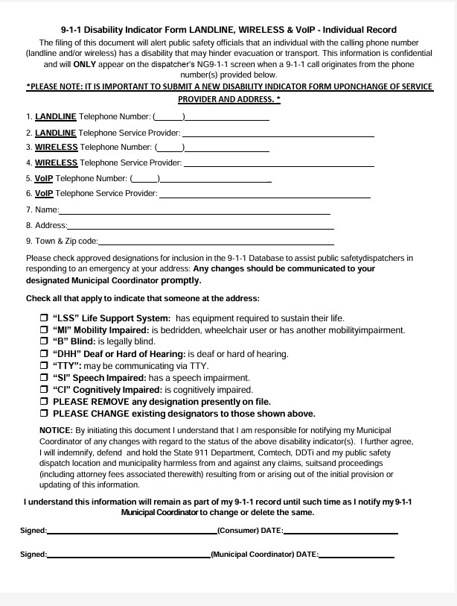

9-1-1 Disability Indicator Form
You are required to complete this form if you want your police department, fire department, or other emergency agency to know about you when you call 9-1-1 in an emergency.
When filling out the form give your telephone number, full name, and home address.
Check the necessary box or boxes.
Sign and date the form.
Submit the form to your 9-1-1 Municipal Coordinator for processing.
If you have any questions regarding the contact information for your designated Municipal Coordinator, please email DisabilityIndicatorForm@mass.gov.
Notes:
Estimated Time: One Minute
Speaker Notes:
As mentioned in the previous slide, the 911 Disability Indicator Form links your phone number and address to the dispatcher’s system to show a vulnerable person lives there. Here is an example of the form and instructions on how to fill out the form.
When filling out the form give your telephone number, full name, and home address.
Check the necessary box or boxes.
Sign and date the form.
Submit the form to your 9-1-1 Municipal Coordinator for processing.
If you have any questions regarding the contact information for your designated Municipal Coordinator, please email DisabilityIndicatorForm@mass.gov.
Interactive/Chat Option:
Add this link to the chat: https://www.mass.gov/how-to/request-a-disability-indicator-form-for-landline-wireless-and-voip-consumers

Slide 15

Water Safety
Ability to swim can reduce risk
Safe water habits start at bathtime
Swimming lessons often need to be adapted for a child with Autism
Notes:
Estimated Time: One Minute
Speaker Notes:
The last “slice of cheese” is water safety. Swimming skills can buy time for responders, but the goal is to find the child before they enter the water.
However, water play is a great time to start thinking about safe water habits.
For example, before bath time, have the child tap an adult on the shoulder. Teaching repetitive behaviors at home can translate to other bodies of water, creating an association that water requires supervision.
Adaptive swimming lessons may also be available in your community. Lessons may include 1-on-1 instruction, specialized instructors, or “sensitizing” sessions to get the child used to the pool's smell, sound, and feel. The YMCA Association of Massachusetts and Mass.gov Learn to Swim page have lists of these providers across the Commonwealth.
Interactive/Chat Option:
Add this link to the chat: https://www.mass.gov/info-details/learn-to-swim

Slide 16
Navigation Support
Autism, wandering, and water safety campaign
Notes:
Speaker Notes:
Next, we’ll talk about how we can support caregivers navigating a child with a tendency to wander. Families are often navigating multiple systems while maintaining constant vigilance.

Slide 17

Caregivers Needs
  Caregivers are primarily responsible for:
  Identifying appropriate services
  Navigating waitlists
  Determining insurance coverage
  Determining eligibility criteria
On top of:
  24/7 vigilance
  Limiting outings
  Few to no respite care options (formal or informal)
Notes:
Estimated Time: 30 Seconds
Speaker Notes:2
Caregivers of children of all abilities who have experienced wandering episodes may be stressed and fearful for their child’s safety should it happen again.
Coordinating a child’s care, remaining constantly vigilant for wandering, and engaging in the routine tasks of caregiving can understandably lead to burnout.
When we ask parents to focus on wandering, we must do it supportively to ensure they get the specific help they need without added stress.

Slide 18
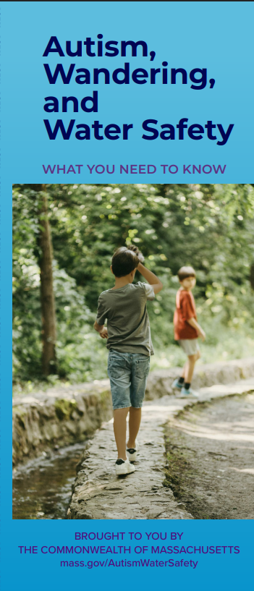
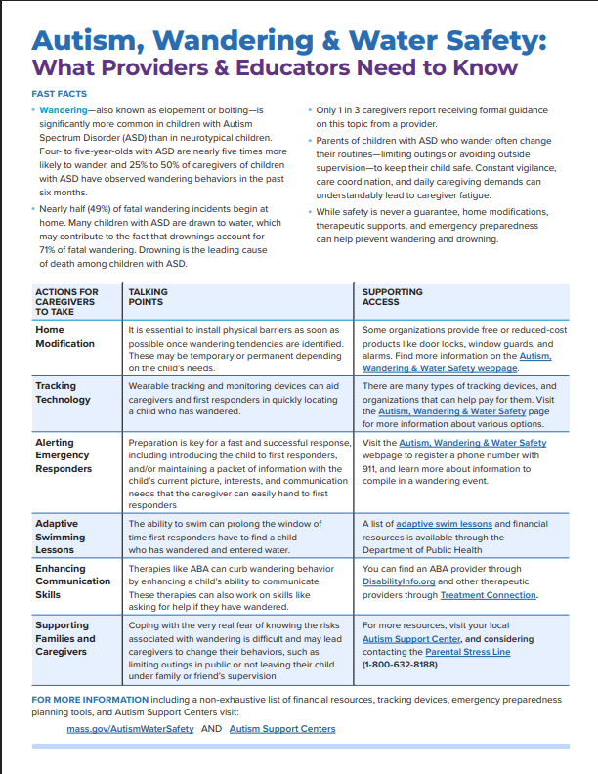

Campaign Materials
Notes:
Estimated Time: ~45 seconds
Speaker Notes:
The campaign includes brochures that exists as a print-at-home version on our website as well.
There is a checklist of action steps that can done right away, as well as information on further resources for both caregivers and providers.
The brochure shown here is translated into seven languages. Shown here is also one-pager for providers, which can help guide anyone supporting a caregiver through recommendations.
Interactive/Chat Option:
Visit https://www.mass.gov/autism-wandering-and-water-safety to find these resources.

Slide 19
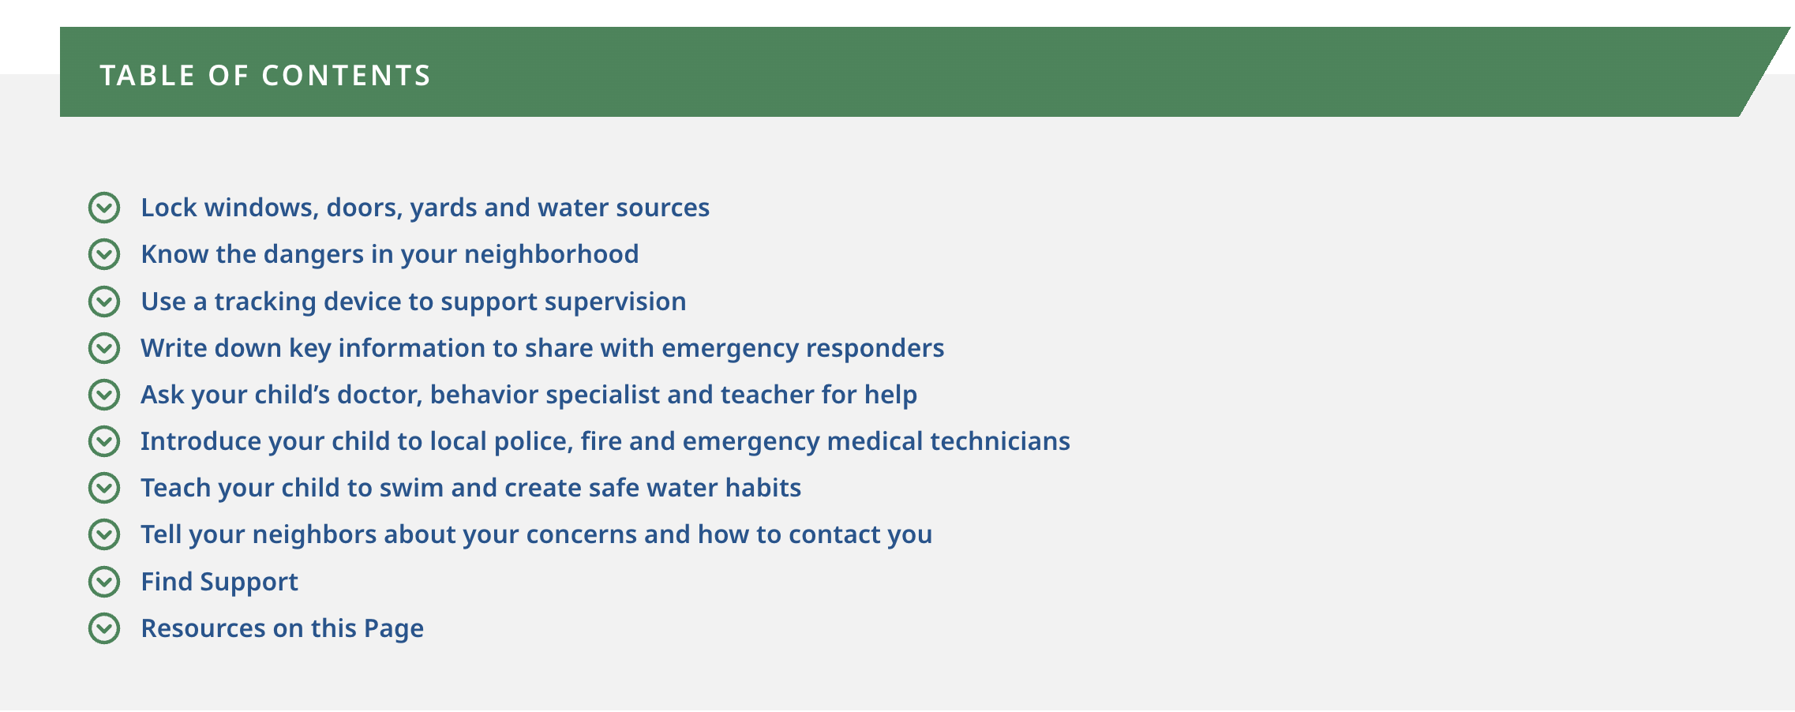
Autism, Wandering, and Water Safety: Information for Caregivers
Notes:
Estimated Time: Two minutes (30 seconds or less of speaking time and at least a minute for participants to review the website)
Speaker Notes:
Now we are going to take a few minutes to walk through the resources on the website. We encourage you to open up your browser on your computer or phone to check out the website now.
Interactive/Chat Option:
Visit https://mass.gov/autismwatersafety

Slide 20
Listed Resources
Adaptive swim lessons list
Financial Resources
Tracking & Monitoring Devices
Autism Support Centers
911 disability indicator
Notes:
Estimated Time: 45 Seconds
Speaker Notes:
On the website, visitors will find:
A list of adaptive swim lessons
Financial resources to support preventative practices
Where to find tracking and monitoring devices
Autism Support Centers, and
The 911 Disability Indicator Form

Slide 21
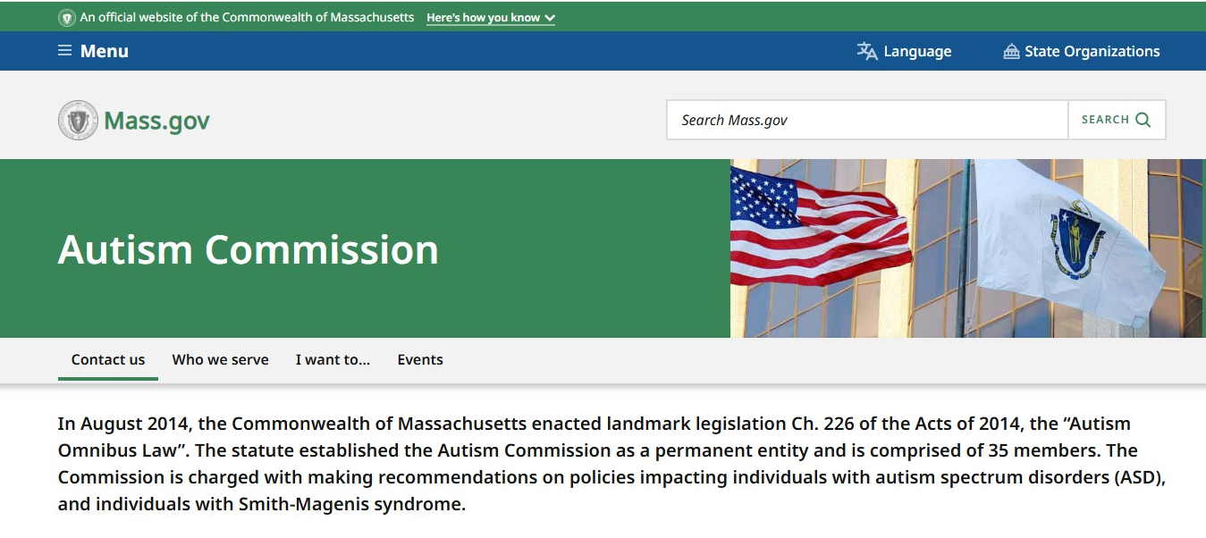
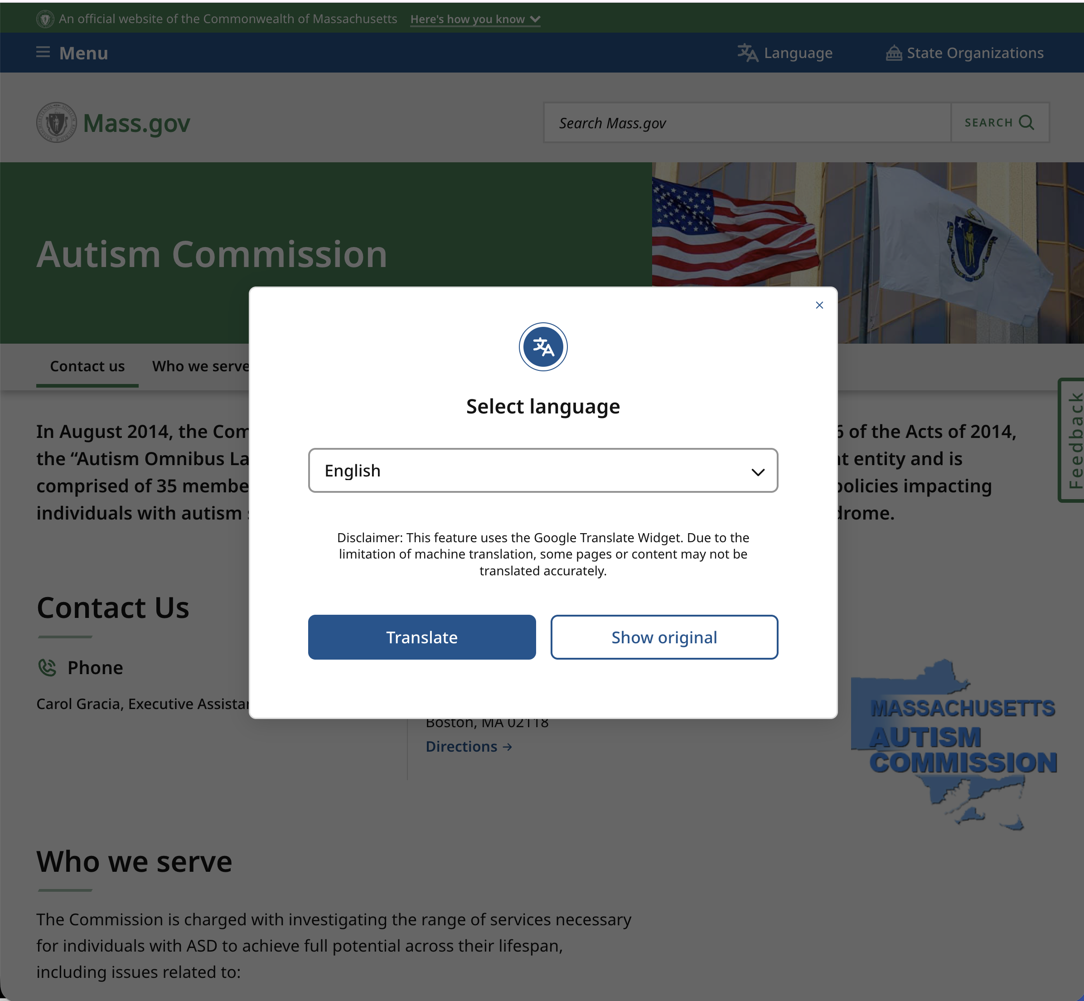
Mass.gov Webpages
  Translates to 200+ languages!
  Resources for:
    Caregivers
    Providers & Educators
    Emergency Medical Service Providers
    Community Members
Notes:
Estimated Time: One minute
Speaker Notes:
You don’t have to remember this URL – just search for autism wandering and water safety you’ll come across this campaign page. The pages translate to more than two hundred languages, and as you can see, has resources for a multitude of audiences. You will see the language icon in the right-hand corner which is depicted here.
Interactive/Chat Option:
Ask in chat or in person: Where could you share this website that might make an impact?

Slide 22

Have you provided or received counseling on wandering in real life?
Let’s Practice!
Role-Play: Caregiver–Provider Conversation
Activity: One participant plays a caregiver concerned about their child’s wandering, and another plays a provider (school staff, therapist, social worker, pediatrician, etc.).
Audience Task: Practice asking the right questions, offering prevention strategies, and referring to resources.
Notes:
Estimated Time: 15-20 Minutes (Optional Activity)
Speaker Notes:
What Providers and Educators Need To Know (Handout)
Ask participants to split up into groups of 2-3.
One participant plays a caregiver, and another plays a provider (if there is a third person in the group they will observe)
Review the “What Providers and Educators Need to Know Handout. Using the talking points listed in the handout practice asking the right questions, offering prevention strategies, and referring to resources.
Participants can alternate if time allows.

Slide 23
Wrapping up
How confident are you in counseling a parent of a child with autism about wandering and water safety?
Notes:
Estimated Time: 90 Seconds (for polling time)
Speaker Notes:
Thank you for taking the time to learn more about what we can do as a community to create more safety measures for children.
Earlier in the presentation, we asked you how confident you were in counseling a parent of a child with autism about wandering and water safety. Please take a moment to share your answer again (add polling feature if virtual; use QR code with Mentimeter if in-person).

Slide 24
Thank You!
Insert contact information
Notes:
Speaker Notes:
We can now open it up for questions or discussion.
Interactive/Chat Option:
Share contact information

Slide 25
Reference
Thomas, B., Crowley, M., Riley, S., & Rezendes, J. (2024). Massachusetts Child Fatality Review Annual Report (pp. 1–60). https://www.mass.gov/doc/fy24-child-fatality-review-annual-report/download
Wikipedia (Ed.). (n.d.). Swiss cheese model - wikipedia. Swiss Cheese Model- Wikipedia. https://en.wikipedia.org/wiki/Swiss_cheese_model

