Slide 1
Background Records Check Project Review
Fiscal and Oversight Committee
February 6, 2018
Prepared by Steve Harvey

Slide 2
Executive Project Dashboard
Category | Previous Week | Current Week | Comments
Overall Project Assessment
Schedule |  |  | Communications, Training, and Support Plan behind schedule.
Budget
Scope
Resources
Risk |  |  | See Issues and Risks slide at end of deck
.
Legend:
On track for completion on or before planned completion date, no issues.
Behind schedule or risk of falling behind. Date will be missed unless issues are resolved quickly. Budget at risk of going over budget. Expectations need management or reset.
Project at risk of stoppage, major delays, budgetary constraints. Executive decisions must be made to mitigate.

Slide 3
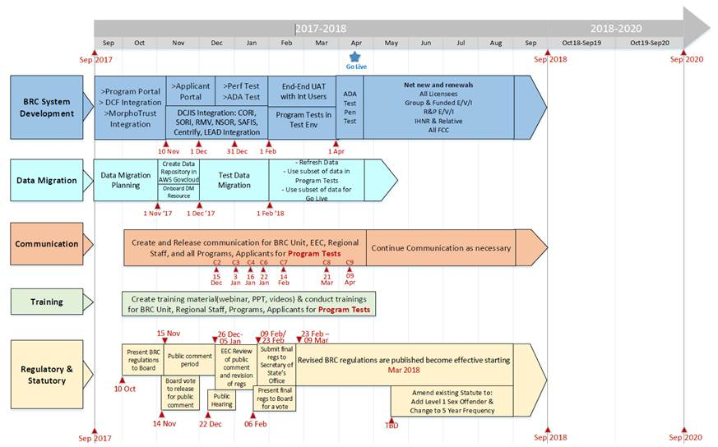
EEC BRC Schedule

Slide 4
Key Milestones
Milestone | Planned Finish Date | Actual Finish Date | Status
AWS Employees Fingerprinted | 12/15/17 | 12/18/17
Statute Changes Filed for Level 1 Sex Offender Access | TBD |  | Not Started
Implementation Plan Accepted by Business | 11/30/17 | 12/7/17
Communication Plan & Content Developed & Ready | 12/29/17 | TBD
Support Strategy & Setup (May need Procurement) | TBD | TBD
Training Plan & Content Developed & Ready | 1/31/18 | TBD
API Integration with DCJIS Information Broker (CORI, SORI, NSOR, RMV)- Dev Complete – Ready for Retest | 1/31/18 | 1/26/18
API Integration with DCF – Need 51B Dev to Complete | 1/31/18
API Integration with Morpho Trust (FP Appointment) Dev Complete – Ready to Test | 1/31/18 | 1/26/18
API Integration with SAFIS (Fingerprint Results) Dev Completed – Ready to Test | 1/31/18 | 1/26/18
Integration with Centrify | 2/14/18
Integration with LEAD Licensing Application | 2/14/18

Slide 5
Key Milestones
Milestone | Planned Finish Date | Actual Finish Date | Status
Data Migration Ready and Tested | 2/7/18
BRC Viewer Module “MVP” ready for UAT | 2/7/18
BRC Program Portal “MVP” ready for Program Test | 2/7/18
BRC Applicant Portal “MVP” ready for Applicant Test | 2/7/18
New EEC BRC Regulations Promulgated
LEAD Go-Live achieved and in Production (necessary for EEC BRC Process) | 1/15/18 3/15/18
ADA Compliance Audit Sign-Off | 4/14/18
Penetration/Security Audit by 3rd Party (E & Y) | 4/21/18
Final Data Migration | 4/25/18
Code Freeze – Release #1
Go-Live | 4/26/18

Slide 6
Infrastructure Build on AWS Govcloud

Slide 7
Current Issues/Risks
# | Date | Description | Priority | Comments | Status | Owner | Target Resolve Date
I 1 | 11/15/17 | Need Communications Finalized | Urgent | Commissioner Weber indicated he wants a “dedicated” communications resource on the project. | Open | EOE/EEC | 12/8/17
I 2 | 9/1/17 | BRC dependent upon LEAD Integration | High | LEAD Integration dependent upon LEAD Phase III go live. Integration spec finalized. BRC Dev Team needs to build and test API with LEAD using Force.com’s JSON API. LEAD Phase III go-live pushed to 3/21. | Open | S. Harvey, Das Nobel | 2/7/18 3/21/18
R1 | 6/1/17 | Regulation and Statute Changes | High | EEC regulatory changes reviewed by the EEC Board on 11/14. Public hearings conducted. Comments will be reviewed by EEC Board, then promulgated when board is ready. | Open | F. Sullivan | 3/3/18
R2 | 11/15/17 | Support Plan for BRC Navigator | High | Need to implement Help Desk support for BRC. Met 1/26/18 and discussed Operational Support Model that works best for EOE, EEC, and TSS. Working this. | Open | S. Harvey | 2/15/18
R3 |  | UAT Resource | High | Commissioner Weber indicated that he wants a dedicated resource on the project to run UAT | Open | S. Harvey | TBD
R 4 |  | Data Migration | High | Need Infrastructure and VPN Security Audit prior to data migration testing of actual (real) data. | Open | J. Merto | 1/27/18

