Slide 1
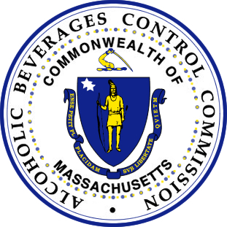
Barnstable Presentation

Slide 2
Agenda
    Navigation of the ABCC Website
    Resources for Local Licensing Authorities.
    Role of a regulator.
    Guidelines when reviewing an application.
    Delivery Concerns
    Municipality progressive discipline process.
    Violation Hearings and Adjudication process.
    Licensee/Applicant appeal process.
    Compliance checks (Brick/Mortar and Direct to Consumers)
    Section 34 Sale or Delivery of alcohol to underage individual.
    Section 34C An individual under the age of 21 in possession of alcohol.
    Receiving MGL c. 90 Section 24J Reports.
    Duplicating ABCC Investigations

Slide 3
Role of a regulator
    Resources for Local Licensing Authorities
    Guidelines when reviewing an application
    Delivery Concerns
    Municipality progressive discipline process.

Slide 4
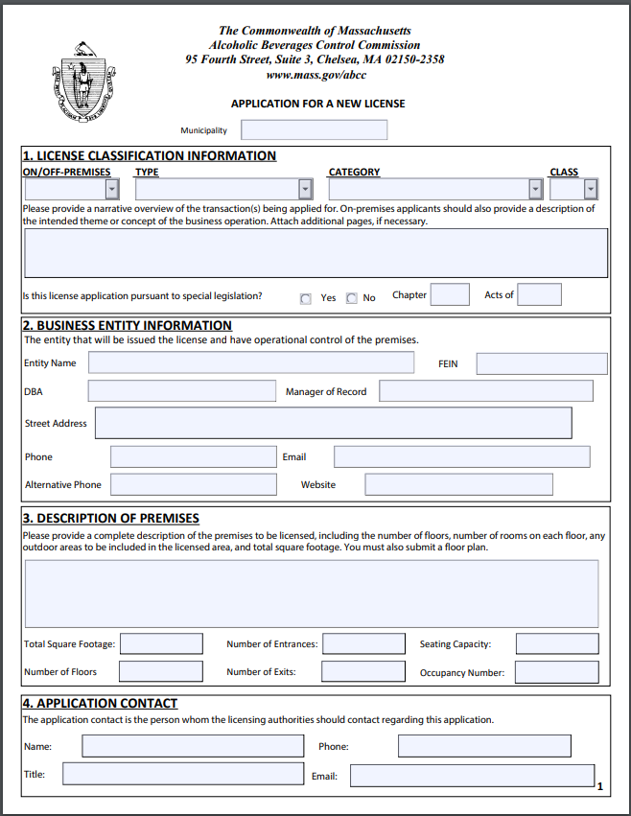
Page 1
Question 3
A detail description of the entire proposed license premise for sales, storage and consumption.
How many rooms, bathroom, bars ect…

Slide 5
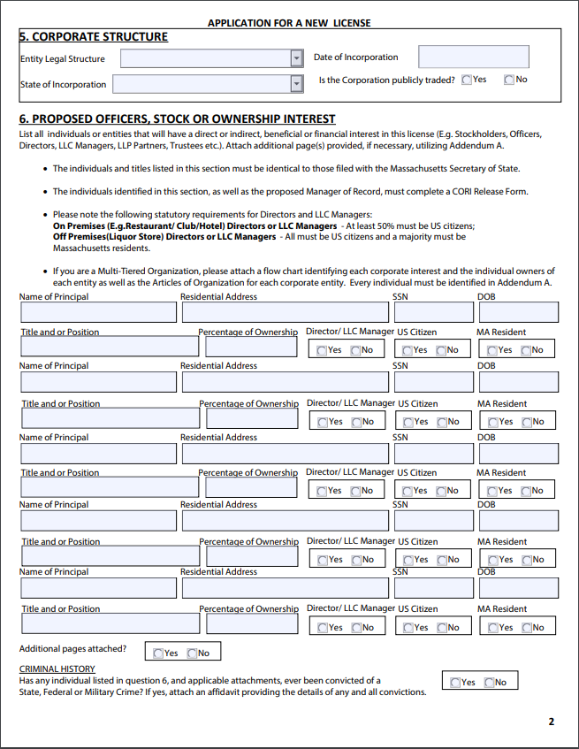
Page 2
Question 6
Disclosure of Criminal history.
Completion of all fields.
Percentage of ownership must total 100%. Undisclosed ownership may require another public hearing.

Slide 6
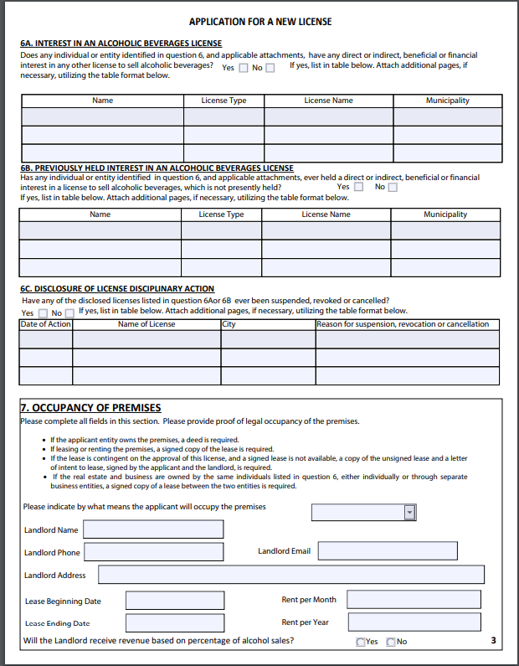
Page 3
Question 6A
Licenses that are currently owned.
Question 6B
Former ownership.
Question 6C
Disciplinary action concerning current and former ownership. This is a tool to consider character and fitness.

Slide 7
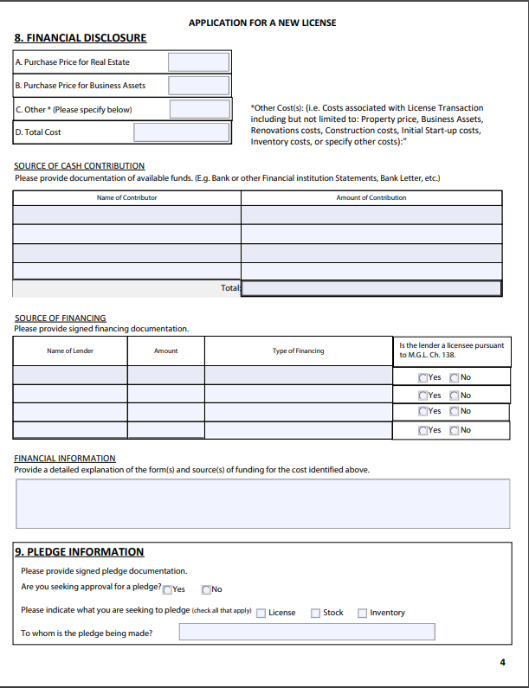
Page 4
Financial Disclosure
Total flow through cost of the transaction.
Source of Financing
Proof of where financing is originating from. Proof of funds are required if the total transaction cost exceeds $50,000.

Slide 8
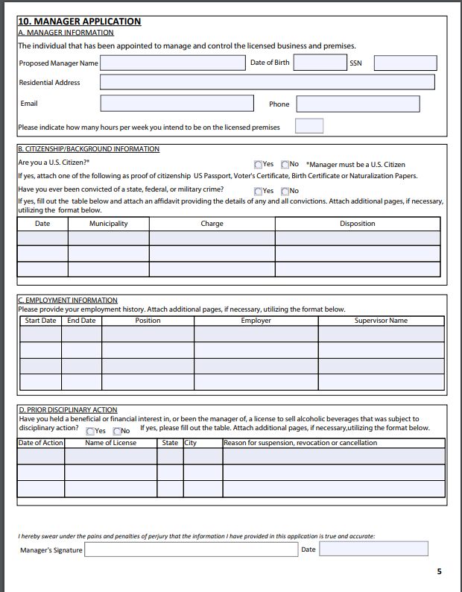
Page 5
How many hours will the manager be on the licensed premise?
Base off the operations of the proposed business type that a manager will be onsite.
A manager hours should be commensurate with type of proposed business operation.
Prior disciplinary actions
This is a tool to consider character and fitness of the proposed manager.

Slide 9
Violation Hearings and Adjudication process
    M.G.L. c. 138, § 64- The licensing authorities after notice to the licensee and reasonable opportunity for him to be heard by them, may modify, suspend, revoke or cancel his license upon satisfactory proof that he has violated or permitted a violation of any condition thereof, or any law of the commonwealth…

Slide 10
    Licensee/Applicant appeal process.
    M.G.L. c. 138, § 67- Any applicant for a license who is aggrieved by the action of the local licensing authorities in refusing to grant the same, or by their failure to act within the period of thirty days limited by section sixteen B, or any person who is aggrieved by the action of such authorities in modifying, suspending, cancelling, revoking or declaring forfeited the same, may appeal therefrom to the commission within five days following notice of such action or following the expiration of said period, upon petition in writing, setting forth all the material facts in the case…

Slide 11
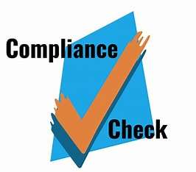
COMPLIANCE CHECKS- Brick and Mortar and Direct to Consumers
Compliance Checks are a training tool required by law.
Municipality and ABCC must conduct compliance checks.
Compliance checks are intended to help the licensee comply with the law and local regulations.

Slide 12
Public Safety Violations: M.G.L. c. 138 Sections 34, 34C, and 69
M.G.L. c. 138, § 34- Sale or delivery of an alcoholic beverage to a person under 21 years of age.
204 CMR 2.05 (2) Permitting an illegality on the licensed premises, to wit: Ch. 138, § 34C – Possession of an alcoholic beverage by a person under 21 years of age
M.G.L. c. 138, § 69- Sale or delivery of an alcoholic beverage to an intoxicated person
Receiving MGL c. 90 Section 24J Reports
Duplicating ABCC Investigations: M.G.L. c. 138, § 23

