Slide 1
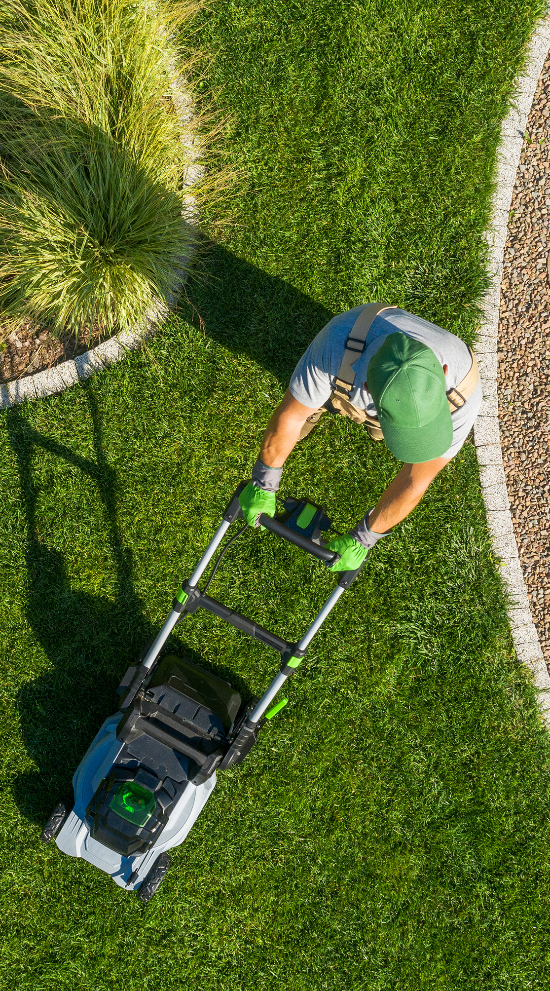
Electrify the Landscape
Battery-Powered Landscaping Equipment (BPLE) and Non-Plated Vehicle Show and Mow
June 24, 2026
Presented by
Morgan Bowler, Department of Energy Resources (DOER)
Julia Wolfe, Operational Services Division (OSD)

Slide 2
Agenda
10:30-11:30: Landscaping and Non-Plated Vehicle Electrification Overview
Benefits of Going Electric (Morgan Bowler, DOER)
Leveraging Grants and Rebates (Morgan Bowler, DOER)
Statewide Contract Resources (Julia Wolfe, OSD)
User Experience Testimonial Panel:
    James McKeon (Town of Warren)
    Todd Cournoyer (UMass Amherst)
Kick-Off (Julia Wolfe, OSD)
11:30-1:00: Show and Mow
Test BPLE offered through Statewide Contract FAC116
Speak with FAC116 vendors
Engage with presenters

Slide 3
Benefits of Going Electric
Morgan Bowler, DOER

Slide 4
Why is Battery Electric Landscaping Equipment (BPLE) Important?
According to a 2020 study:
614,932 tons of carbon dioxide were emitted just from lawn and garden equipment in Massachusetts
This is equivalent to 1.43 billion miles driven in a typical car!
The same study also identified the top 100 counties in the United States for carbon dioxide emissions from lawn and garden equipment in 2020. Two Massachusetts counties ranked within the top 100 (Source: "Lawn Care Goes Electric").
County | Place out of 100 | CO2 Emissions | Car Equivalent
Middlesex | 28 | 153,480 | 33,787
Essex | 93 | 70,771 | 15,580

Slide 5


The Triple Bottom Line
Environmental
Decarbonization
Zero Pollutants
Human Health
Quieter
Smoother
Financial
Reduced fuel costs
Reduced maintenance costs
Cleaner Air
Zero direct emissions

Slide 6
Environmental Benefits
60” Riding Zero-Turn Mower
20” Chainsaw
Over the life of the equipment, the battery electric equipment produces significantly less emissions than their fossil fuel counterparts. (Source: LBE BPLE Savings Calculator)

Slide 7


Human Health Benefits
Reduced noise and vibration for users -> reduced risk of hearing loss and Hand-Arm Vibration Syndrome
Lack of direct emissions eliminates harmful fumes and particulate matter for users
No need to store hazardous chemicals

Slide 8
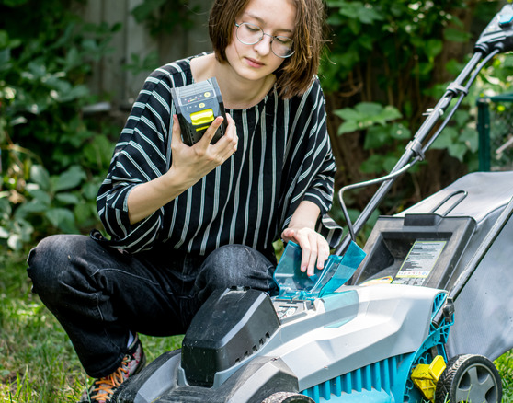
Financial Benefits
Reduced maintenance costs
No oil changes
No replacement of air filters
No replacement of fuel filters
Reduced fuel costs
Equipment | Fuel Cost | Hourly Fuel Cost
Electric 60” Mower | $0.16/kWh | $2.82
Gas 60” Mower | $4.33/gal | $8.66

Slide 9
Leveraging Grants & Rebates
Morgan Bowler, DOER

Slide 10
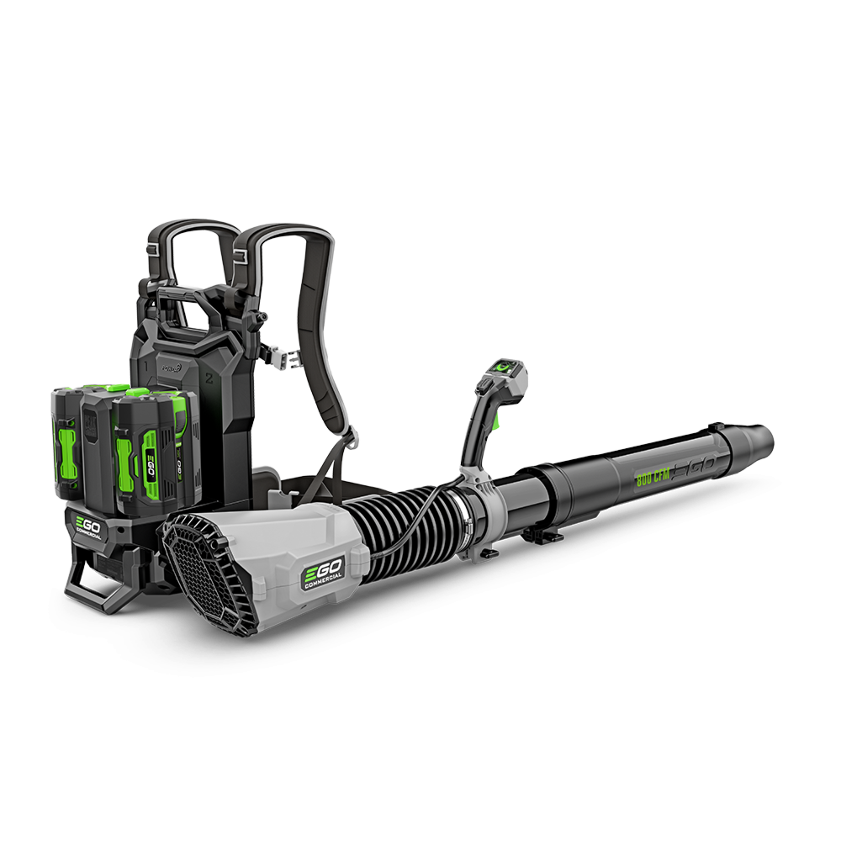
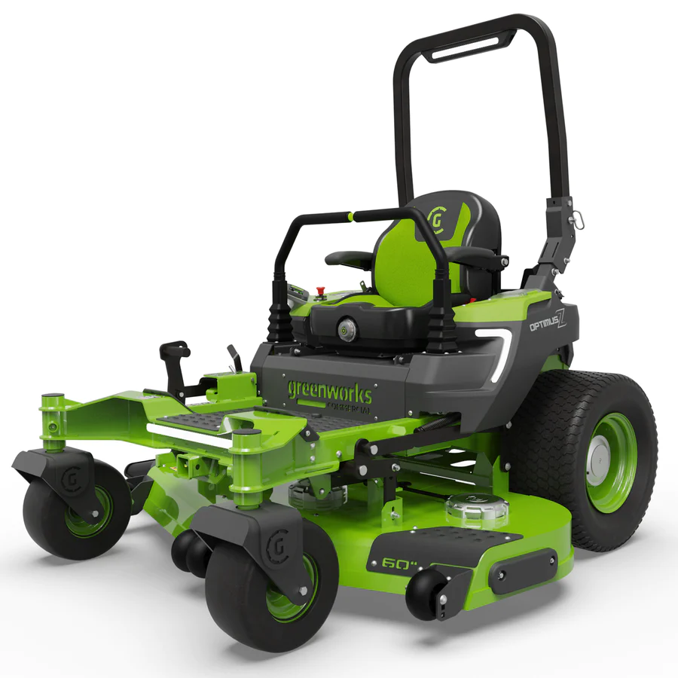
LBE Equipment Decarbonization Grant (1)
LBE funds small-scale decarbonization projects, which includes landscaping equipment!
Who is eligible? Executive branch agencies, public institutions of higher education, and quasi-public authorities
How much does the grant cover?
  40% of total project cost for handheld equipment
  55% of total project cost for ride-on mowers and electric utility vehicles
  Maximum funding of $150,000 per site address

Slide 11
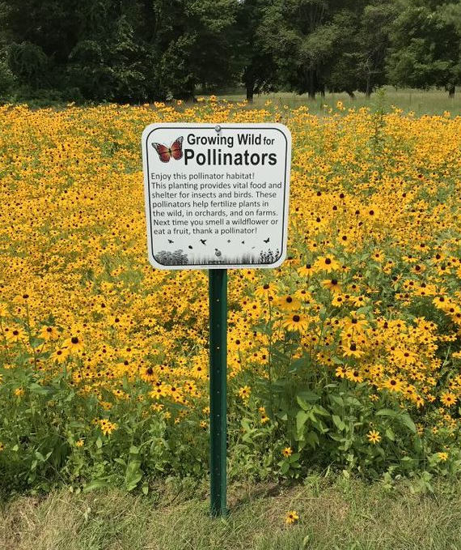
LBE Equipment Decarbonization Grant (2)
What is considered an eligible cost? Costs include but are not limited to equipment procurement and/or infrastructure upgrades
Optional Pollinator Habitat Creation Adder: If you commit to creating at least 0.5 acres of pollinator habitat, you could receive between $5,000 and $10,000 in additional funding to create the habitat.
Optional Climate and Economic Justice Adder: Provides an additional 10% of the base grant amount if located in a Low Income and Disadvantaged community.
Applications are accepted and reviewed on a rolling basis until June 30th, 2027, or until funding runs out.
Learn more about the grant and how to apply by visiting the LBE Equipment Decarbonization Grant page!

Slide 12
Green Communities Regional School District Grant
Green Communities also funds small-scale decarbonization projects, including landscaping equipment!
Who is eligible? Regional School Districts as defined in 603 CMR 41.00
How much does the grant cover?
  Up to 75% of total equipment plus battery costs after accounting for available incentives
  Maximum funding of $150,000 per site address
Adders:
  Optional Pollinator Habitat Creation Adder: Same as the LBE grant
  Optional Climate and Economic Justice Adder: provides up to 100% or up to $150,000 per site address if located in a Low Income and Disadvantaged Community
Learn more about the grant and how to apply by visiting the Regional School District Grant COMMBUYS page!

Slide 13
Green Communities Competitive Grant
Green Communities also funds small-scale decarbonization projects, including landscaping equipment!
Who is eligible? Applicants must be a designated Green Community
How much does the grant cover?
Retail-Grade Battery-Powered Product Categories
  • Lawnmower: up to seventy-five dollars ($75) (battery capacity < 500-watt hours)
  • Leaf blower: up to thirty dollars ($30)
  • String Trimmer: up to thirty dollars ($30)
  • Chainsaw: up to thirty dollars ($30)
Professional-Grade Product Categories
  • Lawnmower or Electric Utility Vehicle: up to three thousand five hundred dollars ($3,500) (battery capacity > 7000-watt hours)
  • Leaf blower: up to one hundred dollars ($100) (battery capacity > 500-watt hours)
  • String Trimmer: up to one hundred dollars ($100) (battery capacity > 500-watt hours)
  • Chainsaw: up to one hundred dollars ($100) (battery capacity > 500-watt hours)
Learn more about the grant and how to apply by visiting the Competitive Grant COMMBUYS page!

Slide 14

Mass Save Rebates (1)
Retail-Grade Battery-Powered Lawn Equipment*
Retail-grade equipment is for property managers or businesses who use lawn equipment for a short period of time during the day.
Equipment | Rebate (per unit)
Lawnmower | $75
Leaf blower | $30
String trimmer | $30
Chainsaw | $30
*Must be battery-powered and have a battery capacity less than 500-watt hours.
See Mass Save website on residential BPLE for more information.

Slide 15
Mass Save Rebates (2)
Professional-Grade Battery-Powered Lawn Equipment
Equipment | Rebate (per unit)
Lawnmower* | $3,500
Leaf blower** | $100
String trimmer** | $100
Chainsaw** | $100
Professional-grade equipment is for landscapers, municipal operations, or those that use equipment throughout a full day.
*Must have a battery capacity more than 7000-watt hours
**Must have a battery capacity more than 500-watt hours
See Mass Save website on commercial BPLE for more information.

Slide 16
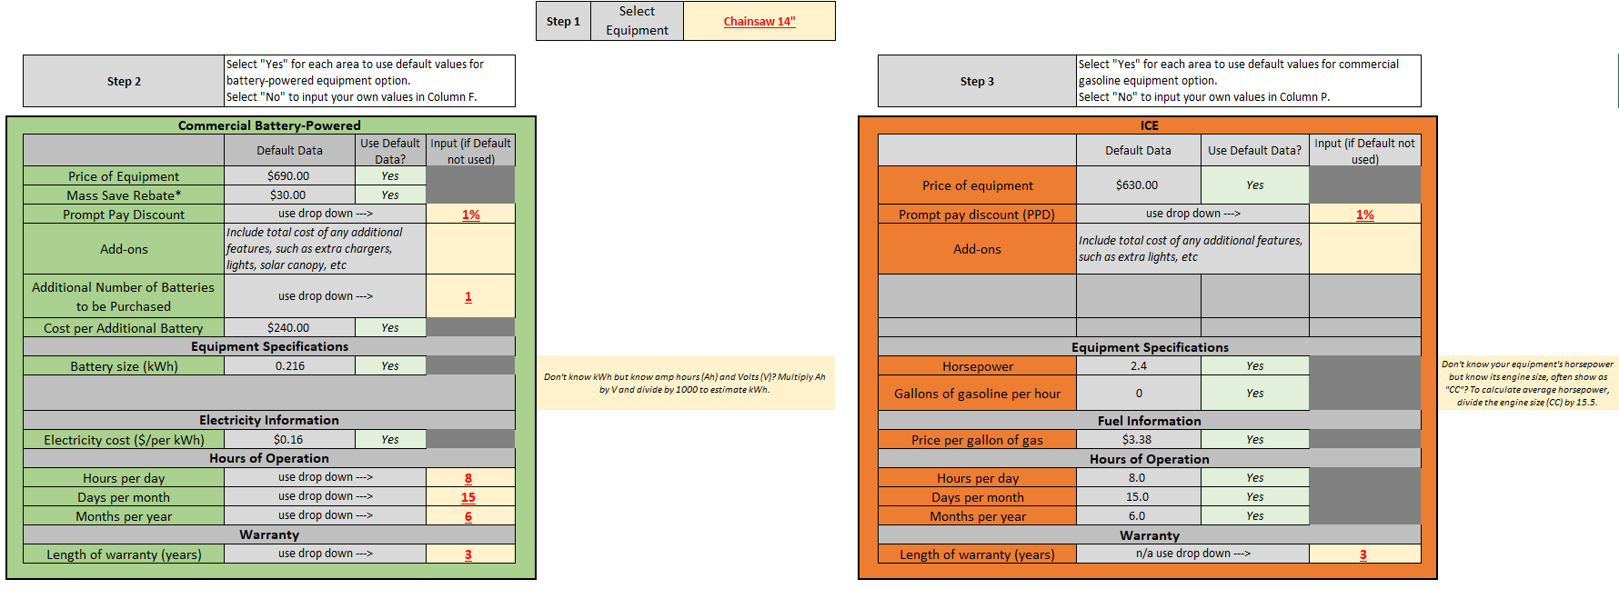
LBE BPLE Savings Calculator (1)
Compare costs and benefits between commercial BPLE and traditional gasoline-powered landscape equipment

Slide 17
LBE BPLE Savings Calculator (2)
How do I use the Calculator?
Visit the LBE Tools and Resources Page > Sustainable Landscaping
Download the calculator (as an Excel file)
Select the type of equipment you are comparing
Input data for your battery-powered equipment and gasoline-powered equipment – default values are provided if you do not have information. Inputs include things like:
  Price of the equipment
  Additional number of batteries purchased
  Hours of operation of the equipment
Results automatically populate in the other tabs based on your inputs!

Slide 18
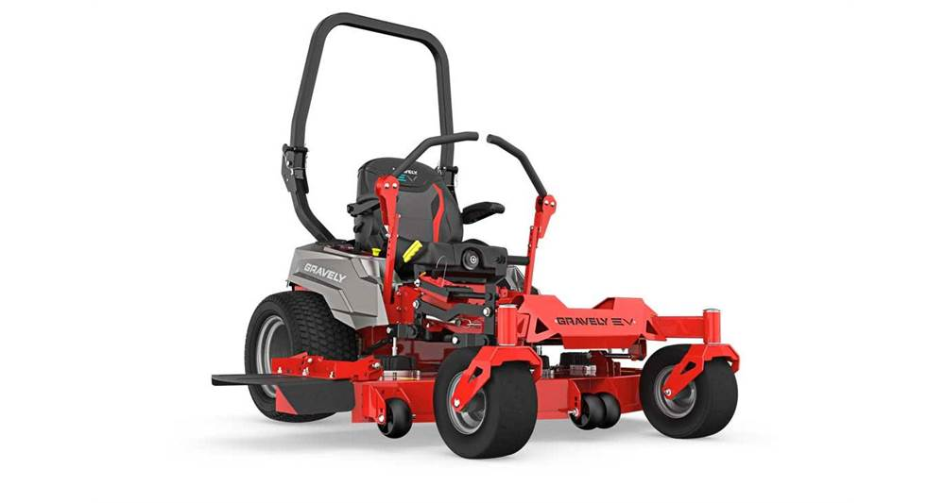
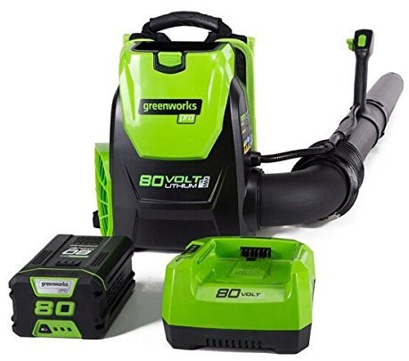
Tool Barn Program
DCAMM lends out tools and equipment to test at no charge!
How does the Tool Barn work?
This is available to state agencies only, to assist you in the repair and maintenance of your agency’s facilities
The Tool Barn is located at DCAMM Central Region Office 220 Old Common Road Lancaster, MA
To review the Tool Barn Inventory, Guidelines, and Request Form, visit the DCAMM Tool Barn webpage.
Contact DCAMM Office of Facilities Management and Decarbonization for more information (info.dcamm@mass.gov).

Slide 19
Additional Resources
DOER Leading by Example
OSD
LBE’s Tools and Resources page provides even more information on sustainable landscaping, from BPLE to pollinator habitats.
Commercial Battery Powered Equipment on Statewide Contract
Municipalities – Contact your OSD Local Government Enablement Team Member for hands-on assistance
DOER Green Communities
American Green Zone Alliance (AGZA)
GC Regional Coordinators provide technical assistance for clean energy and sustainability efforts.
Get AGZA Service Pro Certification (online) and learn all the fundamentals you need to know to move to electric-powered low impact land care.

Slide 20
Leveraging Statewide Contracts
Julia Wolfe, OSD

Slide 21
Statewide Contract FAC116 Lawns and Grounds Equipment, Parts and Services
Julia Wolfe

Slide 22

Operational Services Division Overview
The Operational Services Division (OSD) is an oversight agency of the Commonwealth of Massachusetts within the Executive Office of Administration and Finance.
It oversees the procurement process and supports state agencies, local governments, and other eligible entities in obtaining goods and services.
Establish and manage Statewide Contracts for commodities and services that provide customer satisfaction and ensure best value
Establish policies and procedures that ensure compliance with all state laws, regulations, and executive orders.
Support socioeconomic and environmental goals of the Commonwealth
Manage the Commonwealth’s online market center – COMMBUYS
Find OSD resources on our website: mass.gov/osd.
Notes:
The Operational Services Division (OSD) is a state agency that sets up and manages statewide contracts for goods and services – that any public entity in MA may use. This includes state agencies, local governments, public colleges and universities, and some non-profits, and even public entities in other states may use our contracts
We also manage the Commonwealth’s online market center – which is COMMBUYS.

Slide 23
FAC116 Lawns and Grounds Equipment, Parts and Services
Contract Summary
This contract is for equipment which is intended for the maintenance and care of lawns and grounds areas as well as the parts, repair, and leasing for this equipment.
47 FAC116 Vendors – manufacturer and independent dealer representation
Nine Contract Categories
  Category 3: Utility Vehicles, Golf Carts, Snowmobiles, and Related Accessories
      Utility vehicles, ATVs, snowmobiles, golf carts, sprayers, groomers & sweepers
  Category 8: Commercial Grade Battery Electric Lawn Equipment (26 Vendors)
      Lawnmowers (including ride on), blowers, trimmers, chainsaws & more
  Category 9: Equipment Leasing for Categories 1-8
Notes:
We have over 100 statewide contracts, and sell anything you can think of through them – vehicles, food, furniture, building materials, and also landscape products and equipment. I’m going to review quickly our statewide contract FAC116.
This contract offers a wide variety of landscape equipment and includes the parts, repair, and leasing for the equipment.
The contract has 47 Vendors, which consists of manufacturers and independent dealers
It has 9 categories and ones relevant to this event include Category 3, Category 8, and Category 9.

Slide 24
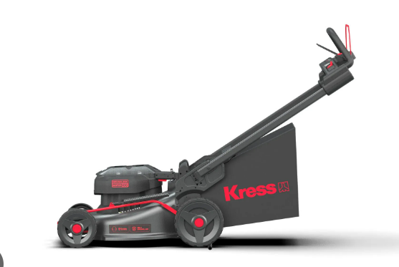
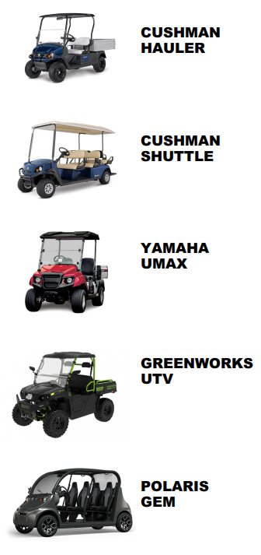
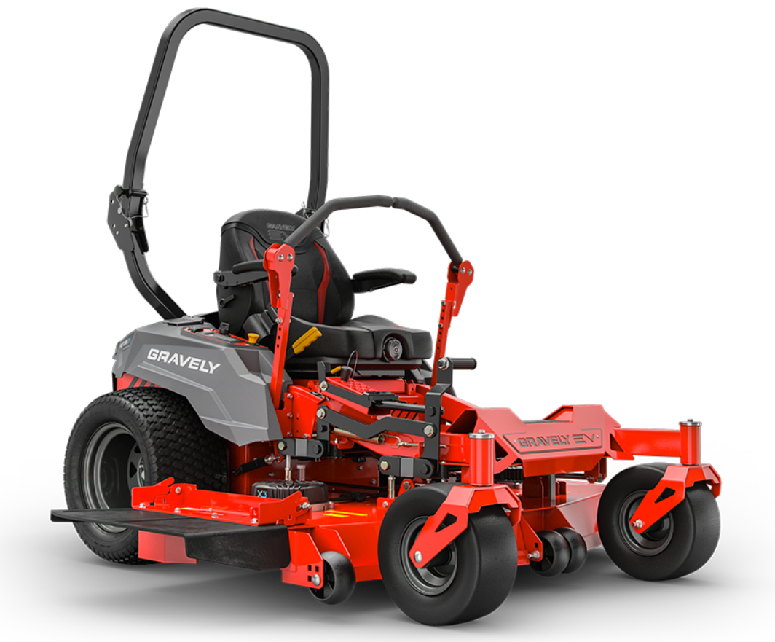
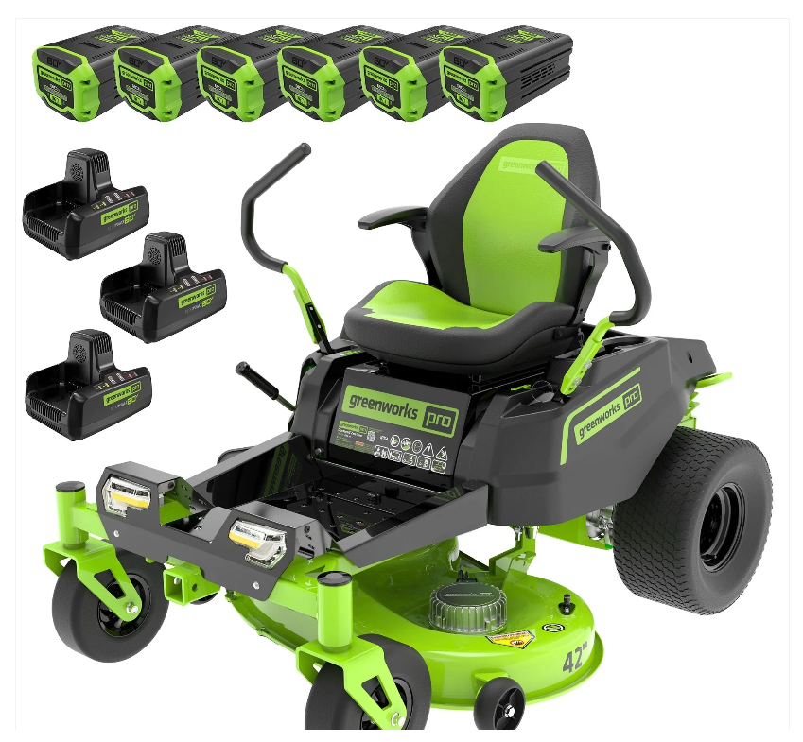
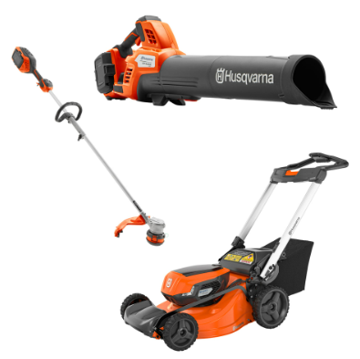

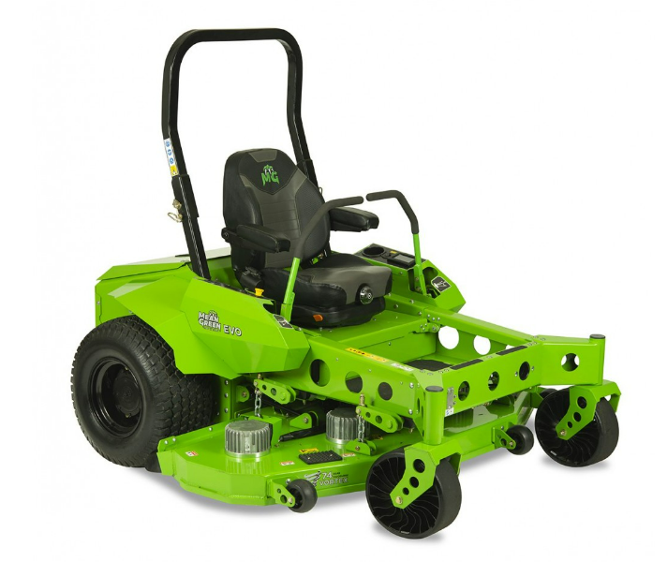
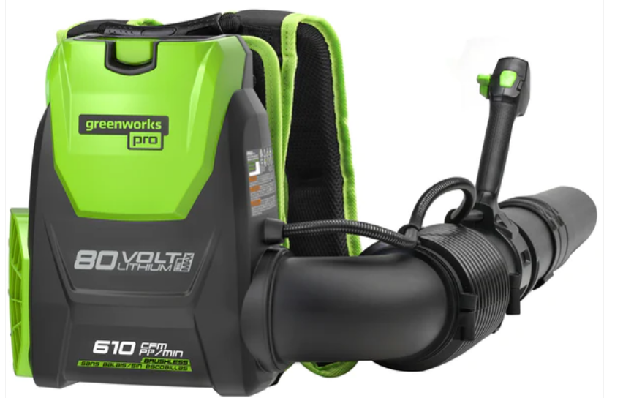
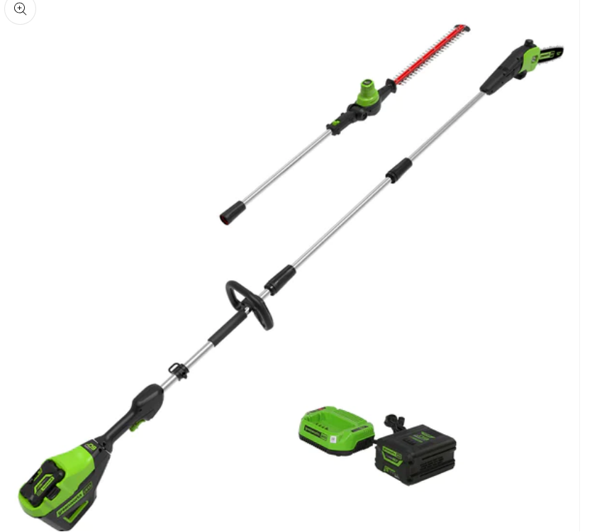
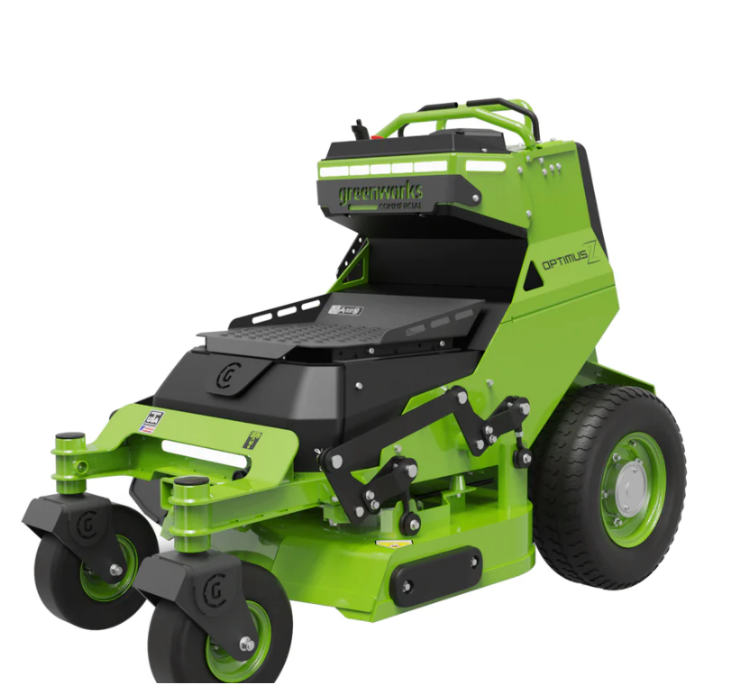
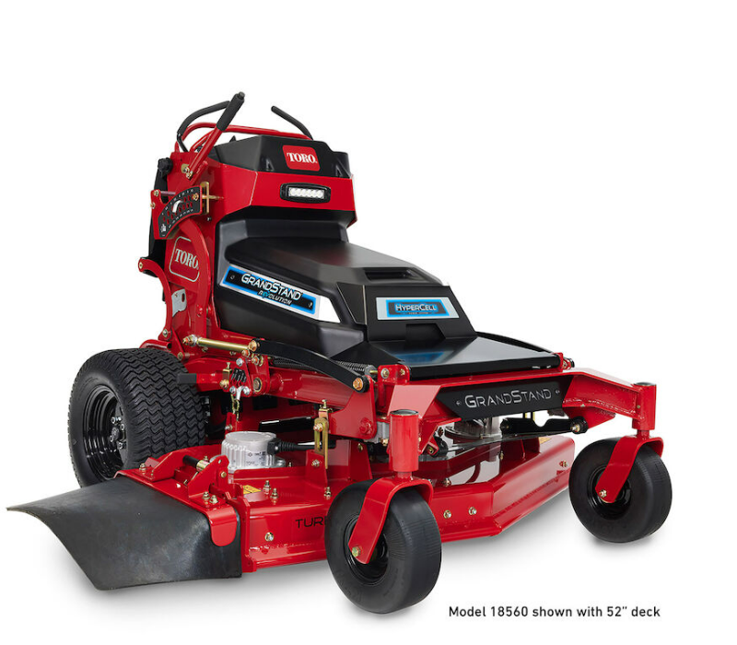
Battery-Powered Equipment Includes…
Category 3: Electrify your fleet with a range of golf carts, shuttles, and utility vehicles
Category 8: Ride-on and stand-on mowers
Category 8: Handheld equipment and push mowers
Notes:
Here are pictures of some of the equipment found in the three categories.

Slide 25
Contract Terms, Pricing, and Environmental Features
FAC116 Contract Terms
Term: May 1, 2021 – April 30, 2027
Rebid: LND001 to launch May 1, 2027
Competitive Pricing and Discounts
Volume Discounts
Dock Delivery
Prompt Pay Discounts
OSD Climate Initiative
Offer Environmental and Climate Preferable Options such as Battery-Powered Landscaping Equipment (BPLE)
Interested in bidding on the upcoming LND001 contract?
It will be available on the LND001 COMMBUYS Bid Page
Also Visit Steps to Consider If You Are Interested in Statewide Contracting for more information.
Notes:
The term spans May 1, 2021 to April 30, 2027. We expect to replace this contract with LND001 May 1, 2027 and are currently working on that rebid. If you are interested in bidding on the new contract – I’ve included a link to the location in COMMBUYS where you will find information, but also point you to some guidance on Steps to Consider if you Are Interested in Statewide Contracting with the first recommendation being to register in COMMBUYS so you get notifications about the bid!
The contract has competitive pricing and discounts, such as volume discounts, dock delivery, Prompt Pay Discounts offered vendors. In addition, we have a robust offering of Battery Powered equipment, which is an Environmental and Climate Preferable Options - the benefits Morgan just reviewed!

Slide 26
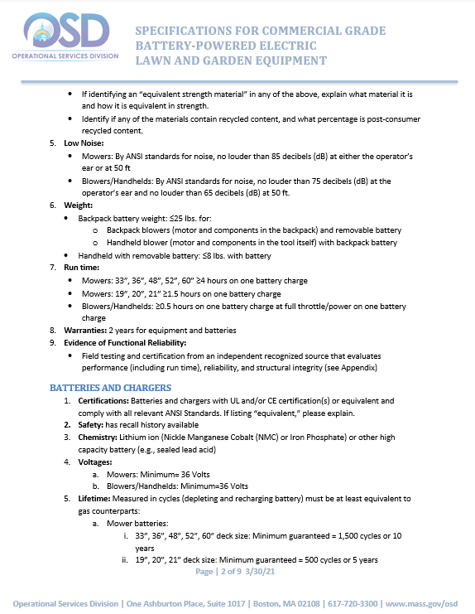
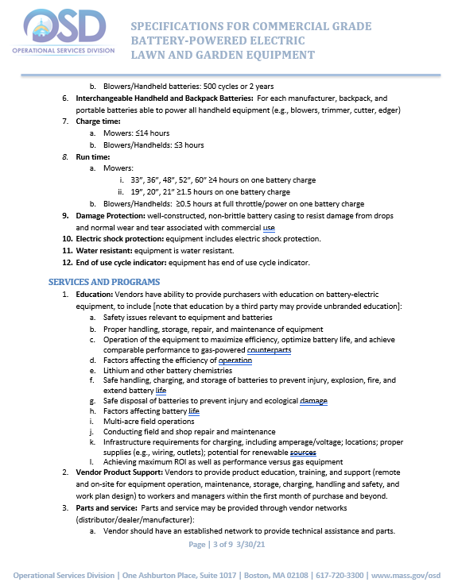
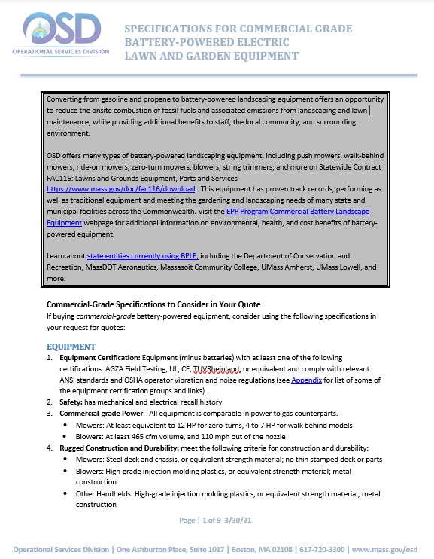
Specifications for Commercial-Grade Equipment
When buying commercial-grade battery-powered equipment, consider using Commercial Grade Battery Powered Landscape Equipment Specifications developed by OSD, including:
  Equipment certification
  Safety
  Commercial-grade power (e.g., 12 HP for zero-turn mowers, 465 CFM for blowers)
  Low-noise
  Light-weight backpack batteries
  Minimum battery run times (e.g., 4+ hours for large mowers, 1.5+ hours for smaller mowers, 30+ minutes for handhelds)
  Those with third-party certifications
Notes:
Buyers looking for commercial-grade equipment, as opposed to residential grade equipment – to view some guidance we put together a few years back, which includes a number of recommendations to help differentiate it from residential grade such as certification, power, weight, battery run times, etc…

Slide 27
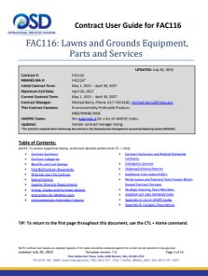
Get Contract Details
The FAC116 Contract User Guide is the buying guide for the contract that reviews:
Contract Coverage
How to Purchase
Contract Exclusions
Pricing and Quote Requirements
Link to commercial-grade specifications
Awarded Contractor Information – including links to their information in COMMBUYS
For more information:
OSD Help Desk - OSDHelpDesk@mass.gov or call 1-888-627-8283
OSD Category Manager sean.corbin2@mass.gov
Notes:
To learn more about the contract, we encourage you to review the buyer guide – what we call the Contract User Guide – which is listed online. This covers all buying details, such as how to purchase, exclusions, quote requirements, and a list and contact info for the awarded vendors. If you have questions, we recommend you reach out to our great Helpdesk at OSD! Also you may contact Sean Corbin who manages this contract.

Slide 28

FAC116 Contacts
Sean Corbin
Category Manager
Operational Services Division
617-720-3105
sean.corbin2@mass.gov
Julia Wolfe
Director, Environmental Purchasing
Operational Services Division
617-720-3153
Julia.wolfe@mass.gov
www.mass.gov/epp
Notes:
Here is contact info for Sean – and also me if you have any questions! Also I am happy to help you navigate finding environmentally preferable options. And we are always interested to hear about new products and services that we could make available on our contract that helps reduce environmental and health impacts.

Slide 29
User Experience Testimonials
Jim McKeon, DPW Director, Town of Warren
Todd Cournoyer, UMass Amherst

Slide 30
Exhibitors
Exhibitors at today’s event:
Able Tool & Equipment
Bacher Corporation of Connecticut
Country Club Enterprises
Gravely (Boston Lawnmower)
Husqvarna
MTE Equipment Solutions, Inc.
Norfolk Power Equipment Inc.
Richley & Clapper, Inc.
Rotti’s Power Equipment
Stewart’s Power Equipment, Inc.
Turf Products Corp

Slide 31
Thank you and have fun!

Slide 32
Contact Information
Morgan Bowler, Clean Energy & Sustainability Coordinator, DOER
morgan.bowler@mass.gov
Julia Wolfe, Director of Environmental Purchasing, OSD
julia.wolfe@mass.gov

