Slide 1
Pilot Protocol for ATS Management of Methamphetamine
Timothy E. Wilens, M.D.
Psychiatric Consultant-Bay Cove Human Services
Co-Director, Center for Addiction Medicine
Chief, Division of Child and Adolescent Psychiatry,
Massachusetts General Hospital
Professor of Psychiatry, Harvard Medical School

Slide 2
Protocol for ATS Management of Methamphetamine: Summary
To our knowledge, first focused methamphetamine protocol for use in ATS (acute detoxification) settings
Thorough development (October-December/2019), vetting (2020), and implementation process (January-March 2021)
Psychoeducation to clinical and administrative staff about methamphetamine and its management is necessary to engage staff
Preliminary QA/QI data suggest feasibility, tolerability, and effectiveness
More work is necessary to enhance protocol and improve patients’ retention on unit

Slide 3
Protocol for ATS Management of Methamphetamine: Iterative Process
Protocol development (T Wilens) using psychological and pharmacotherapy best practices and newest data for methamphetamine management
Vetting and revision of protocol in collaboration with MGH Addiction Team (including internists, addictionologists, pharmacists, psychologists, psychiatrists, social workers)
Vetting and revision with Bay Cove Staff (including medical director [Dr. James O’Connell], nursing, case workers, administration)
Vetting and revision with Department of Public Health (Dr. Alex Walley)
Psychoeducation/in-services on methamphetamine to all Andrew House staff
Initial implementation, feedback and further education (nursing)
Implementation and QA/QI review of initial cases – preliminary data reviewed and further revision and QA underway

Slide 4
Protocol for ATS Management of Methamphetamine: Goal
Ensure patient is medically & psychiatrically safe, assist with acute withdrawal management including behavioral changes, urges/cravings, and help engage in longer-term care (e.g. abstinence, avoidance of drug for brain health)

Slide 5
Protocol for ATS Management of Methamphetamine: Initial Orders
Complete comprehensive medical evaluation with additional emphasis on vital signs, heart rate/rhythm disturbances, pulmonary status, oral/dental care, skin excoriations, or topical infections.
Vitamin C 1000 mg po BID for 48 hours [Assists with mitigating absorption and enhancing excretion of methamphetamine]

Slide 6
Protocol for ATS Management of Methamphetamine: Behavioral Orders
Encourage po intake of fluids, snacks, and meals. Hold meal for later administration if patient unable to attend a meal.
Reduce stimulation (noise, lights, etc.) as much as possible and place patient in quiet area of unit and/or in room away from activity. Allow patient to wear noise canceling devices if requested.
Allow patient to sleep PRN with continued vital sign and other safety checks. Patient may be excused from group and other community-type groupings if sleeping. Do not discharge patient for missing groups or individual counseling if the patient is sleeping. Encourage patient to exercise while awake.

Slide 7
Protocol for ATS Management of Methamphetamine: Pharmacologic Orders
For the duration of the ATS admission:
For agitation, use low dose diphenhydramine (Benadryl) 25 mg po QID-hold for disinhibition.
For panic or anxiety, use chlordiazepoxide (Librium) 25 mg po TID in lieu of standing PRN Librium order-hold for disinhibition.
For moderate-to-severe agitation or paranoia or psychosis, use quetiapine (Seroquel) 25-50 mg po TID PRN-hold for worsening of symptoms (If no result from Librium may administer Seroquel)
Call MD if patient has auditory or visual hallucinations.
For insomnia, mirtazapine 15-30 mg qHS PRN ONLY if no other qHS sleep medications are being administered.

Slide 8
Recent QA/QI Data on the Implementation of the ATS Methamphetamine (Meth) Protocol (N=23)

Slide 9
Notes:
Demographics

Slide 10
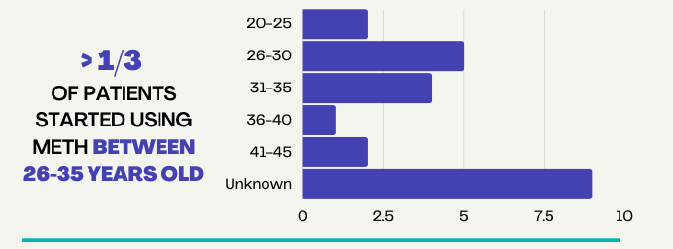
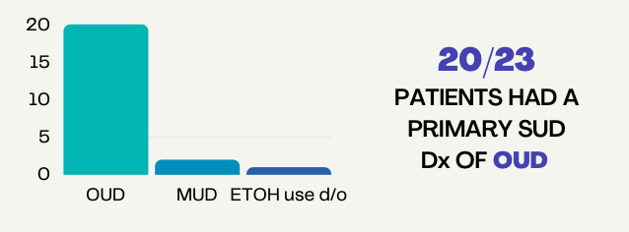
Notes:
Demographics

Slide 11
Notes:
Evidence of Adverse Effects

Slide 12
Meth Protocol Utilization During Hospital Stay
n = 23
Notes:
Demographics

Slide 13
Behavioral Treatments Utilized (N=23)
100%
<5%
Rest PRN
Fluids@ bedside
Redirection
50%
Extra Sleep
Excused from
Group
Bedside
Meds
Ensure
Given

Slide 14
Notes:
Evidence of tolerability
The mean duration of the longest symptom reported in clinical presentation was approximately 2.6 days with the standard deviation being 2.3 days. There was one outlier who had symptoms last for 10 days. Only 4/23 patients stopped the protocol early. This evidence suggests overall tolerability of the protocol.

Slide 15
Nursing Focus Group Feedback
“I like that there are options for meth users.”
“Now, more and more are beginning to be honest about their meth use because they know we have a specific protocol for it. “
“I really like the behavior component”
“I like all the different meds we can use for the protocol and that we are learning more and more about meth use. “
“The Seroquel works the best. Benadryl has helped clients for their anxiety symptoms. Vitamin C I think has been very helpful”
“Maybe it can be expanded into the next level of care.”

Slide 16
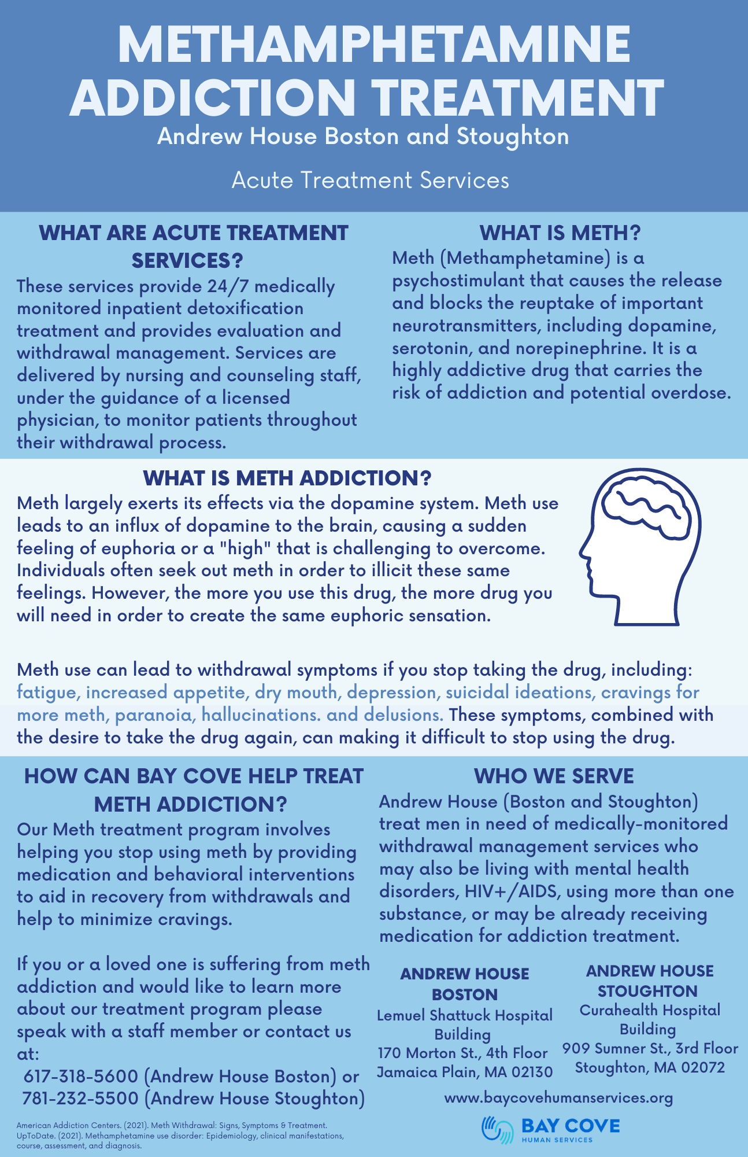
Questions?
Thank you !

