Slide 1
Electronic Visit Verification Phase II Implementation for SCO/One Care Contracted Providers
Executive Office of Health and Human Services
July 23, 2021

Slide 2
Meeting Agenda
Today we will discuss…
High Level Overview of EVV
Options for EVV Compliance
Incremental Steps to Implementing EVV
Updated EVV Website
EVV Communication
Q&A
Please write your questions in the chat box. We will go through any questions in the chat box first during the Q & A period and then open it up for additional questions.

Slide 3
High-Level Overview of EVV
Electronic Visit Verification (EVV) refers to the technology used to capture timesheet and location information of a worker providing in-home services
EVV systems can vary but, instead of a timesheet, the worker uses the EVV system to check in and check out.
The most common types of EVV systems are:
Mobile (using a personal device, usually a phone)
Telephony (using a landline)
Fixed device (acquiring a code from a device that is “fixed” in the consumer’s home)

Slide 4
High-Level Overview of EVV
EVV is a federal requirement based on the 21st Century Cures Act (Cures Act)
Massachusetts is federally required to implement EVV for personal care services provided to Medicaid recipients.
Since personal care is often provided along with homemaking and companion services, EOHHS decided to implement EVV for those services too.
Because EVV requirements extend to many providers, EOHHS decided to implement in phases
This phase (Phase II) impacts providers that contract directly with SCO and/or One Care Plans to provide personal care, homemaking and companion services
Many providers in Phase II are required to implement EVV for Phase I (ASAP-contracted providers) Requirements in Phase II will be similar to Phase I

Slide 5
High-Level Overview of EVV
The Cures Act requires EVV for all Medicaid funded, in-home personal care services by January 1, 2020 and for all home health services by January 1, 2023
The Commonwealth of Massachusetts got a Good Faith Effort extension that extended our personal care implementation deadline to January 1, 2021
CMS will issue financial penalties to states that miss the federal deadline
Because of COVID-related delays, the Commonwealth did not meet the January 2021 deadline
Providers will not be held responsible for penalties associated with COVID-related delay

Slide 6
Options for EVV Compliance
EOHHS offers providers that directly contract with SCO and One Care Plans two options for achieving EVV compliance:
Alternate EVV System
Any system purchased by a provider that meets Cures Act and EOHHS requirements
MyTimesheet
State-sponsored EVV system
Providers can use a variety of technologies to meet EVV requirements
Systems are generally customized for the provider’s specific use
Cost of system and devices, if applicable, is borne by the provider
Providers upload a standard file to EOHHS’ Data Aggregator (a data warehouse of EVV visit data) on at least a monthly basis
Mobile-based system offered by Optum and configured for the State’s use
Integrated with Plans’ systems. Consumer, provider, and service plan data will be uploaded nightly to simplify creation of appointments
Use of MyTimesheet system is free of charge but does not include the cost of devices
EVV data will be automatically uploaded to EOHHS’ Data Aggregator

Slide 7
Incremental Steps to Implementing EVV
If you have not yet implemented EVV, EOHHS recommends completing the following steps
These steps are relevant if you select an Alt-EVV system or the MyTimesheet system
Step 1.
Select your method for EVV Compliance
Step 2.
Complete internal EVV implementation planning
Step 3.
Attend EVV System Trainings
Step 4.
Begin EVV Implementation

Slide 8
Incremental Steps to Implementing EVV
Step 1. Select your method for EVV Compliance
Identify the Key People in your Organization for EVV Decision-Making
Review the EOHHS Cost Considerations Document
Review the EOHHS Cost Considerations Document
Schedule Demonstrations with Alt-EVV Vendor
Attend State-Sponsored EVV Meetings
Attend the MyTimesheet Demonstration

Slide 9
Incremental Steps to Implementing EVV
Step 2. Complete Internal EVV Implementation Planning
Identify Key EVV Users
Primary trainer(s)
Identify EVV Users by User Group
Workers
Execute Alt-EVV Contract and Install System*
Develop Plans for Devices/Check-In Process
Update/create policy & procedures
Primary “tech” support
EVV “HR”
Schedulers
Other Staff
Communicate policy to staff
*For Alt-EVV Providers only

Slide 10
Incremental Steps to Implementing EVV
Step 3. Attend EVV System Training
Consider Who Needs to Attend Trainings
Identify your Goals for Training Prior to Attending
Actively Participate in Trainings
Complete Post-Training “Tests”
If Necessary, Retake Training

Slide 11
Incremental Steps to Implementing EVV
Step 4. Initiate System Set-Up and Implementation
Complete System Set-up Tasks
Add users
Update Policies and Procedures
Identify and update those policies and procedures impacted by EVV implementation
Develop Internal Training Plan
Identify users needing training
Add other organization data (i.e. worker lists)
Have workers download app
Plan and schedule for follow-up training
Distribute to staff
Determine order of training by user group
Set schedule for initial training
*For Alt-EVV Providers only

Slide 12
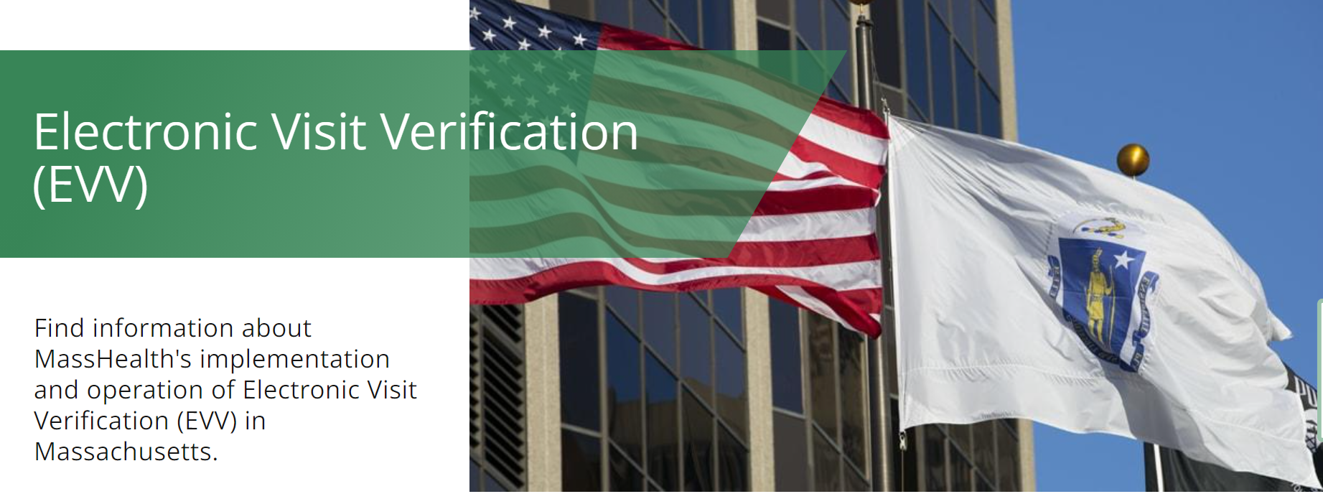
Updated EVV Website
EOHHS updated its website for information on Electronic Visit Verification
The website has a new address: https://www.mass.gov/topics/electronic-visit-verification-evv
If you select the old address, it will redirect you to the new website

Slide 13
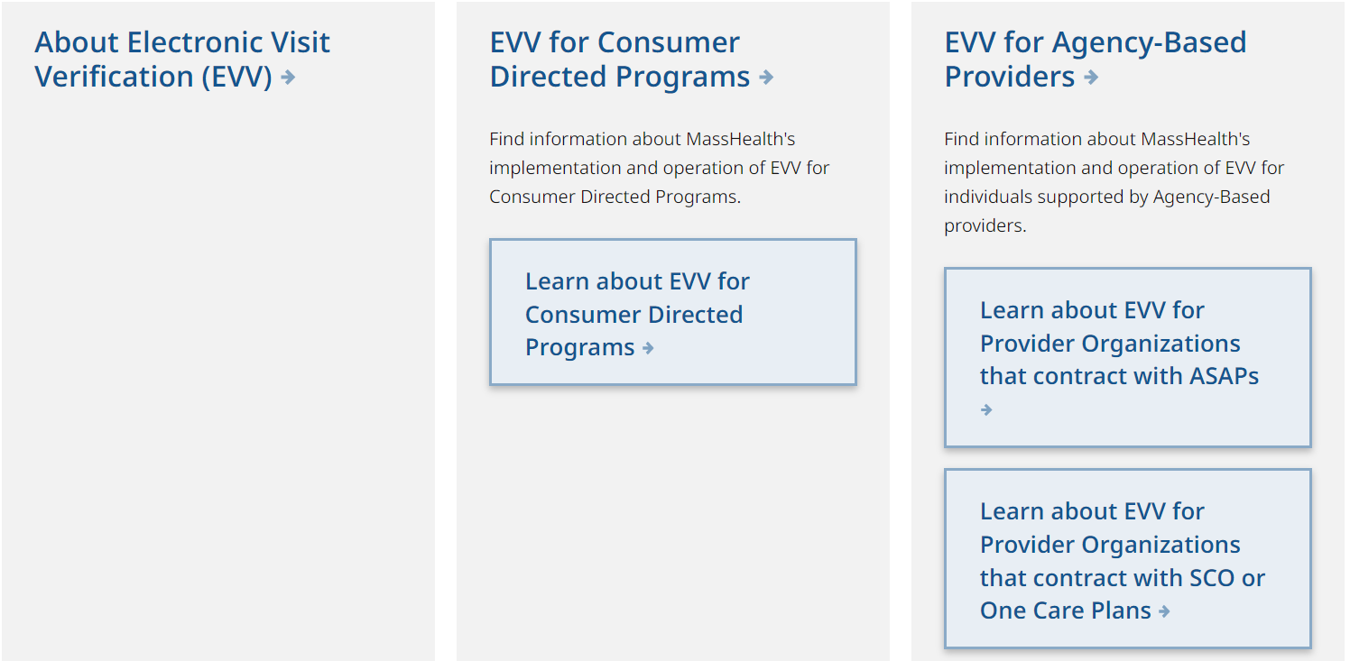
Updated EVV Website
Users are directed to pages specific to the programs and providers impacted by EVV

Slide 14
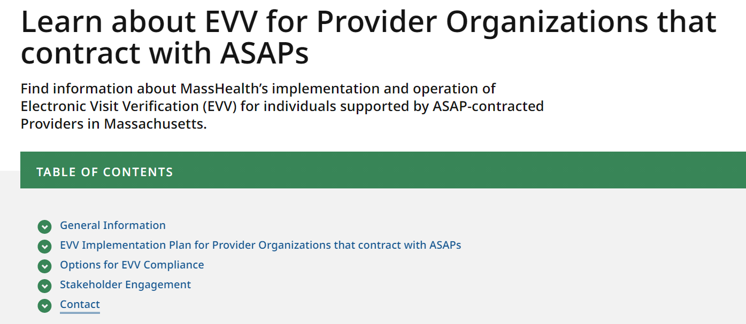
Updated EVV Website
Program-specific information sorted into functional categories
Designated area that illustrates the implementation timeline
ASAP provider-specific instructions for Data Aggregator and MyTimesheet users
ASAP provider-specific documentation

Slide 15
Updated EVV Website
Collated resources in the Options for EVV Compliance section to aid providers in EVV implementation. Includes the following documentation:
Cost Considerations Document
Steps to Using MyTimesheet
Steps to Using the Data Aggregator
Data Aggregator and MyTimesheet Documentation
Data Aggregator User Guide
Data Aggregator API Guide
Updated Frequently Asked Questions

Slide 16
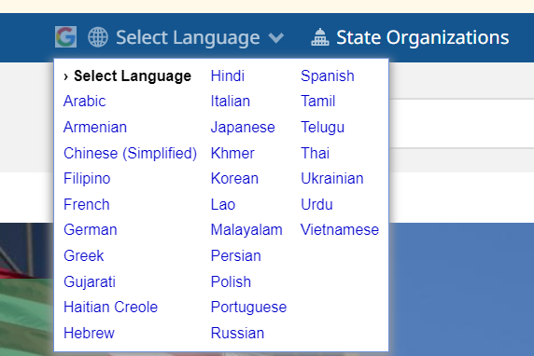
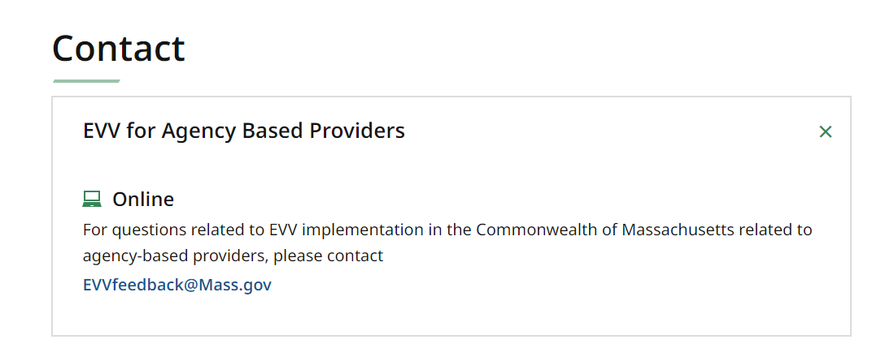
Updated EVV Website
Website available in many languages
Link to EVV email provided on all pages specific to each provider implementation group

Slide 17
EVV Communication
EOHHS has developed multiple channels for communication
Mass.gov website. EOHHS posts provider resources, EVV documents and general EVV information on our EVV website: https://www.mass.gov/topics/electronic-visit-verification-evv. This website has recently been updated to make information about specific implementations easier to find.
Email communication. EOHHS has an email distribution group for SCO and One Care C-contracted providers that we use to provide information about EVV implementation. If you would like to be added to this distribution list, please email us at evvfeedback@state.ma.us.
Dedicated EVV email. The evvfeedback@state.ma.us email account is monitored by the EOHHS EVV team. Feel free to contact us if you have a question about EVV implementation.
Bi-weekly WebEx sessions. We will hold WebEx sessions every other Friday from 1:00pm to 2:00pm. We will present on an EVV-related topic and answer questions from attendees.
EOHHS will be communicating with providers on EVV requirements, not EVV software vendors. Since the federal requirements impact you, we want you to understand how we will work with you to meet them. Our intent is to provide documentation that you can provide to your vendors that is self-explanatory and user friendly. We welcome feedback on areas where we can improve our documentation to meet that standard.

Slide 18
Q&A
We will address question submitted via Chat first and then open the lines for attendees to ask questions.

