Slide 1
CCFA Billing: Overview and Steps
Updated: October 2020

Slide 2
Agenda
Overview
Step by Step Billing Process
Submitted Invoices Page
View Monthly Billing History Page

Slide 3
Overview
Family
Attendance
Billing
Authorization
Placement
All billing must be completed and submitted through CCFA.
Once all attendance has a “Ready to Submit” status, providers must generate ledgers. An Invoice is displayed on the Billing + Pending Invoices page and must be approved by the Billing Administrator.
Once all provider invoices are approved, the billing manager submits one bill to EEC and to their CCRR simultaneously.
CCRRs will review and approve all voucher invoices on Billing + CCRR Pending Invoices. Then CCRRs will review and submit their invoice to EEC by the 20th of each month.
CCFA produces a payment voucher that must be submitted as a hard copy.

Slide 4
Overview
All billing is due to EEC by the 20th.
This includes CCRRs, FCC Systems, and Contract Providers.
Subsidy administrators must submit Payment Vouchers with wet signature by the 20th of every month.
If the 20th falls on a holiday or weekend, billing is due the next business day.
Billing must be submitted on time for prompt payment.
Voucher billing is due on the 13th of the month.
This includes Voucher only providers and contract providers with voucher agreements.
Contract billing will go to EEC, and voucher billing to the CCRR.
This gives the CCRRS time to complete their process.
Notes:
ARE THESE THE CORRECT DATES?
Billing is the 5th Step in the Process
Billing can only be Submitted after:
The family and child have been entered in CCFA
Eligibility information is complete and the Authorization status is Approved
Placements have been created for the child for the Provider Organization
Attendance has been completed and Approved (Generate Ledgers)
See Appendix for Common Issues
Provider Rates should be populated and current
See Appendix for discussion of which rates are used
You will not be paid for unapproved/rejected Attendance that remains unapproved
Modify the Attendance as necessary and resubmit
If after the service month deadline, will be billed next service month

Slide 5
Step by Step Billing Process
Generate Ledgers and agree to attendance submission
Go to Pending Invoices
Review Pending Invoices and Approve/Reject
Click Review Submission
Review Submission
Submit and Confirm

Slide 6
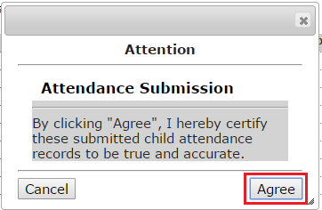
1. Generate Ledgers and Agree to Attendance
Once all months to be included in the current billing cycle say “Ready to Submit” click “Generate Ledgers”
You will be asked to agree to attendance. Click “Agree.”
The billing status will change to say “In progress.”
You must refresh the page in order to change the status.
You can continue to utilize other functionalities in CCFA while billing is processing.
The billing status for all months included in the submission must say “billed” in order to proceed.

Slide 7
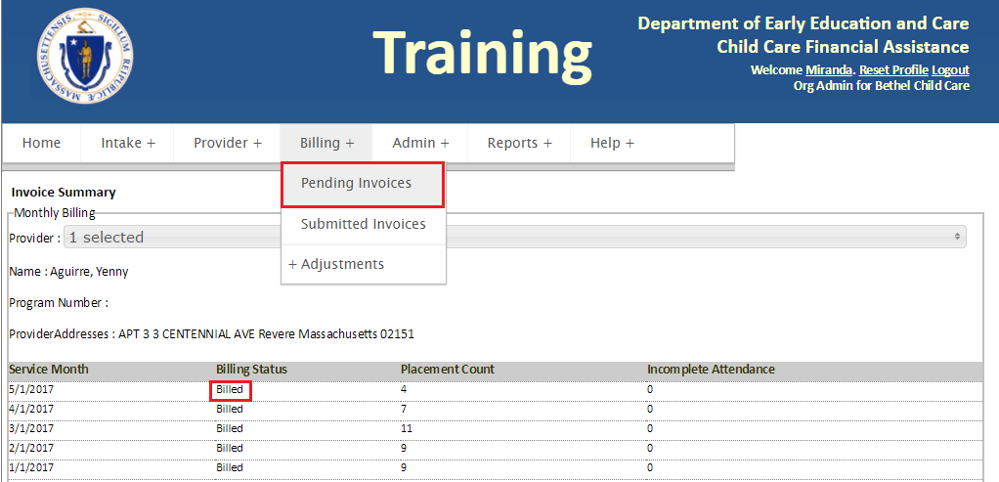
2. Go to Pending Invoices
Once the status says “billed,” go to Billing + Pending Invoices.

Slide 8
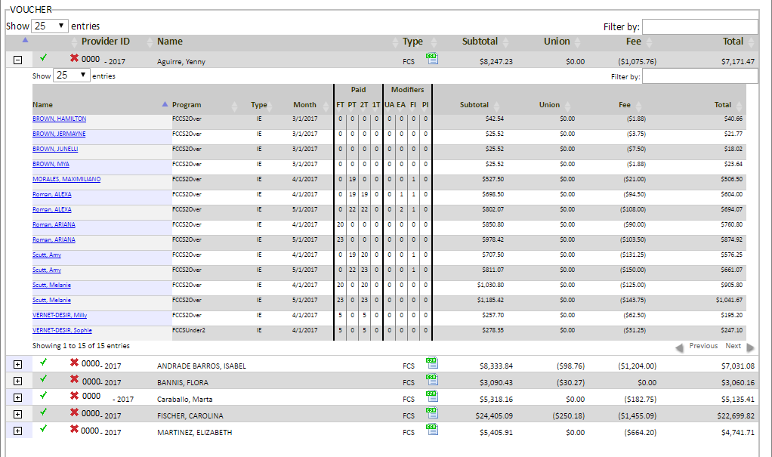
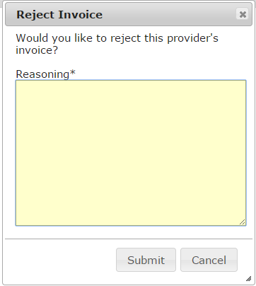
3. Review Pending Invoices and Approve/Reject
Contracts and vouchers are listed separately
You may have to scroll down on the page to see your voucher invoices.
Click the green check to approve the invoice.
Click the red “X” to reject the invoice.
You will be required to type a reason.
Click the “+” sign to expand the invoice to view details for each placement by each month.
Alternatively, click on the csv icon to export the placement level details to a spreadsheet that can be opened with Excel.
The provider’s attendance status will change to “rejected.” There will be a notification on the home dashboard.

Slide 9
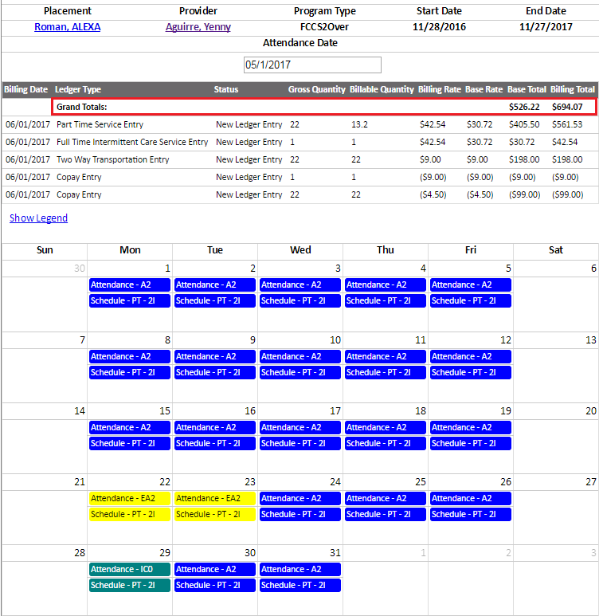
3. Review Pending Invoices and Approve/Reject
Clicking the child’s name will open a separate tab with the Monthly View for the placement.
Child’s name, provider, program type, and placement dates appear at the top of the page.
Child’s name links to Placement Details page
Provider’s name links to Provider Details page.
Shows attendance and ledger entries for that month.
Full-time/ Part-time service
Copay*
Transportation*
Full-time/ Part-time Intermittent service*
Union dues*
QRIS*
Add-ons*
Billing totals for the placement will show at the top
*May not apply to all placements

Slide 10
4. Click Review Submission
Approving an invoice will change the check mark to gray
After all invoices have been approved, click “Review Submission.”

Slide 11
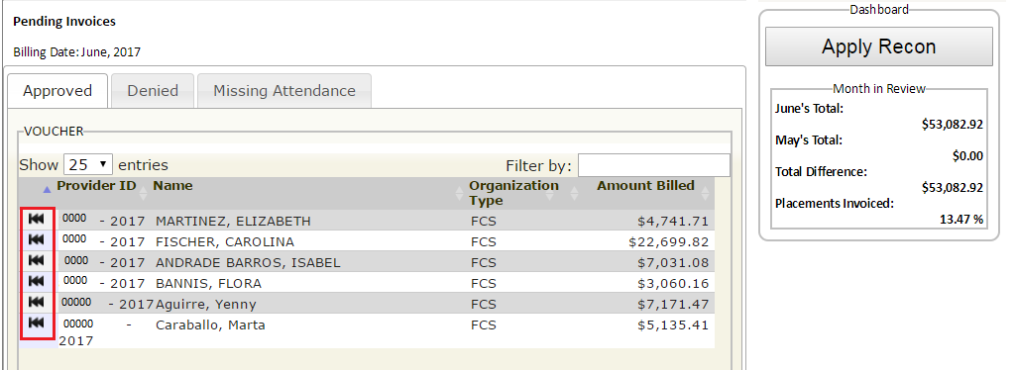
5. Review Submission
The black rewind button allows you to make changes before submitting.
The button rewinds the invoice to the Pending Invoices page where you can reject it.
Note: Though the reconciliation period is over, you will still see an “Apply Recon” button. You must click the button to proceed with billing. CCFA will process the recon, but no reconciliation adjustments will be applied.
Billing Tabs
Approved: Lists approved invoices from the Pending Invoices page
Denied: Lists any invoices that have been denied and not re-approved.
Pending: Lists invoices that are on the Pending Invoices page. Note: This tab is only available for CCRR admins.
Processing: Lists invoices that are still processing. Refresh the page to move these invoices to the Approved tab.
Missing Attendance: Lists providers with incomplete attendance

Slide 12
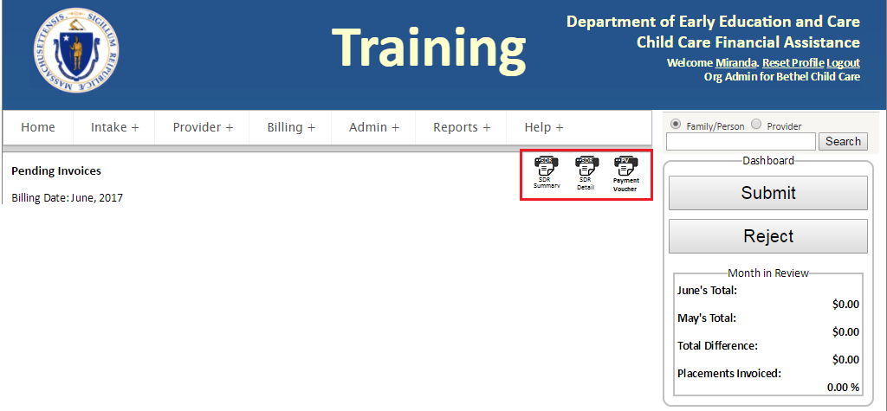
6. Confirm and Submit
A draft of the payment voucher is available
Shows the monthly totals by contract line and/or voucher agreement
Drafts of the SDR reports are available, but are no longer supported.
As changes are made to CCFA the SDR reports are not being updated
Instead, the Billing Month Extract is available in draft form
Click “Submit” to submit your voucher invoices to the CCRR and your contract invoices to EEC.
Click “Reject” to reject the entire submission.
Clicking “Reject” sends the invoices back to the “review and submit” page with the black rewind buttons.
When you click ”Submit,” you will be asked to confirm.
You will be notified of any providers that haven’t been approved.
If you click “yes”, these providers will be excluded from the current billing cycle.

Slide 13
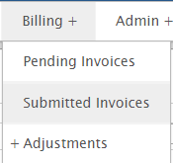
Submitted Invoices Page
After you submit to the CCRR and EEC, you can see all of your past submissions and payments.
The Billing date is the date you submitted your invoice to the CCRR/EEC.
The Submission date is the date the CCRR submitted to EEC.
The Invoice date is the date EEC approved.
The page defaults to the current month.
You MUST print the Payment Voucher from this page.
Sign and submit it as a hard copy to your EEC payment specialist by the 20th of the month.
You will not see any totals populated under the “Month in Review” until your invoices are approved.

Slide 14
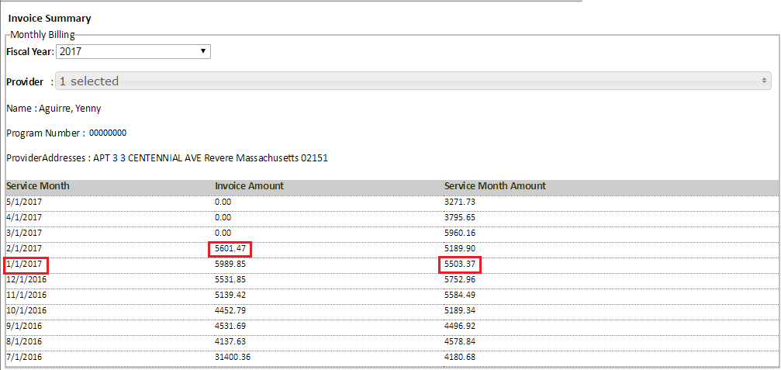
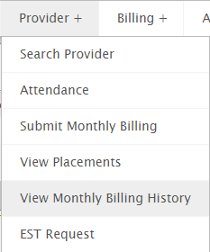
View Monthly Billing History
Allows you to view invoice amounts by provider from a monthly perspective
Option to change the fiscal year
Invoice Amount is the amount paid for that billing month
For example, $5601.47 is the invoice amount paid for January services and any previous months that may have been submitted in the February billing cycle.
The $5503.37 is the total amount for January services alone (see below for more information).
Service month amount is the total billed for that service month
Includes amounts billed across multiple billing months
Includes any pending amounts.

