Slide 1
Regional Model based on
Exemption from Licensure
March 11, 2026
Vita Palazzolo Berg
Telehealth Taskforce, BORIM seat

Slide 2
Objectives
Focus on continuity of care for existing patients
Focus on practice groups located near MA borders
Keep burden low (fees, CME, documentation)
Build from what we know: existing law and COVID experience
Ensure BORIM knows physicians treating patients in MA
Ensure physicians understand that their practice must conform to MA laws and standards

Slide 3
Existing Laws: Chapter 112, section 7
Sets an exemption from the requirement for licensure for a “physician authorized to practice medicine in another state, when he is called as the family physician to attend a person temporarily abiding in the commonwealth.”

Slide 4
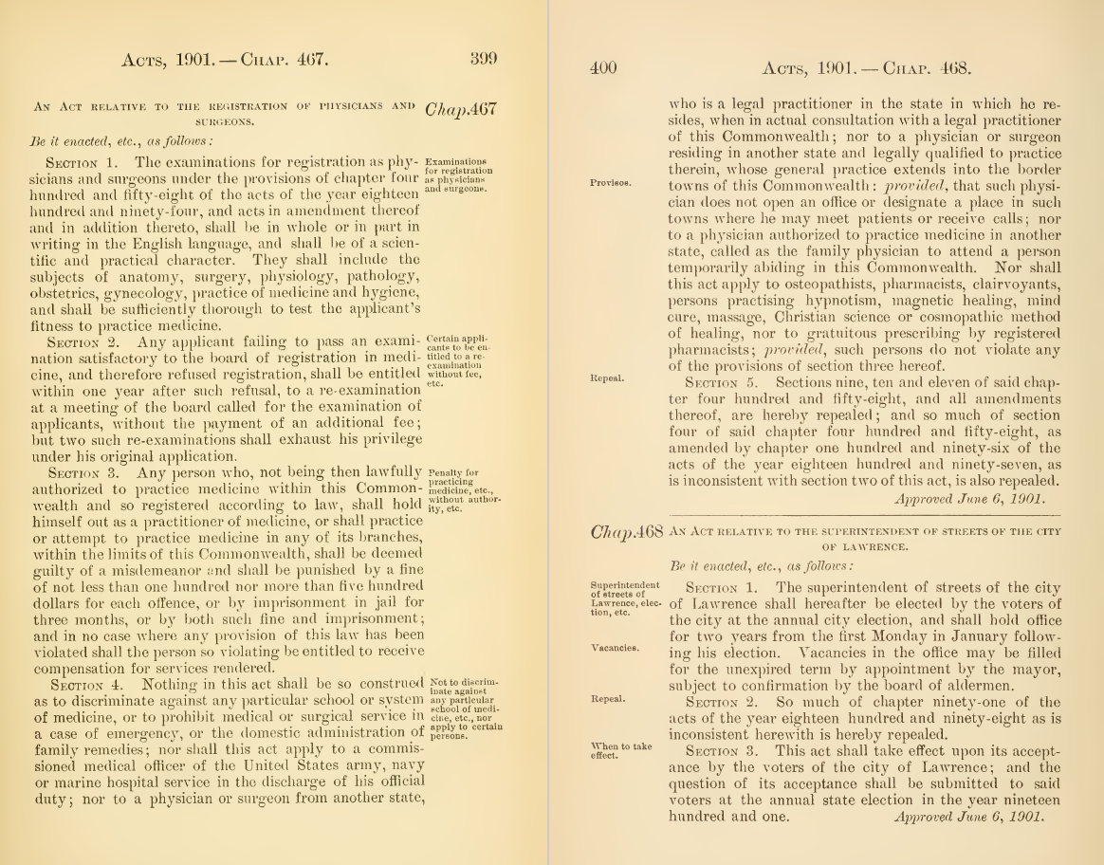
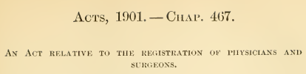
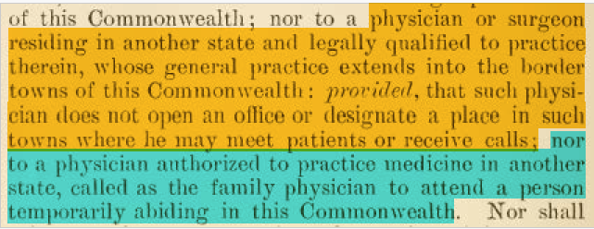
Chapter 112, section 7,continued

Slide 5
Existing Laws: Chapter 94C, section 18
A Massachusetts pharmacy can fill a prescription written by a physician who is not licensed in Massachusetts if:
Medication is | Prescription was issued within the preceding | Pharmacist verifies that prescription was issued by authorized prescriber who
Schedules III – VI | 30 days | Resides and holds license in state where prescription was issued
Non-narcotic Schedule II | 5 days | Holds license and resides or practices in state where prescription was issued
Narcotic Schedule II | 5 days | Holds license in Maine or a contiguous state (ME, NH, VT, NY, CT, RI)

Slide 6
COVID Emergency Temporary Licenses
During COVID, BORIM issued Emergency Temporary Licenses to physicians who presented license verification that they held a license, in good standing, in another state.
Full license based on reciprocity and required no fee.
BORIM utilized a one page application.

Slide 7
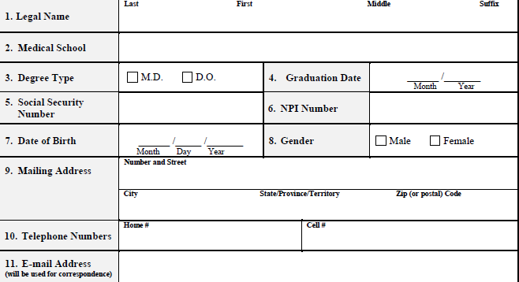
COVID Emergency Temporary Licenses, cont.

Slide 8
COVID Emergency Temporary Licenses, cont.
Prior to issuance, BORIM checked FSMB’s Physician Data Center to verify that all licenses issued to the physician in other states were in good standing
BORIM periodically rechecked FSMB’s Physician Data Center
BORIM implemented a mechanism for automatic license termination by operation of law on basis of information that physician no longer held all licenses in good standing, issued on receipt of documentation that another state took an action

Slide 9
What could a regional expanded exemption look like?
New law setting an exemption in MA law for physicians from 6 states: ME, NH, VT, NY, CT and RI.
For mutuality, the 6 states would need to pass a similar law. MA Law could require mutuality before exemption in MA takes effect.
Exemption would be patient specific and allow treatment of patients who are located in MA with whom the out of state physician has an established physician-patient relationship.
Exemption would be limited to physicians who hold a valid license in one of the 6 states; provided the physician’s license(s) is in good standing in all states where issued and provided that they register with BORIM.

Slide 10
What would the exempt physician need to do?
Submit a simple application that will provide sufficient information to:
  identify the physician’s identity and basic credentials, and
  verify license information in other states
Sign an agreement (details in upcoming slide)
Low or no fee, no CME requirements, registration valid for 2 years, must reapply to renew

Slide 11
Terms of Agreement
License status and absence of any pending complaints or criminal charges
Reporting requirement re: complaints and charges
MA laws & standards apply when treating MA patient
Only established patients
Rescission for:
  Failure to report, treating new patients, violating state laws or standards
  Discipline imposed by another state licensing board*
  Criminal conviction in any state*

Slide 12
What would BORIM need to do?
Publish a registry of approved physicians
Notify the other Boards within the region that issued a license when:
  Physician’s exemption registration is approved, renewed, lapsed or terminated
  Action was taken on a license issued to the physician*
  A complaint was received against a physician*
Share investigation information with Boards that issued a license*
*except to the extent that a state’s Shield Laws may apply

Slide 13
Other states in the region
BORIM made inquiries to the medical boards in the region to learn if they have any existing laws that allow physicians licensed in neighboring states to treat patients in their state.
Maine, Rhode Island, Vermont, New Hampshire and Connecticut have responded. New York has not.
None have laws specific to the neighboring states. While most answered that a physician must have a license to treat patients in their state, some noted that their laws do allow some exemptions.
Common exemptions are consultation, athletic team, military and medical educators

Slide 14
Comparison with IMLC and DC/MD/VA model
 | Regional exemption | IMLC | DC/MD/VA model
Does it require Legislation to pass in MA? | Yes | Yes | No
Does it require Legislation to pass in other states? | Yes | Yes* | No
Full license? | No | Yes | Yes
Application in each state | Minimal | Expedited | Expedited
Licensee fee to each state | No** | Yes | Yes
CME requirements in each state? | No | Yes | Yes
*Most states have already passed
**Low or no registration processing fee

