Slide 1
How are you impacted by climate change in Massachusetts?
See the full report at bit.ly/maclimate
Boston Harbor Region
Let’s find out!

Slide 2
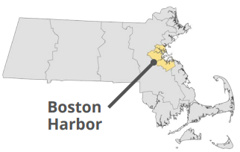
The 2022 Massachusetts Climate Change Assessment evaluated and ranked 37 impacts across 5 sectors for 7 regions throughout the Commonwealth based on:
How big will the impact be from climate change?
How well do current adaptation actions address the impact?
Will populations living in environmental justice areas be disproportionately affected?
The Boston Harbor Region includes the City of Boston and 17 surrounding cities. This region is characterized by dense population, economic activity,
and coastal natural resources. Urban heat islands and coastal flooding drive many of the most urgent impacts.
The next slides show the most urgent impacts per sector for this region →

Slide 3
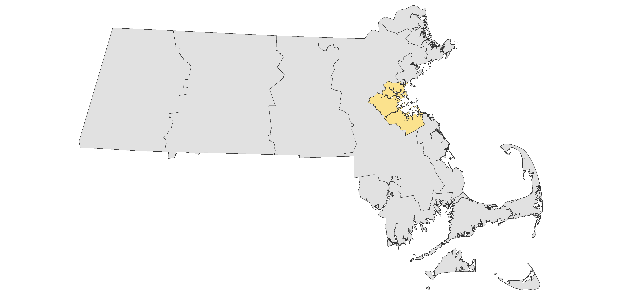
Human Sector
Human Sector
Top Impacts:
Heat-related illness and death during extreme heat events. Extreme heat can also negatively impact learning and productivity.
Other top impacts include health effects of worsening air quality, delays in emergency services and on evacuation routes during flood events, and disruption to food supply from flooded distribution facilities and local farm yields.
Boston Harbor Region

Slide 4
Infrastructure Sector
Infrastructure Sector
Top Impacts:
Damage to train infrastructure (railroads and the T) from extreme heat events cause track buckling, and flooding, especially underground infrastructure.
Loss of urban trees, which are vulnerable to high heat and drought conditions. Weakened trees are also more susceptible to invasive pests
Boston Harbor Region

Slide 5
Natural Environment
Top Impacts:
Marine water ecosystem degradation because of warming, particularly in the Gulf of Maine (which includes Boston Harbor), and ocean acidification.
Freshwater ecosystem degradation due to warming waters and increased runoff in waterways already facing threats of contamination.
Boston Harbor Region

Slide 6
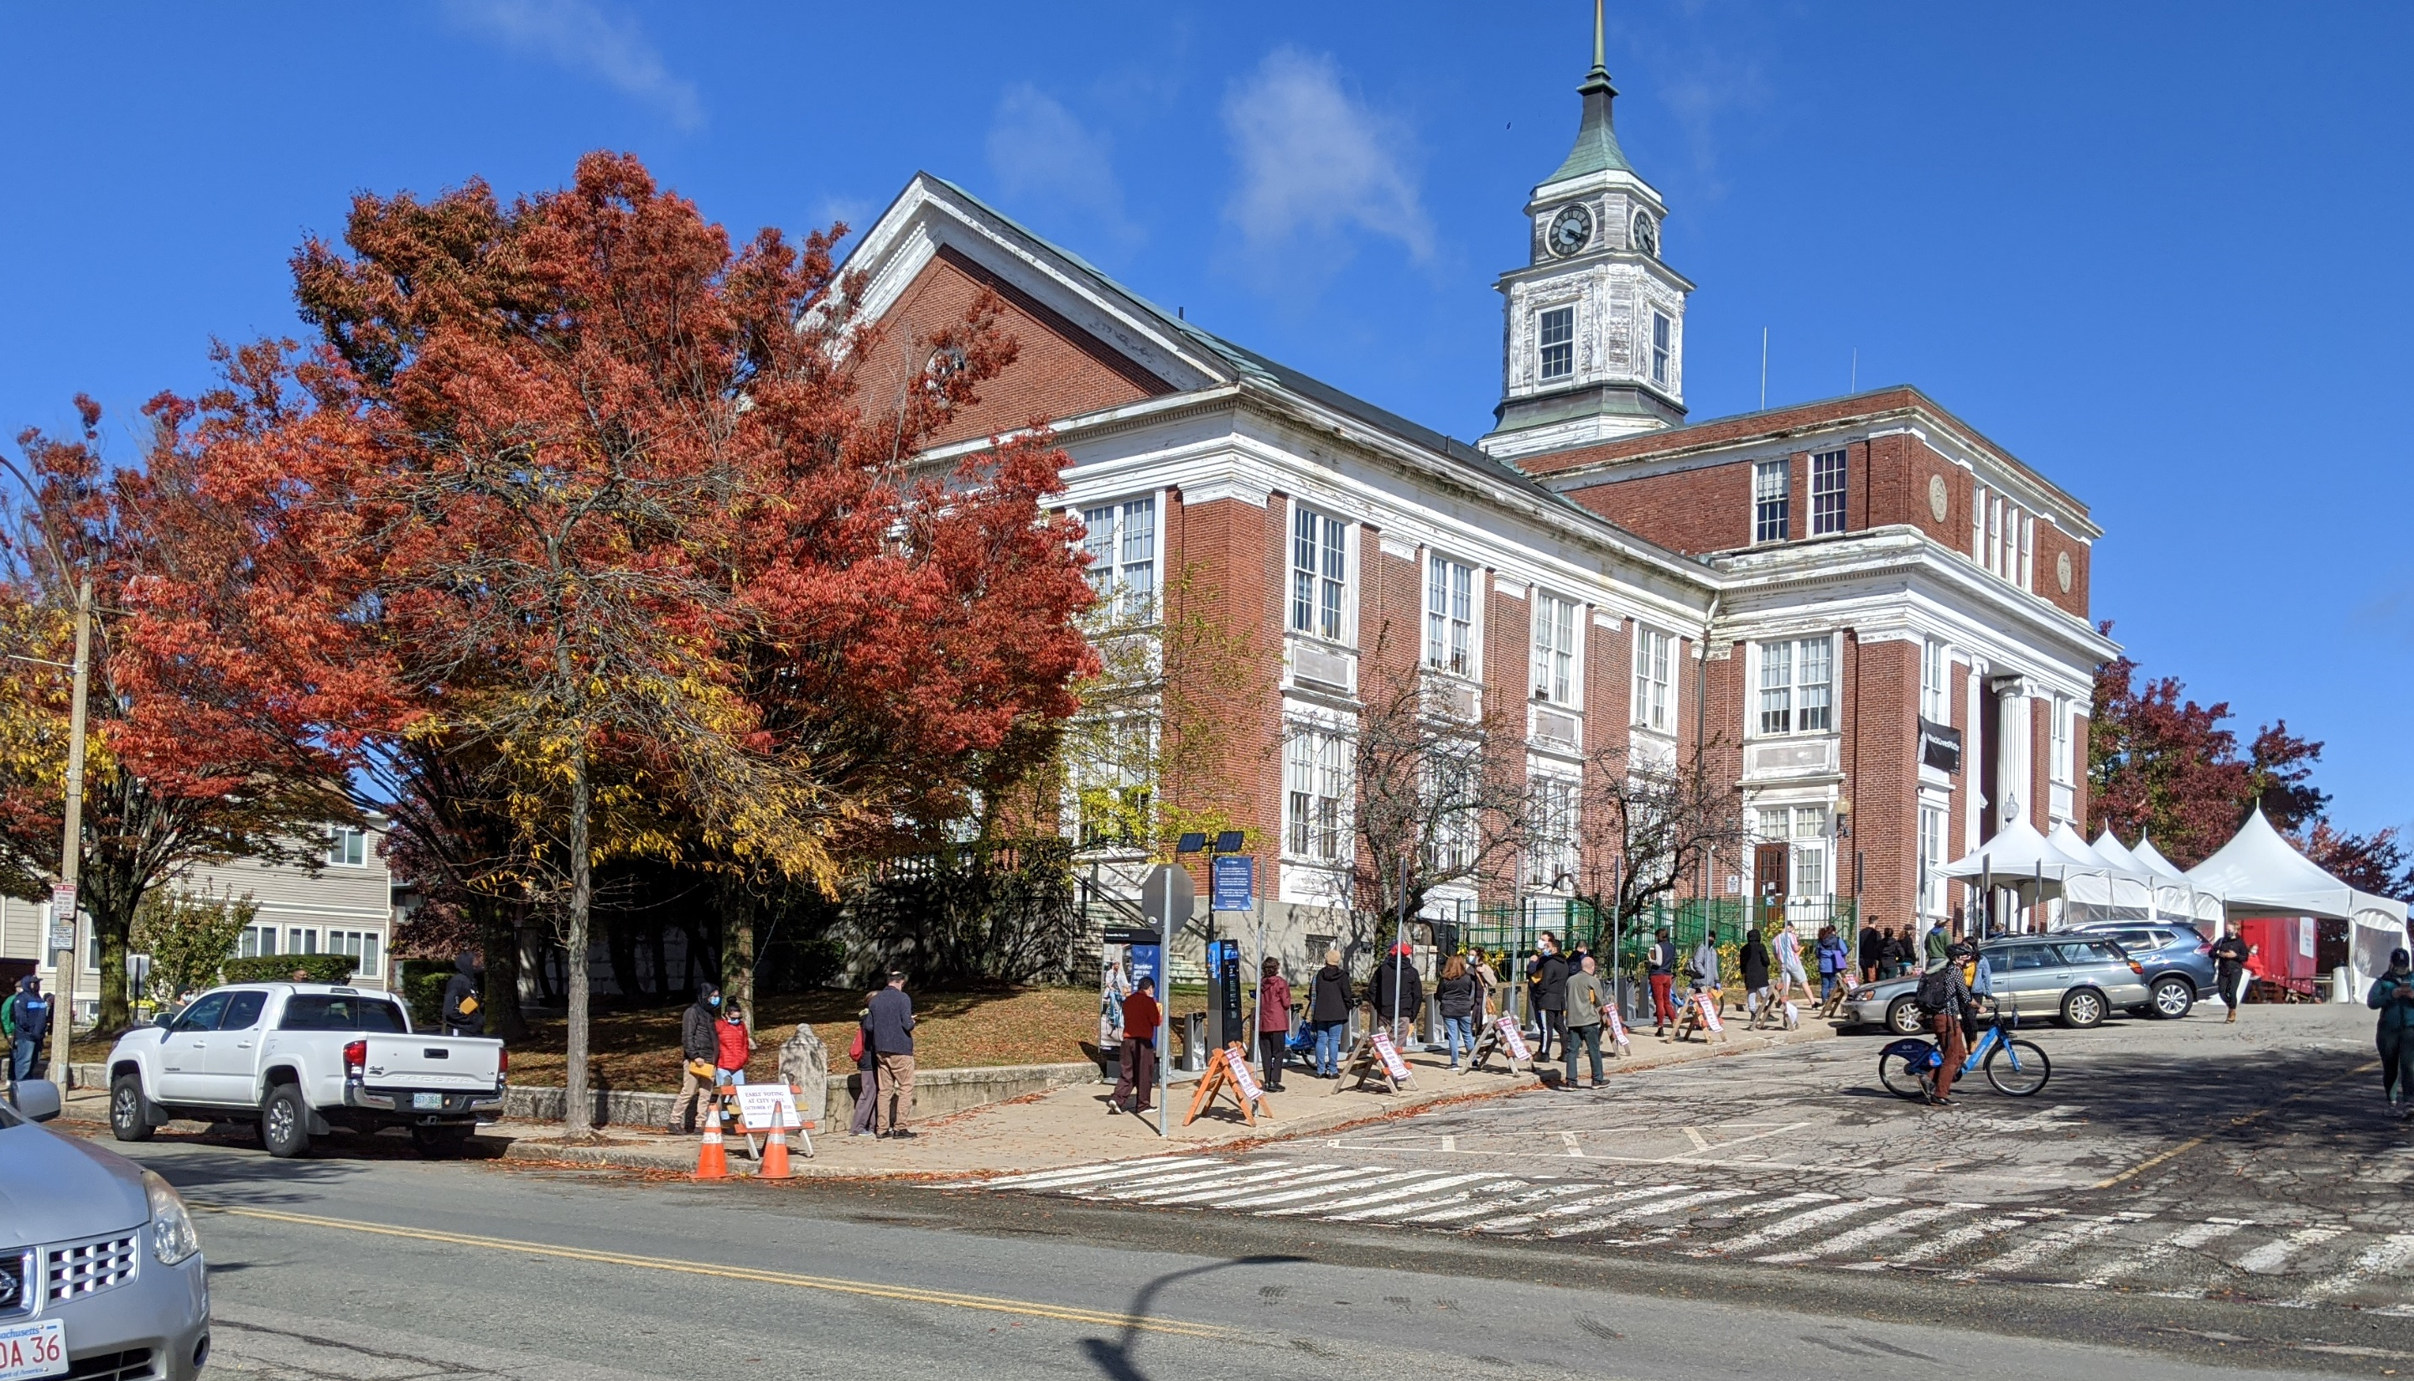
Governance
Sector
Top Impacts:
Reduction in State and municipal revenues, including a reduced property tax base due to coastal flood risk.
Increase in demand for State and municipal government services due to the impacts identified in the Human sector including emergency response, food assistance, and state-sponsored health care.
Boston Harbor Region

Slide 7
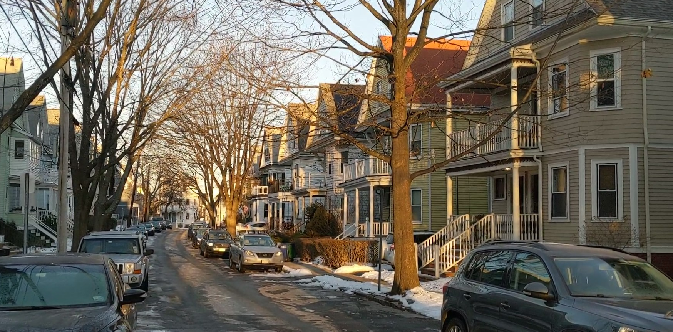
Economic
Sector
Top Impacts:
Reduction in the availability of affordably priced housing from direct flooding damage to affordable housing units and the increased demand for housing outside of flood zones.
Economic losses from commercial building damage (flood and wind) and business interruptions during closures, utility outages, and due to supply chain issues caused by more frequent and intense extreme weather.
Boston Harbor Region

Slide 8
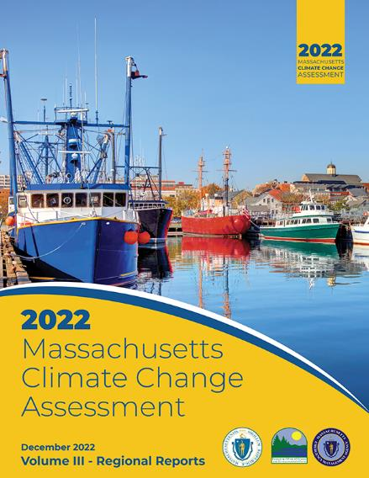
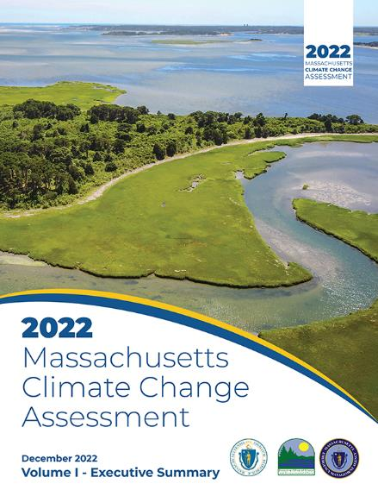
To learn more, check out the full report, available online!
bit.ly/maclimate
Type this link into your browser

