Slide 1
HEALing Communities Study
Presented by: Jeffrey Samet, MD, MPH
Professor of Medicine and Public Health, Boston University
10/4/2022

Slide 2
Goals for Today
Provide an overview of the HEALing Communities Study (HCS)
Describe the HCS community-engaged, data-driven approach to reduce OD deaths
Share examples of coalition strategies in MA
Answer your questions
HEALing Communities Study

Slide 3
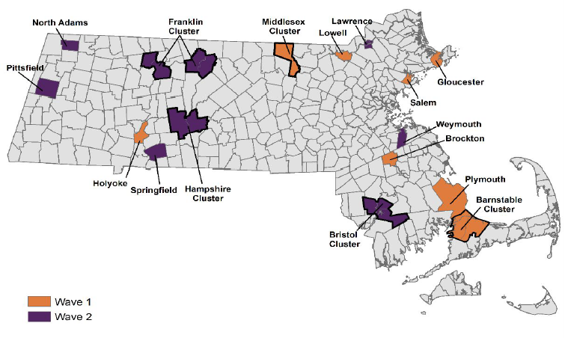
HEALing Communities Study (HCS)
April 2019 – NIH and SAMHSA funded MA, NY, OH, KY to work with 67 highly affected rural and urban communities to reduce opioid overdose (OD) deaths by implementing a process to deliver evidence-based practices in healthcare, behavioral health, criminal legal settings
In MA, 16 communities were randomized into two groups
Wave 1: Jan 2020 – Jun 2022
Wave 2: Jul 2022 – Dec 2023
HEALing Communities Study

Slide 4
Goals of HCS: To implement the Communities that HEAL (CTH) process
To reduce opioid overdose deaths by implementation of evidence-based practices (EBPs)
Increase overdose education & naloxone distribution (OEND)
Increase access to medications for opioid use disorder (MOUD)
Increase safer opioid prescribing & dispensing practices
HEALing Communities Study

Slide 5
What makes the CTH process unique?
Communities work in partnership with medical and public health professionals
Coalition members engage in data driven decision making
Local organizations build capacity to reduce OD deaths
HEALing Communities Study

Slide 6
CTH Phased Planning Process
1
Establish coalition and charter
2
Review community data, identify resources and gaps
3
Discuss EBP strategies
4
Develop Action Plans
5
Implement and monitor strategies
6
Pursue Sustainability
HEALing Communities Study
HEALing Communities Study

Slide 7
Resources for MA Communities
Boston Medical Center (BMC) personnel: facilitator, data manager, addiction expert
Training and Technical Assistance
Communications campaigns
Funding ($800,000 per year-each community):
  Community coordinator
  EBP strategies: Access to MOUD and OEND; Safer Prescribing

Slide 8
Key participating groups in MA
Fiscal Agent
Anchor Agency
Community Organizations
MA Department of Public Health
Boston Medical Center
Community Advisory Board
Coalition

Slide 9
Examples of EBP Strategies in MA

Slide 10
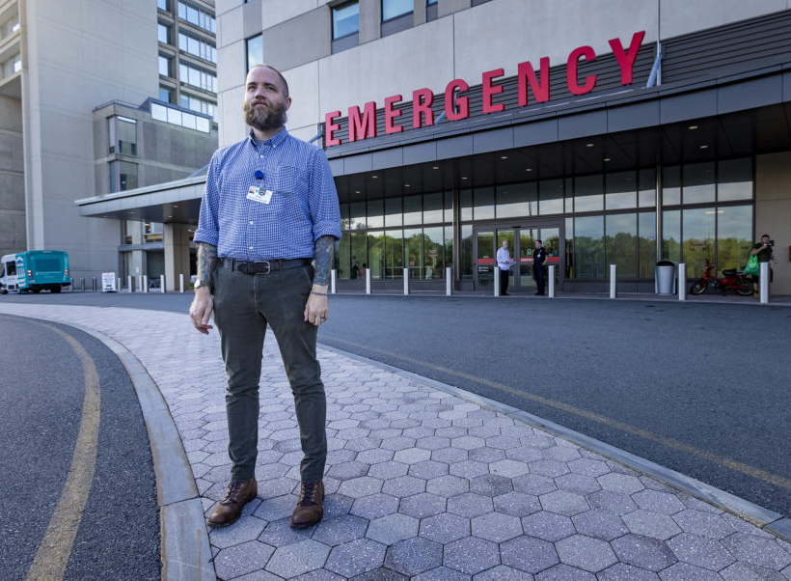
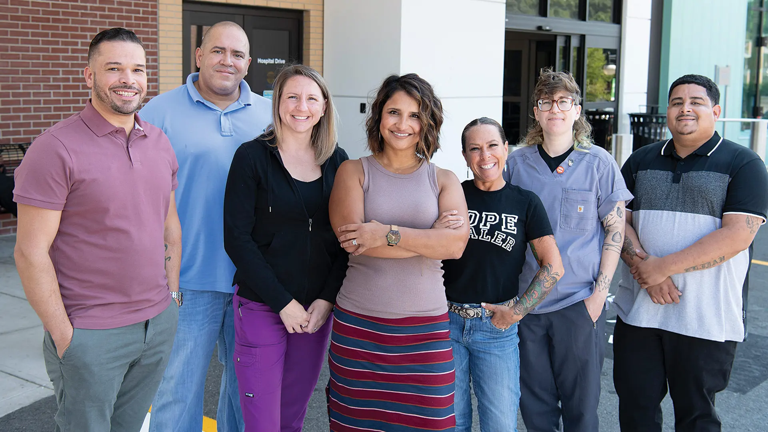
Hospital Based Addiction Consult Services
Brockton, Gloucester, Holyoke, Lowell, Salem
Recovery coach - Salem Hospital
Strategy to initiate MOUD for inpatients and link to MOUD upon discharge
HCS typically supported 2 full time staff (e.g., nurse practitioner [NP], nurse [RN], recovery coach)
Success of treatment model:
  Increase in MOUD initiations, admission to OTPs, referral to buprenorphine providers
  Recovery Coaches key to willingness to initiate MOUD
  Catalyze culture change in hospital re: OUD and MOUD
  Sustainable through billable services
Credit: Jesse Costa/WBUR
Addiction Consult Service Team
Holyoke Medical Center
Credit: George O’Brien
BusinessWest.com

Slide 11
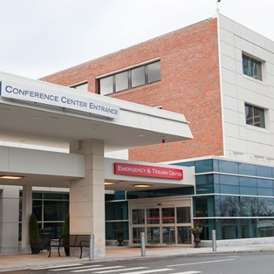
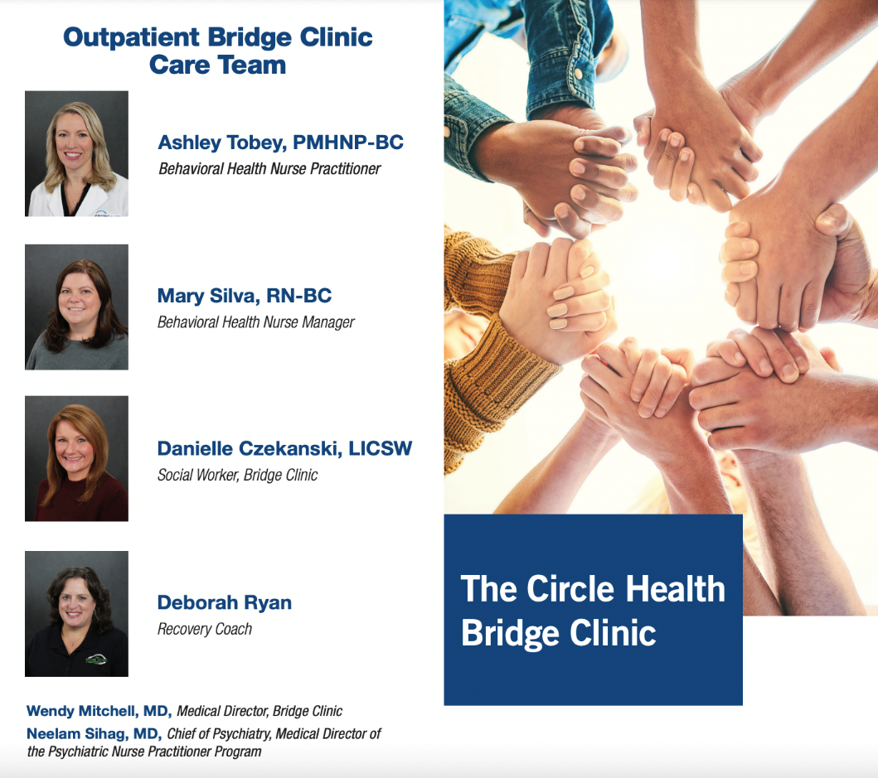
Hospital Bridge Clinic in Lowell
Strategy to initiate MOUD treatment on demand (“same day care”)
Prescriber writes short-term prescription and team connects patient to MOUD care in the community.
HCS Supported a part-time psych NP, RN care manager, social worker, 2 recovery coaches, part-time project manager
Clinic walking distance from Downtown

Slide 12
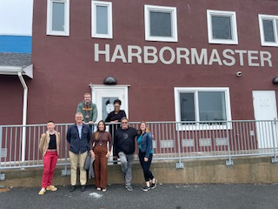
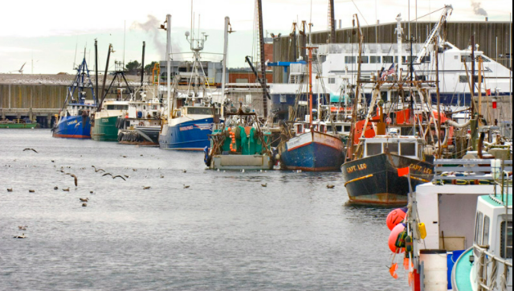
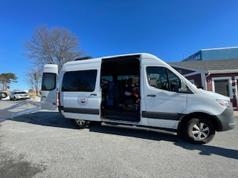

Provider on the Pier: Direct care to the fishing community in Gloucester
New clinic in harbormaster's office offers harm reduction, link to primary care, insurance & MOUD initiation
Innovative way to reach a high risk population. Transient, largely immigrant dock workers
Collaboration with ONESTOP mobile van and four other community organizations
HCS supported part-time Physician Assistant from local hospital and SUD Navigator support
HEALing Communities Study 13

Slide 13
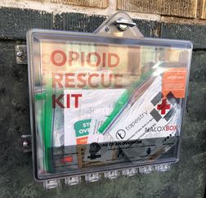
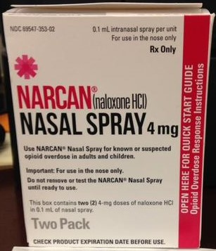
OEND Outreach via Stipends to Peers in
Holyoke and Gloucester *
Compensated people with opioid use disorder for their work to collect syringes, distribute naloxone and other harm reduction supplies
Peers have established relationship with harm reduction center
Expands outreach to previously unreached people who do not otherwise access services
Opportunity to show success in employment history
HEALing Communities Study

Slide 14
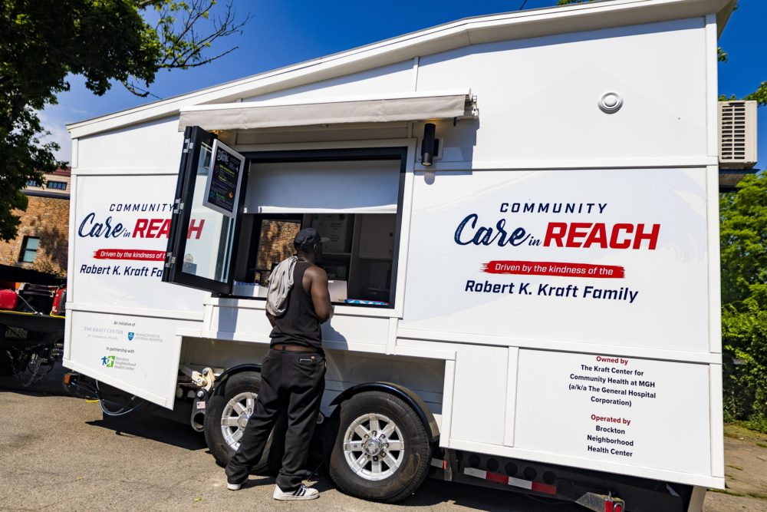
Brockton Mobile Medical Unit – Clinic on Wheels
MOUD for hard to reach populations
Harm reduction services
Link to health center services (e.g., recovery coaching, counseling)
Street outreach, outreach at the correctional facility, library, local drop-in centers
HCS supported NP, LPN, and Cape Verdean Creole speaking outreach worker, pick up truck, IT, supplies
Credit: Jesse Costa/WBUR
HEALing Communities Study

Slide 15
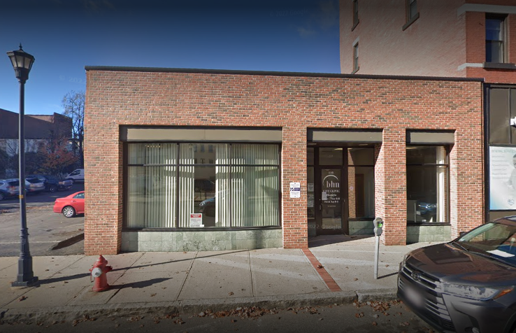
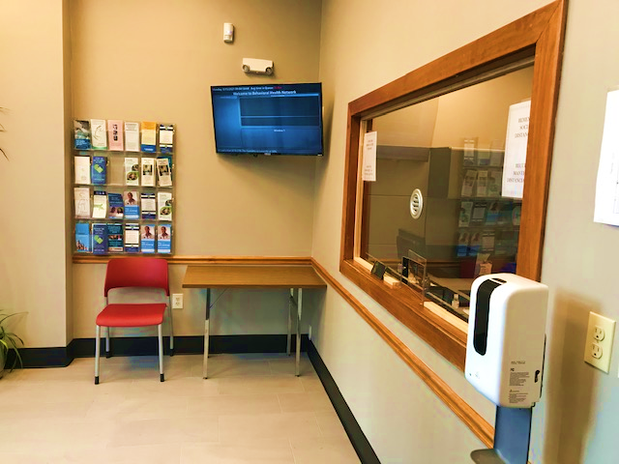
Opioid Treatment Program in Holyoke
Strategy to address a treatment desert
Located in downtown Holyoke, drastically decreased travel time to access methadone
Referral partnerships with two local medical centers, recovery center, and court
HCS funded NP, RN, Care Coordinator, Recovery Coach
HEALing Communities Study

Slide 16
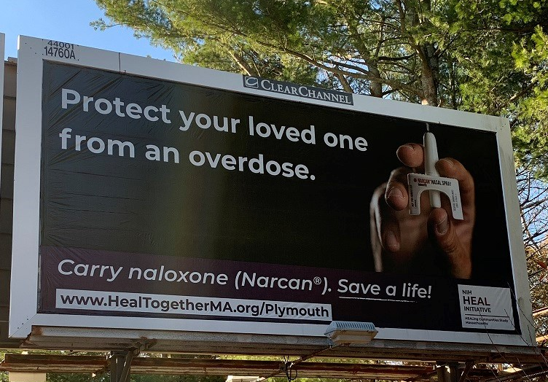
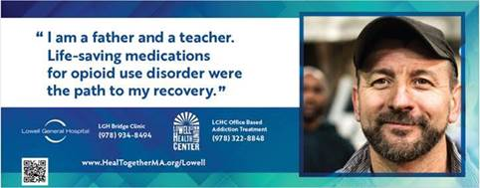
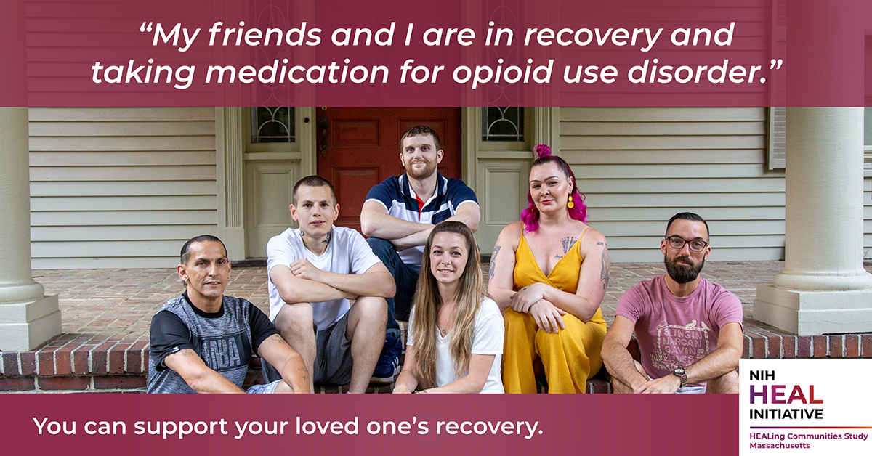
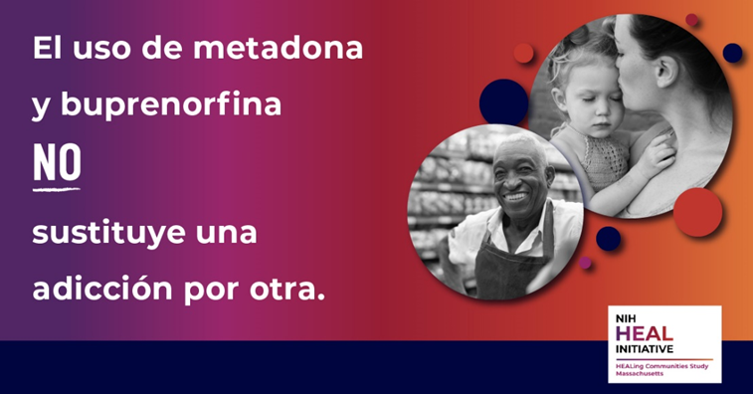
Communication Campaign Products
Marketing for EBPs at Community Organizations
Media buys
(e.g., billboards, bus ads)
Local community images
Available in multiple languages
HEALing Communities Study 16

Slide 17
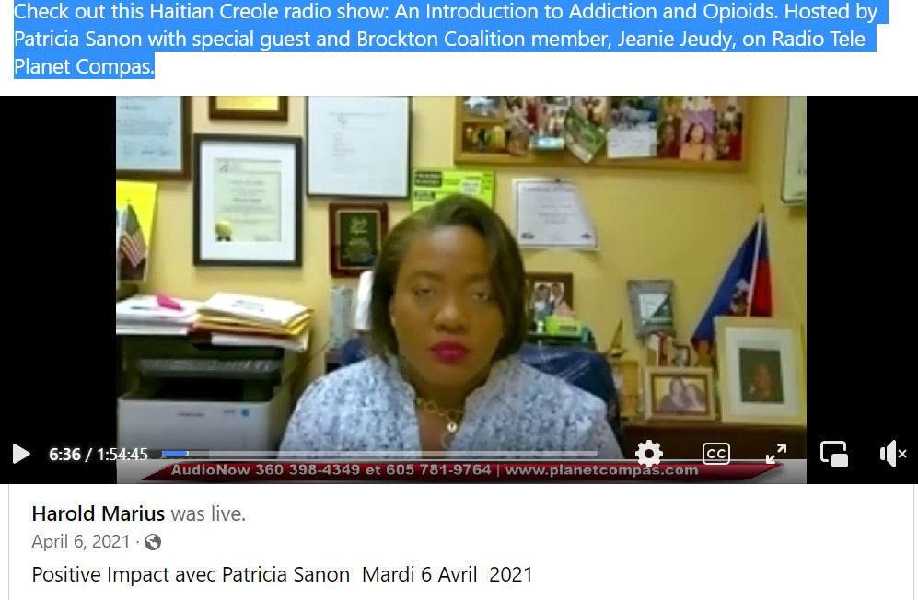
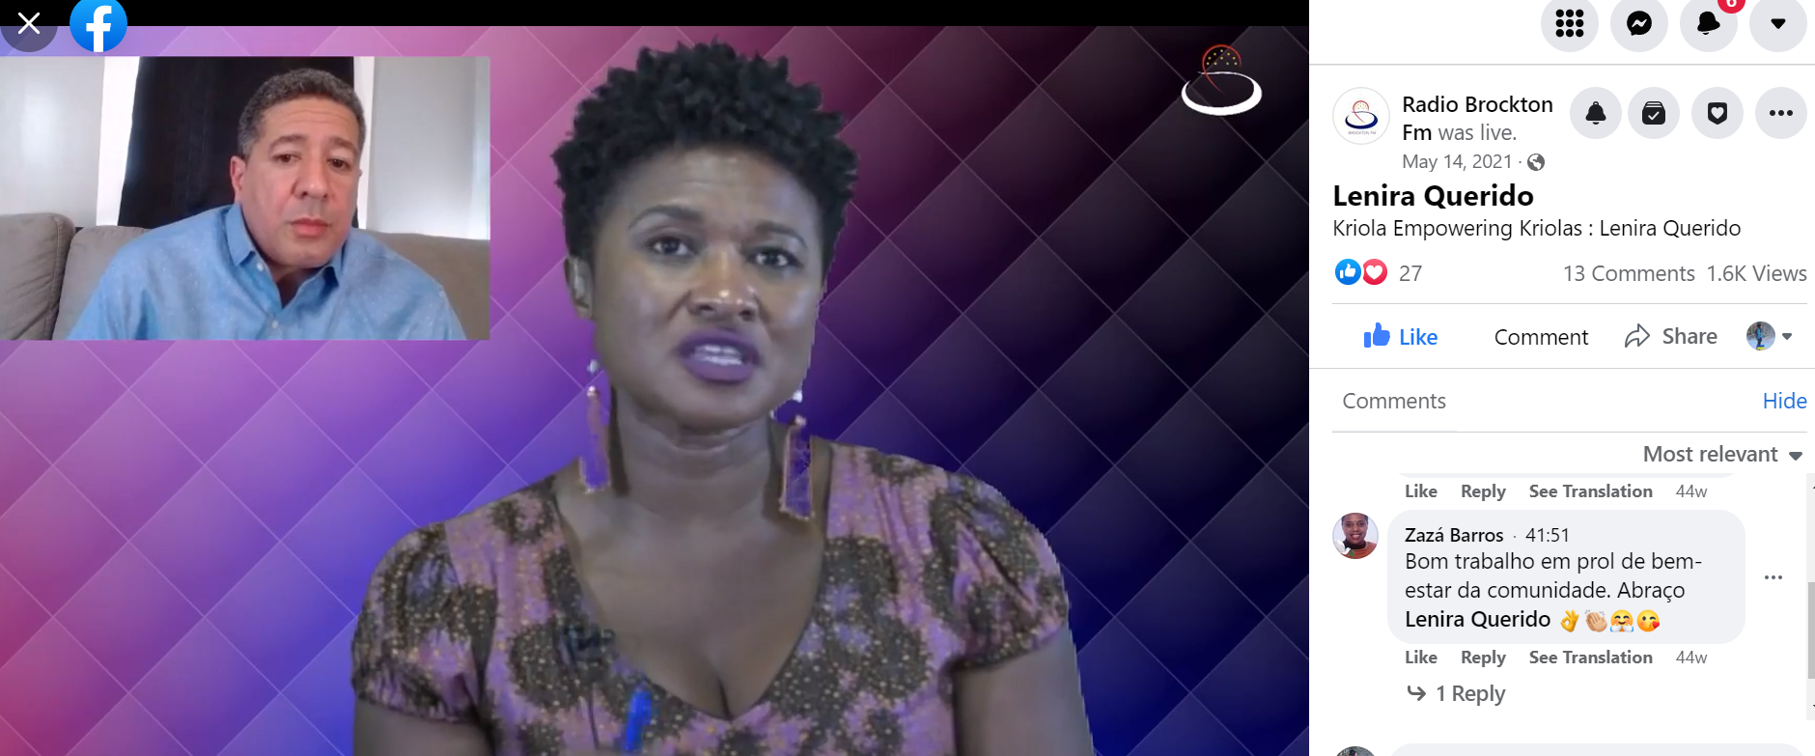
Haitian and Cape Verdean Radio Shows in Brockton
4-part series featuring community guests and spoken in Haitian Creole and Cape Verdean Creole
Premiered on social media
Topics covered
  Addiction 101
  Stigma
  Overdose prevention
  Treatment and Recovery
HEALing Communities Study 16

Slide 18
MA Lessons Learned
Communities know best
Coalition members strengthen relationships between community organizations
Data can identify health disparities
Low cost, high impact strategies are possible
Insights from people with lived experience are critical
Coalitions can develop culturally impactful strategies
Smaller communities can effectively collaborate for greater regional impact
Funds, focused goal & timeline yielded coalition action

Slide 19
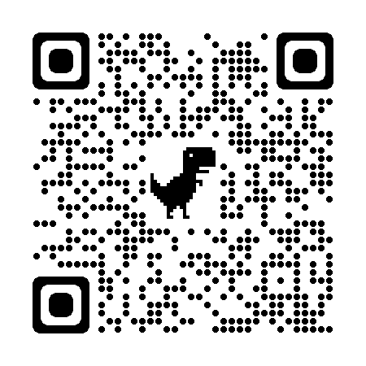
Thank you!
Contact us at HEAL@bmc.org
https://healingcommunitiesstudy.org

