Slide 1
The Supportive Planning and Operations Team (SPOT) Initiative
Stakeholder Presentation
December 10, 2018
Notes:
Kate

Slide 2
Thank you
The Massachusetts Department of Public Health would like to acknowledge the terrific support from Abt Associates in engaging in this work.
Notes:
Kate

Slide 3
SPOT Partners
Bureau Health Care Safety & Quality (BHCSQ), Massachusetts Department of Public Health
  Katherine Fillo, PhD, MPH, RN-BC, Director of Clinical Quality Improvement
  Katherine Saunders, MS, Manager of Data Analysis and Integrity
  Chiara Moore, MPH, Data Analyst
Abt Associates Inc.
  Rosanna M. Bertrand, PhD, Project Director
  Teresa M. Mota, BSN, RN, Task Lead
  Gabrielle Katz, MPP, Data Manager
  Terry Moore, MPH Project Quality Advisor
Bedford Gardens Care and Rehabilitation Center LLC
  Courtney Soqui
Notes:
Kate

Slide 4
Presentation Overview
Background/Introduction
  Objectives of SPOT Initiative
  Review of QAPI
  Background of the SPOT Initiative
2018 SPOT Initiative activities
SPOT Partner Story
  Applying SPOT resources and knowledge gained
Results of the overall SPOT Initiative (Years 1-3)
Lessons learned
Notes:
Rosanna:

Slide 5
Objectives of the SPOT Initiative
The aim of the SPOT Initiative was to foster quality care delivery in skilled nursing facilities across Massachusetts.
SPOT fostered quality care by supporting nursing home teams to develop and improve their quality assurance and performance improvement (QAPI) programs.
Effective QAPI programs can prevent adverse events, promote safety and quality, and reduce risks to residents and caregivers.
Notes:
Rosanna:

Slide 6
QAPI
Quality Assurance (QA)
Specification of standards for quality of service and outcomes.
Performance Improvement (PI)
The continuous study and improvement of processes with the intent to better services or outcomes, and prevent or decrease the likelihood of problems.
A process throughout the organization for assuring that care is maintained at acceptable levels in relation to those standards.
PI aims to improve processes involved in health care delivery and resident quality of life.
Notes:
Rosanna:

Slide 7
Background of the SPOT Initiative
SPOT was funded from civil monetary penalties (CMP) collected from nursing homes.
In 2016, SPOT Year 1, 40 nursing homes were selected.
In March 2017, BHCSQ engaged Abt to implement SPOT Year 2.
  20 additional nursing homes were selected.
Abt was engaged to continue implementing SPOT in Year 3.
  Fifty-five nursing homes remained in SPOT Year 3.
An advantage of SPOT was the opportunity to meet nursing home staff face-to-face on multiple occasions thus establishing a rapport and forming strong partnerships.
Notes:
Rosanna:

Slide 8
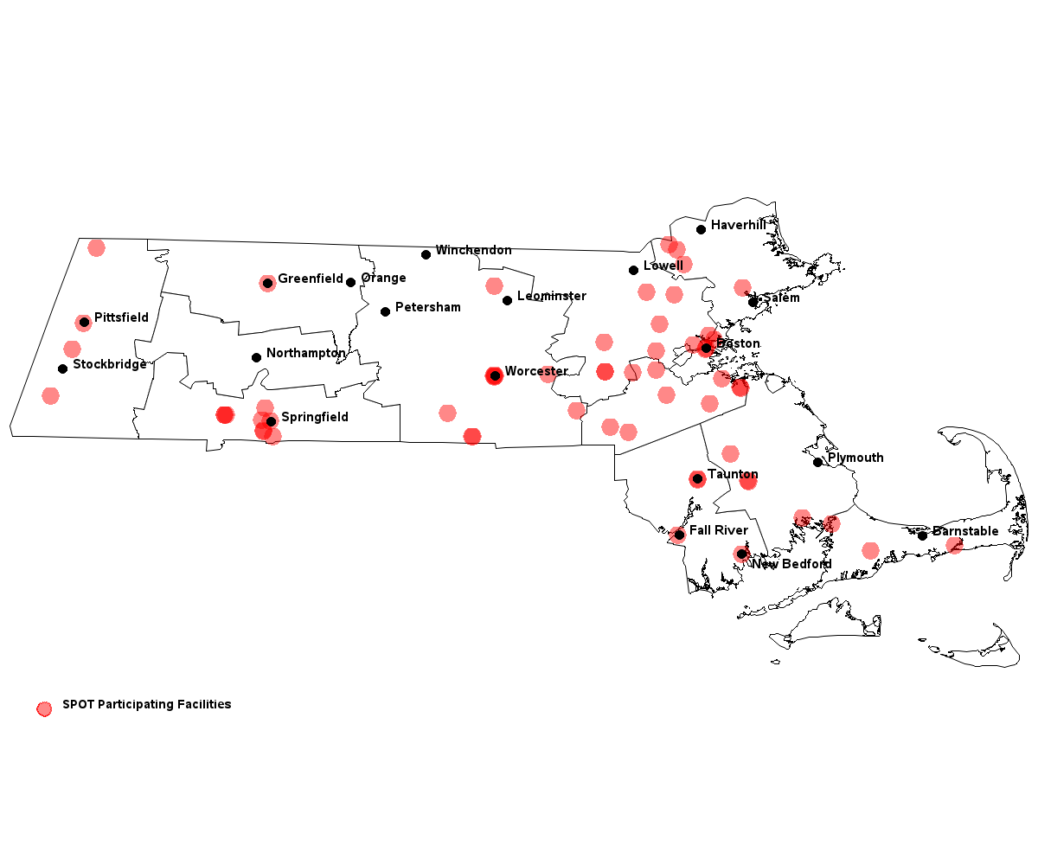

SPOT Nursing Home Locations
SPOT Nursing Homes
Notes:
Rosanna:

Slide 9
2018 SPOT Activities
Notes:
Rosanna:

Slide 10
2018 SPOT Activities
Three regional learning sessions
  QAPI Fundamentals and Overview of Revised QAPI Requirements
  Prevention of Adverse Events
  Measuring Quality
On-site technical assistance visits
  Review facility QAPI plan
  Review Annual Facility Assessment
  Facilitate the QAPI Assessment among three levels of staff
  Provide technical assistance in identified QAPI areas
Telephone outreach and email support
Notes:
Terri:

Slide 11
Regional Learning Sessions
Burlington, Raynham, Springfield,
Woburn, Worcester
2018 SPOT Activities
Notes:
Terri:

Slide 12
2018 Regional Learning Sessions
Three learning sessions offered in different regions of the Commonwealth
Based on the adult learning theory
  Interactive, task-oriented sessions
  Capitalize on what participants already know
  Participant interaction and short didactic presentations
Notes:
Terri:

Slide 13
Learning Session 1: Fundamentals and Revised QAPI Requirements
All-day sessions
Presented on April 24 and 25 in Springfield and Woburn, respectively
Key presentation components:
  Identifying and correcting quality deficiencies
  Using the SPOT Performance Improvement Project (PIP) process Adapting root cause analysis to evaluate quality issues
  Enhancing communication and teamwork
  Sustaining QAPI gains regardless of staff turnover
  Developing steps in a PIP
Notes:
Terri:

Slide 14
Learning Session 2: Prevention of Adverse Events
Half-day events
Presented July 16 – 19 in Springfield, Raynham, Burlington and Worcester, respectively
Key presentation components:
  Defining adverse events and understanding their significance in nursing homes
  Differentiating adverse drug events from adverse drug reactions
  Describing a prescribing cascade
  Evaluating a facility protocol for high-risk medication using CMS’s Adverse Drug Event Trigger Tool
Notes:
Terri:

Slide 15
Learning Session 3: Measuring Quality
Half-day events
Presented October 15 – 18 in Worcester, Burlington, Raynham, and Springfield, respectively
Key presentation components:
  Defining and identifying process and outcome measures
  Identifying intended purposes of nursing home quality improvement quality measures
  Identifying performance improvement topics in the CASPER reports
  Determining process and outcome measures using a facility care protocol
Notes:
Terri:

Slide 16
Technical Assistance Visits
2018 SPOT Activities
Notes:
Terri:

Slide 17
On-Site Technical Assistance Visits
Conducted site visits to provide real-time technical assistance to SPOT partners in QAPI areas identified during the visit
  Conducted an independent review of the QAPI plan and annual facility assessment
  Met with leadership to:
    Review QAPI plan
    Discuss leadership QAPI concerns
    Conduct leadership interview
    Provide feedback and additional technical assistance during a debrief
  Facilitated QAPI assessment with three levels of staff
Notes:
Terri:

Slide 18
Email and Telephone Support
2018 SPOT Activities
Notes:
Terri:

Slide 19
Email and Telephone Support
Email support was available to all SPOT participants via NursingHomeQI@state.ma.us
Members of the Team were available by telephone and email to address participant questions
Notes:
Terri:

Slide 20
SPOT Partner Story
Notes:
Terri:

Slide 21
Applying SPOT Processes to
Improve Quality
Bedford Gardens Care and
Rehabilitation Center LLC
Notes:
Terri:

Slide 22
Bedford Gardens: Overview
Introduction
Nursing home background
  For profit – Vero Health & Rehabilitation
  New Bedford
  Skilled nursing, sub-acute rehabilitation, short- and long-term care, wound care, stroke therapy, orthopedic rehabilitation
  110 beds
Brief overview of experience with SPOT
  SPOT was introduced to Bedford Gardens in 2016 (SPOT Year 1)
  The SPOT PIP process very effective and we applied it to new PIPs
Notes:
Courtney

Slide 23
Bedford Gardens:
Conducting a PIP
Prioritized a PIP on reducing the medication error rate
  Beginning August 2018, Bedford Gardens saw an increase in medication errors.
Goal
  To reduce the percentage of medication errors across the facility from 14 percent to less than five percent by January 2019.
Convened a team and conducted a root cause analysis
Interventions
  In-service training with simulated medication pass for all licensed nursing staff.
  Two-day supervised observation of medication pass for all new hires, prior to working the cart.
  Redesign orientation packets to include medication administration training materials.
  Mandatory competency fair for all licensed nursing staff.
  Perform weekly medication observations on each unit of the facility.
  Perform weekly audits of the narcotic book and MARS for proper documentation.
Notes:
Courtney

Slide 24
Bedford Gardens:
PIP Outcomes
Process measures
  Tracked the number of licensed staff who completed the in-service training – 100 percent (17 licensed staff)
  Track two-day observations for all new hires – 100 percent (ongoing)
  Track attendance of licensed staff at competency fair – 100 percent completion
  Tracked weekly medication pass observations and narcotics book audits
Outcome measure
  Percent of medication errors
Notes:
Courtney

Slide 25
Bedford Gardens:
PIP Outcomes
Notes:
Courtney

Slide 26
Bedford Gardens: Involving and
Informing Residents/Families/Staff
The PIP team will inform residents, families and all levels of staff
  Monthly QAPI meeting
  Traveling QAPI board
  Monthly Bedford Gardens news letter
Identify evolving problems identified through:
  Feedback received at QAPI and resident council meetings
  Safety huddle rounds
  Interdisciplinary team meetings
Notes:
Courtney

Slide 27
Bedford Gardens: Sustainability
Performance improvement is a continuous process
Additional root cause analyses and new interventions will be initiated as needed, and measured and documented to ensure sustainability
Notes:
Courtney

Slide 28
Impact of the SPOT Initiative
Impact of SPOT Across all Three Years
Notes:
Gabby:

Slide 29
Methods
Data Collection
  Data collected by SPOT subject matter experts (SMEs)
    QAPI assessment scores
    Leadership interview data
    Learning session evaluation results
  Existing data accessed
    Health inspection results
Analytic Approach
  Used multiple strategies to explore trends and impact
Notes:
Gabby:

Slide 30
Characteristics of SPOT
Nursing Homes
Nursing Home Ownership and Size |  | Number of Nursing Homes (N=60) | Percent of Total SPOT Nursing Homes
Ownership | For-Profit | 45 | 75%
 | Not For- Profit | 14 | 23%
 | Govt. Owned | 1 | 2%
Size (# of beds) | <50 | 4 | 7%
 | 50-99 | 14 | 23%
 | 100-199 | 37 | 62%
 | >199 | 5 | 8%
County | Barnstable County | 3 | 5%
 | Berkshire County | 4 | 7%
 | Bristol County | 4 | 7%
 | Essex County | 4 | 7%
 | Franklin County | 1 | 2%
 | Hampden County | 9 | 15%
 | Middlesex County | 10 | 17%
 | Norfolk County | 8 | 13%
 | Plymouth County | 4 | 7%
 | Suffolk County | 3 | 5%
 | Worcester County | 10 | 17%
Notes:
Gabby:

Slide 31
Results of the QAPI Assessment
Impact of SPOT Across all Three Years
Notes:
Gabby:

Slide 32
Key Assessment Items: Written QAPI Plan
Notes:
Gabby:

Slide 33
Key Assessment Items: Communication between and within Departments
Notes:
Gabby:

Slide 34
Key Assessment Items: Resident/Family Engagement
Notes:
Gabby:

Slide 35
Key Assessment Items: Informing Staff, Residents and Families
Notes:
Gabby:

Slide 36
Results of Health Survey Outcomes
Impact of SPOT Across all Three Years
Notes:
Gabby:

Slide 37
Relevant Health Survey Outcomes
No change in health inspection survey results associated with SPOT participation
No evidence of a relationship between leadership turnover and change in tags cited
Caveats to these results:
  Low power due to the small sample size and the low number of deficiency tags assigned, limited our ability to detect differences
  Changes to the long-term care survey process in 2017 may have impacted our findings
  A limited number of nursing homes had a follow-up survey within our intervention window
Notes:
Gabby:

Slide 38
Results of 2018 Leadership Interviews
2018 Leadership Interview Results
Notes:
Gabby:

Slide 39
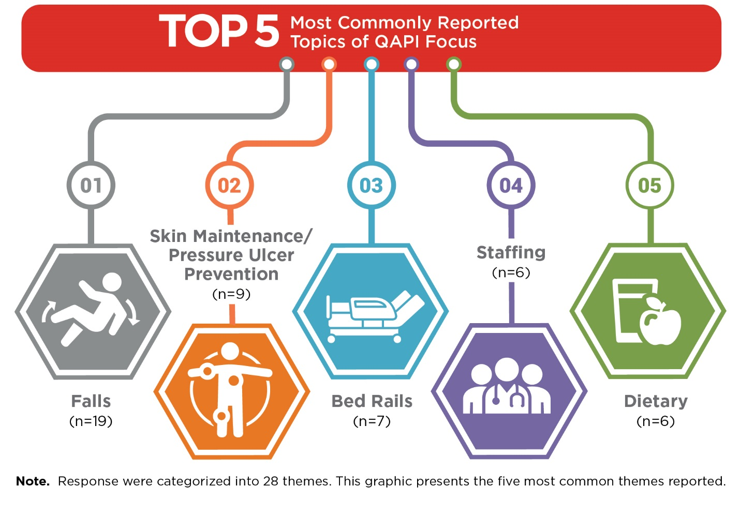
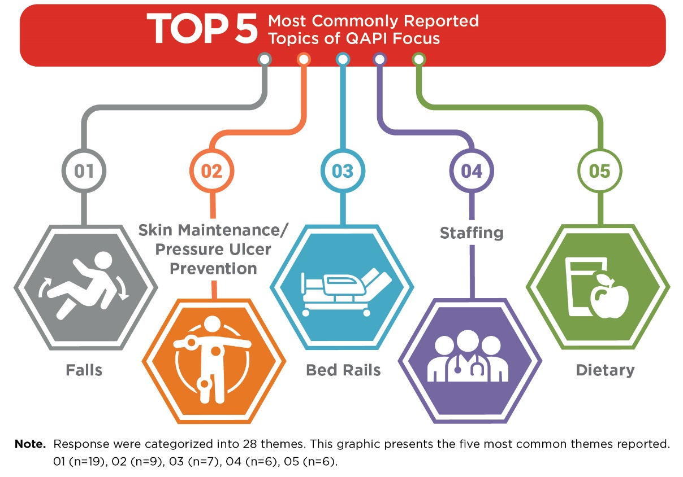
Current QAPI Focus Among SPOT Nursing Homes
Notes:
Gabby:

Slide 40
Contributors to PIP Success
Consistent leadership
Communication between and within departments
Dedicated PIP team
Audits
Involvement of residents and families
Notes:
Gabby:

Slide 41
Leadership Turnover Rate
Position | Range | Average | Median
Director of Nursing | 0 - 37 Years | 2.82 Years | 1 Year
Administrator | 1 Month - 36 Years | 2.51 Years | 0.8 Year
Notes:
Gabby:

Slide 42
Relationship between Leadership Turnover and PIP Status
Notes:
Gabby:

Slide 43
Relationship between Leadership Turnover and QAPI Preparedness
Higher rates of leadership turnover were related to lower levels of QAPI preparedness (indicated by an overall QAPI assessment score).
Turnover in the Administrator position was associated with a 0.12 point lower QAPI score.
Turnover in the DON position was associated with a 0.10 point lower QAPI score.
Notes:
Gabby:

Slide 44
Learning Session Feedback
2018 Learning Session Results
Notes:
Gabby:

Slide 45
Most Important Aspect of the Learning Sessions as Identified by Participants
Learning Session 1
  Using the SPOT tools to create sustainable PIPs
  Understanding QAPI
Learning Session 2
  How to focus on QAPI priorities
  Evaluating adverse drug event protocols
  Tools provided such as guidance on what CMS/DPH uses to guide their survey process
Learning Session 3
  Calculating measures
  Identifying trends and correlations between measures
  Using process measures to improve outcomes
Notes:
Rosanna:

Slide 46
Aspects of the Learning Sessions that Participants will Apply to Their Processes
Learning Session 1
  Use of SPOT processes to create sustainable PIPs
  New SPOT tools
Learning Session 2
  Adverse drug event audits
  Better monitoring tools
  Staff and family education
Learning Session 3
  Identifying and tracking process measures
  Monthly review of quality measures, including utilizing the CASPER reports to identify high risk residents
Notes:
Rosanna:

Slide 47
Participant Suggestions for Future Learning Topics and TA
Offer QAPI tools to monitor residents with substance use disorders within the long-term care setting
Topics related to providers’ roles in regulations
Navigating the survey process and improving residents’ quality of life
Assistance on staffing and securing competent staff; CNA recruitment ideas
Education on basic CNA documentation
Continuing Education Units (CEUs) for session attendance
Notes:
Rosanna:

Slide 48
Participant Feedback from Learning Sessions
“The SPOT Initiative has been very helpful, I would love this program to continue.”
“Very informative, and educational. Love leaving with links/references to look back to.”
“Excellent learning opportunity.”
“Speakers were very knowledgeable and dynamic.”
“I’m really glad that I have attended this meeting!”
“Excellent session!”
“We will adjust current PIPs to include more process measure data.”
“A lot of fun sharing.”
Just wanted to take the time out and thank you ladies for the wonderful experience. I am aware that this is your final conference as SPOT, however I am looking forward to attending many more of your next endeavors.
Notes:
Rosanna:

Slide 49
Lessons Learned Across Three Years of SPOT
Results emphasize the success of SPOT
Consistent leadership staffing fosters PIP sustainability
Effective communication between/ within departments is essential for effective quality improvement, yet this is an area in which participants struggled
Accurate documentation and measurement are key to making successful improvements
Ongoing support is needed to encourage the inclusion of all levels of staff, residents, and families
Offering CEUs may improve participation in future programs
Notes:
Rosanna:

Slide 50


Questions and Discussion
Notes:
Rosanna:

