Slide 1
Brand Guidelines
Behavioral Health Outreach for Aging Populations
Offered by the Executive Office of Aging & Independence

Slide 2
Behavioral Health Outreach for Aging Populations
Support for ages 60+ that meets you where you are.

Slide 3
Introduction
Massachusetts’ behavioral health program for older adults has a new name and identity. Formerly known as Elder Mental Health Outreach Team (EMHOT) and Elder Mobile Outreach Team (EMOT), Behavioral Health Outreach for Aging Populations will continue its proven history, with a modern, more inclusive name.
This guide, intended for contracted programs, outlines naming conventions, common definitions, best practices, and more. It serves as the established standards of Behavioral Health Outreach for Aging Populations.

Slide 4
Content Style
Boilerplate Description
Behavioral Health Outreach for Aging Populations
Through this program, behavioral health clinicians provide in-depth assessments and develop care plans that may include individualized counseling, care coordination to community resources, and referrals. This behavioral health program comes right to the consumer and works with the older adults for six to nine months, or as needed. Clinicians can meet the older adult in their home, or at a location that is comfortable for the consumer, such as a local park.

Slide 5
Content Style Cont.
Editorial Use
  Always use the full name — Behavioral Health Outreach for Aging Populations— upon first mention.
  After first mention, when referring to the program itself in writing, use “this program” or “this behavioral health program.”
  After first mention, when referring to the program verbally, pronounce the program acronym as “Be Hope”.
  After first mention, when referring to services provided, use “behavioral health services.”
  Acronym use: When writing contracts or internal documents, you may use the acronym “BHOAP”.
    When creating consumer-facing materials, such as flyers or brochures, avoid the acronym and instead use the program’s full name “Behavioral Health Outreach for Aging Populations”. After first mention, refer to it as “the program” or “this program.”
  Tagline: When creating consumer-facing materials, such as presentations or brochures, feel free to include the program’s tagline “Support for ages 60+ that meets you where you are.” on cover pages.

Slide 6
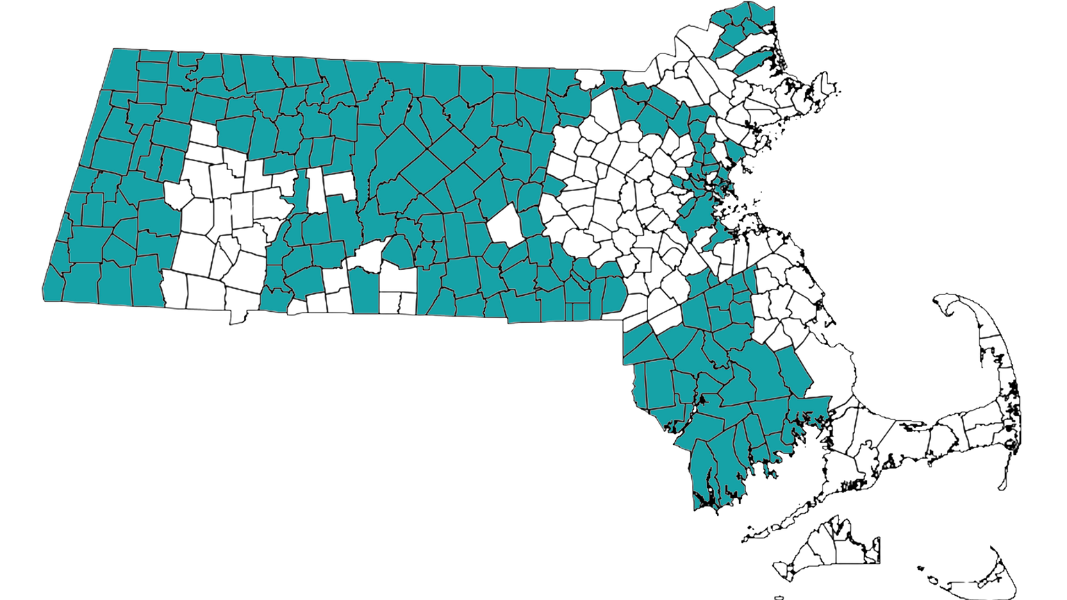
Areas Served
There are 18 community partners contracted to offer services through Behavioral Health Outreach for Aging Populations.
211 cities and towns are served through the program.

Slide 7

Logo
Behavioral Health Outreach for Aging Populations is funded through the Executive Office of Aging & Independence. Therefore, when creating materials associated with the program, you may use the Agency’s logo to indicate a connection between the program and state services.

Slide 8

Logo -- Co-branding Requirements
Logo Order Placement
The Aging & Independence logo should always be on the left. Partner logo will always be on the right.
Dividing Line
The dividing line should be 1pt thick and be in the color Fog Gray (#757574)

Slide 9
Additional Behavioral Health Service Definitions
About Behavioral Health Services
The Executive Office of Aging & Independence funds behavioral health services and programs for adults aged 60+ and their caregivers who need mental health and/or substance use support. Programs are available throughout Massachusetts and vary slightly based on the specific needs of each community.
Services include:
Healthy IDEAS (Identifying Depression, Empowering Activities for Senior)
Healthy IDEAS is designed as a practical intervention to detect and reduce signs and symptoms of depression in older adults. The program aims to empower at-risk older adults through involvement in meaningful activities. Healthy IDEAS is available to older adults enrolled in the Massachusetts Home Care Program.
Certified Older Adult Peer Specialists (COAPS)
Peer Specialists trained on topics including the aging process, suicide, substance use, dementia, physical illness, mental health, and aging in community, provide support, either in-person or remotely, for older adults with mental health challenges. COAPS is available to older adults enrolled in the Massachusetts Home Care Program. The program can also be offered virtually.
Advocacy & Navigating Care in the Home with Ongoing Risks (ANCHOR)
Providing time-intensive, rigorous care management for older adults, with or without a behavioral health diagnosis, who are at risk of institutionalization or homelessness due to the inability to accept or retain services. ANCHOR is available to older adults enrolled in the Massachusetts Home Care Program.

Slide 10
Additional Behavioral Health Service Definitions Cont.
Additionally, the following supports are available to Massachusetts residents of all ages:
Community Behavioral Health Centers (CBHCs)
There are 31 CBHCs across Massachusetts that offer a wide range of mental health and substance use treatment programs. 24/7 in-person crisis support is immediate, confidential, and available for all MassHealth members and MA residents, regardless of insurance status.
988
The 988 Suicide & Crisis Lifeline offers 24/7 call, text and chat access to trained crisis counselors who can help with a suicidal, substance use, and/or mental health crisis, as well as any other kind of emotional distress. The service is also available for anyone worried about a friend or family member who may need crisis support.
Behavioral Health Help Line (BHHL)
BHHL connects individuals and families across Massachusetts to a full range of treatment services for mental health and substance use including outpatient, urgent, and immediate crisis care.
2-1-1
Mass 2-1-1 was created and is staffed by the United Way. This 24/7 service was created as a resource to connect callers to information about critical health and human services programs.

Slide 11
Additional Resources
  Downloadable consumer-facing flyer for Behavioral Health Outreach for Aging Populations
  Standardized definitions of state funded behavioral health services

