Slide 1
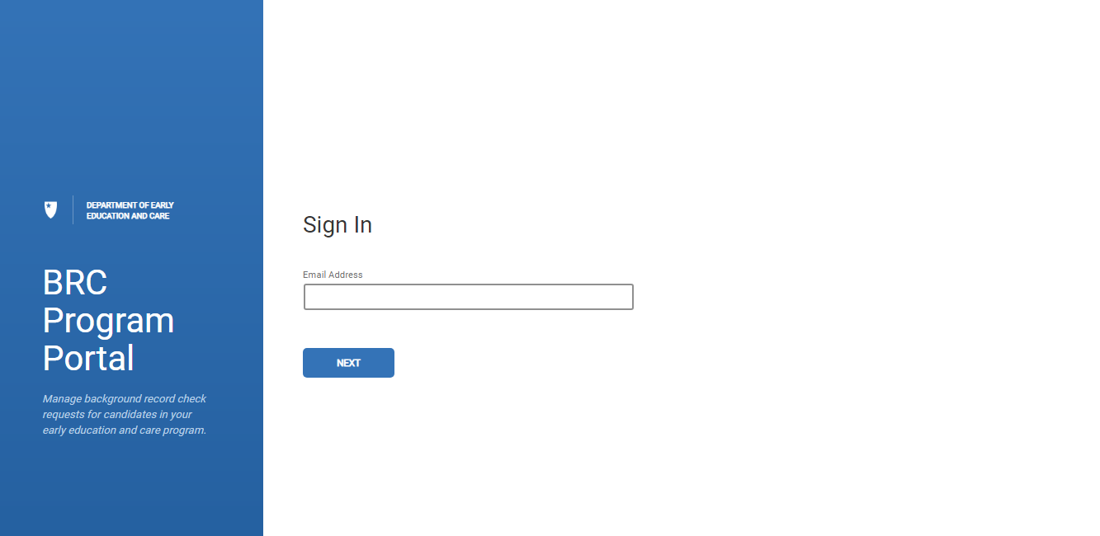
BRC Navigator Program Portal
Logging-In and Functionality – New Submission

Slide 2
BRC Navigator Training
Logging in as a Licensee or BRC Program Admin Role user
Navigation Overview
Listing Pages
Categories:
Applicants
All Staff
Inactive
Functionality:
Sort
Search
Filter
Download
New Submission
BRC Navigator Program Portal
LEAD

Slide 3
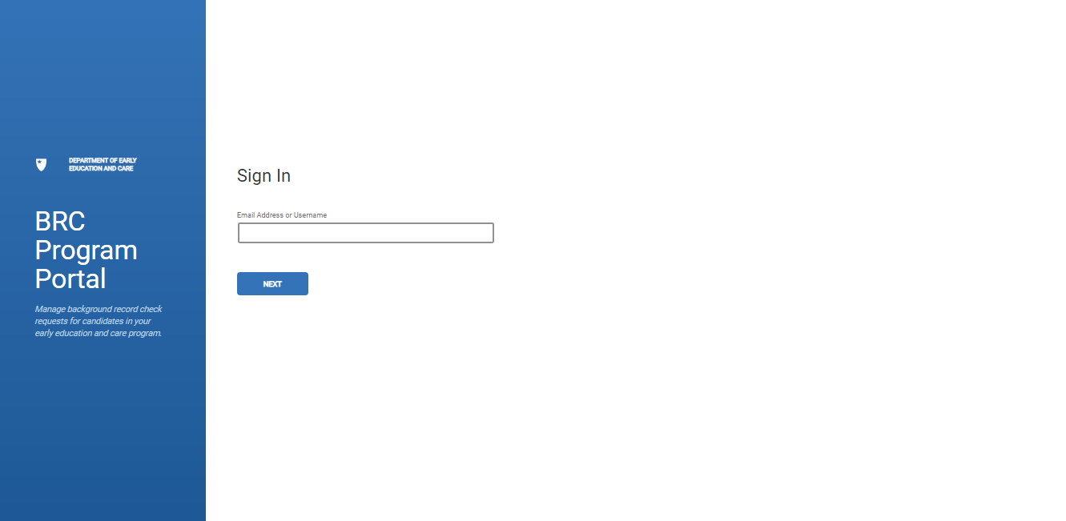
BRC Navigator Program Portal Log in
1
Login to BRC BRC Navigator Program Portal, enter email address associated to EEC BRC Navigator Program Portal Account
2
Click NEXT button to begin first step in password entry process
1
2

Slide 4
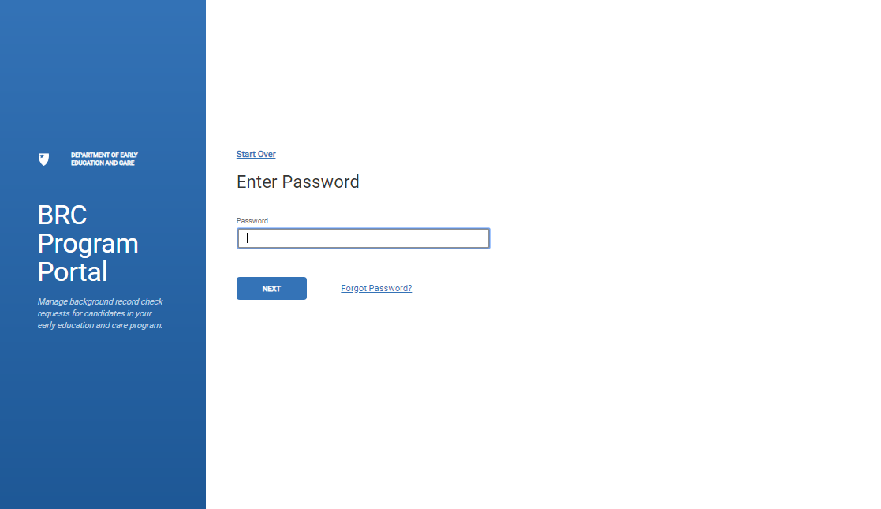
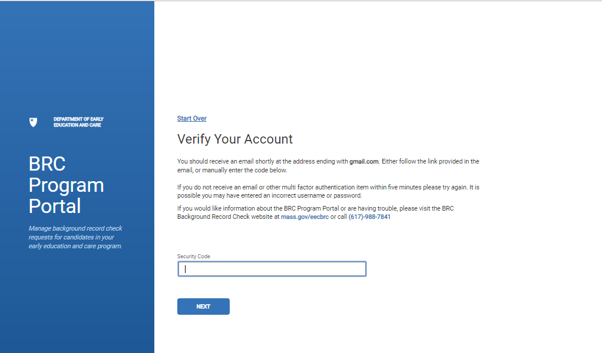
BRC Navigator Program Portal Log in
1
Enter password associated to your account username
1
2
Click NEXT button to continue password entry and verification process
4
3
The password entry page will refresh and open a “Verify Your account” page
2
4
Click “Forgot Password” link to begin password reset process
3

Slide 5
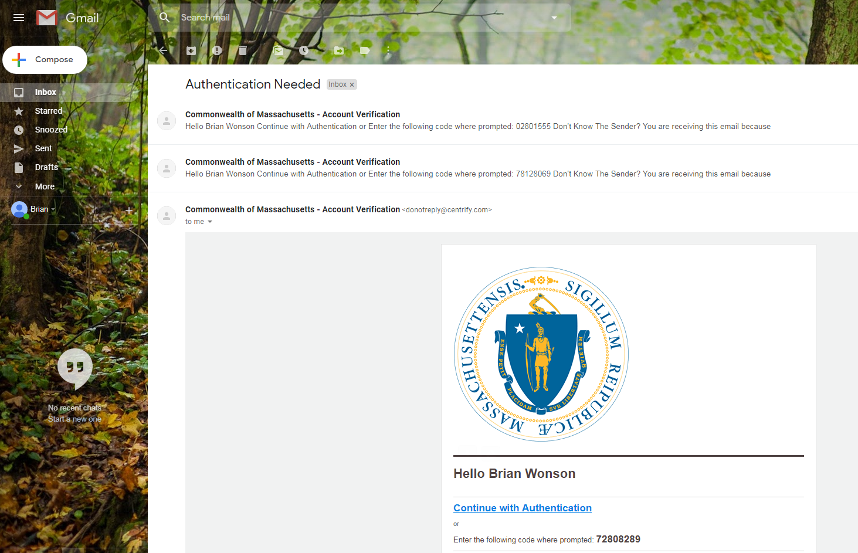
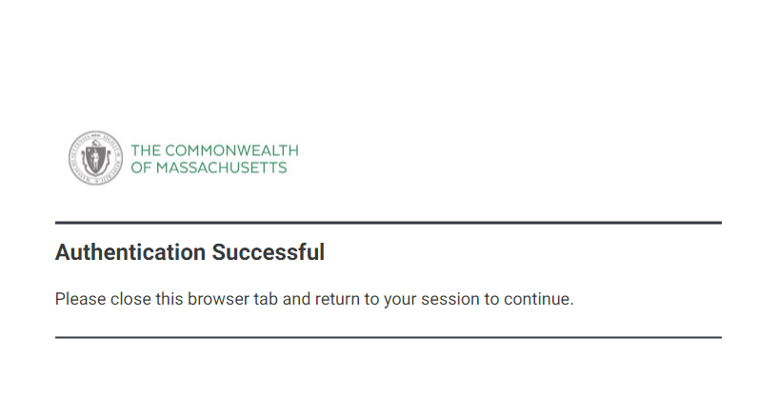
BRC Navigator Program Portal Log in
1
1
Open email address account associated with your EEC BRC Navigator Program Portal account
2
2
Open recently received email from Commonwealth of MA, subject “Account Verification”. As you always want to use the most recent email, it is suggested you delete older emails from this address. You can only authenticate using the most recent code
3
Click “Continue with Authentication” link within email or copy and paste the code provided into the Security code box on the login page that you entered your email address
3
4
If you click on the link, a second tab will open to confirm authentication and allow access to the Portal. This tab can be closed after you get “authentication successful” message
4

Slide 6
BRC Navigator Program Portal Accessed
1
After authentication your login browser will refresh to access Portal, you will land on the ALL STAFF tab
1

Slide 7
Navigation: Three Listing pages
1
The APPLICANTS page is utilized to track all candidates that are currently in the process of a BRC request
2
The All STAFF page is utilized to track active staff members in a “hired” employment status
3
The INACTIVE page is used to track staff members that are in a status other than “hired”
Submissions Index tab
1
2
3

Slide 8
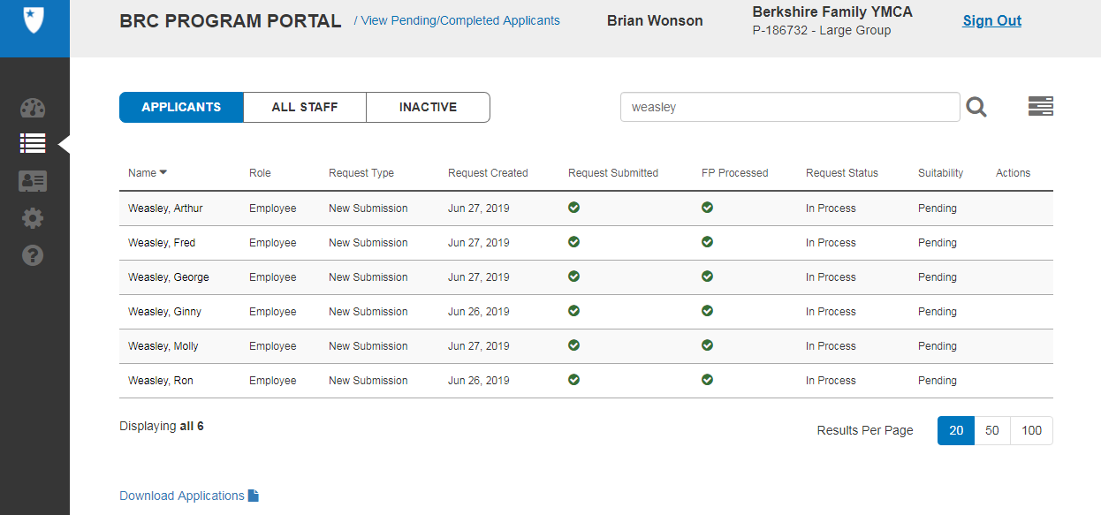
Navigation: 3 Listing Pages (APPLICANTS, ALL STAFF & INACTIVE)
1
On any of the pages (APPLICANTS, ALL STAFF & INACTIVE), users have the ability to sort on each column
3
Users can filter the listing page based on criteria within the Filter panel. Always remember to “Reset All Filters” within the filter panel before searching again
2
Users can use the Search Bar to search for members
Users can download the listing page as a .csv file and open in excel. This file contains additional columns including Program Name.
4
2
3
1
4

Slide 9
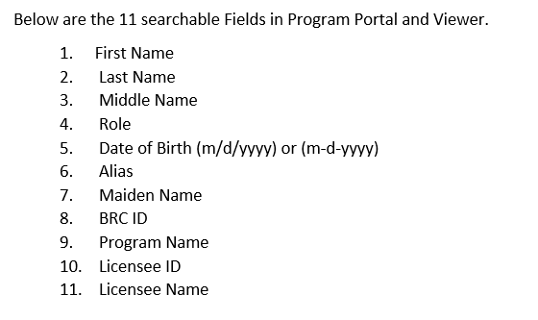
Navigation: 3 Listing Pages (APPLICANTS, ALL STAFF & INACTIVE)
Eleven data items can be used in the search field, the search field exists on all 3 tabs of the BRC Navigator Program Portal and within the Viewer. To remove your search subject, you must backspace the text and press the magnify glass again.
1
1

Slide 10
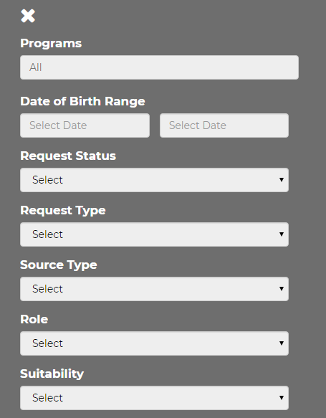
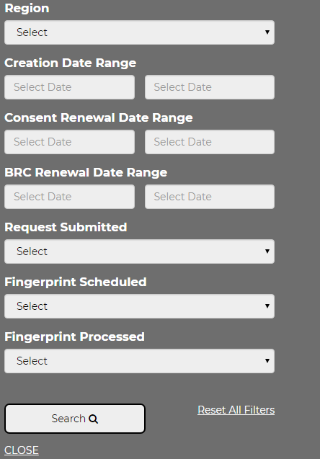
Navigation: 3 Listing Pages (APPLICANTS, ALL STAFF & INACTIVE)
1
The filter option can be found in the top right corner of the screen, next to the Search box. The filter helps you narrow your search, especially useful in larger Programs
2
The below fields can be filtered on. After you select your fields, press the “Search” button at the bottom. Those search parameters will apply to all tabs within the BRC Navigator Program Portal. To remove theses filters you must go back into the filter and choose “Reset All filters”
1
2

Slide 11
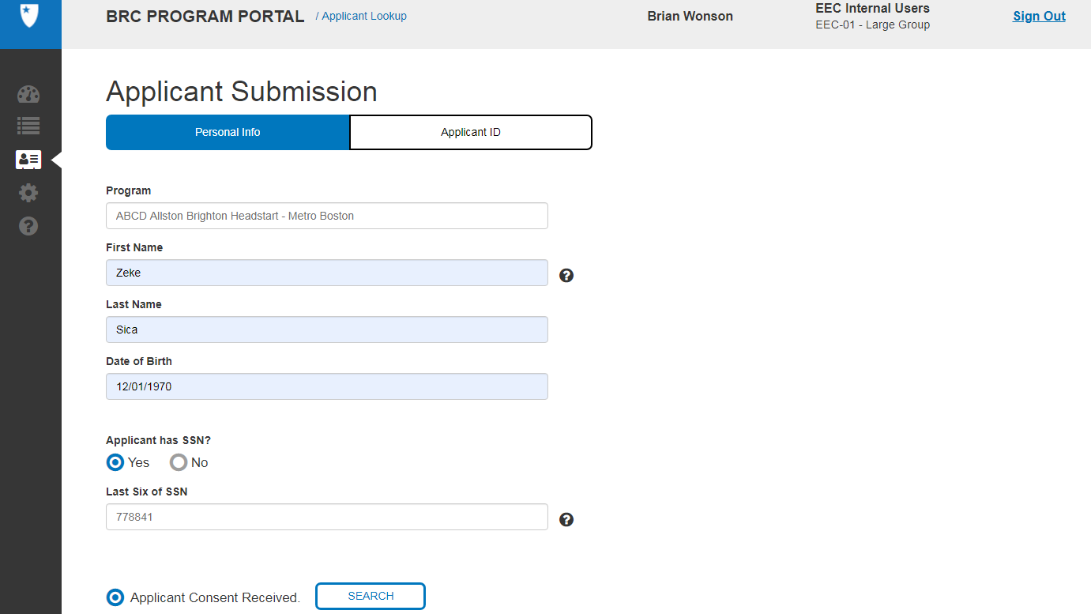
Entering a New Submission for a BRC (BRC Navigator Program Portal)
1
Click on the “New Submission” icon on the left-hand toolbar
3
Enter Data for mandatory fields under Personal Info: First Name, Last Name, Date of Birth (DOB) and SSN. For SSN, if yes, provide last six of SSN, if No, last six data box will disappear
5
If you have the Applicant ID, you can search in the applicant ID tab
2
In the Personal Info tab enter Program Information. Note: this field is not applicable external (for the Program)
4
“Select Applicant Consent Received” radio button and click on SEARCH
5
2
1
3
4

Slide 12
Entering a New Submission for a BRC
If No entry is found, you will get a message to Create a new applicant, click the “Yes, Create New Application”
Your first and last name on your BRC application must be spelled exactly the same as how it appears on your legal identification document. If the names do not exactly match, then you cannot be fingerprinted and you may need to re-pay for your fingerprinting appointment. At this point please verify your name is correct, if not "Retry Applicant Lookup" to start again
1
1

Slide 13
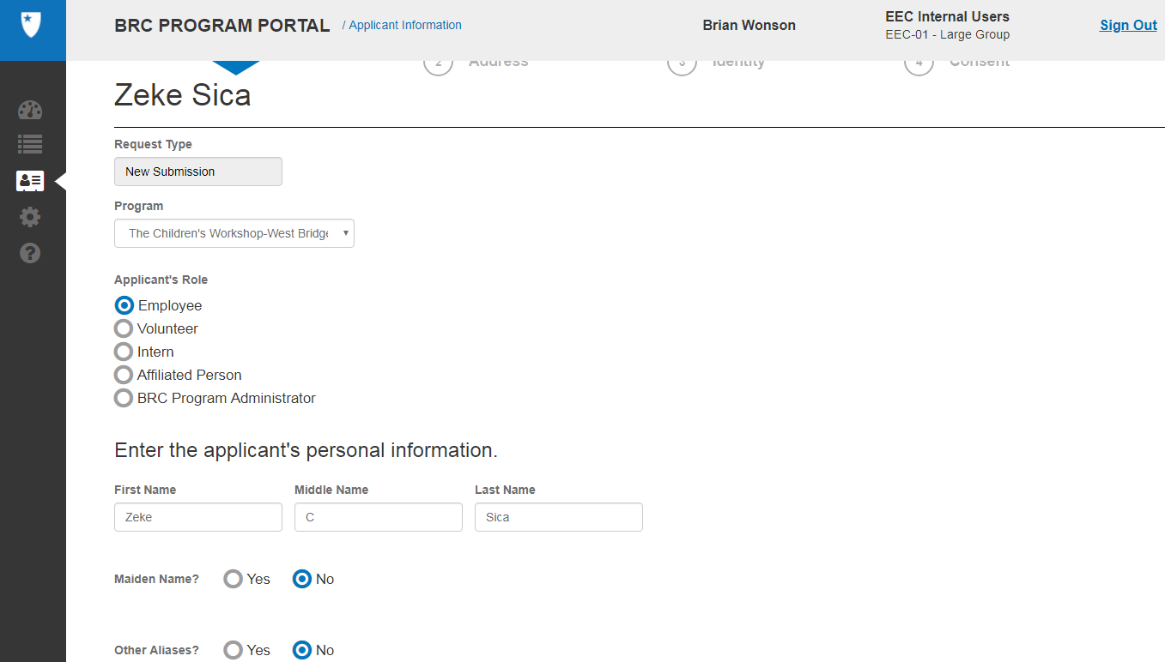
Entering Applicant Information – Personal Info
1
Populate the information for submission, some fields will be pre-populated from your search
1

Slide 14
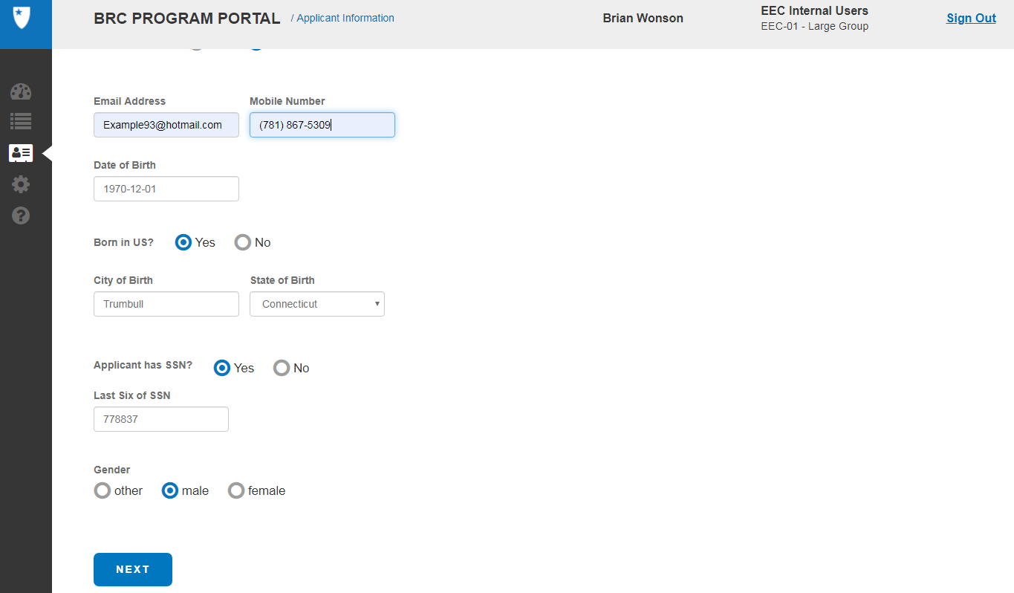
Entering Applicant Information – Personal Info (cont.)
2
Continue populating the information for submission, some fields will be pre-populated from your search, then click the “NEXT” button. After entering personal Info, the Application goes into “Saved” status, and can be resumed from this point.
Please Note: It is suggested the email address you enter should be specific to the Applicant. This should be considered, as personal information could be sent to this address.
Mandatory field
2

Slide 15
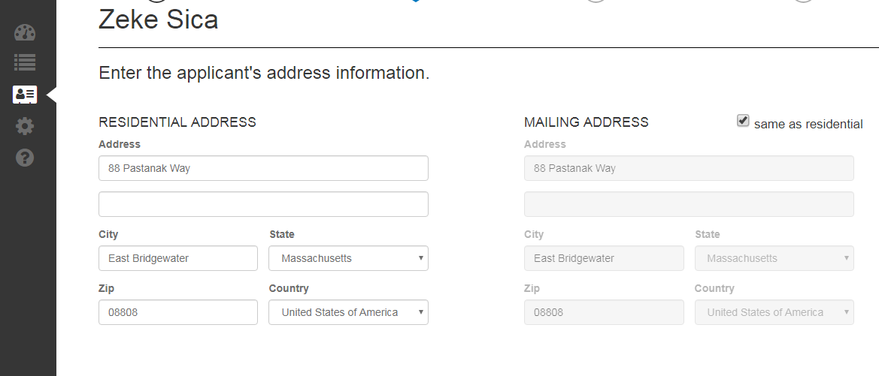
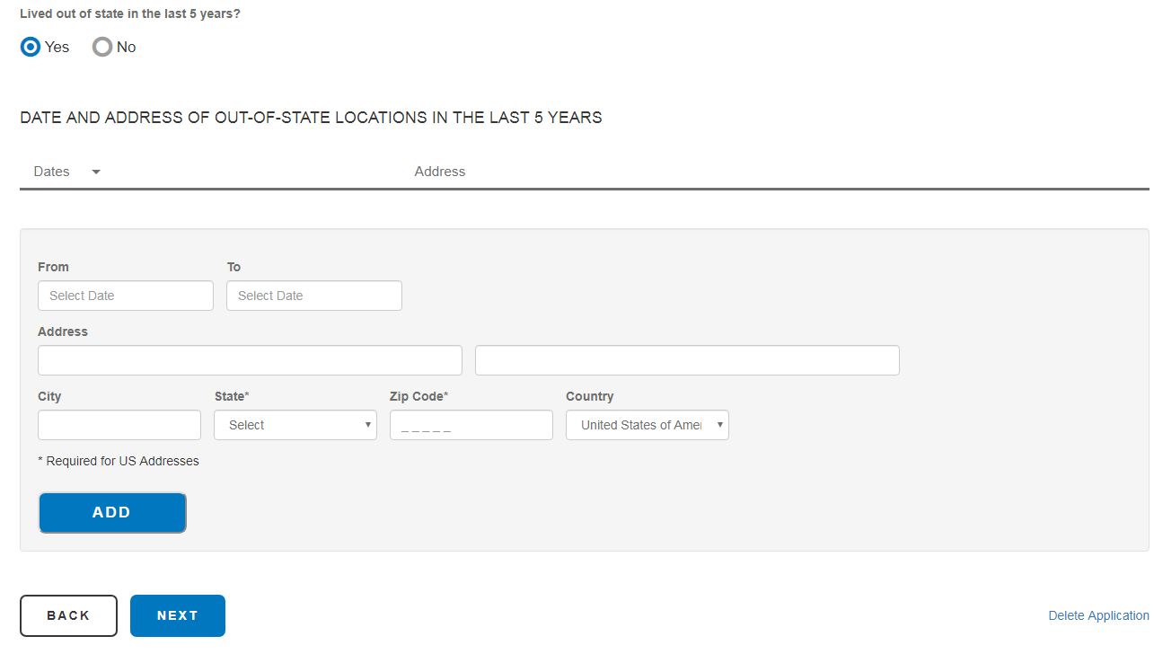
Entering Applicant Information - Address
1
Enter the applicants address information
2
1
2
If the mailing address is the same as residential, click the radio button to indicate this. If not update accordingly.
3
If the applicant has lived outside of the residential address state in the last 5 years, select the radio button here, if “YES” additional address information will be needed
3
4
Click NEXT to proceed
5
You can “Delete” the application at any point
4
5

Slide 16
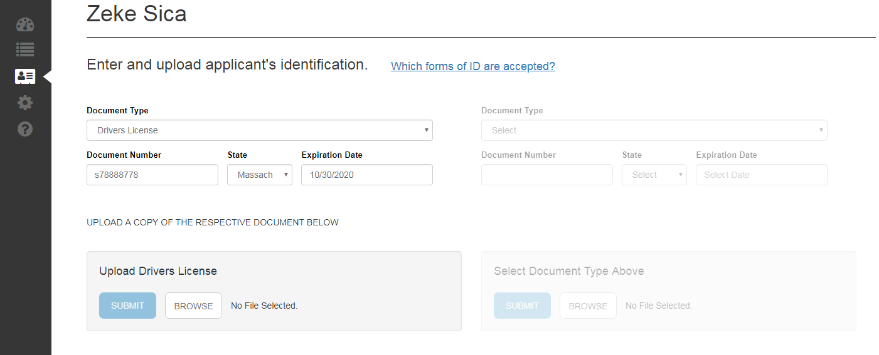
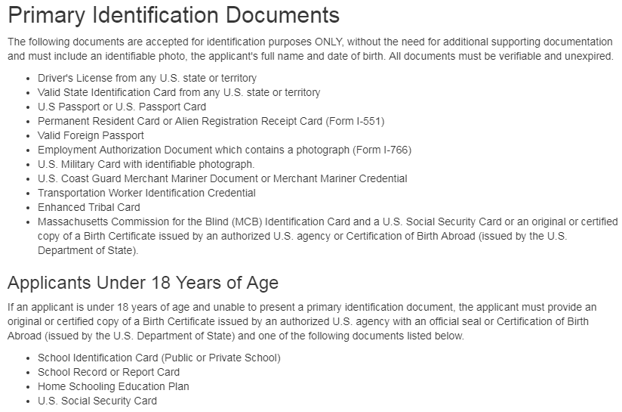
Entering Applicant Information - Identity
3
1
From the “Document Type” dropdown list choose a form of ID
1
2
Depending on the what type of ID you choose, you may have to select a second documents/Identification
2
3
Acceptable Identification documents are listed. Mass Commission of Blind requires a second document
4
4
Documents should be up-loaded
5
Click NEXT to proceed
3
Example file only
5

Slide 17
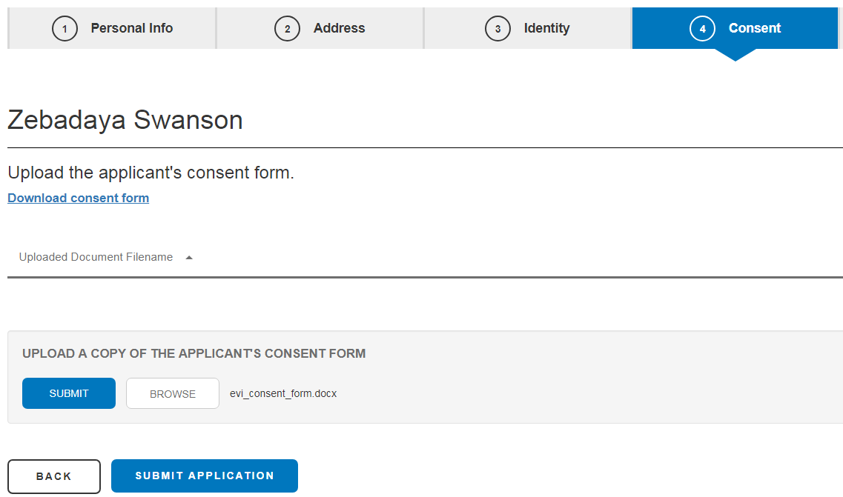
Entering Applicant Information - Consent
Download the consent form, fill out the form and save it. You will need to upload the form
1
1
To upload the form, click the BROWSE button to locate the file you saved
2
Once you have attached the file, you can click the SUBMIT button. The form will appear under the “Uploaded Document Filename” heading
3
2
3
4
Click SUBMIT APPLICATION to finish the process. Once submitted, the applicant goes from request status “saved” to request status “in process”
4
3

Slide 18
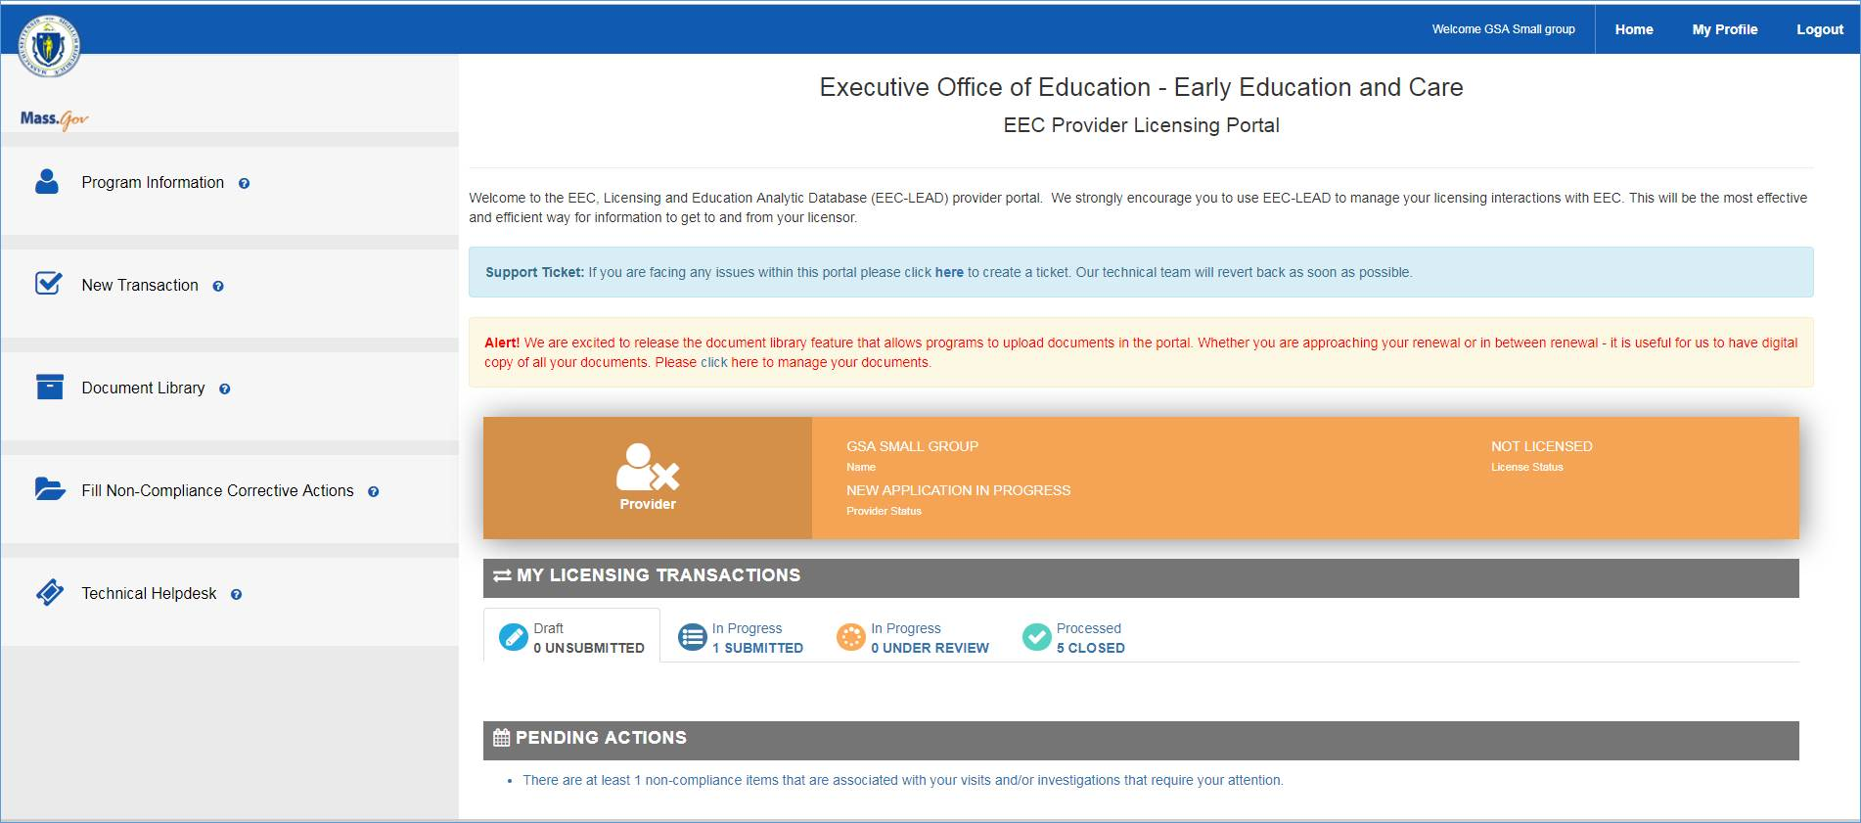
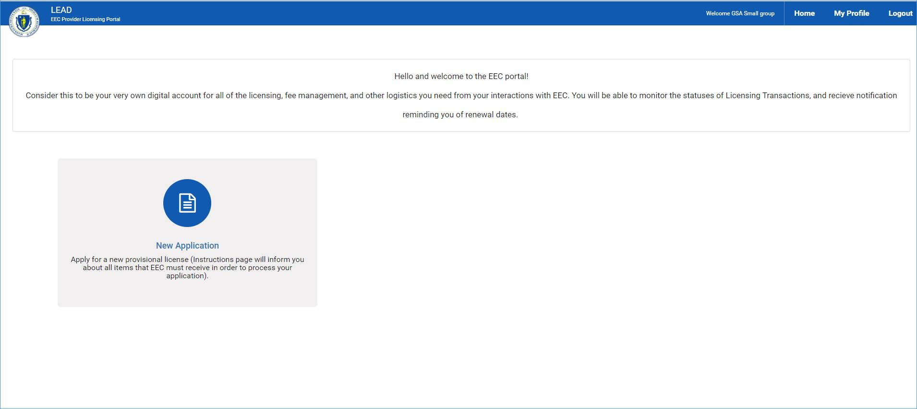
Entering a New Submission for a BRC in the Licensing Education Analytic Database (LEAD)
FOR LICENSING: Within the Executive Office of Education – Early Education and Care – EEC Provider Licensing Portal. The below page is the landing page after a user has logged in. To add a Licensee, a user would:
From there, follow the instructions to complete a Licensee application. The candidate will receive an email with instructions to sign and complete a consent form.
1
Click on the “New Transaction” option on the left-hand toolbar
2
Initiate a New Licensee Application
1
2

Slide 19
Entering a New Submission for a BRC in the Licensing Education Analytic Database (LEAD)
1
Below is the "BRC Results" section within LEAD that will record the Suitability status upon the return of the API (Application Programming Interface – allows applications to communicate with each other) from BRC Navigator
**Please note, this new section replaces the more granular SORI, CORI, DCF, FP dates and suitability information
1

