Slide 1
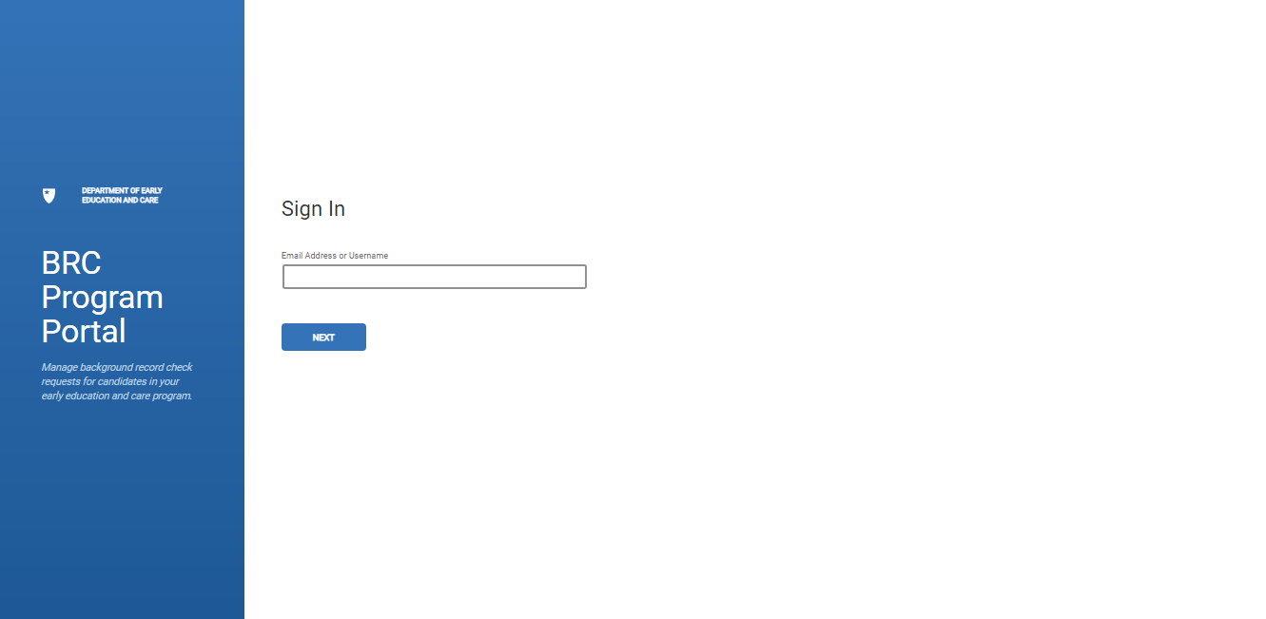
BRC Programs - EEC BRC Navigator – Provisional Approval
Program Overview

Slide 2
BRC Navigator Training
Login
Provisional Approval Process

Slide 3
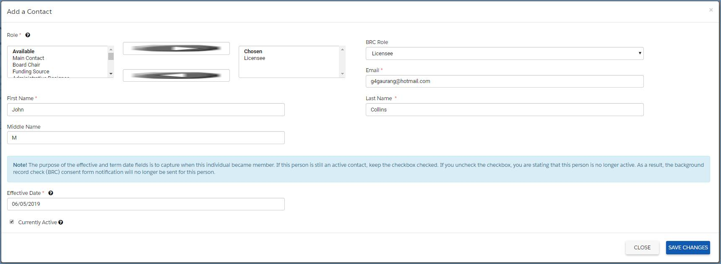
Provisional Approval
The BRC Navigator Viewer receives submissions (requests) from the BRC Navigator Program Portal or LEAD depending on candidate’s role.
1
2
BRC Navigator Program Portal submission for: BRC Program Administrator, Employee, Volunteer, Intern, Affiliated Person
LEAD Submission for Licensee
The BRC Navigator Viewer will automatically initiate the Fingerprint Notification letter through an email to the candidate for below submission types.
New Submission
Re-submission
Renewal
Partial Re-submission (only if FP check is triggered by user)
1

Slide 4
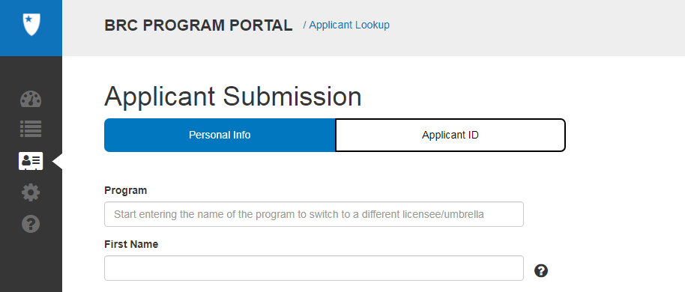
Provisional Approval
The BRC Navigator Viewer receives submissions (requests) from the BRC Navigator Program Portal or LEAD depending on candidate’s role.
1
2
BRC Navigator Program Portal submission for: BRC Program Administrator, Employee, Volunteer, Intern, Affiliated Person
LEAD Submission for Licensee
The BRC Navigator Viewer will automatically initiate the Fingerprint Notification letter through an email to the candidate for below submission types.
New Submission
Re-submission
Renewal
Partial Re-submission (only if FP check is triggered by user)
2

Slide 5
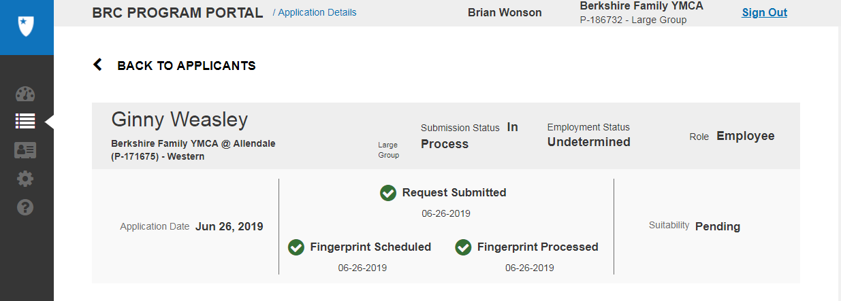
Finger Print Notification Letter
1
A copy of the fingerprint notification letter will be saved in the BRC Navigator Program Portal database on the Candidates Detail page under “Submitted Documents”.
2
The Licensee or BRC Program Administrator will be capable of downloading and printing the fingerprint notification letter.
1
1
2

Slide 6
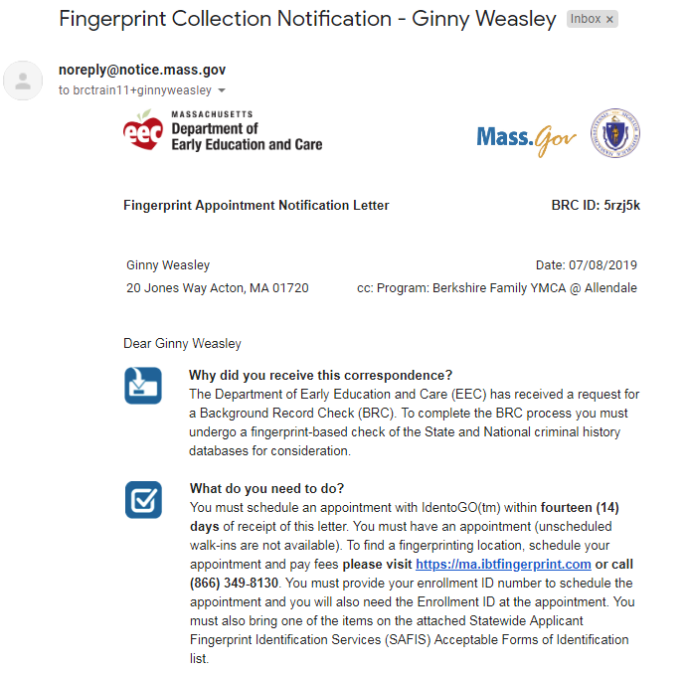
Finger Print Notification Letter
A copy of the fingerprint notification letter will be saved in the BRC Navigator Program Portal database.

Slide 7
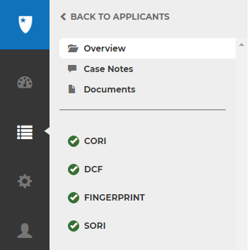
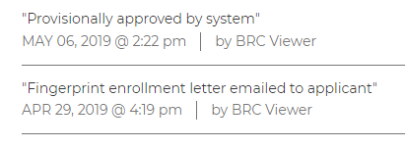
Provisional Approval
1
Idemia will process the Fingerprint background check for the Candidate (Licensees/Affiliates are not eligible for Provisional Approval). Once fingerprint scans are collected and accepted by Idemia, the Navigator triggers the remaining checks. CORI, SORI, and DCF (In real time without any manual effort).
2
Case Notes would be updated automatically, by the BRC Navigator Viewer
Provisional Approval is a status that can be utilized by Programs during the initial phases of the BRC, allowing the Program to hire the Candidate to work awaiting the final determination of their BRC, if the requirement that they are under supervision is met. Provisional status will automatically be set when fingerprint is taken (When the fingers touch the screen.), SORI check is approved and provided candidate does not have a prior “Not Suitable” determination. At this point the EEC isn’t concerned about the status of fingerprint (hit or not) or about the results of the CORI or DCF.
2
1

Slide 8
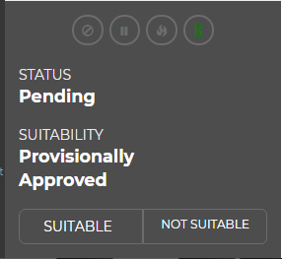
Provisional Approval
1
When a candidate meets this criteria then the BRC Navigator Viewer will issue a Provisional status and Candidate’s suitability is updated to "Provisionally Approved".
2
The Candidate’s Suitability status is also updated in the BRC Navigator Program Portal (APPLICANTS tab) to “Provisionally Approved” - this status means Programs can provisionally hire the candidate and the candidate needs to be supervised while providing care to children until their BRC is completed and a Suitable determination is issued.
1
2

Slide 9
Provisional Approval
1
If a Program wants to provisionally hire the candidate, they can do that by clicking “Provisionally Hired” under Actions.
2
The Candidate’s Employment Status on the BRC Navigator Program Portal (ALL STAFF tab) will be updated from “Undetermined” to “Provisionally Hired”
3
Employment Status is not seen in the BRC Navigator Viewer, it’s only in the BRC Navigator Program Portal.
1
2

Slide 10
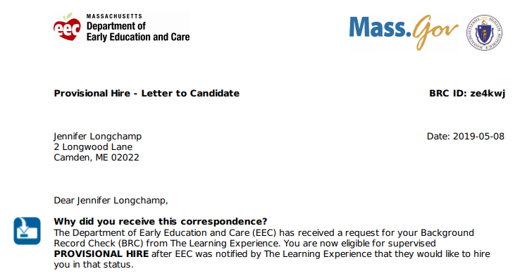
Provisional Approval
1
Once the Candidate is provisionally hired by the Program, the BRC Navigator Viewer will auto generate a “Provisionally Hired” email and send it to the Candidate to inform them of their “Provisional” status.
2
A copy of the “Provisionally Hired” letter will be saved in the BRC Navigator Program Portal database. Programs have access to this letter in BRC Navigator Program Portal in the “SUBMITTED DOCUMENTS” section under the Candidate’s Detail page (by clicking on the candidates name).
1
2

