Slide 1
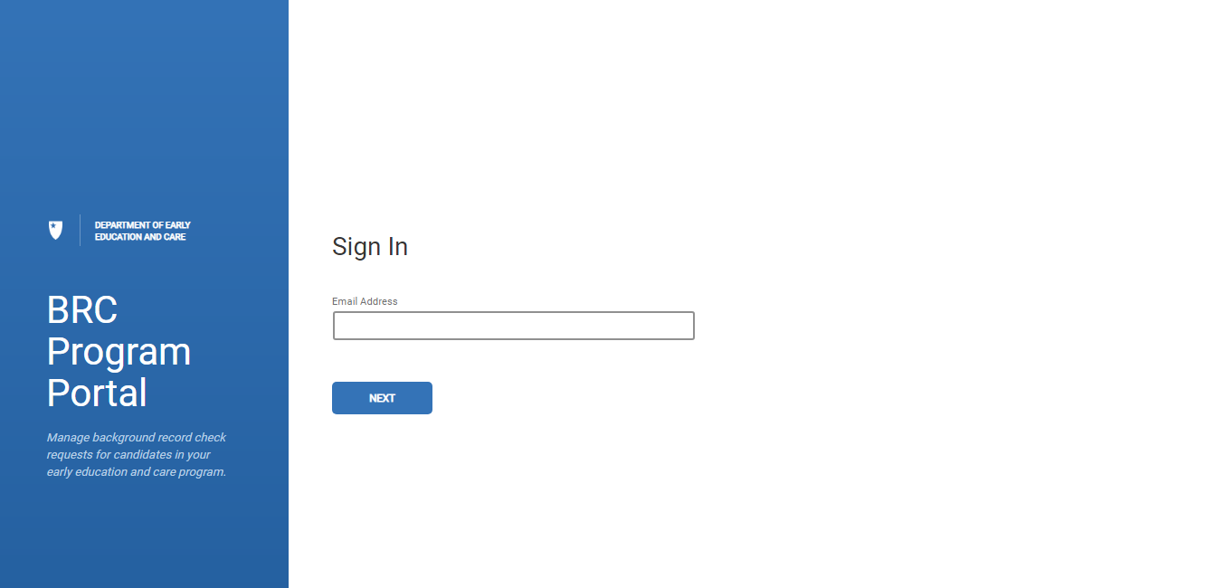
BRC Navigator Program Portal
Program Overview - Suitability Transfer

Slide 2
BRC Navigator Training
Applicant Submission – Suitability Transfer (GSA to GSA under different Umbrellas)
Resubmission
Renewal

Slide 3

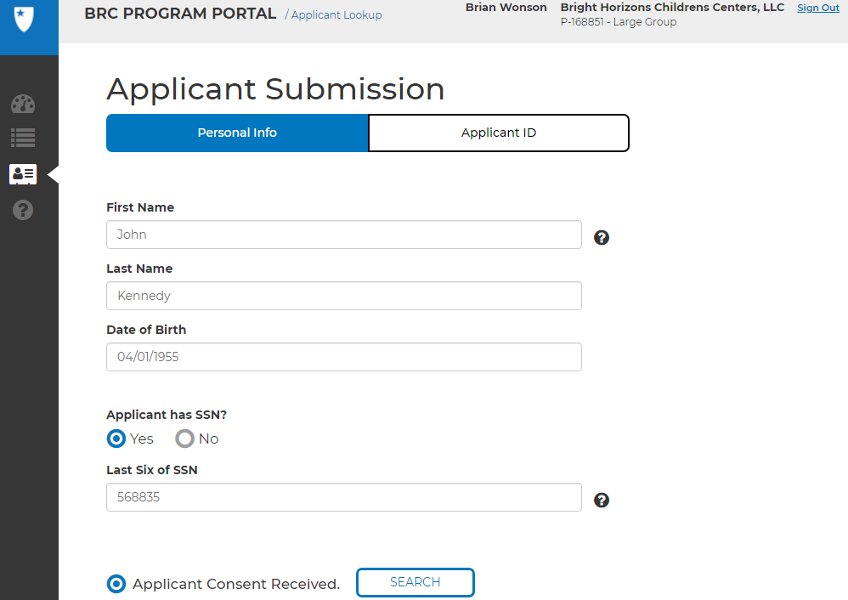
Entering an Applicant Submission for a BRC Suitable Transfer
1
Click on the “New Submission” icon on the left-hand toolbar
3
“Select Applicant Consent Received” radio button and click on SEARCH
2
Enter Data for mandatory fields under Personal Info: First Name, Last Name, Date of Birth (DOB) and SSN. For SSN, if yes, provide last six of SSN, if no, last six data box will disappear
4
If you have the Applicant ID, you can search in the applicant ID tab
1
2
4
3

Slide 4
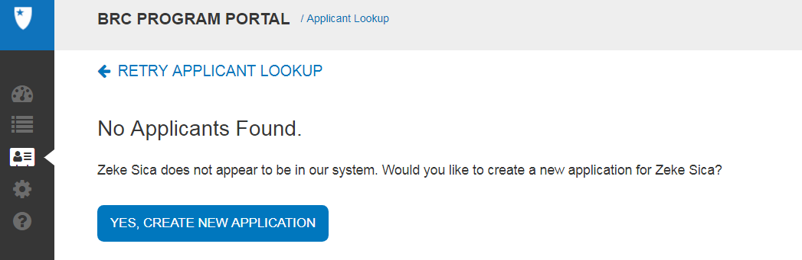
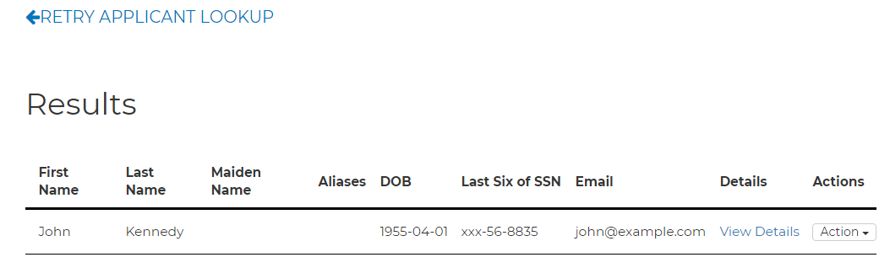
Entering an Applicant Submission for a BRC Suitable Transfer
1
If No entry is found, you will get a message to Create a new applicant, click the “Yes, Create New Application”
2
If an entry is found the Applicant will appear in a Results page after your “search”
2
1

Slide 5
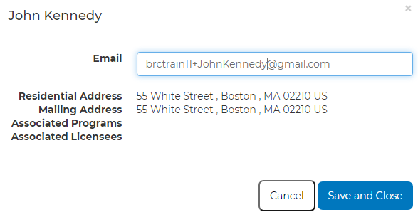
Entering an Applicant Submission for a BRC Suitable Transfer
1
From the results of your search, click on the VIEW DETAILS link in the Details column
2
Update/change the email associated with the candidate and the Program they are transferring to, click “save and close”
1
2

Slide 6
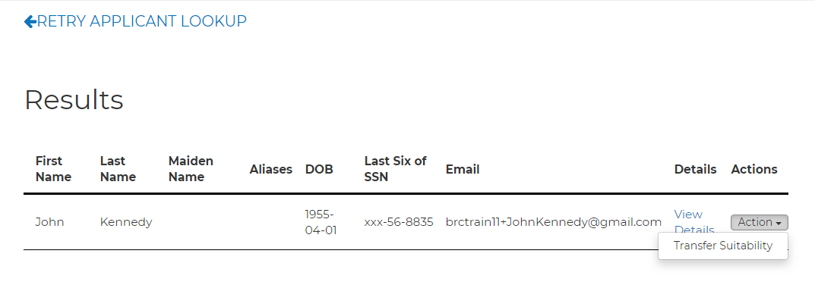
Entering an Applicant Submission for a BRC Suitable Transfer
1
Once you save and close the dialogue box after updating the Applicants email address, you will select “Transfer Suitability” in the drop down box in the Actions column.
1

Slide 7
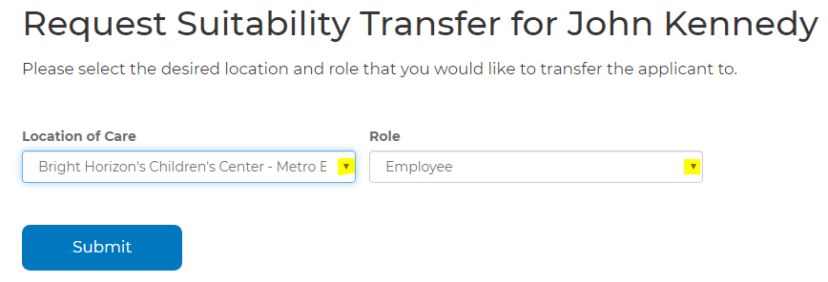
Entering an Applicant Submission for a BRC Suitable Transfer
1
After you select “Transfer Suitability” the below screen will appear. On this screen you will choose the Location of Care where the applicant will be working and the role they will be in. Press the “Submit” button once the fields are selected
1

Slide 8
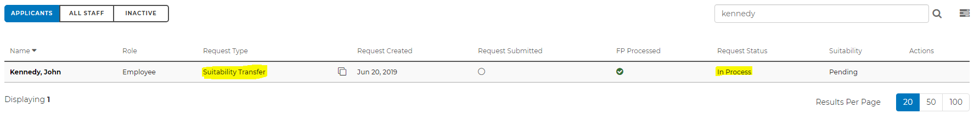
Entering an Applicant Submission for a BRC Suitable Transfer
1
After a successful submission, the below message appears
2
The candidate will appear in the Portal with a “Request Type” of Suitability Transfer and a “Request Status” of In Process
1
2

Slide 9
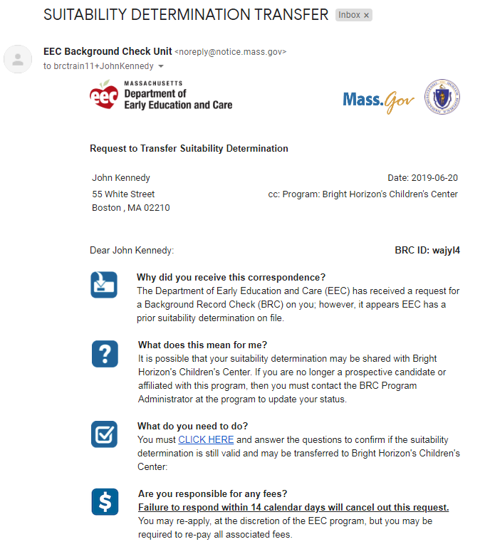
Entering an Applicant Submission for a BRC Suitable Transfer
1
The Candidate will receive an email with further instructions on the request for Suitability Transfer, under the section of “What do you need to do?” there is a link that the candidate clicks on to answer questions to confirm suitability
1

Slide 10
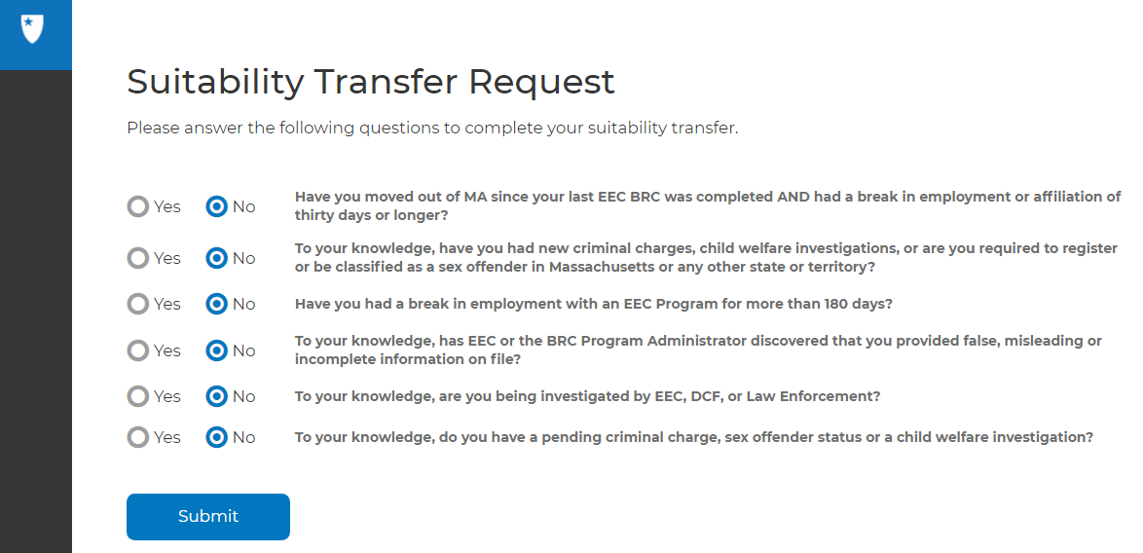
Entering an Applicant Submission for a BRC Suitable Transfer
1
Once the URL link is clicked on, it will bring them to a screen to answer the below questions and “Submit”. If all questions are answered “NO”, the Suitability is automatically transferred
1

Slide 11
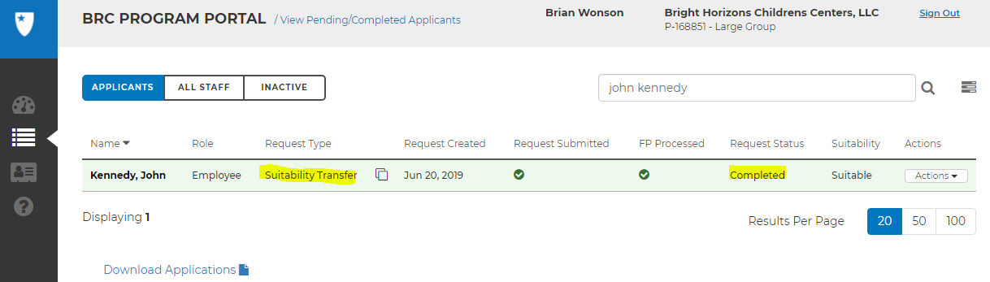
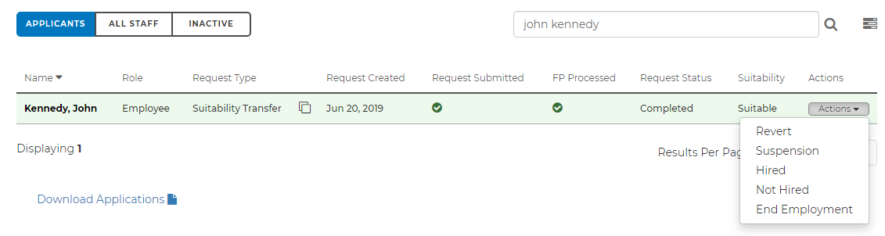
Entering an Applicant Submission for a BRC Suitable Transfer
1
The Applicant now appears in the Portal under the Applicants tab with a Request Type “Suitability Transfer” and a Request Status of “Completed”
2
The Program now has the ability in the Actions column to mark the applicant as “Hired”. If the status is changed to “Hired”, the applicant moves to the ALL STAFF tab, if “Not Hired”, they will move to the INACTIVE tab
1
2

Slide 12
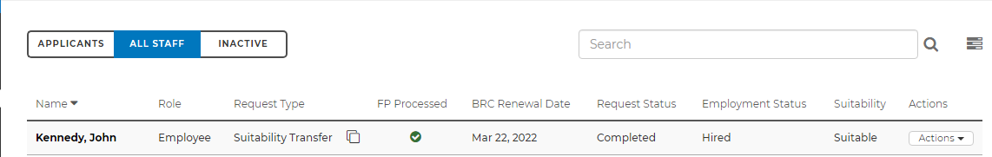
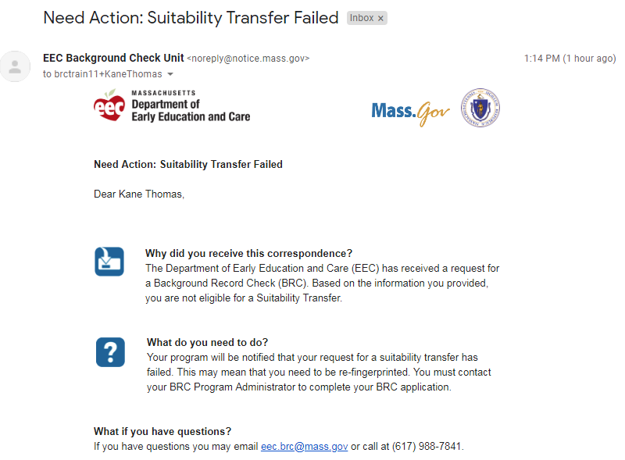
Entering an Applicant Submission for a BRC Suitable Transfer
1
The screen reflects the Applicant as “Hired” on the ALL STAFF tab
If the Applicant answers “yes” to any of the questions on page 12, then the suitability is NOT automatically transferred, however the applicants status does change.
The Applicant will remain on the Applicant tab in a saved status
The Program would need to process a resubmission for this candidate
The candidate would receive a an email notification that the Suitability Transfer Failed based on the responses they provided
1

Slide 13
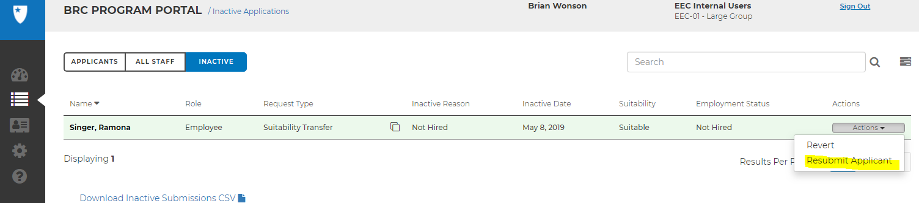
Resubmission
A Candidate can be resubmitted in the BRC Navigator Program Portal for the following reasons:
New Investigation by law enforcement, DCF, or EEC
New or pending charges, sex offender status, or supported child welfare findings reported
Moved out of state and break in employment more than 30 days
Break in employment for 1 year or more with EEC Program
Provided false or misleading information
Other (this would only be used by BRC Staff)
1
After the receipt of the signed BRC Consent form, Program Admins or BRC staff can initiate a Resubmission the following ways:
Through the Applicant submission screen (a full BRC will be run)
Inactive listing page, using the “Resubmit Applicant” under the actions column drop down menu
All staff listing page using “initiate Resubmission”

