Slide 1
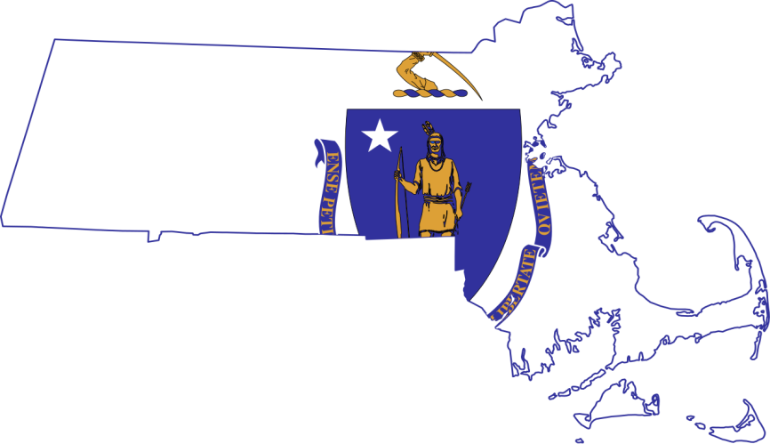
Breaking Barriers: Business Engagement for Veterans
Christopher Mills
Local Veterans Employment Representative
Paul Furbush
Regional Veterans Employment Coordinator

Slide 2
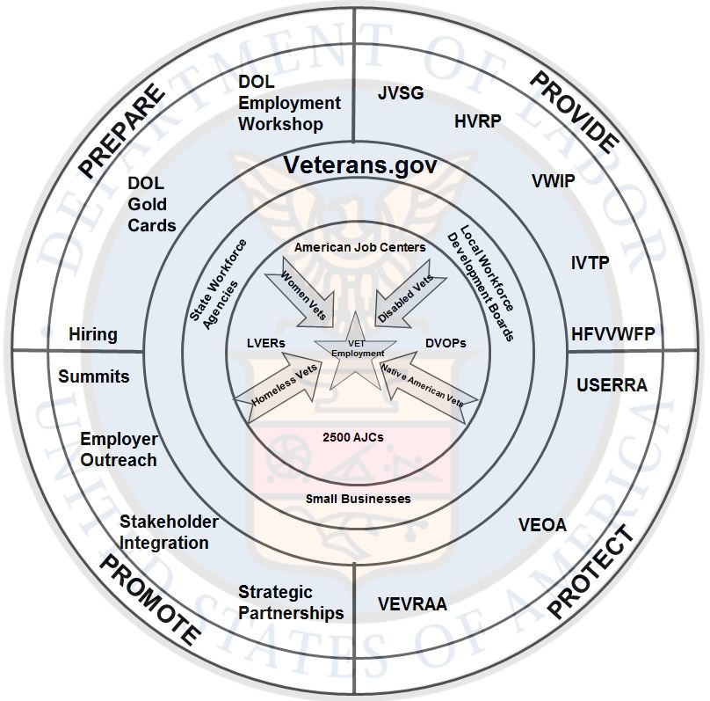
Connecting spokes on a wheel The BIG Picture
State & Federal workforce partners
Working together & sharing resources
Veterans business outreach programs

Slide 3
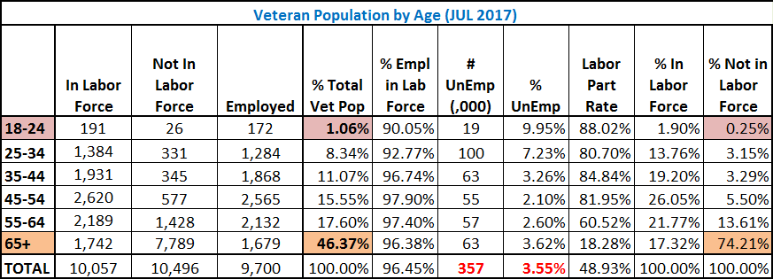
Veteran Demographics
Notes:
20.7 M total veterans in the U.S.
92.7% male
7.3% female
Median age = 64
Nearly 51% of all veterans are in the workforce (10.4M):
409K unemployed veterans
79% of veterans are 45 years or older
56% of unemployed veterans are 45 years or older
13K unemployed veterans are 18-24
Declining unemployment rates- the lowest in last 10 years
Veteran unemployment rates continue to be lower than non-veterans

Slide 4
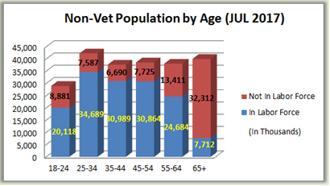
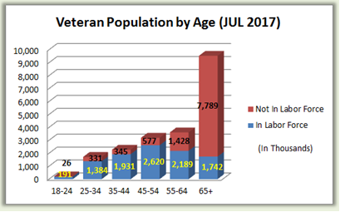
Veteran Unemployment

Slide 5
DOL Assistance & Resources
DOL provides resources and assistance to Businesses, Transitioning Military, Veterans, Reservists, National Guard, and families
Community Leaders should be educated on resources and assistance available and partner with State Workforce Agencies and local AJCs
DOL funds training programs that Veterans may be eligible for
DOL provides assistance for OJT, Apprenticeships and programs that are valuable to many Businesses, at No Cost
DOL is focused on increasing utilization of DOL and AJC services by Veterans, the Military Community and their families
DOL is increasing business engagement through outreach, resulting in better overall employment outcomes
AJC services compliment and do not replace TAP requirements

Slide 6
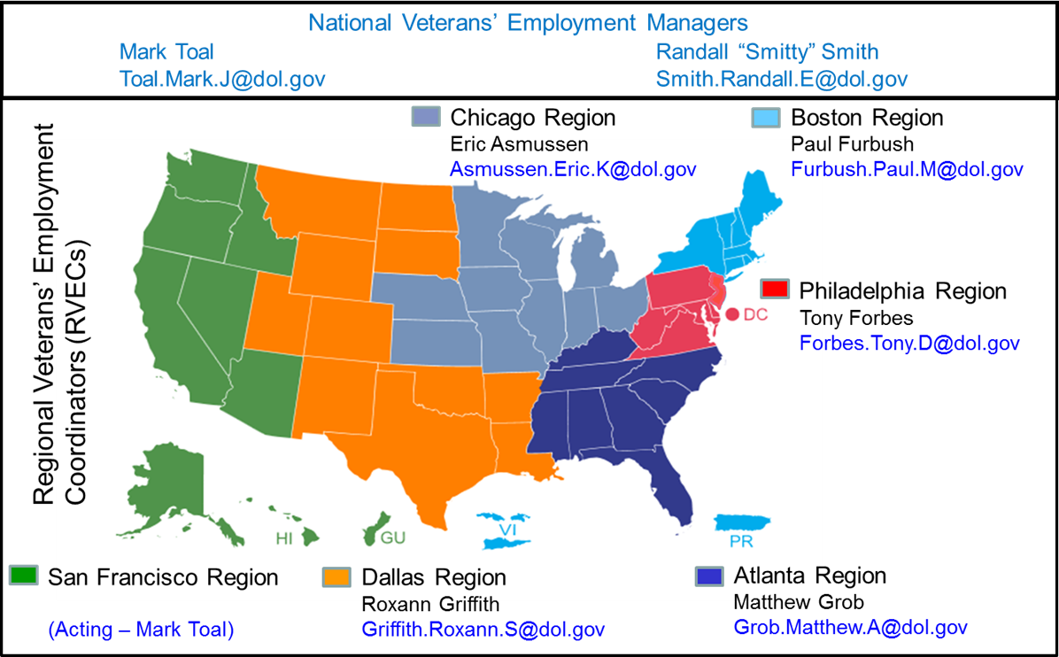
DOL VETS Employer Outreach
Connect companies with federal, state and local resources to facilitate veterans’ employment.
Leverage federal, state and local resources and programs to reduce employer costs.
Coordinate resources and expertise across businesses, employer groups, organizations, workforce partners and government agencies to promote veterans’ employment opportunities.
“Make it easier for employers to find and hire veterans”
Notes:
Outreach Through the Web and Digital Media
Because our veteran clients and stakeholders requested it, VETS now provides a 24/7 online resource easily accessible to all veterans as well as to employers who want to hire veterans. On May 1, 2016, VETS officially launched VETERANS.GOV. The site is designed to be the virtual “first stop” for veterans, transitioning Service members, and their spouses in the employment search process - and for employers in the hiring process. The site brings together job banks, state employment offices, AJCs, opportunities in top trending industry sectors, and employer assistance all in one online spot. There also are links to several platforms that veterans can use to help translate their military skills into skills for the civilian workforce. We are leveraging the Department's Facebook and Twitter accounts as part of our efforts to reach veterans and their families. For veterans, Service members and their spouses looking for their first civilian job after the military, wanting a career change, or hoping to start their own business, VETERANS.GOV is a critical resource that will help connect veterans and their spouses to civilian employment. We believe this new website will be very useful to veterans and their families, and it is another sign of the Department of Labor’s commitment to assist veterans and transitioning Service members in every way possible with training and other opportunities to find meaningful employment and build bright futures for their families.
Our federal partners also are represented on VETERANS.GOV to assist the respective agencies veteran employment efforts and to advocate careers in their respective employment sector. On the VETERANS.GOV landing page, there are links to the SBA, and Departments of Agriculture, Transportation, Homeland Security, and Energy’s veteran pages as well as a link to OPM’s Feds for Vets page that provides information on how to apply for a federal job. As an example of federal and state coordination, users can click on a map of the United States on VETERANS.GOV to quickly receive state-specific veteran employment information. In addition to VETERANS.GOV, the Department also maintains a mobile app, CareerOneStop Mobile, available on both Apple and Android devices. CareerOneStop Mobile provides veterans and non-veterans alike on-the-go access to many of the tools found on VETERANS.GOV such as job banks, military-to-civilian skills translation, local training opportunities, salary data, and an AJC finder.

Slide 7
Integrated Approach
Veterans’ Employment and Training Service (VETS)
Coordinates Agency efforts
Employment & Training Administration (ETA)
National Workforce System (AJCs, UCX, Office of Apprenticeship, WIOA)
Office of the Solicitor (SOL)
Employment law expertise; enforcement in U.S. veteran discrimination cases
Bureau of Labor Statistics (BLS)
Continuously monitors and analyzes U.S. veteran employment statistics
Chief Evaluation Officer (CEO)
Evaluates effectiveness /efficiency of Veteran employment programs
Office of Disability Employment Policy (ODEP)
Focuses on disability-related policies that benefit veterans
Office of Federal Contract Compliance Programs (OFCCP)
Affirmative action provisions
Woman’s Bureau (WB)
Develops policies, advocates for and promotes working women/veterans
Wage and Hour Division (WHD)
Military Family Leave (FMLA)
Employee Benefits Security Administration (EBSA)
Financial literacy/military retirement structure
DOL’s intense and extensive interoperability across all DOL agencies
VETS
EBSA
ETA
WHD
SOL
WB
BLS
CEO
OFCCP
OPED
Regional Locations:
Atlanta, Boston, Chicago, Dallas, Philadelphia, San Francisco

Slide 8
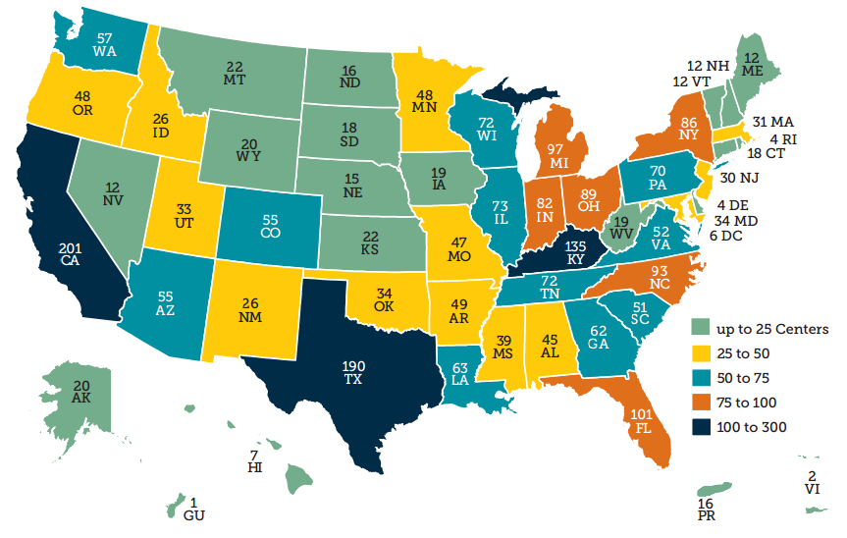
2,414 American Job Centers (AJCs)
VETERANS.GOV
www.careeronestop.org
National Phone Helpline: 1-877-872-5627

Slide 9
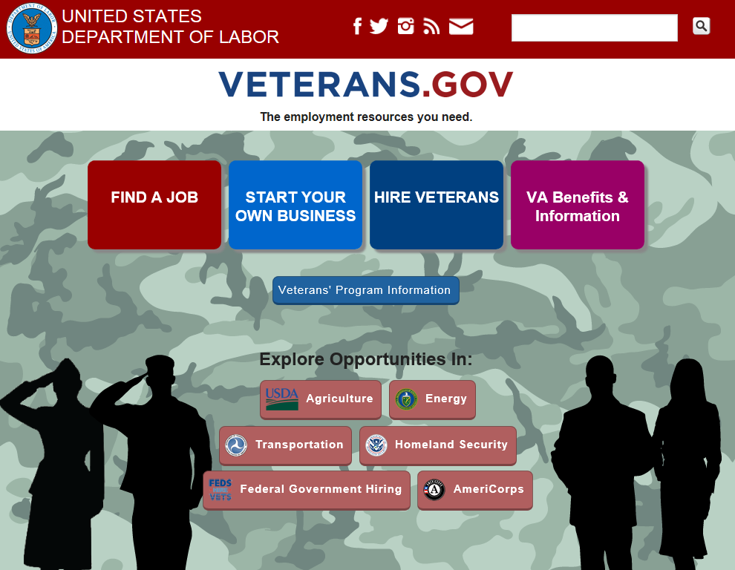
VETERANS.GOV
For Employers:
Connect with regional employer outreach specialists in DOL VETS to access local resources for meeting your unique hiring needs.
Post position descriptions and openings in the Veterans’ Job Bank /National Labor Exchange database.
Access the free veteran hiring toolkit, “America's Heroes at Work,” and other resources.
DOL.GOV/VETERANS
For Job Seekers:
Connect with one-on-one assistance at more than 2,400 American Job Centers
Explore Veterans’ Job Bank/National Labor Exchange online job listings
Search career paths by industry, similarity to military careers, or keyword
Locate approved local training programs, colleges and universities
Access resources from State and Federal partners to connect with industry programs

Slide 10
VETERANS.GOV Inquiry
RVEC receives Email directly from Veterans.gov
Initial response includes brief explanation of AJCs, LVER/BSR, RVEC and includes VETS Resource Cards/Fact Sheets
CC: State Veteran Program Coordinator or appropriate representative and FW: Original Inquiry for reference with communication to state representative
State Representative assigns LVER/BSR to provide assistance
SWA/AJC takes lead on State/Local Businesses
RVEC partners with multiple SWAs, LVERs/BSRs and RVECs (as needed)
for Regional and/or National Businesses
RVEC Follows-Up with Business and SWA, AJC, LVER/BSR

Slide 11
Employment Workshop eBook
FREE
Read On Any Device
https://www.amazon.com/dp/B01JNR2H6A

Slide 12
Licensing and Certifications
Service members are trained in hundreds of occupations with relevance to civilian employment opportunities
There are few nationally recognized licenses and certifications
DOL is working with DOD and the states as they develop their licensing and certification programs
Counselors at the American Job Centers can help veterans navigate through the Licensing and Certification process
The opportunities for service members to translate their experience and skills into civilian employment has never been better!

Slide 13
Education and Experience
Joint Services Transcripts (JST) provide descriptions of military schooling and work history in civilian language
Available to enlisted, officers and warrant officers, active and veterans, from Army, Coast Guard, Marine Corps and Navy.
(Air Force personnel should contact CCAF)
JST is approved by the American Council on Education (ACE) to validate a service member's military experience and training along with the corresponding ACE college credit recommendations.
Accepted by more than 2,300 colleges and universities

Slide 14
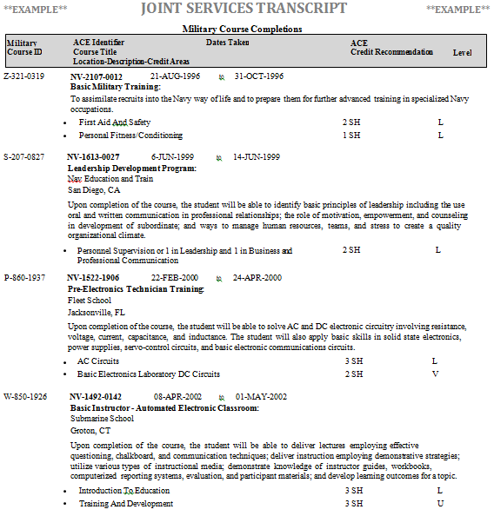
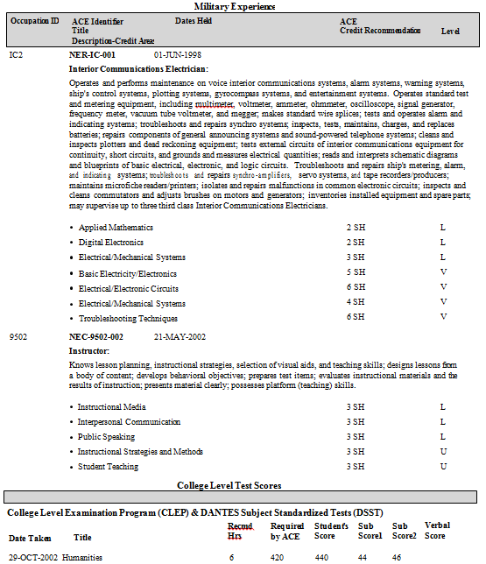
JST Credits
Notes:
The JST includes:
•Military course completions—all courses that have been evaluated by ACE, with full descriptions and credit recommendations
•Military occupations—full descriptions, skill levels, and credit recommendations
•College level test scores—CLEP, DSST, NCPACE, ACT/PEP, and Excelsior
•Other learning experiences—additional completed courses and occupations that have not been evaluated by ACE for college credit

Slide 15
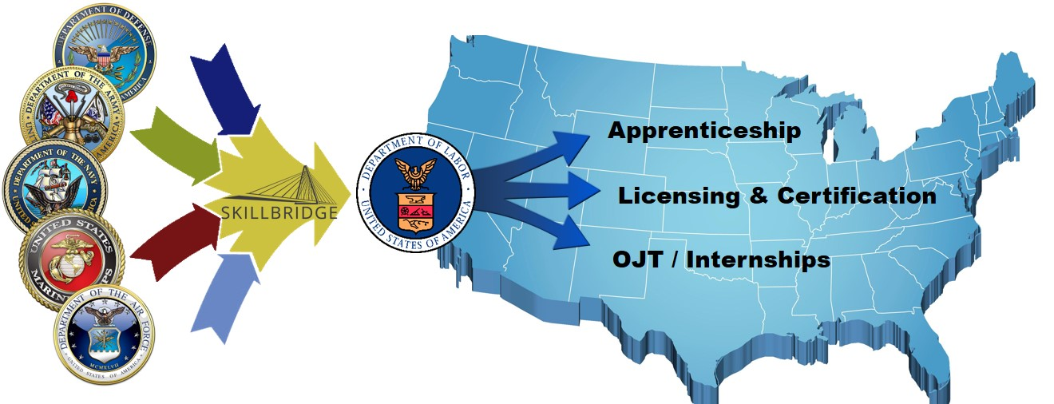
DOD SkillBridge
Through DoD SkillBridge, tremendous potential exists for service members, companies, trade unions, and others to leverage this talent pipeline to meet state, regional, and industry workforce needs.
DoD can use the SkillBridge program to connect to DOL programs already in place and funded to facilitate Transitioning Service Members’ success

Slide 16
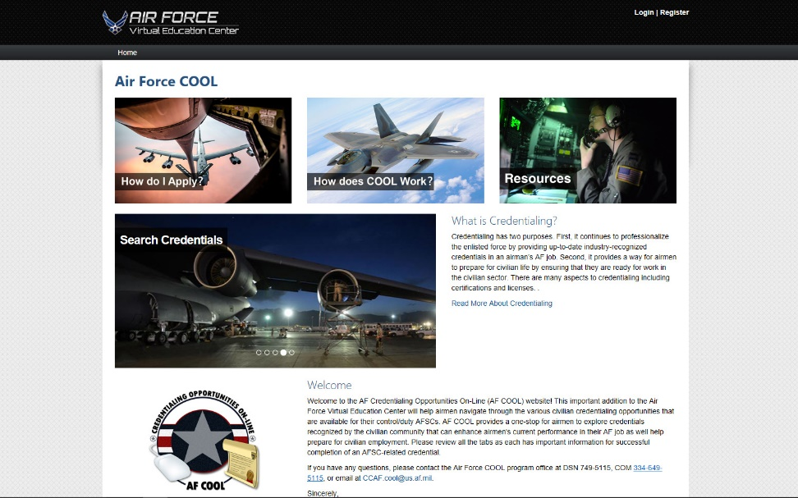
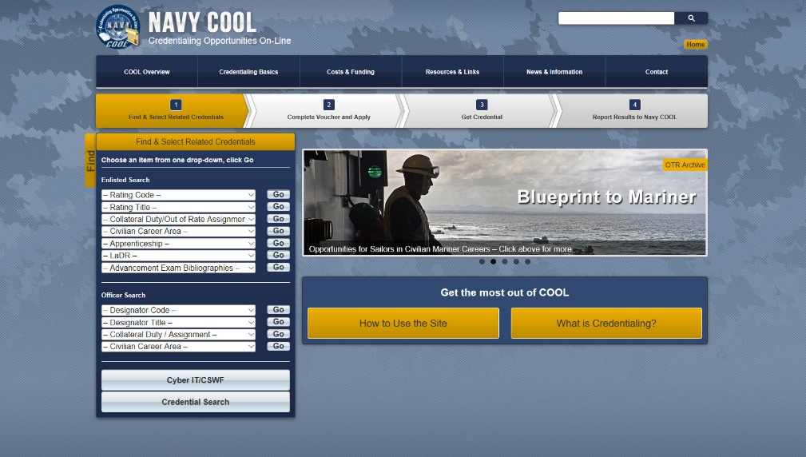
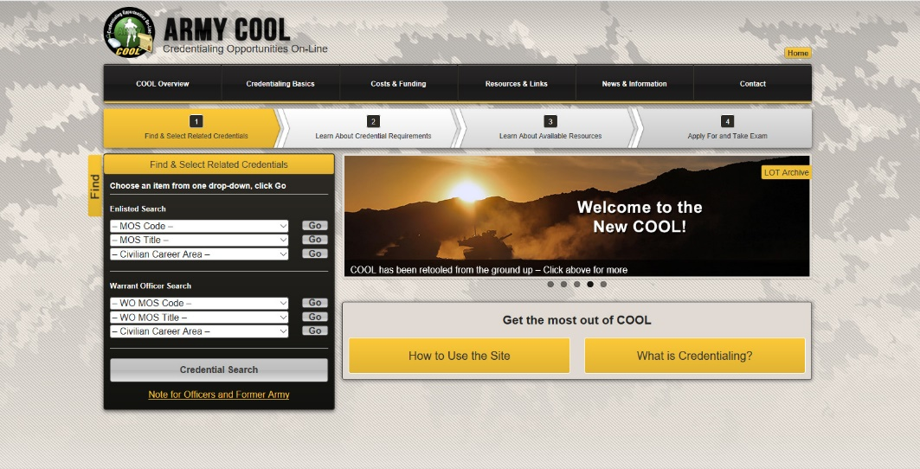
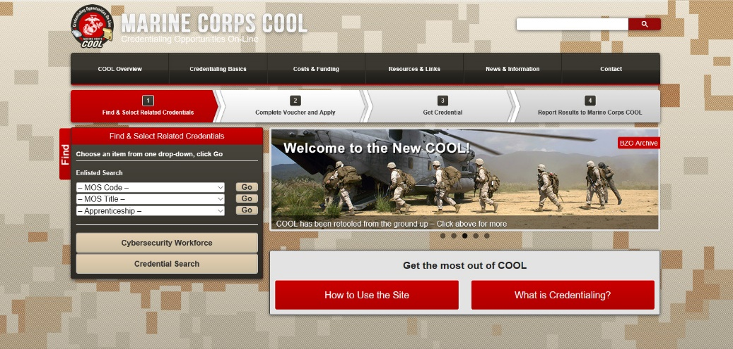
Credentialing Opportunities On-line
COOL (Credentialing Opportunities On-line) helps Service members find information on certifications and licenses related to their jobs. Use COOL to get background information on credentialing and find detailed information on:
Credentials related to an Military Occupational Specialty or Code (MOS or MOC)
Credential requirements and potential gaps between Army training and civilian credentialing requirements
Resources available to fill gaps between military training and civilian credentialing requirements

Slide 17
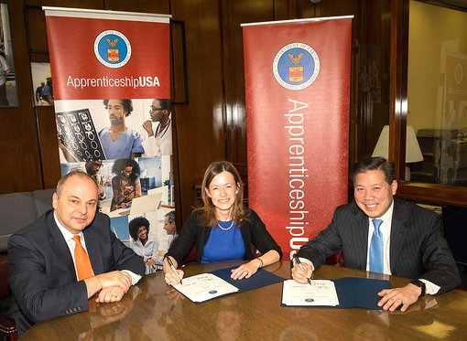
Apprenticeship Partnership
Oct 2016: RVEC speaks with Amazon representative at Hiring our Heroes Transition Summit at Joint Base Lewis McCord regarding possible apprenticeship program for veterans
Nov 2016: DOL VETS, Office of Apprenticeship meeting with Amazon leadership in November 2016.
Jan 2017: Registered DOL Apprenticeship for Amazon icloud support signed
Increased interest from industry leaders and other factors have brought Apprenticeship Training to the forefront of workforce progams.
Presidential Executive Order Expanding Apprenticeships in America

Slide 18
Employment Services for Homeless Veterans
HVRP Grants are independent of the State Workforce System but partner with the AJCs
Provides services to assist in reintegrating homeless veterans into meaningful employment and stimulate development of effective service delivery systems that will address complex homeless veteran problems.
Program Information: www.dol.gov/vets/programs/hvrp/
Nationwide HVRPs: www.nvtac.org/grantees/
Notes:
As I mentioned, the overall declining rates are the result of the integrated efforts of many public, private, and nonprofit organizations to connect veterans with employers and, perhaps most importantly, the result of our veterans once in a workplace, proving to be valuable employees.
The mission of the Veterans' Employment and Training Service (VETS) is to prepare America's veterans, Service members, and their spouses for rewarding careers, provide them with employment resources and expertise, protect their employment rights, and promote their employment opportunities. Before I go further, I would like to take this opportunity to mention that other agencies share DOL’s commitment to improve employment opportunities for our veterans. One example is the Department of Agriculture, whose Fiscal Year (FY) 2017 Budget includes several programs to assist veterans.
We are working hard to improve our performance in support of our veterans, customers, stakeholders, and partners alike. Our efforts have contributed to improved employment outcomes for veterans and strong interagency collaborations. While we recognize there are challenges and much work ahead of us, we seek continued improvement with an approach to build and sustain partnerships and programs that focus on the following key areas:
Engaging our Service members before they transition into civilian life;
Providing a lifetime of employment support to our veterans, from the Gulf War II era veterans who have recently transitioned to previous-era veterans who have been out of uniform for many years;
Engaging and mobilizing communities to establish collaborative partnerships to better support veterans nationwide;
Ending homelessness for veterans;
Addressing the skill gap between veterans and employers who are seeking employees with industry recognized credentials and helping veterans receive occupational, classroom and on-the-job training; and
Conducting employer outreach to make it easier for companies to find and hire veterans by leveraging federal, state, and local resources.

Slide 19
HIRE Vets Medallion Award
August 18th, 2017 News Release
WASHINGTON, DC – The U.S. Department of Labor’s Veterans’ Employment and Training Service (VETS) announced it is accepting public comments on the criteria for the HIRE Vets Medallion Program. A Notice of Proposed Rulemaking (NPRM) was published in the Federal Register today.
The Medallion will recognize employers who recruit, employ, and retain veterans. The Department is establishing the program under the Honoring Investments in Recruiting and Employing American Military Veterans Act, or HIRE Vets Act. President Donald J. Trump signed the act into law on May 5, 2017.
“Veterans have a proven ability to lead under pressure and deliver results,” said U.S. Secretary of Labor Alexander Acosta. “The veteran unemployment rate in July was a low 3.5 percent; yet 356,000 veterans are still looking for work. The HIRE Vets Medallion will recognize employers who hire our nation’s heroes, and encourage others to follow suit.”
www.dol.gov/vets/hirevets/

Slide 20
HIRE Vets Medallion Award
The proposed rule would establish the criteria and the process to enable VETS to receive award applications from employers, to verify the information, and then issue HIRE Vets Medallion awards to recognize employers that meet the criteria. The proposed rule also establishes gold and platinum award levels in categories to recognize small, medium, and large employers.
The Secretary will present chosen recipients with a HIRE Vets Medallion Award and a virtual HIRE Vets Medallion which they can use to show their support for veterans’ employment. The proposed rule will also establish an application fee to cover the program’s costs.
Those interested may submit public comments on this NPRM online using the Federal eRulemaking Portal at www.regulations.gov, or in writing by mail, hand delivery, or courier to Randall Smith, Veterans’ Employment and Training Service, U.S. Department of Labor, Room S-1325, 200 Constitution Avenue NW, Washington, DC 20210.
www.dol.gov/vets/hirevets/

Slide 21
HIRE Vets Medallion Award
All comments should include Regulatory Identification Number 1293-AA21. Comments will close 30 days after publication in the Federal Register.
Please direct any questions regarding the HIRE Vets Medallion Program to:
Randall E. Smith
Smith.Randall.E@dol.gov
(202) 693-4745
www.dol.gov/vets/hirevets/

Slide 22
Get The Resources
Federal Resources
www.veterans.gov
American Job Centers
www.servicelocator.org
Veterans’ Employment and
Training Service (VETS)
www.dol.gov/vets
dol.gov/vets/hirevets
www.mynextmove.org
www.myskillsmyfuture.org
Notes:
Q6. How can military spouses become involved in helping DOL VETS continue to support the military spouse community?
Military Spouses can best support us by letting us know what we can do better for you and your military spouses. Over 250,000 service members are separating from the military each year. This means a large number of individuals and families are undergoing a significant change in their lifestyle, i.e. moving, new careers, education, and budget. We see many service members and their spouses come through our doors who did not have a plan for life after the military. All too often, service members don’t begin planning for life after the military until they are either about to separate, or have already separated, from the military. The more service members have prepared themselves for a career after the military, while they are in the military, the better their chances of success. We at the Department of Labor are there to help you, at any time, through our American Job Centers and our 3-day TAP Employment Workshops. You and your spouses can go there at any point in time and find assistance to help you either find work, or find new employment opportunities.
Also, military spouses can help us by participating with the Military Spouse Employment Partnership (MSEP). Through MSEP network, you can help us get the word out on our support services available to both transitioning service members and spouses at the AJCs. We are partnering with MSEP to strengthen the education and career opportunities of

Slide 23
Massachusetts Veterans Business Engagement

Slide 24
Understanding Military Culture
15 Things Veterans Wants You to Know
https://urldefense.proofpoint.com/v2/url?u=https-3A__player.vimeo.com_video_226368040&d=DwMFaQ&c=lDF7oMaPKXpkYvev9V-fVahWL0QWnGCCAfCDz1Bns_w&r=NDXezwxv2k9_pbst_alQUXQW2ANUR3fm_ohwVmideBs&m=dd_TqIJT3XL9BG9Q2gZEFyIooqvFWOa3kgQIN1Yypg0&s=qKm6blqebgr1gMHuNy_dHRUH5OdToKErF87Qb3_ncQM&e=

Slide 25
Introduction
Overview & Outcome:
Understanding the Massachusetts Veteran Employment & Mass Biz Works
Purpose:
Discuss the Statewide Veterans Employment Program to Businesses within Commonwealth.

Slide 26
Targeting Services to Veterans
Disabled Veterans Outreach Program (DVOP) – focuses on the veterans with Significant Barriers to Employment to find quality employment.
Local Veterans Employment Representative (LVER) – focuses on business engagement along with Business Service Representatives at the American Job Centers.
The Commonwealth relies on partnerships of our WIOA partnering staff to provide services typically sought by “job ready” individuals

Slide 27
Understanding Disabled Veterans
What does a Disabled Veteran look like?
45% of the 1.6 million Iraq and Afghanistan veterans have disability ratings with the VA (Nationwide)
350,000 Veterans in Massachusetts, 102,000 receiving VA Compensation = 29%

Slide 28
What does the LVER do?
The LVER
Massachusetts has 1 statewide LVER
Advocates for employment and training opportunities with business, industry, community based organizations
Works with AJC business service units, rapid response teams, BizWorks
Member of MERLOT

Slide 29
LVER Cont.
The LVER is a member of the MA Apprentices Advisory Board to connect more Veterans to apprenticeship
Coordinate with the Office of Federal Contracting Compliance (OFCCP)
Coordinating statewide Veteran job fairs with partners

Slide 30
National Guard/Homeless
Guard & Reserves
Joint Forces Yellow Ribbon/reintegration initiative
Skills Gap program for AGR
Increased awareness for employers of National Guard
Integration of 18-24 y/o Guard into Youth Programs
Homeless Veterans
Outreach effort is conducted through networking with organizations that work with this barrier population: HVRP, VA, homeless shelters, Veterans, Inc., and other civic services providing assessments/referrals to aid in employment and training future opportunities

Slide 31
Direct Connect
LVER
Employer
Veteran
DVOP/EC

Slide 32
Massachusetts Valor Act
(1) provides that service-members with a license or certificate issued by the Department of Public Safety or the Division of Professional Licensure have at least 90 days after returning from active duty to renew their license or certificate,
(2) directs those licensing entities to accept education, training or service completed by service-members towards the qualifications required to receive the license or certification in question,

Slide 33
Massachusetts Valor Act
(3) directs the licensing entities to expedite the issuance of a license or certification to spouses of military personnel, licensed in another jurisdiction, who relocate due to a military transfer
(4) requires the Board of Higher Education to develop a written policy that requires public higher education institutions to develop policies regarding the granting of academic credit for a student’s prior or concurrent military occupation, training and coursework, and requires higher education institutions to designate a single point of contact for student Veterans;

Slide 34
Conclusion
Integration of Massachusetts and Federal Programs
Partnerships between relative programs
Veterans employment in conjunction with Mass Biz Works

Slide 35
Questions?

