Slide 1
Breath Test Operator’s Manual
Prepared by the Massachusetts State Police Office of Alcohol Testing

Slide 2
This program is funded by the Executive Office of Public Safety and Security (EOPSS) and in accordance with 501 CMR 2.00.

Slide 3
Massachusetts State Police Crime Laboratory
Office of Alcohol Testing
124 Acton Street
Maynard, MA 01754
Main (857) 377-3030
Fax (857) 377-3035
Email: POL-DL-OAT@mass.gov

Slide 4
OAT receives several inquiries per week
These may include questions regarding any invalid tests such as “Mouth Alcohol” or “Interferent Detected” messages or instrument related-inquiries
Inquiries may also include requests for information or questions about Discovery materials
Requests for materials can be emailed to:
OATDiscoveryRequest@pol.state.ma.us
BUT…please be advised that materials
are also available through the eDiscovery Portal.

Slide 5
eDiscovery Portal
MOST Breath Test records generated by OAT
are available through the eDiscovery Portal
Records can be accessed through the following website:
https://oatediscovery.chs.state.ma.us

Slide 6
Training Requirements
Breath Test Operator Certification
Class is taught by BT Instructor
Must successfully complete written exam
Must successfully complete a Training Test on a Draeger Alcotest 9510
Certificates or Letters of Certification are not issued. Proof of Operator Certification is found on the Breath Test Report form per 501 CMR 2.07 (4).

Slide 7
Breath Test Operator Certification
Certification is valid for 3 years from the date of class
Can be certified again any time within the 3 year certification period, but OAT suggests recertification within the six months before your expiration date.
Certification is still valid if you change departments or if you work for more than one department
Must contact OAT by email advising of change.
No extensions are granted
Expired means EXPIRED, no exceptions.
You cannot conduct breath tests if you are expired.
Expired operators may enter a Refusal.

Slide 8
Breath Test Operator Certification
Breath Test Operator Recertification
Web-based online recertification is available for qualified BTO’s.
Online recertification, including completion of the Training Test practical, must be successfully completed BEFORE the BTO’s expiration date.
https://mspbtocertification.com

Slide 9
Breath Test Operator Certification
Under no circumstances are you allowed to use another operator’s ID to administer a breath test!
Doing so may result in the revocation of your BTO privileges.
Do NOT use any operator
ID other than your own!

Slide 10
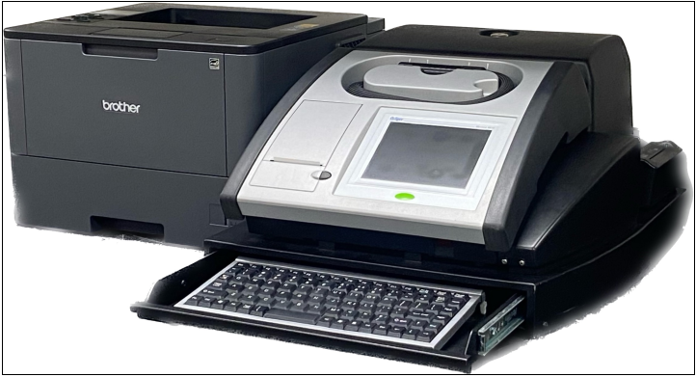
Draeger Alcotest 9510
External
Printer
Internal
Printer
Breath Hose
Scanner
Speaker
Keyboard
Start Button
Display

Slide 11
Draeger Alcotest 9510 BT Technology
Two Breath Samples
Infrared (IR) spectroscopy technology
Electro-chemical cell (EC) technology
Breath Test Measurement
Commonly known as a Fuel
Cell similar to PBTs

Slide 12
MGL C90 s24K
Chemical analysis of the breath of a person CHARGED with a violation of this chapter shall not be considered valid under the provisions of this chapter, unless such analysis has been performed by a certified operator, using infrared breath-testing devices according to methods approved by the Secretary of Public Safety.
1) Certified Operator
2) Infrared Device (Draeger 9510)
3) Approved Methods

Slide 13
MGL C90 s24K continued
Approved Methods:
Test Sequence
One adequate breath sample analysis
One calibration standard analysis
One second adequate breath sample analysis
No use of alcohol-based cleaners
Contact your OIC for cleaning guidance.
Uniform form
Sequential test number

Slide 14
Elements c90 s24
Operation of a Motor Vehicle
Public way
Under the Influence of Alcohol – Two Ways to Prove the Offense…..
With BAC 0.08% or greater (Per Se)
OR
Impairment

Slide 15
Impairment
Still must prove “under the influence”
Diminished capacity to safely operate…
One charge – OUI alcohol
Regardless of BAC level

Slide 16
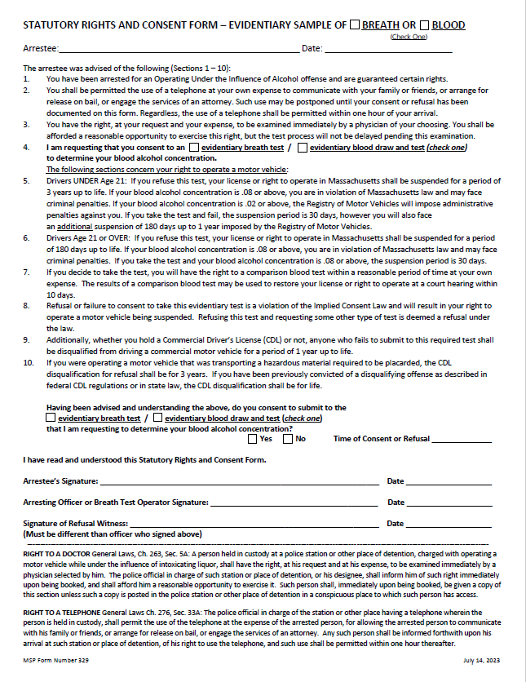
Statutory Rights and Consent Form
This form is required for the administration of a Breath Test or Blood Draw and Test.
The vehicle operator MUST be advised of their rights.
Read all 10 sections of the form to the subject.
Please check to see if you have the most current version of this form. It was revised July 14, 2023.

Slide 17
Statutory Rights and Consent Form
Check the box for the type of evidentiary sample being requested, either Breath or Blood.
The type of evidentiary sample being requested is dependent upon the location of custody, whether it be a hospital or a police station / barracks.

Slide 18
Breath or Blood Test
If the subject is under arrest at a police department and consents.
The evidentiary sample being requested is breath.
If the subject is under arrest at a medical facility for treatment and consents.
The evidentiary sample being requested is blood.
The subject under arrest does not have a statutory right to request a blood test in lieu of a breath test.
This is to be entered as a refusal.

Slide 19
Statutory Rights and Consent Form
John Q. Public
July 16, 2023
Record the Arrestee’s Name
Record the Date

Slide 20
Statutory Rights and Consent Form
John Q. Public
July 16, 2023
Begin reading the form to the Arrestee.
The arrestee was advised of the following (Sections 1 – 10):
You have been arrested for an Operating Under the Influence of Alcohol offense and are guaranteed certain rights.

Slide 21
Right to a Telephone
You shall be permitted the use of a telephone at your own expense to communicate with your family or friends, or arrange for release on bail, or engage the services of an attorney. Such use may be postponed until your consent or refusal has been documented on this form. Regardless, the use of a telephone shall be permitted within one hour of your arrival.

Slide 22
Right to a Telephone
Massachusetts General Laws Ch. 276, Sec. 33A

Slide 23
Right to a Telephone
General Laws Ch. 276, Sec. 33A:
The police official in charge of the station or other place of detention having a telephone wherein a person is held in custody, shall permit the use of the telephone, at the expense of the arrested person, for the purpose of allowing the arrested person to communicate with his family or friends, or to arrange for release on bail, or to engage the services of an attorney. Any such person shall be informed forthwith upon his arrival at such station or place of detention, of his right to so use the telephone, and such use shall be permitted within one hour thereafter.

Slide 24
Right to A Doctor
You have the right, at your request and your expense, to be examined immediately by a physician of your choosing. You shall be afforded a reasonable opportunity to exercise this right, but the test process will not be delayed pending this examination.

Slide 25
Right to A Doctor
General Laws, Ch. 263, Sec. 5A: A person held in custody at a police station or other place of detention, charged with operating a motor vehicle while under the influence of intoxicating liquor, shall have the right, at his request and at his expense, to be examined immediately by a physician selected by him.
The police official in charge of such station or place of detention, or his designee, shall inform him of such right immediately upon being booked, and shall afford him a reasonable opportunity to exercise it.
Such person shall, immediately upon being booked, be given a copy of this section unless such a copy is posted in the police station or other place of detention in a conspicuous place to which such person has access.

Slide 26
Right to a Doctor, cont.
Commonwealth v. Hampe, 419 Mass. 514 (1995) – A police officer’s decision to hold a defendant charged with OUI overnight rather than calling a bail commissioner was inappropriate. A defendant is entitled to obtain a blood test and because evidence is fleeting, time is of the essence.
Commonwealth v. King, 429 Mass. 169 (1999) - The police have no obligation to help him in exercising right. The police are required to afford the defendant a "reasonable opportunity" to exercise right. However, if the bail magistrate fails to conduct a bail hearing promptly this frustrates the defendant's right to an independent medical examination.
Commonwealth v. Mandell, 61 Mass. App. Ct. 526 (2004) - A defendant charged with OUI drugs does not have a right (either statutory or constitutional) to an independent medical exam under G.L. c. 263, §5A.

Slide 27
Request to Consent to an Evidentiary Test
Check the appropriate box for Section 4 and read the correct corresponding statement.
I am requesting that you consent to an evidentiary breath test to determine your blood alcohol concentration.
OR
I am requesting that you consent to an evidentiary blood draw and test to determine your blood alcohol concentration.

Slide 28
Comm. vs Alano, 388 Mass. 871, 448 N.E. 2d 1122 (1983)
Commonwealth v. Alano, 388 Mass. 871, 448 N.E. 2d 1122 (1983). No constitutional or statutory right to a breath test. The police need only inform the defendant of his right to independent examination and allow him access to a telephone.

Slide 29
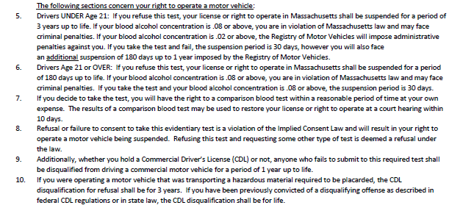
Right to Operate a Motor Vehicle
The following sections concern your right to operate a motor vehicle:

Slide 30
Right to Operate a Motor Vehicle
Drivers UNDER Age 21: If you refuse this test, your license or right to operate in Massachusetts shall be suspended for a period of 3 years up to life. If your blood alcohol concentration is .08 or above, you are in violation of Massachusetts law and may face criminal penalties. If you blood alcohol concentration is .02 or above, the Registry of Motor Vehicles will impose administrative penalties against you. If you take the test and fail, the suspension period is 30 days, however you will also face an additional suspension of 180 days up to 1 year imposed by the Registry of Motor Vehicles.

Slide 31
Right to Operate a Motor Vehicle
Drivers Age 21 or OVER: If you refuse this test, your license or right to operate in Massachusetts shall be suspended for a period of 180 days up to life. If your blood alcohol concentration is .08 or above, you are in violation of Massachusetts law and may face criminal penalties. If you take the test and your blood alcohol concentration is .08 or above, the suspension period is 30 days.

Slide 32
License Suspensions
SUSPENSION | IF 21 OR OVER CLASS D OPERATOR | IF UNDER 21 CLASS D OPERATOR
Refusal Suspension | 180 days or up to life | 3 years or up to life
Fail the Test Suspension | 30 days | 30 days
Additional Suspension | Not Applicable | MGL c90 s24P – 180 days to 1 year

Slide 33
Comparison Blood Test
If you decide to take the test, you will have the right to a comparison blood test within a reasonable period of time at your own expense. The results of a comparison blood test may be used to restore your license or right to operate at a court hearing within 10 days.

Slide 34
Implied Consent Law
Refusal or failure to consent to take this evidentiary test is a violation of the Implied Consent Law and will result in your right to operate a motor vehicle being suspended. Refusing this test and requesting some other type of test is deemed a refusal under the law.
The type of evidentiary test being requested is dependent upon the location of custody, whether it be a hospital or police station / barracks.

Slide 35
Commercial Driver’s License
Additionally, whether you hold a Commercial Driver’s License (CDL) or not, anyone who fails to submit to this required test shall be disqualified from driving a commercial motor vehicle for a period of 1 year up to life.
If you were operating a motor vehicle that was transporting a hazardous material required to be placarded, the CDL disqualification for refusal shall be 3 years. If you have been previously convicted of a disqualifying offense as described in federal CDL regulations or in state law, the CDL disqualification shall be for life.

Slide 36
Commercial Driver’s License
Operating a commercial vehicle
If you stop a CDL motor vehicle and you detect the odor of an alcoholic beverage while you are asking for the driver’s license and registration, you can place the subject out of service per MGL 90F as well as the CFR. SFSTs should then be administered to the operator.

Slide 37
Commercial Driver’s License
Operating a non-commercial vehicle
The 0.04 %BAC threshold for CDL suspension only applies where the CDL operator is driving a commercial vehicle and submits to a required test of breath or blood.
CDL operator refusal
If an operator holds a CDL license and refuses a chemical test, his Class D license is suspended for six months up to life. The operator will face an additional suspension for such refusal as it applies to his CDL license. These suspensions apply whether the subject was operating a commercial vehicle or a non-commercial vehicle.

Slide 38
Consent to Submit to the Evidentiary Test
22:35
Check the box for the type of test being requested, either an “evidentiary breath test” or an “evidentiary blood draw and test”.
Check the “Yes” box if the arrestee consents or check the “No” box if the arrestee refuses to consent.
Record the “Time of Consent or Refusal”.

Slide 39
Consent to Submit to the Evidentiary Test
The arrestee signs and dates that they have read and understood the form and either consent to or refuse the evidentiary test.
The arresting officer or BTO that read the form to the arrestee signs and dates the form.
If the arrestee refuses to consent, a 3rd party must also sign and date the form that they witnessed the Refusal.

Slide 40
Refusal to Answer - Example
A subject is arrested for OUI alcohol and brought back to the station’s booking room. The officer reads the Statutory Rights and Consent form to the subject. When he reaches the section asking the subject to consent to a chemical test, the subject refuses to answer until he can exercise his “right to call an attorney”.
Commonwealth v. Brazelton, 404 Mass. 783 (1989) –
A defendant does not have a constitutional right to confer with his attorney before deciding whether to submit to the test because the moment at which a defendant has to decide to take or refuse the test is not a critical stage in the criminal process.
Commonwealth v. Neary-French, 475 Mass. 167 (2016) –
Reaffirms Brazelton post-Melanie’s Law.

Slide 41
Refusal Witness
An officer must have a witness if the subject refuses the evidentiary test.
This witness can be any party, sworn or civilian, who is present and aware of the refusal.
The RMV and courts require the name of this witness.
The witness must sign and date the Statutory Rights and Consent form and their name will be entered into the Breath Test Instrument by the Breath Test Operator.

Slide 42
Breath or Blood Test
Breath
Blood
Refusal
Sample
Refusal
Sample
MSPCL Toxicology Unit

Slide 43
Administering the BT Test
Breath Test Instrument location
To administer a Breath Test, a certified breath test operator can use the BT instrument at his barracks or department, as well as neighboring agencies upon request.
Your certification and login are valid on any 9510 instrument in Massachusetts

Slide 44
The Main Screen
Instrument designed to be left on at all times.
Push the green button.
6-8 minute “WARM-UP”.

Slide 45
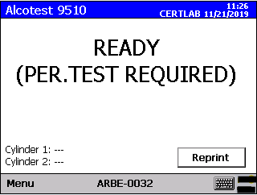
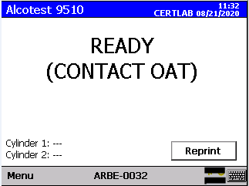
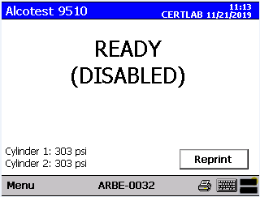
The Main Screen
If “PER. TEST REQUIRED”, “CONTACT OAT”, or “DISABLED” is displayed:
No test can be performed.
Contact OIC.
Transport the subject to neighboring department or barracks to administer breath test and restart the 15 minute observation period again upon your arrival.

Slide 46
Breath Test Sequence
Once the display states “READY,” a breath test can begin.
Push the green button.
Follow the prompts on the touch screen display.

Slide 47
Test Menu
Select 90-24 Arrest to:
Administer an evidentiary breath test to a defendant who has been arrested for Operating a Motor Vehicle Under the Influence of Intoxicating Liquor pursuant to Ch. 90, S. 24.
Report a breath or blood test refusal.
NOTE: This is a “live” breath test; the information IS reported to the RMV.

Slide 48
Operator I.D.’s
Operator IDs can have up to 7 Characters.
Each OIC has a list of operator IDs.
State Police unchanged. Ex- “SP1235” or “SP0143”.
Boston P.D. unchanged. Ex- BP1234 or BP0123.
Local departments-combination of CJIS Agency Code + 4 characters. Ex- “ AUB1234 or AUB12CS”.
Passwords- NO PASSWORD IS REQUIRED. Press enter to skip over password prompt.

Slide 49
Operator ID
Certified Operator: Access to initiate BT and Refusal tests
Enter OAT-issued ID
Leave Password Blank
Uncertified Operator: Access to enter Refusal data only
Select OK Button (not shown) to accept.

Slide 50
Log-In Confirmation
Name: SMITH, DAVID
Department: OAT1
Are you this operator?
Information box validates Breath Test Operator (BTO) identification.
“Are you this operator?”
If “No” – prompt returns to Operator ID and Password “Login”
If “Yes” – Breath Test Operator (BTO) data is auto-populated

Slide 51
Navigation Buttons
Navigation buttons direct the program.
Stop – can be used at anytime to terminate a test
Prev. - scroll back to previous prompt
Summary - directs to review screen
Done – moves onto the next screen
Notice that the keyboard and printer icons are revealed indicating that both are attached and ready.

Slide 52
Case Number
Select “Done” button or “Summary” button.
Optional field
State Police should enter RAMS number.

Slide 53
Uncertified Operator Login
Pursuant to Chap.90 sec.24, any Police Officer, certified or not certified, can enter Refusal data.
Uncertified operators will be required to enter their identifying information.

Slide 54
Uncertified Operator Confirmation
Asks if you are an uncertified operator.
If “No” – uncertified operators need to enter operator information manually
If “Yes” – certified operators should use their operator ID

Slide 55
BTO Summary Screen
Scroll down to review data
Certified BTO: Operator ID info defaults to primary department.
Editable fields, double tap on the item to make the changes.
BTO Phone Number
BTO Department
BTO Department Officer ID Number
Verify auto-populated data and select “Save” button.
Uncertified BTO: Verify manually entered data & select “Save”.

Slide 56
Summary Screens
Selecting “Save” before verifying data activates an information box stating “Please verify all entered data. Scroll down.”

Slide 57
Subject Licensed
Does the arrested subject have a license?
Does not mean “license in possession”.
Check RMV for assigned A or X number.
Includes licenses that are suspended or revoked.

Slide 58
License State
Defaults to Massachusetts.
Drop down box if Out-of-State License.
Touch down arrow on screen.
“Foreign License” and “No License” tabs available
Select letter key (ex: “C” for Connecticut).

Slide 59
Scan MA License
9510 only scans MA Licenses.
MA licenses issued after 2016 will not populate in the BT and the information must be entered MANUALLY.
If an out-of-state license, “Scan” prompt does not appear and data must be entered manually.

Slide 60
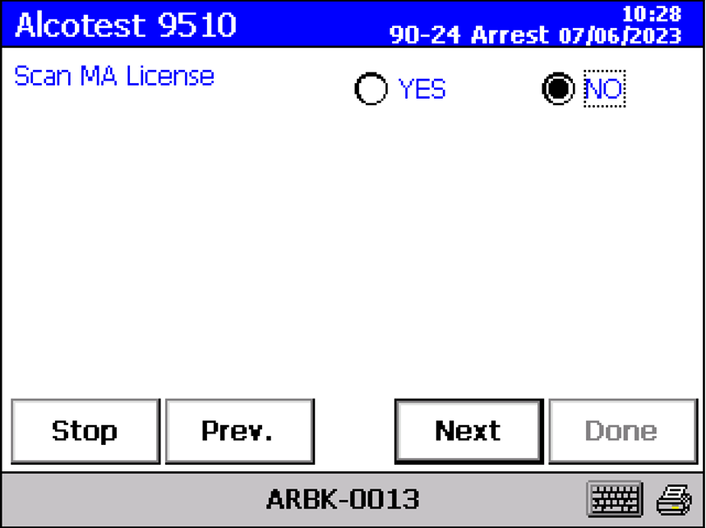
Scan MA License
Once you select “YES” or “NO”, you must press “Next” in order to proceed to the next screen.

Slide 61
Please Scan Driver License
Place the driver’s license in the scanner with the 2D barcode facing the BT.
Pull license out of scanner.

Slide 62
Verifying License Data
Confirm data for accuracy with license.
Hyphenated names are accepted, no corrective action is necessary.
Example: Smith-Jones is acceptable.
To Make Corrections:
Backspace to delete and enter new data manually.

Slide 63
Verifying License Data
Confirm for Accuracy.

Slide 64
Verifying License Data
The non-binary gender code, “X”, is now available on all field instruments. Please select this option when a subject identifies themselves as non-binary.
DOB is still entered as 2 character month; 2 character day; 4 character year (MMDDYYYY).
No need to enter forward slashes (/).

Slide 65
Verifying License Data
Use CURRENT address.
Do not assume address on license is correct.
RMV no longer provides white tape to change address information on back of license.

Slide 66
Verifying License Data
Subject State can be entered using drop down box or entering the letter key to the state desired.

Slide 67
Verifying License Data
This field can be up to 20 characters.
MA licenses limited to 9 characters.
Out of State licenses up to 20 characters.
Check for RMV assigned “S”, “SA”, “A”, or “X” number.

Slide 68
Verifying License Data
Massachusetts “Restricted Hours” licenses.
Not always auto-filled after scanning. Enter information manually.
Example - Restriction “H” (AKA “Cinderella” licenses).
Two additional prompts for Restriction ‘H” that need to be entered manually:
FROM: “HH:MM” (ex. FROM: 08:00) (Military Time)
TO: “HH:MM” (ex. TO: 20:00) (Military Time)

Slide 69
Verifying License Data
If not “D” or “M”, then following prompt will be displayed:

Slide 70
Verifying License Data
If “YES”, then following questions are displayed:
VEH. REQUIRES HAZMAT PLACARD ○ Yes ○ No
OPER. PLACED OUT OF SERVICE ○ Yes ○ No

Slide 71
Operator Placed Out of Service – CDL Vehicle
If “Operator Placed Out of Service” is YES.
Instrument prints “24 Hr. Out of Service” notice upon completion.
If “Operator Placed Out of Service” is NO.
Instrument prints “24 Hr. Out of Service” notice upon completion with any detectable amount of alcohol if “Operating CDL Vehicle” question was answered YES.

Slide 72
Subject Summary
Scroll down verifying data for accuracy.
Once “Save” is selected, no changes can be made.

Slide 73
Public Way
ONE ELEMENT OF THE CRIME
A public way is defined as any street or highway that is open to the public. In addition, a place to which the public has right of access, or any place to which members of the public have access as invitees or licensees.

Slide 74
Operation
ANOTHER ELEMENT OF THE CRIME
Actual Observation – select “YES”
Other Proof of Operation – select “NO”

Slide 75
Arresting Officer’s Observations

Slide 76
Arresting Officer’s Observations
“UNSTEADY ON FEET,” “SLURRED SPEECH,” “GLASSY EYES,” “BLOODSHOT EYES,” “ODOR”
Arresting officer’s observations, NOT BTO’s observation.
Printed in middle portion of “BATS - Completion Record” in the “Breath Test – Arresting Officer Observation Report”.
This is discoverable. Must be included in paperwork provided to ADA.

Slide 77
Arresting Officer’s Observations
Additional “Arresting Officer Observations”.
PBT should be reported in written report.
Last SFST, Pass/Fail and Numerical Result (ex: 0.102).
Report as “Fail” if PBT reading is 0.060% or higher.

Slide 78
Arresting Officer’s Observations
SFST INDICATE IMPAIRMENT
Enter the observed signs of impairment in this field.
SFST indicate impairment
Crossed Dbl Yellow
Marked Lanes Violation
Max. 24 character in this mandatory field.
“Arresting Officer Observation” report is used by RMV Hearings Officers and is subject to scrutiny in a court of law as a discoverable document.

Slide 79
Officer Observation Summary
Scroll down verifying data for accuracy.
Once “Save” is selected, no changes can be made.

Slide 80
Date & Town of Arrest
Confirm for Accuracy.

Slide 81
Arresting Officer
Select “YES”
If Arresting Officer same as BTO.
Officer data will auto-populate.
Select “NO”
If Arresting Officer is NOT the same as the BTO.
Manually enter Arresting Officer’s data.
Be sure to use full proper names.

Slide 82
Arresting Officer

Slide 83
Refusal Consequences
Completing the Statutory Rights and Consent Form satisfies these two prompts.

Slide 84
Arresting Officer Summary
Scroll down verifying data for accuracy.
Once “Save” is selected, no changes can be made.

Slide 85
Test Type
Select “BT Test” to continue with breath test.
Select “Refusal” if subject refuses; then proceed to refusal questions.
REFUSAL TYPE
TOWN OF REFUSAL
DATE OF REFUSAL
REFUSAL WITNESS

Slide 86
Refusal Questions

Slide 87
Refusal Questions
Refusal Witness must be a third party, but can be sworn officer or civilian.
Cannot be Subject Name or Refusal Officer.
The instrument will not allow the witness to be the same as the Refusal officer.

Slide 88
Test Type Summary
Scroll down verifying data for accuracy.
Once “Save” is selected, no changes can be made.

Slide 89
Observation Period
Only select “Yes” if the mandatory 15-minute observation period has occurred.
Remember, there MUST be a 15-minute observation period PRECEDING the breath test.
501 CMR 2.13(3) states “The BTO shall observe the arrestee for no less than 15 minutes immediately prior to the administration of the breath test.”

Slide 90
Observation Period
If the 15 minute observation period has not occurred, select “NO”.
The next screen will ask “Do You Want a 15 Minute Countdown Timer?”.
Select “Yes” and the BT will begin a countdown.
Select “No” and the prompts will then revert back to the “Test Type” screen.
This countdown timer is not reflected on the BT ticket. This event should be reflected in your report.

Slide 91
Observation Period
To document the observation START time, you should:
Use the time located on the display of the BT instrument.
Document it in your written arrest report.
You may use the “Time of Consent or Refusal” from the Statutory Rights and Consent Form but this is not required.

Slide 92
Observation Summary
Remember - the BT does not print the start of the 15 minute observation period. This should be included in the officer’s written report.
Scroll down verifying data for accuracy.
Once “Save” is selected, no changes can be made.

Slide 93
The Observation Period
What is the purpose of the 15 minute observation period?
To allow for the dissipation of mouth alcohol.
501 CMR 2.13(3) further states “If the BTO has reason to believe the arrestee has introduced any item into his or her mouth, the 15 minute observation period shall be restarted.”

Slide 94
The Observation Period
If the observation starts at 21:00, then the BTO can begin the breath test at 21:15.
Although this is true, the seconds are not displayed, so it is best to wait
at least 16 minutes or more to begin the breath test.
Only the BTO who is conducting the Breath Test can enter any data into the BT.
Commonwealth vs Pierre, 72 Mass. App. Ct. 230 (2008), the CMRs which require a BTO to observe the arrestee for fifteen minutes prior to administration of the breath test, does not preclude observation outside the breath testing room prior to being advised of his rights and consenting to take the test.

Slide 95
The Observation Period - Challenges
What if a subject burps loudly 10 minutes into the observation period? Do you start the observation period over or continue?
The observation period shall be restarted.
Remember to document this new time.

Slide 96
Administering the Breath Test
This screen appears when the instrument is READY for a breath test.
Remove hose from storage recess.
Gently insert a new mouthpiece.
Hold the hose for the subject.
It is not recommended that the subject hold the breath hose himself.
This is to protect it from possible damage for the subject who may suddenly decide that the BT instrument is a toy.
Instruct subject to inhale, create and maintain a tight seal around the mouthpiece, then blow.

Slide 97
Changing Minds
If subject REFUSES at this point, select the “STOP” option and process the subject’s refusal.
Commonwealth v. Curley, 78 Mass. App. Ct. 163 (2010) states that the introduction of evidence of a failed breathalyzer attempt by the Commonwealth does not violate a defendant’s right against self-incrimination.
Commonwealth v. Adonsoto 475 Mass. 497 (2016) reaffirmed Curley.

Slide 98
Overview of the Breath Test Sequence
A VALID Breath Test Sequence consists of:
1) air blank test of 0.000%
2) breath sample 1 supplied by subject
3) air blank test of 0.000%
4) calibration check of 0.074% - 0.086%
5) air blank test of 0.000%
6) breath sample 2 supplied by subject
7) air blank test of 0.000%

Slide 99
Breath Sample
Two of the parameters that must be met:
Minimum of 1.5 liters of breath.
Minimum 4.5 continuous seconds of breath.
When the rectangular box is in BOLD, the criteria has been met.
Remove Mouthpiece and only return the mouthpiece when prompted “Please Blow” for the next sample.
It is the officer’s discretion whether or not to replace the mouthpiece in between valid breath samples, but OAT requires that the mouthpiece must always be removed from the breath hose after the individual’s first valid breath test sample. But for each new subject, a new mouthpiece is required.

Slide 100
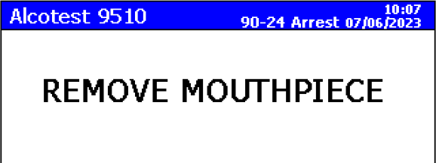
Breath Sample
Remove Mouthpiece and only return the mouthpiece when prompted “Please Blow” for the next sample.
It is the officer’s discretion whether or not to replace the mouthpiece in between valid breath samples, but OAT requires that the mouthpiece must always be removed from the breath hose after the individual’s first valid breath test sample.
For each new subject, a new mouthpiece is required.

Slide 101
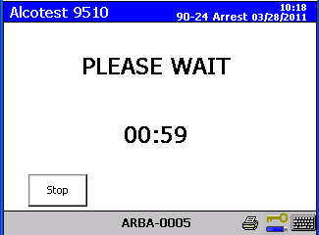
Please Wait
A 60 second countdown after the first sample is initiated to diagnostically ready the instrument for the control standard.

Slide 102
Dry Gas Check
The BT will analyze the control standard during the calibration check.
This utilizes the gas cylinder attached to the BT.
A known alcohol concentration (0.080 %).
This calibration check does not calibrate or adjust the instrument in any way.
The results shall be acceptable if within a range of 0.074%-0.086% as allowed in 501 CMR 2.11(2).

Slide 103
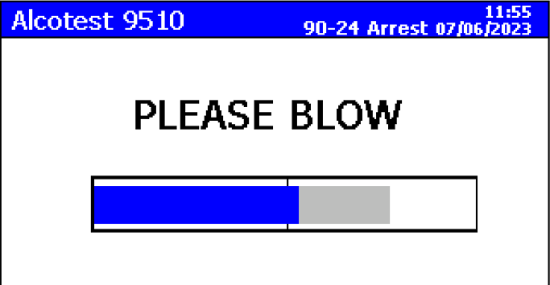
2nd Breath Sample
The grey bar represents the subject’s first breath sample.
When the rectangular box is BOLD, the criteria has been met.

Slide 104
Reportable Value
First breath sample and second breath sample must agree within +/- 0.020 %BAC.
The lower of the two samples will be displayed prior to printout.
Use this result to help answer the prompt “Seized MA License”.

Slide 105
Breath Test Results Summary
0.08 %BAC or above | Per Se Impairment for all operators regardless of age and vehicles.
0.07 %BAC 0.06 %BAC | Probable cause for arrest remains. However, no permissible inference of intoxication. No immediate license loss for operators if over 21 years of age (with the exception of CDL licenses).
Below 0.06 BAC% | No permissible inference of intoxication and released forthwith if OUI Alcohol is the only arrestable charge.
0.04 %BAC or above | Administrative license suspension for CDL operation and CDL vehicle. This applies to the vehicle, not the license. Class D is still active, Class A is not.
0.02 %BAC or above | If operator is under 21 years of age, this will result in an administrative license suspension.

Slide 106
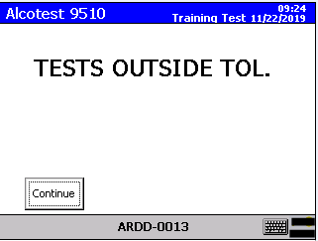
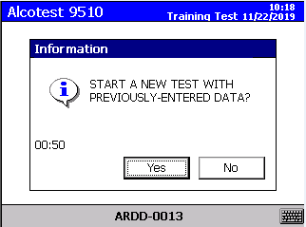
Tests Outside Tolerance
If two samples DO NOT agree within +/- 0.020 %BAC:
“TEST OUTSIDE TOL.” will appear on display briefly and ALSO on the Breath Test Report Form.
The BT will prompt with a question about starting a new test.
Note that the BT retains all the information previously entered.
The observation period does not need to be repeated.
501 CMR 2.14 (4) states “If the sequence…does not result in breath samples that are within ±0.020 blood alcohol content units, a new breath test sequence shall begin.”

Slide 107
ARE THESE TESTS VALID?
Function | SUBJECT 1 | SUBJECT 2 | SUBJECT 3 | SUBJECT 4
Air Blank Test | 0.000 | 0.000 | 0.000 | 0.000
Subject Test 1 | 0.204 | 0.174 | 0.089 | 0.330
Air Blank Test | 0.000 | 0.000 | 0.000 | 0.000
Calibration Check | 0.080 | 0.073 | 0.083 | 0.081
Air Blank Test | 0.000 | 0.000 | 0.000 | 0.000
Subject Test 2 | 0.199 | 0.169 | 0.071 | 0.309
Air Blank Test | 0.000 | 0.000 | 0.000 | 0.000
Notes:
107
DISCUSS SLIDE.
107

Slide 108
Finishing the BT Report
Verifies that the BTO completed the breath test under penalties of perjury.
If this is a “Refusal”, the question would ask:
“Report Prepared By Refusal Officer?”

Slide 109
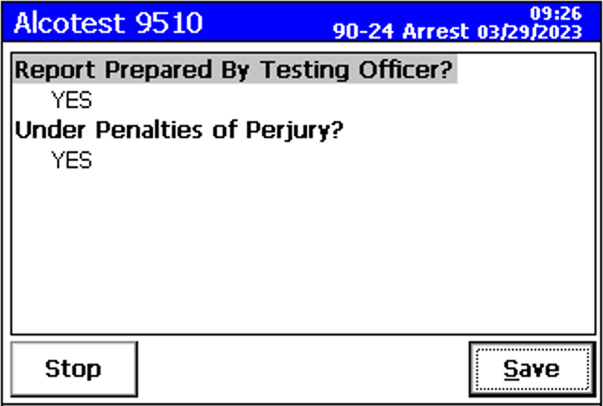
Finishing the BT Report
Once “Save” is selected, no changes can be made and the instrument will continue to the next set of questions.

Slide 110
Seizing Licenses
How do you know if you need to seize the driver’s Massachusetts license?
0.02 %BAC and above | Massachusetts license seized for those under 21 years of age
0.04 %BAC and above | Massachusetts license seized if a CDL operator was driving a CDL vehicle at the time of the alleged offense (but Class D is still active).
0.08 %BAC and above | Massachusetts license seized for everyone licensed in the Commonwealth of MA

Slide 111
Seizing Licenses
20-year-old driver has a test result of 0.034 %BAC.
0.02 %BAC and above | Massachusetts license seized for those under 21 years of age
0.04 %BAC and above but below 0.08% BAC | Massachusetts license seized if a CDL operator was driving a CDL vehicle at the time of the alleged offense (but Class D is still active).
0.08 %BAC and above | Massachusetts license seized for everyone licensed in the Commonwealth of MA
Are they still under arrest?
What happens to their license?

Slide 112
Seizing Licenses
Tractor trailer driver has a test result of 0.058 %BAC.
0.02 %BAC and above | Massachusetts license seized for those under 21 years of age
0.04 %BAC and above but below 0.08% BAC | Massachusetts license seized if a CDL operator was driving a CDL vehicle at the time of the alleged offense (but Class D is still active).
0.08 %BAC and above | Massachusetts license seized for everyone licensed in the Commonwealth of MA
Are they still under arrest?
What happens to their license?

Slide 113
Seizing Licenses
Class B licensed driver driving a Class D vehicle has a test result of 0.057 %BAC.
0.02 %BAC and above | Massachusetts license seized for those under 21 years of age
0.04 %BAC and above but below 0.08% BAC | Massachusetts license seized if a CDL operator was driving a CDL vehicle at the time of the alleged offense (but Class D is still active).
0.08 %BAC and above | Massachusetts license seized for everyone licensed in the Commonwealth of MA
Are they still under arrest?
What happens to their license?

Slide 114
Seizing Licenses
Class B licensed driver driving a Class D vehicle has a test result of 0.072 %BAC.
0.02 %BAC and above | Massachusetts license seized for those under 21 years of age
0.04 %BAC and above but below 0.08% BAC | Massachusetts license seized if a CDL operator was driving a CDL vehicle at the time of the alleged offense (but Class D is still active).
0.08 %BAC and above | Massachusetts license seized for everyone licensed in the Commonwealth of MA
Are they still under arrest?
What happens to their license?

Slide 115
Seizing Licenses
Anyone driving a Class D vehicle has a test result of 0.095 %BAC.
0.02 %BAC and above | Massachusetts license seized for those under 21 years of age
0.04 %BAC and above but below 0.08% BAC | Massachusetts license seized if a CDL operator was driving a CDL vehicle at the time of the alleged offense (but Class D is still active).
0.08 %BAC and above | Massachusetts license seized for everyone licensed in the Commonwealth of MA
Are they still under arrest?
What happens to their license?

Slide 116
Seize MA License
When do you seize an MA License?
0.08 %BAC or higher for all operators.
0.04 %BAC or higher but below 0.08 %BAC for a CDL driver only if he was driving a commercial vehicle at the time of the alleged offense.
0.02 %BAC or higher for all operators under 21.
What do you do with the seized license?

Slide 117
Seizing Licenses
The Registry of Motor Vehicles (RMV) has granted the authority to Local and State Police to destroy “MASSACHUSETTS” licenses and dispose of them whenever a “Notice of Suspension for a Chemical Test Failure or Refusal ” has been issued by the Police.
Do NOT Seize or Destroy Out-of-State licenses!

Slide 118
12 Hour Vehicle Impound
Pursuant to General Laws Ch. 90, Sec. 24 (f) (1):
“If a person refuses to take a test under this paragraph, the police officer shall:
(iii) impound the vehicle being driven by the operator and arrange for the vehicle to be impounded for a period of 12 hours after the operator's refusal, with the costs for the towing, storage and maintenance of the vehicle to be borne by the operator.”

Slide 119
Citation and Tracking Numbers
OPTIONAL FIELDS. If you don’t have the information, move on and complete the Breath Test or Refusal.
To be used to assist in linking separate forms.
OBTN – Offender Based Tracking Number

Slide 120
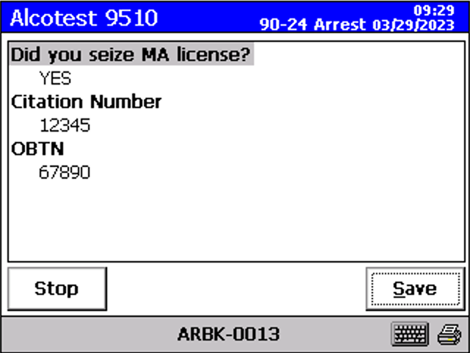
Summary Screen
Once “Save” is selected, no changes can be made and the Breath Test Report will print.

Slide 121
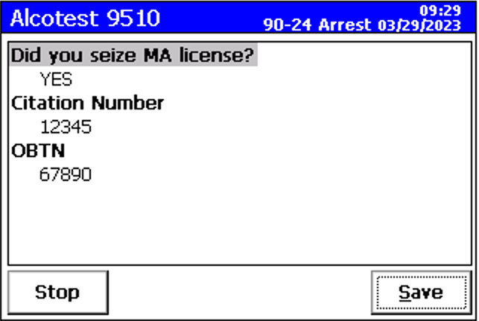
Blank Fields
PLEASE NOTE: If the instrument is left idle for 25 minutes during any of these 5 questions before selecting “Save”, the instrument will time out. The documents will then print and the information will be transmitted but the answers to the questions you have not saved will be blank.

Slide 122
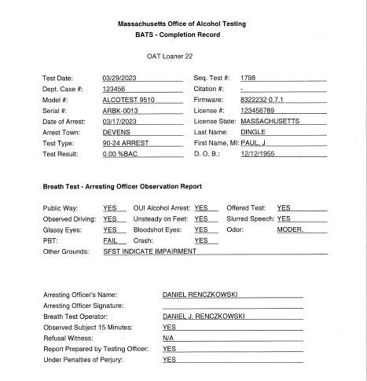
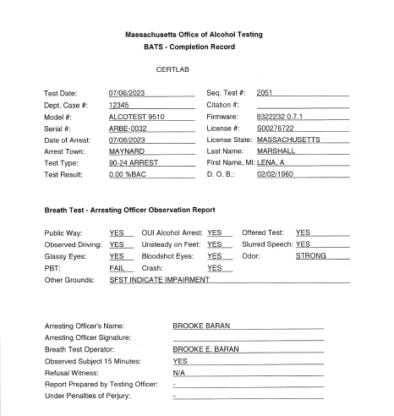
Blank Fields
The answers to the two RMV questions now appear on the BATS – Completion Record and will appear as either “Yes” if the summary screen was saved or as “-” if the data was not saved.

Slide 123
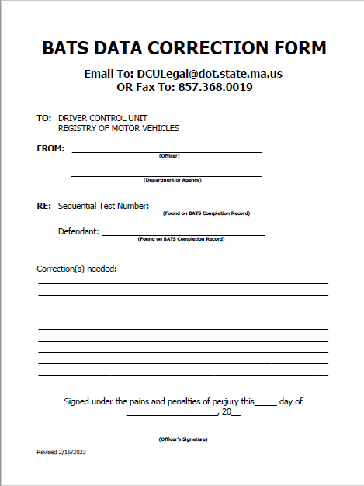
BATS Data Correction Form
25 Minute Timeouts
If you are aware of a time out during any of these 5 questions, fill out a BATS Data Correction Form.
Email or fax the Form directly to the RMV.
Forward any BATS Data Correction Forms to the prosecuting agency.

Slide 124
Printing
A prompt will appear: “Printout Complete?”
This prompt should be answered, but if it is not, then the sequence will still complete automatically.
Check the printed documents for accuracy as well as to ensure the results COMPLY with the current CMRs.
If a notice of suspension has printed, it must be served in hand forthwith.

Slide 125
Printer Problems
If a printer problem exists
Box will display “Check Printer, Paper, Toner, and Cables. Then Press OK.”
Follow the instructions to try and remedy the problem.
After 3rd failed attempt:
Box will display “External Printout Failed. See Internal Printout.”
In this case, use the “Reprint” tab on the initial “Ready” screen.

Slide 126
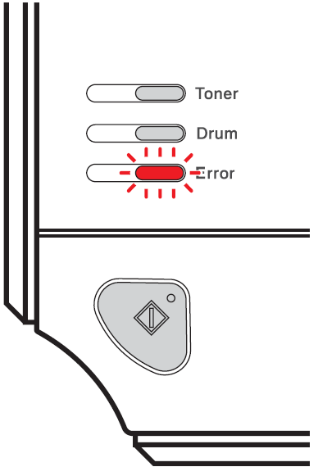
Printer Out of Paper
Error light flashing
Paper Jam
Error light solid
Out of paper
Add paper or remove jam
Press the go button to ready printer, then reprint if needed.

Slide 127
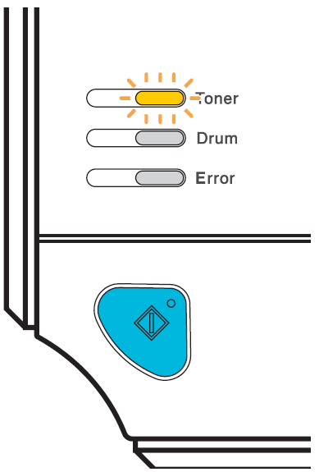
Printer Low on Toner
Toner light flashing
Running low on toner
Advise OIC to replace toner
Toner light solid
Out of toner
Blank paper has come out of printer
Replace toner immediately and reprint

Slide 128
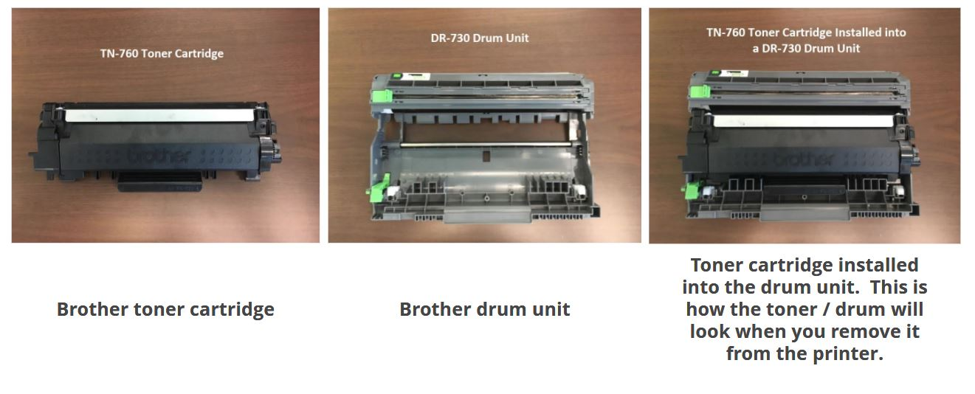
Replacing Toner
Replace
KEEP

Slide 129
Reprint Function
Circumstances that may require use of the REPRINT function.
An officer needs to retrieve a past test or Power Loss.
An officer encounters a printer problem after completing the test.
An OIC needs statistics on an officer.
Power Loss tests do not automatically print. The BTO must go into the Reprint function and reprint the test manually to include with your report.

Slide 130
Reprint Function
The BT can only hold a certain number of tests in its memory and may be cleared during the annual certification at OAT or during repair.
Do NOT wait to reprint!

Slide 131
Retrieving and Reprinting Breath Test Records
Press “Reprint” to print tests.
Highlight desired test type from drop down box.

Slide 132
Records Can Be Retrieved One of Three Ways
Records can be retrieved by:
Entering in the record number (Sequential Test Number)
Search Text (BTO name, subject data, or any other text)
General Search

Slide 133
Records Retrieved Entering Record Number (Sequential Test Number)
Enter Sequential Test Number
Select “Print”
A copy of the selected test will be printed

Slide 134
Records Retrieved Using Search Text
Enter the following:
BTO Name (or)
Subject Data (or)
Any key text related to the test record
A list of all tests with the entered text will appear on the screen

Slide 135
Records Retrieved Using Search by Text
Highlight the desired record number you wish to retrieve.
Select “Save”
The record number will auto-populate.
Select “Print”

Slide 136
Records Retrieved By General Search
Select “Search” to display all breath test records.
A list of saved breath test records will appear on the screen.

Slide 137
Records Retrieved By General Search
HIGHLIGHT the desired record number you wish to retrieve.
Select “Save”
The record number will auto-populate.
Select “Print”

Slide 138
Mistries
When the BT is unable to analyze a breath sample due to how the subject is blowing, it is referred to as a mistry.
When a mistry occurs, the BT will ask for another sample.
Mistries are not recorded on the Breath Test Report Form.
Message codes that are mistries:
“Blowing Time Too Short”
“Blowing Not Allowed”
“Minimum Volume Not Achieved”
The officer should note these in the report.

Slide 139
Alcohol in Ambient Air
If there is a source of alcohol in the vicinity of the BT, the BT will sense it and this message may occur.
Example – hand sanitizer
Ventilation is the best recourse.
Once the air around the BT is cleared, conduct a new test.
A new 15 minute observation is not required.

Slide 140
Calibration Standard Failure
This message occurs when the control standard is outside of the acceptable range.
Review the Breath Test Report Form control standard result to confirm.
A Periodic Test will be required.
If the OIC is unavailable, you must utilize another BT at a nearby police department or barracks.
A new 15 minute observation must occur if this period has been interrupted.

Slide 141
Interferent Detected
A common cause for this status message can be a range disparity between the IR and the Fuel Cell.
Retest the subject on the same BT instrument.
It may take 15 minutes or more for the interfering substance to dissipate.
If an interferent is detected again, utilize another BT at a nearby police department or barracks.
A new 15 minute observation must occur if direct observation has been interrupted.

Slide 142
Mouth Alcohol
An additional 15 minute observation period must be observed before retesting the subject.
This allows for the dissipation of mouth alcohol.
The new observation period must begin utilizing the time recorded for the last test on the BT Ticket with the Mouth Alcohol status message.

Slide 143
Cal Gas Supply
Both gas cylinders may be empty or not installed properly.
You must contact your OIC.
If your OIC is not available, utilize another BT at a nearby police department or barracks.
A new 15 minute observation must occur if direct observation has been interrupted.

Slide 144
Data Transfer
The Breath Test Instrument transmits the data promptly to CJIS and the RMV when the breath test sequence is complete.
Look for the “Outgoing Message” screen, as it is an important notification.

Slide 145
Data Not Transmitted
If the data has not transmitted in approximately 1.5 minutes, a “BATS Data Not Transmitted” fax sheet will print out.
Complete and fax this form with corresponding documentation for this Breath Test to OAT’s fax number listed or email the documents to OATnotifications@mass.gov.

Slide 146
Breath Test Documents BATS – Completion Record
Chap.90 sec.24K
Uniform Forms
Sequentially Numbered
“Arresting Officer Observation Report”
Arresting Officer and/or BTO name and information
List of Associated Documents
Ensure this BATS completion corresponds to the observations in your written report as it may be scrutinized in a court of law.

Slide 147
Breath Test Report Form
Only the BTO may sign the report.
Time indicated in Breath Sequence Details is when the instrument completed its IR measurement.
Subject Result
Subject Refusal

Slide 148
Notice of Suspension for a Chemical Test Failure and Refusal

Slide 149
Data Transmission
Run a “KQ” the next business day.
If the subject’s license was suspended, no further action is necessary.
If it has not been suspended, contact OAT with the following documentation:
BATS Completion
Record
Breath Test Report Form
Either a Subject Test
or Refusal

Slide 150
BATS Data Correction Form
Any Administrative Changes
Fill out the BATS Data Correction Form.
Email or fax the Form directly to the RMV.
Remember, the BT documents will not change, only the information maintained in the Registry will.
Forward any BATS Data Correction Forms to the prosecuting agency.

Slide 151
The Two Factors For Determining Under the Influence of Alcohol
Impairment – you need to prove that there was a diminished capacity to safely operate a vehicle
AND/OR
≥ 0.080 %BAC – greater than or equal to 0.080 %BAC is the per se level of impairment
There can be only one charge of OUI alcohol even if both diminished capacity and BAC of 0.080% or greater exist.

Slide 152
Do You Know?
MGL c90 s24 paragraph (1)(e) states that the “…evidence of the percent, by weight, of alcohol in the defendant’s blood at the time of the alleged offense, as shown by chemical test or analysis of his blood or… of his breath, shall be admissible and deemed relevant to the determination” of the subject’s guilt or innocence.

Slide 153
Comm. vs Colturi, 448 Mass. 809 (2007)
Commonwealth v. Colturi, 448 Mass. 809 (2007) - Where the Commonwealth proceeds on a per se theory of operating under the influence, prosecutors are not required to present expert testimony on retrograde extrapolation to admit a breath test if the test was given within 3 hours of arrest.
SJC Ruling: April 19, 2007 – Breath tests are admissible within a reasonable time of the operation. Reasonable time is defined as up to three (3) hours.

Slide 154
What does the ADA needs from YOU?
The Three Documents…
Statutory Rights and Consent Form
Proves Defendant Consented
BATS - Completion Record
Officer’s Observation Report is DISCOVERABLE
Breath Test Report Form
Instrument / Operator Certified
Breath Test is VALID

Slide 155
Documentation
All documents may be requested by investigating agencies including the DA’s Office
Statutory Rights and Consent Form
BATS Data Correction Form
Notice of Suspension for Chemical Test Failure
Notice of Suspension for Chemical Test Refusal
Breath Test Report Form (including Power Loss tests)
Periodic Test Reports (maintained by your department’s Officer in Charge)
Any and all Breath Test reports resulting in status messages
(i.e. Mouth Alcohol)

Slide 156
Review
What are the three situations that require entering data into the BT instrument every time?
A breath test
A breath test refusal
A blood test refusal
A blood test is NEVER entered into the BT instrument!

Slide 157
Blood Test Refusal
Advise the subject of the Statutory Rights and Consent Form in its entirety at the medical facility.
Record the subject’s refusal with his/her/their signature and yours on the Statutory Rights and Consent Form.
Have a third party individual, sworn or civilian, witness the Refusal and sign the Statutory Rights and Consent Form.
Process the subject’s blood test refusal on a BT instrument.
Serve the subject with the Notice of Suspension.
Remember – the officer entering the blood test refusal into the BT instrument does not have to be the arresting officer. They can be any sworn officer, BTO certified or uncertified.

Slide 158
Entering Blood Test Refusal Information
.
Place of Refusal
Should contain a city or town
Example – “Mass. Gen. Boston”
Date of Refusal
Use the date format MM/DD/YYYY
Refusal Officer
Example “Tpr David Smith”
Refusal Witness
Type in the witness’s name
This is the third-party individual’s name that witnessed the refusal

Slide 159
Blood Test at Hospital
Under Arrest, at Medical Facility, Charged with OUI Alcohol c90-s24, and Consents to an Evidentiary Blood Draw and Test.
Medical conditions that exempt a subject from a blood test:
Hemophilia
Diabetics
Condition Requiring Anticoagulants
Blood Drawn at the Direction of a Police Officer by: MD, RN, or CMT.

Slide 160
Blood Draw Guidelines
MD, RN, or CMT should prep the arm with a NON-Alcohol swab.
Two (2) tubes of blood containing a powdered anticoagulant and a preservative are recommended by the Crime Laboratory.
AVOID using RED stopper test tubes! They do not contain anticoagulants.
Shake test tubes to activate the anticoagulant.
Refrigerate (not freeze!) the blood samples at the station in a refrigerated evidence locker.
When transporting to the Crime Laboratory, ensure they remain chilled.
Make sure the chain of custody is documented.
Notify the ADA for arraignment to reserve a 90-24N hearing pending the blood test results.

Slide 161
Submittal Process to Crime Laboratory
You must call to make an appointment to drop off evidence.
Sudbury 508-358-3155
Danvers 978-538-6111
Springfield 413-205-1837
Lakeville 508-946-1310
The Toxicology Unit will then analyze the sample.
Questions? Contact the Toxicology Unit at
857-377-3010.

Slide 162
Serum Conversions
Medical records are introduced by the ADA at trial and contain a serum or plasma alcohol level.
After 24N Hearing elements have been met.
Crime Laboratory Forensic Scientists can convert serum or plasma alcohol levels into blood alcohol levels.
Usually happens because of a motor vehicle accident and operator was hospitalized.
DA’s office summons hospital for medical records and requests the conversion from the MSPCL Toxicology Unit.

Slide 163
Other Examples
Subjects arrested for OUI and being treated at a medical facility licensed under MGL c. 111 § 51 may be offered an opportunity to submit to a blood test in lieu of a breath test.
Prior to the drawing of a subject’s blood, the subject’s consent must be obtained in writing. Where a subject’s blood was previously drawn independently by a hospital, the subject’s consent must still be obtained prior to sending the sample for analysis. Commonwealth v. Moreau, 490 Mass. 387 (2022).
A warrant may be obtained to draw and/or analyze the blood of a person being investigated for homicide by motor vehicle (G.L. c. 90, s. 24G), serious bodily injury by motor vehicle while under influence (G.L. c. 90, s. 24L), or manslaughter (G.L. c. 265, ss. 13 & 13 1/2).

Slide 164
OUI Drugs and Considerations
No Statutory Rights and Consent Form is issued to an operator charged with OUI Drugs only.
Statutory Rights and Consent Form is for an operator in custody charged with OUI alcohol.
DREs (Drug Recognition Experts) can be consulted.
For MSP, the detainee must be under arrest for OUI in order to request a DRE evaluation as per TRF-14.
If appropriate, “Immediate Threat Form” 90-22(a).
If appropriate, consider additional charges such as negligent operation.

Slide 165
OUI Alcohol and Drugs
Comm. vs Stathopoulos, 401 Mass 453 (1988)
A defendant may be found guilty of driving under the influence of intoxicating liquor if the defendant’s ability to operate a vehicle safely is diminished, and alcohol is one contributing cause. It does not have to be the sole or exclusive cause.

Slide 166
Immediate Threat
M.V. Homicide c.90 s.29
Under 90-29, the operator shall be suspended unless the preliminary investigation indicates one or more operators are not at fault.
Medical Condition c.90 s.22
A medical condition that inhibits driving such as epilepsy.
Disregard for Public Safety c.90 s.22
For example, pursuits.
Criminal Complaint c.90 s.22
For example, a person who has been taken to a medical facility for treatment and is not in custody.

Slide 167
Immediate Threat Form and Medical Evaluation Form

Slide 168
Office of Alcohol Testing
Any questions or concerns from officers regarding the Alcotest 9510 should be directed to the Office of Alcohol Testing at 857-377-3030.

