Slide 1
Brief Surveillance Data Overview of Sexually Transmitted Infections, Massachusetts,
2000-2024
Notes:
Picture description: logo for the Massachusetts Department of Public Health

Slide 2

Outline
Sexually Transmitted Infection (STI) Trends and Descriptions:
General STI Trends Through 2024
Chlamydia
Gonorrhea
Infectious syphilis

Slide 3
Massachusetts STI Trends
Chlamydia: 2000 - 2024
Notes:
Picture description: logo for the Massachusetts Department of Public Health

Slide 4
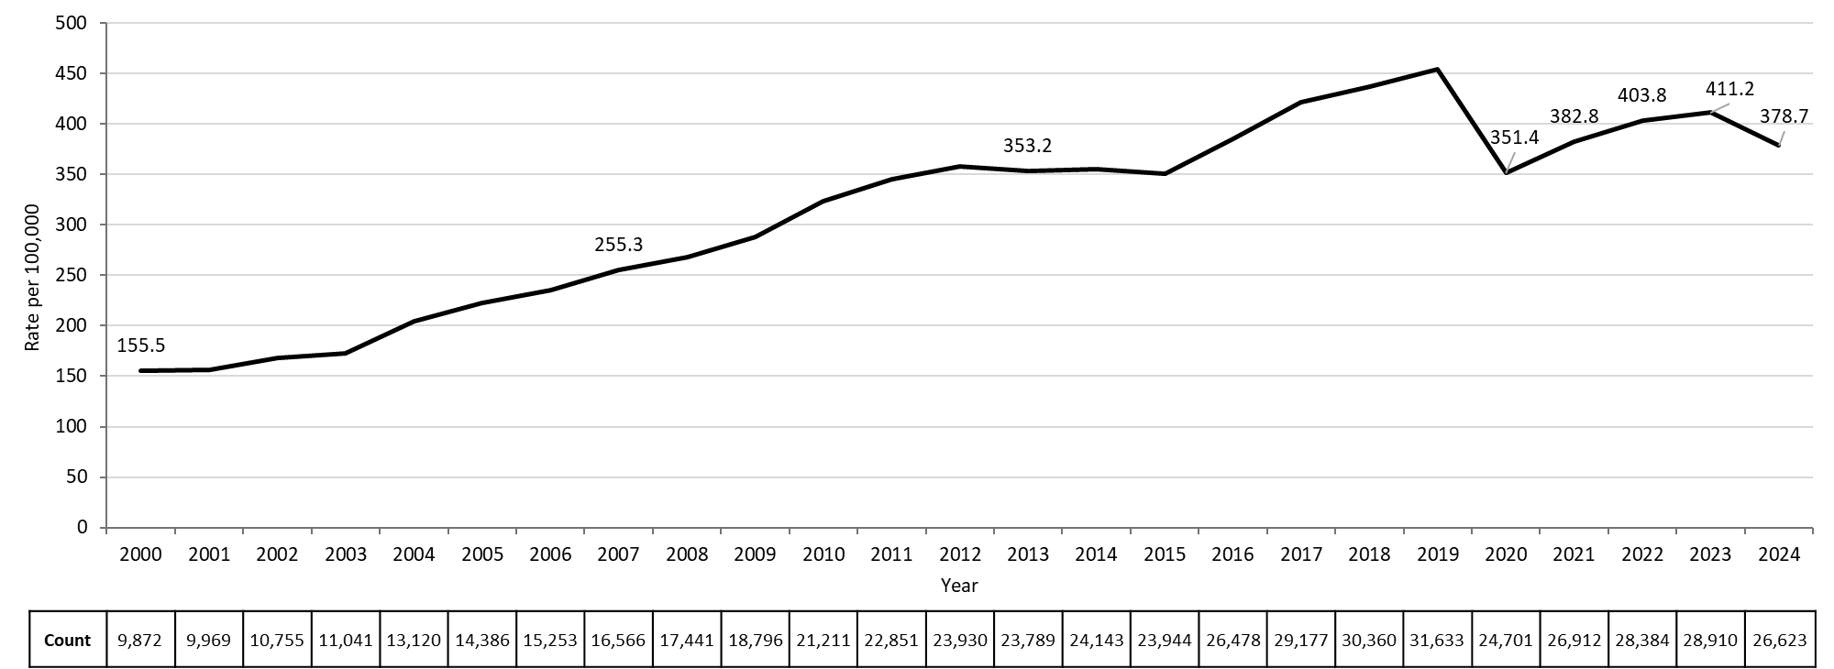
Rate of Confirmed Chlamydia Cases, Massachusetts, 2000-2024¹
Data are current as of 06/02/2025 and are subject to change.
Data Source: Massachusetts Department of Public Health/Bureau of Infectious Disease and Laboratory Sciences/ Division of STD Prevention and HIV Surveillance.
Population denominators estimated by the University of Massachusetts Donahue Institute using a modified Hamilton-Perry model (Strate S, et al. Small Area Population Estimates for 2011 through 2020 report, Oct 2016).
1. Please consider the impact of the COVID-19 pandemic on infectious disease screening, treatment and surveillance in the interpretation of 2020-2023 data.
Notes:
Rate of Confirmed Chlamydia Cases, Massachusetts, 2000 to 2024
Graph depicts the rate per 100,000 population of confirmed cases of chlamydia in Massachusetts between 2000 and 2024. It begins at low of 155.5 in 2000 and then climbs to a high of 454.1 in 2019. It drops to 382.8 in 2021, followed by a rise to 411.2 in 2023, and another drop to 378.7 in 2024.

Slide 5
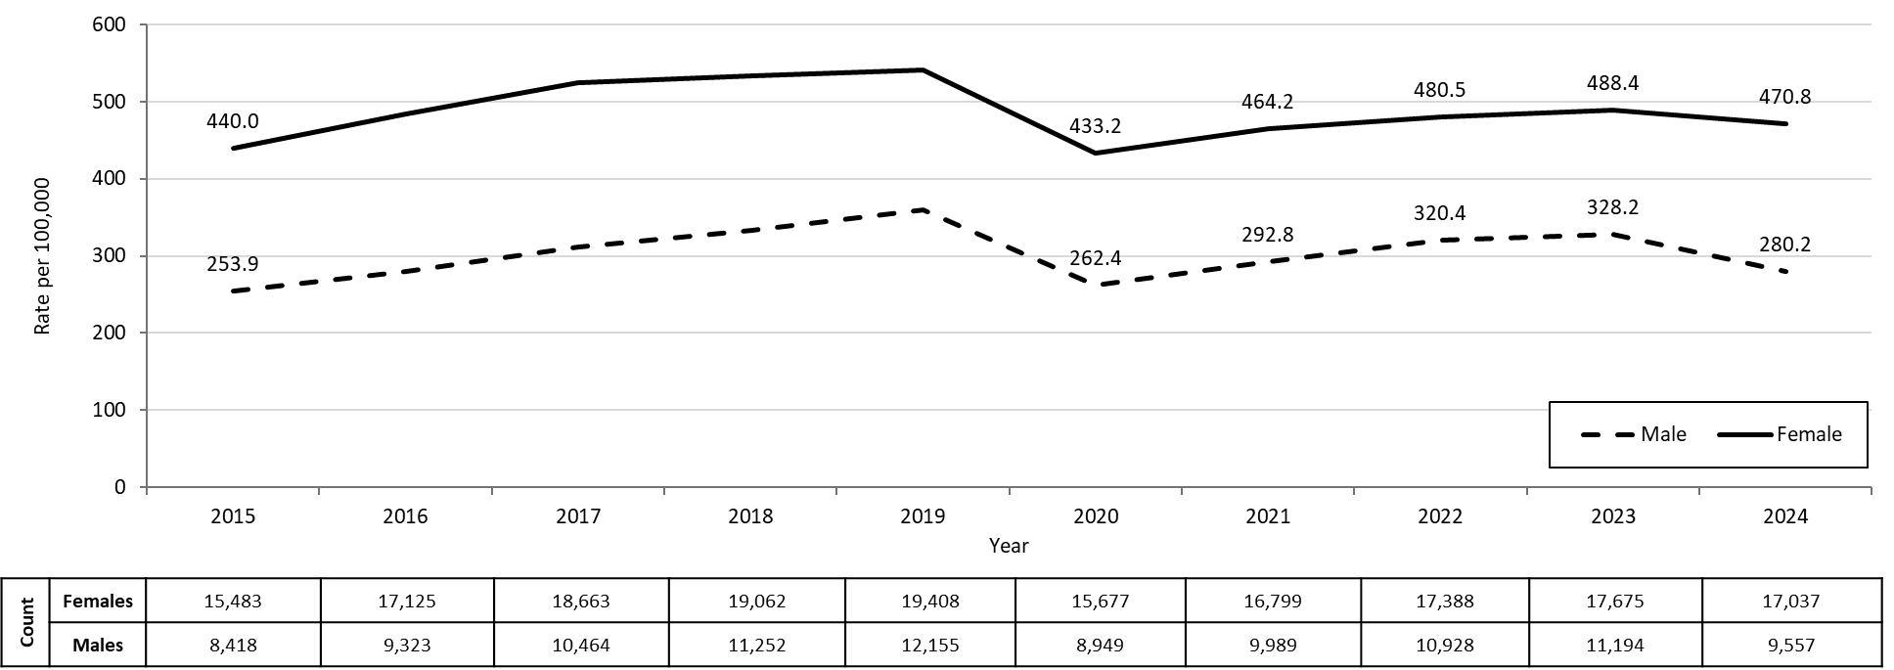
Confirmed Chlamydia Rates by Gender¹, Massachusetts, 2015 to 2024²
Data are current as of 06/02/2025 and are subject to change.
Data Source: Massachusetts Department of Public Health/Bureau of Infectious Disease and Laboratory Sciences/ Division of STD Prevention and STD-HIV Surveillance.
Population denominators estimated by the University of Massachusetts Donahue Institute using a modified Hamilton-Perry model (Strate S, et al. Small Area Population Estimates for 2011 through 2020 report, Oct 2016).
1. In 2024, there were 9 individuals of transgender experience reported in our data system who do not have current gender documented. These cases were excluded since population estimates for individuals of transgender experience are not available at this time. There were 17 other individuals with unknown gender which are not included in this slide.
2. Please consider the impact of the COVID-19 pandemic on infectious disease screening, treatment and surveillance in the interpretation of 2020-2023 data.
Notes:
Confirmed Chlamydia Rates by Gender, Massachusetts, 2010 to 2024
Graph depicts the rates per 100,000 population of chlamydia in Massachusetts by gender identity between 2012 and 2024. There are two lines, one for females that begins at 437.6 in 2010 and climbs to 541.5 in 2019 and another for males that begins at 201.9 in 2010 and climbs to 359.4 in 2019. In 2024, females had a rate of 470.8 and males had a rate of 280.2.
Note: There were cases reported among transgender individuals in 2014 through 2024. In 2024, there were 9 cases of chlamydia among transgender identified individuals and 17 other individuals with unknown gender not included on this slide.

Slide 6
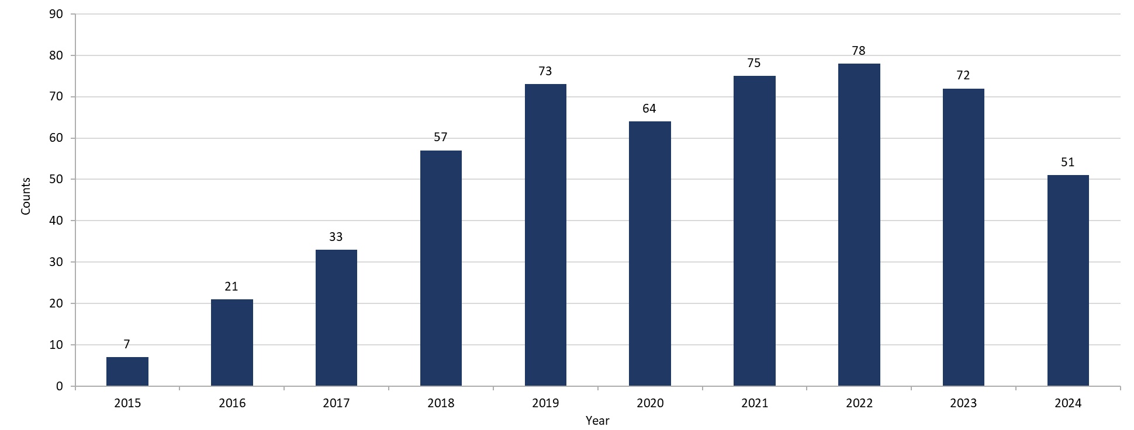
Chlamydia Among Individuals of Transgender Experience,^{1, 2} Massachusetts, 2015-2024³
Data are current as of 06/02/2025 and are subject to change.
Data Source: Massachusetts Department of Public Health/Bureau of Infectious Disease and Laboratory Sciences/ Division of STD Prevention and HIV Surveillance.
1. Prior to 2015 MA DSTDP was not able to capture expanded gender identity including individuals of transgender experience within our data system.
2. All individuals of transgender experience are included in this graph regardless of current gender.
3. Please consider the impact of the COVID-19 pandemic on infectious disease screening, treatment and surveillance in the interpretation of 2020-2023 data.
Notes:
Chlamydia Among Individuals of Transgender Experience, Massachusetts, 2015 to 2024
Graph shows the number of chlamydia cases among transgender individuals in Massachusetts between 2015 and 2024. The case counts 7, 21, 33, 57, 73, 64, 75, 78, 72, and 51 for 2015, 2016, 2017, 2018, 2019, 2020, 2021, 2022, 2023, and 2024, respectively.

Slide 7
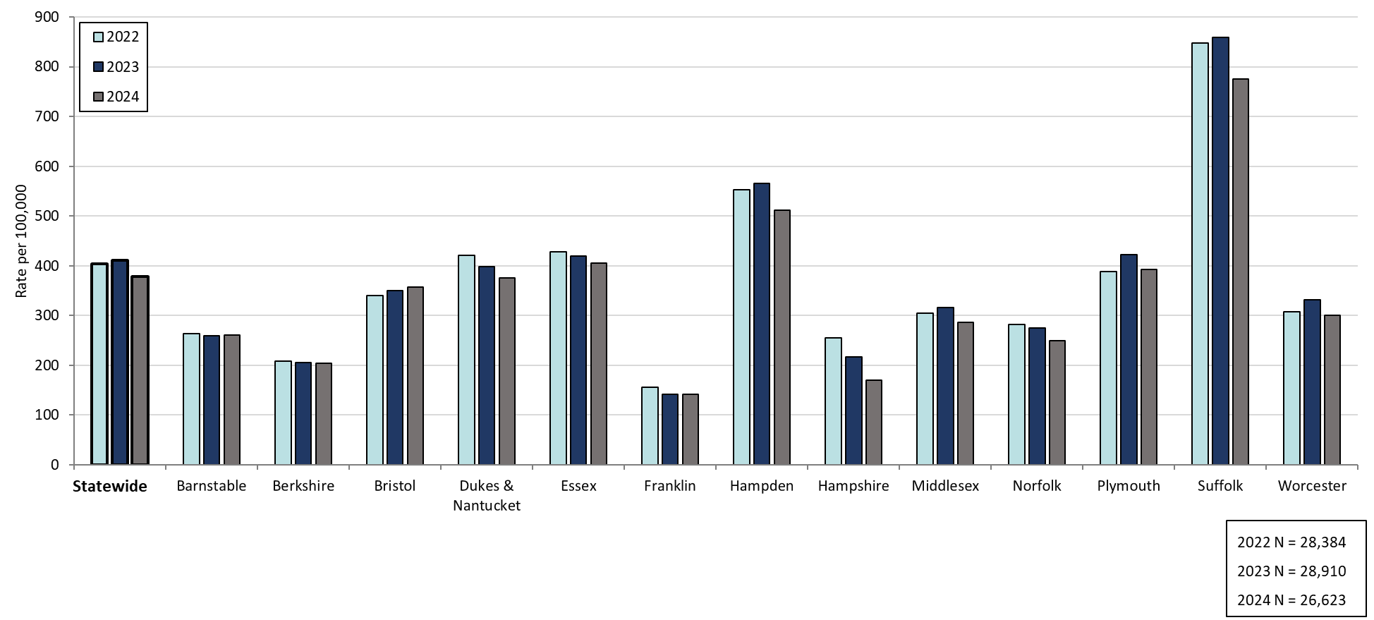
Confirmed Chlamydia Rates by County and Statewide, Massachusetts, 2022-2024¹
Data are current as of 06/02/2025 and are subject to change.
Data Source: Massachusetts Department of Public Health/Bureau of Infectious Disease and Laboratory Sciences/ Division of STD Prevention and HIV Surveillance.
Population denominators estimated by the University of Massachusetts Donahue Institute using a modified Hamilton-Perry model (Strate S, et al. Small Area Population Estimates for 2011 through 2020 report, Oct 2016).
1. Please consider the impact of the COVID-19 pandemic on infectious disease screening, treatment and surveillance in the interpretation of 2020-2023 data.
Notes:
Confirmed Chlamydia Rates by County and Statewide, Massachusetts, 2022-2024
Graph depicts rate per 100,000 population of chlamydia cases reported in Massachusetts by county comparing 2022 through 2024. The rate in 2024 is highest in Suffolk county with a rate of 776.0 followed by Hampden county with a rate of 511.1. The lowest rates were in Franklin and Hampshire county.

Slide 8
Gonorrhea: 2000 - 2024
Massachusetts STI Trends
Notes:
Picture description: logo for the Massachusetts Department of Public Health

Slide 9
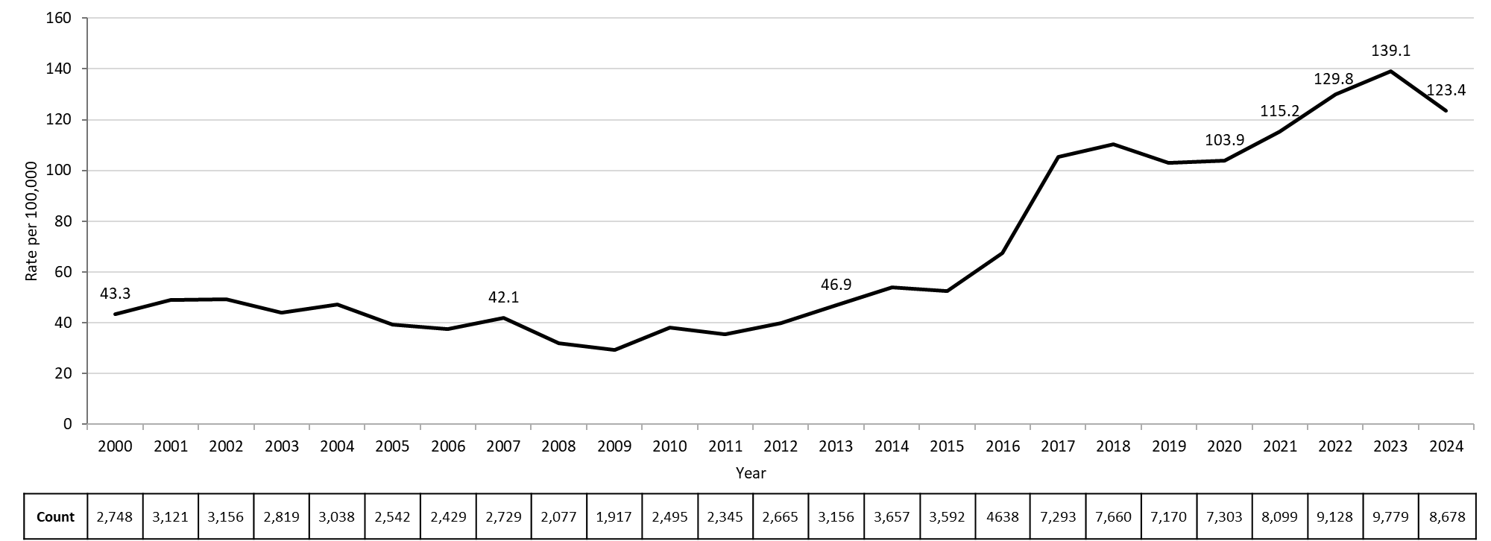
Rate of Confirmed Gonorrhea Cases, Massachusetts, 2000-2024¹
Data are current as of 06/02/2025 and are subject to change.
Data Source: Massachusetts Department of Public Health/Bureau of Infectious Disease and Laboratory Sciences/ Division of STD Prevention and HIV Surveillance.
Population denominators estimated by the University of Massachusetts Donahue Institute using a modified Hamilton-Perry model (Strate S, et al. Small Area Population Estimates for 2011 through 2020 report, Oct 2016).
1. Please consider the impact of the COVID-19 pandemic on infectious disease screening, treatment and surveillance in the interpretation of 2020-2023 data.
Notes:
Rate of Confirmed Gonorrhea Cases, Massachusetts, 2000 to 2024
Graph depicts the rate per 100,000 population of confirmed cases of gonorrhea in Massachusetts between 2000 and 2024. It begins at 43.3 in 2000, drops to a low of 29.4 in 2009 and climbs to a high of 139.1 in 2023, followed by a drop to 123.4 in 2024.

Slide 10
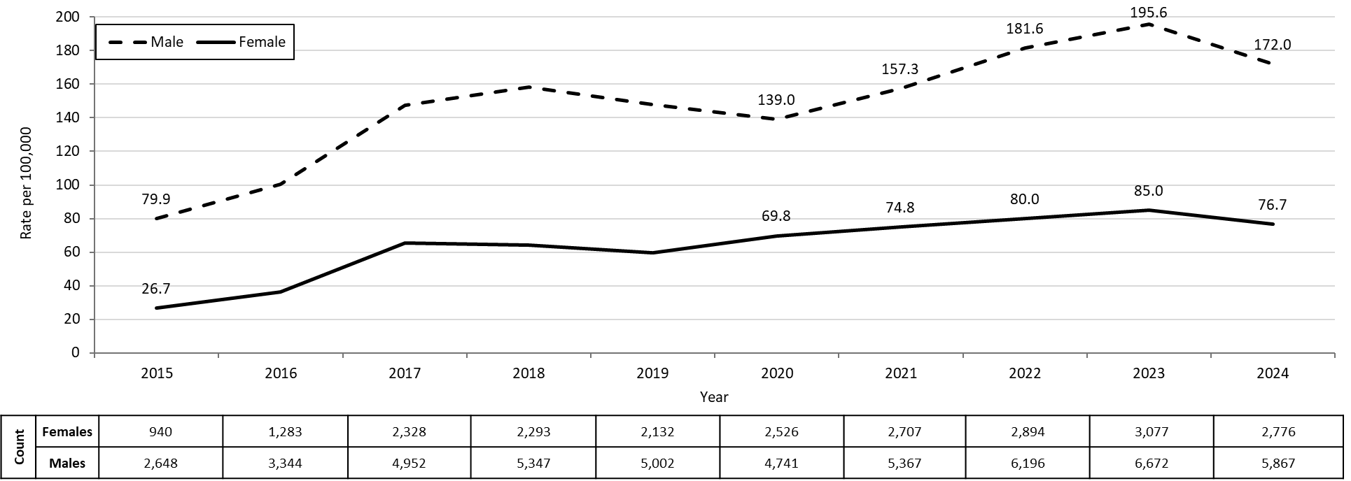
Confirmed Gonorrhea Rates by Gender¹, Massachusetts, 2015-2024²
Data are current as of 06/02/2025 and are subject to change.
Data Source: Massachusetts Department of Public Health/Bureau of Infectious Disease and Laboratory Sciences/ Division of STD Prevention and STD-HIV Surveillance.
Population denominators estimated by the University of Massachusetts Donahue Institute using a modified Hamilton-Perry model (Strate S, et al. Small Area Population Estimates for 2011 through 2020 report, Oct 2016).
1. In 2024, there were 26 individuals of transgender experience reported in our data system who do not have current gender documented. These cases were excluded since population estimates for individuals of transgender experience are not available at this time. There were 9 other individuals with unknown gender which are not included in this slide.
2. Please consider the impact of the COVID-19 pandemic on infectious disease screening, treatment and surveillance in the interpretation of 2020-2023 data.
Notes:
Confirmed Gonorrhea Rates by Gender, Massachusetts, 2010 to 2024
Graph depicts the rates per 100,000 population of confirmed cases of gonorrhea in Massachusetts by gender identity between 2010 and 2024. There are two lines, one for females that begins at 29.9 in 2010 and climbs to 76.7 in 2024 and another for males that begins at 46.8 in 2010 and climbs to 172.0 in 2024.
Note: There were cases reported among transgender individuals in 2014 through 2024. In 2024, there were 26 cases of gonorrhea among transgender identified individuals and 9 other individuals with unknown gender not included on this slide.

Slide 11
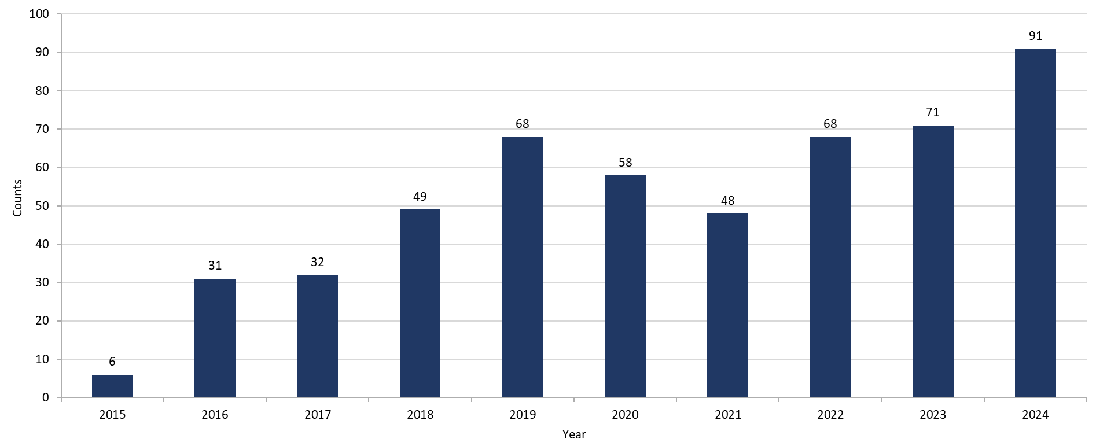
Gonorrhea Among Individuals of Transgender Experience¹, Massachusetts, 2015-2024²
Data are current as of 06/02/2025 and are subject to change.
Data Source: Massachusetts Department of Public Health/Bureau of Infectious Disease and Laboratory Sciences/ Division of STD Prevention and HIV Surveillance.
1. All individuals of transgender experience are included in this graph regardless of current gender.
2. Please consider the impact of the COVID-19 pandemic on infectious disease screening, treatment and surveillance in the interpretation of 2020-2023 data.
Notes:
Gonorrhea Among Individuals of Transgender Experience, Massachusetts, 2015 to 2024
Graph shows the number of confirmed gonorrhea cases among transgender individuals in Massachusetts between 2015 and 2024. The case counts are 6, 31, 32, 49, 68, 58, 48, 68, 71, and 91 for 2015, 2016, 2017, 2018, 2019, 2020, 2021, 2022, 2023, and 2024, respectively.

Slide 12
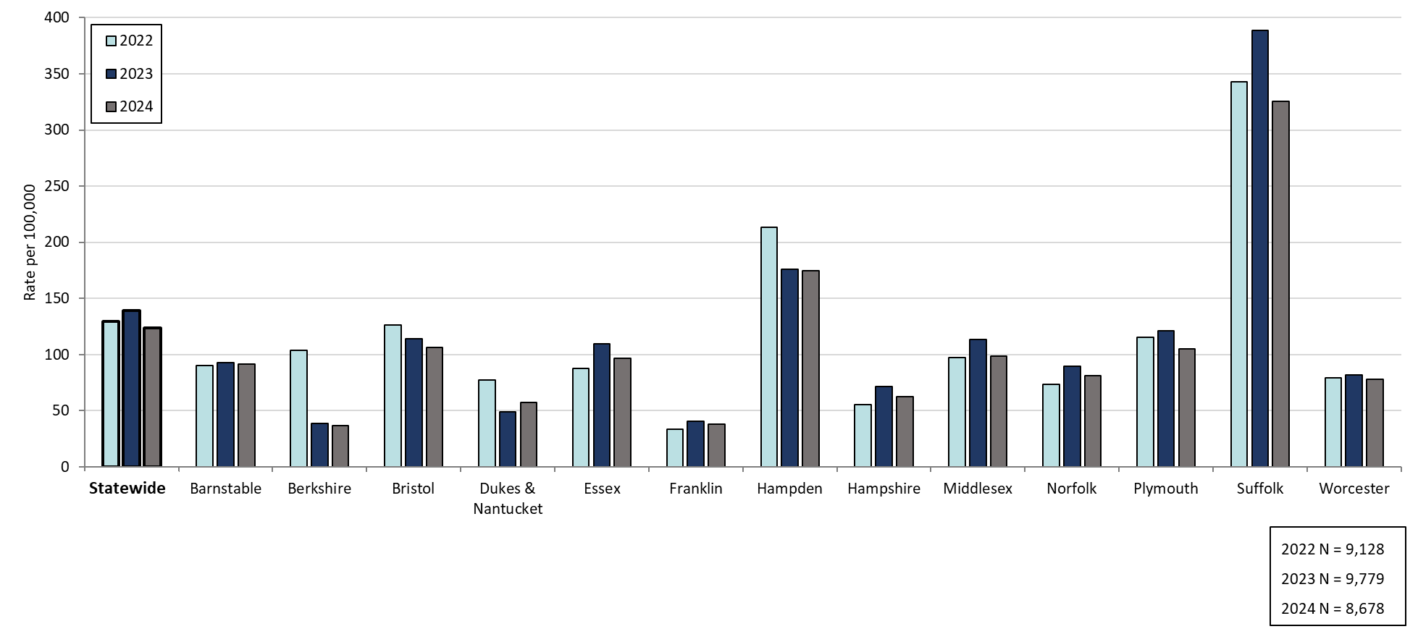
Confirmed Gonorrhea Rates by County and Statewide, Massachusetts, 2022-2024¹
Data are current as of 06/02/2025 and are subject to change.
Data Source: Massachusetts Department of Public Health/Bureau of Infectious Disease and Laboratory Sciences/ Division of STD Prevention and HIV Surveillance.
Population denominators estimated by the University of Massachusetts Donahue Institute using a modified Hamilton-Perry model (Strate S, et al. Small Area Population Estimates for 2011 through 2020 report, Oct 2016).
1. Please consider the impact of the COVID-19 pandemic on infectious disease screening, treatment and surveillance in the interpretation of 2020-2023 data.
Notes:
Confirmed Gonorrhea Rates by County and Statewide, Massachusetts, 2022-2024
Graph depicts rate per 100,000 population of gonorrhea cases reported in Massachusetts by county comparing 2022 through 2024. The rate in 2024 is highest in Suffolk county with a rate of 325.6 followed by Hampden county with a rate of 175.0. The lowest rates were in Berkshire and Franklin counties.

Slide 13
Infectious Syphilis: 2000 - 2024
Massachusetts STI Trends
Notes:
Picture description: logo for the Massachusetts Department of Public Health

Slide 14
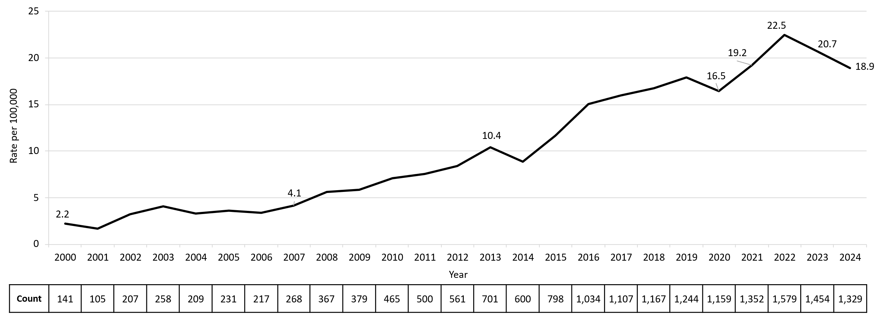
Confirmed and Probable Infectious Syphilis¹ Rates, Massachusetts, 2000-2024²
Data are current as of 06/02/2025 and are subject to change.
Data Source: Massachusetts Department of Public Health/Bureau of Infectious Disease and Laboratory Sciences/ Division of STD Prevention and STD-HIV Surveillance.
Population denominators estimated by the University of Massachusetts Donahue Institute using a modified Hamilton-Perry model (Strate S, et al. Small Area Population Estimates for 2011 through 2020 report, Oct 2016).
1. Infectious syphilis is defined as primary, secondary and early latent stages of syphilis within one year of infection.
2. Please consider the impact of the COVID-19 pandemic on infectious disease screening, treatment and surveillance in the interpretation of 2020-2023 data.
Notes:
Confirmed and Probable Infectious Syphilis Rates, Massachusetts, 2000 to 2024
Graph depicts the rate per 100,000 population of confirmed and probable cases of infectious syphilis in Massachusetts between 2000 and 2023. It begins at 2.2 in 2000, drops to a low of 1.6 in 2001, and climbs to a high of 22.5 in 2022, before falling to 18.9 in 2024.

Slide 15
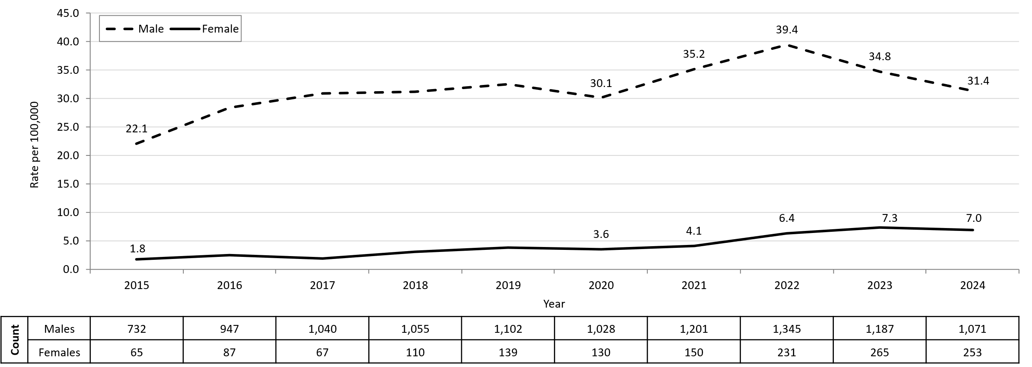
Confirmed and Probable Infectious Syphilis¹ Rates by Gender,² Massachusetts, 2015-2024³
Data are current as of 06/02/2025 and are subject to change.
Data Source: Massachusetts Department of Public Health/Bureau of Infectious Disease and Laboratory Sciences/ Division of STD Prevention and STD-HIV Surveillance.
Population denominators estimated by the University of Massachusetts Donahue Institute using a modified Hamilton-Perry model (Strate S, et al. Small Area Population Estimates for 2011 through 2020 report, Oct 2016).
1. Infectious syphilis is defined as primary, secondary and early latent stages of syphilis within one year of infection.
2. In 2024, there were 5 individuals of transgender experience reported in our data system who do not have current gender documented. These cases were excluded since population estimates for individuals of transgender experience are not available at this time.
3. Please consider the impact of the COVID-19 pandemic on infectious disease screening, treatment and surveillance in the interpretation of 2020-2023 data.
Notes:
Confirmed and Probable Infectious Syphilis Rates by Gender, Massachusetts, 2015 to 2024
Graph depicts the rates per 100,000 population of confirmed and probable cases of syphilis in Massachusetts by gender identity between 2015 and 2024. There are two lines, one for females that begins at 1.8 in 2015 and remains relatively stable with a high of 7.3 in 2023. Another line is for males that begins at 22.1 in 2015 and climbs to a high of 39.4 in 2022 before falling to 31.4 in 2024.
Note: Infectious syphilis is defined as primary, secondary and early latent stages of syphilis within one year of infection.
There were cases reported among transgender individuals in 2015 through 2024. They are classified on this slide based on their current gender. In 2024, there were 5 cases of infectious syphilis among transgender identified individuals not included on this slide as MA DSTDP does not have current gender information for those individuals.

Slide 16
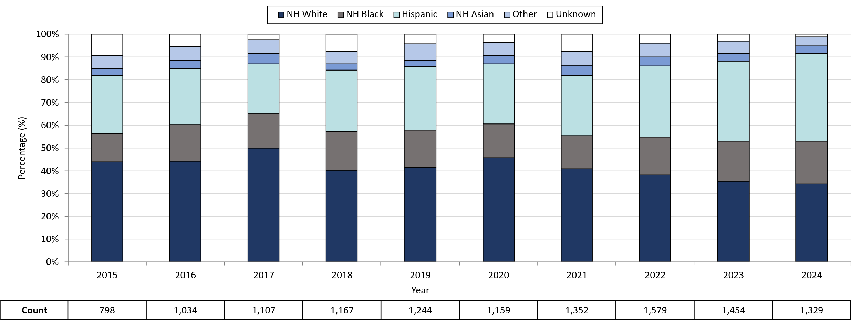
Infectious Syphilis¹ Reported Cases by Race/Ethnicity², Massachusetts, 2015-2024³
Data are current as of 06/02/2025 and are subject to change.
Data Source: Massachusetts Department of Public Health/Bureau of Infectious Disease and Laboratory Sciences/ Division of STD Prevention and STD-HIV Surveillance.
Note: National Notifiable Diseases Surveillance System (NNDSS) Congenital Syphilis case definition was updated in 2014.
1. Infectious syphilis is defined as primary, secondary and early latent stages of syphilis within one year of infection.
2. Other Race/Ethnicity includes individuals who identify as American Indian/ Pacific Islander/ Alaskan Native.
3. Please consider the impact of the COVID-19 pandemic on infectious disease screening, treatment and surveillance in the interpretation of 2020-2023 data.
Notes:
Infectious Syphilis Reported Cases by Race/Ethnicity, Massachusetts, 2015-2024
Graph depicts the proportion of Massachusetts reported confirmed and probable infectious syphilis cases broken down by race/ethnicity for the years 2015 through 2024. The highest percentage of cases for each year prior to 2024 identified as Non-Hispanic White making up a high of 50.0% of cases in 2017 and a resulting 34.2% of cases in 2024. 2024 represents the first year the highest percentage of cases identified as Hispanic with a low of 22.0% in 2017 and a high of 38.3% in 2024. In total, over the nine-year period, the proportion of cases by race/ethnicity were from highest to lowest: Non-Hispanic White, Hispanic, Non-Hispanic Black, Non-Hispanic Other, Unknown, and Non-Hispanic Asian.
Note: Infectious syphilis is defined as primary, secondary and early latent (non-primary/non-secondary) stages of syphilis within one year of infection.

Slide 17
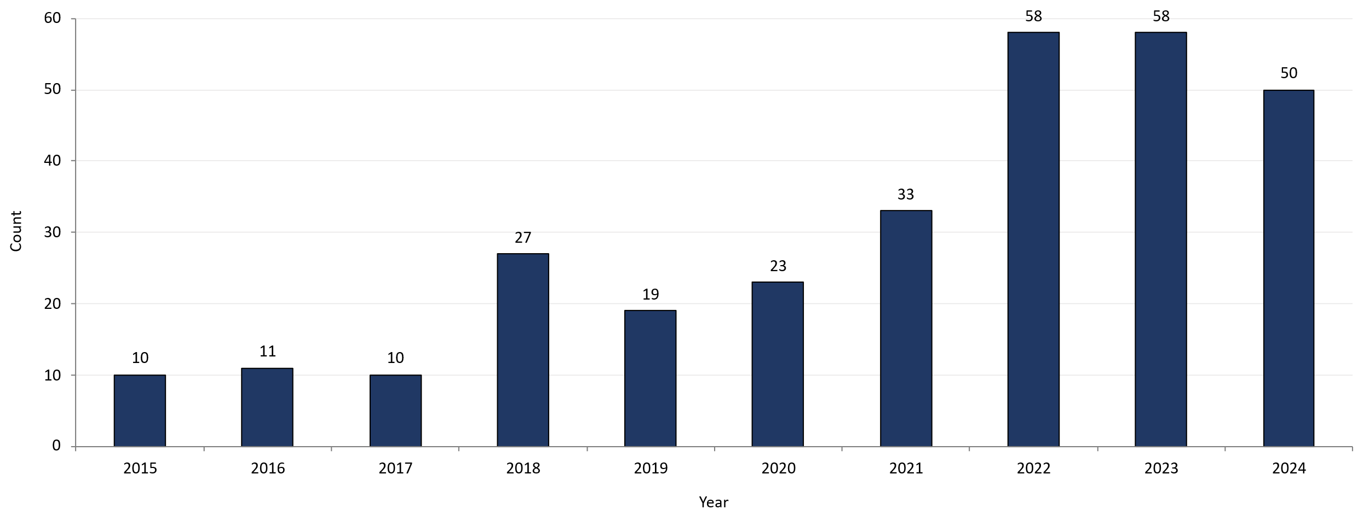
Confirmed and Probable Infectious Syphilis¹ Among Individuals of Transgender Experience², Massachusetts, 2015-2024^{3, 4}
Data are current as of 06/02/2025 and are subject to change.
Data Source: Massachusetts Department of Public Health/Bureau of Infectious Disease and Laboratory Sciences/ Division of STD Prevention and STD-HIV Surveillance.
1. Infectious syphilis is defined as primary, secondary and early latent stages of syphilis within one year of infection.
2. All individuals of transgender experience are included in this graph regardless of current gender.
3. Please consider the impact of the COVID-19 pandemic on infectious disease screening, treatment and surveillance in the interpretation of 2020-2023 data.
4. In 2022, a retrospective verification project was conducted to improve data quality in capturing current gender information.
Notes:
Confirmed and Probable Infectious Syphilis Among Individuals of Transgender Experience, Massachusetts, 2015 to 2024
Graph shows the number of confirmed and probable infectious syphilis cases among transgender individuals in Massachusetts between 2015 and 2024. The case counts are 10, 11, 10, 27, 19, 23, 33, 58, 58, and 50 for 2015, 2016, 2017, 2018, 2019, 2020, 2021, 2022, 2023, and 2024 respectively.
*Infectious syphilis is defined as primary, secondary and early latent stages of syphilis within one year of infection.

Slide 18
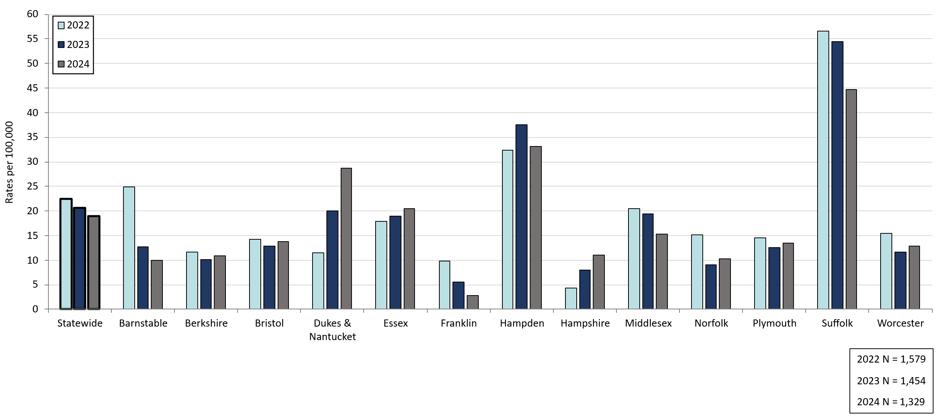
Confirmed and Probable Infectious Syphilis¹ Rates by County and Statewide, Massachusetts, 2022-2024²
Statewide
Data are current as of 06/02/2025 and are subject to change.
Data Source: Massachusetts Department of Public Health/Bureau of Infectious Disease and Laboratory Sciences/ Division of STD Prevention and STD-HIV Surveillance.
Population denominators estimated by the University of Massachusetts Donahue Institute using a modified Hamilton-Perry model (Strate S, et al. Small Area Population Estimates for 2011 through 2020 report, Oct 2016).
1. Infectious syphilis is defined as primary, secondary and early latent stages of syphilis within one year of infection.
2. Please consider the impact of the COVID-19 pandemic on infectious disease screening, treatment and surveillance in the interpretation of 2020-2023 data.
Notes:
Confirmed and Probable Infectious Syphilis Rates by County and Statewide, Massachusetts, 2022-2024
Graph depicts rate per 100,000 population of infectious syphilis cases reported in Massachusetts by county comparing 2022 through 2024. The rate is highest in Suffolk county with a rate of 56.6 in 2022 before falling to 44.7 in 2024, followed by Hampden county with a rate of 37.6 in 2023 which fell to 33.1 in 2024. The lowest rates were in Hampshire and Franklin county.

Slide 19
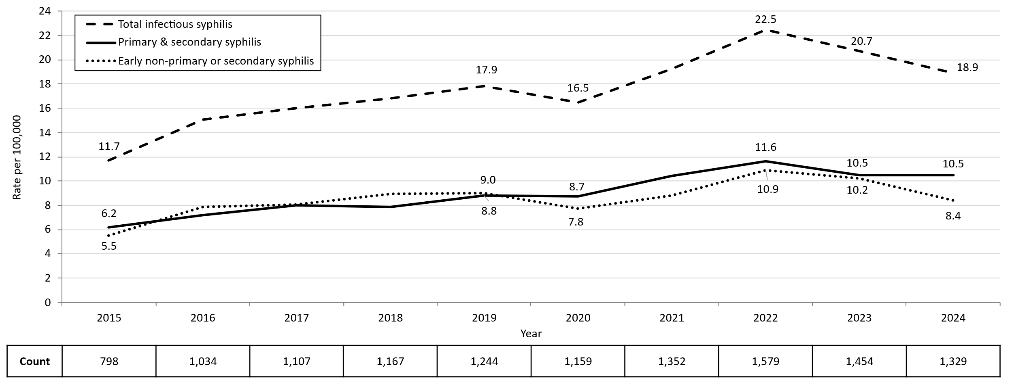
Confirmed and Probable Infectious Syphilis¹ Rates by Stage of Infection, Massachusetts, 2015-2024²
Data are current as of 06/02/2025 and are subject to change.
Data Source: Massachusetts Department of Public Health/Bureau of Infectious Disease and Laboratory Sciences/ Division of STD Prevention and STD-HIV Surveillance.
Population denominators estimated by the University of Massachusetts Donahue Institute using a modified Hamilton-Perry model (Strate S, et al. Small Area Population Estimates for 2011 through 2020 report, Oct 2016).
1. Infectious syphilis is defined as primary, secondary and early latent stages of syphilis within one year of infection.
2. Please consider the impact of the COVID-19 pandemic on infectious disease screening, treatment and surveillance in the interpretation of 2020-2023 data.
Notes:
Confirmed and Probable Infectious Syphilis Rates by Stage of Infection, Massachusetts, 2015–2024
Graph depicts the differences between the rate of infectious syphilis diagnosed in the primary and secondary stage compared to those cases diagnosed in the early non-primary and non-secondary stages reported in Massachusetts from 2015 to 2024. There are three lines on the graph. One line for primary and secondary cases starting with a rate of 6.2 per 100,000 in 2015 and peaking with a rate of 11.6 in 2022, before falling to 10.5 in 2024. Another line for non-primary non-secondary cases starting with a rate of 5.5 in 2015, peaking with a rate of 10.9 in 2022, before falling to 8.4 in 2024. The final line shows the total infectious syphilis starting with a rate of 11.7 in 2015 and peaking at a rate of 22.5 in 2022, before falling to 18.9 in 2024.
Note: Infectious syphilis is defined as primary, secondary and early latent (non-primary/non-secondary) stages of syphilis within one year of infection.

Slide 20
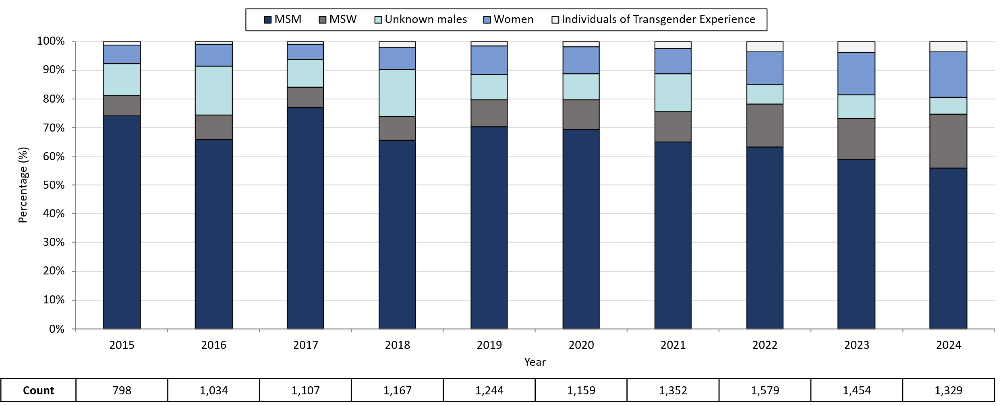
Infectious Syphilis¹ Reported Cases by Sexual Risk Categories, Massachusetts, 2015-2024²
Data are current as of 06/02/2025 and are subject to change.
Data Source: Massachusetts Department of Public Health/Bureau of Infectious Disease and Laboratory Sciences/ Division of STD Prevention and STD-HIV Surveillance.
Note: National Notifiable Diseases Surveillance System (NNDSS) Congenital Syphilis case definition was updated in 2014.
1. Infectious syphilis is defined as primary, secondary and early latent stages of syphilis within one year of infection.
2. Please consider the impact of the COVID-19 pandemic on infectious disease screening, treatment and surveillance in the interpretation of 2020-2023 data.
3. The MSM (men who have sex with men) category includes MSMT, MSMW, MSMWT, and MST with “W” referring to women and “T” referring to individuals of transgender experience.
Notes:
Infectious Syphilis Reported Cases by Gender of Sex Partners, Massachusetts, 2015-2024
Graph depicts the proportion of Massachusetts reported confirmed and probable infectious syphilis cases broken down by gender of sex partners for the years 2015 through 2024. The highest percentage of cases for each year reported male sex partners and are classified as MSM (men who have sex with men) making up a high of 77% of cases in 2017 and a resulting 55.9% of cases in 2024. In total, over the nine-year period, the proportion of cases by gender of sex partners were from highest to lowest: MSM, MSW (men who have sex with women), unknown males, women, and transgender individuals. For 2024, the order in frequency from highest to lowest is: MSM, MSW, women, unknown males, and individuals of transgender experience.
Note: Infectious syphilis is defined as primary, secondary and early latent (non-primary/non-secondary) stages of syphilis within one year of infection.

Slide 21
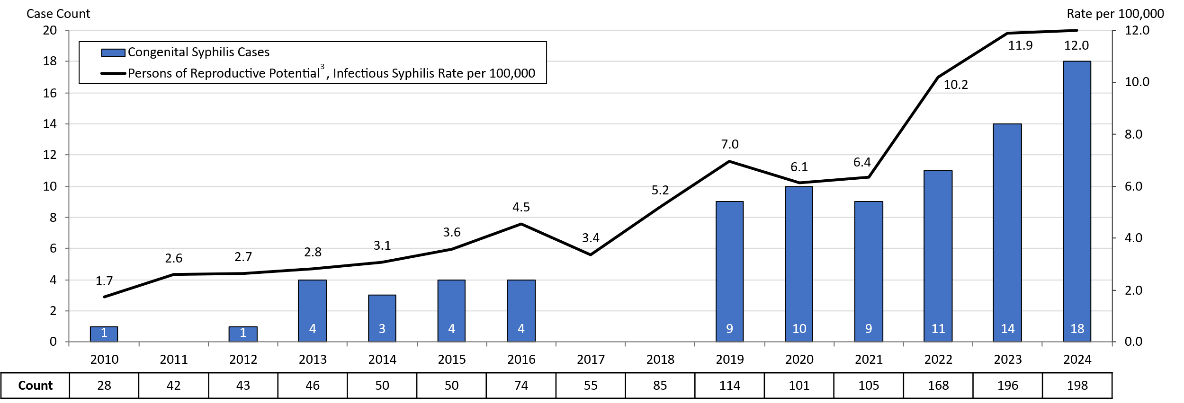
Congenital Syphilis Cases and Rate of Confirmed and Probable Infectious Syphilis¹ Among Persons of Reproductive Potential Ages 15 to 49 Years, Massachusetts, 2010-2024²
Data are current as of 06/02/2025 and are subject to change.
Data Source: Massachusetts Department of Public Health/Bureau of Infectious Disease and Laboratory Sciences/ Division of STD Prevention.
Population denominators estimated by the University of Massachusetts Donahue Institute using a modified Hamilton-Perry model (Strate S, et al. Small Area Population Estimates for 2011 through 2020 report, Oct 2016).
Note: National Notifiable Diseases Surveillance System (NNDSS) Congenital Syphilis case definition was updated in 2014.
1. Infectious syphilis is defined as primary, secondary and early latent stages of syphilis within one year of infection.
2. Please consider the impact of the COVID-19 pandemic on infectious disease screening, treatment and surveillance in the interpretation of 2020-2023 data.
3. Persons of Reproductive Potential refers to individuals thought to be capable of pregnancy ages 15 to 49 years and not known to be assigned sex male at birth.
Notes:
Congenital Syphilis Cases and Rate of Confirmed and Probable Infectious Syphilis Among Individuals Thought to be Capable of Pregnancy Ages 15 to 49 Years, Massachusetts, 2010-2024
Graph depicts the case count for confirmed and probable congenital syphilis cases reported in Massachusetts between 2010 and 2023. The case counts are 1, 0, 1, 4, 3, 4, 4, 0, 0, 9, 10, 9, 11,14, and 18 for 2010, 2011, 2012, 2013, 2014, 2015, 2016, 2017, 2018, 2019, 2020, 2021, 2022, 2023, and 2024, respectively. Additionally, the graph shows a line depicting the rate per 100,000 population of confirmed and probable infectious syphilis among individuals thought to be capable of pregnancy ages 15 to 49 years which starts with a rate of 1.7 in 2010 and peaks in 2024 with a rate of 12.0 cases per 100,000 population.
Note: Infectious syphilis is defined as primary, secondary and early latent (non-primary/non-secondary) stages of syphilis within one year of infection.

Slide 22
Thank You!
If you have questions or to request more information: call the Massachusetts Department of Public Health, Division of STD Prevention, at 617-983-6940

