Slide 1
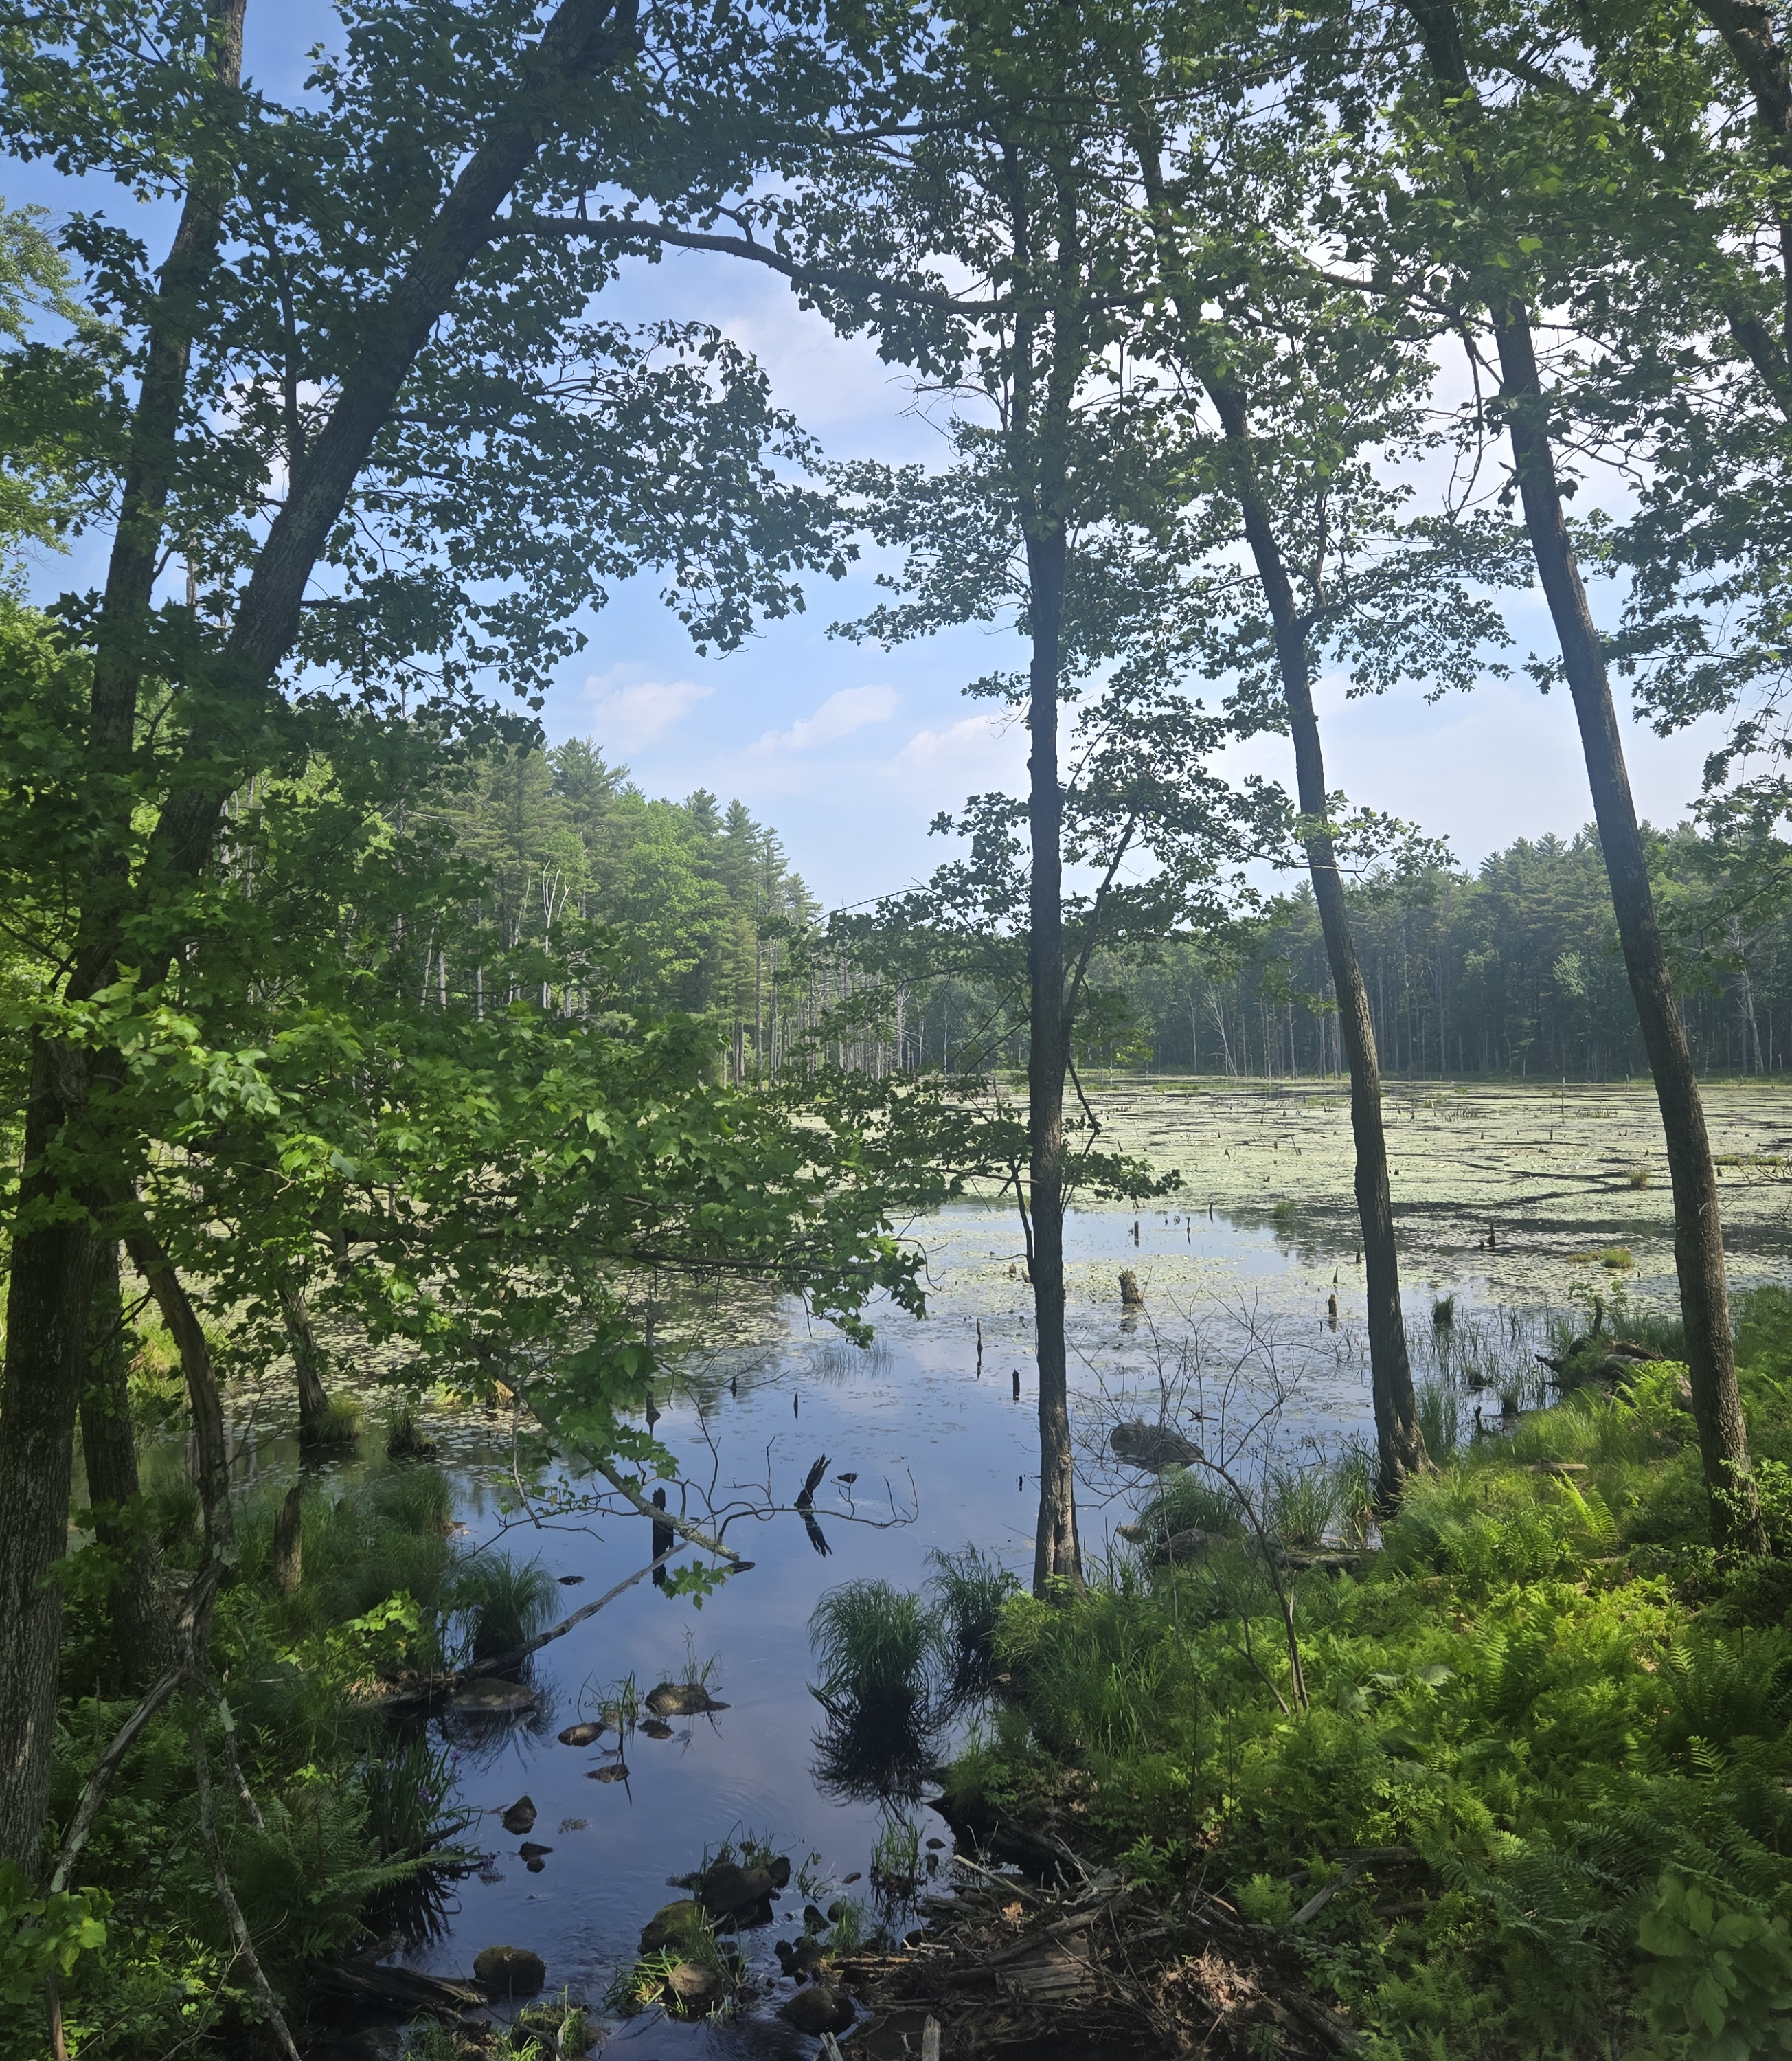
Brimfield State Forest
Trail System Master Plan
Public Meeting
Click icon to add photo
October 7, 2026 • 6:00pm
ZOOM

Slide 2
Commonwealth of Massachusetts

Slide 3

DCR Mission and Core Principles

Slide 4
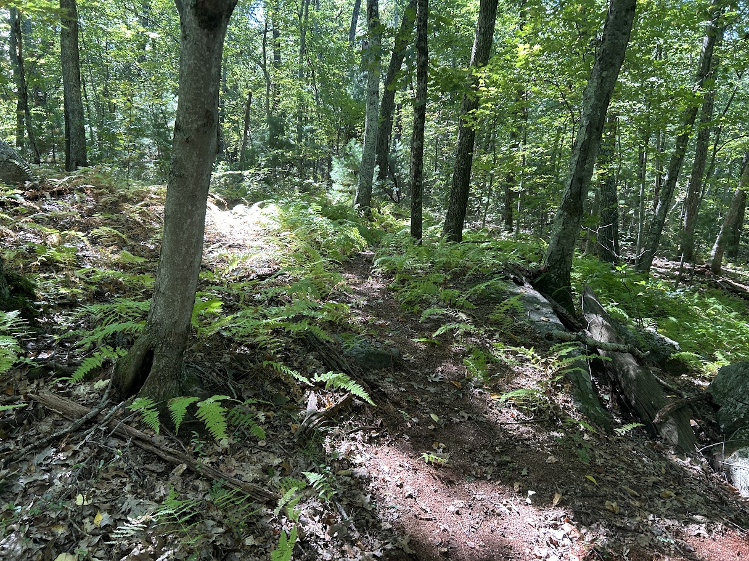
Meeting Logistics
Photo: Brimfield State Forest

Slide 5
Agenda
Update on progress since Fall 2025 public meeting
Recap site analyses
Basis of Recommendations
Proposed trail system map recommendations
Discussion

Slide 6
Key Activities since Fall 2025 meeting
  Pre-filing consultations with NHESP
  Meeting with DCR Operations, Forestry, Rangers and Fire Control
  Meeting with Forest Reserves Scientific Technical Advisory Committee
  Review and incorporation of collaborator/public comments
  Co-occurrence analysis- Trails and Wildlife
  Drafting trail system master plan maps & report

Slide 7
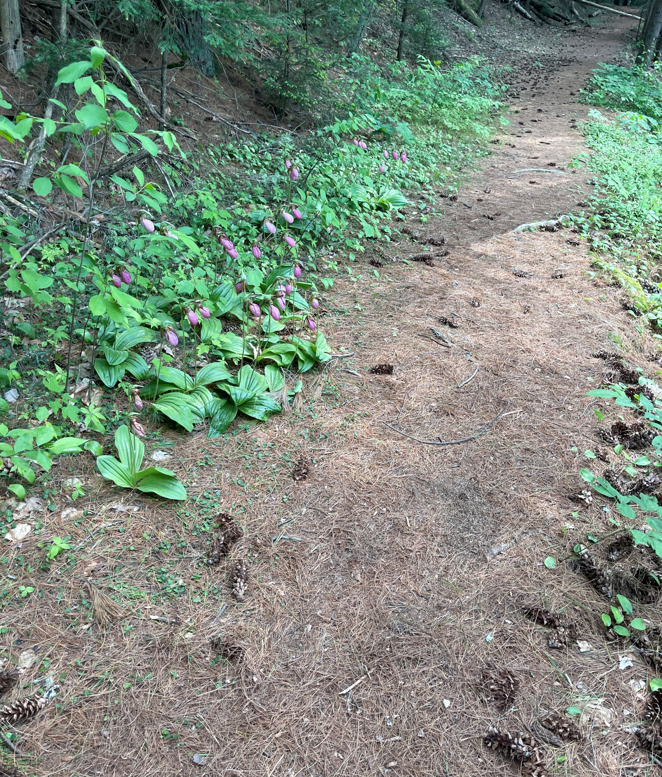
Recap Findings: Trail and Property Inventory & Assessment
Moderate trail density - exceeds Reserve standards
  Reserves: Low Density <3 km/sqkm
  Current: Moderate 6.36 km/sqkm
  59 miles of trails (28 authorized/31 unauthorized)
Impacts to rare species and wildlife habitat
  50.5% is Rare Species Habitat
  7 Rare Species
    5 Animals
    2 Insects
Impacts to wetlands & waterways
  Coldwater fisheries
Presence of Cultural Resources
  394 Potential Cultural Resources
Unsustainable trails and trail issues
  Erosion & Washouts
  Rutting & Mud Holes
  Trail Braiding & Widening
  Fall Line Design
Photo: Brimfield State Forest

Slide 8
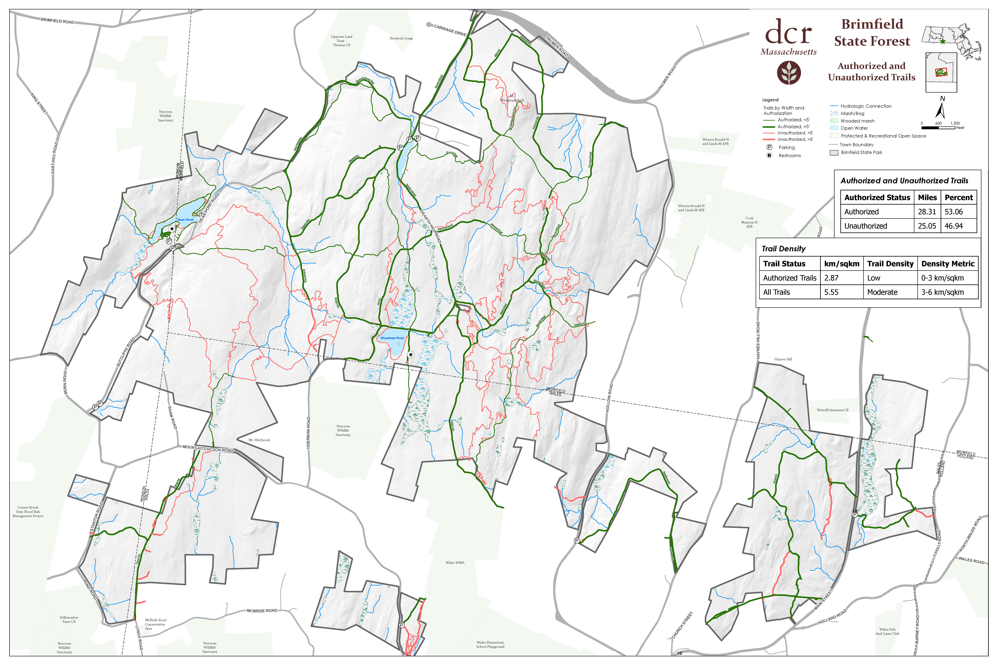
Current Authorized and Unauthorized Trails

Slide 9
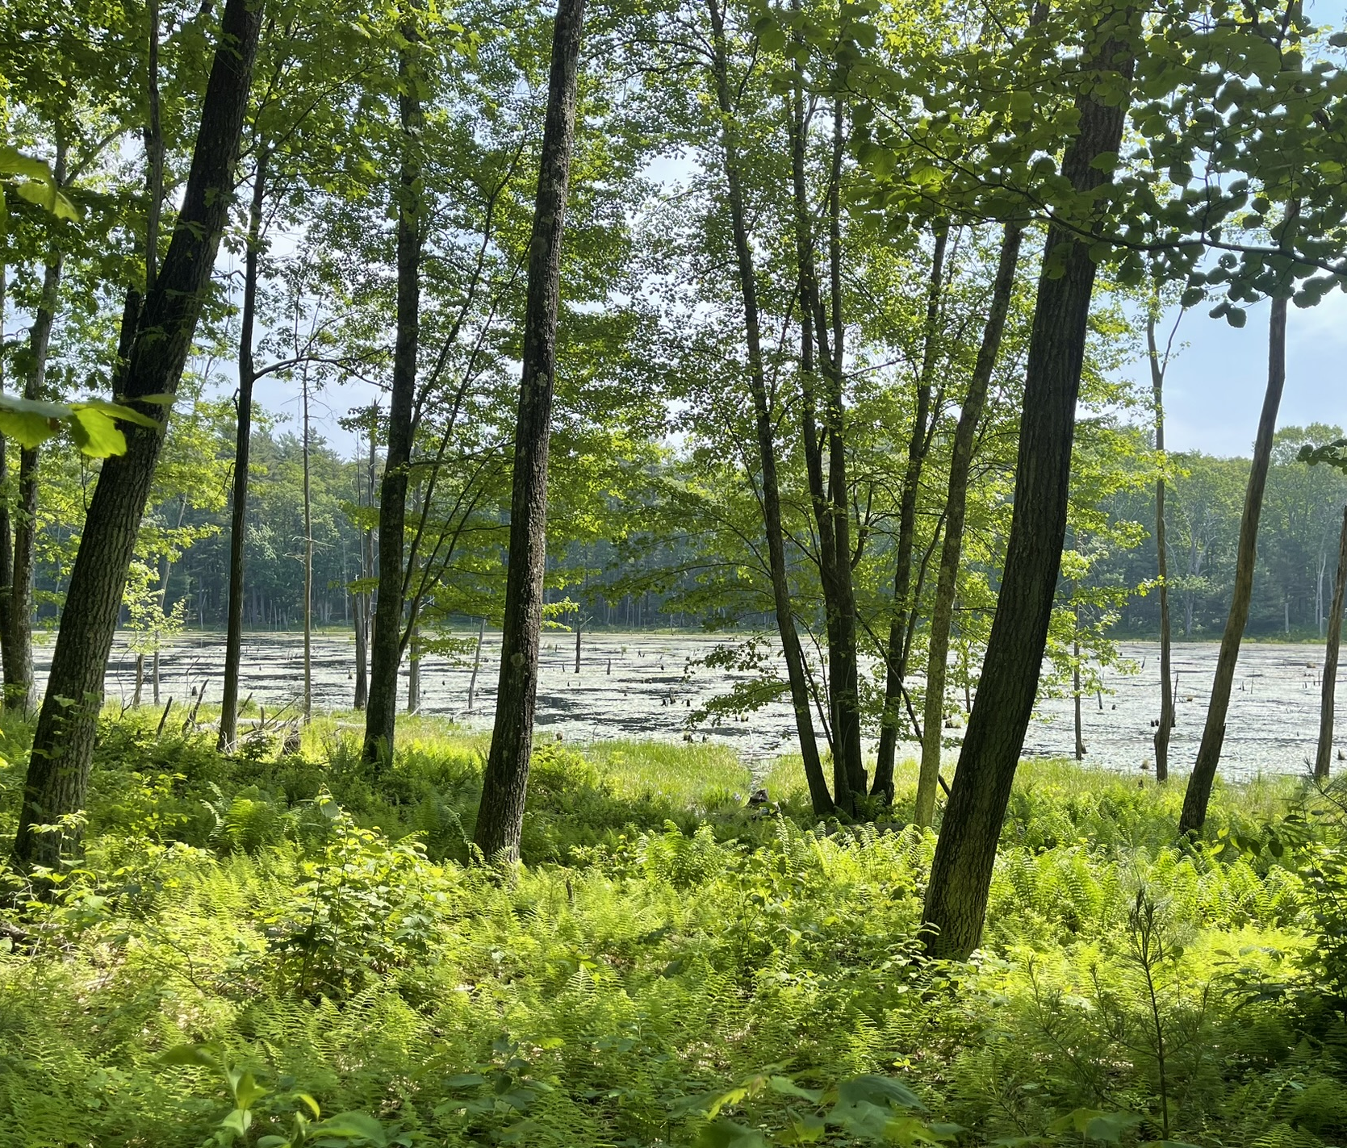
Survey Feedback
Trail Experience
  Trails are generally in good condition.
  Users value the variety of recreational opportunities.
  More resting areas may be needed.
Navigation and Access
  Trail markings and the DCR map need improvement.
  Many visitors rely on other navigation apps.
  Some visitors regularly use trails not shown on the official map.
Trail Needs
  Most respondents do not think the park needs more trails overall.
  Interest is stronger in improved hiking and accessible trail opportunities.
  The focus should be on improving the existing network rather than expanding it.
Visitor Values
  Physical health, personal safety, and access to nature strongly motivate trail use.
  Visitors place a high value on protecting natural and cultural resources.
  Respondents generally believe their trail use does not negatively affect wildlife.
Photo: Brimfield State Forest

Slide 10
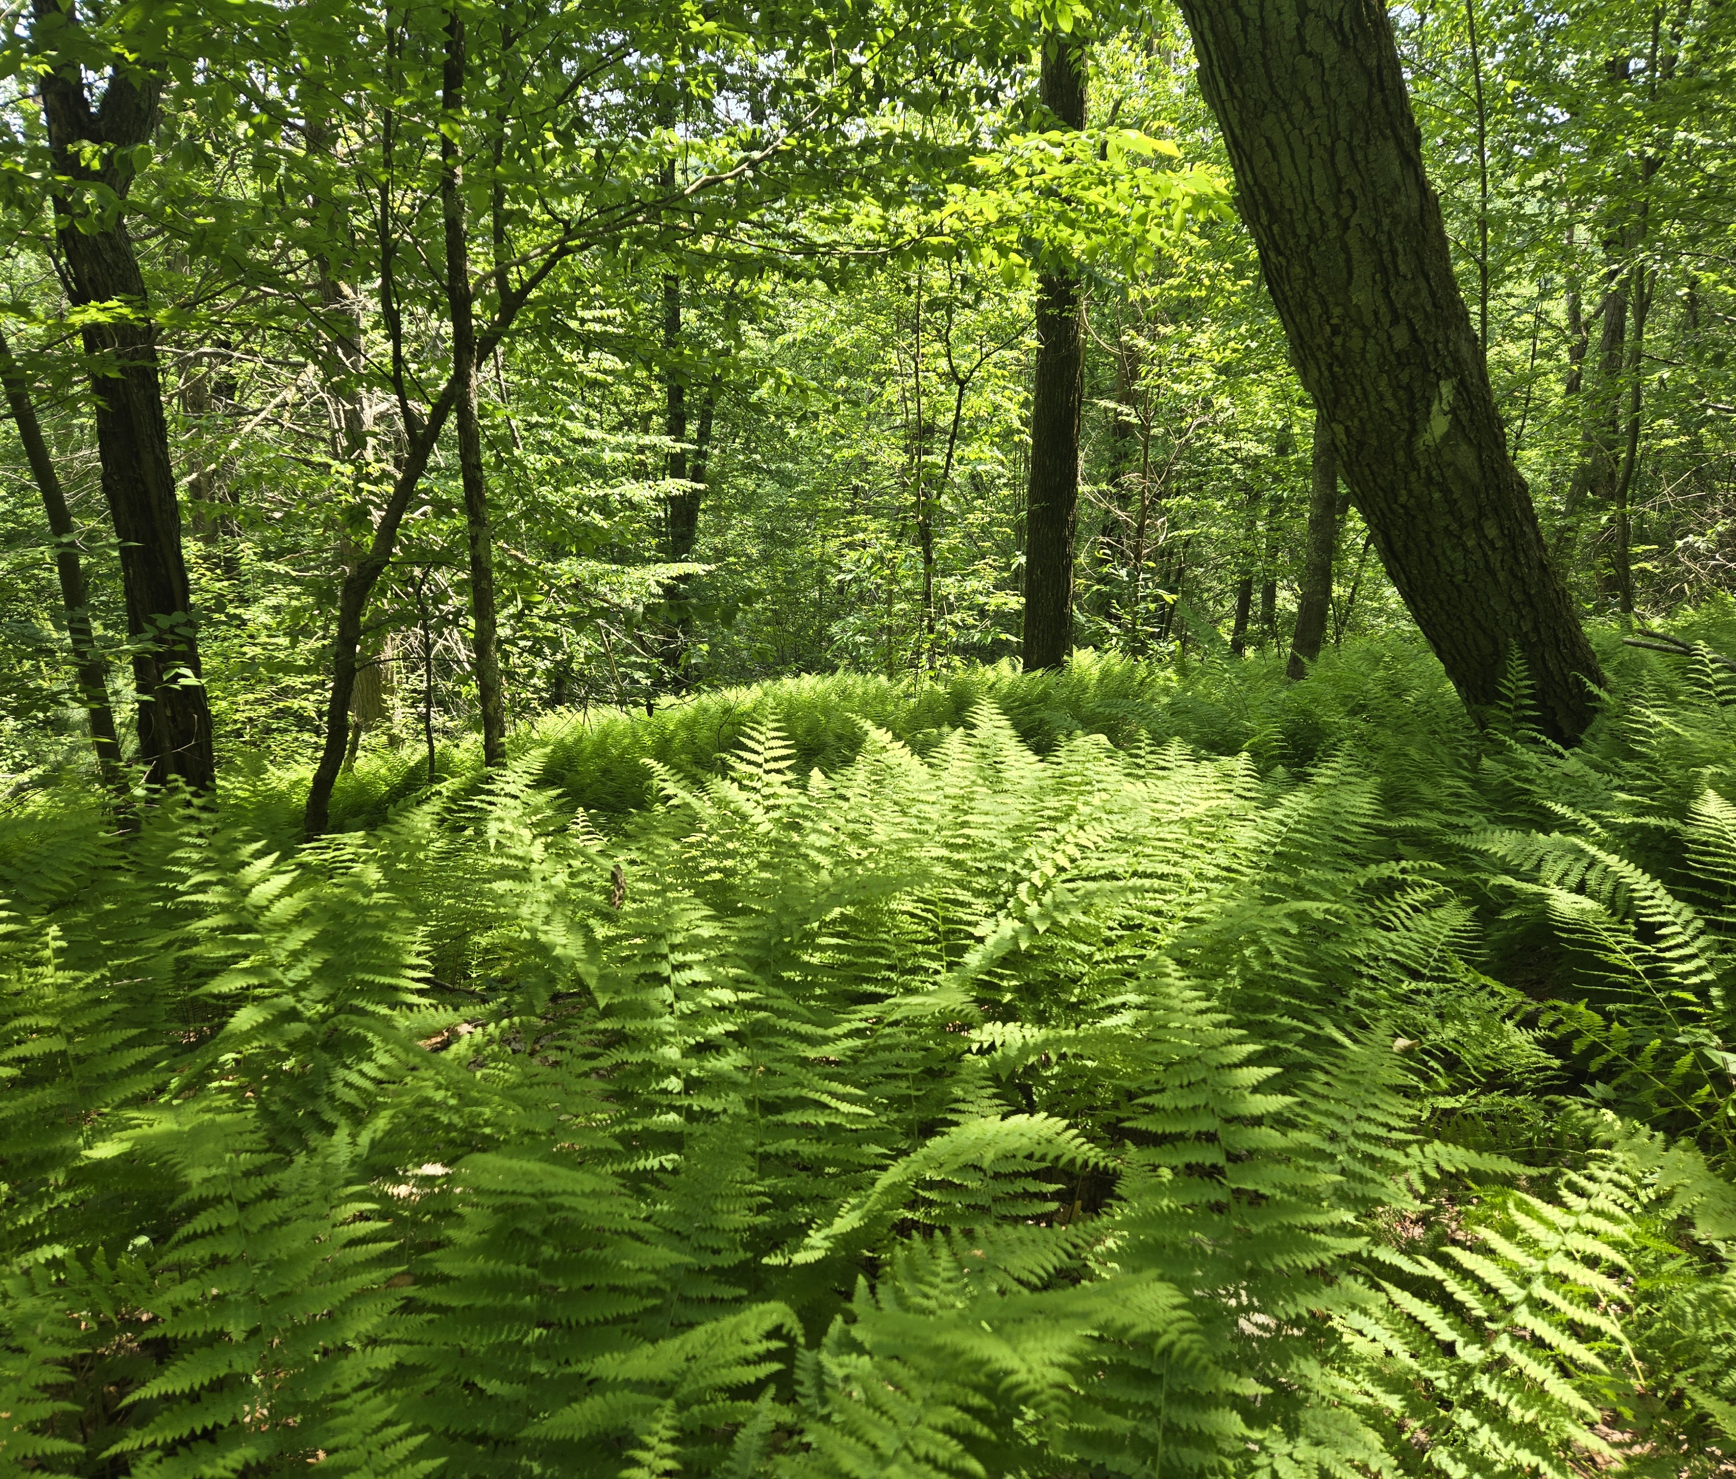
Staff & Collaborator Feedback
Parking, trailers, and event access
  Horseback riders and snowmobile require trailer parking
  Mountain bike groups require large parking areas for group rides
Appropriate recreational uses & accessibility concerns
  mountain biking, snowmobiling, horseback riding, hunting, hiking, off-road vehicles, and mobility access
  Public safety and access for responders
Trail conditions, safety, and legacy impacts
  2012 Tornado - extensive storm damage & temporary forest closure
  COVID Shutdown - increased demand for outdoor spaces
Create & formalize loops of varying distances
  Loop options of approximately 5, 10, and 12–15 miles
  NEMBA requested retention of existing high-use loops
Trail Signs & Circulation
Photo: Brimfield State Forest

Slide 11
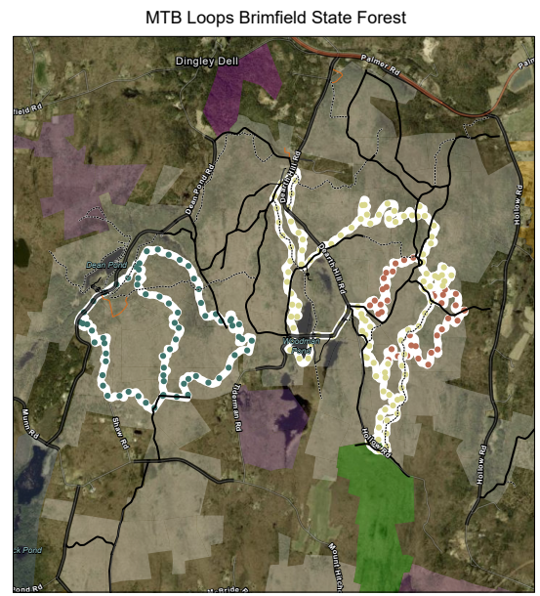
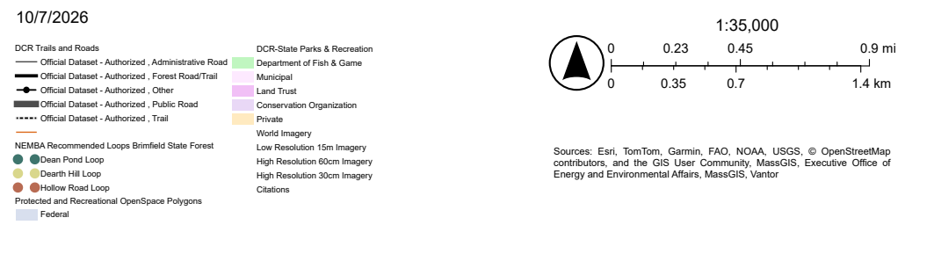
Requested High-Use Mountain Biking Trail Loops

Slide 12
General recommendations
Sustainable network and maintenance
  Designate a core trail system with varied recreational opportunities, evaluate select unauthorized routes, reduce redundant or braided trails, improve drainage and structures, and apply climate resiliency standards.
Trailheads, wayfinding, and recreation
  Formalize trailheads and appropriate parking, create consistent naming and route identification, classify trails by use and difficulty, strengthen loop experiences, and assess accessible recreation opportunities.
Resource protection and restoration
  Avoid sensitive habitats and cultural resources, relocate recurring impact areas, restore closed trails, and monitor sensitive corridors to guide seasonal management, hardening, or relocation.
Outreach, stewardship, and connectivity
  Explain responsible recreation and DCR’s approval process, coordinate volunteer work through formal agreements, and connect major destinations with appropriate regional and authorized access points.
Photo: Brimfield State Forest

Slide 13
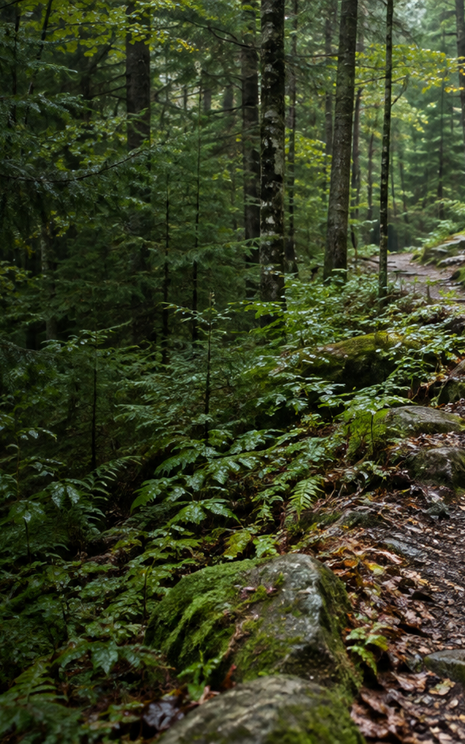
What Makes a Trail Sustainable?
Sustainable trails protect resources, meet user needs, and remain practical to manage and maintain over time.
ECOLOGICAL
MANAGEMENT
Avoid sensitive habitats and cultural resources. Reduce erosion and fragmentation, relocate recurring impacts, and restore closed trails.
Designate a core trail system. Evaluate select unauthorized routes and keep the network within available staff and volunteer capacity.
MAINTENANCE
CLIMATE RESILIENCE
Improve drainage and trail structures. Reduce redundant and braided routes to limit recurring repairs and long-term maintenance needs.
Apply climate-resilient design standards. Monitor sensitive corridors to guide seasonal management, hardening, or relocation.
The result is a durable, clearly defined trail network that protects resources and can be sustained over time.

Slide 14
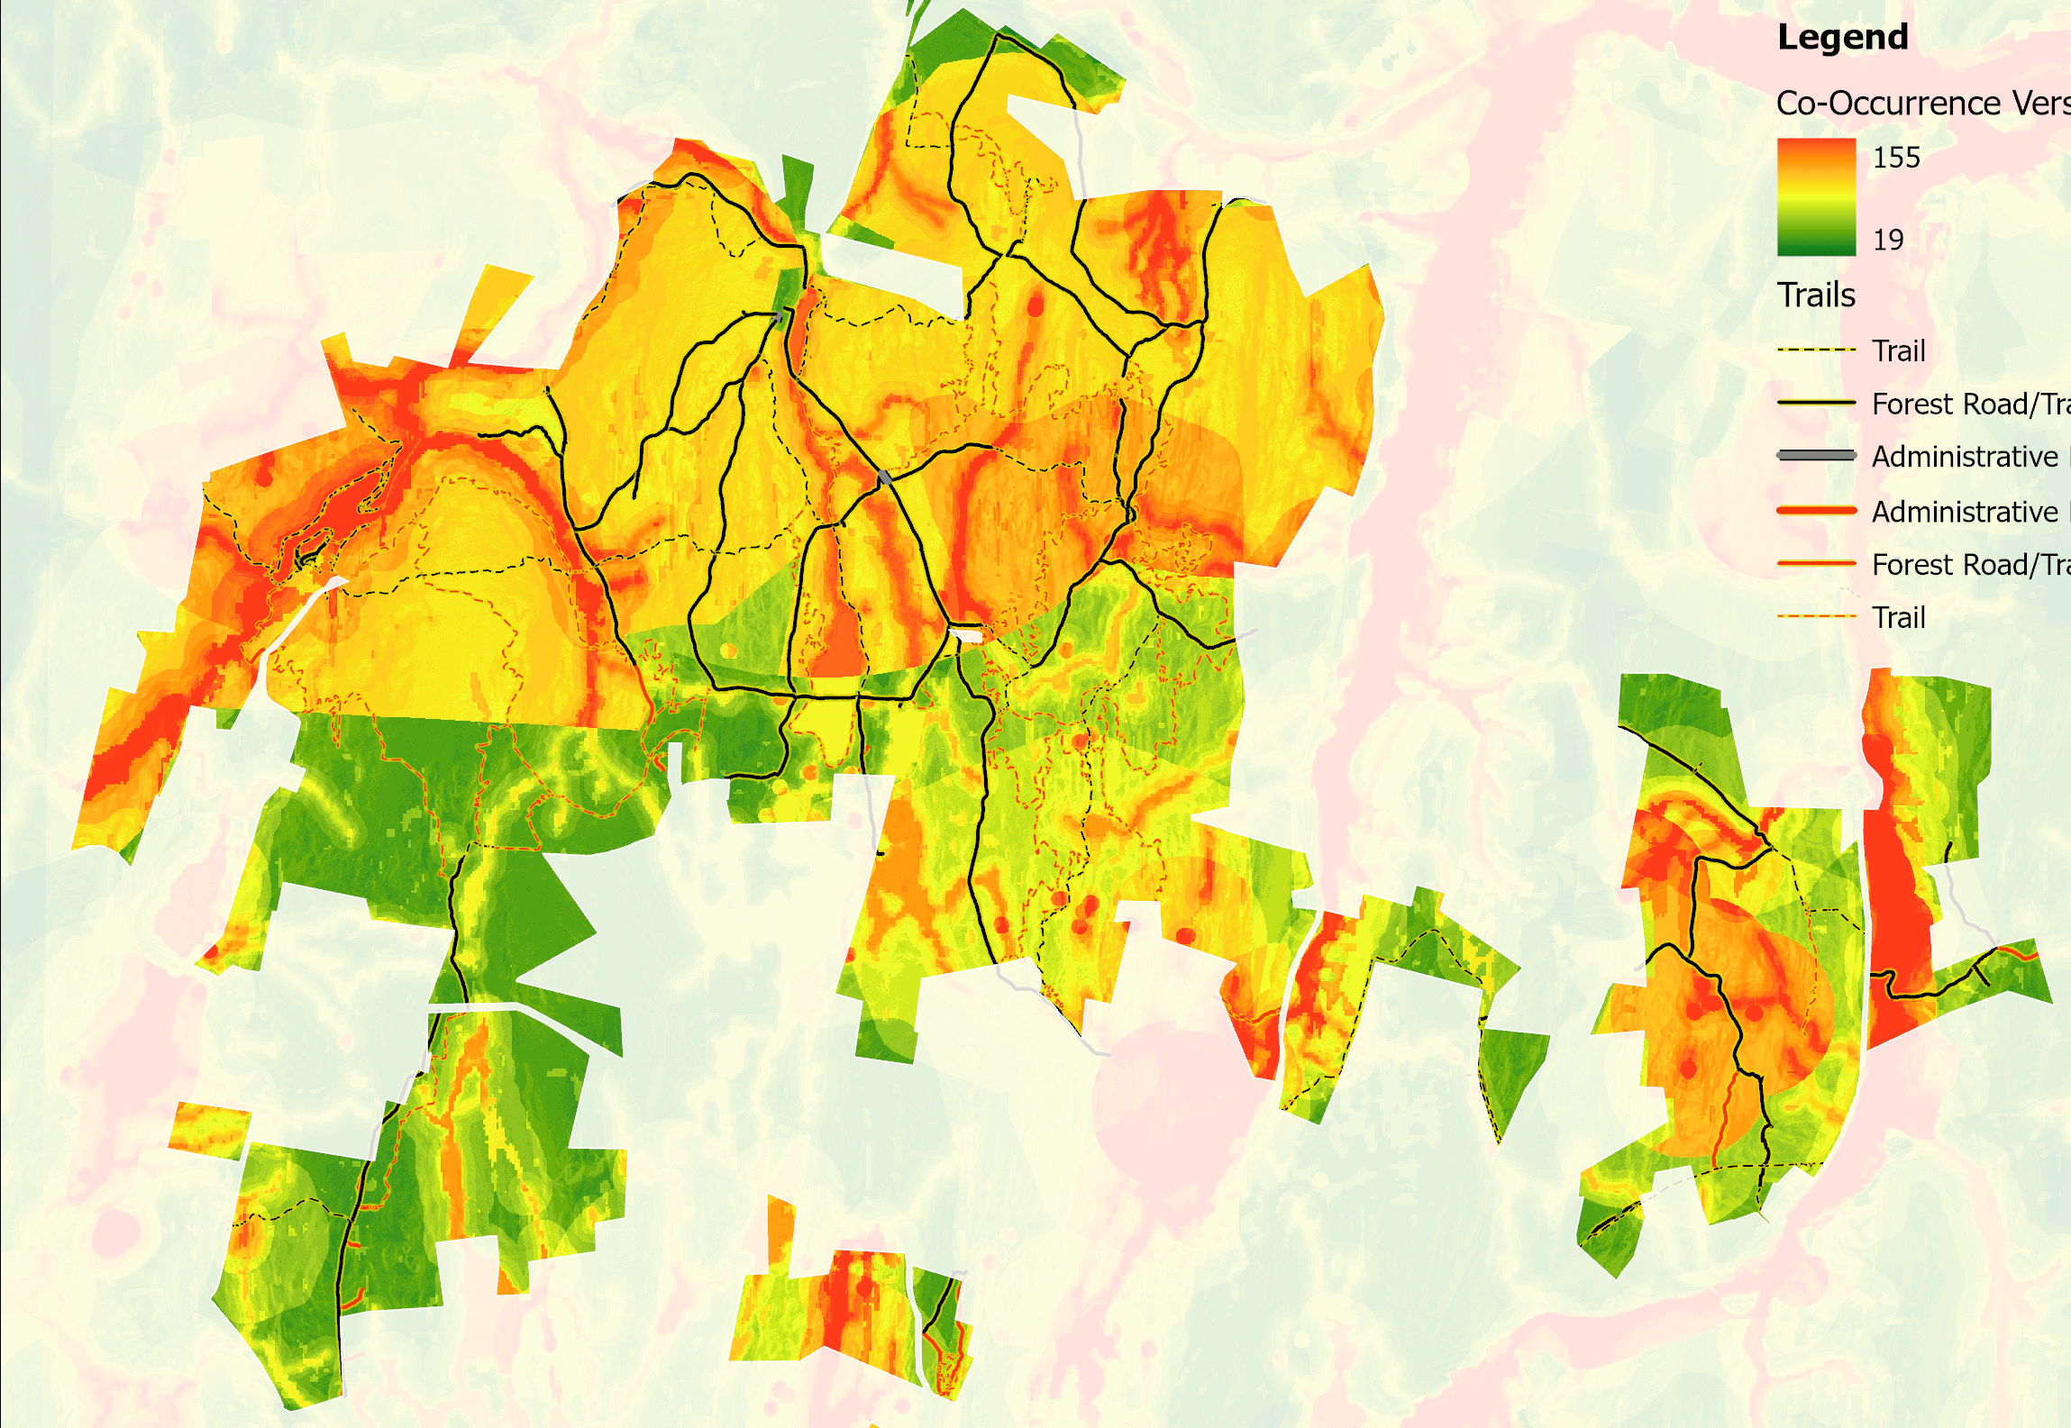

DRAFT
Co-Occurrence Analysis
High Sensitivity Areas
  Rare & Endangered Species
  Wetlands & Waterbodies
  Steep Slopes
  Highly-Erodible Soils
  Unique Habitat Features
Based on NH Methodology
https://www.wildlife.nh.gov/get-outside/trails-people-and-wildlife

Slide 15
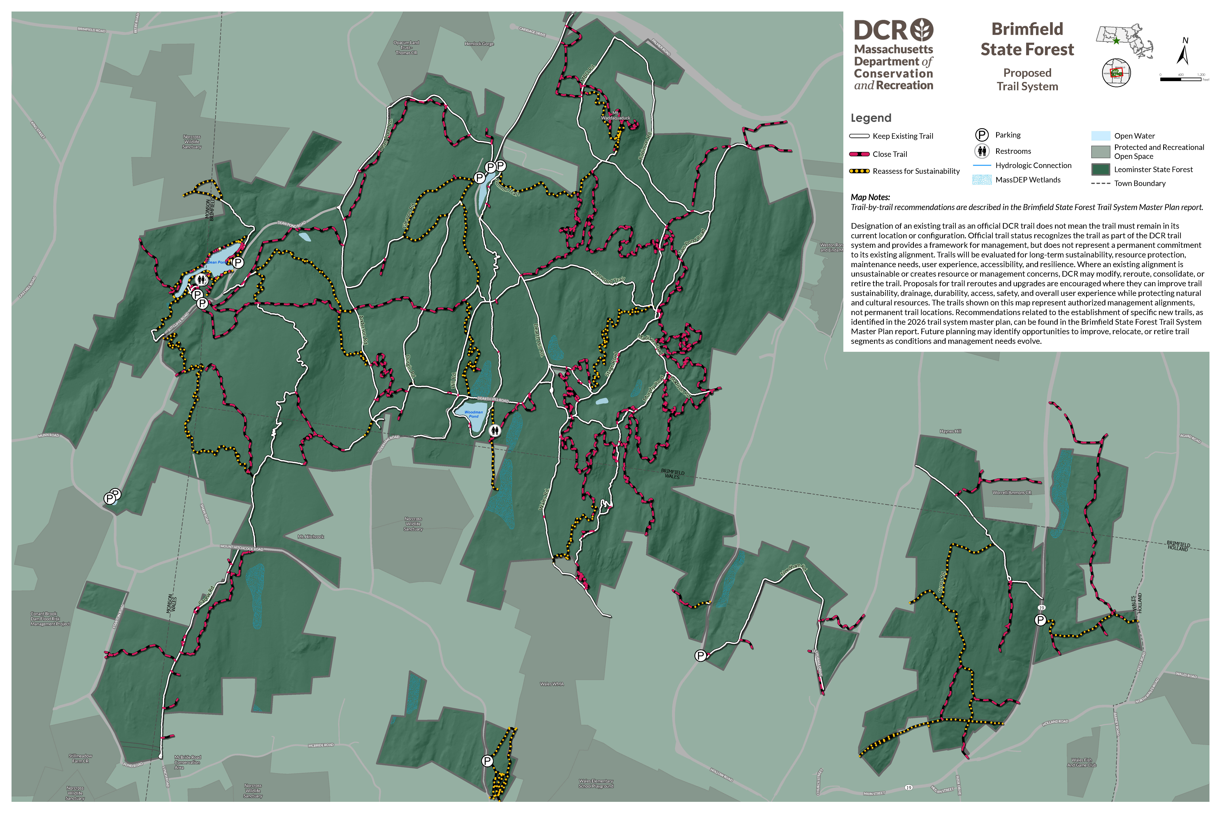
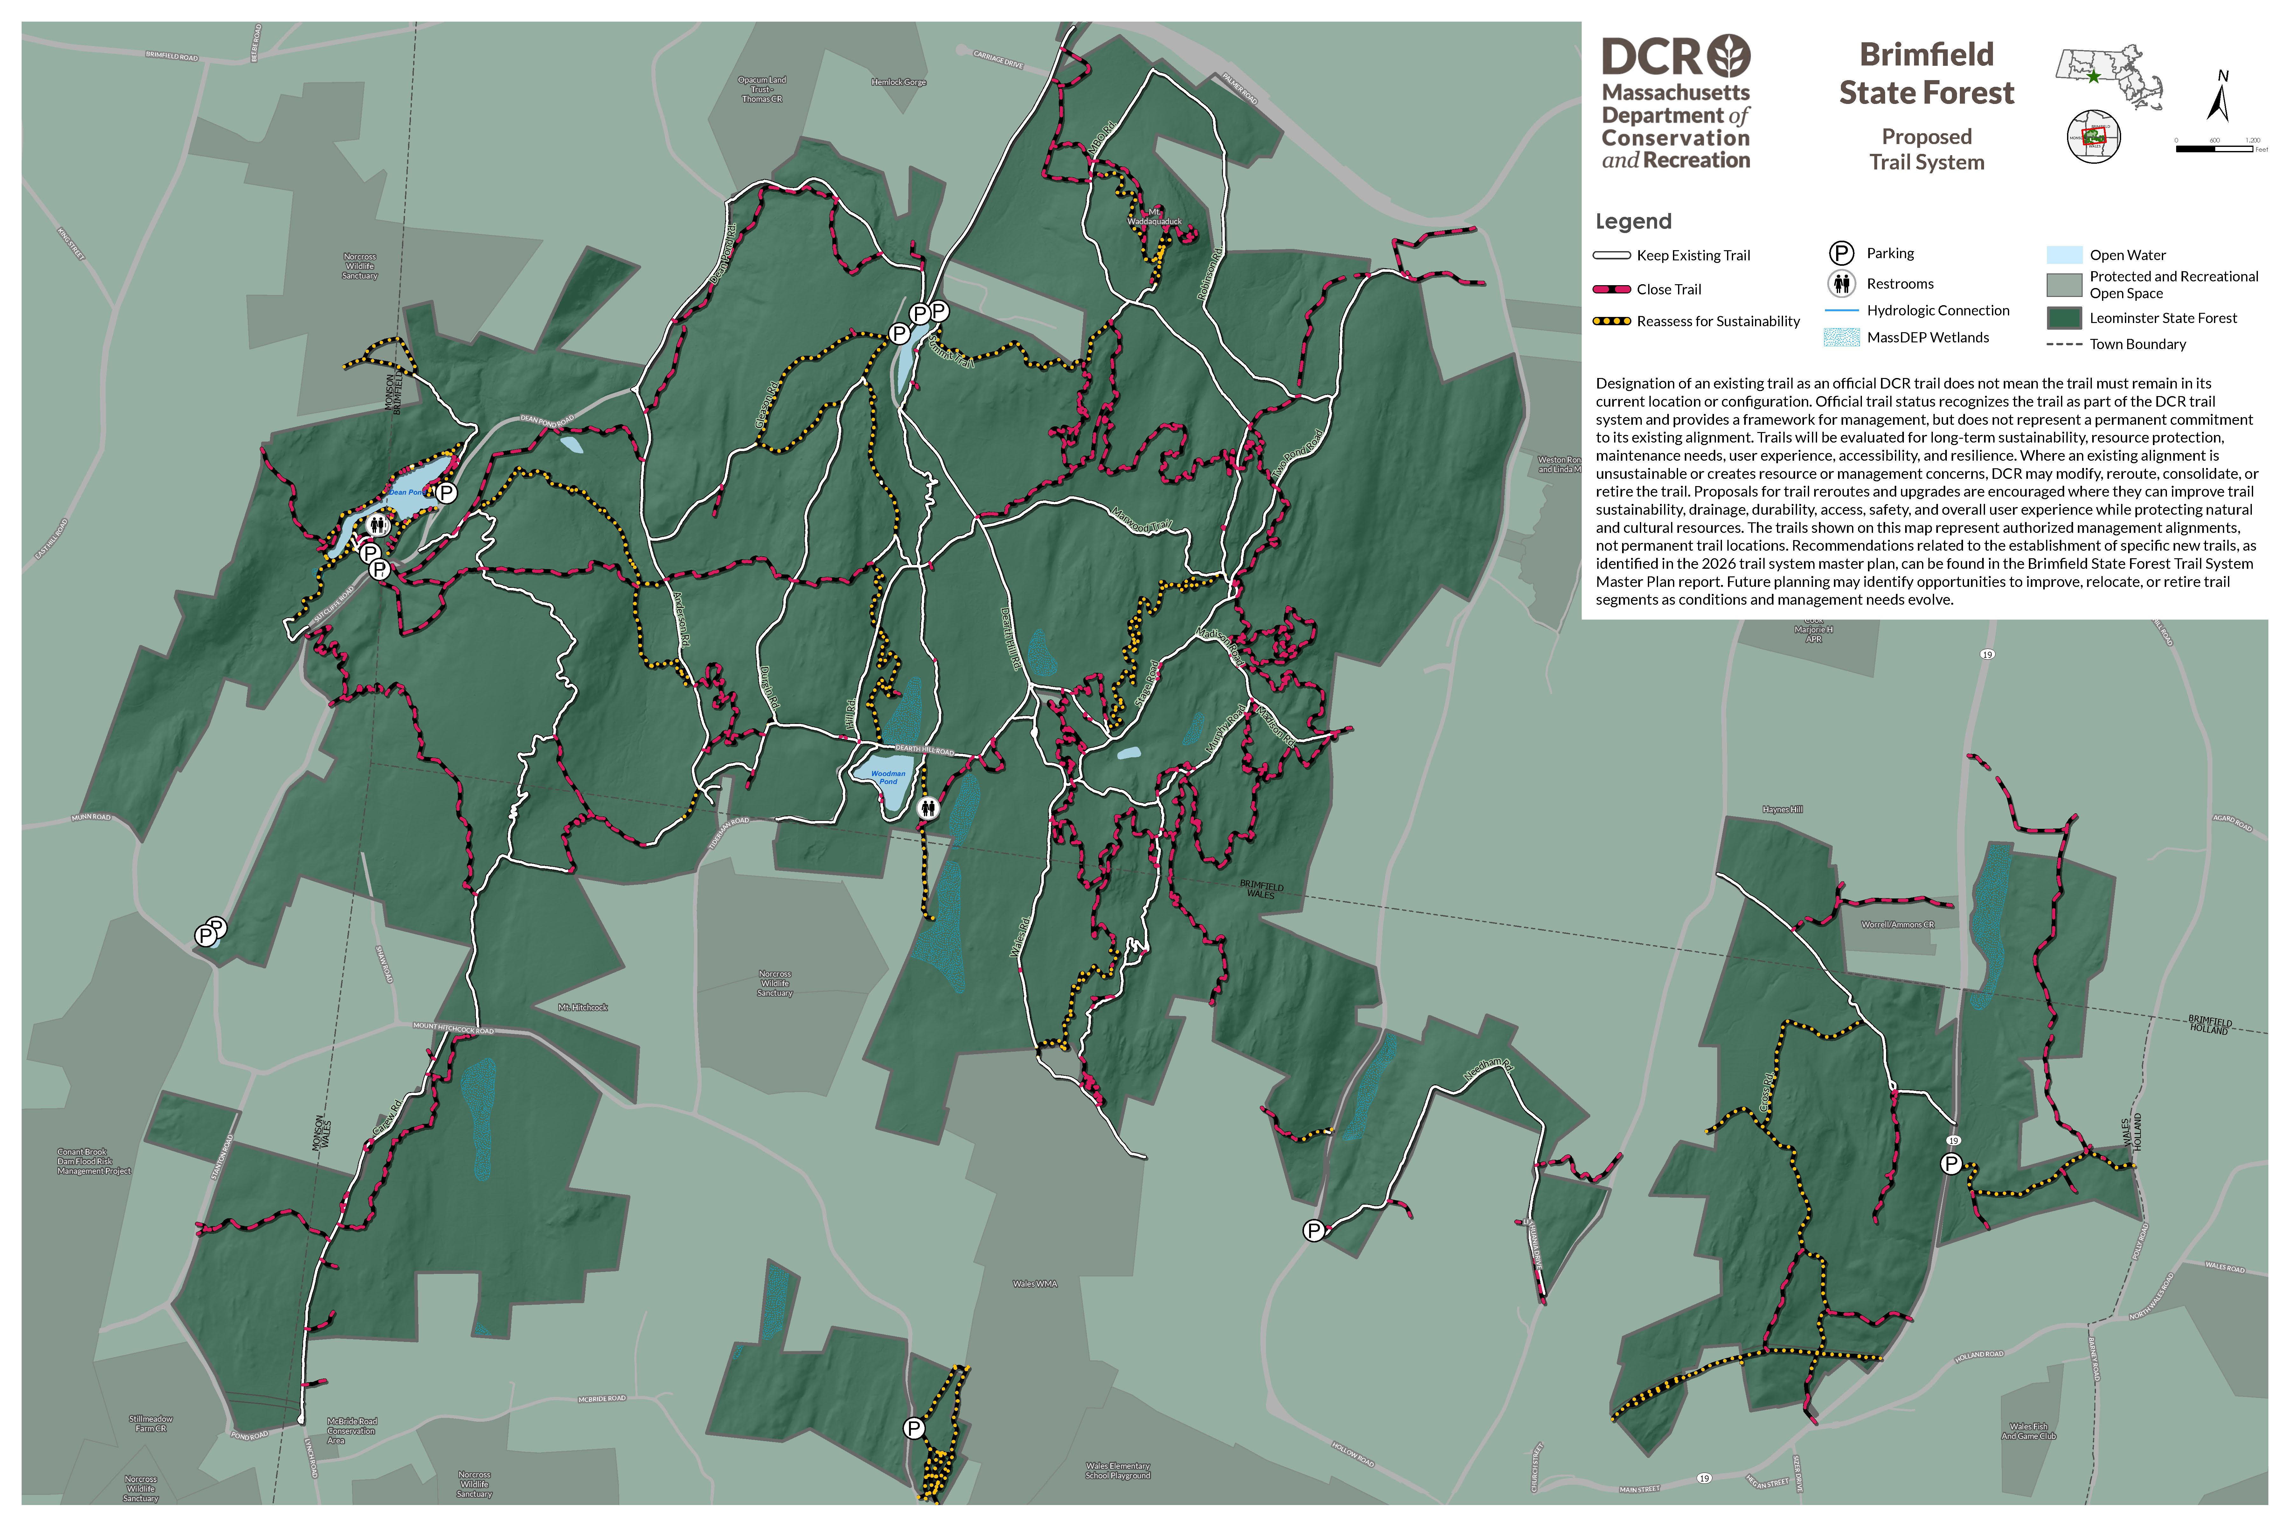
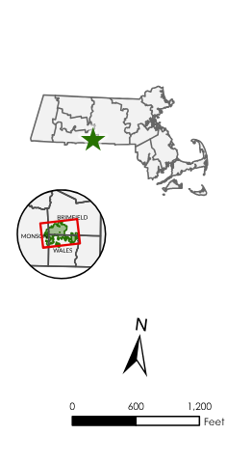
Figure 1. Proposed Trail System Map
Figure 1. [Caption]

Slide 16
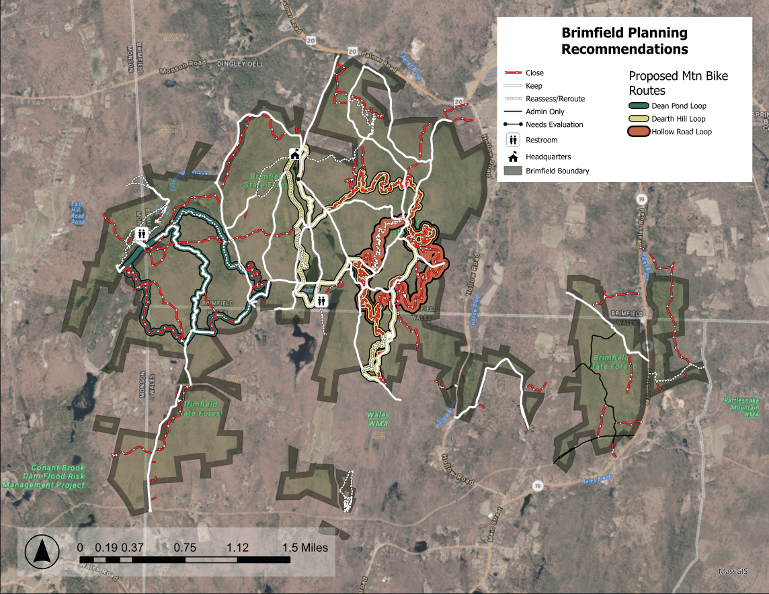
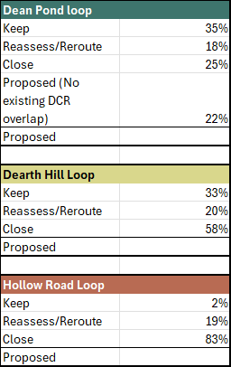
Evaluation of Requested High-Use Trail Loops

Slide 17
Brimfield Trail Densities
Existing Trail Calculations
  Authorized trails: 28 miles
  Unauthorized trails: 31 miles
  Total Trails: 59 Miles
  Trail Density: 6.36 km/sqkm
Proposed Trail Calculations
  Authorized trails: 26 miles
  Unauthorized trails: 12 miles
  Total Trails: 38 Miles
  Trail Density: 4.14 km/sqkm

Slide 18
Figure 1. Proposed Trail System Map
Trail Sustainability and Resource Protection
T1
A1
A2
T4
A3
T2
A4
A21
A5
T14
A19
A6
T13
A7
A24
A20
A8
A25
A10
A9
A14
T11
A16
T9
A15

Slide 19
Figure 1. Proposed Trail System Map
Property Ownership and Connectivity
T3
T4
A3
A21
T13
A20
T7
A12
A10
A9
A14
T5
T6
T8
T10
T9
A15

Slide 20
Figure 1. Proposed Trail System Map
Parking Areas and Trailheads
T1
T3
T4
T15
T2
T14
T13
T7
T12
T5
T11
T6
T8
T10
T9

Slide 21
Figure 1. Proposed Trail System Map
Views, Destinations, and Points of Interest
A2
T2
T14
A20

Slide 22
C1
Figure 1. Proposed Trail System Map
External Trail Connections
C6
C3
C5
C2
C4

Slide 23
Implementation of Trail Recommendations
Initial Priorities (Public Safety, Visitor Experience, Resource Protection)
Update trail maps to reflect the recommended trail network
Improve wetland crossings where needed
Add kiosks and signs to help visitors navigate
Close and restore trails identified for decommissioning
Coordinate with DCR departments on projects that improve recreation
Work with trail partners and communities to support the recommended trail network

Slide 24
Questions & Discussion
General Feedback
Ideas for future connections and/or additional needs
Partnership Opportunities
The Final Draft of the Trail Master Plan, including the recommendations and trail system map, will be posted on the DCR Public Meeting Page following this meeting. We encourage you to review the plan and share your detailed feedback

Slide 25
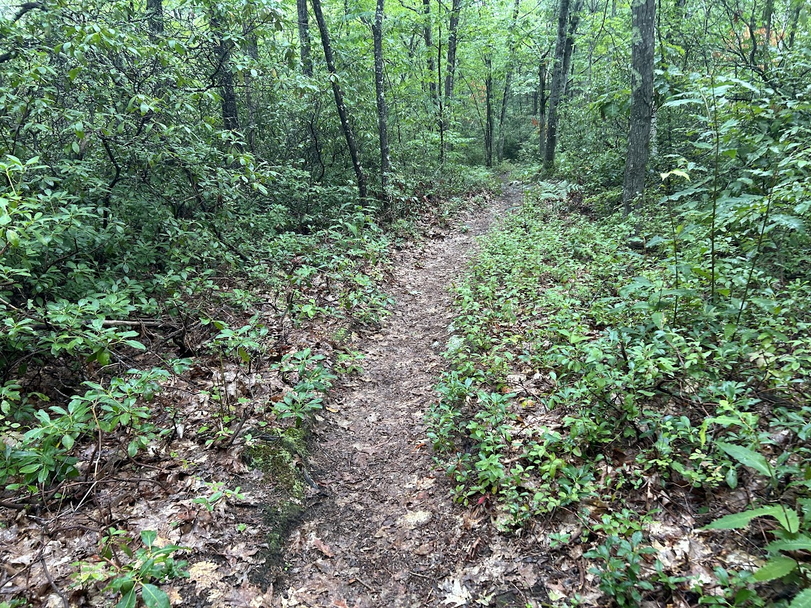
Public Feedback and Other
Recording and tonight’s slide deck will be available at: https://www.mass.gov/dcr-public-meetings-information​​
Public Comments: https://www.mass.gov/forms/dcr-public-comments ​​, please pick Brimfield Trail Master Plan
Deadline: October 21, 2026,​
Please note: the contents of comments submitted to DCR, including your name, town and zip code, will be posted on DCR’s website. Additional contact information provided, notably email address, will only be used for outreach on future updates to the subject project or property.​​
Photo: Forest Trail

Slide 26
Figure 1. Proposed Trail System

