Slide 1
Update on MOUD in Correctional Settings and Other Correctional/Re-Entry Efforts
1/5/2022

Slide 2
Presentation Overview
Background
Updates on Key Initiatives
MOUD and Other SUD Treatment in Correctional Settings
Q&A
Black and Latino Men’s Re-Entry Program
Behavioral Health Supports for Justice Involved Individuals (BH-JI)

Slide 3
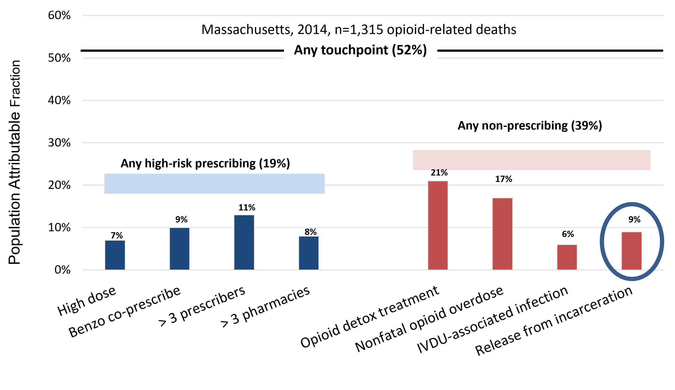
Opportunities for Intervention
Based on data from the landmark Chapter 55 report, our systems touch over half of the individuals who die from opioid-related causes in the 12 months prior to their death.
Each of these touchpoints are opportunities for intervention.
People being released from incarceration represent 9% of these individuals.
Source: Larochelle MR, Bernstein R, Bernson D, Land T, Stopka TJ, Rose AJ, Bharel M, Liebschutz JM, Walley AY.
Touchpoints–opportunities to predict and prevent opioid overdose: a cohort study. Drug and Alcohol Dependence. 2019 Sep 3

Slide 4
Release from Incarceration: A Missed Opportunity
Treatment transitions from 1 month before to 1 month after short-term incarceration (Massachusetts 2011 – 2015)
Incarceration represents a missed opportunity for intervention with the number of individuals receiving MOUD actually decreasing once a person becomes incarcerated.
These individuals are also less likely to re-initiate their medication when they are released.
Source: Analysis from Massachusetts Public Health Data Warehouse. Medication for opioid use disorder
before and after short-term incarceration Walley et al, Poster at College on Problems in Drug Dependence

Slide 5
Overdose Survivors Who Receive MOUD Live longer
Cohort of 17,755 overdose survivors in Mass. (2012 - 2014)
Individuals who have previously overdosed and are receiving any of the three FDA-approved MOUD have at least twice the survival rate while they receive the medication.
This data emphasizes the importance of not only initiating people on MOUD, but retaining them on these life-saving medications.
None
Methadone
Buprenorphine
Naltrexone
Larochelle MR, Bernson D, Land T, Stopka TJ, Wang N, Xuan Z, Bagley SM, Liebschutz JM, Walley AY. Medication for Opioid Use Disorder After Nonfatal Opioid Overdose and Association With Mortality: A Cohort Study. Annals of Internal Medicine. 2018 2018 Aug 7;169(3):137-145.

Slide 6

Piloting MOUD in Correctional Settings
On August 9, 2018, Governor Baker signed into law
Chapter 208 of the Acts of 2018, An Act for Prevention
and Access to Appropriate Care and Treatment of Addiction
(often referred to as the CARE Act).
The legislation named five county houses of correction
(HOC) and four department of corrections (DOC) facilities
to participate in a pilot to offer broad access to all three forms of FDA-approved MOUD to individuals housed in these institutions regardless of release date and/or adjudication status.
Two additional Sheriffs Departments were later named in the supplemental budget.

Slide 7
Piloting MOUD in Correctional Settings
April 1, 2019: DOC began offering buprenorphine and naltrexone in all named facilities
Sept. 1, 2019: All HOCs began offering broad access to MOUD
Oct. 2020:
First annual outcomes report submitted by DPH to Legislature
Sept. 2021: Second annual HOC outcomes report due from DPH to Legislature
Aug. 2019: Approved HOC implementation plans submitted to Legislature
Dec. 2020: DOC began offering methadone in all named facilities
June 2021: First biennial DOC outcomes report submitted by DPH to Legislature

Slide 8
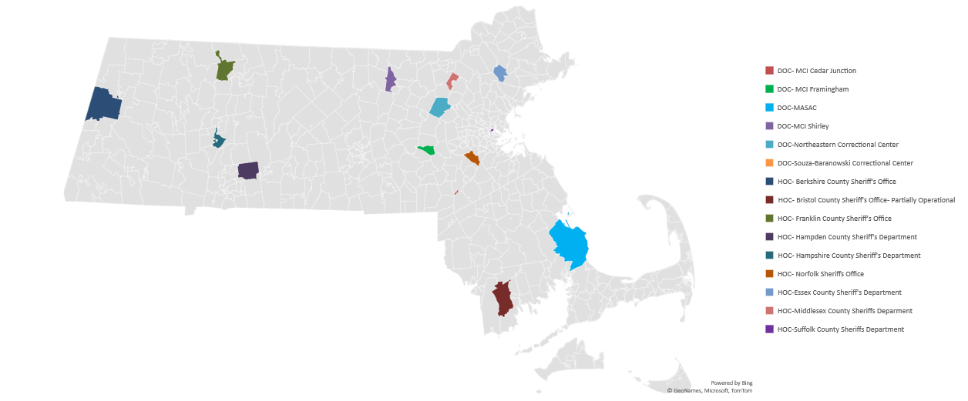
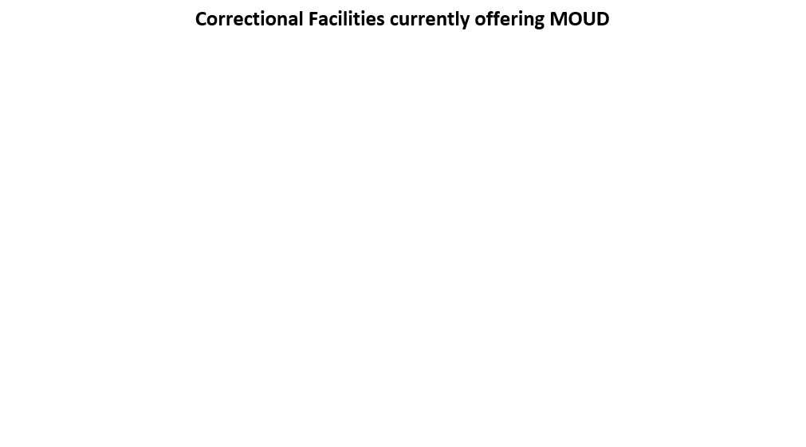
Piloting MOUD in Correctional Settings –
Map of Participating Facilities

Slide 9
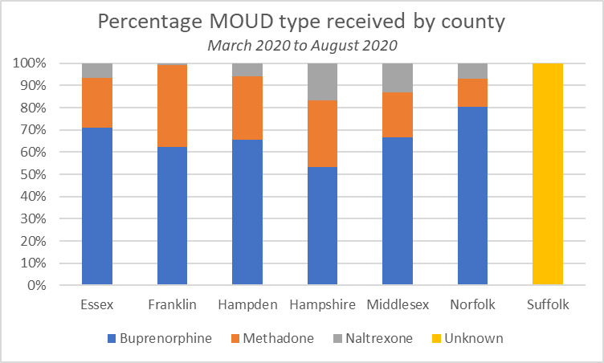
Total HOC Enrollments and Breakdown by Medication Type
The total number of HOC enrollments from September 1, 2019 to February 29, 2021 was 2,325
The most administered MOUD type administered in HOCs was buprenorphine followed by methadone
*Suffolk did not provide complete data on medication type for this time period due to limitations of their electronic medical record.
Source: Preliminary Data from HOC

Slide 10
Total DOC Enrollments and Breakdown by Medication Type
As of 4/15/21, 2,849 individuals have received access to medications for opioid use disorder across DOC facilities.
Of these 2,849 individuals who received MOUD:
  Majority (82%) had been released from incarceration as of 4/15/21
  Average age = 37.1 years
  Majority (68.4%) identified as male
  Buprenorphine was the mostly commonly administered medication type (~77%) followed by methadone (13%) and then Naltrexone (~10%)
Source: Preliminary Data from DOC

Slide 11
Other State Efforts to Address SUD in Correctional Settings
Additionally, DPH funds all 13 HOCs to offer non-MOUD specific SUD programming and re-entry services within their SUD treatment units.
Program length and specific services offered vary by HOC, but may include psychoeducational counseling, etc.
Total annual funding = $819K with various amounts awarded per HOC based on the size/census of each.
HOC | Total FY22 ISA
Barnstable | $ 47,677
Berkshire | $ 50,912
Bristol | $ 115,600
Dukes | $ 4,600
Essex | $ 70,200
Franklin | $ 18,773
Hampden | $ 108,500
Hampshire | $ 52,500
Middlesex | $ 77,200
Norfolk | $ 56,100
Plymouth | $ 56,200
Suffolk | $ 80,867
Worcester | $ 79,883
TOTAL | $ 819,012

Slide 12
Black and Latino Men’s Re-Entry Program
On 12/22/2020, DPH released an RFR on seeking applicants to develop and implement culturally-responsive, wrap-around, re-entry services pre-and-post release in response to increasing overdoses deaths among Black and Latino men.
On 5/22/21, DPH announced that the following five agencies had been selected for awards:
  Casa Esperanza, Inc. in Suffolk County
  Fathers’ Uplift in Suffolk County
  Greater Lawrence Family Health Center in Essex County (in collaboration with the Lynn Community Health Center)
  Legendary Legacies in Worcester County
  New North Citizens’ Council in Hampden County
DPH is working closely with these vendors to further develop their program models and offer services such as assessment, individual services planning, linkages and ongoing care coordination within dedicated community spaces.
Total annual funding = $4.7m

Slide 13
Looking Forward/Future Opportunities
Invest in diversion/alternatives to incarceration
Improve access to health services behind the wall
Other opportunities to support individuals who are incarcerated?

Slide 14
EOHHS Initiatives to Improve Healthcare for Justice Involved Individuals
Behavioral Health Supports for Justice Involved Individuals (BH-JI)

Slide 15
BH-JI Goals and Process
Goals:
Develop a reach-in, re-entry model for engaging Justice Involved Individuals with mental health and addiction needs Demonstrate improved health outcomes, decreased fatal overdoses, and effective, efficient healthcare utilization for Justice Involved Individuals enrolled in the BH-JI program Connect and transition eligible Enrolled Individuals to appropriate health care services and Community Services, using Navigator model Expand BH-JI program statewide
Process:
Began in 2017, with guidance from Council on State Governments at request of Governor and MA leadership Developed in partnership with Probation, Parole, state & county correction agencies, DPH and DMH in alignment with MassHealth larger health reform strategy, and informed by best practices & stakeholder interviews BH-JI Statewide based on success of the BH-JI Demonstration that began in 2019 with Advocates and Open Sky Goal to obtain federal match for community supports by January 2022 BH-JI Statewide Vendors contracted and will launch BH-JI Supports in February 2022

Slide 16
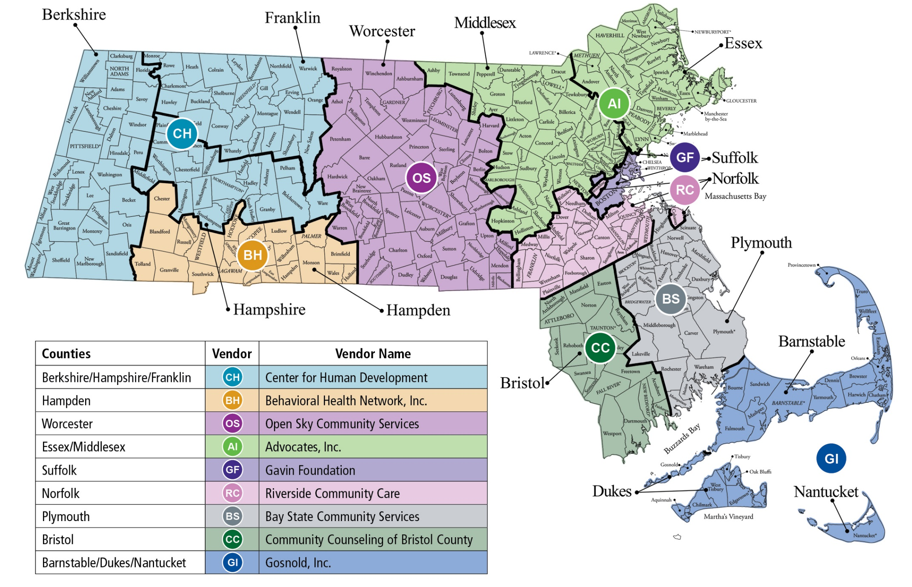
BH-JI Statewide Vendors and Support Areas (beginning Feb. 2022)

Slide 17
BH-JI Supports
Identification, Enrollment and In-Reach Supports within Correctional Facilities | Supports While In the Community
Identify justice involved individuals with substance use and/or mental health conditions with high risk of recidivism Includes individuals releasing from jail/prison or recently released, and/or on Probation or Parole Provide education to inmates on accessing BH-JI supports, invite individuals to enroll In-Reach Supports (as applicable) Group and individual In-Reach sessions Conduct Bio-Psycho-Social assessment, including criminogenic needs Develop support plan & safety plan Make appointments with providers Assist with obtaining housing, other services Coordinate releases with providers, other supports | Trained paraprofessional staff provide intensive supports: Up to daily contact for up to 1st month, then as needed Plan to meet on day of release Coordinate with health care providers, other supports 24-7 on-call crisis support Supports while in 24-7 Facility Navigators receive Clinical Supervision Implement support plan Assist with making and keeping appointments Assist with obtaining and maintaining housing Assist with accessing social services, benefits Warm hand-off to post-BH-JI supports

Slide 18
Appendix on BH-JI

Slide 19
BH-JI (CSP-JI) Eligibility
Administrative criteria
  MassHealth eligible (In statewide: FFS to be served through Vendor contracts)
Programmatic criteria – must meet all of the following:
  Clinical diagnosis of mental illness, addiction treatment needs or co-occurring mental illness and addiction treatment needs
  At risk for admission to a 24-hour facility (inpatient hospital, crisis stabilization, detoxification, residential treatment, or to a Correctional Institution)
  Criminogenic risk profile constitutes a barrier to accessing or consistently utilizing essential medical or behavioral health services
Geographic Criteria
  Statewide: Need to be a resident of MA to have MassHealth

Slide 20
BH-JI Findings: Enrollees’ Behavioral Health Needs
Mental Health Diagnosis | Diagnosis | Percent (N=441)
 | Schizophrenia | 8.6%
 | Bipolar | 31.3%
 | PTSD | 35.4%
 | Major Depression | 47.6%
 | Anxiety Disorder | 57.1%
 | Any Mental Health Diagnosis | 81.2%
Substance Use Diagnosis | Diagnosis (Abuse, Dependence, or Use) | Percent (N=441)
 | Cannabis | 29.9%
 | Cocaine | 32.4%
 | Opioid | 48.3%
 | Alcohol | 48.5%
 | Nicotine Dependence | 66.4%
Source: UMMS analysis of MassHealth claims for the time period 7/1/2018 to 8/31/2020

Slide 21
BH-JI Preliminary Data Trends from Evaluation and MassHealth Claims Analysis
BH-JI enrollees were more likely to use fewer behavioral health inpatient hospital, emergency transportation, and emergency department services than before BH-JI.
Enrollees used more behavioral health outpatient services and medication assisted treatment.
Pre- and post- costs for MassHealth services were comparable.
After six months, individuals who have stable housing increased by 20% and individuals who were employed increased from 27% to 38%.
Source: UMMS analysis of MassHealth claims for the time period 7/1/2018 to 8/31/2020

Slide 22
Response from Participants
“My navigator really was that lifeline – that connection to that new life that I encountered.” – JS
“I have been in the system over 30 years, and this experience I am having with this program is one of the best things in my life.
The advocate that I have treats me like my present, my past don’t play a part in what it is that’s going on today.
She looks at me as a person, she looks at me as someone that’s trying to better themselves, and she doesn’t bring up my past.”
– CB
“Without her help and the
resources, like, I probably would have already violated parole, would have been back in prison.
When you come home, the most important thing, I would say,
is getting all your mental health stuff correct. You know, talking to somebody, getting the treatment you need, if you need it.” – JP

