Slide 1
Harm Reduction Strategies for Stimulant Use
2/24/22

Slide 2
Harm Reduction for Stimulant Use
With an increasingly contaminated drug supply and ongoing trends of poly substance use, harm reduction strategies remain a critical pillar in the state’s response to keep people who use stimulants alive and reduce the potential harms associated with their use.
Harm Reduction Strategies
Outreach and education on increased risk for overdose due to contamination
Drug checking including increased access to fentanyl test strips
Increased access to naloxone and overdose prevention education for stimulant users
Increased access to other harm reduction services and supplies for people who use drugs through non-injectable means
Safe spaces including harm reduction housing, quiet rooms, chill out spaces, etc.
Support for other basic needs including access to showers, water for hydration, tooth paste and toothbrush
Education on safe/safer sex practices and resources including condoms, pre and post exposure prophylaxis (PrEP and PEP)
Testing for HIV and HCV

Slide 3
What are MA and Other States Doing?
While the opioid crisis has been a focus here in MA for some time now, other states have been wrestling with stimulant use for some time now allowing us to learn from their experience the same way they have learned from our innovative approaches to opioids.
The following slides outline a number of approaches the other states are pursuing to address stimulant use:
Outreach and Education
Culturally-specific Work with Tribes
Drug Checking
Increased Access to Naloxone
Safe Spaces
Decriminalization

Slide 4
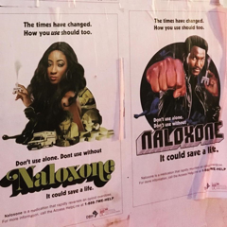
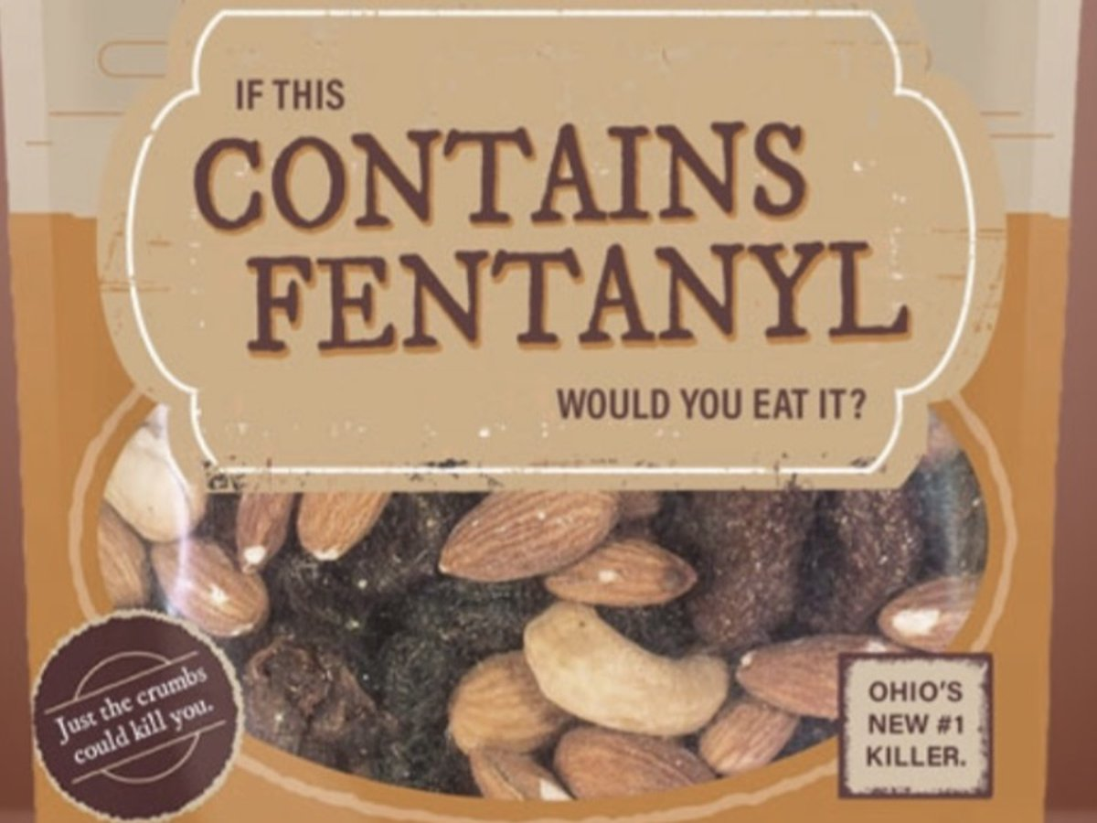
Outreach and Education: Multiple States
A number of states have rolled out targeted outreach and education campaigns to increase awareness about the contamination of cocaine and fentanyl in the drug supply.
By developing targeted public health messaging and rolling it out strategically in settings and communities where individuals may be using stimulants, they were able to reach more diverse audiences and increase community awareness about the potential risks associated with using stimulants that may be contaminated with fentanyl as well as reinforce the importance of carrying naloxone.
Washington, DC
Cocaine and Fentanyl
Awareness Campaign
New York Cocaine and Fentanyl Awareness Campaign
Ohio Cocaine and Fentanyl Awareness Campaign

Slide 5
Culturally Specific Work with Tribes: MA
Here in Massachusetts, BSAS has been working closely with tribal partners to offer culturally-responsive training related to substance use including stimulant use disorder.
In particular, BSAS have an upcoming three-part training series on this topic that we are offering in partnership with the Opioid Response Network and New England Addiction Technology Transfer Center.

Slide 6
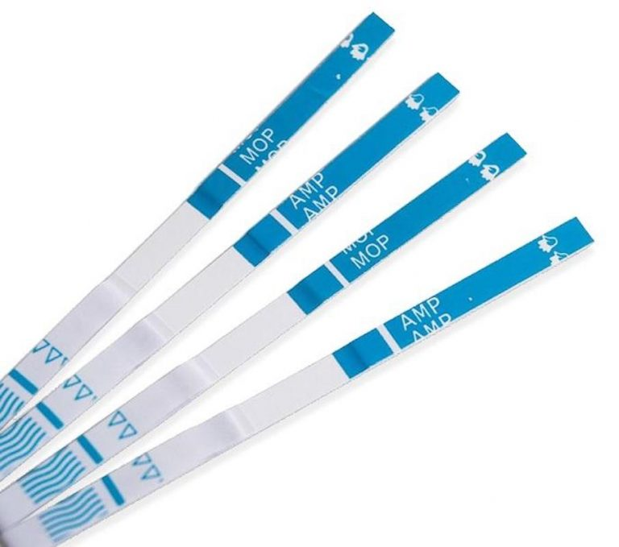
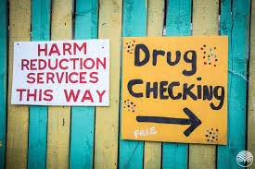
Drug Checking: Multiple States
With federal support, many states including Massachusetts have begun to offer expanded access to drug checking including distribution of fentanyl test strips.
Drug checking empowers people who use drugs to understand what is going into their bodies and make informed decisions about how to stay safe. It also acts an important tool for engaging individuals who may be using stimulants to understand their risk and the benefits of carrying naloxone.

Slide 7
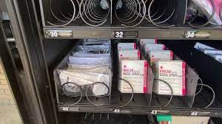
Increased Access to Naloxone, etc.: Multiple States
Additionally, many states including Nevada, Ohio and New York have increased access to naloxone and other harm reduction supplies through strategies such as the purchasing of vending machines; a strategy recently endorsed by SAMHSA as part of their recently released harm reduction grant opportunity.
These vending machines allow individuals to access life-saving supplies after hours and without the stigma of needing to come into a syringe exchange, a step some people may not feel comfortable with, particularly if they are not injecting. Additionally, some states have began offering mail-based delivery options to further reduce barriers and ensure robust access.

Slide 8
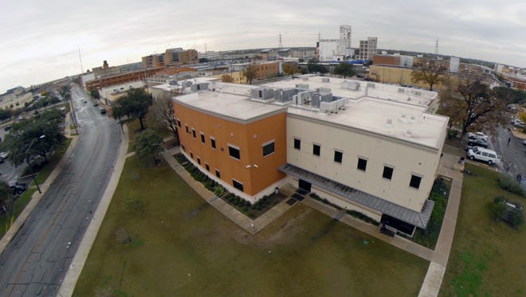
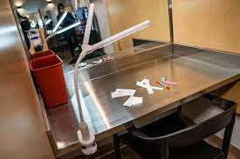
Safe Spaces: Multiple States
Many states including Massachusetts have begun to explore options for creating safe spaces for people who use substance in general, both as a supervised location to consume substances (New York City) and as a quiet location to rest and receive supportive services.
Many of these spaces have incorporated dedicated spaces for people who use stimulants. Some examples include the restoration center in San Antonio, TX; the Sobering Center in Austin, TX and the newly opened Safe Consumption Site in New York.
San Antonio, TX
Restoration Center
Austin, TX
Sobering Center
New York
Safe Consumption Site

Slide 9
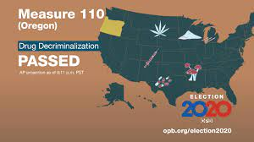
Decriminalization: Oregon
In 2020, Oregon voters passed Measure 110, which decriminalized possession of small amounts of illicit drugs. It also reduced the penalties for possessing larger amounts, acknowledging that addiction cannot be treated as both a disease and a crime simultaneously.
The measure also expanded funding and access to addiction treatment services using tax revenue from the state’s cannabis industry, as well as from expected savings from a reduction in arrests and incarceration.

Slide 10
Summary of Key Points
Harm reduction is critical in addressing stimulant use due to contaminated drug supply, poly substance use and increasing rates of opioid overdoses with stimulants present.
Key harm reduction strategies include:
More outreach and education
Drug checking including fentanyl test strips
Increased access to naloxone and other harm reduction services/supplies
Safe spaces including harm reduction housing, etc.
Access to other basic needs including showers, water, etc.

Slide 11
Discussion/Q&A

