Slide 1
Massachusetts Department of Public Health Bureau of Substance Addiction Services Office of Youth and Young Adult Services
School Based Programming for Youth
Community Behavioral Health Promotion and Prevention Commission
December 9, 2021
Brian Jenney, Director
Rebecca Butler, Assistant Director

Slide 2
OYYAS Mission:
To promote personal & family growth by ensuring youth and young adults experiencing substance use and co-occurring disorders have access to developmentally appropriate, culturally responsive, trauma-informed services and supports.

Slide 3
OYYAS Goals:
Build and support the Office of Youth and Young Adult Services and its providers to maintain a continuum of comprehensive, integrated services.
01
Facilitate efforts to improve external stakeholder capacity to work with youth and young adults with substance use disorders.
02
Promote and support a youth and young adult recovery community network.
03
Utilize research and data to drive system change in an effort to close any gaps that exist within the OYYAS continuum of services.
04

Slide 4
OYYAS Scope of Services
OYYAS
School-Based Intervention
Community-Based Intervention
Residential Treatment
Recovery Supports
Outpatient Treatment
Youth Detoxification & Stabilization
Medication for Opioid Use Disorder

Slide 5
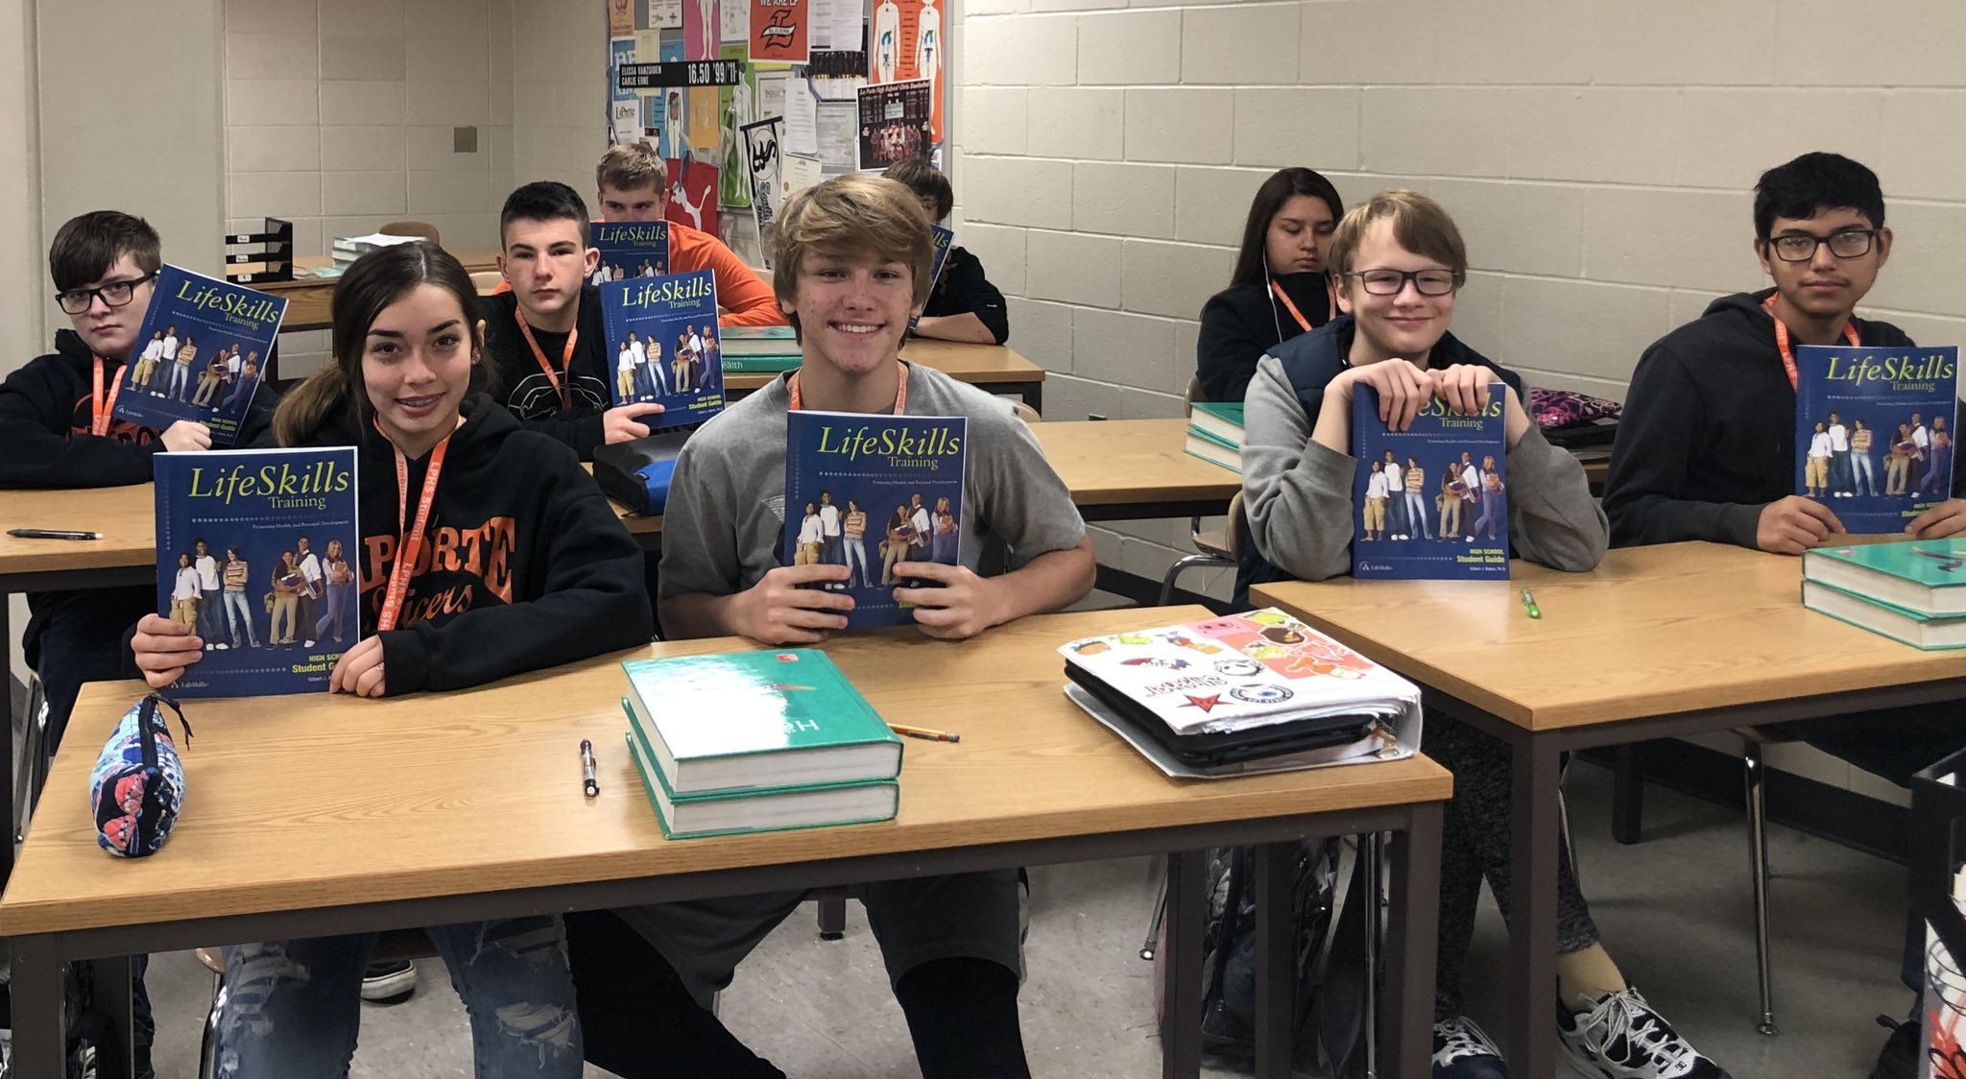
DPH/BSAS Prevention Unit
Botvin LifeSkills Training (LST) is a comprehensive substance use prevention program that focuses on targeting the social and psychological factors that initiate risky behaviors rather than simply educating participants on the dangers of drug and alcohol use. By building self- confidence and strengthening the skills needed to successfully handle challenging situations, LST has been proven time and again to significantly reduce the risks of alcohol, tobacco, drug use and violence.
This evidence-based program:
Teaches students the necessary skills to resist peer pressures to smoke, drink, and use drugs.
Helps to develop a healthy self concept and confidence.
Gives students the skills needed to effectively cope with anxiety.
Increases knowledge of the immediate consequences of substance abuse.
Enhances cognitive and behavioral competency to reduce and prevent a variety of health risk behaviors.
BSAS has trained 638 facilitators since 2017.
Student participation: FY19: 3,450 FY20: 5,567

Slide 6
DPH/BSAS Prevention Unit
The Good Behavior Game:
An evidence-based universal preventive intervention applied by teachers in the classroom.
Consists of a set of research-based strategies with origins in behavioral science, neuroscience, and cultural wisdom that operate together to improve children’s self-regulation.
Teachers implement these strategies as part of their daily routines in carrying out tasks such as getting students’ attention, selecting students for tasks, transitioning from one task to the next, working as part of a team, limiting problematic behavior, and reinforcing pro-social behavior.
The Good Behavior Game helps to build children’s self-regulation, resulting in improved focus and attention, improved test scores and other academic outcomes, reduced alcohol and other drug use, reduced psychiatric disorders, and reduced suicide.
Since 2017, BSAS has trained and offered implementation supplies to 344 teachers and administrators.

Slide 7
Progression of Intervention Services
Service Type: Treatment
Modality: A-CRA/Co-Occurring Response Teams
Target Population: 12-24
Staff: Clinicians
Site: School, Community,
Clinic
Reimbursement: 3rd party or FI Blanket
Service Type: Intervention
Modality: Intensive Case Management
Target Population: 8-17
Target Population: Parents
Staff: Clinicians and/or BA
Site: School
Service Type: Intervention
Modality: Project AMP
Target Population: 13-17
Staff: BA/ paraprofessional/ *lived experience
Site: School, Community
Service Type: Intervention
Modality: iDECIDE
Target Population: 12-17
Staff: BA/ paraprofessional
Site: School, Community

Slide 8
iDECIDE
Education-based intervention for students caught violating school substance use policy.
Science-based alternative to suspension and other exclusionary disciplinary responses to student substance use.
Students participating in iDECIDE will gain:
A scientific understanding of the impact of substance use and addiction on the adolescent brain and body,
An understanding of the common tactics used by industry to target youth,
An ability to identify and respond to personal impulses to use alcohol and other drugs and,
A sense of empowerment and a plan to make healthier, positive choices in line with long term goals for the future.
iDECIDE is a collaboration between OYYAS, Massachusetts General Hospital, the Institute for Health and Recovery.

Slide 9
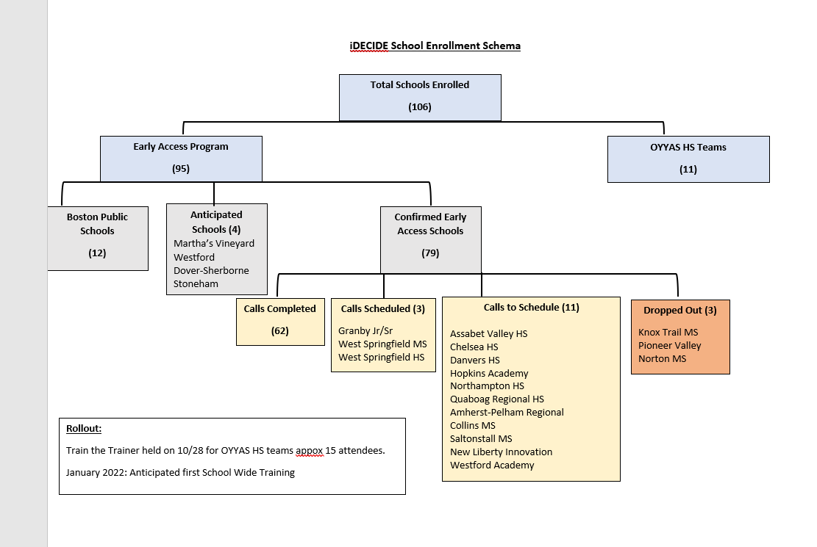

Slide 10
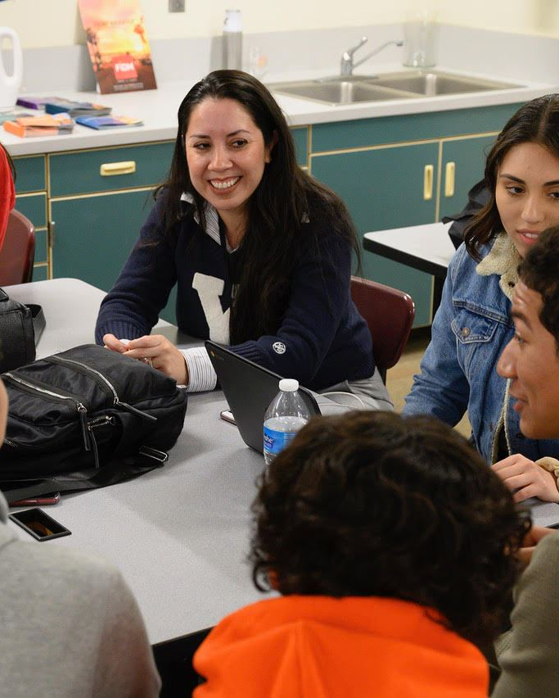
School Based Intensive Intervention:
Intensive Case Management
School-based long-term (6-24 months) intervention
Service youth ages 8-17 at risk for developing substance use disorder
Goal to reduce risk factors & increase protective factors to prevent future substance use
Students are identified and referred by school staff for poor school attachment or academic performance, conduct problems, and family history of substance use
Continued expansion of program model

Slide 11
Region | Town | School | Agency Partner
Western MA | North Adams | Drury High School | Brien Center
 | Pittsfield | Taconic High School
 |  | Reid Middle School
 | West Springfield | West Springfield Middle School | Center for Human Development
 | Holyoke | William R. Peck Middle School | River Valley Counseling Center
 |  | Veritas Preparatory Schools
Central MA | Ayer/Shirley | Ayer-Shirley Regional Middle School | Community HealthLink
 | East Brookfield | Knox Trail Middle School
 | Leominster | Skyview Middle School
 | Worcester | Worcester East Middle School
 | Fitchburg | Montachusett Regional Vocational Tech | L.U.K. Crisis Center
 |  | Memorial Middle School
 | Webster | Webster Middle School
Northeast MA | Beverly | NEC Collaborative District | YMCA North Shore
 |  | Beverly Middle School | Lahey Health Behavioral Services
 | Gloucester | Gloucester Middle School
Greater Boston | Malden | Salemwood School | Institute for Health & Recovery
 | Chelsea | Joseph A. Brown Middle School | North Suffolk Mental Health
 |  | Eugene Wright Science & Technology
 | Winthrop | Winthrop Middle School
 |  | Arthur T. Cummings Elementary
 | Boston | Dever Elementatry School | Wediko Childrens Services
 |  | Perkins Elementary School
Southeast | Taunton | Taunton High School | High Point Treatment Center
 |  | Taunton Alternative High School
 | Wareham | Wareham Middle School
 | Attleboro | Attleboro Community Academy | Justice Resource Institute, Inc.
 | New Bedford | Keith Middle School | Child and Family Services
 |  | Normandin Middle School
 |  | Roosevelt Middle School
Current Capacity:
13 Agencies serving 30 Schools
Calendar Year | Enrollments
2019 | 243
2020 | 245
2021 | 307
All Years | 795

Slide 12
Project Amp:
Enhanced brief intervention delivered by trained near-peer mentors
Goals:
Explore strengths, interests, and personal goals
Enhance self-efficacy to achieve goals
Emphasize wellness and resiliency
Expand knowledge of substance use harm
Engage with community resources
4-6 sessions in school-based settings
Age 13-17
Expansion of services into additional communities expected by the end of 2021.

Slide 13
Outpatient Treatment
Adolescent Community Reinforcement Approach (A-CRA)
Evidence-based and developmentally tailored brief, behavioral intervention for transition age youth 12-24.
Aim to increase family, social, and educational/vocational reinforcers to replace substance using behaviors.
OYYAS currently has 32 A-CRA locations representing 16 agencies across the Commonwealth.

Slide 14
Partnership between community based behavioral health providers and their local high schools.
Three levels of care:
Intervention (Project Amp)
Diversion (iDECIDE)
Treatment (A-CRA)
Students referred by school staff, outside collaborative agencies, parent(s), or self-referred.
Targets “at-risk” students struggling at home, in school, or within community with respect to social-emotional indicators for substance use disorder or co-occurring disorders.
Team: A-CRA Supervisor; A-CRA Clinician; & Project Amp Mentor.
Service components include a comprehensive needs assessment, individual brief intervention, individual and group treatment, psychoeducation/diversion groups, and case management.
High School Response Teams

Slide 15
Current Capacity - High School Response Teams:
6 Agencies serving 11 Schools
Region | Town | School | Agency Partner
Western MA | Great Barrington | Monument Mountain Regional High School | Brien Center
 | Holyoke | Holyoke High School - North Campus | River Valley Counseling Center
Central MA | Athol | Athol High School | Heywood
 | Orange | RC Mahar Regional Middle & High School
 | Baldwinville | Narragansett Regional High School
 | Winchendon | Murdock High School
 | Gardner | Gardner High School
 |  | Gardner Academy for Learning & Technology
Greater Boston | Malden | Malden High School | IHR
 | Revere | Revere High School | North Suffolk Mental Health Association
Southeast | New Bedford | New Bedford High School | High Point

Slide 16
School Based Telebehavioral Health Services
$3,532,000 legislative earmark.
Objectives:
To reduce barriers to access for critically needed behavioral health services
To demonstrate the feasibility and elements necessary for success to replicate this program in other schools.
Brookline Center for Community Mental Health:
Designing a pilot program after conducting a thorough needs assessment and investigation of past successful projects
Implementing the pilot program including site selection, funding, and support to sites to achieve sustainability in the provision of services
Providing a rigorous evaluation of the program
Producing a replication guide to assist additional schools in starting a telebehavioral health program
Public-private partnership including the following
agencies:
Department of Public Health:
Bureaus of Community Health and Prevention
Bureau of Substance Addiction Services
Executive Office of Health and Human Services
Department of Mental Health
Department of Elementary and Secondary Education
Mosakowski Institute for Public Enterprise at Clark University,
DMA Health Strategies

Slide 17
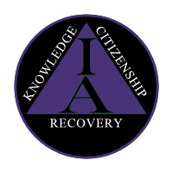
School Based Day Treatment/Transition Program
Program Design:
Multi-tiered model that will create a continuum of care in one building.
10-day alternative to suspension program,
45-day intervention, and
Recovery high school.
Designed to assess, stabilize, educate, and transition all students who enroll
Goals:
Connect youth with specialists in the field of adolescent substance use, trauma, and mental health to promote emotional stabilization, healing and recovery; and
Develop proficiency in social and emotional learning competencies by introducing self-management techniques in order to stabilize and/or enhance appropriate behavioral self-regulation; and
Educate students through evidence-based instruction on adolescent development, personal wellness, relationship skills, responsible decision making and life skills to promote healthy life choices; and
Offer academic supports to assist students with their academic progress or prevent students from disruption in their academic careers in order to encourage a seamless re-integration back into a more traditional school environment (e.g., community based High School); and
Provide opportunities for students to become engaged in appropriate aftercare services including outpatient therapy, SUD recovery support, or other developmentally appropriate activities.
Key Components:
Biopsychosocial and educational assessment
Educational programming and academic support
Individual and group counseling
Family engagement and support
Aftercare planning
Independence Academy
460R Belmont Street
Brockton, MA 02301
Phone: 508 510-4091

Slide 18
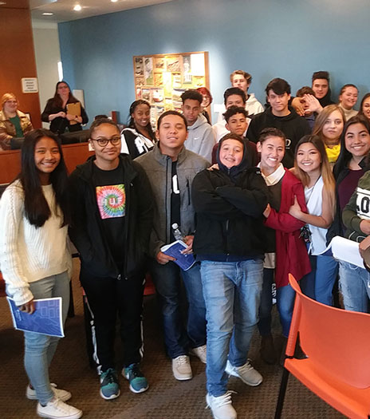
Supportive Afterschool Enrichment
OYYAS recognizes that for many adolescents, the hours directly after school are unstructured and often lack supervision from or interaction with supportive adults.
For students struggling with a substance use disorder, a lack of structure and routine can lead to boredom and become a trigger for a potential relapse.
To increase community-based recovery supports for youth ages thirteen to seventeen, OYYAS has partnered with the Recovery High Schools in Springfield, Boston, and Beverly to provide after school and out-of-school educational assistance and support as well as socially engaging and developmentally appropriate activities.
Each of the Recovery High Schools have specialized training and experience in addiction and recovery services, trauma informed care, and can provide academic tutoring and educational assistance on site making this a great community resource.
Programming is open to all youth within the school’s catchment area regardless of RHS enrollment.

Slide 19
Other Intervention Strategies
Family Intervention & Support
Invitation to Change
Learn to Cope
Allies in Recovery
Community Based Intervention & Support
Project READY (in partnership with DYS)
Recovery Support Navigators at DMH Access Centers
Youth SEARCH (Street Outreach)
Project Amp
Community Innovation Funding
Green Care – Animal and Wilderness Education
Alternative Peer Groups (APG)

Slide 20
Any
Questions?

Slide 21
Contact Information (MA DPH/BSAS/OYYAS):
Brian Jenney, MA CAGS, LMHC, LADC I
Director, Office of Youth and Young Adult Services
Brian.Jenney@mass.gov
Rebecca Butler, MSW, LCSW
Assistant Director, Office of Youth and Young Adult Services
Rebecca.D.Butler@mass.gov

