Slide 1
2017 Rapid Response Summit
Business Cycle 101
John McCarthy
Eric Nelson
Jil Wonoski

Slide 2
Business Cycle 101
Everything Starts With A Business Assessment
Tour = Company Culture, Type Equipment, etc.
Admin Info = FEIN, Company Structure, Locations
Operations = Type Product/Service, Number Employees, Number Shifts
Competitors & Collaborators = External Influence / Pressure
Current Challenges = Employee Retention, Contracts, etc.
What Does Your Future Look Like = Short Term, Long Term
1.6 Million Other Questions…..Such As…..
WHERE ARE YOU IN YOUR BUSINESS CYCLE?
The Goal = Right Service(s), Right Timing

Slide 3
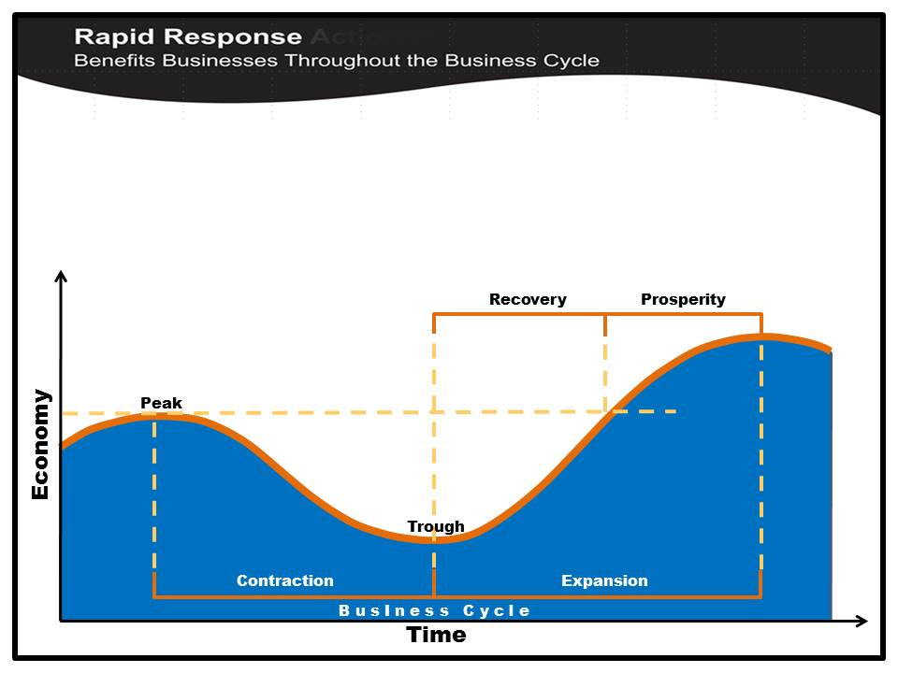
Business Activity “bottoms out”
Production and Employment at lowest capacity
OJT
Apprenticeship
Community College Business Programs
Workforce Training Fund Program
Production and Employment at near full capacity
High point of expansion
Worker training/retraining
Worker training/retraining
Rising Production
Hiring activity
Considering future expansion
KEY POINT: Business Cycles Vary by Industry, Company, and Location
Lower sales activity
Limited or reduced future contract activity
Layoffs may begin here
Access to qualified workers
Job Order Postings
Individual Recruitments
Specialized Recruitments
Job Fairs
Access to qualified workers
Nearing peak Production
& Employment
Expansion activity may
begin
Production continues to decline
Layoffs
May begin shutdown – all or part

Slide 4
Worker training/retraining
OJT
Apprenticeship
Community College Business Programs
Workforce Training Fund Program
DIA Safety Grant / DLS Consultation
Access to business
expansion strategies
and resources
Rapid Response Layoff Aversion
DUA WorkShare
Access to qualified workers
Alternatives to layoffs,
Options for downsizing
Mass Office of Business
Development (MOBD)
Mass Development
Energy Efficiency Programs
SERVICE STRATEGIES
Job Order Postings
Individual Recruitments
Specialized Recruitments
Job Fairs
Mass Office of Business
Development (MOBD)
Mass Development
MASS Growth Capital Corp
Business retention
Strategies and resources
Worker transition
and reemployment
DUA UI Program
Career Centers
OJT
Apprenticeship

Slide 5
Business Cycle 101
The 4 Parts to Understanding the Business Cycle
Know Your Customer
Know Their Industry
Know What Services Are Available
1. Know What They Need & When They Need It

Slide 6
Business Cycle 101
Example: Today
Pharmaceutical
Industry In
Sharp Decline
XYZ Pharma:
Funded for New Drug R&D
Hiring 100+
Opening New Satellite Lab
Industry in Contraction
Company in Expansion
XYZ Pharma, Inc.
Pharmaceutical
Industry

Slide 7
Business Cycle 101
Example:
18 Months Later
Pharmaceutical
Industry In
Steep Growth
XYZ Pharma:
Sold Research
Layoffs
Closing Satellite Lab
Industry in Expansion
Company in Contraction
Pharmaceutical
Industry
XYZ Pharma, Inc.

Slide 8
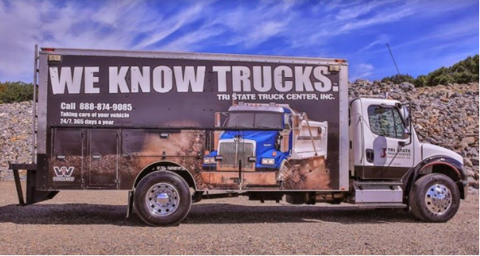
Business Cycle 101
Tri State Truck Center, Inc.
Jil Wonoski, Marketing Consultant

Slide 9
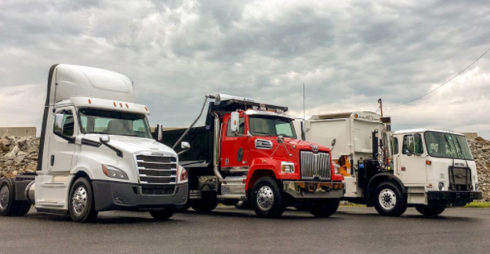
Introduction
Marketing Consultant/Director of Marketing
Tri State Truck Center
Company History

Slide 10
Problem
How do we fill the gap in the skilled labor market? Plumbers, Electricians, Carpenters, Etc.
For us it’s Diesel Tech’s in the Industry
For every 10 Diesel Tech’s retiring only 2 are entering the industry

Slide 11
Details
Career & Pay Scale
Service
Sales
Parts
“If a Truck Stopped.”
Answer & Win
These are great jobs

Slide 12
Partnering with Worcester Workforce Central Team
Stepping into the unknown
Jeff Turgeon & John McCarthy
Tour of Tri State
Business Assessment
John Review of Programs and Grants

Slide 13
Partnering Programs and Grants
Job Fairs/Recruiting from Career Center
Veteran’s Recruiting
Workforce Training Fund Grant
On The Job Training Program
Safety Training Grant
State Certification to become a Diesel Mechanic training site
WDB Membership
Do you know trucks? Come work with us!
Calling out employee training and development

Slide 14
Apprenticeship Program(s)
1st Grant Funded Diesel Tech Program in MA
On-site Diesel Tech Apprenticeship Program
Earn & Learn
Mentorship with employees
Pre Apprenticeship Program at South High

Slide 15
Closing
Moving Forward
Next Steps & Recommendations
Questions & Answers

