Slide 1
Advancing Business Engagement with Career Readiness Initiative Tools Spring 2017

Slide 2
Introductions
Name
Agency
Position in Agency
Role within CRI

Slide 3
Agenda and Goals
Learn about CRI resources and how they can help you serve jobseekers and businesses in your region.
Discuss how the CRI resources and tools can be incorporated into your region’s WIOA plan for business engagement.
Identify right-fit businesses and staffing needs for promoting CRI tools and resources.
Develop action steps for your region’s CRI
business outreach.

Slide 4
MA Career Readiness Initiative Context
Unemployment is most acute and chronic for individuals with the least amount of education and technical skill
1/3 of students entering public higher education require literacy and math remediation (higher at community colleges)
Over 20,000 individuals on wait lists for adult education classes
WIOA requires better alignment of basic skill pathways across core programs, systems and resources for coordinated services for shared customers.

Slide 5
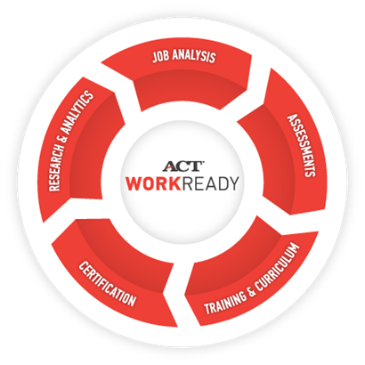
MA Career Readiness Initiative
3
Objectives:
Align and coordinate across WIOA partners (Adult Education, Workforce Development, and Community Colleges) to serve shared customer base and facilitate basic skills pathways through shared tools.
Supplement basic skills delivery for low-skilled individuals
Improve business services, though work-based skills and job matching

Slide 6
Massachusetts CRI Model
Assess and Remediate Basic Skills
Credential for Jobseekers
Business Engagement
Aligned w/Career Goals and Skill Requirements
Workplace Documents
(reading)
Applied Math
Graphic Literacy
Matching Skills
w/ Demand
Aligned w/Career Goals and Skill Requirements
Career Exploration
Reading for Information
Applied Math
Locating Info/Graphic Literacy
Soft Skills
WorkKeys Test &
NCRC
Data base of 20K jobs &
Trained Job Profilers :
Improve accuracy of job descriptions
Develop OJT plans
Identify NCRC skill match
Improve screening
Reduce turnover
Career Ready 101

Slide 7
Career Ready 101 Assess & Remediate Baseline Skills
Computer-based, online, self-paced curriculum.
Pre-test identifies baseline skills
Career Exploration – identifies skill level needed for career goals
Leveled lessons to help participants attain the targeted skill level.
Instruction in Reading, Math, Locating Info (Graphic Literacy), Soft Skills, Career Exploration, and more.
CR 101 Can be used on its own and as preparation for WorkKeys.
Notes:
I want to take a moment now to make sure we’re all clear about the tools our presenters will be talking about today.
During this brief refresher, listen for the answers to the quiz questions from earlier.
CR 101 – is a curriculum that contains courses on a variety of subjects. While a core component of CR 101 is a set of pre-tests to assess baseline skills, CR 101 is not a test system, but a system that delivers curriculum and instruction to improve and remediate an array of skills needed to be successful in the workplace.
The CR 101 courses include , Keytrain workplace skills - reading for information, locating information, and applied mathematics and soft skills. CR 101 also includes tools for career exploration and resume writing among others.
(Under this initiative 100 CR 101 licenses have been activated over the last 2 years.
WorkKeys - is a timed, proctored test of skills in these 3 areas – reading for info, applied math, locating info
WK tests are scored and expressed in skills from 1-7
WorkKeys test administration is an entirely separate function from the CR 101 curriculum system
.
So again, Work Keys is the test, NCRC is the resulting award/certificate

Slide 8
Massachusetts Statewide Career Ready 101 User Data, May 2016-May 2017
Number of new students | 6,770
Number of students active during this period | 8,032
Total hours worked | 48,594.1
Pretests completed | 12,578
Hours spent on pretests | 5,175.5
Lessons passed | 8,280
Hours spent on passed lessons | 23,244.3
Lessons in progress | 10,568
Hours spent on lessons in progress | 19,191.3

Slide 9
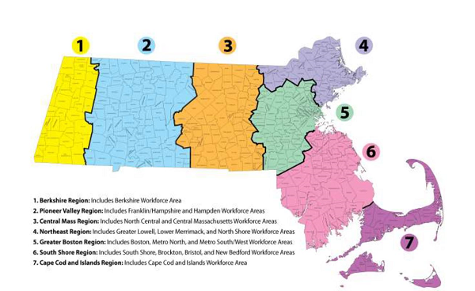
Career Ready 101 User Data
 | Greater Boston (Metro North, Metro South/West, & Boston) May 2016-May2017 | Northeast (Greater Lowell, Merrimack Valley, & North Shore) May 2016-May2017
Number of new students | 1495 | 1696
Number of students active during this period | 1495 | 1349
Total hours worked | 10,736.15 | 1695
Pretests completed | 2031 | 11005.8
Hours spent on pretests | 968.05 | 2261
Lessons passed | 1499 | 1096.6
Hours spent on passed lessons | 4912.61 | 1310
Lessons in progress | 2302 | 4895
Hours spent on lessons in progress | 4235.34 | 2594

Slide 10
Career Ready 101 User Data
 | Southeast (Brockton, Bristol, South Shore, Greater New Bedford, Cape & Islands) May 2016-May2017
Number of new students | 1,478
Number of students active during this period | 1,280
Total hours worked | 6,957
Pretests completed | 2,189
Hours spent on pretests | 945
Lessons passed | 549
Hours spent on passed lessons | 2,900
Lessons in progress | 1,090
Hours spent on lessons in progress | 2,992

Slide 11
Career Ready 101 User Data
 | West/Central (Berkshire, Central Franklin/Hampshire, Hampden, North Central) May 2016-May2017
Number of new students | 2,028
Number of students active during this period | 2,216
Total hours worked | 10,526
Pretests completed | 4,763
Hours spent on pretests | 1,669
Lessons passed | 3,351
Hours spent on passed lessons | 6,116
Lessons in progress | 1,864
Hours spent on lessons in progress | 2,657

Slide 12
WorkKeys & NCRC – Credentialing
WorkKeys:
Timed and proctored, high-stakes test of skills in these subjects:
Workplace Documents (new title for Reading for Info)
Applied Math
Graphic Literacy (new title for Locating Info)
National Career Readiness Certificate (NCRC):
The credential earned when a minimum level of 3 is achieved in all 3 tests.

Slide 13
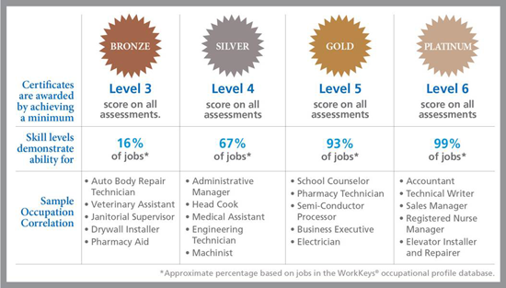
NCRC Scoring System
Notes:
NCRC is the certificate earned, when a test taker meets the minimum score of level 3 on the Work Keys.
The NCRC is a nation-wide, portable credential that documents foundational skills related to work-related capacities
There are 4 levels of NCRC and they are awarded based on the results of the WorkKeys test
As you can see here in the slide:
Bronze is the first level – to earn it a test-taker must score a minimum of level 3 on each of the 3 tests.
To earn a silver, the 2nd level , test-takers must score a minimum of level 4 on each of the 4 tests).
Let’s look at the middle row for a moment.
ACT has profiled the skills needed for thousands of occupations. Based on these profiles, they have determined that someone with a bronze level NCRC, has demonstrated the skills needed to perform 16% of jobs.
Looking at the bottom row we see examples of what some of these Level 3 jobs might be.
In contrast, if we look to the far right at Platinum, we see that the skills reflected in a Level 6 Platinum NCRC equip one to perform 99% of jobs. And the examples of those jobs are provided below.
% of jobs is based on a skill analysis of more than 20,000 jobs.

Slide 14
WorkKeys Testing Roll-Out
20 sites are set-up to administer WorkKeys test
3 have begun administering WorkKeys test
The rest are set-up, but have not begun testing
CRI Team will circulate list of testing sites next week
Voucher System
3 Sites are in the process of being set-up
Completing contractual paperwork
Employer demand is very important!

Slide 15
Job Profiling – Demand Driven
12 profilers completed intensive training in Fall, 2016.
Formal profiling is an in depth, on site process for a single position:
task analysis, job shadowing
review job description, job aids, manuals, SOPs
interviews/focus groups w/multiple employees
End result is clarity about the WorkKeys score and/orNCRC level required to function optimally in the position
In order for a business to require an NCRC for hiring or promotion, a position must be profiled by an ACT-trained job profiler .
Businesses can PREFER that applicants have an NCRC without profiling a position.

Slide 16
Intended Outcomes
Outcomes/Results
Individuals improving skill level through Career Ready 101
Individuals certified work ready (NCRC)
Direct enrollment in postsecondary credit courses (bypassing developmental ed)
Improved employment and retention through matching skills to demand.
Employers using WK and NCRC in hiring process
Partners coordinating around common service delivery, training models, and certifications

Slide 17
Using CRI Tools to Address Business Challenges
Business Challenge | Which Businesses? | Which CRI Tools could address it? | How could the tools be incorporated?
No process in place for assessing basic reading and math skills of new applicants and incumbents. | CG Power Systems | WorkKeys , NCRC | CG may include a specific NCRC level in the job posting and use to screen new applicants.
Outdated and inaccurate job descriptions | CG Power Systems - needed new descriptions | Job Profiling, NCRC | Job Profiler works with company to identify WK/NCRC level needed for new positions.
High Turnover | Inova | Job Profiling, WorkKeys | Care Team Assistant profiled to determine WK skill level needed. WorkKeys used as pre-screen in application process.
Anticipated expansion of workforce | CG Power Systems | KeyTrain, WorkKeys, | Provide WorkKeys testing and Key Train remediation to prepare internal applicants/ incumbents for work in new plant .

Slide 18
Regional Break-Out Groups
Review the business challenges listed in the left column.
Add challenges to the list that are missing.
Identify the CRI tools - Career Ready 101, WorkKeys, NCRC, Job Profiling - that might be used to address the challenge.
Note how you could incorporate the tools into your current work/approach with this business.
After you’ve worked your way through the matrix, identify top two priority challenges to describe to the large group in report out.
Report Out:
2 Priority challenges and ideas for using CRI tools
Any business challenges you added to the list

Slide 19
Businesses Supporting NCRC
Industry clusters
Accommodation and Food Services
Aerospace
Construction
Finance
Health Care
Information Systems
Manufacturing
Professional, Scientific, and Technical
Retail
Transportation and Warehousing
ACT’s NCRC Employer Directory
https://www.workreadycommunities.org/national/businesses
16,802 employers total

Slide 20
Employer Engagement Tips
Provide BSRs with adequate information about the tools and the value added so they can easily integrate into their employer toolbox.
Provide BSRs and employers an opportunity to take a sample of the WorkKeys test themselves.
Customize WorkKeys and NCRC marketing materials to specific industry sectors to reflect the skills matched to occupations.

Slide 21
Regional Action Planning
Develop a set of action steps (at least 2-3) that you’ll commit to in the coming months.
Use the chart paper to identify:
what steps your team will take
what team member will take the lead
when will they complete it and report back to the team
We’ll use the follow-up meeting to share progress again across regions.

Slide 22
Resources
For Employer Outreach Materials: Work Ready Communities https://www.workreadycommunities.org/
Career Readiness Initiative Website http://www.mass.gov/massworkforce/careerready/
ACT Data base of job profiles (aligned with WorkKeys skill levels) http://profiles.keytrain.com/profile_search/
Career Readiness Initiative contact careerreadiness@state.ma.us

