Slide 1




Business front door overview
Start, GROW, THRIVE in Massachusetts

Slide 2
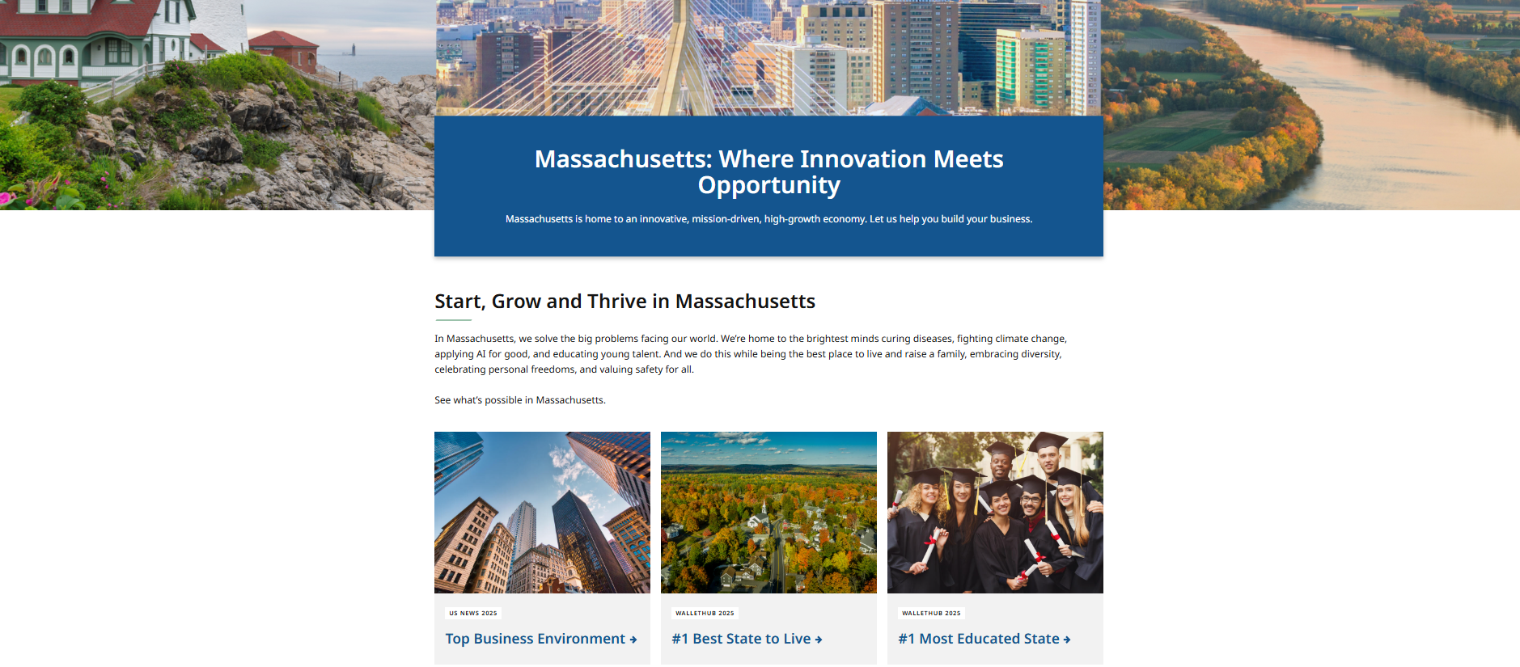
Massachusetts is an AMAZING place to do business

Slide 3
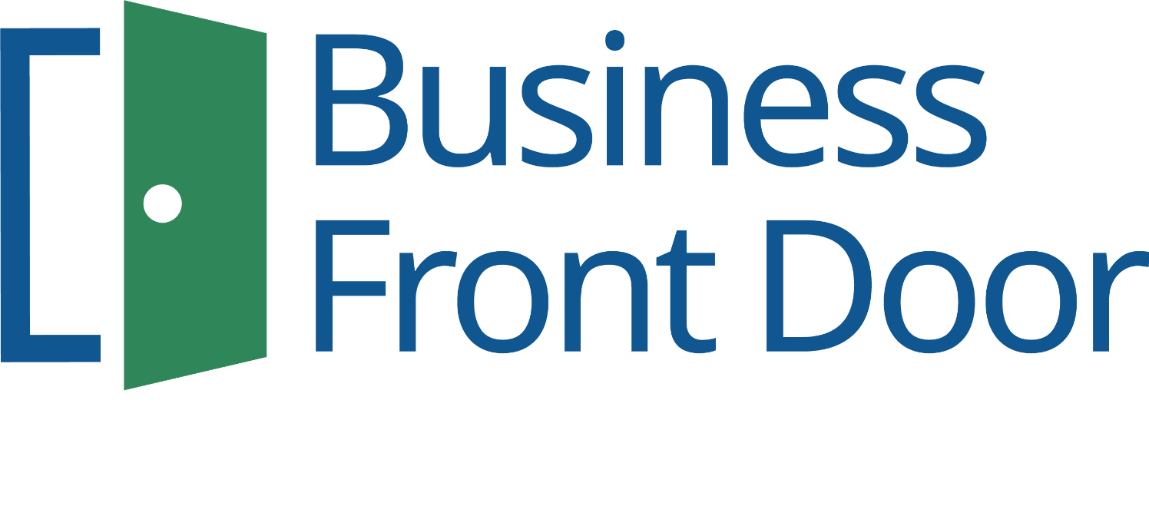
Massachusetts Welcomes you!
Team MA is excited to connect you with the latest and most relevant resources available for businesses. We are here to support you through every step of your business journey. At the Business Front Door, we can help start, scale or grow your business in Massachusetts.

Slide 4











Who is Team MA?
EOED
Executive Office of Economic Development
MOBD
Massachusetts Office of Business Development

Slide 5
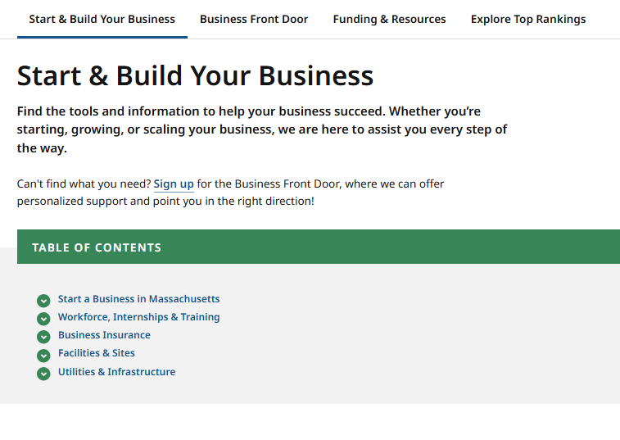
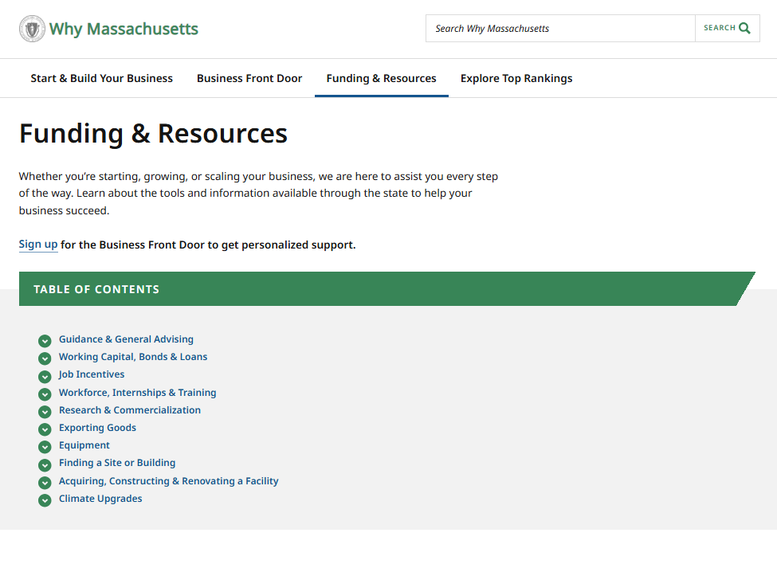
Browse Relevant Business Resources @ Mass.gov/BFD

Slide 6
Example Programs
Biz-M-Power
This funding opportunity is available for businesses with fewer than 20 employees and no more than $2.5 million in revenues. The program aims to help small and microbusinesses offset the costs of acquisitions, expansions, improvement or lease of a facility, purchase or lease of equipment, and other capital needs.
Workforce Training Fund – Express Program
Provides small businesses with fast, simple access to grant-funded training, helping employers respond quickly to change and keep employees engaged. Funds are distributed as a reimbursement for the cost of training, up to $15,000 per calendar year
Mass SAVE Small Business Assessment
No-cost assessment of potential energy-saving measures for small businesses. The energy specialist will also inform the business of incentives available on these measures.

Slide 7
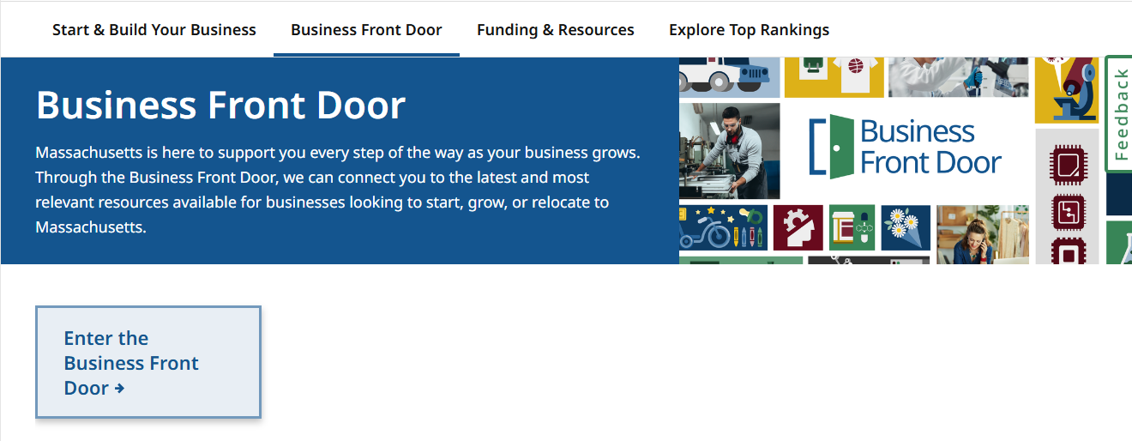
Full Concierge Service @ Mass.gov/BFD

Slide 8
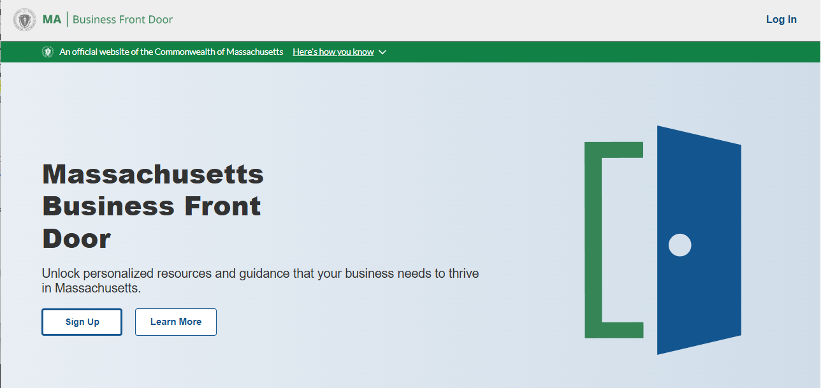
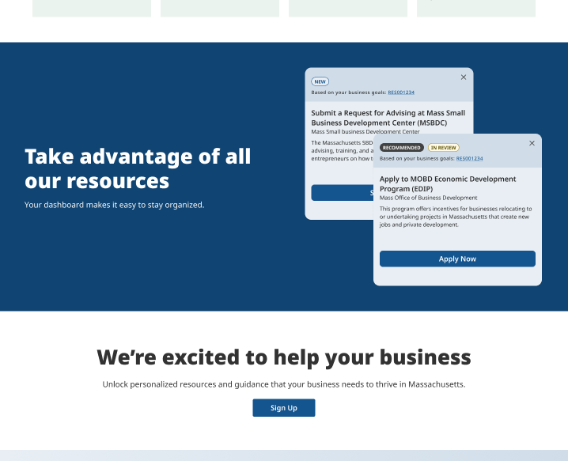
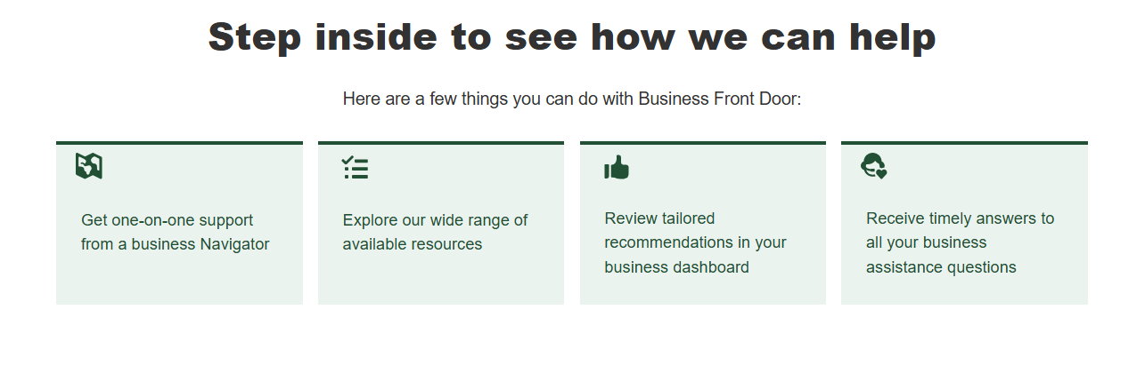
Enter the Business Front Door

Slide 9
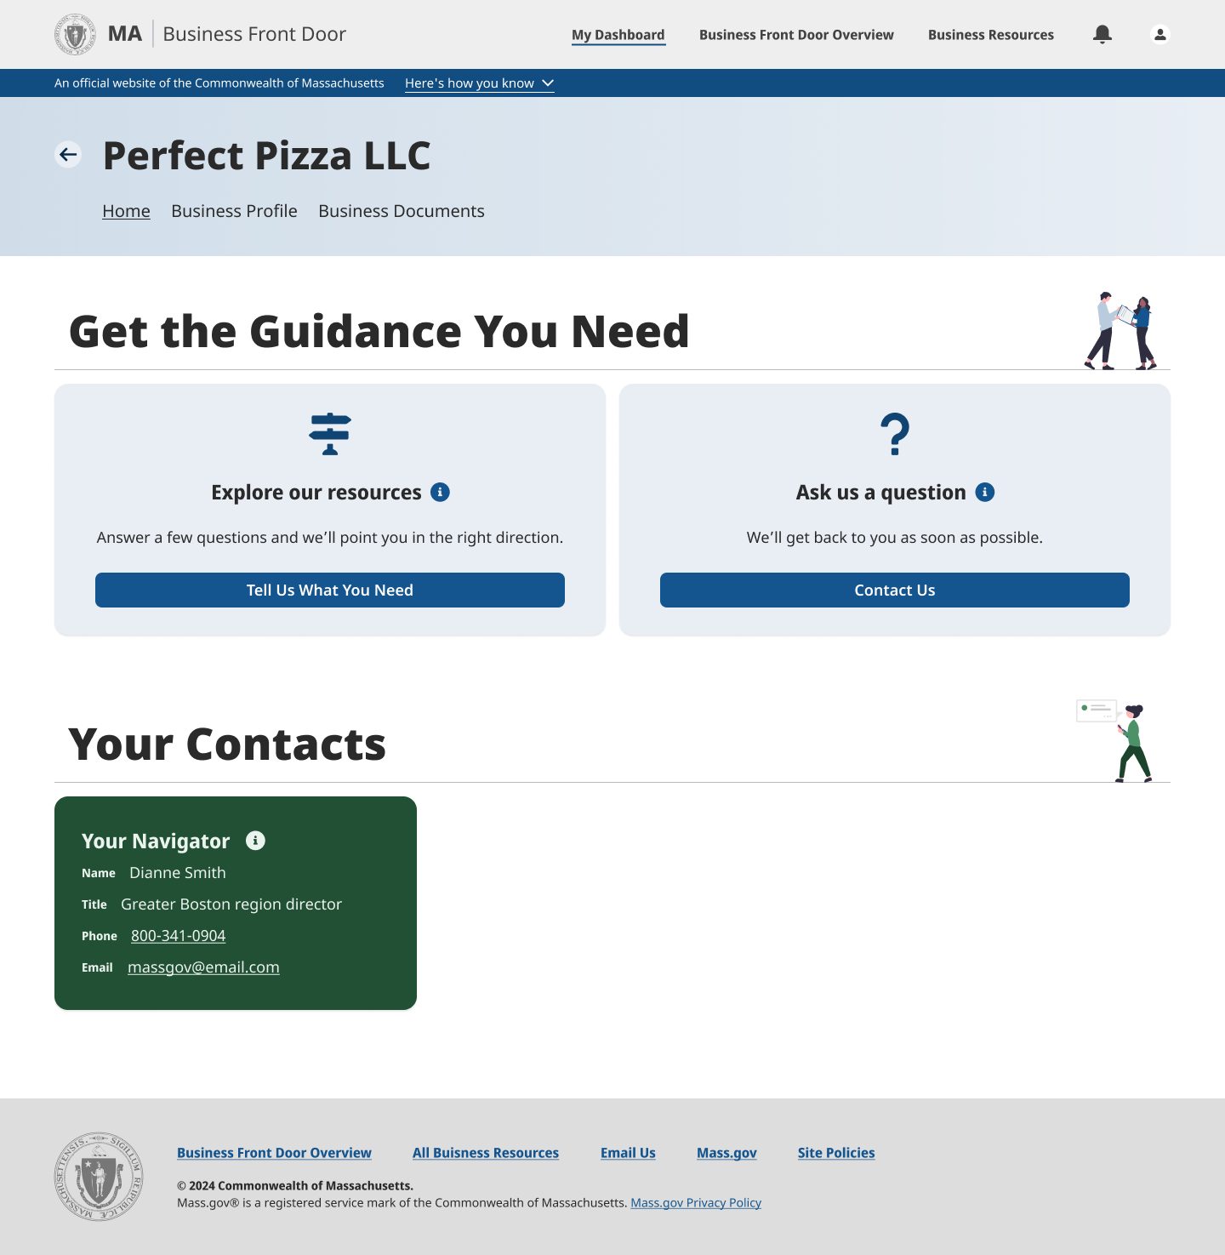

Get Your Dedicated Point of Contact
Businesses in the Business Front Door receive a personal Team MA Navigator, a dedicated single point of contact to address business needs.

Slide 10
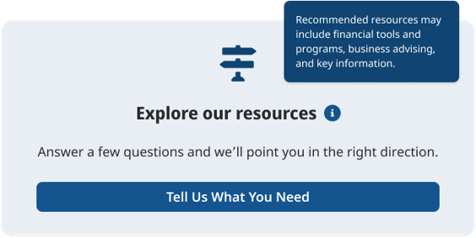
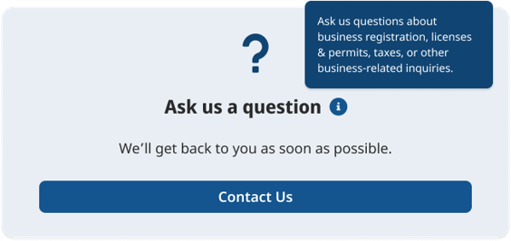
At Any Point, Ask Team MA for Guidance

Slide 11
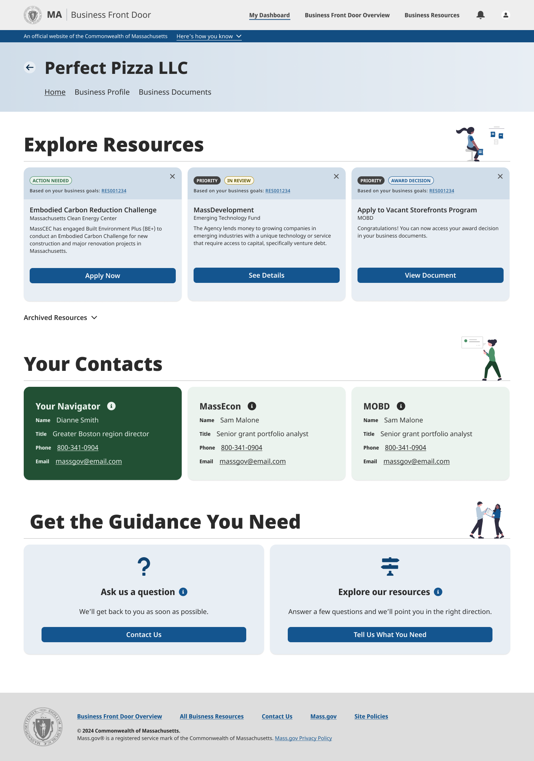
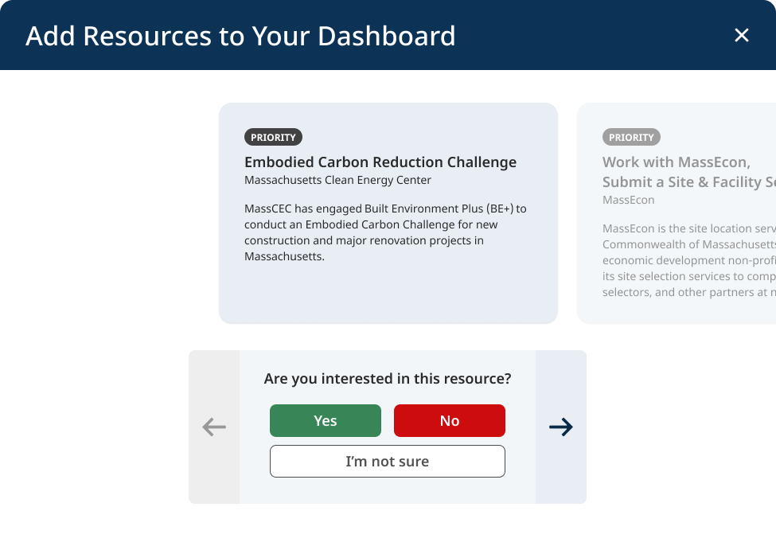
Review Recommended Resources in a Central Dashboard
Apply to MOBD Economic Development Incentive Program (EDIP)
This program offers incentives for businesses relocating to or undertaking projects in Massachusetts that create new jobs and private development.

Slide 12
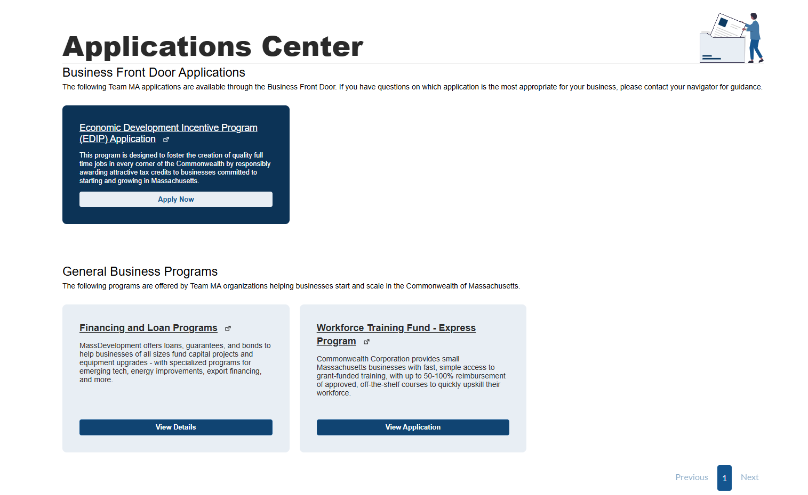
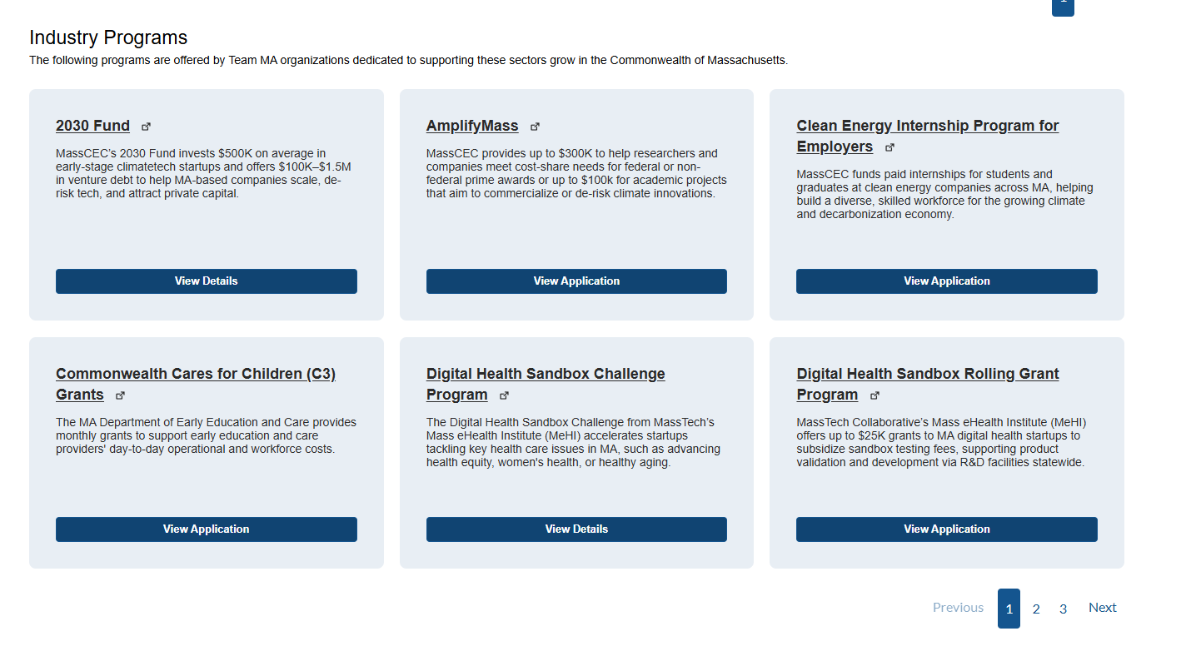
Explore Team MA Programs in One Place
In your Applications Center,
browse business programs across Team MA agencies and launch applications from the site.

Slide 13
Business Benefits of the Business Front Door
Designated Point of Contact
A tailored list of business opportunities
Pathway to ask questions and flag issues
More easily contact
Team MA
See all available business resources
Streamlined page about doing business in MA

Slide 14

Check us out at mass.gov/BFD!

