Slide 1
IDEA Dispute Resolution: Trends & Considerations
Melanie J. Reese, Ph.D.
Director
BSEA Advisory Council Meeting
September 11, 2023

Slide 2
Agenda
About CADRE
Dispute Resolution (DR) Data
Overview
Limitations
The National Landscape
Mediation, State Complaints and Due Process Activity
Trends
MA Data (5 yrs.)
Comparison to US
CADRE’s Approach to DR System Improvement
Five Management Function Areas
Cultural and Linguistic Competence Assessment for Dispute Resolution Systems
Cost Comparison Tool

Slide 3
The National Center on Dispute Resolution in Special Education
Founded in 1998, CADRE is a national technical assistance center under the U.S. Department of Education’s Office of Special Education Programs (OSEP), serving all states and territories (60).
www.cadreworks.org

Slide 4
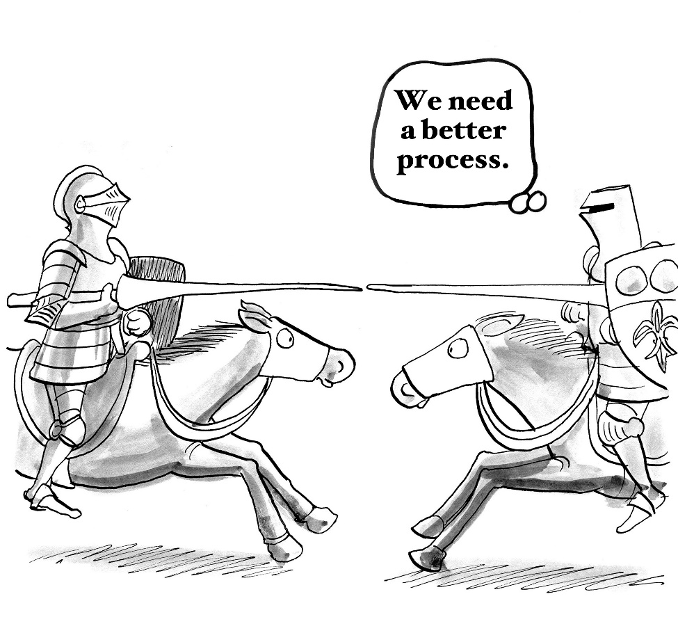
DR Options Under IDEA
CADRE provides products and services for the IDEA dispute resolution options of:
Mediation
State Complaint
Due Process Complaint
and actively promotes and supports early and preventative approaches.

Slide 5
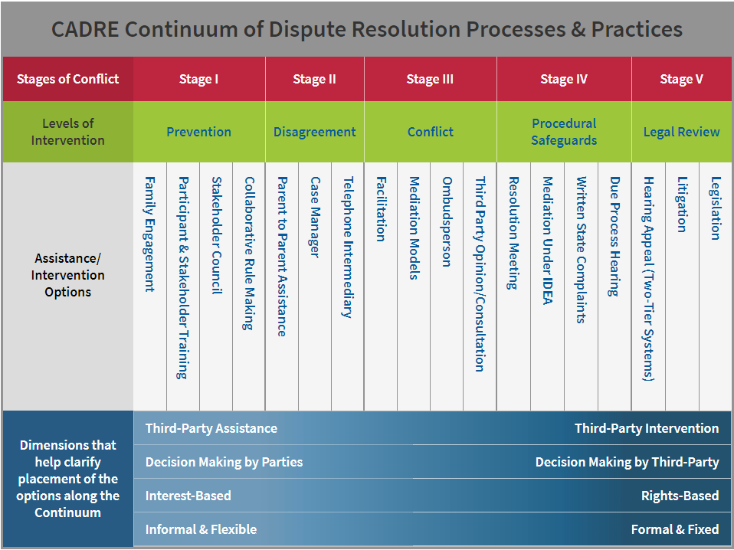
CADRE Continuum of DR Processes

Slide 6
IDEA Dispute Resolution Data
CADRE’s National Longitudinal DR Database includes data from 2004-05 through 2020-21
Includes raw totals and rates per 10K child count
Data for 2021-22 coming in October
Coming soon!
Online Access to CADRE’s
Interactive and Comparative
National Longitudinal Dispute
Resolution Database
Based on State Reporting of Annual 618 data to OSEP and the Child Count data

Slide 7
Data Quality & Limitations
CADRE reviews all data for questionable values, and if found, contacts state
CADRE accepts revisions
Limitations of the data
Not a complete picture of events
Data quality has improved over time, but older data and a few current data elements may be less accurate
Some data elements still hide as much as they reveal
Notes:
CADRE reviews all data for mathematically impossible and highly improbable values based on definitions in the Emap 618 Data instructions – when such values are identified, CADRE contacts states
Data adjustments : If states have more accurate information to provide, CADRE accepts revisions (not frequent)
Limitations of the data
Not a complete picture of events: The 618 data covers only events begun in the reporting year and their disposition
Data quality has improved over time, but older data and a few current data elements may less accurate
Some data elements accurately reported may still hide as much as they reveal. You’ll see, for example, the number of due process hearings left pending is high. We do not know what happens with those from the data.

Slide 8
Activity per 10,000 Child Count
Answers the question: “For every 10,000 students in special education, how many of a particular type of DR event (e.g., State Complaints Filed) are there?”
Formula: [# of DR events divided by Child Count for the state, region, etc.] multiplied by 10,000
Why it helps: It allows comparisons across states of differing Child Counts
Where it is less helpful: For entities that have Child Counts less than 10,000 (makes the activity appear to be more frequent than it is)
Notes:
CADRE takes the childcount from each state and calculates the activity based on that number.

Slide 9
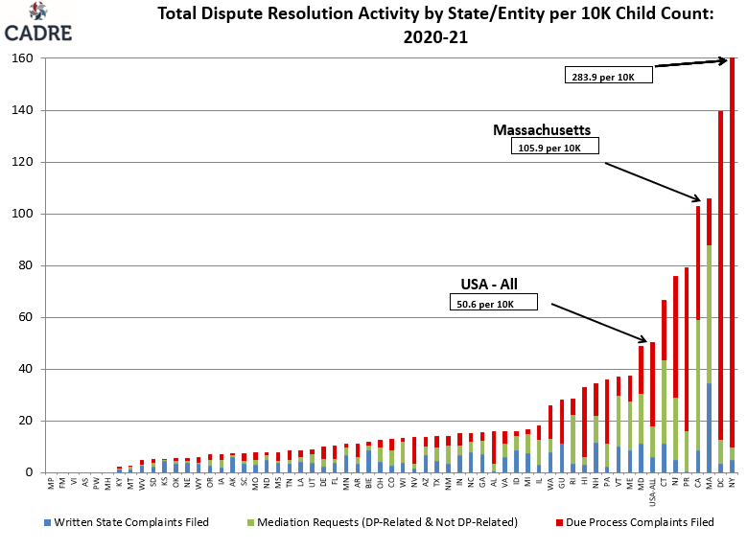
Total DR Activity by State per 10K Child Count: 2020-21

Slide 10
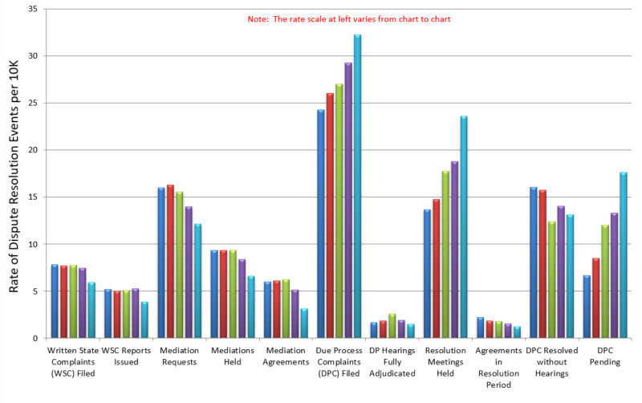
National DR Trends: All Activity

Slide 11
National DR Trends: State Complaints
Notes:
Written State Complaints: The number of Written State Complaints (WSC) Filed had remained relatively steady between SY 2010 and SY 2019, with a 10 year average of 5,201. SY 2020 saw a 19% decrease in filings from the prior 10 year mean, to 4,186. However, the results of the State complaints filed remained relatively consistent, with 64% of reports issued yielding findings of noncompliance. The majority (92%) of State complaint investigations continued to be timely (up from 89% in SY 2019). Pending complaints remained steady at just over 3%, while Complaints Withdrawn or Dismissed rose slightly from 27.1% to 30.4% over SY 2019

Slide 12
National DR Trends: Mediation
Notes:
Mediations: Mediation Requests, Mediations Held and Mediation Agreements, all decreased slightly in SY 2019, and showed a marked decline in 2020-21. From SY 2019 to SY 2020, Mediation Requests decreased 16%, Mediations Held decreased 23.7%, and Mediation Agreements (for both Due Process and non-due process mediations) dropped from nearly 62% nationally to 48.5%, the lowest agreement rate since CADRE started tracking the data in SY 2004. However, SY 2020 did show that Mediation Agreements Not Related to Due Process did demonstrate a much higher agreement rate of 69%, compared to the 32.9% agreement rate reported for Mediation Agreements Related to Due Process.

Slide 13
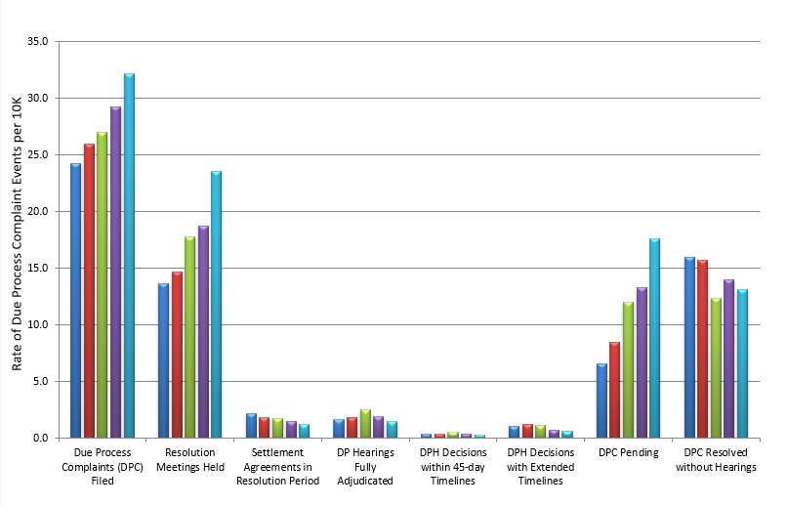
National DR Trends: Due Process
Notes:
Due Process Complaints: The number of Due Process Complaints Filed reached another 11-year peak for the fifth consecutive year in 2020-21, at 23,567 filings nationally, marking a 25% increase over 11 years. Two States accounted for nearly 77% of the due process complaints filed (up from their representing 68% in SY 2019), with one State contributing a staggering 62% of the total due process complaint activity in SY 2020. Four states accounted for nearly 88% of the fully adjudicated due process complaints in SY 2020, with one State reporting over 50% of them. As shown in the charts to the right, for the decade prior to 2020-21 (SY 2010 to SY 2019), 61.7% of the Due Process Complaints Filed were withdrawn, dismissed, or resolved without a hearing, with 26% pending at the end of the reporting period (88% overall). In comparison, SY 2020 saw an increase over the previous ten year average, with 41.5% of due process complaints reported withdrawn, dismissed, or resolved without a hearing, and 53% remained pending (an increase to 94.5% overall). Only 5.5% of Due Process Complaints Filed resulted in a fully-adjudicated hearing in 2020-21, compared to 11.8% in 2019-20
Resolution Sessions: Resolution Meetings Held continued an upward trend, with an increase of 22.6% over SY 2019. Despite the increase, settlement agreements continued to fall far short of the number of meetings held, resulting in a national Settlement Agreements in Resolution Period rate of 6.5% (down from 9% in 2019-20). Settlement agreements in the resolution period have shown steady decline, ending 50% lower (1,124) in SY 2020 as compared to the previous ten year average (2,279).

Slide 14
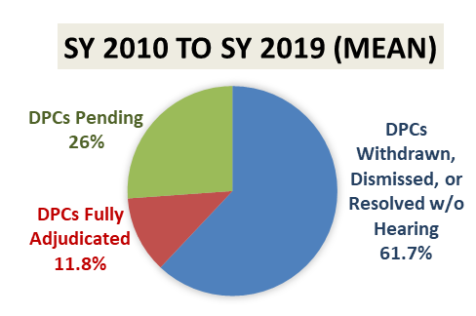
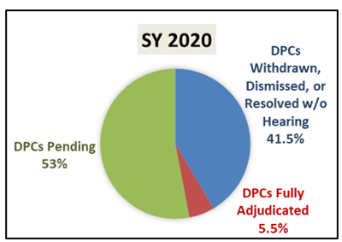
DP: Pandemic Year (2020-21)
Notes:
Collaborative Dispute Resolution Approaches: The SY 2020 DR data reflects the substantial disruption of the COVID-19 pandemic. During this period, however, states continued to make investments in early conflict resolution activities not required by the IDEA, while simultaneously working to improve required DR systems. A bright spot in the data for 2020-21 can be found in the high mediation agreement rates for mediations held not related to due process complaints. Additionally, innovations in virtual DR options, such as IEP facilitation, mediations, DP resolution meeting, and hearings were widespread and continue to be part of the DR landscape. CADRE contends that well-designed, skillfully implemented, and collaborative approaches, such as IEP facilitation and mediation, can mitigate the reliance on more adversarial and costly dispute resolution processes. Early dispute resolution options are generally cost-effective and more expedient than other processes and may foster collaborative educator-family relationships.

Slide 15
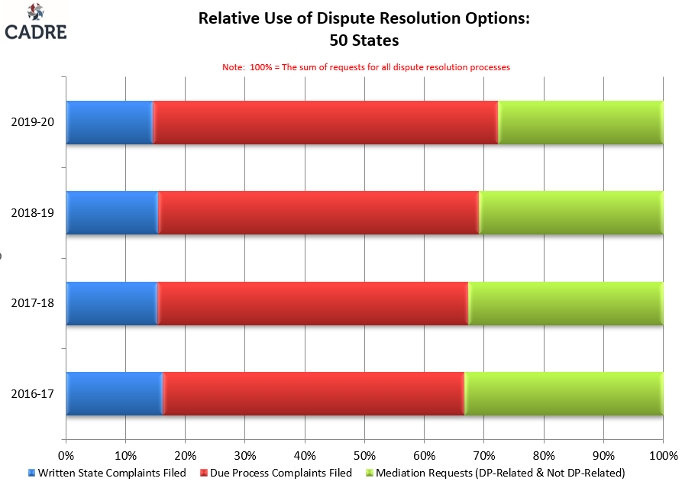
National DR Trends: Relative Use
Notes:
Nationally, you can see a heavy reliance on due process complaints.

Slide 16
Five Years of Massachusetts DR Data

Slide 17
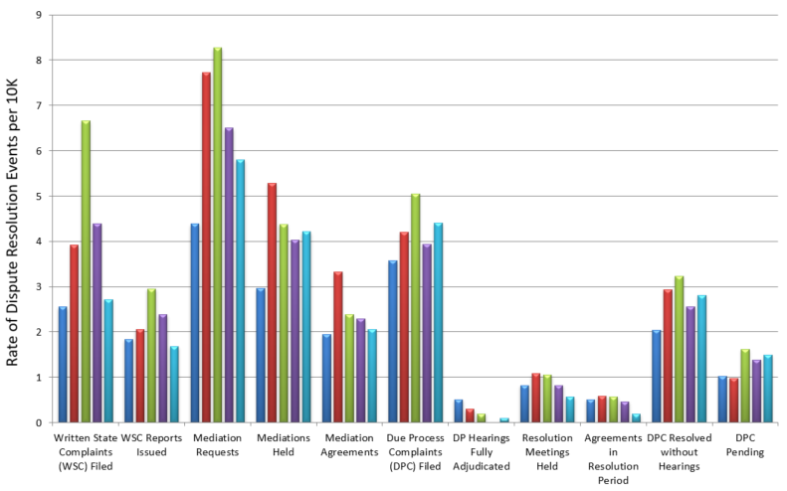
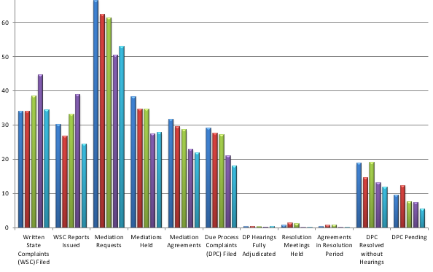
Total DR Activity in Massachusetts

Slide 18
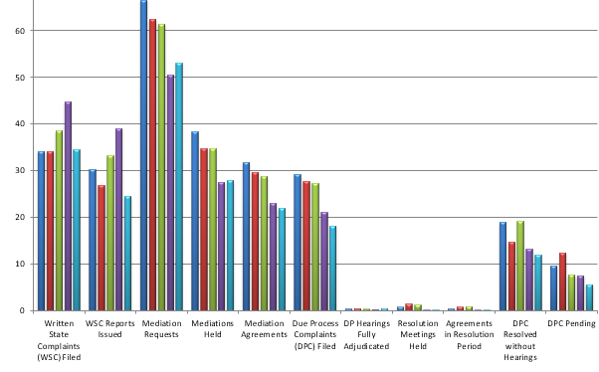
Comparison of DR Activity
Massachusetts
50 States

Slide 19
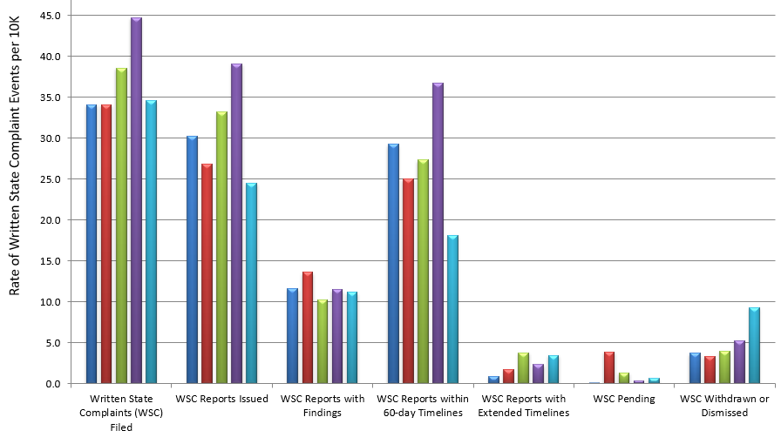
State Complaints in MA

Slide 20
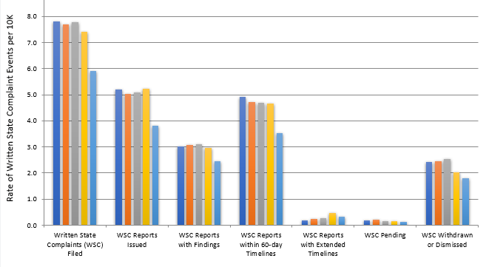
Comparison of State Complaints
Massachusetts
50 States

Slide 21
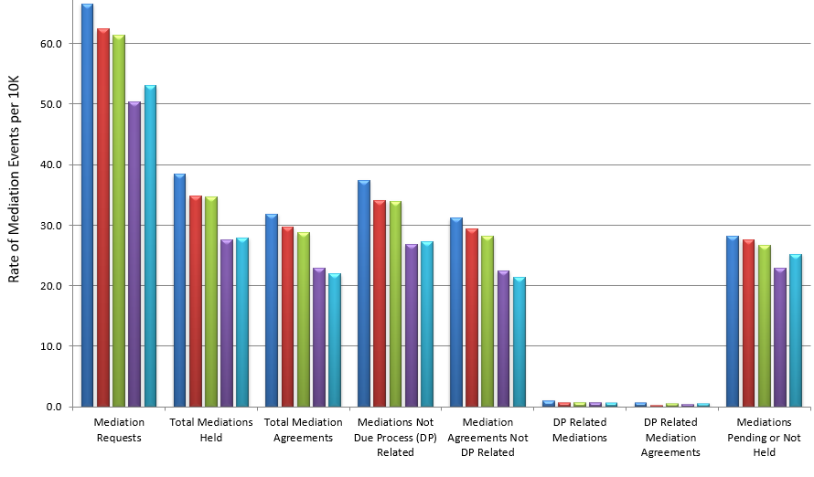
Mediations in MA

Slide 22
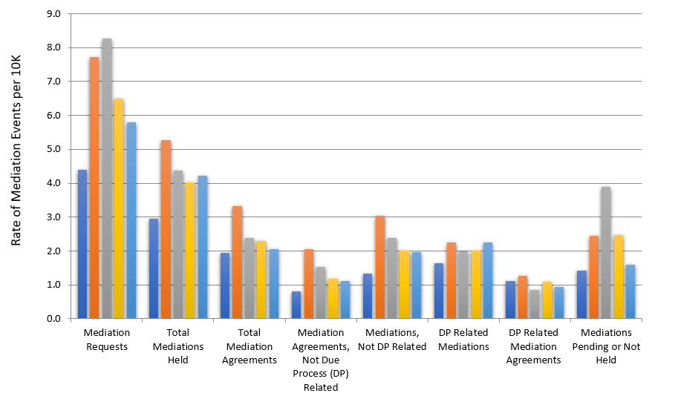
Comparison: Mediation
Colorado
Massachusetts
50 States

Slide 23
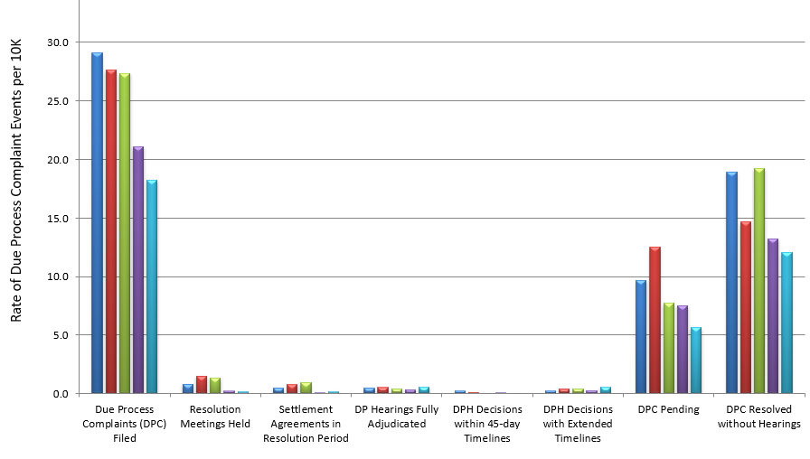
Due Process in MA

Slide 24
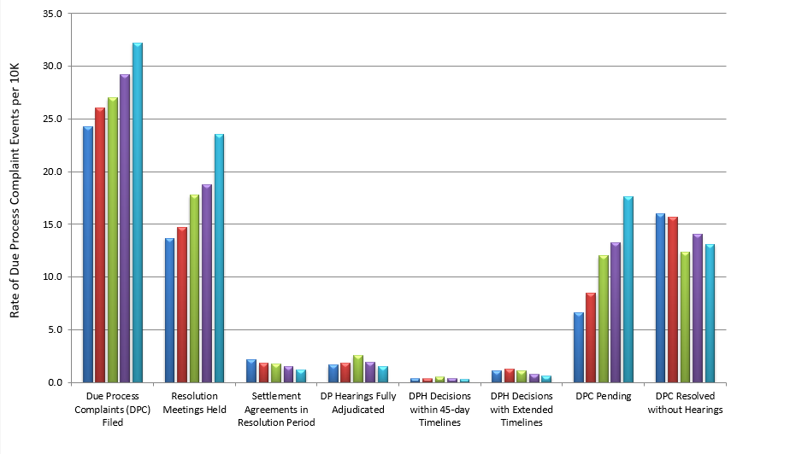
National DR Trends: Due Process
Massachusetts
50 States

Slide 25
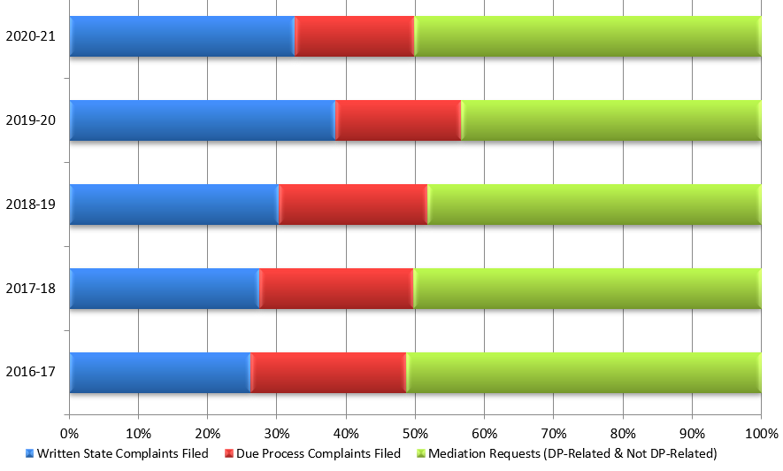
Relative Use of DR Options in MA

Slide 26
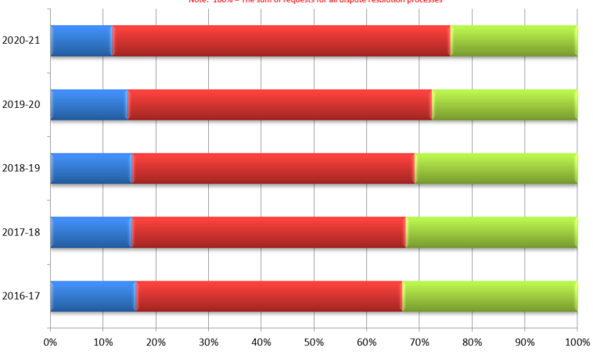
Relative Use Side by Side
50 States
Massachusetts

Slide 27
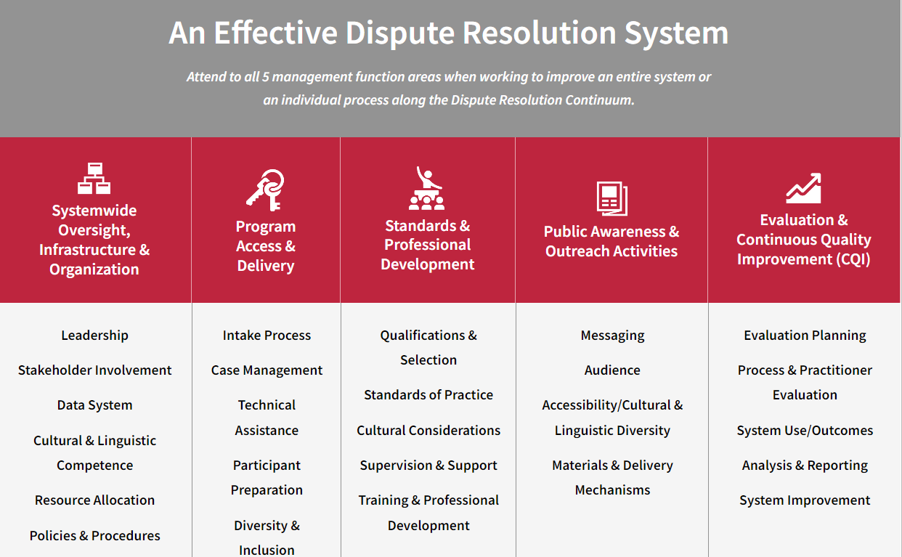
CADRE’s Approach to Improving Dispute Resolution Systems
https://www.cadreworks.org/improving-your-system

Slide 29
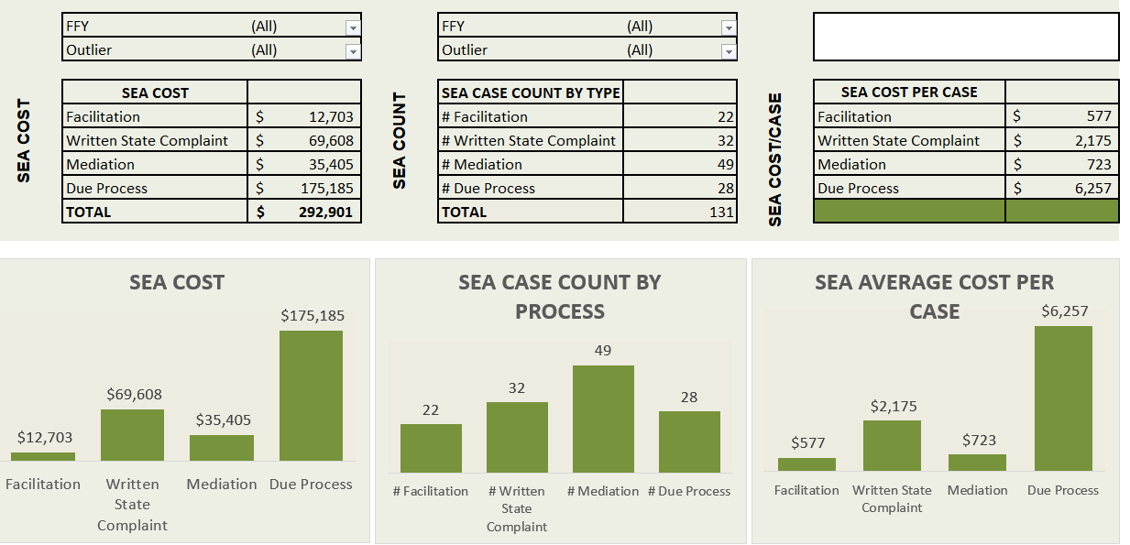

Slide 30
Questions ?

