Slide 1



Career Center Redesign:
Creating an integrated, demand-driven system
MA Workforce Partners Meeting
Oct. 5, 2016

Slide 2
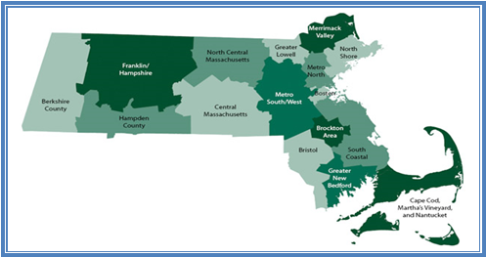
Central MA Workforce Area

Slide 3


Career Center Redesign

Slide 4
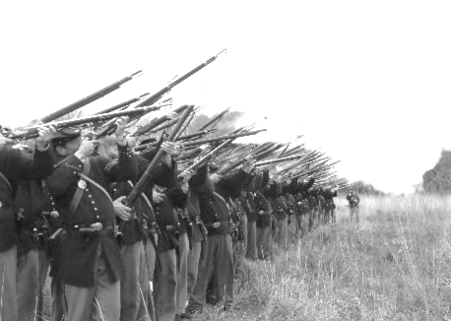
Why the Change?
"The most successful business is the one that holds onto the old just as long as it is good, and grabs the new just as soon as it is better."
— Robert P. Vanderpoel
"The greatest danger in times of turbulence is not the turbulence; it is to act with yesterday’s logic."
— Peter Drucker

Slide 5

Theory of Action
With greater emphasis upon serving employers, we will open greater direct access to employment opportunities for our job seeking customers, ultimately, providing both customer groups with greater value. Achieving this greater value will in turn help drive greater demand and support for our services.
https://www.youtube.com/watch?v=bh1eULtwfVQ

Slide 6
Goals for the redesigned Career Center
An increase in the number and depth of employer relationships:
  increased placement opportunities for WCCC referred candidates
  increased usage of employer resources such as HITG, WTFP, and Apprenticeship.
Job Seekers moving through assessment, career action planning, and remediation of career readiness, technical, and academic skills – and then into employment
Alignment of the ACT/Career Ready 101 system with job openings and job seeker assessments
Development of new trainings offered to address the skill gaps identified through the new demand-facing model.

Slide 7

Career Center Redesign
Background:
  Redesign concepts began approx. 2 ½ years ago
  Initial steps, included:
    Development of joint WCCC /CMWIB Redesign Planning Team Force - June, 2015
      Research conducted on best practices, online services/portal, mandated service elements
      Four working groups formed for planning
    Redesign grant funding sought & received

Slide 8
Redesign Team Working Groups:
New Job Seeker Services Flow
Job Seeker Online Services Portal
Staff Training
Staff Structure
What Services offered to whom & When
Member tools for job search, planning, and readiness
How many staff assigned for each function & how are they organized
Training for all staff on redesign, portal, and teamwork; training for business staff

Slide 9

Project Timeline
  Establish Joint Taskforce & Project Consultant Contracts; Fall, 2015
  Gather stakeholder feedback; Spring, 2016
    Employer & Job Seeker Discussions
    Staff discussions & kick-off event
  Develop Redesigned Customer Flow, Staff Structure, Performance Metrics, Online Portal, and Staff Training Plan; July 1, 2016
  Staff Training; Sept.1, 2016
  Launch New Customer Flow, Staff Structure & Performance, Online Portal; Oct. 15, 2016
  Program Monitoring & Adjustment; Ongoing Thereafter
  WIOA Partner Integration; July 1, 2017

Slide 10
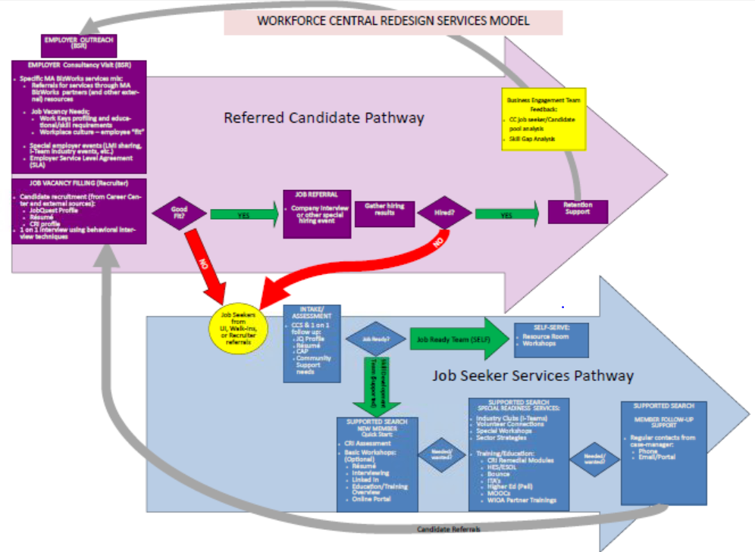


Customer Flow
Notes:
GREET participants
INTRODUCE presenters – Deb, Jenn, Kathy
STATE: We are going to approach this by taking the overall WFC Redesign Services Model and breaking it down step by step in order to cover all aspects of it as far as it relates to the interaction between our customers and ourselves within our various roles
TRANSITION: First we’ll start with the Job Seeker Services Pathway, which is shown in the blue

Slide 11

Job Seeker Services
JOBSEEKERS
Job Ready?
Self-Serve
Intake / Assessment
YES
NO
Supported Search
& RESEA
Notes:
SAY: We receive job seekers into the career center in a number of ways and for a variety of reasons. However, right now we’re going to focus on
people coming in for a CCS and
walk-ins
At a basic level, the jobseeker services pathway is based on the intake and assessment results identified by the counselors, who will recommend either the self-serve or supported search depending on the customers needs in terms of
education and employment goals,
barriers to employment,
eligibility for various programs and services, etc.
TRANSITION: For CCS attendees…

Slide 12
Job Seeker Services
JOBSEEKERS
CCS
IAI or JSSA (assessment)
CAP or IEP
JobQuest
Resume
Support needs
RESEA Review or Meet with EC
Notes:
SAY: …the assessment process happens immediately following the seminar.
Both RESEA and NON-RESEA customers will be treated the same way with variations in the MOSES data entry. All participants will receive an Initial Assessment Interview (RESEA) or Job Search Skills Assessment (Non-RESEA) where the counselor and member will begin developing a Career Action Plan (RESEA) or Individual Employment Plan. All members should be registered on JobQuest and have a resume. The counselor will address any support needs the customer has and a follow up meeting will be scheduled – either a RESEA Review or a Meet with Employment Counselor appointment.
For walk-in customers, the assessment will start at the front desk. These customers may be coming in for
Professor Teaches
Volunteer Connections
to use the Resource Room to gain access to online resources, such as JobQuest, various LMI sites, the WFC site, and the online portal
to use the fax or copier
TRANSITION: Self-serve customers…

Slide 13
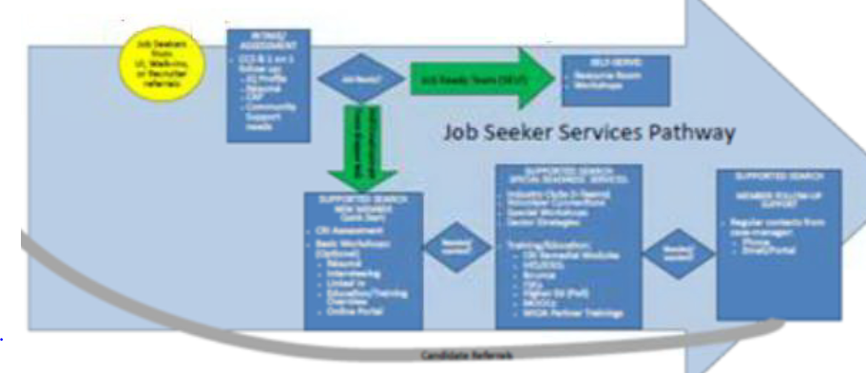
SELF-SERVE
Resource Room
Workshops
Fast Track Consult
Professor Teaches
Volunteer Connections
I-Teams
JOBSEEKERS
Notes:
SAY: are the customers from the CCS who are “job ready” or not interested in the job seeker services provided under supported search and just want to use the Resource Room or pick certain workshops they want to attend
OR
they might be walk-ins looking for a quick assessment or some guidance, in which case the “counselor on duty” would do a “fast track consultation” to provide things like:
Resume Critique
Interviewing Skills suggestions
Workshop referrals
Referral to Business Engagement Unit & determine if match for open opportunities
Review of Job Match feature in Job Quest
Referral to Temp Agencies for urgencies
Referral to community agencies for additional support
Note that fast track services will be indicated in MOSES by the counselors using a Career Center Specific field
EXAMPLE: Self-serve can be jobseekers who are “job-ready” or they could be people who decline other jobseeker services we offer
TRANSITION: if a customer chooses supported search…

Slide 14
QUICK START
AND/OR
SPECIAL READINESS
JOBSEEKERS
Notes:
SAY: …then dependent on their needs they can choose from the Quick Start (new member boot camp) AND / OR Special Readiness menus.
TRANSITION: The quick start menu…

Slide 15
Job Seeker Services
SUPPORTED SEARCH: QUICK START
JOBSEEKERS
Career Ready Assessment
Basic Workshops
  Résumé Writing
  Interviewing Skills
  LinkedIn
Online Portal
Notes:
SAY: …includes the Career Ready Assessment, basic workshops such as Résumé Writing, Interviewing Skills and LinkedIn and access to the online portal.
TRANSITION: the special readiness menu includes…

Slide 16
Job Seeker Services
SUPPORTED SEARCH:
SPECIAL READINESS
JOBSEEKERS
Specialty Workshops
Sector Strategies
Career Ready Assessment
Bounce Readiness
Training / Education
ITA’s / TABE
ABE / HSE
Higher Ed / QCC Navigator
Online training
Partner Trainings
➔
Notes:
SAY: things like:
Industry Job Clubs
Volunteer Connections
Specialty Workshops like Bounce and Stress Reduction or other workshops that we don’t offer as frequently as the basic ones
Sector Strategies
Career Ready Assessment
AND
Training / Education options such as
ITA’s / TABE (note upcoming eligibility training for counselors)
ABE / HSE
Higher Ed / QCC Navigator
Online training opportunities
MOOCs and WIOA Partner trainings
TRANSITION: All jobseekers who are using the supported search options will be…

Slide 17
Job Seeker Services
SUPPORTED SEARCH:
FOLLOW UP SUPPORT
JOBSEEKERS
Notes:
SAY:…included in follow-up support. Counselors will conduct follow-ups with jobseekers in their caseloads according to an established schedule. The jobseekers in these caseloads will also be looked at for making job referrals.
TRANSITION: Now we’re going to move on to the Business Engagement Team section of the customer flow…

Slide 18
Customer Flow
Notes:
SAY: … which is the purple / pink section at the top of the model
TRANSITION: Starting with the Business Service Reps…

Slide 19

Referred
Candidate
Mass BizWorks
Business Needs?
Special Events
Vacancy
Notes:
SAY: The BSRs will be servicing the business community based on its needs – business contact includes maintaining existing employer relationships and conducting consultancy visits. This can be:
Contact by business to B.E.T
Inquiries to / from MA BizWorks
Internal targeted business outreach requests from counselors
Regardless of whether the business engagement is initiated by the employer or is the result of outreach, the BSR makes the determination on what is the best way to service them based on the request or business needs.
There are three primary options the BSR will offer:
Mass BizWorks resources
Special Events
And assistance with filling open jobs
TRANSITION: Mass BizWorks resources will be recommended if…

Slide 20

Referred
Candidate
Mass BizWorks
Business Needs?
Training & Consultation
Layoff Aversion & Management
Business Development / Partnerships
Important Websites
Notes:
SAY:…the business needs information or resources, such as:
Training & Consultation to include Workforce Training Fund, safety grants, and other training related resources available locally that the business can take advantage of.
Layoff Aversion & Management
Business Development / Partnerships
AND / OR
Important Websites
TRANSITION: BSR’s will collaborate or engage businesses to…

Slide 21
Referred
Candidate
Special Events
  LMI sharing
  Industry events
  Job fairs / recruitments
  Mass BizWorks information sessions
Business Needs?
Special Events
Notes:
SAY:…participate in special events, such as
LMI sharing
Industry events
Job fairs / recruitments
Mass BizWorks information sessions
TRANSITION: Finally, the BSR’s will…

Slide 22
Referred
Candidate
VACANCY
“Standard” job ads (orders)
Recruitment referral services
ie. Demand 2.0 implementation
Business Needs?
Vacancy
Notes:
SAY:…assist employers with filling their open positions.
Based on the request or business needs, the BSR will make a decision on which vacancies will be handled as standard job ads (orders) and which will be done using recruitment referral services based on established criteria (TBD).
TRANSITION: When recruitment referral services will be used…

Slide 23
Referred
Candidate
Recruitment referral services
Gather detailed job / company information
Complete Career Ready job profile
Determine preferred referral process
Secure Service Level Agreement
Add Confidential job order
Communicate information to Recruiter(s)
Notes:
SAY:…the BSRs will
Gather detailed job and relevant company (culture) information (Post consultation debrief report; must document meeting in MOSES and email BEM a copy of meeting summary (template TBD)
Complete Career Ready job profile for vacancies to be filled by the Recruiter
Determine the preferred referral process for connecting candidates with the company (passing on candidate name and info, conducting meet and greets or on-site interviews, etc.)
Complete and sign Services Level Agreement with the employer rep. (TBD)
Enter job lead into MOSES as a “confidential” job order.
Work with B.E.T members on proper assignment and corresponding communication for individual job order. (The BEM will develop a formal assignment process – by shared BSR/Recruiter teams, territories, industries, or something else??)
TRANSITION: The recruiter part of the process

Slide 24
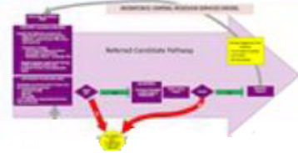
Recruitment
referral services
Internal candidates from Career Center counselor referrals
External candidates from community network (recruit into career center)
Interview & screen candidates
Notes:
SAY:…the Recruiters will:
Update a Recruited Job List which will be housed on a shared drive – this is expected to be done BY THE END OF THE DAY IT IS RECEIVED FROM THE BSR (or as soon as possible) – template TBD
Share the confidential job lead(s)s with WCCC counselors
When receiving candidate referrals from the Counselors – the recruiters will review job seeker’s MOSES casefile notes, counselor endorsement notes and CRI results. If necessary, they will contact counselors for validation.
Contact the candidate to schedule a telephone or in-person interview.
TRANSITION: we’re going to go back to the jobseeker services path for a moment…

Slide 25
Business
Engagement
Team
Feedback / Debrief Process:
Track hiring demand trends
Identify hard to fill – labor “gaps”
Notes:
SAY: BET feedback process between the recruiters and BSRs to assess the job seeker / candidate pool in order to determine the possibility of future skills training grants or to pursue job development with employers.
Recruiter: when the position for the job order is filled, or the hiring deadline has passed, or all referred candidates for the position have either been hired or recommended to WCCC, the Recruiter will update the “Recruited Job List” – cut the appropriate job order and paste it on to the Recruited Job List’s tab under “Placement Outcomes”, noting the total number of candidates referred to the position including the specific number of Hired vs. Not Hired
Weekly Business Engagement reports (these will roll up into monthly, quarterly and yearly reports):
# of businesses that utilize WCCC services
# referrals to MA BizWorks partners
# of jobs posted with WCCC
# of “Recruiter Assisted” openings
# of candidates assessed by B.E.T staff
# candidates referred to Job Openings
# job placements, referred candidates hired
TBD as required by ongoing WCCC demands
TRANSITION: this concludes our review of the customer flow. Final thought…

Slide 26


Staff Training
Delivered through Career Team and Bounce USA
Career Team: (http://careerteam.com/)
  Business Services, Sales, Time Management
Bounce USA:
  Teambuilding, Communication, Rapport-Building & Establishing Relationship

Slide 27
Staff Portal
Developed by Career Team
Online workshops
Resume Builder (searchable)
Counselor messaging
Links to JobQuest, ACT, DUA, MA CIS
Career plan checklist
Usage tracking

Slide 28















Central MA WIOA Partners planning
June 29, 2016

Slide 29
Thank You!

