Slide 1
Career Center Redesign: Creating an integrated, demand-driven system Massachusetts WIOA Partner Convening Dec. 6, 2016

Slide 2
Central MA Workforce Area

Slide 3
Career Center Redesign

Slide 4
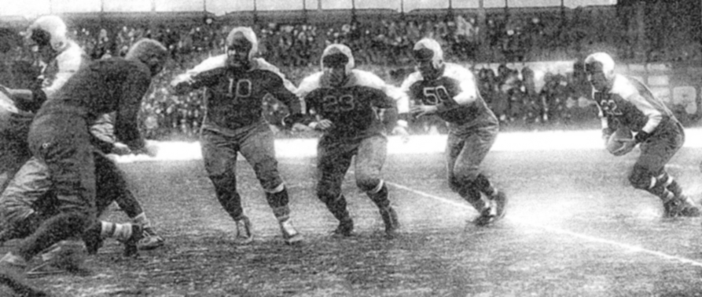
Why the Change?
"The most successful business is the one that holds onto the old just as long as it is good, and grabs the new just as soon as it is better."
— Robert P. Vanderpoel
"The greatest danger in times of turbulence is not the turbulence; it is to act with yesterday’s logic."
— Peter Drucker

Slide 5
Theory of Action
With greater emphasis upon serving employers, we will open greater direct access to employment opportunities for our job seeking customers, ultimately, providing both customer groups with greater value. Achieving this greater value will in turn help drive greater demand and support for our services.
https://www.youtube.com/watch?v=bh1eULtwfVQ

Slide 6
Goals for the redesigned Career Center
An increase in the number and depth of employer relationships:
increased placement opportunities for WCCC referred candidates
increased usage of employer resources such as HITG, WTFP, and Apprenticeship.
Job Seekers moving through assessment, career action planning, and remediation of career readiness, technical, and academic skills – and then into employment
Alignment of the ACT/Career Ready 101 system with job openings and job seeker assessments
Development of new trainings offered to address the skill gaps identified through the new demand-facing model.

Slide 7
Career Center Redesign
Background:
Redesign concepts began approx. 2 ½ years ago
Initial steps, included:
Development of joint WCCC /CMWIB Redesign Planning Team & Working Groups
Research on best practices (thank you Don Gillis, David Megenhardt, Sylvia Beville, Ellie Rose, Mary Sarris, Mark Whitmore, Dave Gadaire, Maddrey Goode, Jim Oliveira, Tim Sappington, and others!)
Redesign grant funding sought & received

Slide 8
Redesign Team Working Groups:
New Job Seeker Services Flow
Job Seeker Online Services Portal
Staff Training
Staff Structure
What Services offered to whom & When
Member tools for job search, planning, and readiness
How many staff assigned for each function & how are they organized
Training for all staff on redesign, portal, and teamwork; training for business staff

Slide 9
Project Timeline
Establish Joint Taskforce & Project Consultant Contracts; Fall, 2015
Gather stakeholder feedback; Spring, 2016
Employer & Job Seeker Discussions
Staff discussions & kick-off event
Develop Redesigned Customer Flow, Staff Structure, Performance Metrics, Online Portal, and Staff Training Plan; July 1, 2016
Staff Training; Sept.1, 2016
Launch New Customer Flow, Staff Structure & Performance, Online Portal; Oct. 15, 2016
Program Monitoring & Adjustment; Ongoing Thereafter
WIOA Partner Integration; July 1, 2017

Slide 10
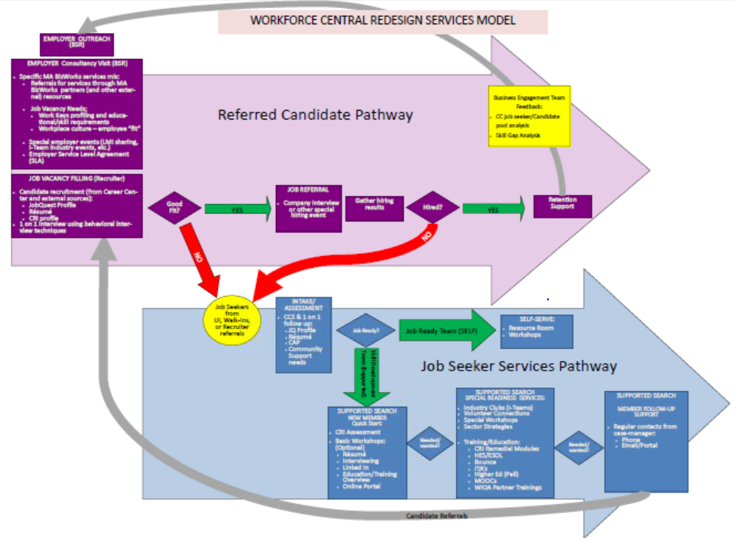
Customer Flow
Notes:
GREET participants
INTRODUCE presenters – Deb, Jenn, Kathy
STATE: We are going to approach this by taking the overall WFC Redesign Services Model and breaking it down step by step in order to cover all aspects of it as far as it relates to the interaction between our customers and ourselves within our various roles
TRANSITION: First we’ll start with the Job Seeker Services Pathway, which is shown in the blue

Slide 11
Addressing Change
Inclusive decision making has limits
Past success can be a barrier
Cultural shifts are important – and difficult
Integrated program service delivery flow
BSR’s: Transactional v. BizWorks consultanting
Customer-centered approach for businesses (BET - understanding who it is that you serve)
Embracing (and actually using) new technology

Slide 12
Central MA WIOA Partners planning
June 29, 2016

Slide 13
Thank You!

