Slide 1
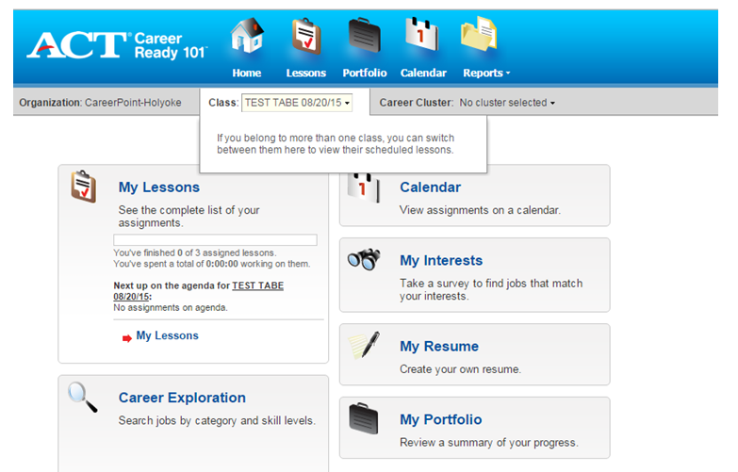
After you log into the system, this is what you will see
CLICK HERE

Slide 2
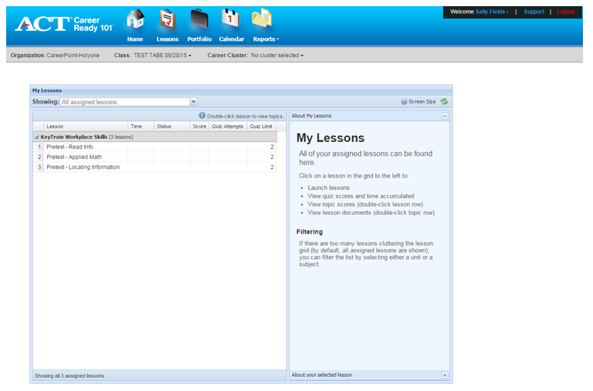
Reading for Information Pre-Test
CLICK HERE

Slide 3
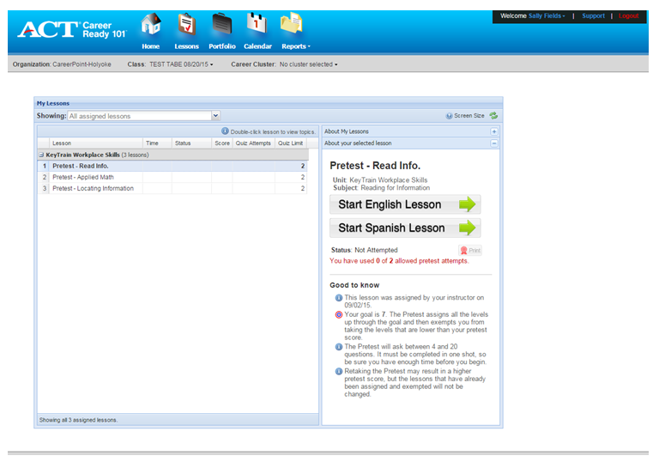
When you are given the signal to begin, you will click here
DO NOT CLICK IT NOW

Slide 4
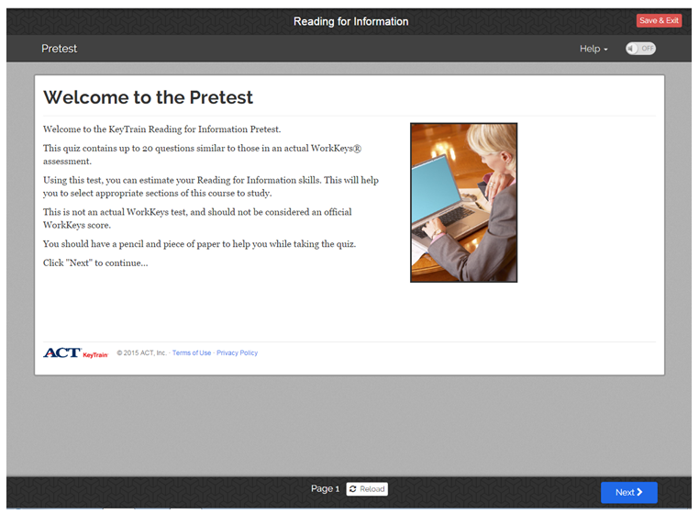
To advance from one page to the next, you click this button.

Slide 5
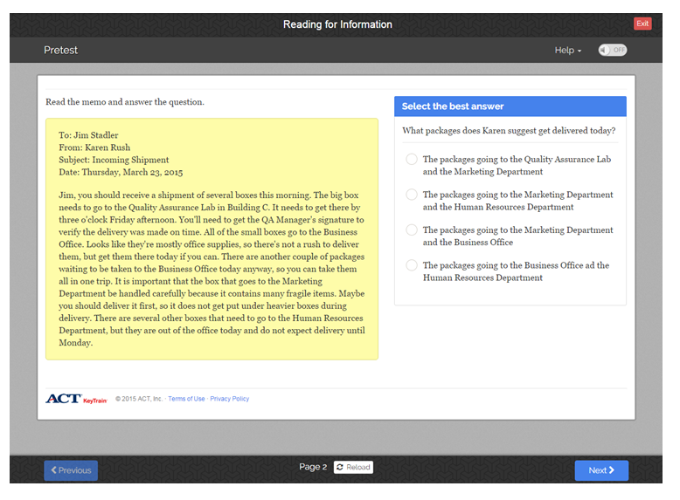
You will click on the circle next to an answer to select it.

Slide 6
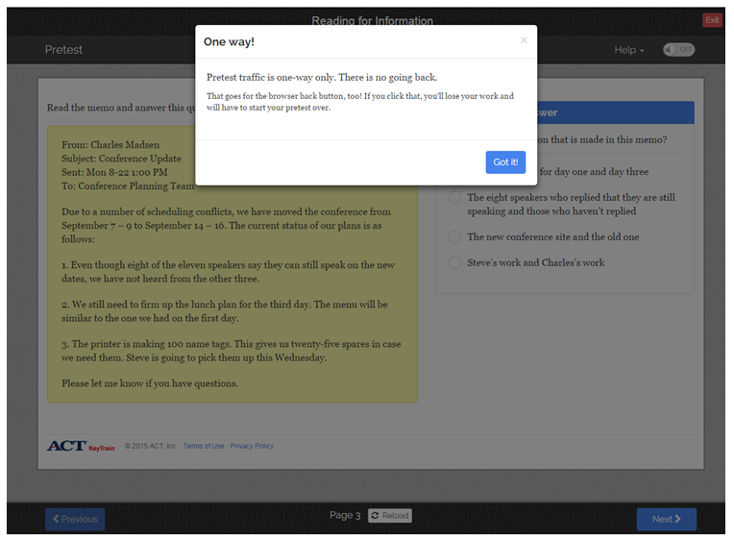
BE CAREFUL – You are not able to go backward and change your answer.

Slide 7
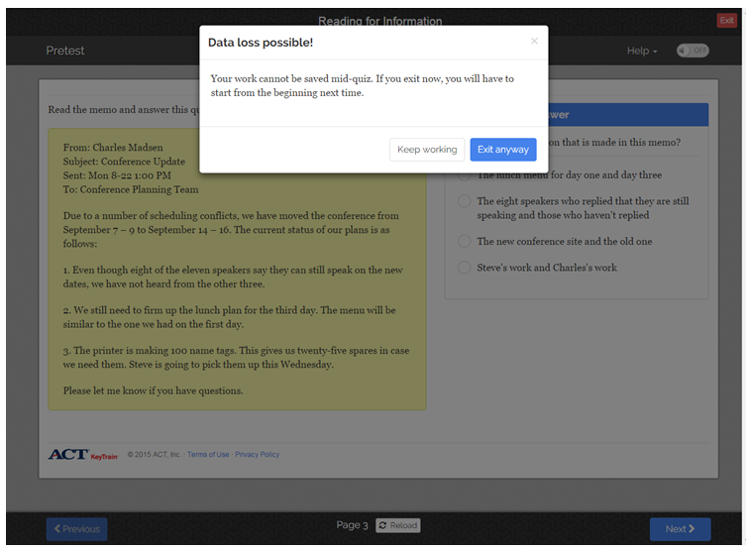
You must finish the Pre-test in one session. You cannot stop and start again.

Slide 8
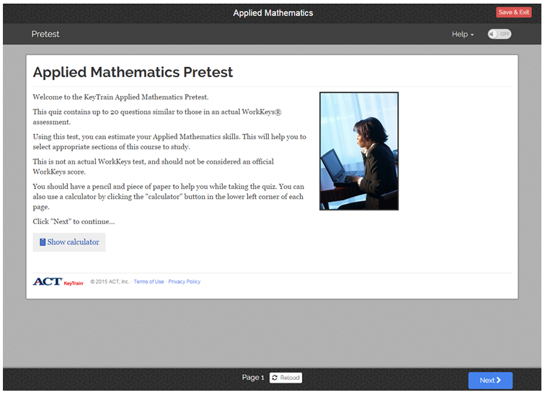
Applied Mathematics Pre-Test

Slide 9
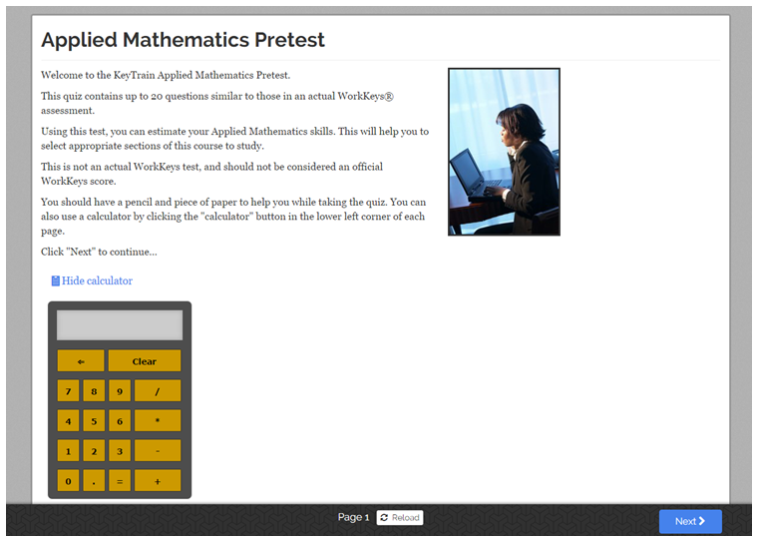

Slide 10
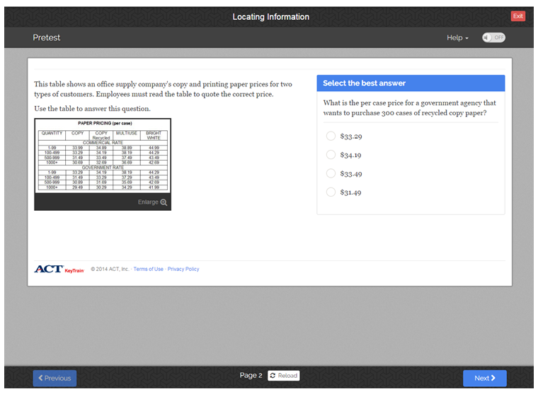
Locating Information Pre-Test

Slide 11
