Slide 1
Disaster Recovery Reform Act of 2018 (DRRA)
Public Assistance Management Cost Funding
MEMA Disaster Recovery

Slide 2
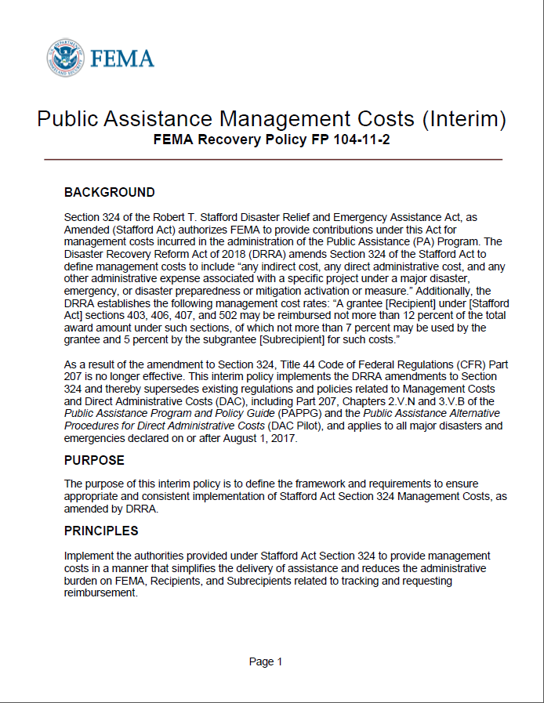
Disaster Recovery Reform Act
The DRRA (Disaster Recovery Reform Act) amends the definition of management cost under Section 324 of the Robert T. Stafford Act to include: “any indirect cost, any direct administrative cost, and any other administrative expense associated with a specific project under a major disaster, emergency, or disaster preparedness or mitigation activation or measure.”
For incidents declared on or after October 5, 2018, management cost will be processed only under the DRRA authorities.
Retroactively to all FEMA emergency and major declarations on or after August 1, 2017 (includes 4372 and 4379)

Slide 3
Public Assistance Management Costs Under DRRA
Management costs will be obligated via one Category Z project (per disaster) and funded at 100% Federal share. This includes management costs for all projects (small projects, large projects, and any projects completed under Stafford Act Section 428, Public Assistance Program Alternative Procedures).
Management costs are based on actual costs incurred.
Subrecipients may request up to 5% of the total of all obligated projects (per disaster)
Total Award Amount: Sum of actual eligible PA project costs, including the non—Federal share, after insurance and any other reductions.

Slide 4
Public Assistance Management Costs
Once FEMA obligates all of a Subrecipient’s Category A-G projects, FEMA may provide a Category Z project obligation for up to 5% of the sum total of all amounts obligated.
FEMA may process additional versions to the Category Z project for 5% of that Subrecipient’s total project obligations as project costs change, on a quarterly basis as needed.
After FEMA has received and processed all of a Subrecipient’s final actual cost project claims on large projects, and upon receipt of the Subrecipient’s final actual management cost claim, FEMA will process the final Category Z obligation or deobligation based on actual reasonable costs up to the maximum 5%.

Slide 5
Eligible Use of Funds (subject to review)
Activities eligible as management costs include those related to developing eligible PA projects and receiving reimbursement. These activities may included, but not limited to:
PDAs (Preliminary Damage Assessments)
Meetings regarding the PA Program or overall PA damage claim
Organizing PA damage sites into logical groups
Preparing correspondences
Site inspections
Travel expenses
Developing detailed site-specific damage description
Evaluating Section 406 hazard mitigation measures
Preparing small and large projects
Reviewing Projects
Training
Collecting, copying, filing, or submitting documents for a claim
Requesting disbursement of PA funds
Reasonable supplies and equipment purchases
Notes:
This is going to be a big change for subrecipients as they didn't previously have all the options that Recipients did for the use of funds; purchasing equipment (such as scanner, laptops) to assist in the Delivery Model project development is a big question that has been asked- thus far HQ supports it. Subrecipients would just need to be cautious on cost (see PAAPG Equipment Purchases & Reasonableness Job Aid) and theoretically the use- shouldn't need 5 laptops if only 1 staff working PA

Slide 6
Ineligible Use of Funds
Activities related to ineligible projects are not eligible to be claimed under the management cost contribution.
Excess management cost funding may not be retained.
Unreasonable management costs may be deemed ineligible.

Slide 7
Management Cost Reimbursement Requirements
Must Clearly Document:
Explanation of each specific task
Number of hours spent on task(s)
Hourly Rate of individual performing task
Title or Position
Specific activities which required Materials, Equipment, or Space
Number and purpose of meetings/site inspections
Purpose for travel, and travel policy
Location, course offered for training costs
Notes:
An important note for Subrecipents, they no longer need to track/separate costs by Project (the way they did under traditional DAC) however they do still need many of those same details- who, how, when, what was done/worked for the development/management of Projects

Slide 8
Required Backup Documentation
Actual cost documentation must include information necessary to demonstrate eligibility of cost and activates claimed as management cost, including but not limited to
Timesheets/timecards
Payroll data
Procurement procedures
Contracts
Invoices
Equipment costs (may use FEMA cost codes)
Information to demonstrate that costs are reasonable, as described in FEMA’s Public Assistance Reasonable Cost Evaluation Job Aid.
FEMA makes the final decision regarding all eligibility determinations under the PA Program including whether costs are reasonable.

Slide 9
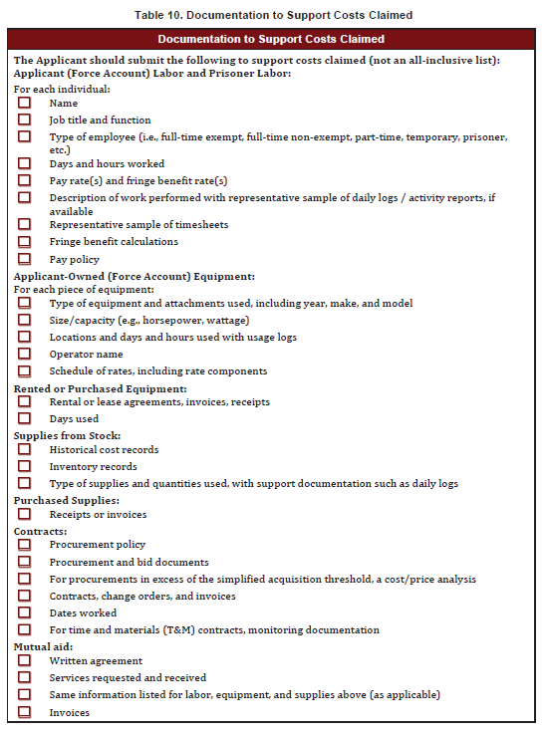
Documentation
Table 10 PAPPG Page 150

Slide 10
Deadlines for Management Cost Submission
The Subrecipient may claim management costs incurred up to whichever of the following occurs first:
180 days after work is completed on the last non-management cost PA project (Cat A-G) for the declaration; or
180 days after the latest performance period of non-management cost PA project for the declaration; or
2 years from the date of an Emergency Declaration; or
8 years from the date of the Major Disaster Declaration.

Slide 11
Differences between Administrative Cost Policies
Standard Direct Administrative Costs (DAC) Policy | NEW Management Cost Policy (DRRA)
Administrative Costs reimbursed at 75% | Administrative Costs reimbursed at 100%
Only direct admin. costs eligible | Direct AND indirect admin. costs eligible
Must track admin. costs per project, per disaster | Track admin. costs per disaster
Reimbursed based on actual or estimated costs | Reimbursed based on actual costs
No limit $$ of admin. costs claimed (costs must be reasonable) | Request up to 5% of total project costs towards management costs (costs must be reasonable)

Slide 12
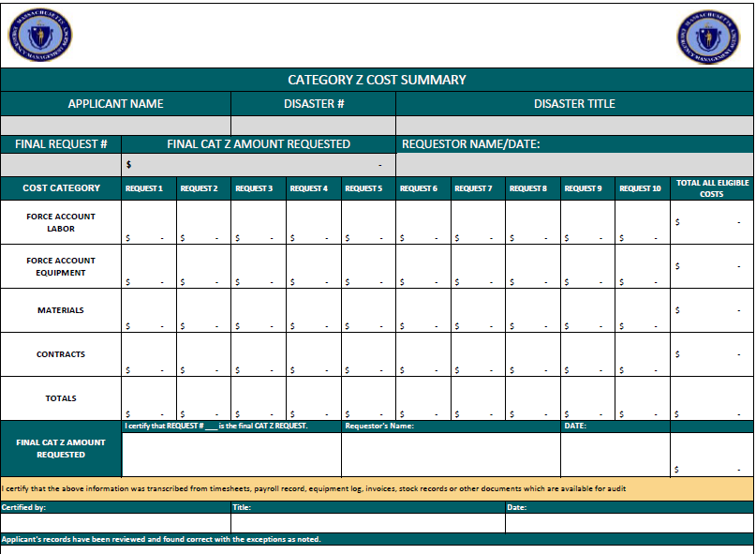
Management Cost Workbook
MEMA has developed a Management Cost workbook to help subrecipients track their management costs
Complete 1 workbook per disaster
Tracks management costs over multiple requests (if necessary)

Slide 13
Resources
https://www.fema.gov/disaster-recovery-reform-act-2018
Robert T. Stafford Disaster Relief and Emergency Assistance Act https://www.fema.gov/media-library-data/1519395888776-af5f95a1a9237302af7e3fd5b0d07d71/StaffordAct.pdf
Public Assistance Management Cost https://www.fema.gov/media-library-data/1542302514280-24931ac70e361feb2dc802a2e0363b1e/PA_Management_Costs_Interim_Policy_508_FINAL_11-15-2018.pdf
Public Assistance Reasonable Cost Evaluations https://www.fema.gov/media-library-data/1539879525279-d00ae1c43f9765c5a4b415e1a31202c5/PA_Reasonable_Cost_Evaluation_Job_Aid_508_FINAL_10-16-2018.pdf

Slide 14
Questions

