Slide 1
Community Behavioral Health Promotion and Prevention Commission
Proposal for promotion and prevention-related recommendations to address the impact of the pandemic on the behavioral health of children and families, with a focus on the disproportionate impact of COVID on communities of color and low-resource communities.

Slide 2
Pandemic conditions and quarantines are having an impact on the behavioral health of people all over the world.
In the United States, according to a CDC survey of a representative sample of adults over 18 conducted June 24-30, 2020, 40.9% of respondents reported at least one adverse mental or behavioral health condition. This was two to four times the prevalence of specific conditions cited in a similar survey conducted a year earlier.
Also from the CDC, data on mental health-related emergency department visits for children and youth under the age of 18 during the pandemic have increased substantially compared to data from 2019: 24% for children ages 5-11 and 31% for youth aged 12-17.

Slide 3
The events of 2020 include many stressors and challenges:
Presence of a novel, life-threatening pathogen
Illness and loss of loved ones
Quarantine, which has been shown to produce post-traumatic stress disorder in children (Jiao et al., 2020)
Social isolation which may impact the mental health of youth up to nine years later (Loades, et al., 2020)
Disruption to education and access to health care, including mental health care
Structural racism, violence against Black people in encounters with police, threats of violence against Asian people related to blaming China for the pandemic
Housing and food insecurity
Increased risk of child abuse and domestic violence
Exposure to unhealthy coping behaviors
(Cites from the Judge Baker Children’s Center’s brief “Impact of the COVID-19 Pandemic on Children, Youth and Families” https://jbcc.harvard.edu/news/impact-covid-19-pandemic-children-youth-and-families-spotlight-policy-brief)
Notes:
We all know these things…above yet…
The impacts of all of these stressors has disproportionally impacted communities of color and low resource communities, with higher rates of disease, mortality, job loss, housing and food insecurity and disrupted education and health care

Slide 4
What can help?
From the Massachusetts Childhood Trauma Task Force’s June report “Protecting our Children’s Well-Being During COVID-19”:
Finding #5: Technology-Based Resources Hold the Potential to Overcome Many (But Not All) Barriers to Mental Health Services – If Allocated Equitably
Finding #6: Caring Adults in Regular Contact with Children are Key to Recovery
Notes:
So with that in mind we have looked closely at what exists and recommend we put efforts toward building and sustaining those

Slide 5
Building on what exists:
There Are Many Existing Initiatives and Intervention Models Focused on Childhood Trauma and Mental Health Upon Which We Can Build
HandholdMA.org
Massachusetts COVID 19 Trauma Response
LINK-KID
Family Resource Centers
DPH Suicide Prevention Task Force
Substance Use Helpline
Network of Care
Referral Sources
Notes:
From the Massachusetts Childhood Trauma Task Force’s June report “Protecting our Children’s Well-Being During COIVD-19”: Key will be to hold these efforts in place past the recovery period of the pandemic as quick fix is not going to happen..and these efforts need support and funding to grow and change with what we will face as we enter recovery
BEGIN WITH GETTTING WORD OUT ABOUT THESE EFFORTS

Slide 6
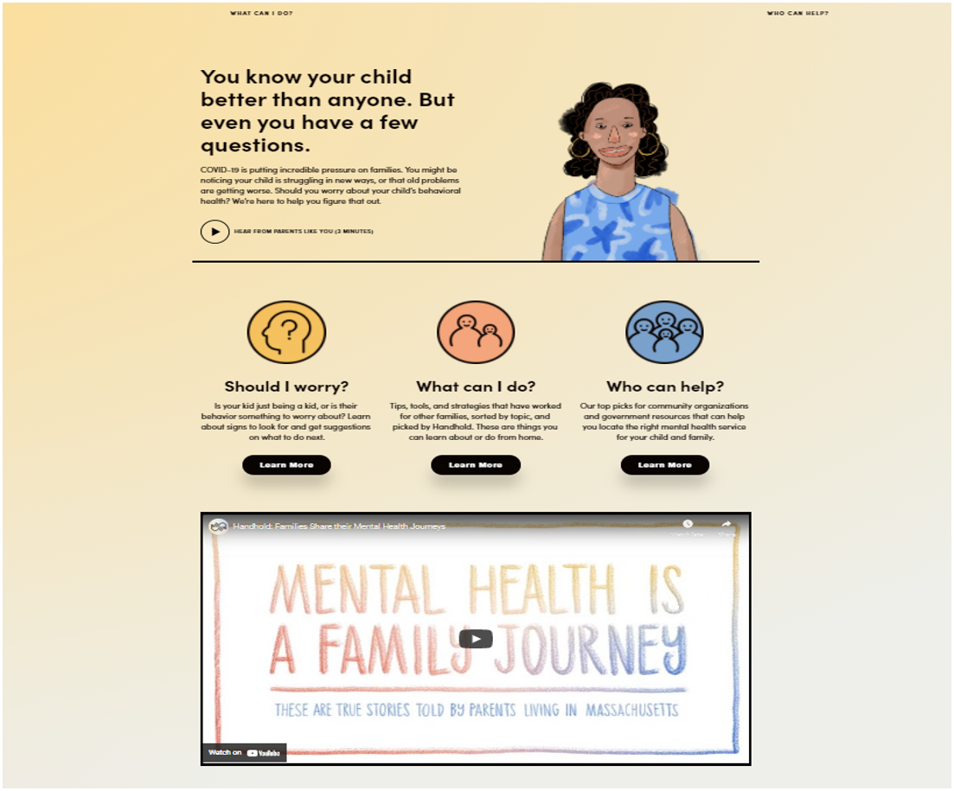
HandholdMA.org
Produced by the Office of the Child Advocate, Department of Mental Health and EOHHS

Slide 7
HandholdMA.org

Slide 8
Statewide number:
888-215-4920
Email: MassSupport@riversidecc.org

Slide 10
Subcommittee Recommendations for Action: Themes
Public education about the mental health impact of the pandemic and how to support mental health and well-being for people of all ages
Equip caring adults in regular contact with children with the skills to support their mental health and well-being
Help schools access mental health services and supports for students and staff
Parents need information, access to peer support and help with basic needs
Communities hardest hit by the pandemic should receive priority access to these interventions
Notes:
Campaign
NASW webinar for BIPOC

Slide 11
Recommendations:
Designate or hire staff to be added to Commonwealth’s Pandemic Command Center to coordinate the State’s COVID-19 Public Mental Health Response, including working with a broad coalition of stakeholders
Develop and implement a public health campaign to educate Massachusetts residents about the mental health impact of the pandemic and how to support mental health and well-being for themselves and others, including materials targeted to youth and young adults.
Equip adults who work with children and youth with skills to support their well-being:
MassSupport consultations for teachers, child-care workers, etc.
Free online trainings in Mental Health First Aid for Youth
Support adults who work with children and youth: telephonic support, online groups and in-person group consultations by MassSupport

Slide 12
Recommendations, cont.:
Helping schools access mental health services for students
Explore expanding Project Interface to cities hardest hit by COVID
State agencies facilitate communication between community-based mental health providers and schools
Support for Parents
Widely promote HandHoldMA.org
Create and publicize parent support groups
Widely publicize sources of support for basic needs, including Family Support Centers
Offer free online MH First Aid for Youth trainings for parents
Fund Family Partners and Community Health Workers to reach out to parents of children not attending online or in-person school in communities hardest hit by COVID

