Slide 1
CCFA: Paid Family Medical Leave (December 2019 release)
January 2020

Slide 2
Agenda
Billing User Interface changes
Reports
Questions

Slide 3
Billing User Interface Changes

Slide 4
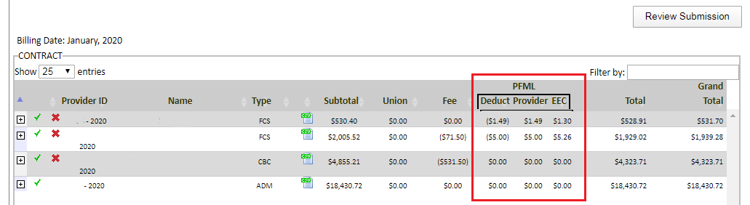
Provider Pending Invoices
New PFML columns show provider deduction, provider contribution and EEC match.
The Total column represents the sum of the subtotal, union, fee, and deduction columns.
The Grand Total column represents the sum of the provider total and the PFML provider contribution and EEC match columns.

Slide 5
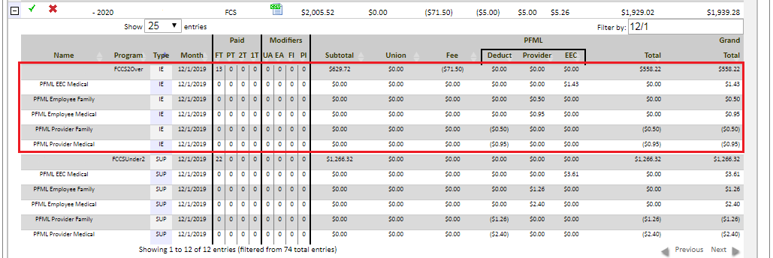
Provider Pending Invoices
Expanding a location of care shows the provider deduction and provider contribution split between family and medical.
Provider PFML deductions will show on separate rows as “PFML Provider Medical” and “PFML Provider Family”
  These deductions are split by funding source and service month
Provider PFML contributions will show on separate rows as “PFML Employee Medical” and “PFML Employee Family”
  These contributions are split by funding source and service month
EEC PFML match will show as “PFML EEC Medical” separated by funding source and service month.

Slide 6
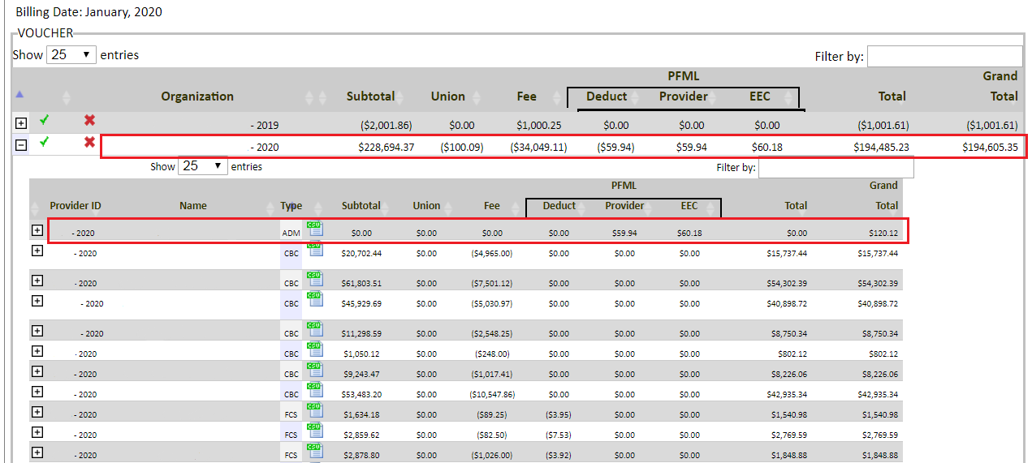
CCRR Pending Invoices
CCRR pending invoices will show the provider deduction, provider contribution at the admin level.
Expanding the admin will show details of the deductions by provider.

Slide 7
Reports

Slide 8
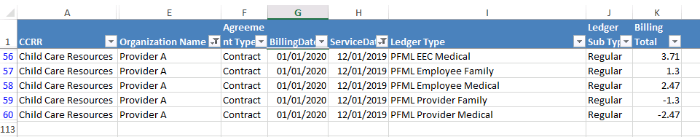
Invoiced Billing and Service Month Extracts
Sheet 2 of the extract will show:
  PFML Provider Family—the amount the provider is being taxed for the family portion (0.13% of eligible wages)
  PFML Provider Medical—the amount the provider is being taxed for the medical portion (0.248% of eligible wages)
  PFML Employee Family—the provider’s contribution to the family portion
  PFML Employee Medical—the provider’s contribution to the medical portion
  PFML EEC Medical—EEC’s match (0.372% of eligible wages)

Slide 9
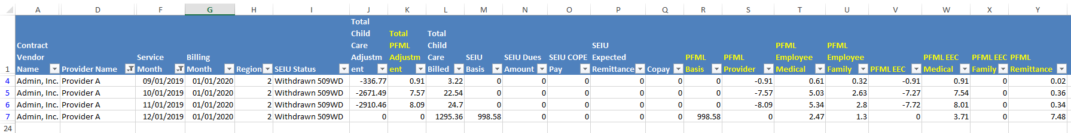
SEIU/PFML Remittance Report by Contract/Voucher Provider
The SEIU/PFML Remittance Report has been updated to include columns for the following:
  Total PFML Adjustment—represents adjustments to provider PFML deductions/contributions from a previous billing month
  PFML Basis—Provider Base Total
  PFML Provider—provider deduction from PFML changes released in November 2019
  PFML Employee Medical—provider PFML medical contribution (December 2019 release)
  PFML Employee Family—provider PFML family contribution (December 2019 release)
  PFML EEC—EEC PFML match from PFML changes released in November 2019
  PFML EEC Medical—EEC PFML medical match (December 2019 release)
  PFML Remittance—Sum of all PFML ledgers (columns S – X)

Slide 10
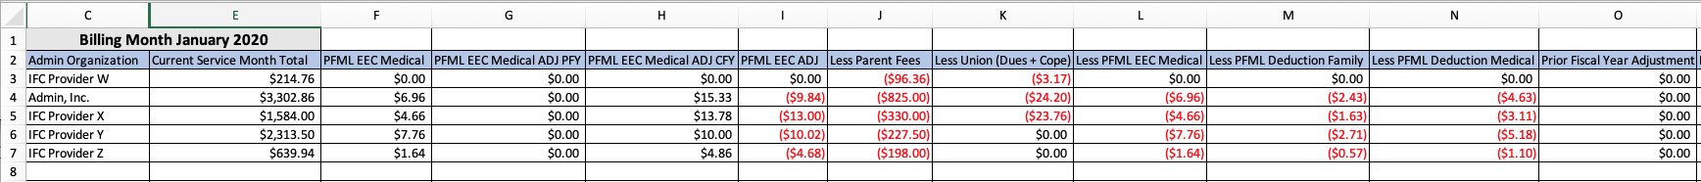
CCRR Batching Sheet
The Batching Sheet has been updated to include show all PFML ledgers.
Below is a breakdown of what each column represents:
  E. Current Service Month Total—the total the provider billed for the current service month
  F. PFML EEC Medical—EEC contribution to Medical
  G. PFML EEC Medical ADJ PFY—any adjustments to EEC medical contribution from a prior fiscal year
  H. PFML EEC Medical ADJ CFY—any adjustments to EEC medical contribution from the current fiscal year
  I. PFML EEC ADJ—PFML adjustments (November 2019 release)
  L. Less PFML EEC Medical—offsets column F
  M. Less PFML Deduction Family—PFML tax on the provider or admin for the family portion of PFML
  N. Less PFML Deduction Medical—PFML tax on the provider or admin for the medical portion of PFML

Slide 11
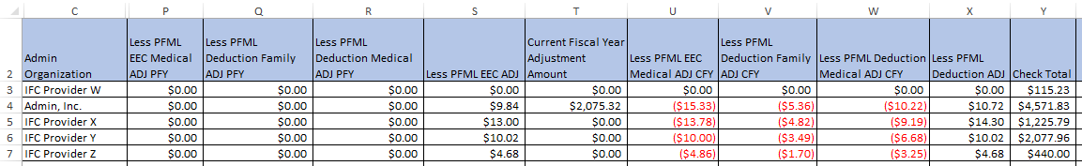
CCRR Batching Sheet
Breakdown of what each column represents, cont.:
  P. Less PFML EEC Medical ADJ PFY—offsets column G
  Q. Less PFML Deduction Family ADJ PFY—any adjustments to the provider/admin portion of the family piece of the PFML tax from a prior fiscal year
  R. Less PFML Deduction Medical ADJ PFY—adjustments to the provider/admin portion of the medical piece of the PFML tax from a prior fiscal year
  S. Less PFML EEC ADJ—offsets column I
  U. Less PFML EEC Medical ADJ CFY—offsets column H
  V. Less PFML Deduction Family ADJ CFY—any adjustments made to the family piece of the PFML in the current fiscal year
  W. Less PFML Deduction Medical ADJ CFY—any adjustments made to the medical piece of PFML in the current fiscal year
  X. Less PFML Deduction ADJ—Any PFML adjustment for prior months
  Y. Check Total
    For Systems this total will include EEC match and provider contributions
    For independent providers, this total will include PFML deductions

Slide 12
PV LOC Voucher/ Contract
The PV LOC Voucher/ Contract Report breaks down provider PFML deductions and contributions by Service Month and then by contract
  i.e. Supportive, Priority Population Supportive, etc.
The report will further show the breakdown of the PFML ledger type, units, and associated rate
  The PFML ledger type will list under “Program Type”
PFML Ledgers are explained on the next slide.

Slide 13
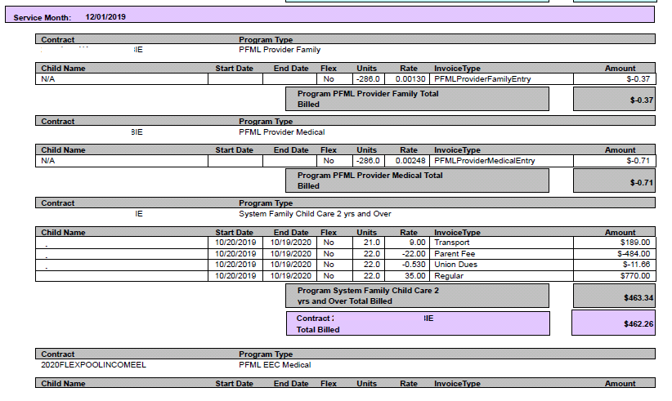
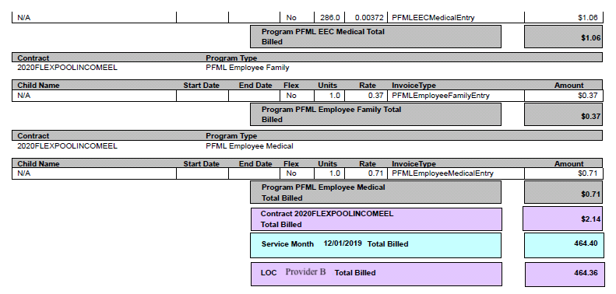
PV LOC Voucher/ Contract – PFML Ledgers
PFML EEC Medical
  Rate reflects the PFML calculation
  0.372% of eligible wages
PFML Employee Family
  Rate reflects the provider’s family contribution
  0.13% of eligible wages
PFML Employee Medical
  Rate reflects the provider’s medical contribution
  0.248% of eligible wages
PFML Provider Family
  Rate reflects the PFML calculation
PFML Provider Medical
  Rate reflects the PFML calculation

