Slide 1
CCS Employment Services ​ and Operations​
Provider Training Series 8-27-26
Notes:
Rachel

Slide 2
Agenda
Welcome- Rachel Reyes, Director of Career Services Operations
Overview – Adam Garber, Senior Career Services Director​
​Content Presenters:
Bronwen Lafferty, Business Improvement Partner​
Molly Eastman, Business Improvement Partner
Amelia DeGregorio, Business Improvement Partner
Notes:
Rachel

Slide 3
Comprehensive Career Services- Employment
MassAbility’s CCS- Employment Services program is an evolution from its previous CIES (Competitive Integrated Employment Services) program
MassAbility is committed to participant choice and ensuring that there are multiple providers serving each Area Office
All providers will be offering all the CCS Employment Services as described in the RFR
Services require direct, face to face interactions with job seekers and onsite job coaching
Career Exploration (assessments) and Skills Training are not part of the service model
MassAbility will be contracting with
Notes:
Adam

Slide 4
CCS Employment Provider - October 2026
Advocates, Inc. | CapeAbilities | Easter Seals
AEI | CCBC | Emerge Careers
ARC of Opportunity | CCI | Fellowship Health
ATI | CRC | JVS
BCArc | CSA | LIFE
BFAIR | CWS | Lifeworks
Notes:
Adam

Slide 5
CCS Employment Provider -Continued
Martha's Vineyard CS | Riverside CC | Triangle
Nemasket Group | Road to Responsibility | VAC
Northeast ARC | ServiceNet | Viability
Open Sky | Seven Hills | Work Inc.
Pride | Tempus | WOU
 | Transitions
Notes:
Adam

Slide 6
Comprehensive Career Services - Employment
Comprehensive Career Services - Employment​
​
The new MassAbility Comprehensive Career Services
Employment Services goes live October 1, 2026, replacing CIES
What remains the same: The Goal of Competitive Integrated Employment
What has changed: More options, better partnership, incentives, better support for providers, more consistency in expectations​
Partnering with MassAbility Business Relations Unit
Integrated resource team approach meant to better support the job seeker
More options to meet the needs of each job seeker ​
Work experience opportunities to help skill up job seekers
Incentive payments for successful 5-day and 90-day employment
One contract per provider, not by district
One Business Improvement Partner, one AD Lead
Community of Practice
The CCS Webpage with forms, resources and training materials
Notes:
Adam

Slide 7
Who will be referred to CCS?
Counselors work with individuals with all types of disabilities
There are some counselors with specialty caseloads: Bilingual Counselors, DMH-ACCS Connected Mental Health Specialist Counselors, Rehabilitation Counselors for the Deaf and DTA Connected Counselors
All counselors can access CCS services for their job seekers
Counselors and job seekers together decide what type of services best fit their needs
Job seekers will be in an Individual Plan of Employment with a specified job goal prior to referral
Some job seekers will have an active family member, spouse, provider, etc. who will be supporting the individual’s journey towards employment; and this person(s) may be asked to be part of an integrated resource team (IRT) during the placement process.
Notes:
Adam

Slide 8
Integrated Resource Team Approach
Counselors discuss options with the job seeker before a referral to CCS or JPS is made
Choosing which service model makes sense for each job seeker, it can be a team decision involving the job seeker, counselor, JPS, and at times the family or others supporting the job seeker (DDS/DMH/Residential Support), however the job seeker is always the center of this team and the final decision maker
As part of the process of determining the appropriate path for the job seeker, the counselor is encouraged to discuss the job seeker’s interests, skills, needs and labor market realities with the Business Relations staff prior to making a referral to a CCS Provider
Job seekers can be served by members of the Business Relations Team and CCS provider at the same time and working collaboratively is an expectation of the program
Notes:
Adam

Slide 9
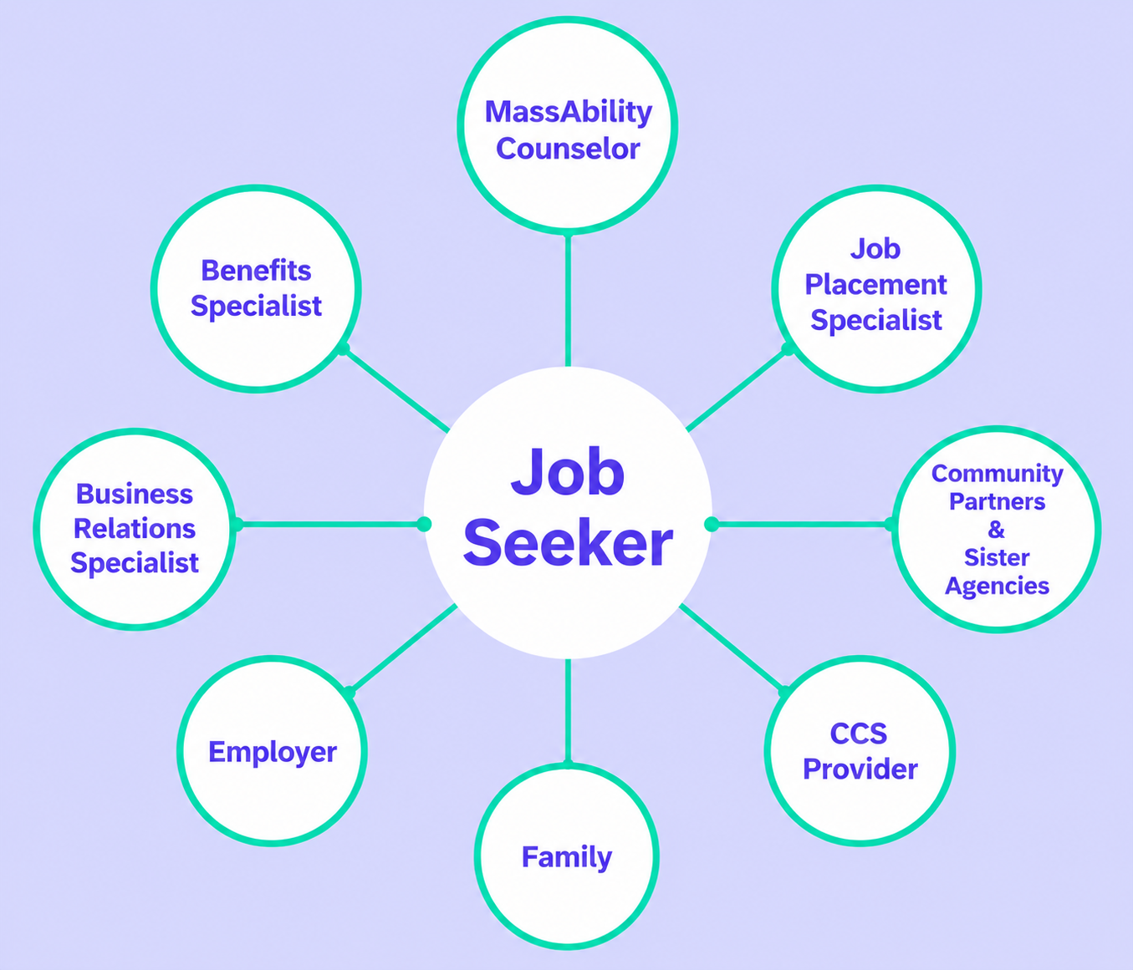
Integrated Resource Team Diagram
Notes:
Adam

Slide 10
What is the MassAbility Business Relations Team?
MassAbility has a team that supports both job seekers and employers
Business Relations Specialists (BRS) establish and maintain relationships with employers using a variety of strategies including but not limited to identifying employment opportunities that meet the needs of both employers and jobseekers, educating businesses about employing individuals with disabilities; establishing, planning, and organizing hiring events and employer recruitment sessions; and are versed in local area and regional labor markets.
Job Placement Specialists (JPS) provide consistent support and services to agency jobseekers seeking competitive integrated employment. The JPS works collaboratively with both the Career Service Staff and the job seeker throughout the life of the case. This allows the JPS to help provide information to identify a job goal, to assess the job seekers qualifications against the current labor market, recommend relevant trainings and to provide direct job placement assistance.
Notes:
Adam

Slide 11
When do we purchase CCS Employment Services?​
​
Referral Decision Tree​
The Counselor consults with MassAbility's internal Business Relations Unit (Placement) when job seeker has identified a job goal, has a basic resume/work history, and has demonstrated follow-through on Career Services tasks.​
If the JPS believes their team can help the job seeker find a job and does not foresee barriers working with the job seeker, referral will go to the JPS, and no provider will be engaged at this time. ​
If the JPS believes they can help the job seeker but believes the job seeker needs direct support with resumes/cover letters and completing online applications, single service Job Search Supports may be purchased.​
If the JPS believes they can place the job seeker but recognizes the individual is going to need either onsite or offsite job coaching once placed, single service Job Coaching Services may be purchased. ​
If the JPS believes the job seeker will need more intensive supports or specialized supports to become employed, beyond JPS capacity, the Counselor may make a referral to a CCS provider for Job Development & Placement Bundle. ​
Notes:
Bron

Slide 12
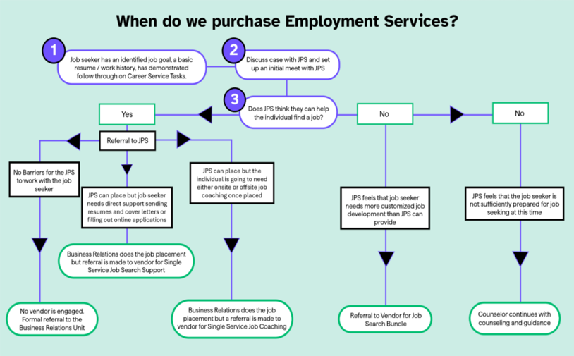
When do we purchase employment services
Notes:
Bron

Slide 13
CCS Employment Referral Process​
If after collaborative discussions between the counselor, the job seeker, and when applicable the Job Placement Specialist (JPS), it is determined CCS Employment Services are appropriate, the referral process is as follows: ​
Initial Discussion: The Counselor contacts the provider to discuss a potential new referral and confirm program fit and capacity. Basic information is shared with the provider during this outreach.​
Introduction Meeting: The counselor schedules a brief (approximately 15-minute) three-way meeting with the provider and the job seeker (in-person or remotely) to review individual choice and commitment and outline expectations including desired wage and hours.​
Agreement: The provider will confirm their ability to provide the requested services within three days of the introduction. The job seeker will also confirm their commitment and participation.​
Referral & CO Creation: If all parties agree, the counselor generates a Contract Order (CO) and a Referral for services within one (1) business day of the agreement, including specific services requested and outlines the job seeker’s specific job goal and other relevant information.​
Notes:
bron

Slide 14
The Role of The Provider in the Referral Process​
The provider will determine if they have capacity on their current contract for the new referral/service(s) ​
The provider determines there is no conflict of interest working with the job seeker ​
If a provider is declining a referral, the reason(s) must be submitted in writing within three (3) business days of receiving the referral. ​
Unacceptable reasons for declining referrals include job seekers’ level of need, disability type, or CORI status. ​
The Provider must receive fiscal authorization (CO) and completed referral form before initiating services. ​
Notes:
Bron

Slide 15
Job Development & Placement Bundle​
Job Development and Placement Services (Service Bundle) includes the full spectrum of job development and placement supports designed to assist job seekers to achieve successful employment outcomes. ​
These services encompass job development, job placement, and ongoing support activities (up until day 30).​
If additional supports are required after day 30 of employment, a job coaching contract can be negotiated.​
Comparable to CIES JD&P ​
​
Notes:
Bron

Slide 16
Job Development & Placement Bundle Payment​
Authorization and Payment Details:
Initiation payment of $2,998.00 ​
  Provider can bill this milestone once Employment Plan is developed and received by the Counselor. ​
Completion payment of $4,498.00​
  Provider can bill this milestone once the Job Seeker has reached 30 days of successful employment​.
Early Stabilization Incentive of $250.00​
  Provider can bill for this once the Job Seeker has completed 5 days of employment​. A separate CO will be provided.
Sustained Employment Incentive of $1,000.00 ​
  Provider can bill for this once the Job Seeker has completed 90 days of employment.​ A separate CO will be provided.
Notes:
Bron

Slide 17
Case Example – Job Development and Placement Bundle
Case Example – Job Development and Placement Bundle ​
Keith is a 30-year-old man who suffered a stroke at age 23. He continues to experience hemiplegia on his right side, slurred speech, and difficulty remembering things. His health has been stable for the past four years and he would like to return to work. Keith has not worked since his stroke, and while he studied engineering in college, he has not retained substantive knowledge that would allow him to work as an engineer now. Keith has always loved books and would love to work in a library putting books back on the shelves. ​After discussion with the BRU team, labor market analysis in Keith’s community shows that this is a viable option. Based on Keith’s anticipated support needs, the team feels that a full JD and P referral to a provider would best support Keith.
Keith’s goal will require customized job development. MassAbility contracts with a provider for full job development and placement. The provider approaches multiple libraries in Keith’s area and finds a library that has a position open. The provider assists with all aspects of onboarding and provides job coaching and support for Keith’s first month of employment.
After the first month, Keith is doing well, the library is happy with his work, and subsequently MassAbility determines no further support is required. ​Counselor continues to follow up with Keith to ensure success on the job.
Notes:
Bron: In this example the provider would receive a JDP Referral, a CO for Initiation and completion of JDT and a CO for the early stabilization incentive payment and sustained employment incentive.

Slide 18
Single Service: Job Search Support​
Job Search Supports (Single Service) are for individuals primarily served by MassAbility’s Job Placement Specialists or Counselors who require additional time and support to complete a successful job search. Providers will develop Job Search Supports in close partnership with the counselor and/or the Job Placement Specialist (JPS), who will continue to actively support the job seeker throughout the process. ​
Supports may include résumé refinement, direct interview assistance, hands-on job search activities, transportation to interviews, and the development of online employment profiles. ​
The Counselor will authorize the CO for an agreed upon number of hours which may be increased or decreased as needed.​
Providers are expected to meet and plan with the job seeker before service implementation and are authorized for up to three (3) hours of services before official service initiation. ​
Providers should bill for voicemails left, texts sent, and emails sent in ¼ hour units (15 minutes) in EIM. ​
Notes:
Bron

Slide 19
Single Service: Job Search Support Payment​
Authorization and Payment Details:
Hourly rate of $60.80​
Initial CO includes the ​3 hours to get to know individual and hours agreed upon for the Job Search Support work, with 15 hours being the recommended start unless otherwise agreed upon
Services are billed at 15-minute increments (0.25 in EIM)​
​
Early Stabilization Incentive of $250.00​
  Provider can bill for this once the Job Seeker has completed 5 days of employment​. A separate CO will be provided.
​
Notes:
Bron

Slide 20
Case Example – Single Service Job Search Supports​
Case Example – Single Service Job Search Supports​
Thirty-eight-year-old Alice sustained a TBI 5 years ago. She has no physical restrictions but struggles to focus and remember things from one day to the next. Alice worked in retail before acquiring TBI. Following physical and cognitive restorative treatment, she felt ready to return to work in an entry level retail capacity. She has basic computer and internet skills with strong in-person interpersonal skills, but she sometimes struggles with emails and cover letters.​
The MassAbility Business Relations Unit feels that they can place her in a job. Alice needs support completing online applications and with mock interviews. MassAbility contracts with a provider to provide three hours of services per week for four weeks to assist with the job search. Alice receives business names and websites from the JPS. Alice and the provider then meet weekly to work on online applications and conduct weekly mock interviews. ​
Notes:
Bron

Slide 21
Single Service: Job Coaching Support​
Job Coaching (Single Service) allows for one-on-one support to complete onboarding, training, or learning a new job.​
​
This direct, face-to-face service must connect to the job’s activities and expectations. ​
​
The coach will meet, establish rapport, and understand the job seeker’s needs and support requirements ahead of their hire. ​
​
If Single Service Job Coaching is expected, the provider should be brought into the process early on, before the start of employment. Counselors will authorize 3 hours for establishing a connection with the job seeker and to meet with the Job Placement Specialist prior to initiating job coaching. Wherever possible, the provider will also get the opportunity to meet the employer ahead of time.
Notes:
Amelia

Slide 22
Single Service: Job Coaching Support Payment​
Authorization and Payment Details:
Job coaching is an hourly rate billed at $60.80​
​
Early Stabilization Incentive Payment – 5 days of employment: $250.00​
​
Sustained Employment Incentive Payment – 90 days of employment: $1000.00​
​
Counselors will contract for no more than 25 hours at a time for job coaching. This may be reassessed on a case-by-case basis tied to individual need and job performance.​
​
Services are billed at 15-minute increments (0.25 in EIM)​
Notes:
Amelia

Slide 23
Case Example – Single Service Job Coaching
Case Example – Single Service Job Coaching​
Joe is a 22-year-old young man diagnosed with ID/DD. He has no physical limitations but lacks prior work experience and requires repetition and practice to learn new tasks. The Business Relations Unit leverages their connections to place Joe in an entry level job in a retail warehouse. ​
When the JPS began supporting Joe, it was recognized that Joe would need job coaching. MassAbility contracted with a provider that they thought would align well with Joe. They brought the provider in to meet and get to know Joe, his needs, and his learning style before the placement occurred. ​
During the job placement process, the JPS informed the employer that Joe could access a job coach as he settles into the job. Upon hire, the JPS coordinates a meeting with the provider and employer to review job duties and expectations. The provider assists Joe with the onboarding paperwork and provides onsite and offsite direct support to Joe. When issues arise, the JPS, provider, and Counselor closely communicate to align while supporting Joe’s needs. Within two months, Joe acclimates to the job, and his job coach reduces their time from three hours a week to one hour. By the end of the third month, the job coach disengages, Joe successfully maintains his job and MassAbility closes Joe’s case.​
Notes:
Amelia

Slide 24
Single Service: Work Experience​
Work Experience is for individuals with no prior work history, those with a significant employment gap that raises questions about their current skill level, and/or those who require on-site skill development to strengthen both hard and soft workplace skills. ​
The service helps job seekers build and strengthen the skills needed to move toward competitive integrated employment.
Work Experience is not a situational assessment.​
Work Experience placement sites are competitive and integrated.​
Area Directors must authorize the time-limited Work Experience opportunities.​
If the work experience is a paid experience, the payment will be minimum wage, paid by the provider. Provider will bill MassAbility for the wages paid. Providers will also be contracted to provide support hours to ensure the Work Experience is successful.
Notes:
Amelia

Slide 25
Single Service: Work Experience Payment​
Work experience is reimbursed through two different billing components:​
    Staff hours spent supporting the individual = $60.80/hr​
    Hourly rate paid to the individual Job Seeker = $20/hr​ ($15.00 to the Job Seeker
    and $5.00 for Tax, Fringe etc.)
It is expected that worksite development is an ongoing opportunity for providers and is not billed separately/additionally. The development time is part of the administrative costs associated with a fully loaded rate.
Prior to seeking AD approval for a work experience opportunity, the job seeker, provider, and counselor should identify the number of hours/weeks of the experience. ADs will be responsible for approving the site (completive/integrated location), support hours, and hours job seeker will work.

Slide 26
Case Example - Single Service Work Experience​
Ellen is a 40-year-old woman diagnosed with a mental health disorder. Ellen dropped out of college after receiving her diagnosis and experienced multiple hospitalizations, outpatient treatment programs, and long-term medication management over the next two decades. With relatively stabilized mental health, she would like to enter the workforce but is unsure which profession. Her strengths and necessary job supports are unclear given her history of mental health issues and lack of recent work experience and references. ​
MassAbility contracts with a provider to help Ellen try out different work scenarios, including a week in the backroom of a retail establishment, a week at a manufacturing facility for medical equipment, and a week in food service. The provider pays Ellen through each of these experiences while also offering onsite and offsite support.
With this new work experience, references, and increased self-confidence Ellen, the counselor, and the provider feel she is now ready for an entry level position. Ellen believes continuing to speak with her counselor and her therapist about work will provide her the support she needs for success.​
Notes:
Amelia

Slide 27
Case Example - The service continuum​
​Robert is a young man with a learning disability. During high school, Robert benefited from student transition services (Pre-ETS). Through his provider, Robert attended a career camp and participated in a summer work experience. This was a positive experience for Robert, leading him to want to find a job after high school.
Robert opened a MassAbility Career Service case and identified a job goal in manufacturing. Given the Business Relations team’s industry connections, Robert began to work with the JPS. Robert’s learning disability made it difficult to complete job applications alone. Consequently, MassAbility contracted the same provider who provided Robert’s transition services in high school to provide job search supports. Robert continued to use the provider for coaching services once hired. The existing relationship between Robert and the provider contributed to his success.​
Notes:
Amelia

Slide 28
Employment Services Reminders ​
Services do not follow a linear path; services do not need to be purchased in any specific order​
In some cases, more than 1 single service may be authorized​; example, Job Search Supports could overlap a Work Experience
In some case, if the team begins with single service but it is determined additional supports are needed, a subsequent Bundle authorization may be appropriate.​
Notes:
Amelia

Slide 29
Additional Contract Expectations
Participation in a three/four way meeting prior to accepting the referral
Monthly progress notes from provider for any Employment Service​
Employment/Placement plan for Bundle Service​
Job Coaching plan for Job Coaching single service​
Job Placement Form for Early Stabilization (5 day) Incentive payment
Sustained Employment Incentive Form for 90 day Incentive Payment
Communication with counselors and/or Business Relations during the month with issues, concerns, etc. ​
Participation in IRT or other periodic meetings with Job Seeker, team members, and provider to support the process
Notes:
Molly

Slide 30
Language Services​
  MassAbility will reimburse providers for spoken language/ASL interpretation services to ensure a job seeker’s active and meaningful participation in Employment Services.
  ​
  Contracted interpretation services are reimbursable when included in the Contract Order and authorized and approved by MassAbility
  Reimbursement rates for language interpretation services must align with and cannot exceed established rates in OSD’s RFR for Spoken Language Translation (PRF75) and the Massachusetts Commission for the Deaf and Hard of Hearing (MCDHH)’s Contract for American Sign Language Interpreters and Translators for the Deaf and Hard of Hearing. ​
Notes:
Molly

Slide 31
Language Services Process​
Provider and Counselor agree language services are needed​
Provider procures the service ​
Provider utilizes the service​
Provider receives an invoice for the service and pays the invoice ​
Provider will send MassAbility a request for reimbursement for the invoice (PV, not through EIM)​
​
Notes:
Molly

Slide 32
Carryover from CIES to CCS
Notes:
Molly

Slide 33
CIES Becomes CCS Employment Services: Carryover Job Seeker Guidance ​
Counselor and provider review each current Job Seeker enrolled/engaged in CIES ​
  Collaboratively, the team including the Job Seeker determines next steps ​
  Continuing on in job search? ​
  With same Employment provider or a new provider? ​
  Not continuing at this time? ​
  Continuing on in job search and adding in Business Relations involvement? ​
If Job Seeker will continue on their job search as of October 1, moving from CIES to CCS,​
    With same Employment provider: if Counselor sent the initial JD&P referral and CO more than 9 months ago (Prior to January 2026), a new initiation of JD&P Bundle should be sent to provider ​
    With new Employment provider: Counselor should send new initiation of JD&P Bundle and/or other service to provider after 3-way meeting and all parties agreeing ​
If Job Seeker is continuing on their job search as of October 1, and Counselor sent the initial referral and CO less than 9 months ago (January 2026), no additional CO is required for the provider to continue the service. Counselor should confirm this with provider by email and document the continuation of services in a case note.
Notes:
Molly

Slide 34
CIES Becomes CCS Employment Services: Carryover Job Seeker Guidance ​
If Job Seeker started a job in September and it has been less than 30 days:
  Counselor should write completion Bundle CO​
  Incentive eligible ​
If started a job and has worked more than 30 days (completion of JD&P paid under CIES):​
  If Initial Employment Supports was sent, first half under CIES, Counselor should send second half via CCS Employment hourly supports​
  If Counselor authorized hourly CIES IFS to support from day 31 on, Counselor may continue, if appropriate, with hourly supports
  Incentive eligible ​
Notes:
Molly

Slide 35
Q & A
Notes:
Molly

Slide 36
Thank you for joining us today!​
Notes:
Molly

